Slide 1
Scalable GNN Training System with Cache 2024.12.03
Yuwei Xu
School of Data Science
Chinese University of Hong Kong, Shenzhen
Notes:
Good morning everyone, I am Zhang yue, a phd student from school of data science. Today I will introduce about Systems for Scalable Graph Analytics.

Slide 2
OUTLINE
Introduction (5 min)
Graph Tasks
GNN training
Analysis & Motivation (10 min)
Bottleneck of Large Scale Training
Strategies
Proposed Methods (35 min)
Ginex
OUTRE
TIGER
Conclusions (5 min)
Q/A
Notes:
The presentation includes five parts, I will introduce them step by step. If you have any question, feel free to ask me. Ok, Let’s get started!

Slide 3
Introduction - Graph Tasks (1/6)
Graph
Notes:
So what is a graph. before discussing the analysis of graphs, I will introduce a few definitions. A graph is a set of vertices and edges, having some labels. Let’s me illustrate this idea with an example. Consider the following graph:
This graph contains four vertices (depicted as yellow circles). These vertices have labels such as “10” and “11”.
These labels provide information about the vertices. For example, imagine that this graph is a chemical molecule/mDlikjul/. The label 10 and 11 could represent the chemical elements of Hydrogen/haidredgen/ and Oxygen, respectively.
Labels do not need to be unique. In other words, the same labels may be used to describe several vertices in the same graph.

Slide 4
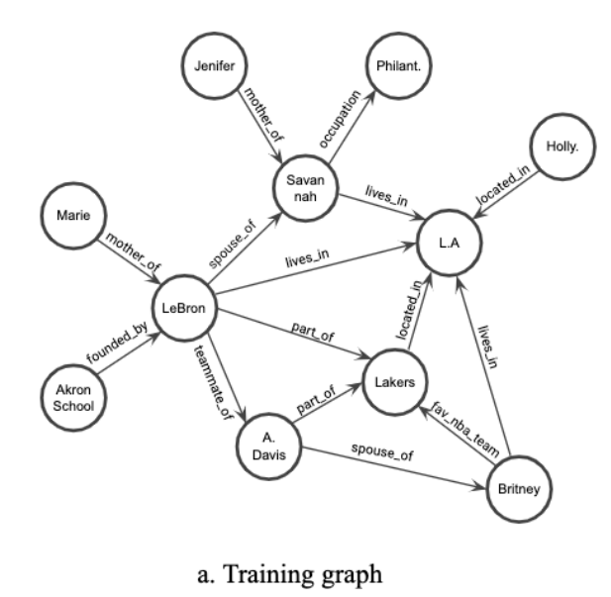
Introduction - Graph Tasks (2/6)
Graph & Knowledge Graph
$$e=(u,v)$$
$$e=(u,r, v)$$
1
2
3
5
4
6
7
8
9
10
11
Notes:
So what is a graph. before discussing the analysis of graphs, I will introduce a few definitions. A graph is a set of vertices and edges, having some labels. Let’s me illustrate this idea with an example. Consider the following graph:
This graph contains four vertices (depicted as yellow circles). These vertices have labels such as “10” and “11”.
These labels provide information about the vertices. For example, imagine that this graph is a chemical molecule/mDlikjul/. The label 10 and 11 could represent the chemical elements of Hydrogen/haidredgen/ and Oxygen, respectively.
Labels do not need to be unique. In other words, the same labels may be used to describe several vertices in the same graph.

Slide 5
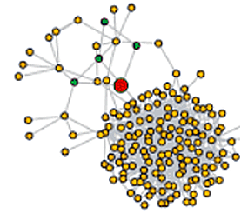
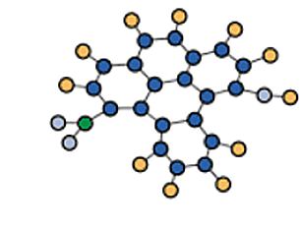
Introduction - Graph Tasks (3/6)
Graph Classification
Node Classification
A lot of graphs
Find a single label for each individual graph
A huge graph with many nodes
Predict the missing labels for the unknown nodes
GNN
Input
GNN
Prediction
Molecule‘s Mutagenicity
Node’s Structural Role
Notes:
So what is a graph. before discussing the analysis of graphs, I will introduce a few definitions. A graph is a set of vertices and edges, having some labels. Let’s me illustrate this idea with an example. Consider the following graph:
This graph contains four vertices (depicted as yellow circles). These vertices have labels such as “10” and “11”.
These labels provide information about the vertices. For example, imagine that this graph is a chemical molecule/mDlikjul/. The label 10 and 11 could represent the chemical elements of Hydrogen/haidredgen/ and Oxygen, respectively.
Labels do not need to be unique. In other words, the same labels may be used to describe several vertices in the same graph.

Slide 6
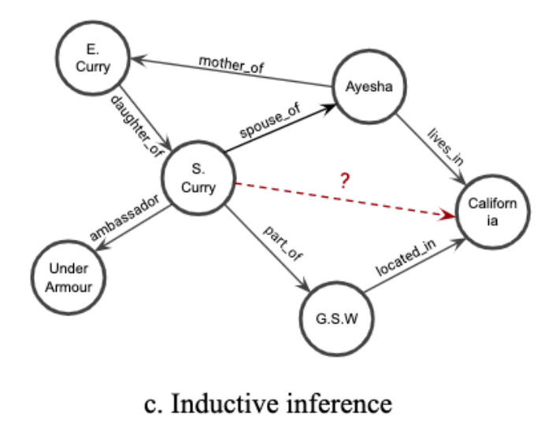
Introduction - Graph Tasks (4/6)
Transductive KG Reasoning (Link Prediction)
Inductive KG Reasoning
Predict new triples/links in the current KG
Predict on a new knowledge graph
Fixed Entities / Fixed Relations
Unseen Entities / Unseen Relations
?
occupation
father_of
?
Applications: KG Completion, Drug Discovery
Question Answering, Recommendation System
<Head Entity, Relation> Tail Entity
Notes:
So what is a graph. before discussing the analysis of graphs, I will introduce a few definitions. A graph is a set of vertices and edges, having some labels. Let’s me illustrate this idea with an example. Consider the following graph:
This graph contains four vertices (depicted as yellow circles). These vertices have labels such as “10” and “11”.
These labels provide information about the vertices. For example, imagine that this graph is a chemical molecule/mDlikjul/. The label 10 and 11 could represent the chemical elements of Hydrogen/haidredgen/ and Oxygen, respectively.
Labels do not need to be unique. In other words, the same labels may be used to describe several vertices in the same graph.

Slide 7
Introduction - GNN Training (5/6)
Host CPU
Mini-Batch Loop
GPU
Training
Queries
Query
Sampling
Embedding
Generating
Model
Computation
GNN Model

Slide 8
Introduction - GNN Training (6/6)
Representative efficient KGE methods:
TransE, DistMult, RotatE, AttH
Predict via the calculation of embedding vectors
Earlier GNN methods:
R-GCN, CompGCN
Encode embeddings by aggregating message from neighbors
For inductive KG reasoning:
MorsE, INDICO
Integrate candidate triples through annotated graphs.
However, these methods encode all candidates together in the entire KG.
It struggles with numerous candidate entities and large-scale KGs.
Notes:
So what is a graph. before discussing the analysis of graphs, I will introduce a few definitions. A graph is a set of vertices and edges, having some labels. Let’s me illustrate this idea with an example. Consider the following graph:
This graph contains four vertices (depicted as yellow circles). These vertices have labels such as “10” and “11”.
These labels provide information about the vertices. For example, imagine that this graph is a chemical molecule/mDlikjul/. The label 10 and 11 could represent the chemical elements of Hydrogen/haidredgen/ and Oxygen, respectively.
Labels do not need to be unique. In other words, the same labels may be used to describe several vertices in the same graph.

Slide 9
OUTLINE
Introduction (5 min)
Graph Tasks
GNN training
Analysis & Motivation (10 min)
Bottleneck of Large Scale Training
Strategies
Proposed Methods (35 min)
Ginex
OUTRE
TIGER
Conclusions (5 min)
Q/A
Notes:
The presentation includes five parts, I will introduce them step by step. If you have any question, feel free to ask me. Ok, Let’s get started!

Slide 10
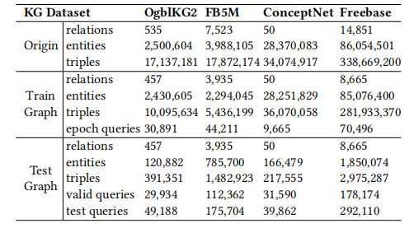
Analysis – Bottleneck of Large Scale Training (1/7)
Statistics of inductive KG datasets. OgblkG2 denotes the Ogbl-wikikG2 dataset
Notes:
The task of finding frequent subgraphs in a set of graphs is called frequent subgraph mining. As input the user must provide:
a graph database (a set of graphs)
a parameter called the minimum support threshold (minsup).
Then, a frequent subgraph mining algorithm will enumerate as output all frequent subgraphs. A frequent subgraph is a subgraph that appears in at least minsup graphs from a graph database. For example, let’s consider the following graph database containing three graphs:
[click]
Now, let’s say that we want to discover all subgraphs that appear in at least three graphs. Thus, we will set the minsup parameter to 3. By applying a frequent subgraph mining algorithm, we will obtain the set of all subgraphs appearing in at least three graphs:
[click]

Slide 11
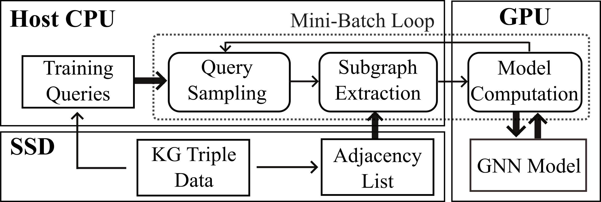
Analysis – Bottleneck of Large Scale Training (2/7)
Efficiency and Scalability Issues on Large-scale KGs
Training Pipeline for GNN-based Models
The data size of large-scale KG may reach up to a few TBs.
The memory capacity of single machine is unaffordable.
Extract subgraphs for each mini-batch training
Remain KG data in the solid-state disk (SSD)
Notes:
The task of finding frequent subgraphs in a set of graphs is called frequent subgraph mining. As input the user must provide:
a graph database (a set of graphs)
a parameter called the minimum support threshold (minsup).
Then, a frequent subgraph mining algorithm will enumerate as output all frequent subgraphs. A frequent subgraph is a subgraph that appears in at least minsup graphs from a graph database. For example, let’s consider the following graph database containing three graphs:
[click]
Now, let’s say that we want to discover all subgraphs that appear in at least three graphs. Thus, we will set the minsup parameter to 3. By applying a frequent subgraph mining algorithm, we will obtain the set of all subgraphs appearing in at least three graphs:
[click]

Slide 12
Analysis – Bottleneck of Large Scale Training (3/7)
Bottleneck: Subgraph Extraction Process
Compared with training, Subgraph occupies most of the time.
The number of triples in subgraph also increases rapidly when degree increases.
Figure(a) Training time breakdown on large-scale KGs, and (b) The 3-hop subgraph size (triple number) of central entities with different degrees
Notes:
Queries on KGs often depend on semantic relevance rather than structural locality, sampling with matrix multiplication is unfeasible.

Slide 13
Analysis – Graph Strategy (4/7)
Graph Partitioning
Subgraph sampling on partitioned subgraph.
Advantages
Greatly reduces time cost, each mini batch only needs to work with one subgraph.
It also supports parallelization.
Disadvantages:
Neighbor information will be lost
Some graphs do not support balanced partition
Additional partition cost will be added
11
10
9
Notes:
Unfortunately, before T-thinker, all current solutions are IO-bound and materialize the subgraphs level-by-level in a search tree, causing a lot of intermediate subgraphs being materialized which not only hurts performance but also limits the size of the graph that can be processed.
Surprisingly, these works were accepted by the best systems conferences such as OSDI and SOSP.

Slide 14
Analysis – Graph Strategy (5/7)
Selected Reasoning Path
Select only few edges during propagation.
Advantages
Greatly reduce computational cost.
Filter critical paths or influential nodes.
Make the model more interpretable
Disadvantages:
May overlook global structure, lead to local bias.
Add additional model for path selection.
Dependency on selection criteria.
11
10
9
Notes:
Unfortunately, before T-thinker, all current solutions are IO-bound and materialize the subgraphs level-by-level in a search tree, causing a lot of intermediate subgraphs being materialized which not only hurts performance but also limits the size of the graph that can be processed.
Surprisingly, these works were accepted by the best systems conferences such as OSDI and SOSP.

Slide 15
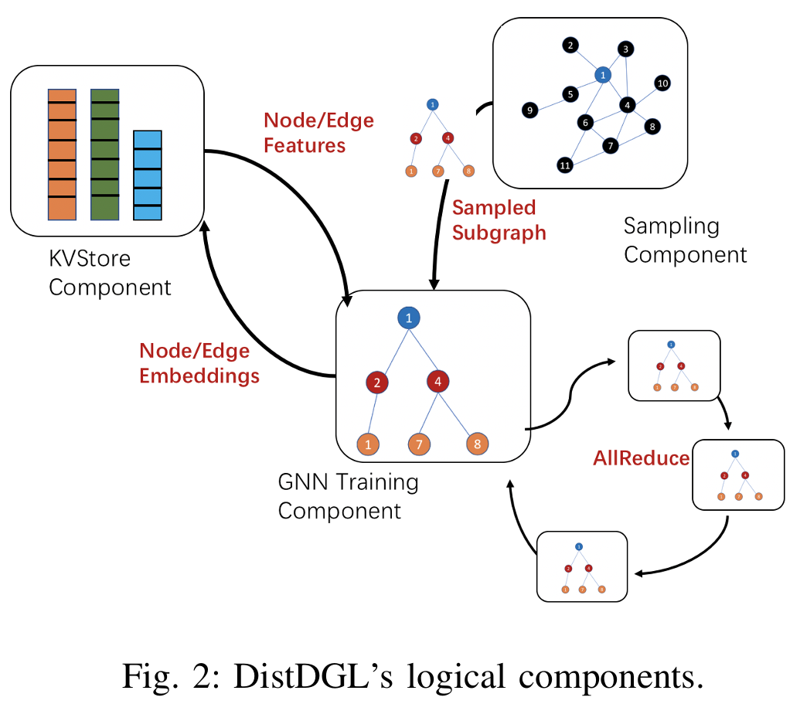
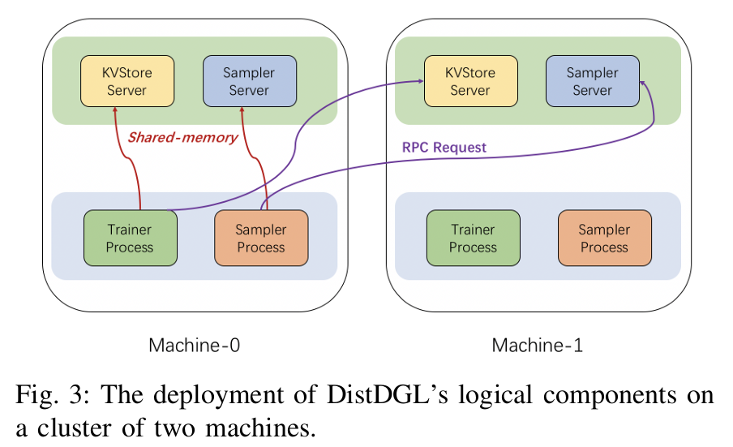
Analysis – System Strategy (6/7)
Distributed System
Notes:
We would like to indicate that in recent years, a few systems have been proposed,
[click]
which now avoid subgraph materialization as much as possible by resorting to backtracking search as in the serial algorithm counterparts, and they have achieved orders of magnitude speedup.

Slide 16
Analysis – System Strategy (7/7)
Distributed System
Notes:
We would like to indicate that in recent years, a few systems have been proposed,
[click]
which now avoid subgraph materialization as much as possible by resorting to backtracking search as in the serial algorithm counterparts, and they have achieved orders of magnitude speedup.

Slide 17
OUTLINE
Introduction (5 min)
Graph Tasks
GNN training
Analysis & Motivation (10 min)
Bottleneck of Large Scale Training
Strategies
Proposed Methods (35 min)
Ginex
OUTRE
TIGER
Conclusions (5 min)
Q/A
Notes:
The presentation includes five parts, I will introduce them step by step. If you have any question, feel free to ask me. Ok, Let’s get started!

Slide 18
Ginex
Notes:
We would like to indicate that in recent years, a few systems have been proposed,
[click]
which now avoid subgraph materialization as much as possible by resorting to backtracking search as in the serial algorithm counterparts, and they have achieved orders of magnitude speedup.

Slide 19
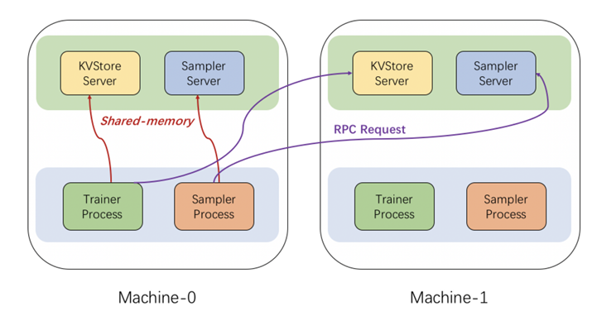
Ginex : Introduction (1/10)
The size of real-world graph datasets reaches hundreds of GB or even a few TB (and growing), which may exceed the main memory capacity. Disk-based GNN training is a promising alternative as modern NVMe SSDs can offer enough capacity to hold the entire input graph as well as much higher read performance than the previous generations.
Distributed Systems are expensive and unachievable for some researchers
Disk-based methods are cheap and easy to expand
Disk-based methods are still in one single machine, and improving its performance can be developed simultaneously with distribution
Notes:
We would like to indicate that in recent years, a few systems have been proposed,
[click]
which now avoid subgraph materialization as much as possible by resorting to backtracking search as in the serial algorithm counterparts, and they have achieved orders of magnitude speedup.

Slide 20
Ginex : Contributions (2/10)
We profile SSD-based GNN training and make two main observations regarding the sub-optimality of the OS page cache and the conventional training pipeline.
Based on our observations, we introduce a novel GNN training pipeline that enables realization of the optimal caching mechanism for feature gathering, which cannot be realized in the conventional training pipeline.
We present an efficient algorithm to simulate the optimal cache replacement policy and accelerate it with GPU.
We prototype Ginex on PyG, a popular GNN library, and demonstrate its effectiveness using four billion-scale datasets that do not fit in memory.
Notes:
We would like to indicate that in recent years, a few systems have been proposed,
[click]
which now avoid subgraph materialization as much as possible by resorting to backtracking search as in the serial algorithm counterparts, and they have achieved orders of magnitude speedup.

Slide 21
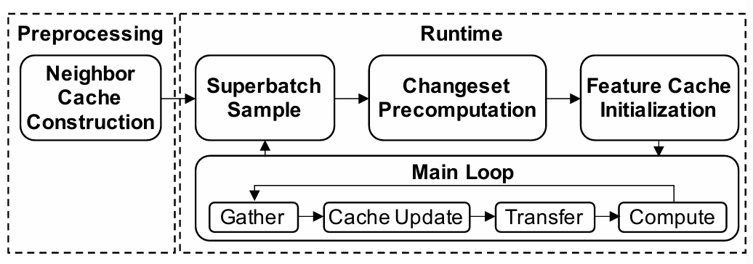
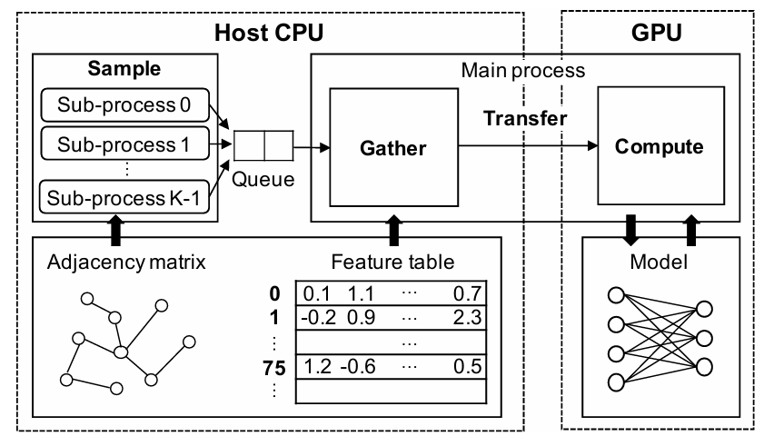
Ginex : Method (3/10)
Fig2. Ginex training pipeline overview
Fig1. Overview of conventional GNN training system
Fig3. Superbatch-level pipeline of Ginex
Notes:
We would like to indicate that in recent years, a few systems have been proposed,
[click]
which now avoid subgraph materialization as much as possible by resorting to backtracking search as in the serial algorithm counterparts, and they have achieved orders of magnitude speedup.

Slide 22
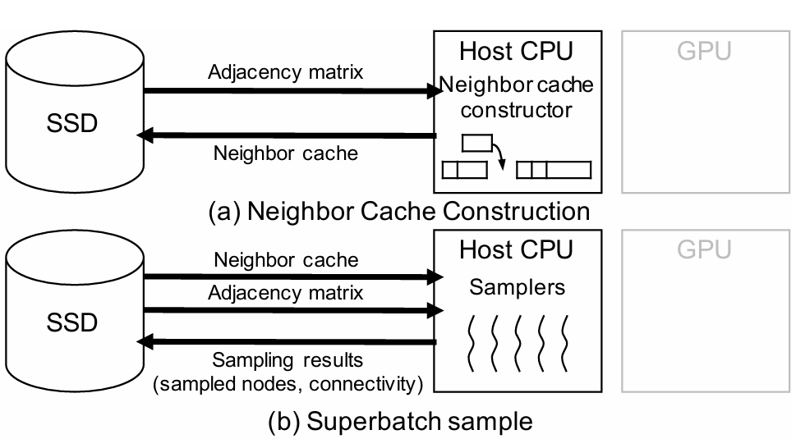
Ginex : Method (4/10)
Notes:
We would like to indicate that in recent years, a few systems have been proposed,
[click]
which now avoid subgraph materialization as much as possible by resorting to backtracking search as in the serial algorithm counterparts, and they have achieved orders of magnitude speedup.

Slide 23
Ginex : Method (5/10)
Fig4. Example of cache update followed by gather
For gather, Ginex first checks 𝑎𝑑𝑑𝑟𝑒𝑠𝑠_𝑡𝑎𝑏𝑙𝑒 for the nodes in 𝑖𝑑𝑠 1 .
The feature vectors of the nodes present in the cache (Node 0 and Node 7) are fetched from the cache 2
The others are read from SSD 3 to make the batch input.
Then Ginex puts these vectors into the cache lines originally holding the feature vectors of 0 and 6, whose address can be found by checking 𝑎𝑑𝑑𝑟𝑒𝑠𝑠_𝑡𝑎𝑏𝑙𝑒 as well 4 .
Lastly, Ginex updates 𝑎𝑑𝑑𝑟𝑒𝑠𝑠_𝑡𝑎𝑏𝑙𝑒 5 , and cache update for Iteration 𝑖 ends.
Notes:
This example shows the change of feature cache when moving onto Iteration (𝑖 +1) from Iteration𝑖.
In this example, the total number of nodes are 10, and five of them are cached (Node 0, 1, 4, 6, and 7).
𝑖𝑑𝑠 refers to the sampled node IDs, while 𝑖𝑛_𝑖𝑑𝑠, 𝑜𝑢𝑡_𝑖𝑑𝑠 and 𝑖𝑛_𝑝𝑜𝑠𝑖𝑡𝑖𝑜𝑛𝑠 are cache update information for the current iteration.
For gather, Ginex first checks 𝑎𝑑𝑑𝑟𝑒𝑠𝑠_𝑡𝑎𝑏𝑙𝑒 for the nodes in 𝑖𝑑s
After the batch input is made, Ginex performs cache update by referring to 𝑖𝑛_𝑖𝑑𝑠, 𝑜𝑢𝑡_𝑖𝑑𝑠 and 𝑖𝑛_𝑝𝑜𝑠𝑖𝑡𝑖𝑜𝑛𝑠. In the figure, 𝑖𝑛_𝑖𝑑𝑠 and 𝑜𝑢𝑡_𝑖𝑑𝑠 indicate that the feature vectors of Node 2 and Node 5 should replace the cache lines occupied by the feature vectors of Node 0 and 6. As the feature vectors of Node 2 and 5, which are newly loaded from SSD, are buffered in the batch input, Ginex locates these two vectors with 𝑖𝑛_𝑝𝑜𝑠𝑖𝑡𝑖𝑜𝑛𝑠. Then, Ginex puts these vectors into the cache lines originally holding the feature vectors of Node 0 and Node 6, whose address can be found by checking𝑎𝑑𝑑𝑟𝑒𝑠𝑠_𝑡𝑎𝑏𝑙𝑒 as well 4 . Lastly, Ginex updates𝑎𝑑𝑑𝑟𝑒𝑠𝑠_𝑡𝑎𝑏𝑙𝑒 5 , and cache update for Iteration 𝑖 ends.

Slide 24
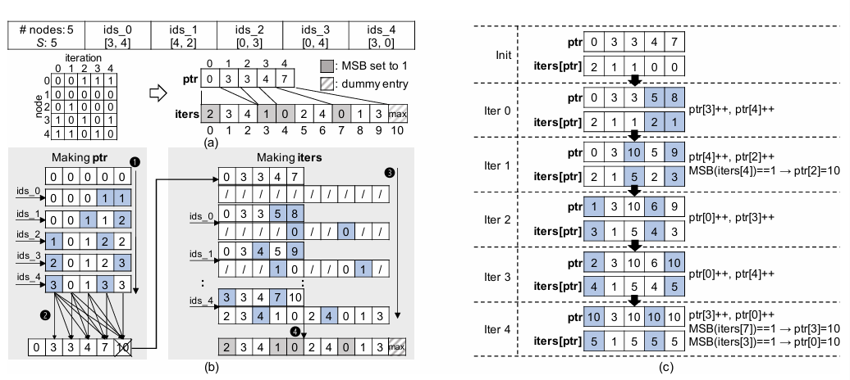
Ginex : Method (6/10)
Fig5. Example for next accessed iteration tracking
Notes:
Figure 12(a) illustrates the data structure utilized by Ginex for tracking node access iterations.
There are five nodes, with two nodes sampled per iteration.
The access traces can be represented as a binary matrix, where each row corresponds to a node and each column corresponds to an iteration.
The matrix is maintained in a compressed sparse row (CSR) format with two arrays:
iters: Lists the accessed iterations of node in sorted order.
ptr: Point to the start of node's iterations in the iters.
For instance, ptr[3] = 4 indicates that Node 3 appears in iterations listed starting from iters[4].
Ginex counts the number of appearances of each node.
It performs a cumulative sum of the count results, inserts a zero at the front, and removes the last element from ptr.
In the second pass, Ginex creates the iters based on ptr.
Ginex restores ptr through a simple shift, appends a dummy entry to iters, and sets the most significant bits for elements pointed by ptr to 1.

Slide 25
Ginex : Experiment (7/10)
Table 1. Graph datasets
Notes:
Figure 12(a) illustrates the data structure utilized by Ginex for tracking node access iterations.
There are five nodes, with two nodes sampled per iteration.
The access traces can be represented as a binary matrix, where each row corresponds to a node and each column corresponds to an iteration.
The matrix is maintained in a compressed sparse row (CSR) format with two arrays:
iters: Lists the accessed iterations of node in sorted order.
ptr: Point to the start of node's iterations in the iters.
For instance, ptr[3] = 4 indicates that Node 3 appears in iterations listed starting from iters[4].
Ginex counts the number of appearances of each node.
It performs a cumulative sum of the count results, inserts a zero at the front, and removes the last element from ptr.
In the second pass, Ginex creates the iters based on ptr.
Ginex restores ptr through a simple shift, appends a dummy entry to iters, and sets the most significant bits for elements pointed by ptr to 1.

Slide 26
Ginex : Experiment (8/10)
Overall Performance
Fig6. Normalized training time breakdown of PyG+, Ali+PG, and Ginex. Smaller is better.
Fig7. Normalized training time breakdown of Ginex-PG and Ginex
Notes:
We would like to indicate that in recent years, a few systems have been proposed,
[click]
which now avoid subgraph materialization as much as possible by resorting to backtracking search as in the serial algorithm counterparts, and they have achieved orders of magnitude speedup.

Slide 27
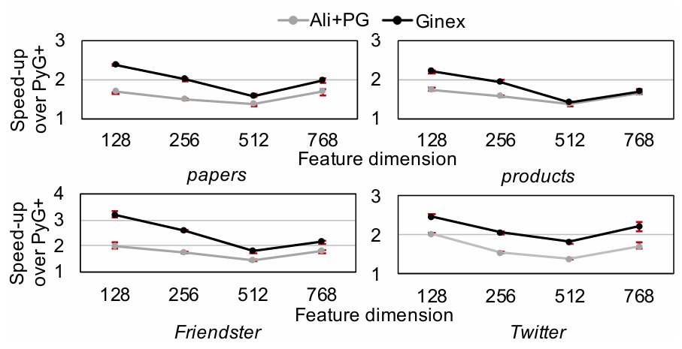
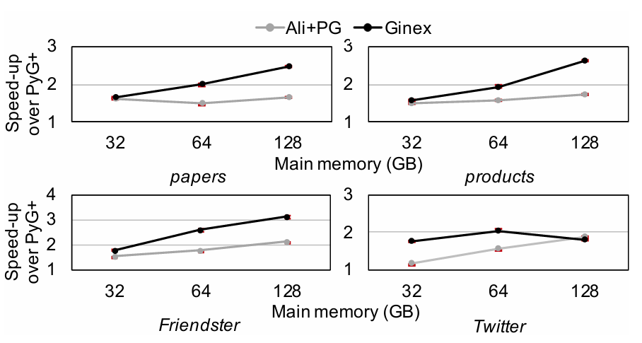
Ginex : Experiment (9/10)
Sensitivity Study
Fig8. Speed up of Ali+PG and Ginex over PyG+ with varying feature dimensions
Fig9. Speed up of Ali+PG and Ginex over PyG+ with varying main memory size
Notes:
We would like to indicate that in recent years, a few systems have been proposed,
[click]
which now avoid subgraph materialization as much as possible by resorting to backtracking search as in the serial algorithm counterparts, and they have achieved orders of magnitude speedup.

Slide 28
Ginex : Experiment (10/10)
Cost Comparison with Distributed Training
Notes:
We would like to indicate that in recent years, a few systems have been proposed,
[click]
which now avoid subgraph materialization as much as possible by resorting to backtracking search as in the serial algorithm counterparts, and they have achieved orders of magnitude speedup.

Slide 29
OUTLINE
Introduction (5 min)
Graph Tasks
GNN training
Analysis & Motivation (10 min)
Bottleneck of Large Scale Training
Strategies
Proposed Methods (35 min)
Ginex
OUTRE
TIGER
Conclusions (5 min)
Q/A
Notes:
The presentation includes five parts, I will introduce them step by step. If you have any question, feel free to ask me. Ok, Let’s get started!

Slide 30
OUTRE
Notes:
We would like to indicate that in recent years, a few systems have been proposed,
[click]
which now avoid subgraph materialization as much as possible by resorting to backtracking search as in the serial algorithm counterparts, and they have achieved orders of magnitude speedup.

Slide 31
OUTRE : Introduction (1/8)
Sampling based GNNs still requires neighborhood information which are in-memory existence of the entire graph.
However, previous work found that the performance bottleneck of sampling-based GNN is the data preparation process that issues a great number of data requests.
On the other hand, the computing devices (e.g., GPUs) are often underutilized during training. Thus, this method is not economical.
Besides, the additionally introduced communication cost may further exacerbate the underutilization issue of computing devices.
Notes:
We would like to indicate that in recent years, a few systems have been proposed,
[click]
which now avoid subgraph materialization as much as possible by resorting to backtracking search as in the serial algorithm counterparts, and they have achieved orders of magnitude speedup.

Slide 32
OUTRE : Introduction (2/8)
The attempts that extend the memory space to external storage (e.g., disk, SSD) are referred to as “out-of-core” executions.
There are two kinds of data redundancies exist in out-of-core sampling based GNN training.
Neighborhood Redundancy Plenty of nodes are redundantly included in the sampled 𝐿-hop neighborhoods of many different training batches
Temporal Redundancy Calculating the exact node embedding at every training iteration incurs many unnecessary data requests as most embeddings only experience modest changes across training iterations.
Notes:
We would like to indicate that in recent years, a few systems have been proposed,
[click]
which now avoid subgraph materialization as much as possible by resorting to backtracking search as in the serial algorithm counterparts, and they have achieved orders of magnitude speedup.

Slide 33
OUTRE : Contributions (3/8)
(1) New Findings. We present a new design perspective, reducing the overall requested data volume, and locate two kinds of data redundancies through a quantitative analysis.
(2)New Framework. We propose a framework, we present partition-based batch construction and historical embedding cache to reduce the data redundancies.
Neighborhood Redundancy: Propose training batches with min-cut graph partitions.
Temporal Redundancy: Approximate node embeddings with their histories to reduce Temporal Redundancy.
Present an automatic cache space management module to help OUTRE adapt to various datasets and hardware configurations.
Notes:
We would like to indicate that in recent years, a few systems have been proposed,
[click]
which now avoid subgraph materialization as much as possible by resorting to backtracking search as in the serial algorithm counterparts, and they have achieved orders of magnitude speedup.

Slide 34
OUTRE : Method (4/8)
Fig1. The workflow overview of OUTRE
Notes:
We would like to indicate that in recent years, a few systems have been proposed,
[click]
which now avoid subgraph materialization as much as possible by resorting to backtracking search as in the serial algorithm counterparts, and they have achieved orders of magnitude speedup.

Slide 35
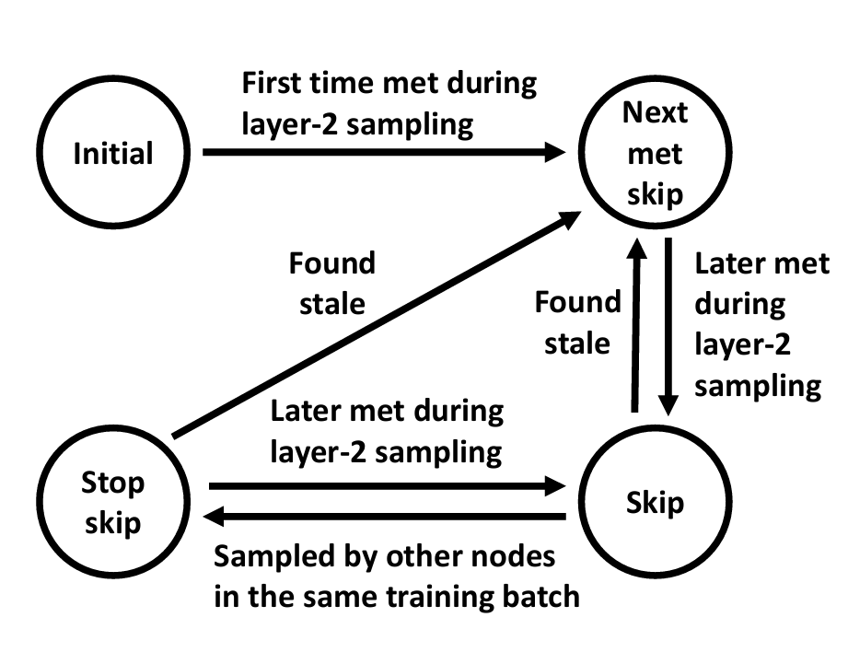
OUTRE : Method (5/8)
Staleness Definition:
An embedding is considered stale if the difference between the current iteration number and the last update iteration exceeds predefined threshold known as staleness.
Fig2. The FSM for state changes of cache candidates.
Notes:
We would like to indicate that in recent years, a few systems have been proposed,
[click]
which now avoid subgraph materialization as much as possible by resorting to backtracking search as in the serial algorithm counterparts, and they have achieved orders of magnitude speedup.

Slide 36
OUTRE : Experiment (6/8)
Table 1. Overview of the four large-scale graph datasets.
Notes:
We would like to indicate that in recent years, a few systems have been proposed,
[click]
which now avoid subgraph materialization as much as possible by resorting to backtracking search as in the serial algorithm counterparts, and they have achieved orders of magnitude speedup.

Slide 37
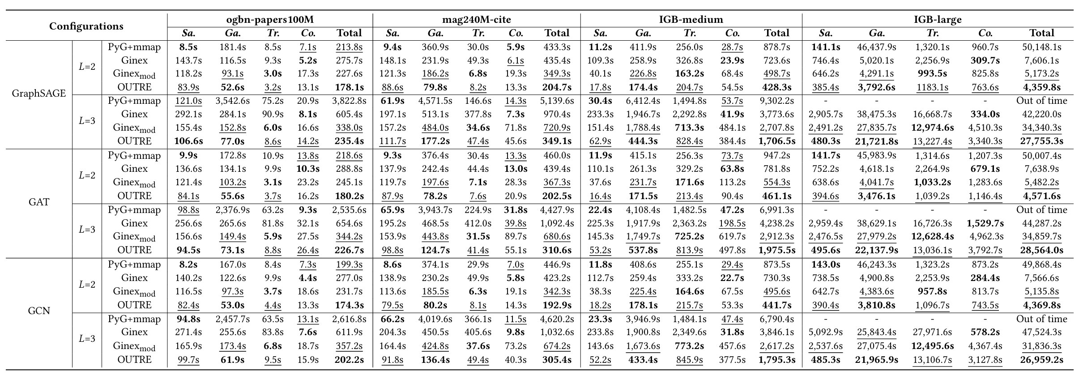
OUTRE : Experiment (7/8)
Table 2. Overall training performance comparison on four datasets
Notes:
We would like to indicate that in recent years, a few systems have been proposed,
[click]
which now avoid subgraph materialization as much as possible by resorting to backtracking search as in the serial algorithm counterparts, and they have achieved orders of magnitude speedup.

Slide 38
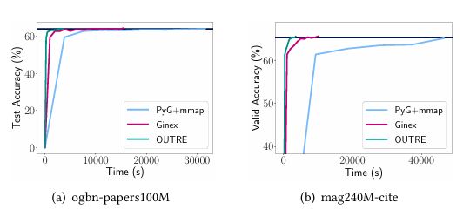
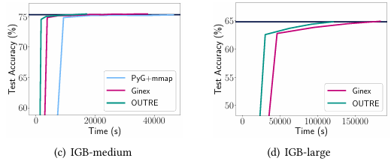
OUTRE : Experiment (8/8)
Fig3. Time-to-accuracy comparison of PyG+mmap, Ginex and OUTRE.
Notes:
We would like to indicate that in recent years, a few systems have been proposed,
[click]
which now avoid subgraph materialization as much as possible by resorting to backtracking search as in the serial algorithm counterparts, and they have achieved orders of magnitude speedup.

Slide 39
OUTLINE
Introduction (5 min)
Graph Tasks
GNN training
Analysis & Motivation (10 min)
Bottleneck of Large Scale Training
Strategies
Proposed Methods (35 min)
Ginex
OUTRE
TIGER
Conclusions (5 min)
Q/A
Notes:
The presentation includes five parts, I will introduce them step by step. If you have any question, feel free to ask me. Ok, Let’s get started!

Slide 40
TiGER
Notes:
We would like to indicate that in recent years, a few systems have been proposed,
[click]
which now avoid subgraph materialization as much as possible by resorting to backtracking search as in the serial algorithm counterparts, and they have achieved orders of magnitude speedup.

Slide 41
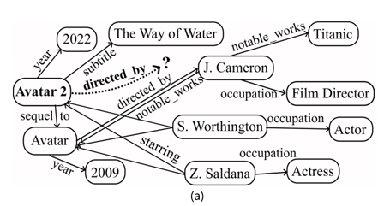
TIGER : Introduction (1/8)
While Ginex works on homogeneous graph, how about heterogeneous graph, like Knowledge Graph?
A 3-hop subgraph in the FB5M: up to one million triples,
consuming 75% to 90% of training time.
Challenges
Subgraph Data Completeness
Heterogeneous Graph Structure
SSD Storage and Access
Fig1: Example of knowledge graph reasoning.
Notes:
We would like to indicate that in recent years, a few systems have been proposed,
[click]
which now avoid subgraph materialization as much as possible by resorting to backtracking search as in the serial algorithm counterparts, and they have achieved orders of magnitude speedup.

Slide 42
TIGER : Introduction (2/8)
Although recent models like AdaProp and A*Net are more efficient, they rely on the initial extraction of a complete subgraph from large-scale KGs
Graph embedding systems like DGL-KR, HET-KG mainly focus on distributed parallelism and embedding storage, which cannot be directly used for large-scale inductive KG
Many scalable frameworks, like NeuGraph and AliGraph, work on large-scale GNN training, but do not specifically address the issue of subgraph extraction
Distributed GNN training systems using graph partitioning algorithms frequently tend to obstruct subgraph completeness, lead to additional data.
Notes:
2. reasoning due to the more complex nature of the GNN models

Slide 43
TIGER : Contributions (3/8)
1. Slice & Cache Framework
Introduces a streaming-based "Slice & Cache" method to precompute subgraphs efficiently.
2. Atom-Based Subgraph Slicing
Defines subgraphs as combinations of atoms, enabling exclusion of redundant triple data during slicing, reducing communication and complexity.
3. SiGMa Algorithm: A two-stage slicing algorithm that:
- Matches subgraph atoms with existing slices.
- Creates new reusable slices for unmatched atoms.
Notes:
We would like to indicate that in recent years, a few systems have been proposed,
[click]
which now avoid subgraph materialization as much as possible by resorting to backtracking search as in the serial algorithm counterparts, and they have achieved orders of magnitude speedup.

Slide 44
TIGER : Method (4/8)
Basic Training Pipeline:
Accelerating subgraph extraction is crucial
Two Core Processes:
1. Subgraph Slicing
Segment the subgraph triples into equal-size slices;
Reuse slices to construct multiple subgraphs;
2. Subgraph Caching
Caching slices to reduce SSD access;
Dynamicaly update cache for high hit ratio;
New Training Pipeline:
Notes:
We would like to indicate that in recent years, a few systems have been proposed,
[click]
which now avoid subgraph materialization as much as possible by resorting to backtracking search as in the serial algorithm counterparts, and they have achieved orders of magnitude speedup.

Slide 45
TIGER : Method (5/8)
Atom-level Subgraph Slicing
Each atom are treated as an indivisible unit for efficient slicing;
Load subgraphs with atom-level slices as small as possible;
Fig2: Atom-based Subgraph Data
Optimization Target:
Slice Redundancy: less zero-filling/redundant space in each slice;
Slice Utilization: more reused slices in multiple overlapping subgraphs;
Notes:
We would like to indicate that in recent years, a few systems have been proposed,
[click]
which now avoid subgraph materialization as much as possible by resorting to backtracking search as in the serial algorithm counterparts, and they have achieved orders of magnitude speedup.

Slide 46
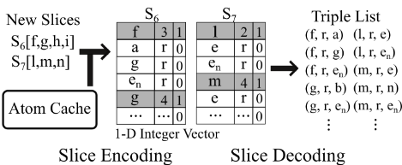
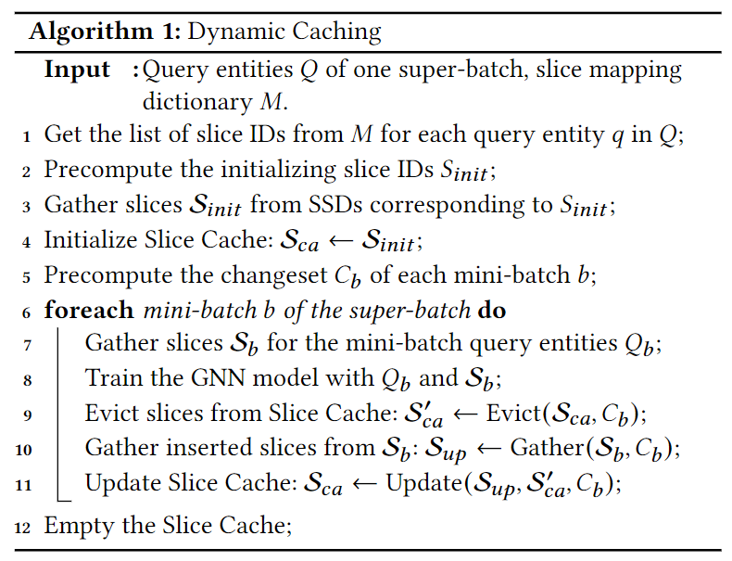
TIGER : Method (6/8)
Atom-based Slice Storage
Store a KG triple with a single uint64 integer;
Effectively reduces the storage requirement
by a factor of three;
Dynamic Caching Mechanism
To minimize SSD access, TIGER’s Slice Cache is dynamically updated with each mini-batch loop.
Prioritize slices that would be accessed soon in the current super-batch;
Evict slices with the longest wait time before needed;
Notes:
We would like to indicate that in recent years, a few systems have been proposed,
[click]
which now avoid subgraph materialization as much as possible by resorting to backtracking search as in the serial algorithm counterparts, and they have achieved orders of magnitude speedup.

Slide 47
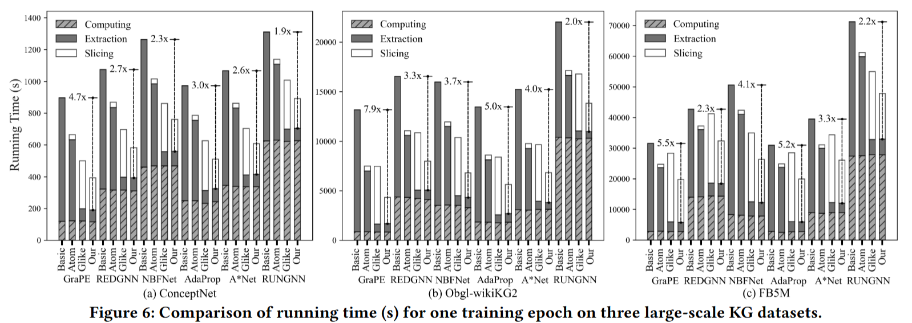
TIGER : Experiment (7/8)
Across six diverse GNN models: NBFNet, REDGNN, AdaProp, A*Net, GraPE, RUNGNN
Fig3: Comparison of running time (s) for one training epoch on three large-scale KG datasets.
Notes:
We would like to indicate that in recent years, a few systems have been proposed,
[click]
which now avoid subgraph materialization as much as possible by resorting to backtracking search as in the serial algorithm counterparts, and they have achieved orders of magnitude speedup.

Slide 48
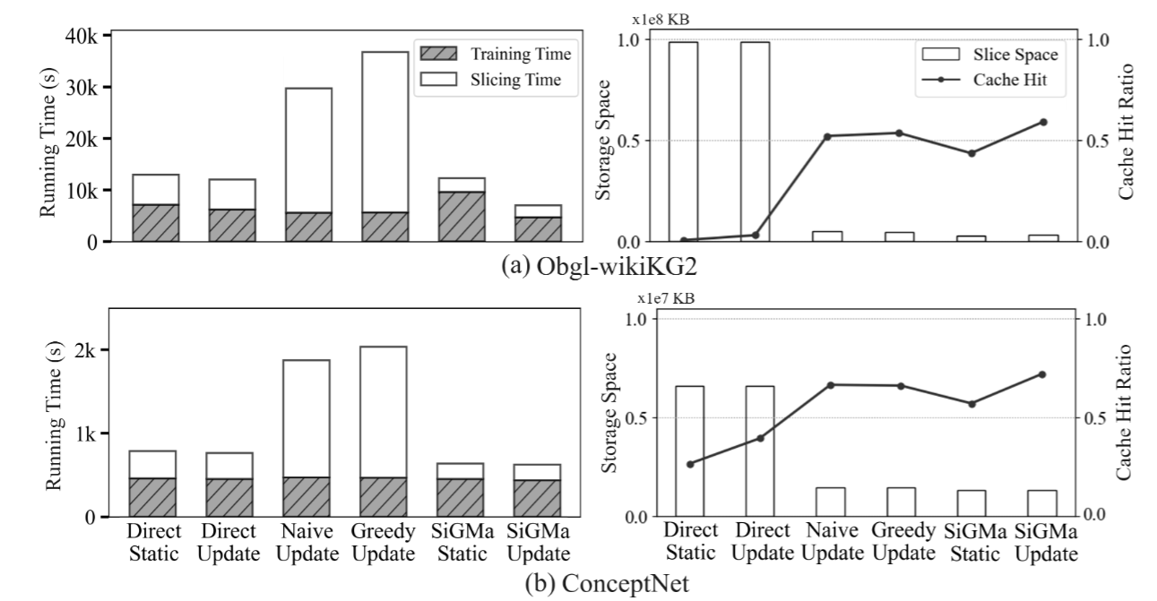
TIGER : Experiment (8/8)
Albation Studies:
Outperform in all four aspects: training time, slicing time, slice storage space, cache hit ratio
Scalability Studies:
Stable performance on varying-sized datasets generated from large-scale KGs
Fig5:Scalability studies on different scale KG datasets.
Fig4. Ablation studies of the TIGER and five variants. Training time (s) refers to the total time of subgraph extrac tion and model computing
Fig6: Training curves on the Freebase dataset.
Notes:
We would like to indicate that in recent years, a few systems have been proposed,
[click]
which now avoid subgraph materialization as much as possible by resorting to backtracking search as in the serial algorithm counterparts, and they have achieved orders of magnitude speedup.

Slide 49
OUTLINE
Introduction (5 min)
Graph Tasks
GNN training
Analysis & Motivation (10 min)
Bottleneck of Large Scale Training
Strategies
Proposed Methods (35 min)
Ginex
OUTRE
TIGER
Conclusions (5 min)
Q/A
Notes:
The presentation includes five parts, I will introduce them step by step. If you have any question, feel free to ask me. Ok, Let’s get started!

Slide 50
Conclusions
Ginex, support billion-scale graph datasets on a single machine with SSD, optimizing feature caching to alleviate the I/O bottleneck.
OUTRE introduces an out-of-core sampling-based framework that focuses on reducing overall data volume requests for external storage.
TIGER enhances inductive KG reasoning by accelerating subgraph extraction through a Slice & Cache procedure, which improves SSD sequential access. The SiGMa slicing algorithm balances redundancy and efficiency, offering significant computational savings.
Notes:
In this paper, we propose three novel systems—Ginex, OUTRE, and TIGER—to address the challenges of scalable GNN training with caching. Ginex leverages SSDs to support billion-scale graph datasets on a single machine, optimizing feature caching to alleviate the I/O bottleneck. This results in significant speedups, enabling GNN training on datasets far larger than what a single machine’s CPU memory could handle. OUTRE introduces an out-of-core sampling-based framework that focuses on reducing overall data volume requests for external storage, rather than just minimizing the percentage of data attempts. By identifying and addressing data redundancies, OUTRE incorporates partition-based batch construction, historical embedding caching, and automatic cache space management.Finally, TIGER enhances inductive KG reasoning by accelerating subgraph extraction through a Slice\&Cache procedure, which improves SSD sequential access. The SiGMa slicing algorithm balances redundancy and efficiency, offering significant computational savings. Overall, Ginex, OUTRE, and TIGER push the boundaries of scalable GNN training by optimizing data access and memory usage, setting the stage for even more efficient large-scale graph learning systems.

Slide 51
Q & A
Q & A
Notes:
Figure 13 shows the CPU rates for the first 120 seconds, where we can see that the CPU rate of T-FSM (blue line) jumps to 3200% and completes the job quickly.

Slide 52
Thank you!
Notes:
Figure 13 shows the CPU rates for the first 120 seconds, where we can see that the CPU rate of T-FSM (blue line) jumps to 3200% and completes the job quickly.

