Slide 1
GNN Training Systems on Large Graphs:
Optimization Strategy for Mini-batch Training
2024.11.19
Taotao Wang
School of Data Science
Chinese University of Hong Kong, Shenzhen

Slide 2
Outline
Introduction (8 min)
Proposed Methods & Performance Evaluation (30 min)
  Cache-Based Methods (20 min)
    Single Cahce Method (10 min)
    Dual Cache Method (10 min)
  UVA-Based Method (10 min)
Conclusions(3 min )
Q&A (5 min)

Slide 3
Outline
Introduction (8 min)
Proposed Methods & Performance Evaluation (30 min)
  Cache-Based Methods (20 min)
    Single Cahce Method (10 min)
    Dual Cache Method (10 min)
  UVA-Based Method (10 min)
Conclusions(3 min )
Q&A (5 min)

Slide 4
Introduction - Graph (1/8)
A Simple Graph
Adjacency Matrix
1
2
 | 1 | 2 | 3 | 4
1 | 0 | 1 | 1 | 1
2 | 1 | 0 | 0 | 0
3 | 1 | 0 | 0 | 1
4 | 1 | 0 | 1 | 0
3
4

Slide 5




Introduction - Graph (2/8)

Slide 6
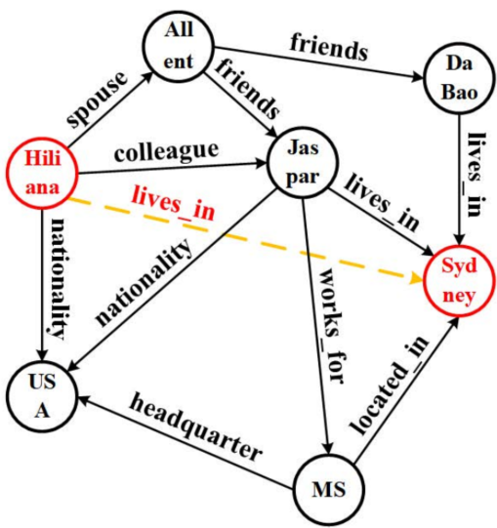
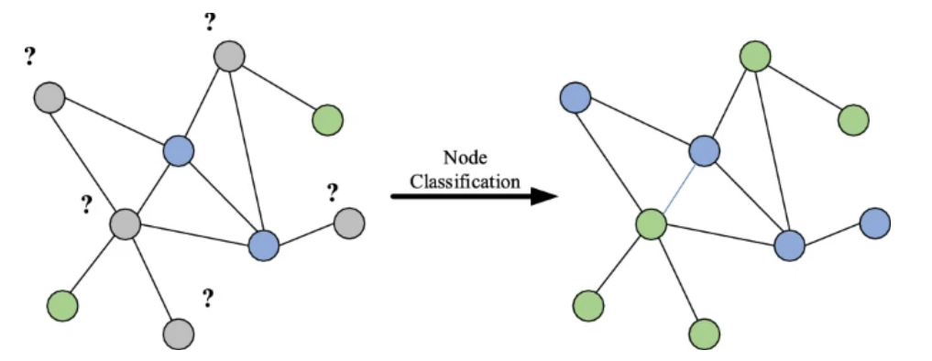
Introduction - Classic Tasks In Graphs (3/8)
Node Classification
Link Prediction

Slide 7
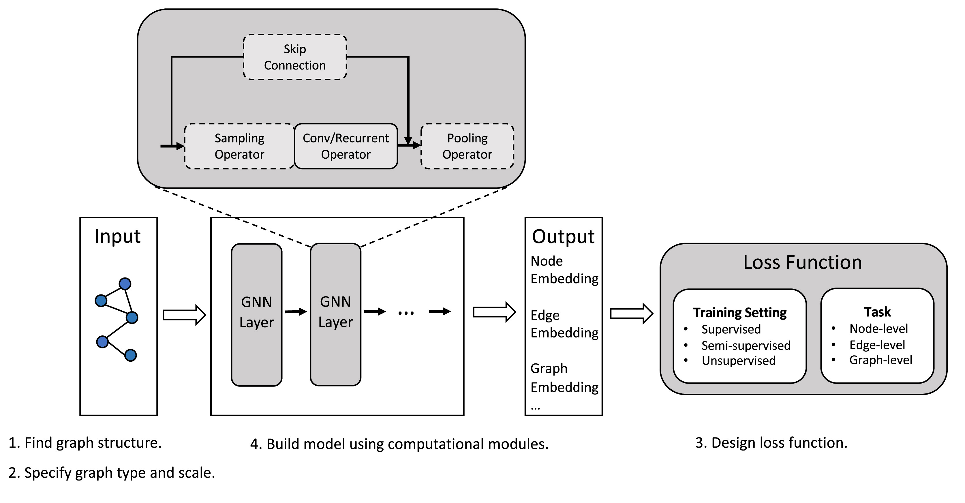
Introduction - GNN (4/8)
What is GNN ?
GNN: Graph nueral network.
Powerful tools to handle problems modeled by the graph and have been widely adopted in various applications.
Each GNN layer can be expressed as a vertex-centric message-passing round at the k-th layer, each vertex v aggregates the features of its neighbors u ∈ N(v) and uses that information to compute its new feature

Slide 8
Introduction - Challenges (5/8)
When the graphs are very large,
how could we train GNNs for downstream tasks?

Slide 9
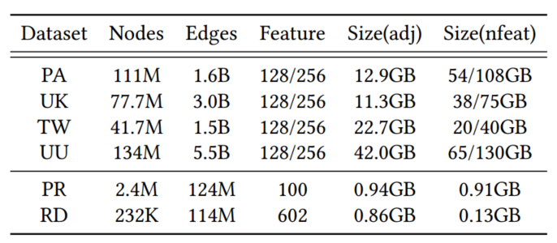
Introduction - Challenges (6/8)
citation graph in Open Graph Benchmark Ogbn-Papers100M (PA)
social graphs: Twitter (TW)
web graphs:UK-2006-05 (UK) and UK-Union(UU)
co-purchasing network Ogbn-Products (PR)
online posts network Reddit (RD)

Slide 10
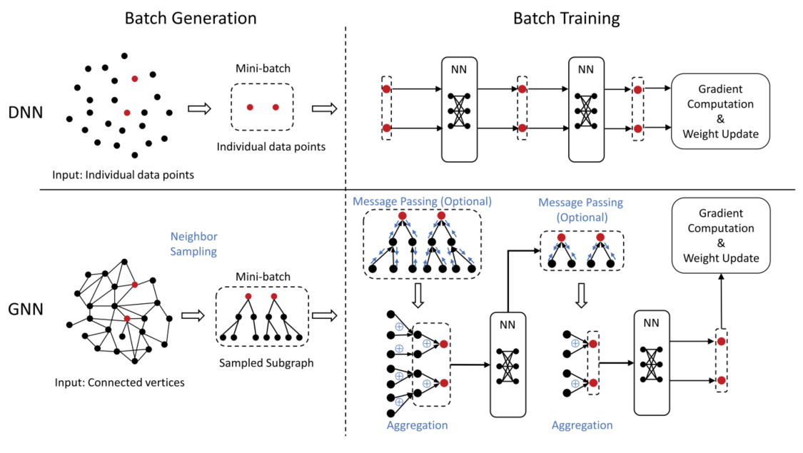
Introduction - GNN Training Process (7/8)

Slide 11
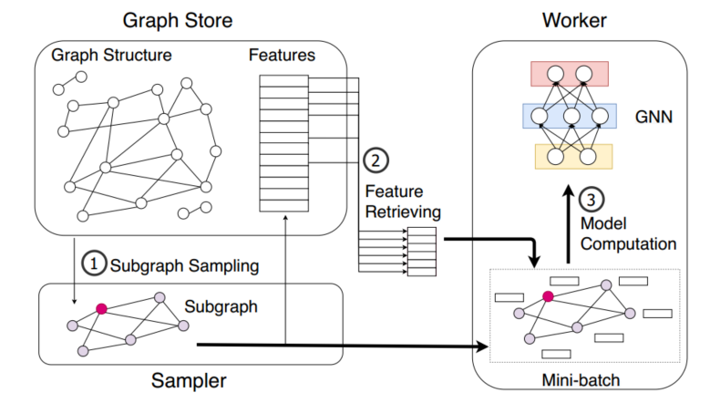
Introduction - Mini-Batch Training (8/8)

Slide 12
Outline
Introduction (8 min)
Proposed Methods & Performance Evaluation (30 min)
  Cache-Based Methods (20 min)
    Single Cahce Method (10 min)
    Dual Cache Method (10 min)
  UVA-Based Method (10 min)
Conclusions(2 min)
Q&A (5 min)

Slide 13
Outline
Introduction (8 min)
Proposed Methods & Performance Evaluation (30 min)
  Cache-Based Methods (20 min)
    Single Cahce Method (10 min)
    Dual Cache Method (10 min)
  UVA-Based Method (10 min)
Conclusions(2 min)
Q&A (5 min)

Slide 14
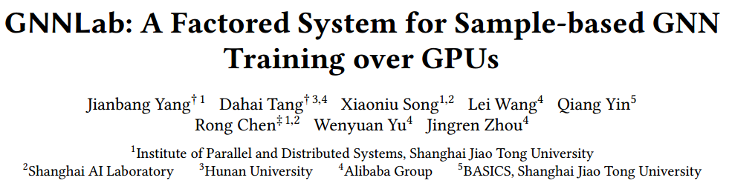
Single Cache Method: GNNLab (1/9)

Slide 15
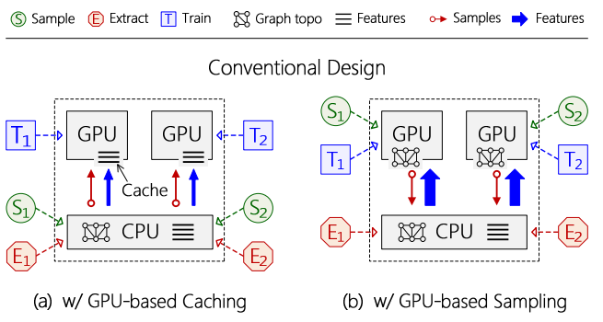
Single Cache Method: GNNLab (2/9)

Slide 16
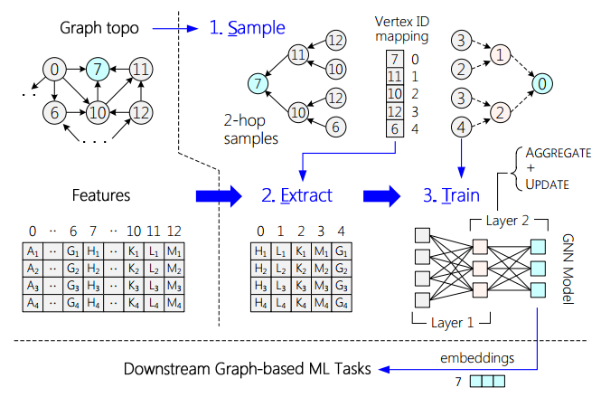
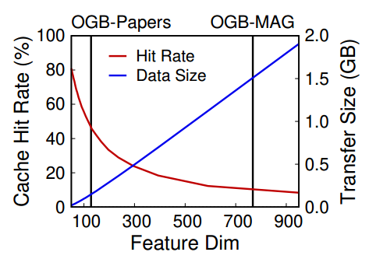
Single Cache Method: GNNLab (3/9)
The first challenge is how to eliminate contention on GPU memory between different stages of the SET model.
SET model

Slide 17
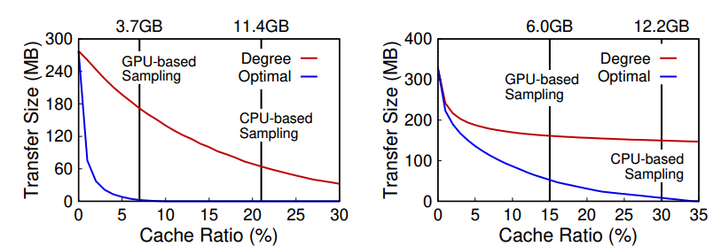
Single Cache Method: GNNLab (4/9)
The second challenge is how to achieve optimal cache efficiency for diverse GNN datasets and sampling algorithms

Slide 18
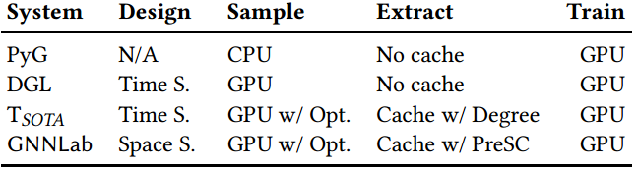
Single Cache Method: GNNLab (5/9)
GNNLab is a new factored GNN system that performs different stages of the SET model on different processors (GPUs and CPUs).
GNNLab can support two key optimizations:
sampling graph data (sampler and trainer)
caching features over GPUs (PreSC policy)

Slide 19
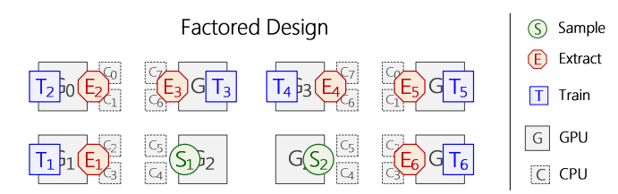
Single Cache Method: GNNLab (6/9)
Motivation: different training epochs in the same stage share a large amount or even all of the data, which means that sample-based GNN training has extremely good inter-task data locality.
Inspired by factored operating system
An example of the factored design for sample-based
GNN training over 8 GPUs and two 8-core CPUs.

Slide 20
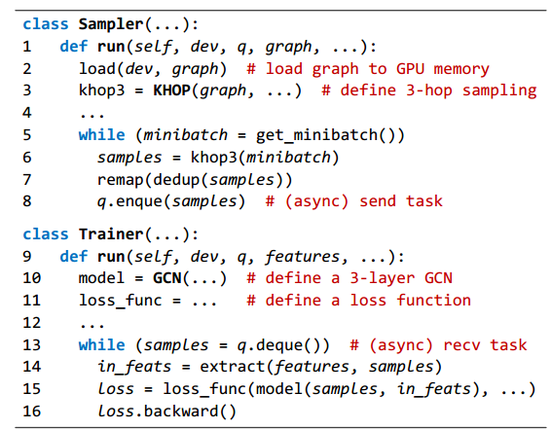
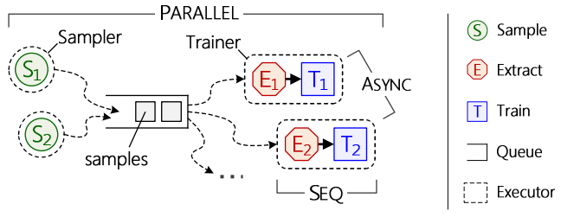
Single Cache Method: GNNLab (7/9)
Optimized Sampling Strategy: A simple data-parallel programming model
GNNLab divides the training pipeline of the SET model into two kinds of individual executors, named Sampler and Trainer respectively.

Slide 21
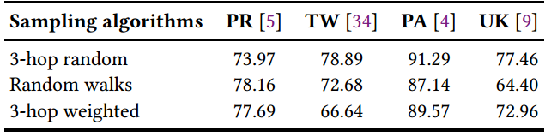
Single Cache Method: GNNLab (8/9)
Caching features over GPUs: A Pre-sampling Based Caching Policy (PreSC)
PreSC conducts K sampling stages, starting from the vertices in Training set T. Here K is a user-defined parameter.
It records the visit count of the sampled vertices and uses the average count as the hotness metric.
PreSC#K denotes the variant of PreSC that conducts K sampling stages.
The similarity (in percentage) of access footprint between two epochs for various datasets and sampling algorithms

Slide 22
Single Cache Method: GNNLab (9/9)

Slide 23
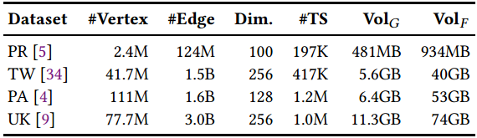
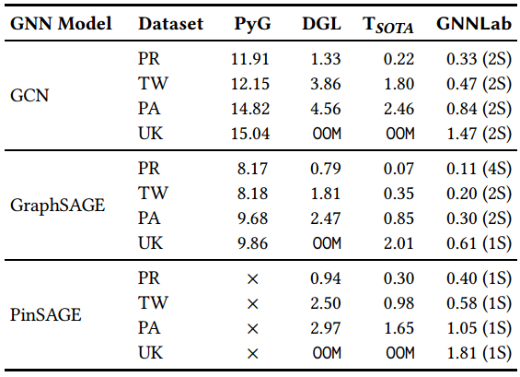
Evaluation - GNNLab (1/3)
The runtime (in seconds) of one epoch on different GNN
systems. (nS) represents n GPUs allocated to Samplers in GNNLab.
“×” indicates that the target GNN model is not supported.
co-purchasing network OGB-Products (PR)
social graph Twitter(TW)
citation network OGB-Papers (PA)
web graph UK-2006 (UK)

Slide 24
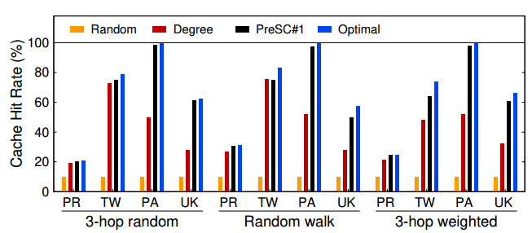
Evaluation - GNNLab (2/3)
The comparison of the cache hit rate for various workloads by using different caching policies.
The cache ratio of features is set to 10%.

Slide 25
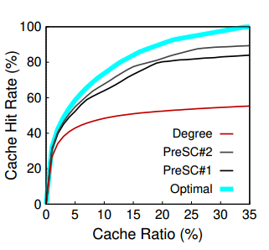
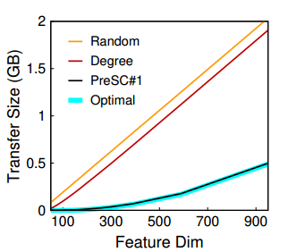
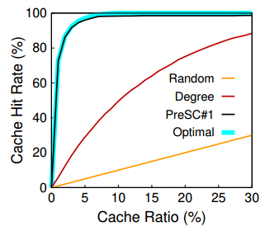
Evaluation - GNNLab (3/3)
OGB-Papers with the increase of feature dimensions
Twitter with weighted sampling
OGB-Papers with 3-hop neighborhood
The comparison among different caching policies. PreSC#K conducts K sampling stages.

Slide 26
Outline
Introduction (8 min)
Proposed Methods & Performance Evaluation (30 min)
  Cache-Based Methods (20 min)
    Single Cahce Method (10 min)
    Dual Cache Method (10 min)
  UVA-Based Method (10 min)
Conclusions(2 min)
Q&A (5 min)

Slide 27
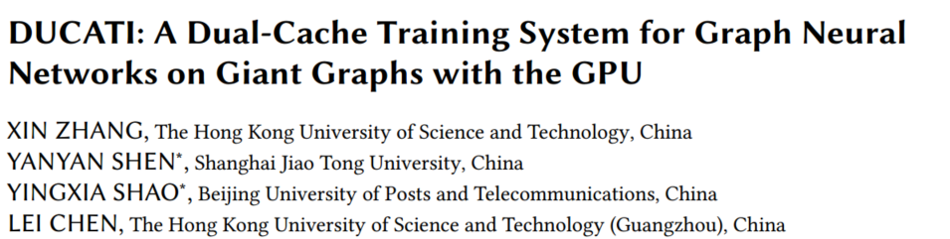
Dual Cache Method: DUCATI (1/12)

Slide 28
Dual Cache Method: DUCATI (2/12)
Challenge for mini-batch training
The preparation of such mini-batches is notoriously expensive
  For example, when we train the GraphSAGE model on the OgbnPapers100M dataset, the preparation time for one mini-batch, which includes the time of generating the mini-batch and transferring it from the CPU to the GPU, is about 240ms, far exceeding the actual computation time (about 10ms) for forward computation, backward propagation, and weights update
Therefore, cahce-based GNN training systems are proposed to accelerate the preparation of mini-batches by leveraging the locality of graph data and the under-utilized GPU memory

Slide 29
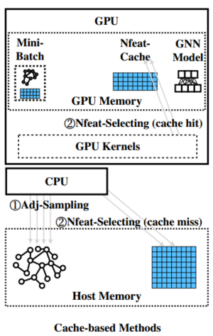
Dual Cache Method: DUCATI (3/12)
Cache-based systems accelerate the preparation of mini-batches:
leverage the locality of node features
leverage under-utilized GPU memory
These systems cache frequently accessed node features in spare GPU memory to reduce the
time of Nfeat-Selecting (selection on the node features tensor), and reduce the data transfer
from the CPU to the GPU.
Assumptions:
Nfeat-Selecting is always more time-consuming than Adj-Sampling (sample the adjacency matrix)
Nfeat-Cache can make full use of the spare GPU memory
However, these assumptions may not always hold in practice

Slide 30
Dual Cache Method: DUCATI (4/12)
Current single-cache systems cannot adapt to such diverse workloads :
These systems blindly optimize Nfeat-Selecting even when Adj-Sampling is more expensive.
Single-Cache systems may not fully utilize the GPU memory and can waste up to several gigabytes of the GPU memory
For example, when training GraphSAGE on the Ogbn-Papers100M dataset, Nfeat-Cache was found that it can only utilize 2.5 GB of the 6 GB spare GPU memory.
This provides an opportunity to allocate another cache to accelerate Adj-Sampling, whose data accesses also exhibit data locality
Based on their findings, DUCATI is proposed to adapt to different workloads while making better use of the spare GPU memory by:
Adj-Cache
Nfeat-Cache

Slide 31
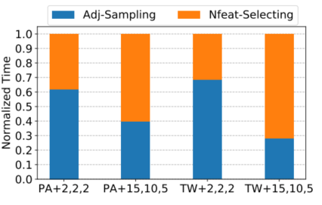
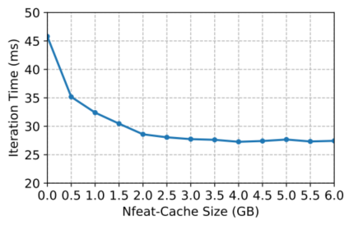
Dual Cache Method: DUCATI (5/12)
Motivations:
The data access to the adjacency matrix also has locality.
For example, when training GraphSAGE on the Ogbn-Papers100M dataset, 0.7 GB entries in the 12.9 GB of the adjacency matrix account for more than 98% of the total adjacency accesses.
Adj-Sampling can be more time-consuming than Nfeat-Selecting.
Depending on the input settings, the workloads of Adj-Sampling and Nfeat-Selecting are diverse (Figure 1).
Nfeat-Cache cannot utilize all spare GPU memory.
Nfeat-Cache exhibits the marginal effect as the cache size increases. As observed in Fig 2, Nfeat-Cache can hardly benefit from more than 2.5 GB cache budget. Thus the leftover spare GPU memory is not utilized properly.
Figure 1
Figure 2

Slide 32
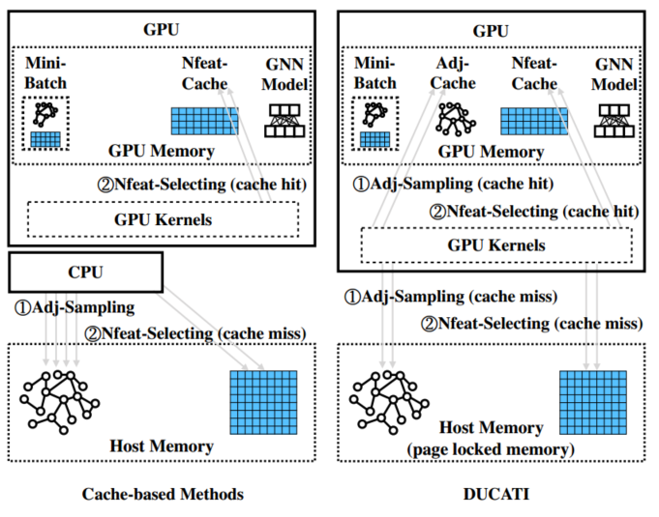
Dual Cache Method: DUCATI (6/12)

Slide 33
Dual Cache Method: DUCATI (7/12)
How to design Adj-caches?
How to jointly allocate Adj-Cache and Nfeat-Cache in the GPU memory?

Slide 34
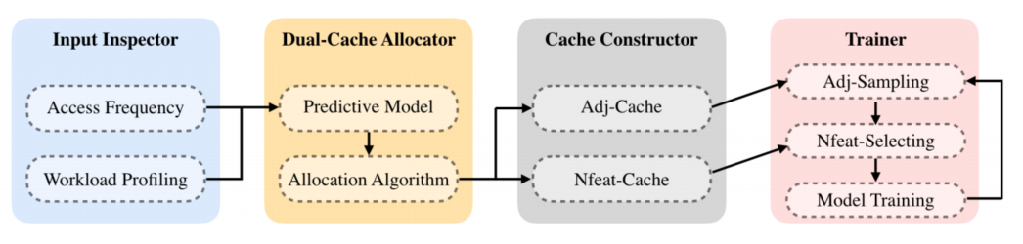
Dual Cache Method: DUCATI (8/12)
Overview of DUCATI

Slide 35
Dual Cache Method: DUCATI (9/12)
How to jointly allocate Adj-Cache and Nfeat-Cache in the GPU memory?
Input Inspector extracts two pieces of crucial information from the input with offline sample runs:
Information of entries’ access frequency.
The access frequency is used to estimate the real access probability of each entry.
Information of workload profiling.
Different inputs usually lead to different workloads of Adj-Sampling and Nfeat-Selecting. The same cache budget also leads to different improvements when allocated to Adj-Cache or Nfeat-Cache with different ratios.
These 2 information is leveraged to bulid a workload-aware Dual-Cache Allocator

Slide 36
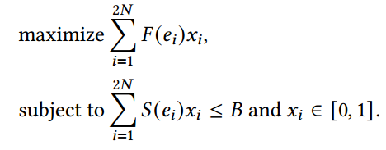
Dual Cache Method: DUCATI (10/12)
How to jointly allocate Adj-Cache and Nfeat-Cache in the GPU memory?
Dual-Cache Allocator compare the benefit of caching each entry and select the most beneficial ones among all the candidates.
The Benefit Prediction Model.
A predictive model that maps the theoretical properties of one entry to the empirical reduction of the system running time if we cache the entry. This model is used to evaluate the benefit of caching each entry.
The Allocation Algorithm.
Given 2N entries (N adjacency lists and N node features), the benefit F(e_{i}) given by the benefit prediction model and the cost S(e_{i}) of caching each entry e_{i}, and a total cache budget B. The dual-cache allocation problem is defined as follows:

Slide 37
Dual Cache Method: DUCATI (11/12)
How to design Adj-caches?
Challenges:
the variable length of adjacency lists may require auxiliary data structure and procedures for the storing and the lookup of Adj-Cache
the special workload of Adj-Sampling requires a lightweight cache lookup mechanism.

Slide 38
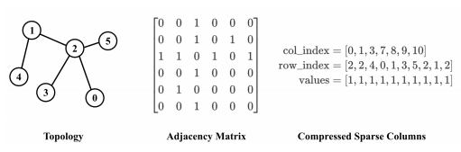
Dual Cache Method: DUCATI (12/12)
How to design Adj-caches?
These two challenges are addressed by adopting a CSC-like format for Adj-Cache combined with graph reordering.
This design requires no auxiliary data structure for Adj-Cache and a very lightweight cache lookup mechanism.
Adj-caches:
perform a graph reordering so that these cached adjacency lists are at the front of all adjacency lists.
slice these elements at the front of three original CSC arrays and form three cached CSC arrays
This design avoids maintaining an auxiliary address map that stores the address and offsets of the scattered cached entries with variable lengths.
Nfeat-caches: construct the same Nfeat-Cache as previous works
An adjacency matrix stored in CSC format

Slide 39
Evaluation - DUCATI (1/3)
citation graph in Open Graph Benchmark Ogbn-Papers100M (PA)
social graphs: Twitter (TW)
web graphs:UK-2006-05 (UK) and UK-Union(UU)
co-purchasing network Ogbn-Products (PR)
online posts network Reddit (RD)

Slide 40
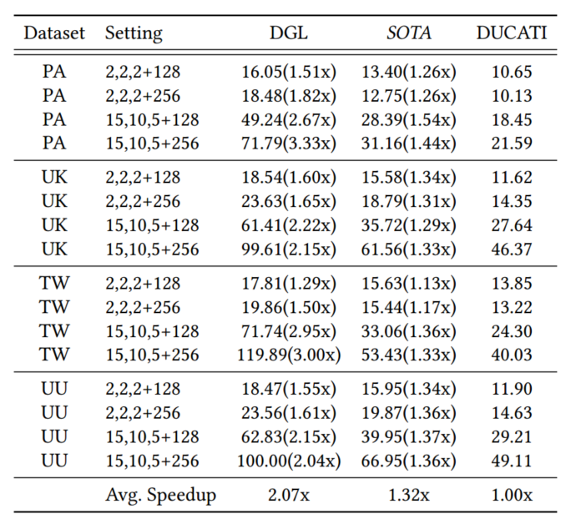
Evaluation - DUCATI (2/3)
Setting:
• fanouts=(2,2,2), dimension=128;
• fanouts=(2,2,2), dimension=256;
• fanouts=(15,10,5), dimension=128;
• fanouts=(15,10,5), dimension=256.
Baselines:
DGL: Deep Graph Library, a library for graph deep learning.
In the experiments, it serves as a system with UVA techique.
SOTA: SOTA employs UVA for Adj-Sampling, UVA for Nfeat-Selecting, and NfeatCache. SOTA constructs the same Nfeat-Cache as GNNLab.

Slide 41
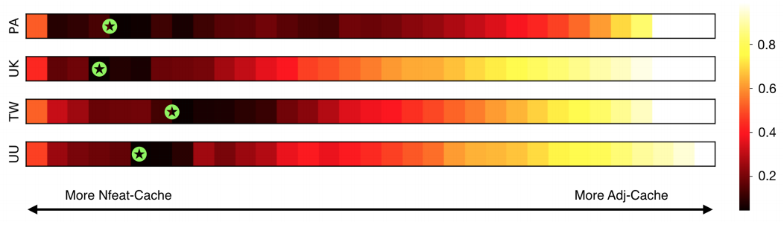
Evaluation - DUCATI (3/3)
The heatmap that visualizes the normalized execution time of all possible allocation plans. Here each rectangle represents one allocation plan. The position of the rectangle indicates the size of Adj-Cache. From left to right, the size of Adj-Cache increases from zero to the total available cache budget with a fixed step size, and the size of Nfeat-Cache decreases accordingly. The hollow green pentagram denotes the allocation plan given by our Dual-Cache Allocator. The darker color means shorter time.

Slide 42
Outline
Introduction (8 min)
Proposed Methods & Performance Evaluation (30 min)
  Cache-based Methods (20 min)
    Single Cahce Method (10 min)
    Dual Cache Method (10 min)
  UVA-Based Method (10 min)
Conclusions(2 min)
Q&A (5 min)

Slide 43
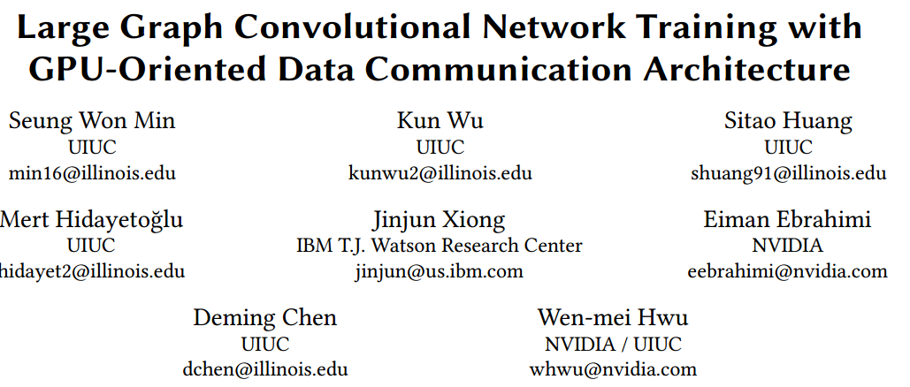
UVA-Based Method (1/8)

Slide 44
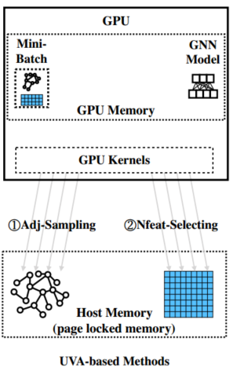
UVA-Based Method (2/8)
UVA-based systems accelerate the preparation of mini-batches:
UVA : Unified Virtual Addressing
improve the utilization of PCIe bandwidth when transferring graph data to the GPU
allows us to store the large graph data in the host memory while harnessing the GPU to
perform fast accessing and processing of irregular graph data.

Slide 45
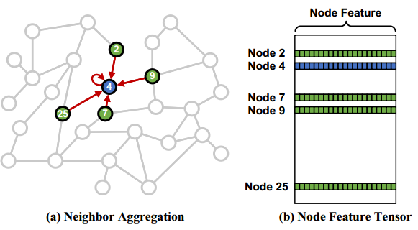
UVA-Based Method (3/8)
One of the direct access data methods: DMA
CPU can quickly gather the sparse features on the fly
DMA engines are specialized in transferring large blocks of data independently
However, to collect relational information from those neighboring nodes, we may need to access thousands of scattered locations in memory.
Without a doubt, such data access patterns make the traditional block data transfer method ineffective.

Slide 46
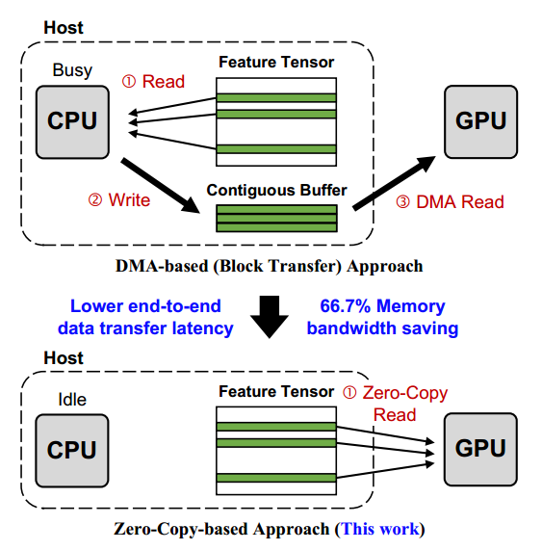
UVA-Based Method (4/8)
Program GPU cores to directly access host memory with zero-copy memory access
This approach allows the application developers to direct the GPU cores
to exactly the locations that hold the data needed for computation
Some works have shown that the ability to issue a massive number of concurrent memory accesses enables GPUs to tolerate latency effectively when accessing complicated data structures like graphs that reside in host memory

Slide 47
UVA-Based Method (5/8)
Three major questions in this work:
Can zero-copy memory access fully utilize PCIe bandwidth while training GCN considering the long latency for accessing host memory?
What would be the price of consuming GPU cores for zero-copy memory access?
Can we show real end-to-end application performance benefit from our method?

Slide 48
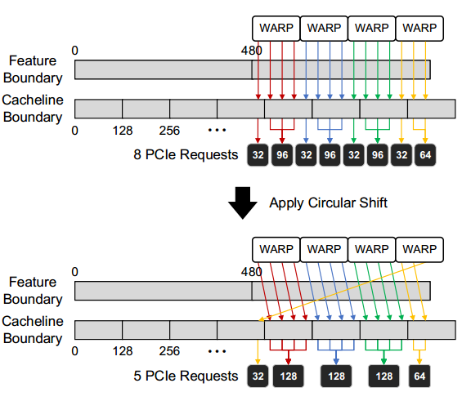
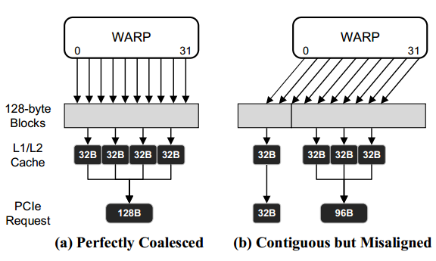
UVA-Based Method (6/8)
1. Can zero-copy memory access fully utilize PCIe bandwidth while training GCN considering the long latency for accessing host memory?
propose an automatic data access alignment optimization in GPU data indexing kernel. With our optimization, zero-copy PCIe bandwidth can match up to 93% of block transfer PCIe bandwidth.
There is a hard limit on the number of outstanding PCIe read requests that PCIe devices can generate at a given moment.

Slide 49
UVA-Based Method (7/8)
2. What would be the price of consuming GPU cores for zero-copy memory access?
propose a novel CUDA multi-process service(MPS)^{[1]} based resource provisioning optimization to minimize GPU resource consumption of zero-copy memory accesses.
Even if the authors tried to maximize the zero-copy GPU kernel efficiency, there is at least 80% and up to 91.8% of the GPU resources available for other workloads.
It only needs small amount of GPU resources to fully saturate the limit, it is worthwhile to seek for a way to achieve the concurrency.
It is concluded that they can saturate PCIe even if only a few number of GPU cores are generating zero-copy accesses. Therefore, the optimization isolates only small portion of GPU resources for the zero-copy accesses and leaves the rest for computationally intense workloads.
[1] NVIDIA. 2020. MULTI-PROCESS SERVICE.https://docs.nvidia.com/deploy/pdf/CUDA_Multi_Process_Service_Overview.pdf

Slide 50
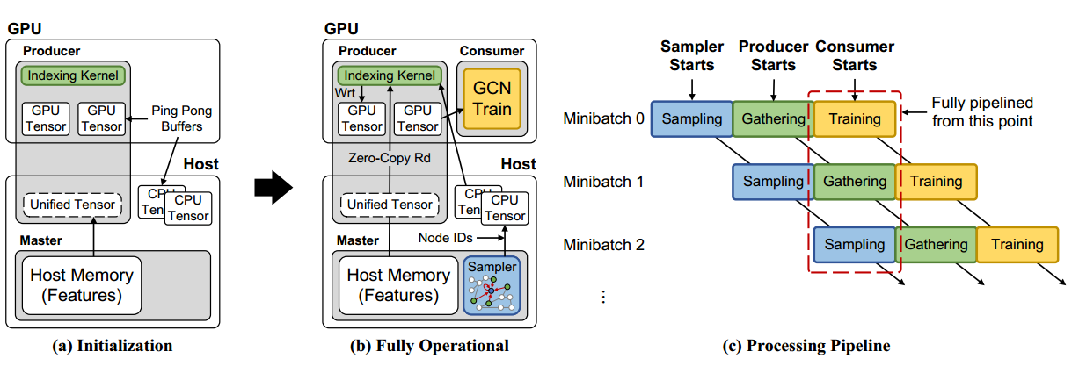
UVA-Based Method (8/8)
3. Can we show real end-to-end application performance benefit from our method?
build an end-to-end zero-copy GCN training flow in PyTorch.
To enable zero-copy memory access, the authors devised a new class of tensor called "unified tensor". This tensor provides an address mapping of host memory for GPUs so they can directly access host memory with zero-copy accesses.
(a) setup unified tensor and the returned pointer is passed to GPU for zero-copy accesses.
(b) The sampler generates node IDs used by the producer and the producer gathers scattered node features in the host memory. The consumer uses the gathered node features for training.
(c) A visualization of processing pipeline.

Slide 51
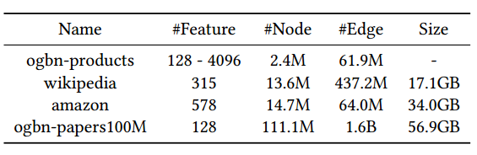
Evaluation (1/3)

Slide 52
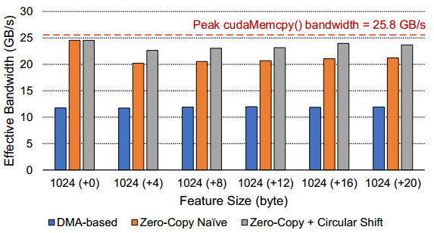
Evaluation (2/3)

Slide 53
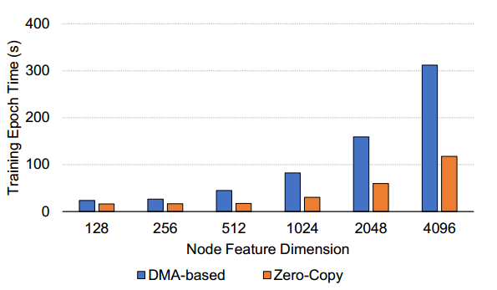
Evaluation (3/3)

Slide 54
Outline
Introduction (8 min)
Proposed Methods & Performance Evaluation (30 min)
  Cache-Based Methods (20 min)
    Single Cahce Method (10 min)
    Dual Cache Method (10 min)
  UVA-Based Method (10 min)
Conclusions(2 min)
Q&A (5 min)

Slide 55
Conclusions
This talk focus on the optimization strategy of mini-batch GNNs training on large graphs
This talk presented exsintg methods of training GNNs on large graphs with GPUs and evaluated thier performance.
  Cache-based methods
  UVA-based method

Slide 56
Outline
Introduction (8 min)
Proposed Methods & Performance Evaluation (30 min)
  Cache-Based Methods (20 min)
    Single Cahce Method (10 min)
    Dual Cache Method (10 min)
  UVA-Based Method (10 min)
Conclusions(2 min)
Q&A (5 min)

Slide 57
Q&A
Q&A

Slide 58
Thank you!

