Slide 1
Optimizing Performance-Resource Trade-Off for Serverless Functions 2024.11.14
Zhouruixing Zhu
School of Data Science
Chinese University of Hong Kong, Shenzhen

Slide 2
Outline
Introduction (10 min)
Background (5 min)
Proposed Methods & Performance Evaluation (15 min)
Hybrid (2020’ USENIX ATC)
Defuse (2021’ ICDCS)
SPES (2024’ ICDE)
Summary (2 min)
Q/A (5 min)

Slide 3
Outline
Introduction (10 min)
Background (5 min)
Proposed Methods & Performance Evaluation (15 min)
Hybrid (2020’ USENIX ATC)
Defuse (2021’ ICDCS)
SPES (2024’ ICDE)
Summary (2 min)
Q/A (5 min)

Slide 4
Introduction - Serverless Computing (1/6)
What is Serverless Computing?
Serverless computing enables developers to build applications faster by eliminating the need for them to manage infrastructure.
With serverless applications, the cloud service provider automatically provisions, scales, and manages the infrastructure required to run the code.
Top benefits of serverless computing

Slide 5
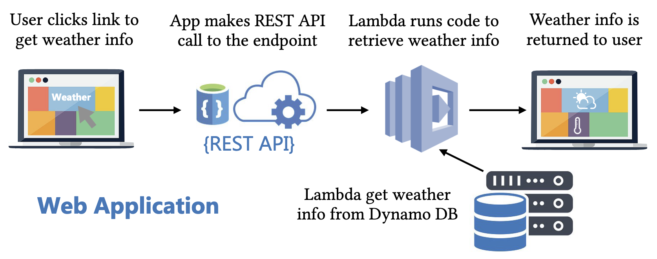
Introduction- Function as a Service (FaaS) (2/6)
FaaS shifts the burden of infrastructure management from developers to cloud providers, allowing developers to focus on their application functionality.
AWS Lambda
IBM Cloud Functions
Microsoft Azure Functions
For the rest of this talk, Serverless = Serverless FaaS

Slide 6
Introduction- Function as a Service (FaaS) (3/6)
If you are a customer…
Very attractive abstraction:
Pay for use
Infinite elasticity from 0 (and back)
No worry about servers
Provisioning, reserving, configuring, patching, managing

Slide 7
Introduction- Function as a Service (FaaS) (4/6)
If you are a cloud provider…
A big challenge
You do worry about servers!
Provisioning, scaling, allocating, securing, isolating
Illusion of infinite scalability
Optimize resource use
Fierce competition
A bigger opportunity
Fine grained resource packing
Great space for innovating, and capturing new applications, new markets

Slide 8
Introduction- Cold Start (5/6)
- A cold start: A FaaS provider first downloads the code of users and initiates the execution environment in the memory on cluster machines.
- A warm start: The code is already in memory that can be executed directly.
Cold Start:
Retrieving code from storage
Container (or VM) initialization
Loading code into memory
Executing the function’s handler
A serverless function’s lifecycle.
Typically range between 0.2 to a few seconds.

Slide 9
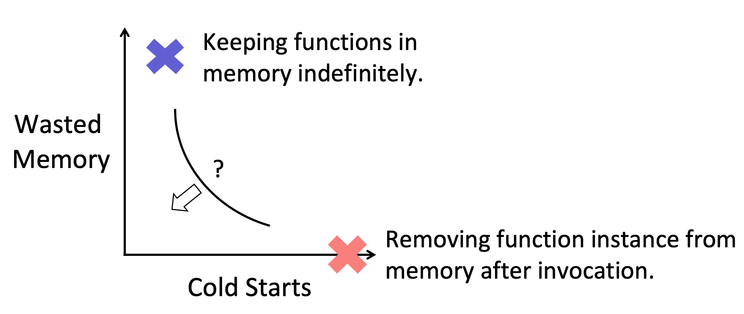
Introduction-Performance-Resource Trade-Off (6/6)
Performance
Resource

Slide 10
Outline
Introduction (5 min)
Background (15 min)
Proposed Methods & Performance Evaluation (20 min)
Hybrid (2020’ USENIX ATC)
Defuse (2021’ ICDCS)
SPES (2024’ ICDE)
Summary (5 min)
Q/A (5 min)

Slide 11
Background - Cold Start Management Policy (1/2)
A key aspect of FaaS is the trade-off between reducing cold starts by keeping instances warm, and the resources (e.g., VMs, memory) they need.
No-unloading policy:
Keep every application image loaded in memory all the time
Get no cold starts but would be too expensive to operate
Fixed keep-alive policy:
Most FaaS providers use a fixed keep-alive policy for all applications
Application instances are kept loaded in memory for a fixed amount of time after a function execution
Simple to implement and maintain
It can have many cold starts while wasting resources for many applications
Other policy? -> Proposed methods section

Slide 12
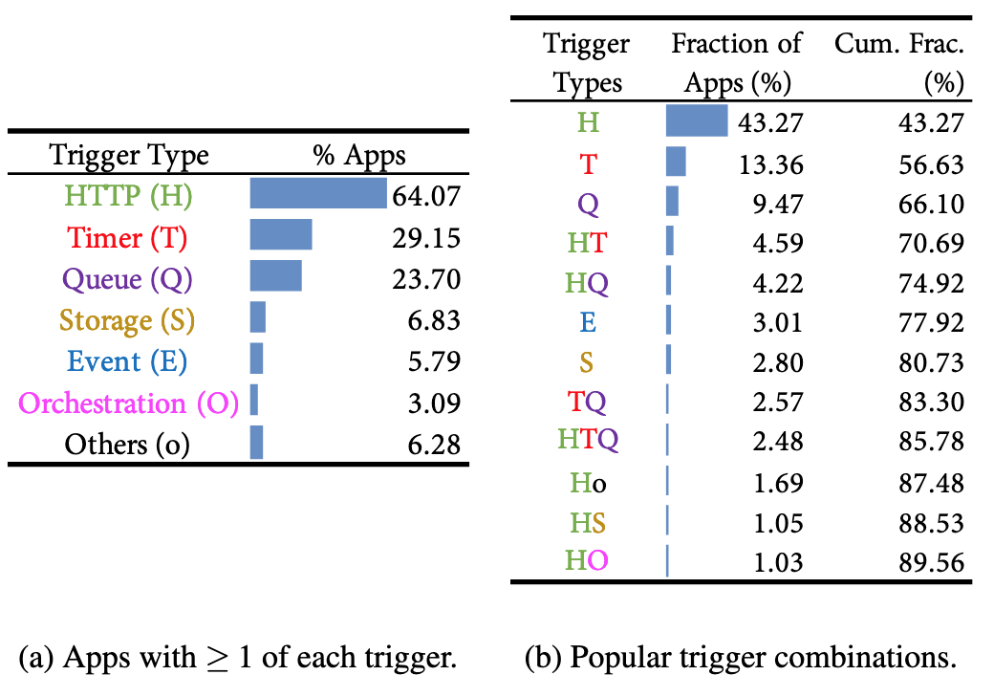
Background - Cold Start Management Policy (2/2)
Designing a practical policy poses several challenges:
Hard-to-predict invocations
Predicting the next invocation is challenging for various triggers.
Heterogeneous applications
Applications with infrequent invocations
Tracking overhead
The cost to track the information for each application should be small.
Execution overhead
Since function executions can be very short (i.e., more than 50% of executions take less than 1 second), running the policy and updating its state need to be fast.

Slide 13
Outline
Introduction (10 min)
Background (5 min)
Proposed Methods & Performance Evaluation (15 min)
Hybrid (2020’ USENIX ATC)
Defuse (2021’ ICDCS)
SPES (2024’ ICDE)
Summary (2 min)
Q/A (5 min)

Slide 14
Proposed Method 1 - Hybrid
2020 USENIX Annual Technical Conference
Number of citations: 664

Slide 15
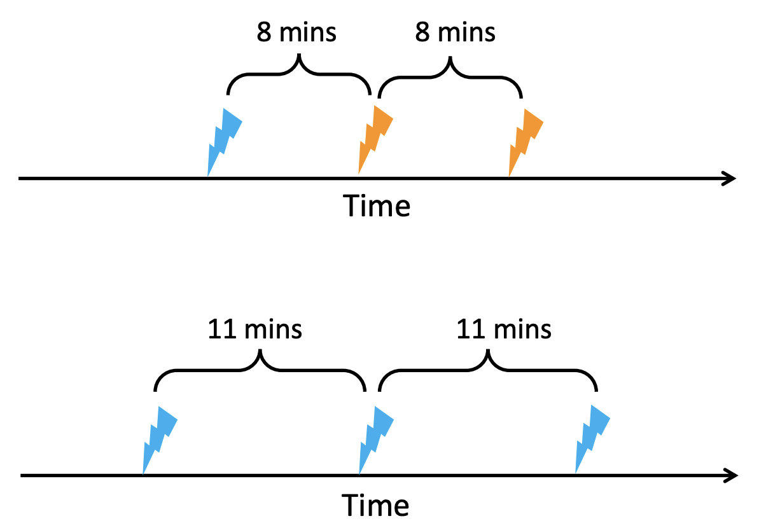
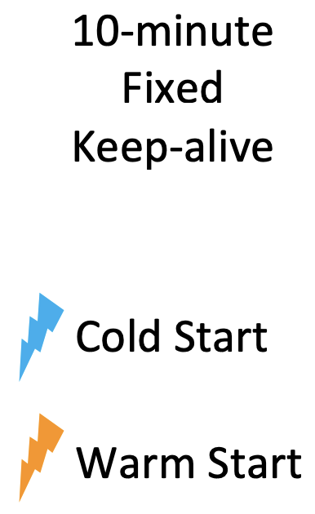
Hybrid - Fixed Keep-Alive Policy (1/6)
Fixed Keep-Alive Won’t Fit All

Slide 16
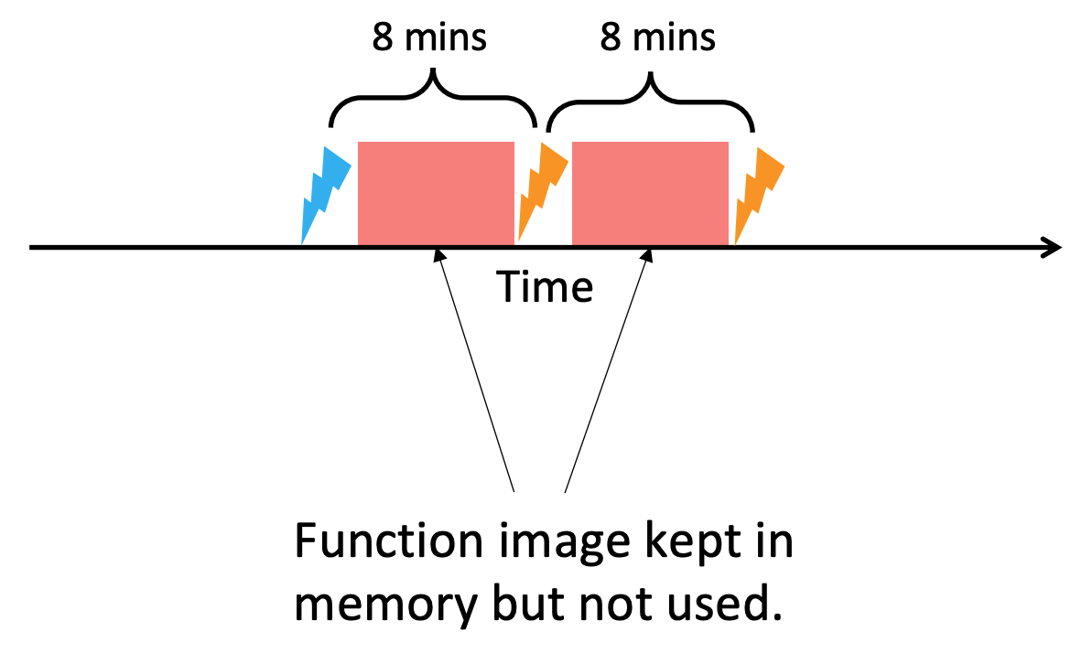
Hybrid - Fixed Keep-Alive Policy (2/6)
Fixed Keep-Alive Is Wasteful

Slide 17
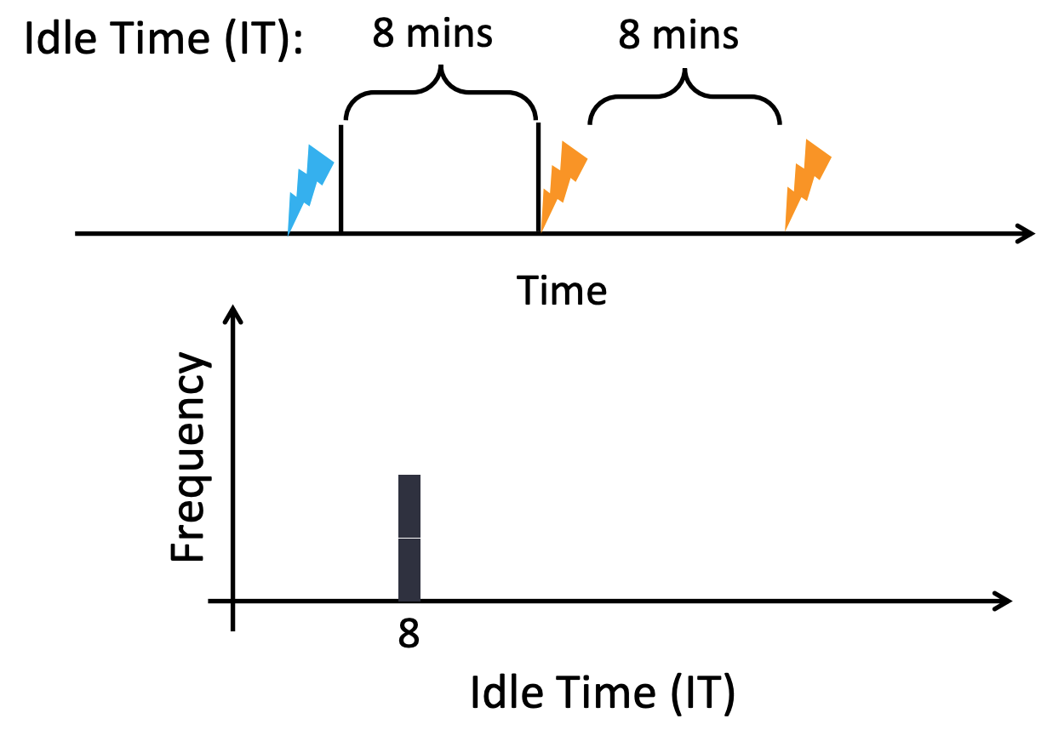
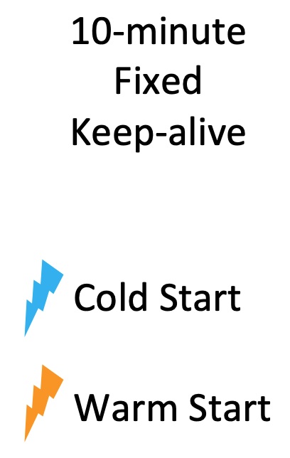
Hybrid - A Histogram Policy To Learn Idle Times (3/6)

Slide 18
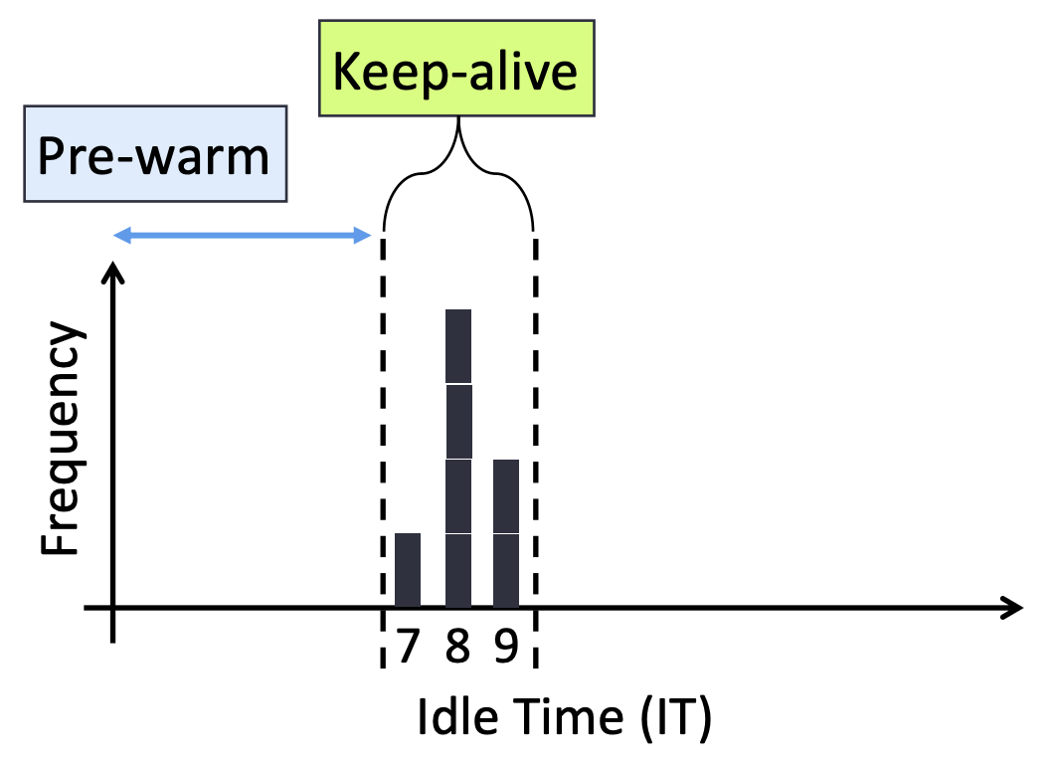
Hybrid - A Histogram Policy To Learn Idle Times (4/6)

Slide 19
Hybrid - A Hybrid Histogram Policy (5/6)
We can afford to run complex predictors given the low arrival rate.
A histogram might be too wasteful.
Time Series Forecast

Slide 20
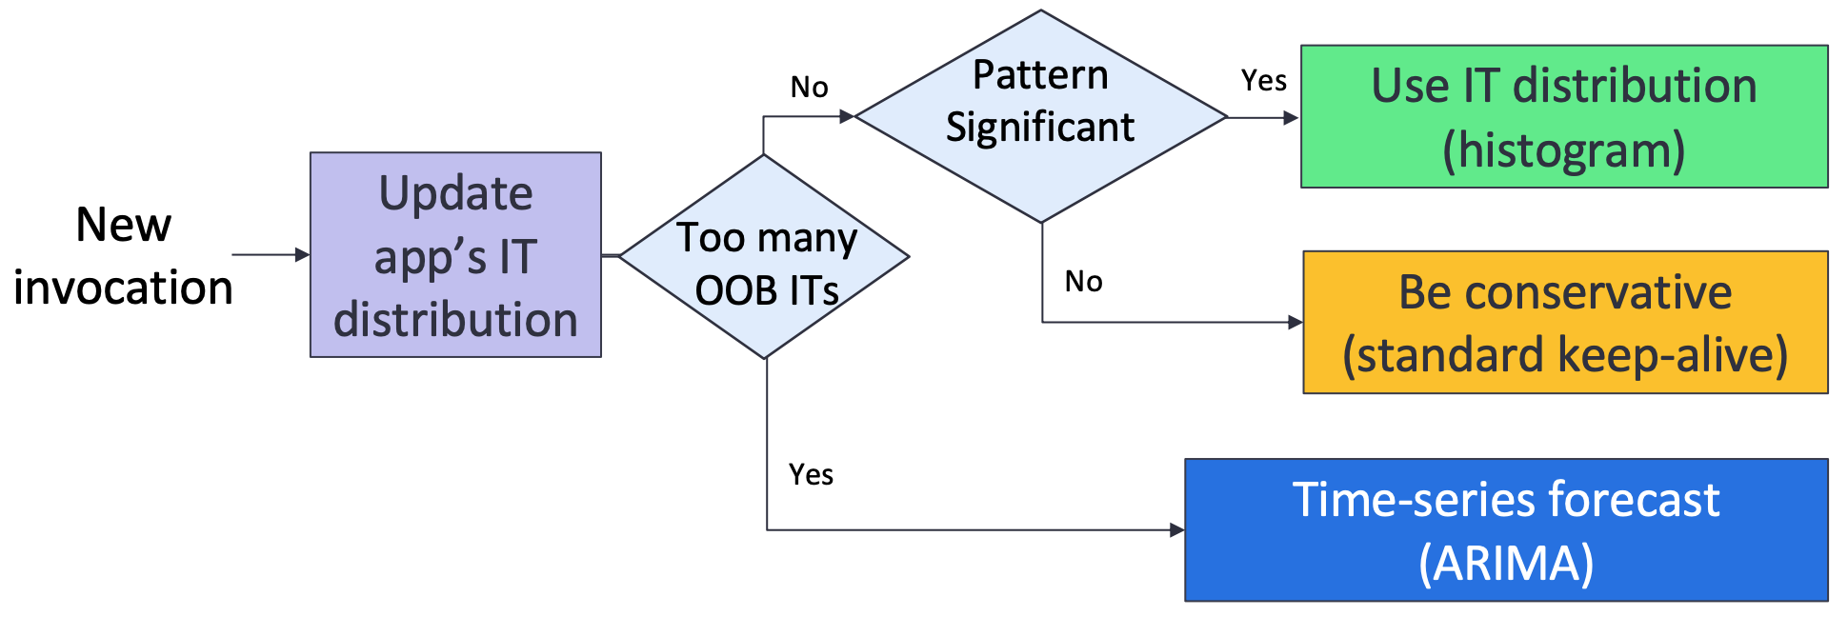
Hybrid - A Hybrid Histogram Policy (6/6)
ARIMA: Autoregressive Integrated Moving Average

Slide 21
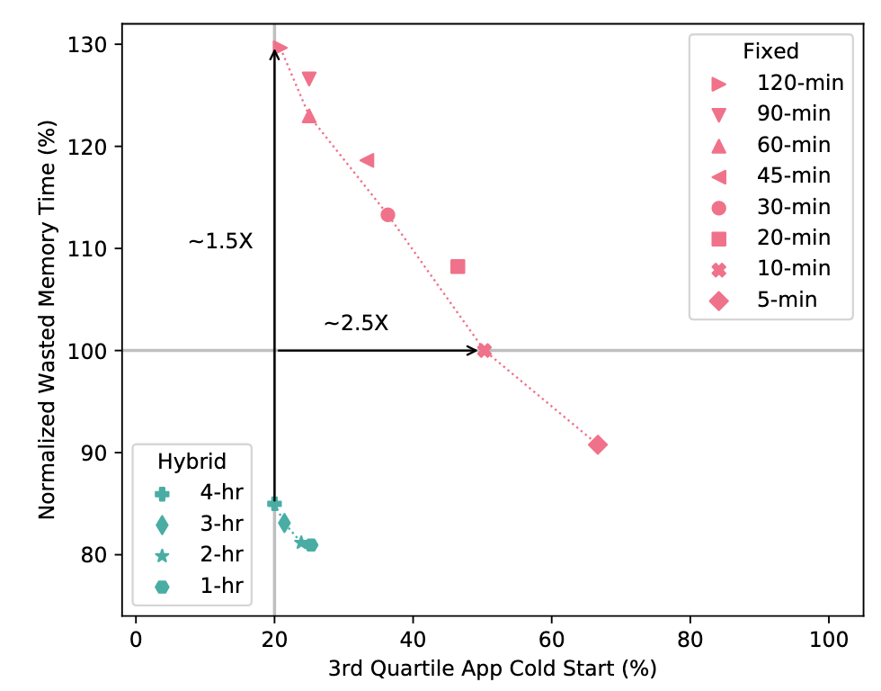
Evaluation - Hybrid (1/2)

Slide 22
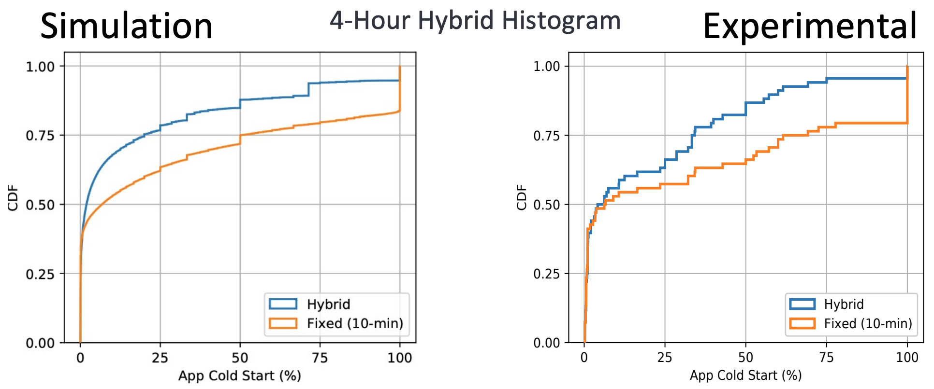
Evaluation - Hybrid (2/2)
Average exec time reduction: 32.5% 99th–percentile exec time reduction: 82.4%
Container memory reduction: 15.6%
Latency overhead: < 1ms (835.7µs)

Slide 23
Proposed Method 2 - Defuse
2021 International Conference on Distributed Computing Systems (ICDCS)
Number of citations: 33

Slide 24
Defuse - A Dependency-Guided Function Scheduler (1/3)
Two types of dependencies:
(1) Some functions may be frequently invoked together;
(2) Some functions may be invoked by others.

Slide 25
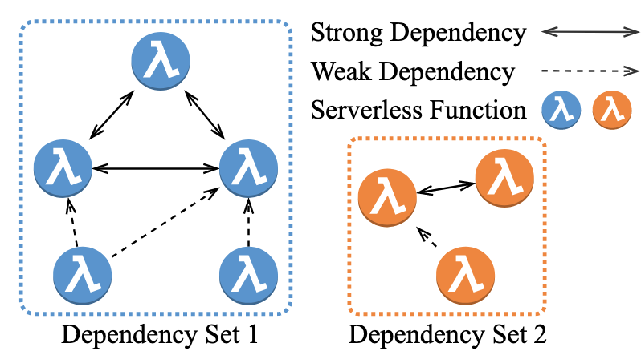
Defuse - A Dependency-Guided Function Scheduler (2/3)
B. Dependency Mining
C. Dependency Set Generation
Strong Dependency Mining
Weak Dependency Mining
The dpendency graph and dependency sets of serverless functions.

Slide 26
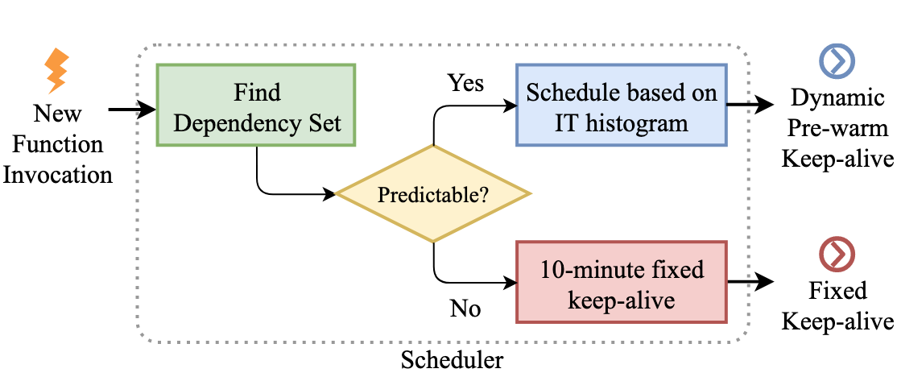
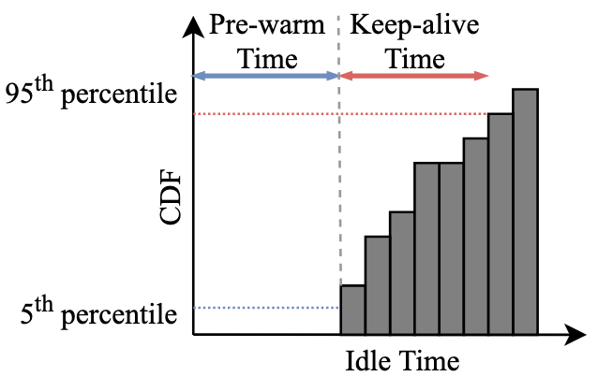
Defuse - A Dependency-Guided Function Scheduler (3/3)
D. Scheduling
1. When to pre-warm it (load it into memory) ;
2. How long to keep it in memory after invocation (keep-alive time).

Slide 27
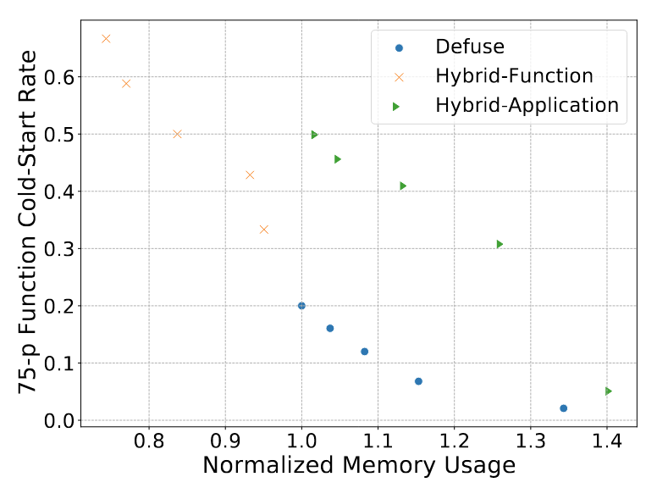
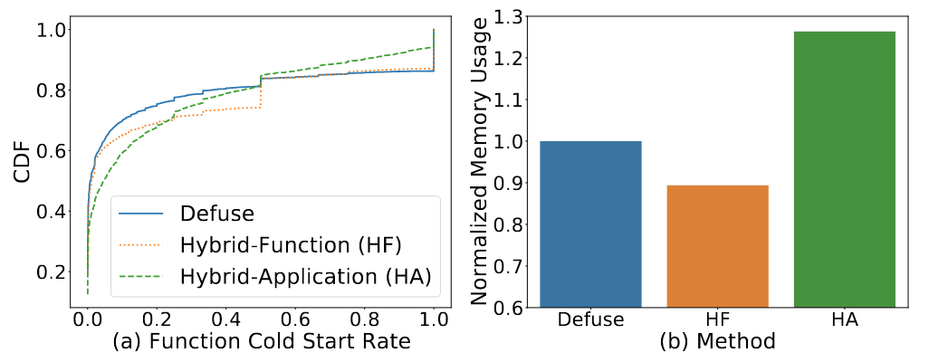
Evaluation - Defuse (1/2)
75th percentile function cold-start rate under different memory usage.
CDF of function cold start rate of Defuse, Hybrid-Function, and Hybrid-Application.

Slide 28
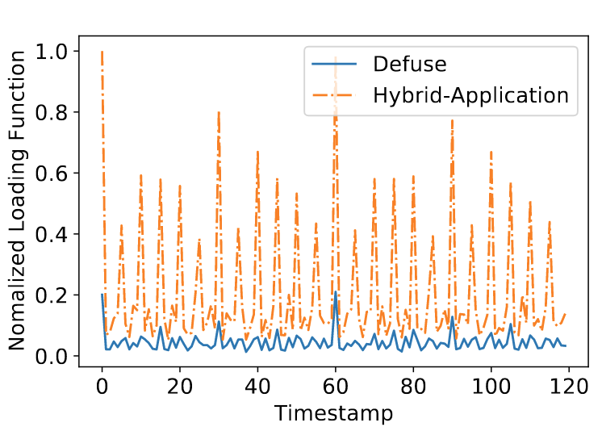
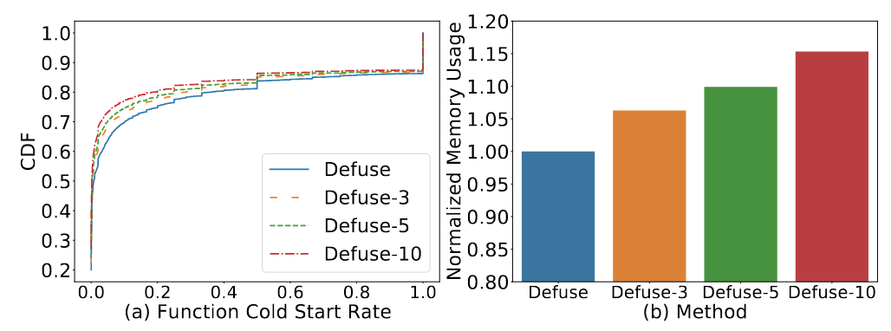
Evaluation - Defuse (2/2)
The overhead of Defuse. Normalized number of loading functions in 2 hours.
Performance under different memory consumption.

Slide 29
Proposed Method 3 - SPES
2024 International Conference on Data Engineering (ICDE)

Slide 30
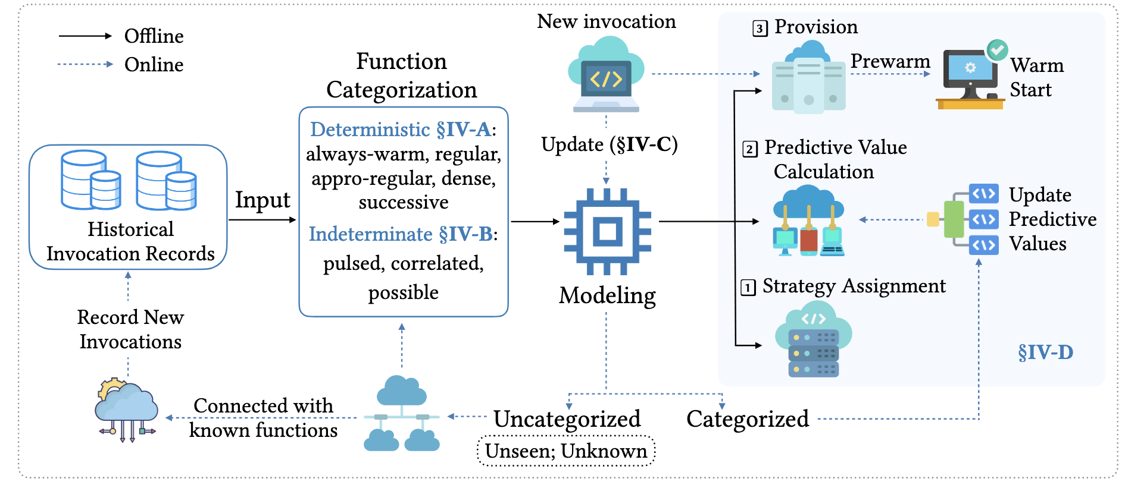
SPES - Optimizing the Serverless Workload (1/2)

Slide 31
SPES - Optimizing the Serverless Workload (2/2)
Deterministic Function Categorization

Slide 32
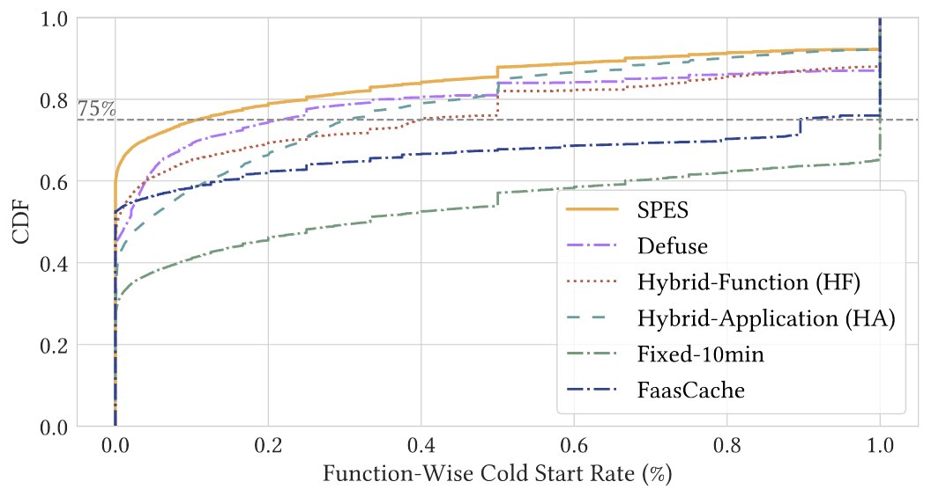
Evaluation - SPES (1/2)
SPES reduces the 75th percentile cold-start rate from 0.215 to 0.108 compared to Defuse, the best-performing baseline, achieving 49.77% improvement, and reduces 75-CSR by 64.06% - 89.20% compared to other baselines.
Cold start behaviors of SPES and its competitors.

Slide 33
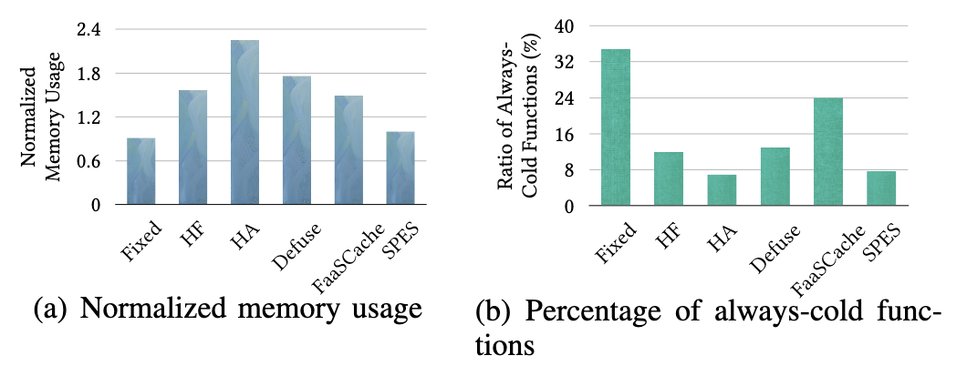
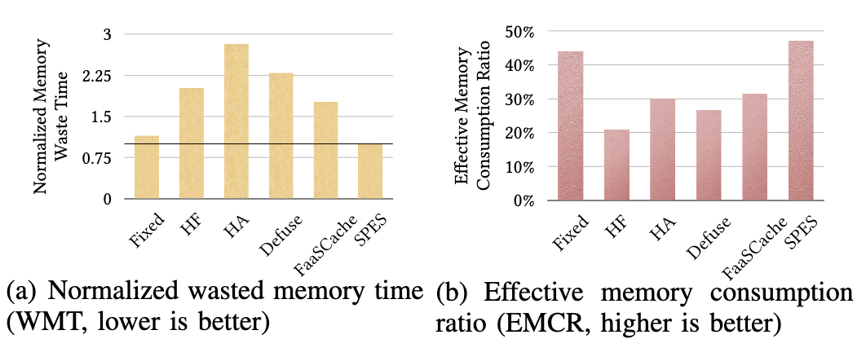
Evaluation - SPES (2/2)
SPES is memory-efficient compared to most baselines with relatively few always-cold functions.
SPES significantly reduces memory waste and achieves more effective memory consumption.

Slide 34
Outline
Introduction (10 min)
Background (5 min)
Proposed Methods & Performance Evaluation (15 min)
Hybrid (2020’ USENIX ATC)
Defuse (2021’ ICDCS)
SPES (2024’ ICDE)
Summary (2 min)
Q/A (5 min)

Slide 35
Summary
The talk focused on Faas Performance-Resource Trade-Off, outlining its fundamental principles, benefits, and operational mechanisms.
The presentation discussed challenges and research questions of optimizing the serverless workload at a large cloud provider view.
The presentation discussed cutting-edge research and presented existing solutions to address the outlined issues effectively.

Slide 36
Outline
Introduction (10 min)
Background (5 min)
Proposed Methods & Performance Evaluation (15 min)
Hybrid (2020’ USENIX ATC)
FaasCache (2021’ASPLOS)
Defuse (2021’ ICDCS)
SPES (2024’ ICDE)
Summary (2 min)
Q/A (5 min)

Slide 37
Q & A
Thank you!

