Slide 1
Systems for Scalable Graph Analytics
2024.11.5
Yue Zhang
School of Data Science
Chinese University of Hong Kong, Shenzhen
Notes:
Good morning everyone, I am Zhang yue, a phd student from school of data science. Today I will introduce about Systems for Scalable Graph Analytics.

Slide 2
Outline
Introduction (5 min)
  What is a graph?
  What is Frequent Subgraph Mining (FSM)?
  Two problem settings
  Mining frequent subgraphs in a single graph
Analysis & Motivation (5 min)
  Existing Solutions
  Think Like a Task (T-Thinker)
Proposed Methods (25 min)
  G-thinker
  PrefixFPM
  T-FSM
Experiments (5 min)
Q/A (5 min)
Notes:
The presentation includes five parts, I will introduce them step by step. If you have any question, feel free to ask me. Ok, Let’s get started!

Slide 3
Outline
Introduction (5 min)
  What is a graph?
  What is Frequent Subgraph Mining (FSM)?
  Two problem settings
  Mining frequent subgraphs in a single graph
Analysis & Motivation (5 min)
  Existing Solutions
  Think Like a Task (T-Thinker)
Proposed Methods (25 min)
  G-thinker
  PrefixFPM
  T-FSM
Experiments (5 min)
Q/A (5 min)
Notes:
The presentation includes five parts, I will introduce them step by step. If you have any question, feel free to ask me. Ok, Let’s get started!

Slide 4
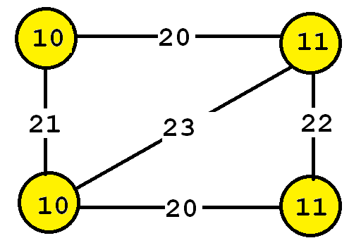
Introduction (1/4)
What is a graph?
Notes:
So what is a graph. before discussing the analysis of graphs, I will introduce a few definitions. A graph is a set of vertices and edges, having some labels. Let’s me illustrate this idea with an example. Consider the following graph:
This graph contains four vertices (depicted as yellow circles). These vertices have labels such as “10” and “11”.
These labels provide information about the vertices. For example, imagine that this graph is a chemical molecule/mDlikjul/. The label 10 and 11 could represent the chemical elements of Hydrogen/haidredgen/ and Oxygen, respectively.
Labels do not need to be unique. In other words, the same labels may be used to describe several vertices in the same graph.

Slide 5
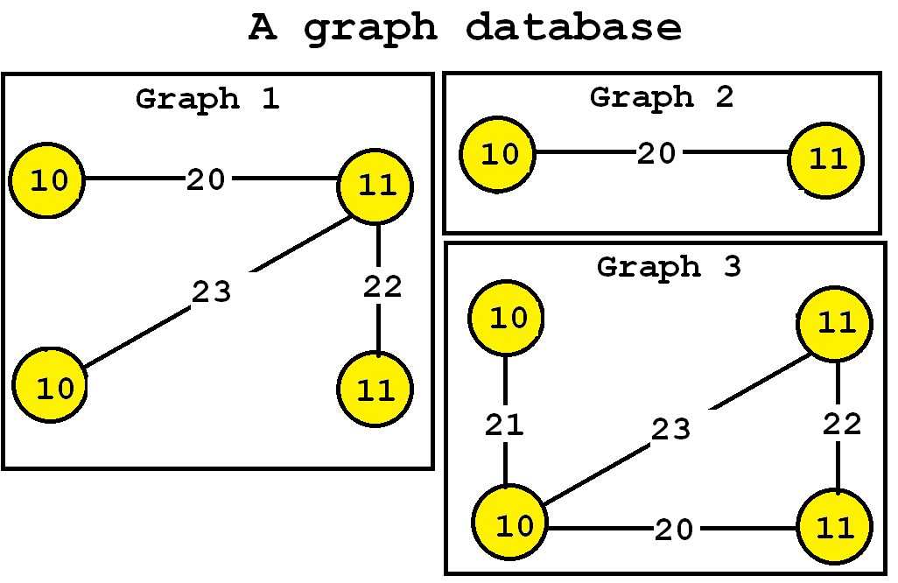
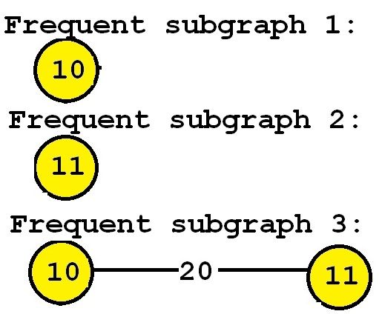
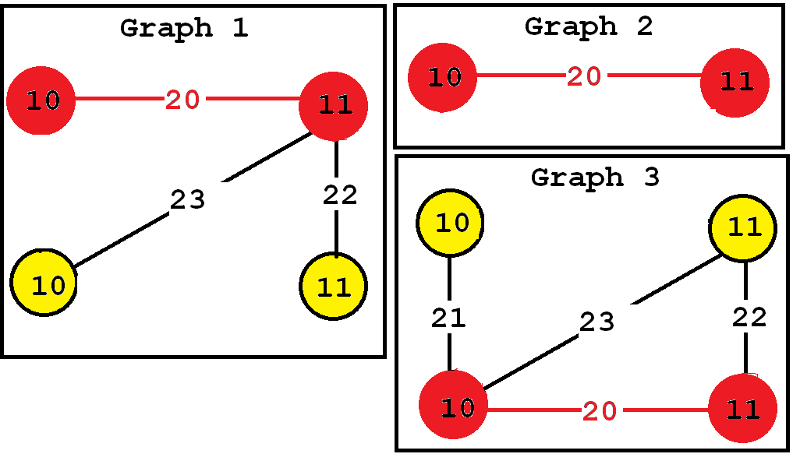
Introduction (2/4)
What is Frequent Subgraph Mining (FSM)?
Frequent subgraph pattern mining (FSM) finds all subgraph patterns that appear more frequently than a given threshold in a graph database.
  a graph database (a set of graphs)
  a parameter called the minimum support threshold (minsup).
Notes:
The task of finding frequent subgraphs in a set of graphs is called frequent subgraph mining. As input the user must provide:
a graph database (a set of graphs)
a parameter called the minimum support threshold (minsup).
Then, a frequent subgraph mining algorithm will enumerate as output all frequent subgraphs. A frequent subgraph is a subgraph that appears in at least minsup graphs from a graph database. For example, let’s consider the following graph database containing three graphs:
[click]
Now, let’s say that we want to discover all subgraphs that appear in at least three graphs. Thus, we will set the minsup parameter to 3. By applying a frequent subgraph mining algorithm, we will obtain the set of all subgraphs appearing in at least three graphs:
[click]

Slide 6
Introduction (3/4)
Two problem settings: finding frequent patterns either
  in a database comprising many graph transactions (e.g., a set of chemical compounds),or
  from a single big input graph (e.g., a social network or a PPI network).
Notes:
FSM has 2 problem settings: finding frequent patterns either (i) in a database comprising many graph transactions (e.g., a set of chemical compounds),
or (ii) from a single big input graph (e.g., a social network or a PPI network).

Slide 7
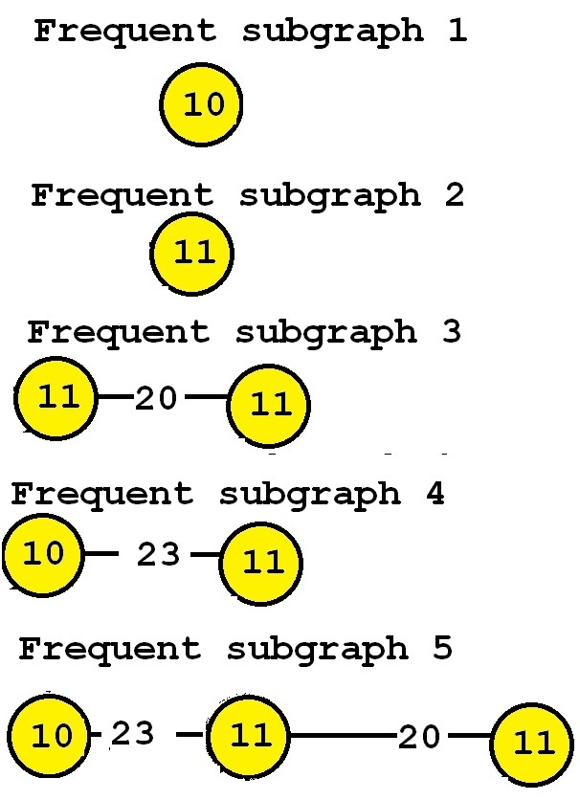
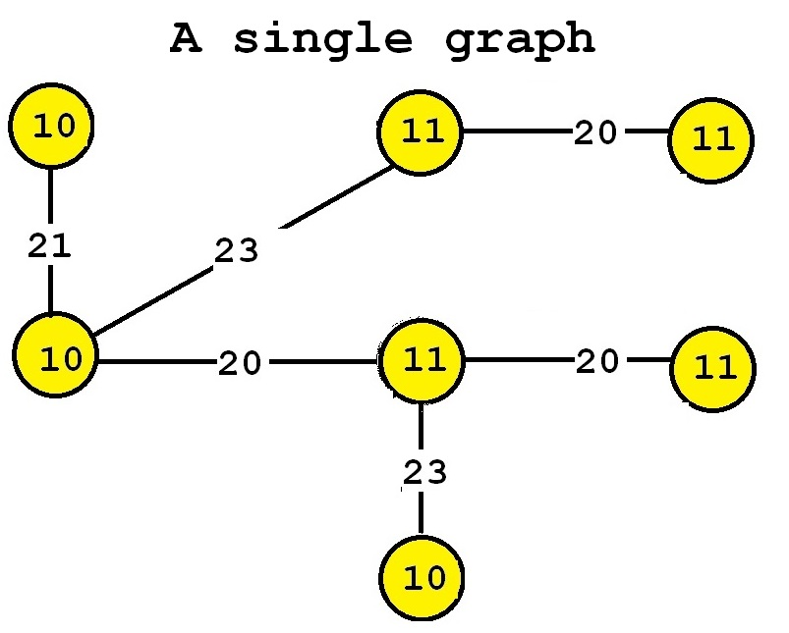
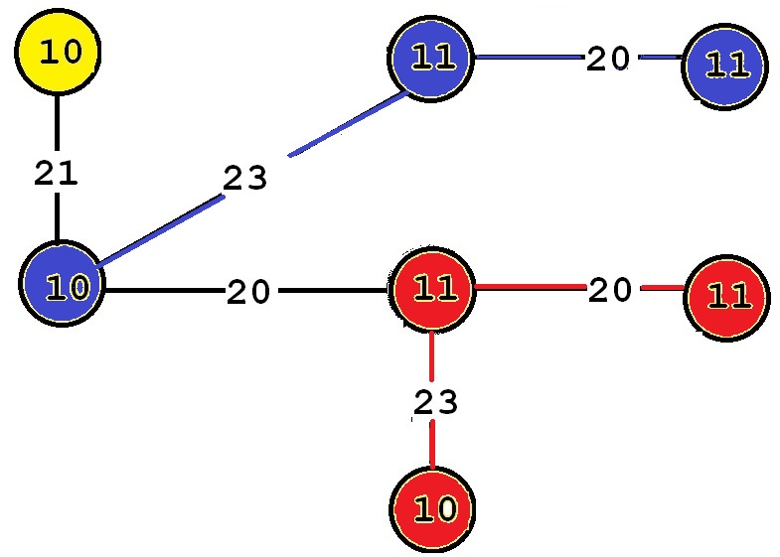
Introduction (4/4)
Mining frequent subgraphs in a single graph
  Finding all frequent subgraphs in a single graph rather than in a graph database
Notes:
Besides discovering graphs common to several graphs, there is also a variation of the problem of frequent subgraph mining that consists of finding all frequent subgraphs in a single graph rather than in a graph database. The idea is almost the same. The goal is also to discover subgraphs that appear frequently or that are interesting. The only difference is how the support (frequency) is calculated. For this variation, the support of a subgraph is the number of times that it appears in the single input graph. For example, consider the following input graph:
[click]
This graph contains seven vertices and six edges. If we perform frequent subgraph mining on this single graph by setting the minsup parameter to 2, we can discover the five following frequent subgraphs:
[click]
These subgraphs are said to be frequent because they appear at least twice in the input graph. For example, consider “Frequent subgraph 5”. This subgraph has a support of 2 because it has two occurrences in the input graph. Those two occurrences are highlighted below in red and blue, respectively.

Slide 8
Outline
Introduction (5 min)
  What is a graph?
  What is Frequent Subgraph Mining (FSM)?
  Two problem settings
  Mining frequent subgraphs in a single graph
Analysis & Motivation (5 min)
  Existing Solutions
  Think Like a Task (T-Thinker)
Proposed Methods (25 min)
  G-thinker
  PrefixFPM
  T-FSM
Experiments (5 min)
Q/A (5 min)

Slide 9
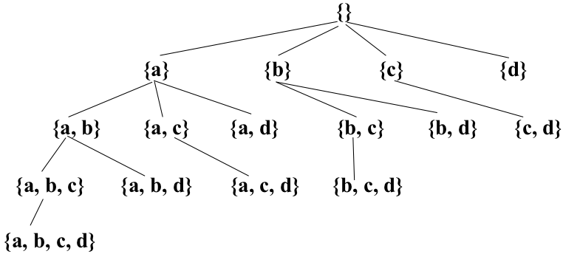
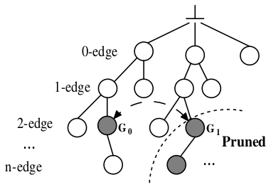
Analysis & Motivation (1/4)
Existing Solutions
  Programming Simplicity Over-Emphasized
Dense Subgraph Mining
Frequent Subgraph Mining
pattern-to-instance
instance-to-pattern
Embedding-Centric: Arabesque (SOSP’15), RStream (OSDI’18)
Notes:
Unfortunately, before T-thinker, all current solutions are IO-bound and materialize the subgraphs level-by-level in a search tree, causing a lot of intermediate subgraphs being materialized which not only hurts performance but also limits the size of the graph that can be processed.
Surprisingly, these works were accepted by the best systems conferences such as OSDI and SOSP.

Slide 10
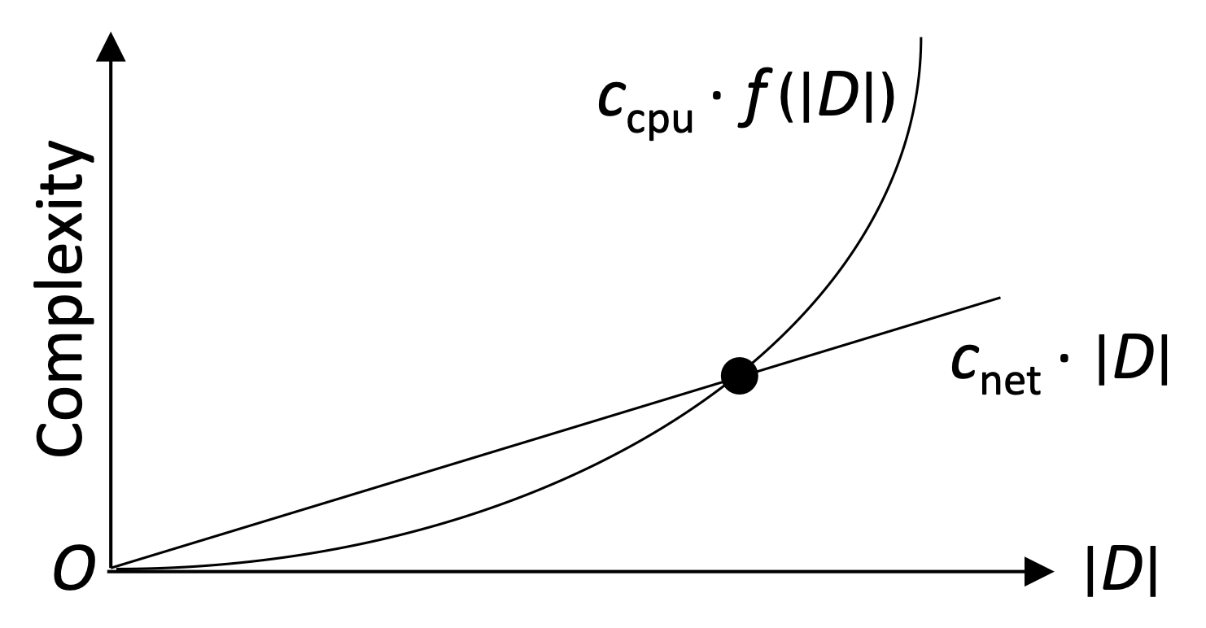
Analysis & Motivation (2/4)
Think Like a Task (T-Thinker)
  Divide and Conquer
    Data pulling + computation on top
[1] Yan D, Guo G, Chowdhury M M R, et al. T-thinker: a task-centric distributed framework for compute-intensive divide-and-conquer algorithms[C]//Proceedings of the 24th Symposium on Principles and Practice of Parallel Programming. 2019: 411-412.
Notes:
Since the problems we target has a high time complexity, as long as each task handles sufficient data, the cost of pulling the data into memory by a thread is linear while the computation on top is super-linear, so the communication can be fully overlapped with computation to keep CPUs in a cluster busy.

Slide 11
Analysis & Motivation (3/4)
Think Like a Task (T-Thinker)
  Tasks & Programming Model
Notes:
In the framework, the system engine manages the various tasks to ensure high concurrency and bounded memory usage.
Users need to specify how to create initial tasks from individual vertices by a specifying a task_spawn function, and how to grow and mine a subgraph afterwards specifying a compute function.

Slide 12
Analysis & Motivation (4/4)
Think Like a Task (T-Thinker)
  Recent Systems Start to Explore the Right Direction!
Notes:
We would like to indicate that in recent years, a few systems have been proposed,
[click]
which now avoid subgraph materialization as much as possible by resorting to backtracking search as in the serial algorithm counterparts, and they have achieved orders of magnitude speedup.

Slide 13
Outline
Introduction (5 min)
  What is a graph?
  What is Frequent Subgraph Mining (FSM)?
  Two problem settings
  Mining frequent subgraphs in a single graph
Analysis & Motivation (5 min)
  Existing Solutions
  Think Like a Task (T-Thinker)
Proposed Methods (25 min)
  G-thinker
  PrefixFPM
  T-FSM
Experiments (5 min)
Q/A (5 min)
Notes:
The presentation includes five parts, I will introduce them step by step. If you have any question, feel free to ask me. Ok, Let’s get started!

Slide 14
Proposed Methods (1/29)
3 systems
  G-thinker
    subgraph finding: dense subgraphs, subgraph matching, …
  PrefixFPM
    frequent subgraph patterns (many small graph transactions)
  T-FSM
    frequent subgraph patterns (a single big graph)
Notes:
We would like to indicate that in recent years, a few systems have been proposed,
[click]
which now avoid subgraph materialization as much as possible by resorting to backtracking search as in the serial algorithm counterparts, and they have achieved orders of magnitude speedup.

Slide 15
Proposed Methods (2/29)
G-thinker
  Vertex Pulling & Remote Vertex Caching
Tasks can share vertices to reduce # of remote vertex requests
8
6 | 7
0
1 | 3
6
5 | 8
5
4 | 6
8
6 | 7
0
1 | 3
1
0 | 2 | 3
2
1 | 3 | 4 | 7
3
0 | 1 | 2 | 7
4
2 | 5 | 7
5
4 | 6
6
5 | 8
7
2 | 3 | 4 | 8
8
6 | 7
M₀
M₁
M₂
Notes:
G-thinker is a distributed system where the adjacency lists are kept with a distributed key-value store.
Each machine also maintains a vertex cache to cache remote vertices so that multiple local tasks can access them without requesting again.

Slide 16

Proposed Methods (3/29)
G-thinker
  Task-Centric Programming Interface
    UDF: spawn_task(vertex)
    UDF: compute(task, frontier)
    pull (vertex_id)
    add_task (task)
Task Metadata
* UDF = user-defined function
Task Subgraph
Notes:
The programming interface is shown on this slide, where initial tasks are spawned from individual vertices.
Each task computes in iterations, where the input argument "frontier" keeps the adjacency lists of all vertices requested in the previous iteration, and one may call the pull function to request for new vertices.
Users can expand the subgraph of the current task in iterations until all the needed data are ready, after which the computation can happen on the subgraph.
One may also decompose the current task into smaller tasks and call the add_task function to add them to the system for parallel computation.

Slide 17
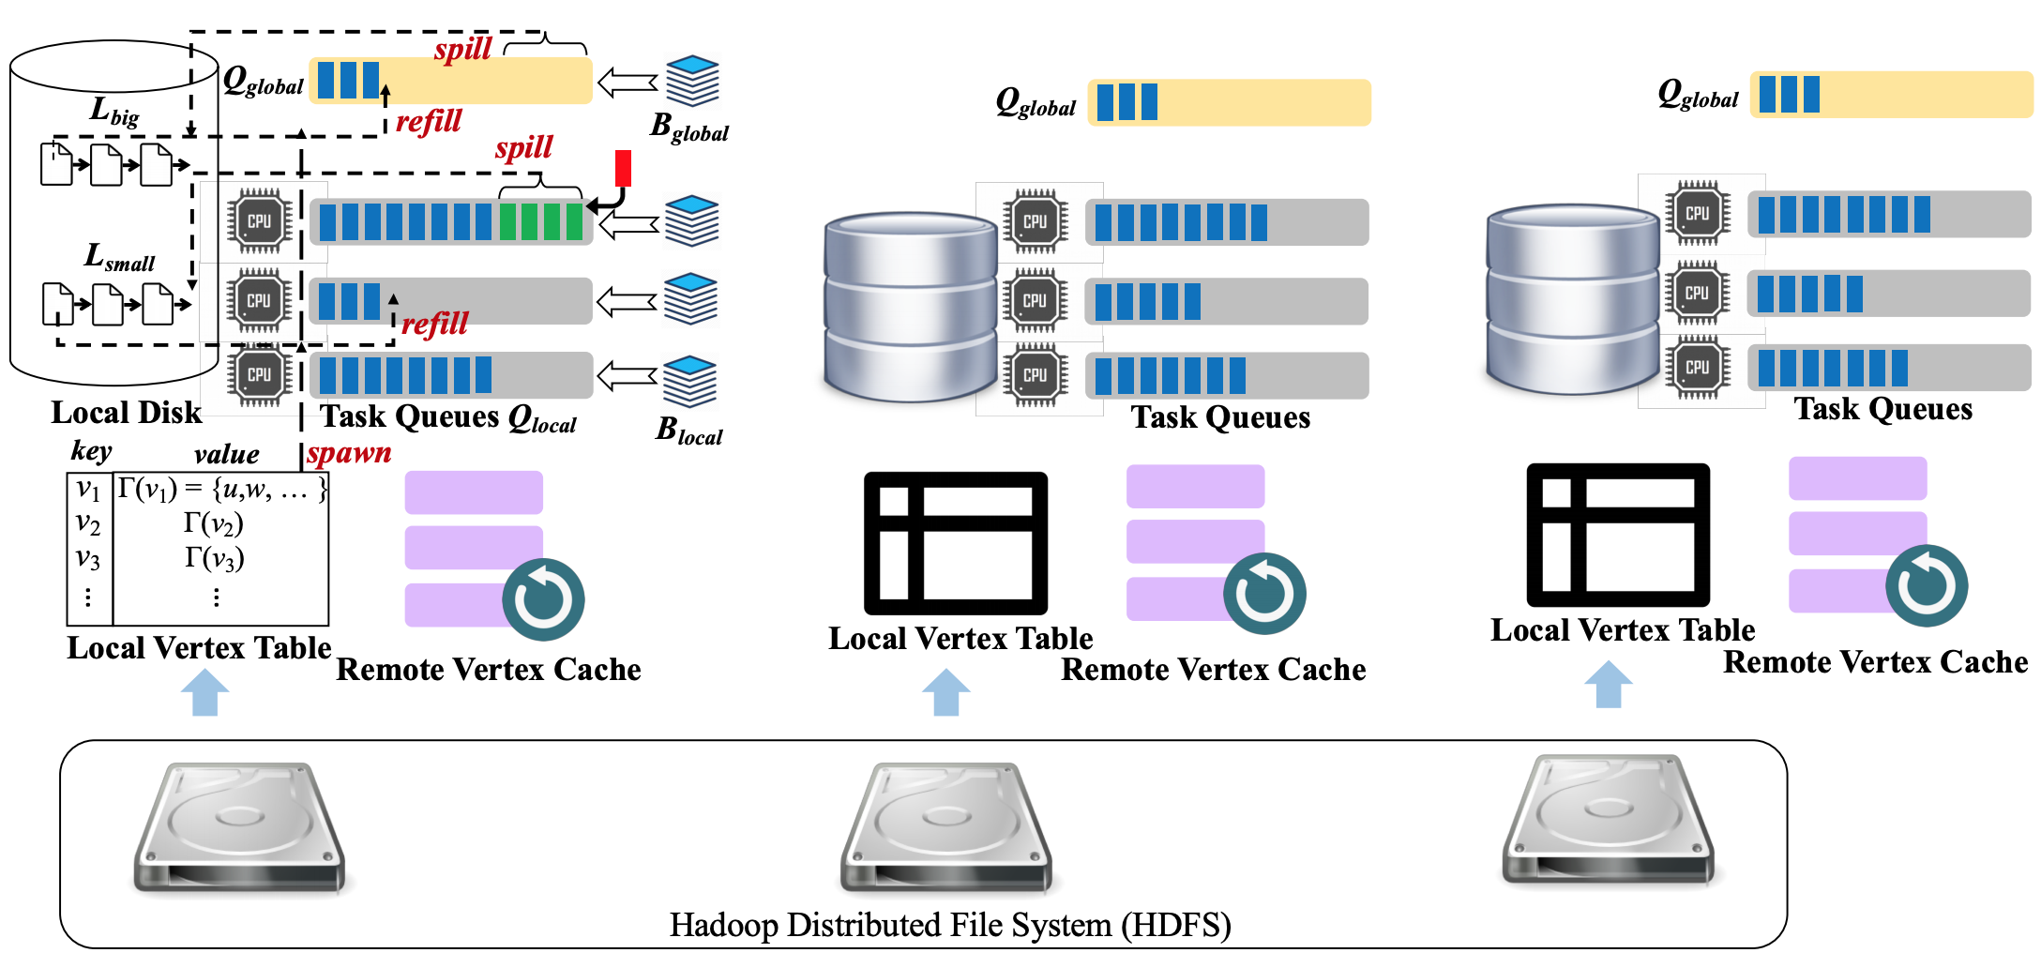
Proposed Methods (4/29)
G-thinker
[2] Yan D, Guo G, Khalil J, et al. G-thinker: a general distributed framework for finding qualified subgraphs in a big graph with load balancing[J]. The VLDB Journal, 2021: 1-34.
Notes:
Here is an overview of the G-thinker system with three machines.
Note that each machine has a yellow global task queue to hold big tasks that are time-consuming, and gray task queues local to each CPU core to hold regular tasks to avoid contention.

Slide 18
Proposed Methods (5/29)
G-thinker
  small task
  big task
Head-of-line blocking
Task Queues
Task Queues
[2] Yan D, Guo G, Khalil J, et al. G-thinker: a general distributed framework for finding qualified subgraphs in a big graph with load balancing[J]. The VLDB Journal, 2021: 1-34.
Notes:
Note that without a shared global task queue, if a local task queue holds many big tasks,
[click]
head-of-line blocking happens where a CPU core becomes the straggler while the other CPU cores finish quickly and become idle.

Slide 19
Proposed Methods (6/29)
G-thinker
  small task
  big task
Work Stealing
Q_{global}
Q_{global}
Task Queues
Task Queues
[2] Yan D, Guo G, Khalil J, et al. G-thinker: a general distributed framework for finding qualified subgraphs in a big graph with load balancing[J]. The VLDB Journal, 2021: 1-34.
Notes:
By keeping all big tasks in the shared global task queue supporting work stealing among machines,
[click, wait for annotation to complete] [click]
the big tasks can be scheduled with priority among all available CPU cores for timely processing, or even be further decomposed to create more parallelism opportunities.

Slide 20
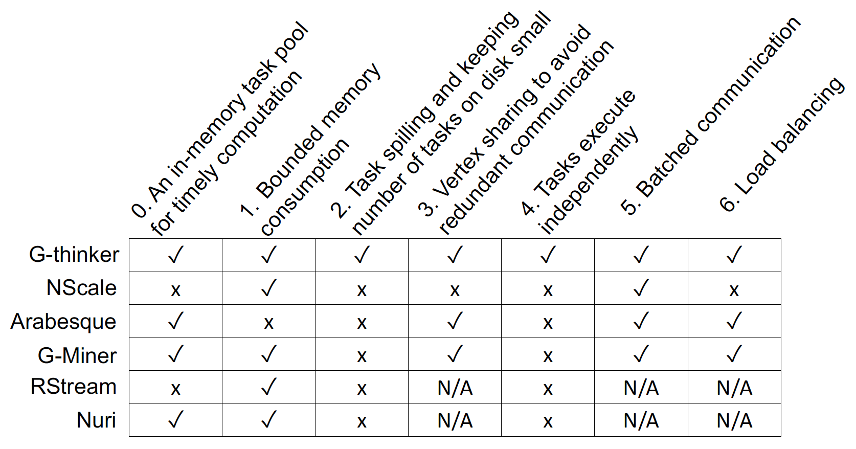
Proposed Methods (7/29)
G-thinker
Friendster (|V| = 65.6 M, |E| = 1806 M)
  Maximum Clique:
    G-Miner: 10644 sec / 7.4 GB per machine
    G-thinker: 252 sec / 3.4 GB per machine
  Triangle Counting:
    G-Miner: 10915 sec / 9.2 GB per machine
    G-thinker: 516 sec / 3.1 GB per machine
Large Maximum Cliques
  WikiLinks: |Q_{max}| = 1109 / 70 min 51 sec
  WebUK: |Q_{max}| = 944 / 691 sec
Notes:
G-thinker is two orders of magnitude faster than existing systems, and can find very large maximum cliques of size over 1000 vertices in a reasonable amount of time, for which other systems would run almost forever.

Slide 21
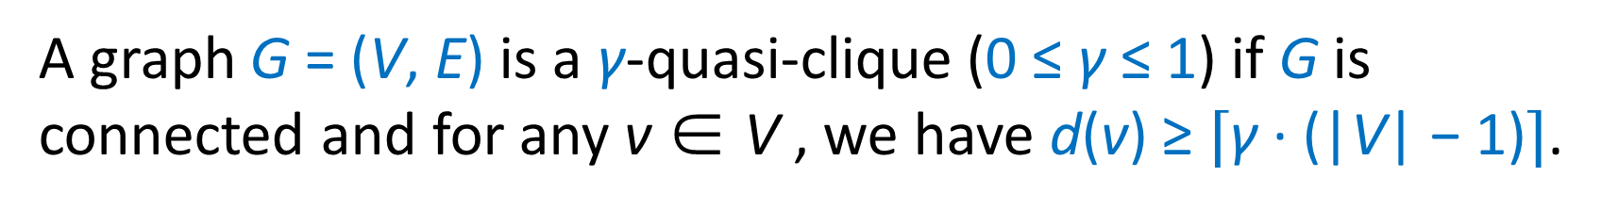
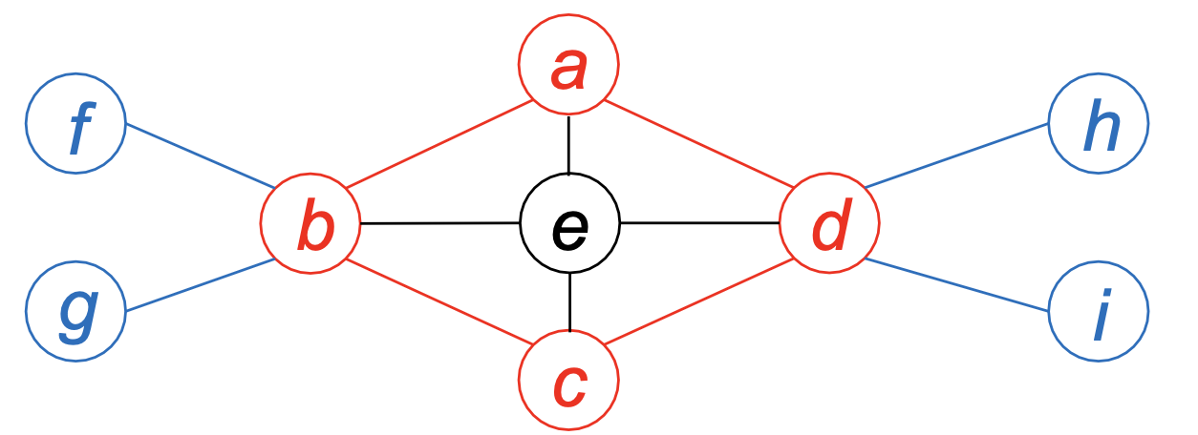
Proposed Methods (8/29)
Quasi-Cliques on G-thinker
S₁ = {a, b, c, d}
S₂ = S₁ ∪ e
Both S₁ and S₂ are 2/3-quasi-cliques
Only S₂ is a maximal 2/3-quasi-clique
[3] Khalil J, Yan D, Guo G, et al. Parallel mining of large maximal quasi-cliques[J]. The VLDB Journal, 2022, 31(4): 649-674.
Notes:
We have tested many algorithms on G-thinker such as maximum clique finding, triangle counting and subgraph matching, all achieved ideal speedup with the number of CPU cores.
So, we moved on to tackle the more challenging problem of mining gamma-quasi-cliques, which previously has only been tested on very small graphs.
A gamma-quasi-clique is a dense subgraph where every vertex connects to at least gamma fraction of the other vertices. Consider the subgraph induced by a,b,c,d, we can see that each vertex connects to at least 2 of the 3 other vertices.
For example, "a" connects to b,d but not c. Therefore, abcd is a 2-by-3 quasi-clique.
Next consider abcde, and the induced subgraph is also a 2-by-3 quasi-clique since each vertex connects to at least 3 of the other 4 vertices, and the ratio 3/4 is larger than 2/3
Since abcde contains abcd, abcd is not maximal and our goal is to find all the maximal gamma-quasi-cliques.

Slide 22
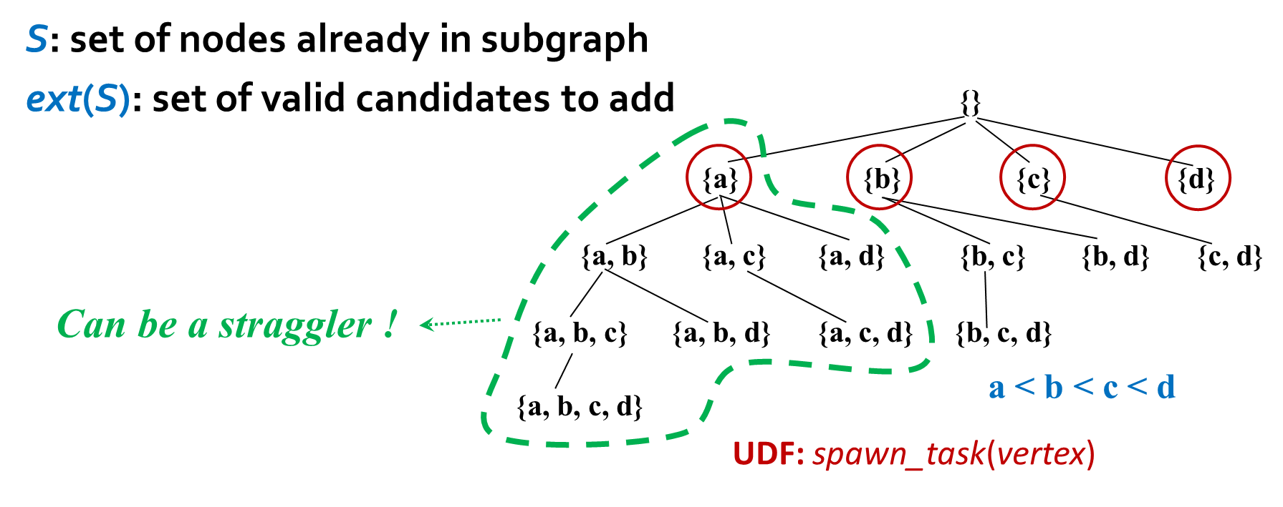
Proposed Methods (9/29)
Quasi-Cliques on G-thinker
[3] Khalil J, Yan D, Guo G, et al. Parallel mining of large maximal quasi-cliques[J]. The VLDB Journal, 2022, 31(4): 649-674.
[4] Guo G, Yan D, Özsu M T, et al. Scalable mining of maximal quasi-cliques: An algorithm-system codesign approach[J]. arXiv preprint arXiv:2005.00081, 2020.
Notes:
In G-thinker, [click] we can create initial tasks from individual vertices,
[click]
but these tasks can have very imbalanced workloads.

Slide 23
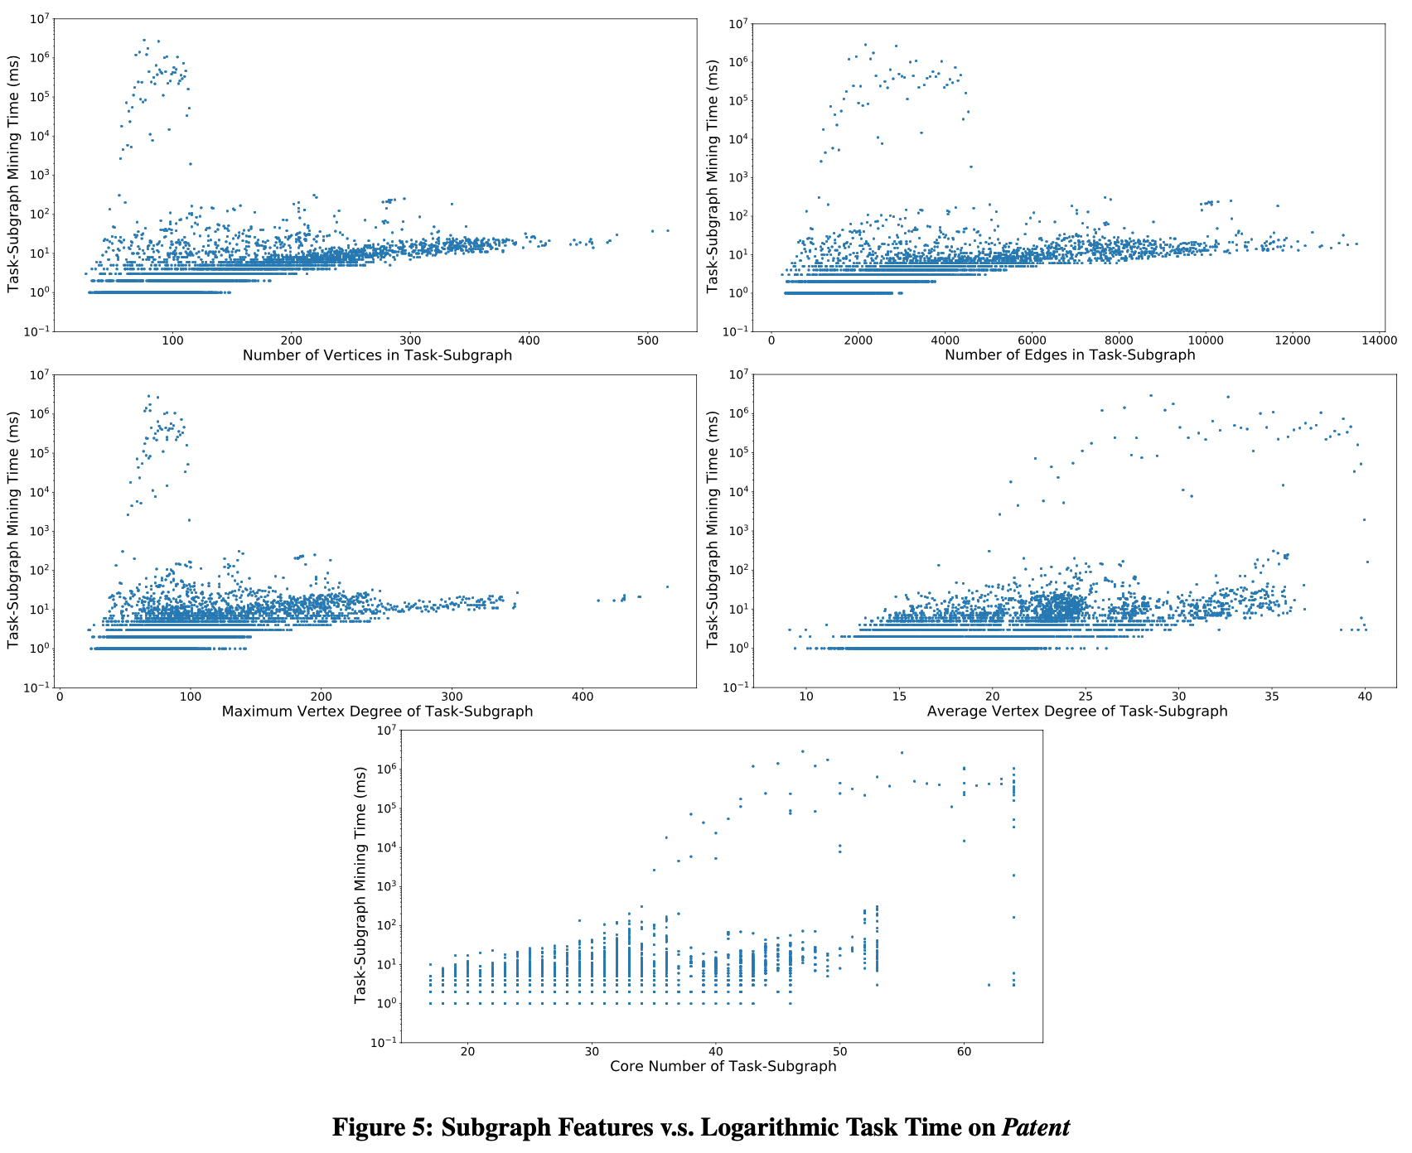
Proposed Methods (10/29)
Quasi-Cliques on G-thinker
8 orders of magnitude
Why Such Huge Task Time Difference?
Notes:
Here we explored the task running time with respect to difference subgraph features such as number of nodes and edges, and density measures such as average degree and core number, but we can see that even for small feature values, some tasks can be orders of magnitude more expensive than others, and we find that no machine learning model can predict these expensive big tasks effectively.
[click]
Why is there such a huge task time difference among tasks?

Slide 24
Proposed Methods (11/29)
Quasi-Cliques on G-thinker
  Heavily relies on pruning rules to be tractable
    Graph-Diameter Based Pruning
    Size-Threshold Based Pruning
    Degree-Based Pruning
    Upper- and Lower-Bound Based Pruning
    Critical-Vertex Based Pruning
    Cover-Vertex Based Pruning
Notes:
This is because our algorithm relies on many pruning rules to significantly reduce the search space, but these rules depend on the complicated connection relationships among the current set of vertices under exploration, and the timing when a pruning rule is applicable is difficult to predict.

Slide 25
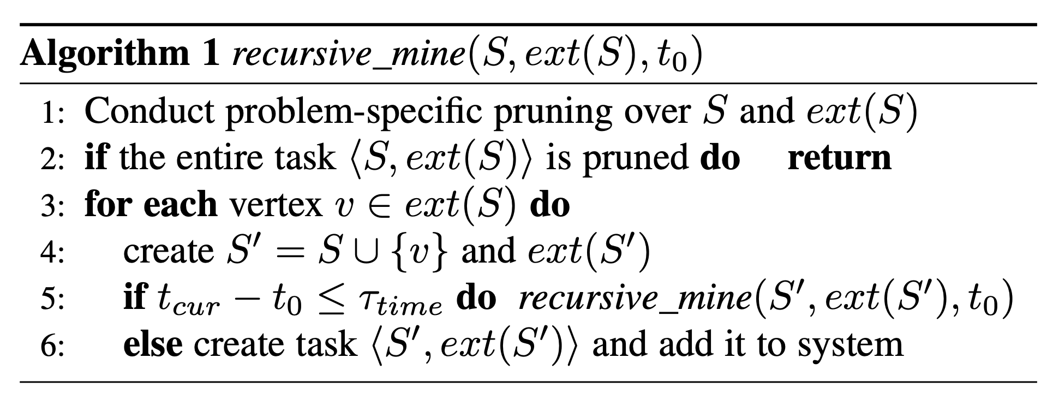
Proposed Methods (12/29)
Quasi-Cliques on G-thinker
  Timeout Mechanism for Task Decomposition
When {a, c} computes, it may timeout and decompose again
t₀ = 0
{a}
t₆ > τ_{time}
Q_{global}
t₁
t₅ > τ_{time}
{a, b}
{a, c}
{a, d}
t₂
t₄ > τ_{time}
{a, b, c}
{a, b, d}
{a, c, d}
t₃
{a, b, c, d}
[3] Khalil J, Yan D, Guo G, et al. Parallel mining of large maximal quasi-cliques[J]. The VLDB Journal, 2022, 31(4): 649-674.
[4] Guo G, Yan D, Özsu M T, et al. Scalable mining of maximal quasi-cliques: An algorithm-system codesign approach[J]. arXiv preprint arXiv:2005.00081, 2020.
Notes:
We therefore propose a timeout mechanism, where a task runs the recursive algorithm to traverse the search space tree in depth-first order, but if the task runs for too long and beyond a timeout threshold, we let the task create new subtasks to be added to the system rather than to recursively process the search space by itself.
For example, the task spawned by {a} here traverses the search space tree and right before it processes abd, it finds that the time t4 times out, so abd becomes an independent task added to the system, and when the recursive algorithm backtracks, t5 and t6 also time out so ac and ad are also created as new tasks.
[click, let animation to finish] Smaller tasks will be added to the local queue, while big tasks such as those with many candidate vertices to expand will be added to the global queue,
[click]
and it may timeout again and be further decomposed later.
This way, straggler tasks are effectively eliminated to allow effective load balancing.

Slide 26
Proposed Methods (13/29)
3 systems
  G-thinker
    subgraph finding: dense subgraphs, subgraph matching, …
  PrefixFPM
    frequent subgraph patterns (many small graph transactions)
  T-FSM
    frequent subgraph patterns (a single big graph)
Notes:
We next review PrefixFPM, which is for frequent pattern mining in general, for the context where there are many data transactions, and we would like to find patterns that appear in at least certain fraction of all the transactions.

Slide 27
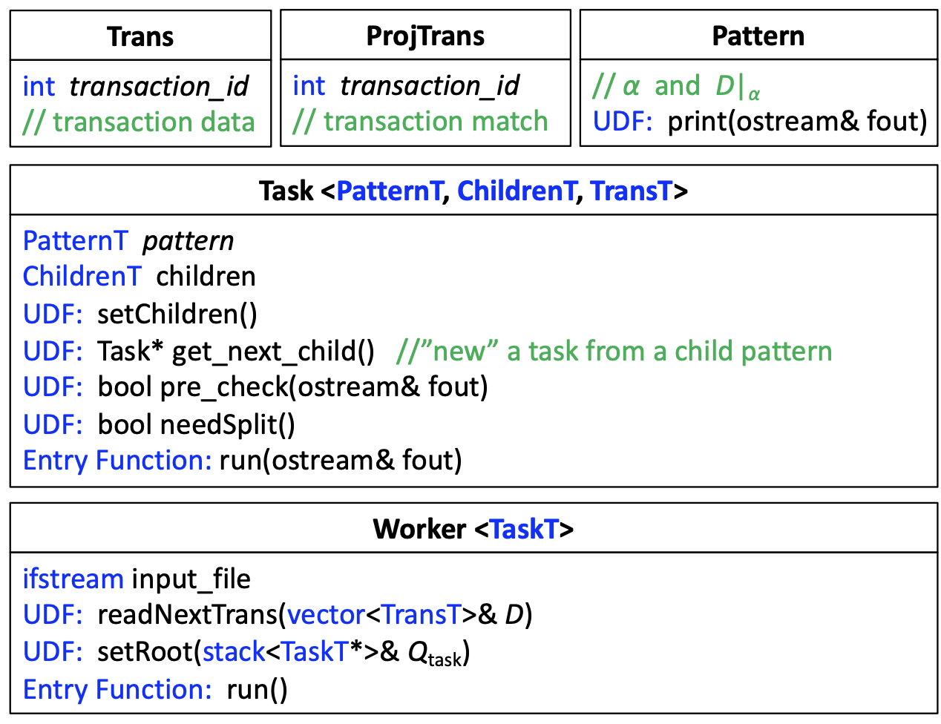
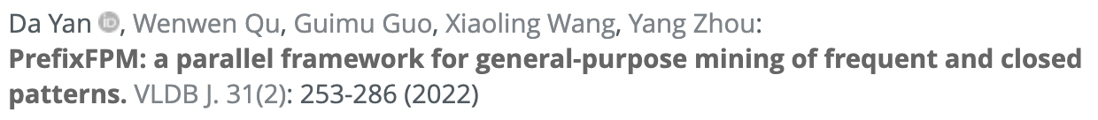

Proposed Methods (14/29)
PrefixFPM
  General Programming Framework for Frequent Pattern Mining
    Subsequences, subtrees, subgraphs, submatrices
Notes:
PrefixFPM provides a unified programming interface for users to specify the mining algorithms for various patterns.
There are some papers apply PrefixFPM for mining various patterns such as subsequences, subtrees, subgraphs and submatrices.
The related papers are listed on this slide.

Slide 28
Proposed Methods (15/29)
PrefixFPM
  Prefix Projection (Illustration by Sequence DB)
SID | Sequence
s₁ | ABCBC
s₂ | BABC
s₃ | AB
s₄ | BC
SID | Sequence
s₁ | _BCBC
s₂ | _BC
s₃ | _B
SID | Sequence
s₁ | _CBC
s₂ | _C
s₃ | _
SID | Sequence
s₁ | _BC
s₂ | _
A
B
C
(d) D|_{ABC}
(b) D|_{A}
(c) D|_{AB}
(a) D
Projected DB
Transaction DB
Pattern: ABC
Pattern: ∅
Pattern: A
Pattern: AB
Notes:
The key idea of PrefixFPM’s design is prefix projection, which we illustrate here using sequential pattern mining.
Initially, the prefix is empty so we have all the sequences in the database.
[click]
If we grow the prefix with an element A, then s4 is gone since it does not contain A, and the matched positions of the other three sequences are recorded in the database projected by A [click].
[click]
If we further grow the prefix with B, then we can match B on the previous projected database, and a new database projected by AB is obtained.
Here, if the frequency threshold is 3 or less, AB is still a frequent pattern,
[click]
so we can grow it further with element C

Slide 29
Proposed Methods (16/29)
PrefixFPM
  Prefix Projection (Illustration by Sequence DB)
Alphabet is {A, B, C}
Transaction DB
∅
Projected DB
frequent
A
C
B
…
…
Projected DB
Projected DB
AA
AB
AC
A stack of projected DBs with shrinking size
…
infrequent
frequent
Incremental projected DB construction
Projected DB
Projected DB
ABC
Child-branches are embarrassingly parallel !!!
ABA
ABB
…
infrequent
infrequent
Notes:
Here is an example of the mining process
[… need to keep describing while clicking]
[click]
The benefit of this approach is that, each pattern extension only checks a small projected database rather than the entire database
[click]
Also, the pattern to database matching is incremental from the previous matches rather than from scratch
[click]
Finally, the child branches in this search tree are totally independent and can run in parallel.

Slide 30
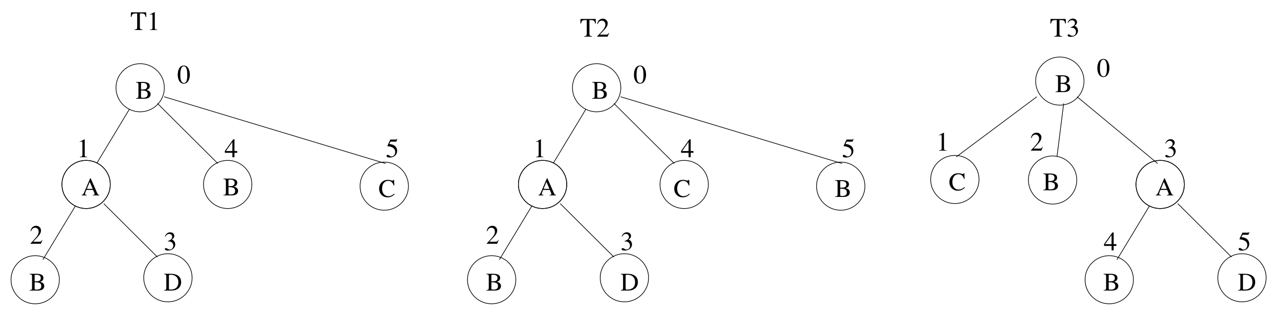

Proposed Methods (17/29)
PrefixFPM
  From Sequences to Graphs
Duplicated patterns for different sequences
Deduplicate by canonical encoding
BAB$D$$B$C$
BAB$D$$C$B$
BC$B$AB$D$$
canonical encoding
Notes:
Note that the idea of prefix projection carries over to graph patterns, but since different pattern extension paths may lead to isomorphic patterns, redundancy avoidance is important.
Here, we show three tree patterns that are isomorphic if we ignore the children order.
We can define the one whose DFS serialization code is the smallest to be canonical, then we only need to expand a pattern if its DFS serialization code is canonical.
[click]
For tree patterns, canonicality is easy to check since only the pattern with children ordered exactly following the element order in the alphabet is canonical. This checking is more complicated for graphs but schemes like the DFS code of gSpan can be applied.
[click]
The other redundant branches will be pruned as shown on the right.

Slide 31
Proposed Methods (18/29)
PrefixFPM
  Task Parallelism
Alphabet is {A, B, C}
Transaction DB
∅
PDB-parallelism (root task)
Projected DB
A
B
C
…
…
Thread 3
Thread 4
AA
AB
AC
infrequent
…
Thread 2
ABA
ABB
ABC
Thread 1
Notes:
Here we show the mining process in PrefixFPM, where the first available node on the leftmost path will be fetched as a task by each computing thread for mining its subtree.
[click] x 4
If the mining by a task times out, the subtrees of the child nodes will be treated as new tasks and added to the system for parallel processing to avoid stragglers.
[click]
Initially when there are not many patterns, parallelism can come from the concurrent examining of data items for pattern matching.

Slide 32
Proposed Methods (19/29)
3 systems
  G-thinker
    subgraph finding: dense subgraphs, subgraph matching, …
  PrefixFPM
    frequent subgraph patterns (many small graph transactions)
  T-FSM
    frequent subgraph patterns (a single big graph)
Notes:
Finally, we review the T-FSM system which is for frequent subgraph pattern mining on a single big graph.

Slide 33
Proposed Methods (20/29)
Frequent Subgraph Patterns from a Big Graph
  Frequency is not anti-monotonic
S₁
u₁
G₁
v₂
A
B
count = 1
v₁
A
S₂
u₁
A
B
u₂
v₃
B
v₄
B
count = 3
Notes:
A notable difference from mining frequent patterns from a transaction database is that, frequency here is not an anti-monotonic measure.
[click]
For example, S1 appears only once in G1, but its superpattern S2 appears 3 times, which is even larger.

Slide 34
Proposed Methods (21/29)
Frequent Subgraph Patterns from a Big Graph
  Anti-monotonic measure: MNI
    Least number of distinct valid matches from any pattern vertex
x
G₂
v₂
v₆
B
A
v₁
A
v₅
B
S₂
u₁
A
B
u₂
v₃
B
v₄
B
v₇
A
v₈
A
4
[5] Yuan L, Yan D, Qu W, et al. T-FSM: A task-based system for massively parallel frequent subgraph pattern mining from a big graph[J]. Proceedings of the ACM on Management of Data, 2023, 1(1): 1-26.
Notes:
MNI is the widely adopted anti-monotonic measure for support, which equals the least number of distinct valid matches from any pattern vertex
For example, u1 in S2 has four valid matches [click] x 4

Slide 35
Proposed Methods (22/29)
Frequent Subgraph Patterns from a Big Graph
  Anti-monotonic measure: MNI
    Least number of distinct valid matches from any pattern vertex
x
G₂
v₂
v₆
B
A
v₁
A
v₅
B
S₂
u₁
A
B
u₂
v₃
B
v₄
B
v₇
A
v₈
A
4
4
MNI ={ , } = 4
Ground truth is 2
[5] Yuan L, Yan D, Qu W, et al. T-FSM: A task-based system for massively parallel frequent subgraph pattern mining from a big graph[J]. Proceedings of the ACM on Management of Data, 2023, 1(1): 1-26.
Notes:
and u2 also has four valid matches [click] x 4
[click]
So the MNI is the minimum of the two numbers which is 4.
[click]
However, the ground truth should be 2 [click] since we can get at most 2 pairs of AB in the data graph
Surprisingly, this overestimation issue of MNI did not raise attention in prior works that unanimously used MNI for support.

Slide 36
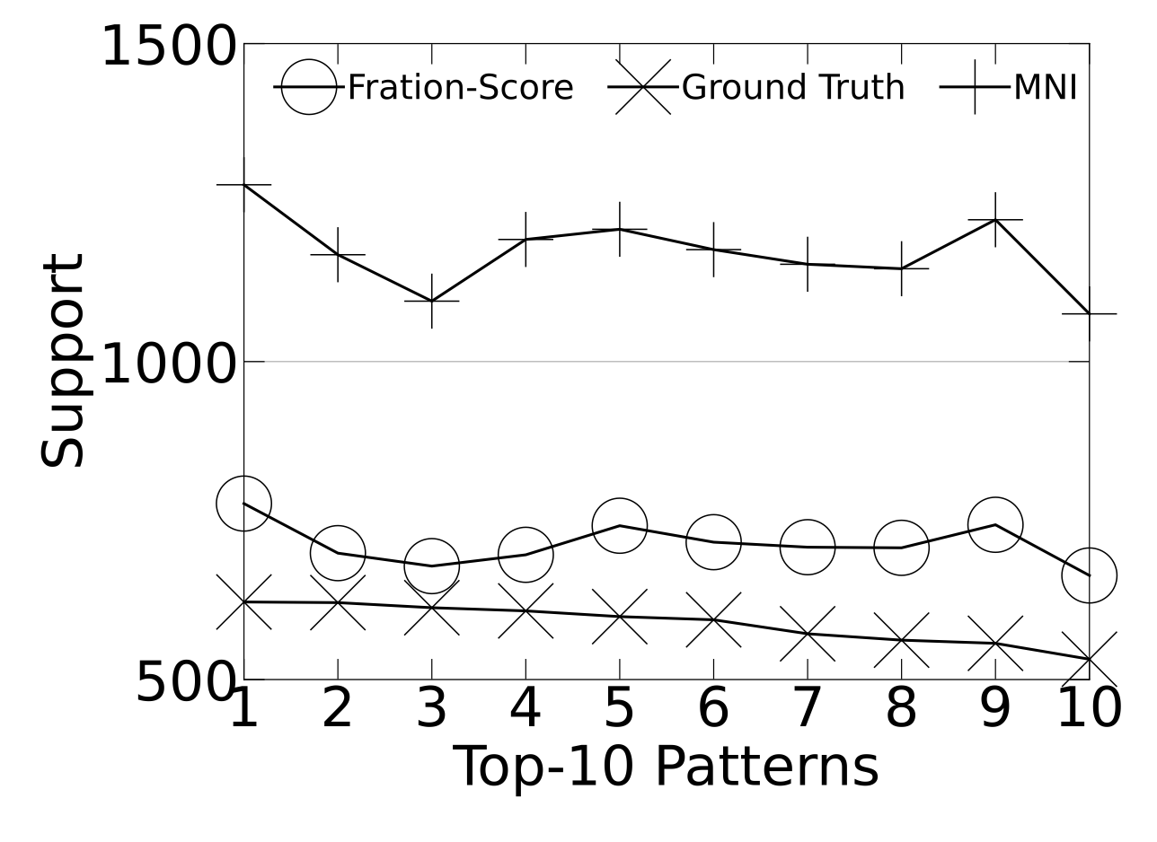
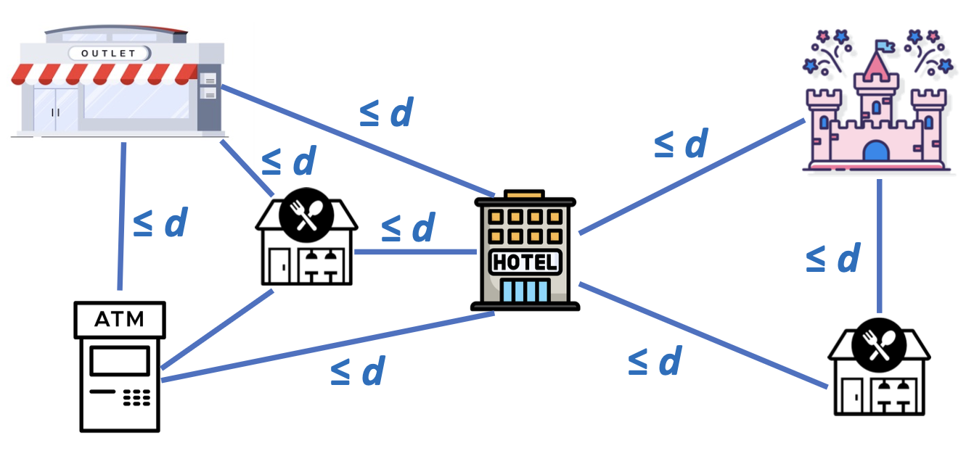
Proposed Methods (23/29)
Solution: Fraction-Score
  Extending from prior work on colocation pattern mining
[5] Yuan L, Yan D, Qu W, et al. T-FSM: A task-based system for massively parallel frequent subgraph pattern mining from a big graph[J]. Proceedings of the ACM on Management of Data, 2023, 1(1): 1-26.
Notes:
The solution of this paper is to extend the concept of Fraction-Score from prior work on colocation pattern mining to the current setting.
Note that colocation pattern mining requires every POI to be within distance d from each other, while our patterns are more general as shown on the right, which allows two clusters of locations around a hotel, one for theme park visit on a day of travel, and the other for shopping at an outlet on another day.
Fraction-Score is much tighter than MNI in this context since it avoids double counting an object involved in multiple matches.
In the figure on the left, the proposed method use a synthetic dataset for which we know the ground-truth support to compare the tightness of Fraction-Score and MNI, where we can see that Fraction-Score is much closer to the ground truth.
In our previous example, Fraction-Score can successfully recover the ground-truth support 2.

Slide 37
Proposed Methods (24/29)
Previous Methods
  a huge memory cost
  some approximate approaches are often not accurate
  mainly focus on mining small-sized patterns...
Notes:
some recent parallel systems have been developed to accelerate FSM in the single-graph setting. However, most of them (e.g., DistGraph [27] and Fractal [22]) grow and materialize patterns and all their matched instances in 𝐺, so they fail to utilize the above pruning opportunities and often incur a huge memory cost,
Even though ScaleMine [1] conducts pruning, it uses some approximate approaches that treat patterns as frequent (resp. infrequent) as long as they are frequent (resp. infrequent) with a high probability, but the paper find that the results are often not accurate and could be inconsistent even in different runs.
Also, previous works mainly focus on mining small-sized patterns, since their subgraph matching procedure is inefficient.
The paper observed prohibitively long running time or out-of-memory error when they mine patterns with ≥ 6 vertices.
These problem are all solved by the proposed method.

Slide 38
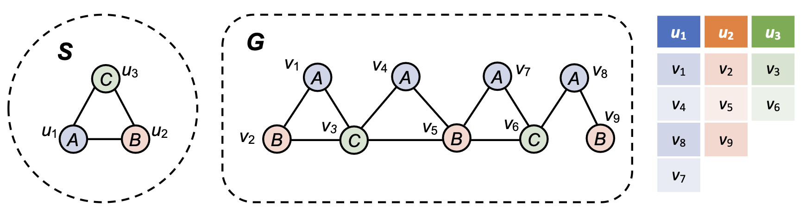
Proposed Methods (25/29)
Domain Table
  Each pattern = many subgraph-matching tasks
[5] Yuan L, Yan D, Qu W, et al. T-FSM: A task-based system for massively parallel frequent subgraph pattern mining from a big graph[J]. Proceedings of the ACM on Management of Data, 2023, 1(1): 1-26.
Notes:
As we have previously seen, given a pattern, to check if it is frequent according to MNI or Fraction-Score | can be converted into the checking of whether a subgraph matching of the pattern can be found from each data vertex v that can match each query vertex ui
MNI is simply the smallest number of valid matches to any ui.
[can use u1 -> v1, v4, v8-noTriangle, v_7 to illustrate]
Note that a lot pruning is possible. For example, if we require MNI to be 2 to be frequent, then we can stop checking the data vertices for each ui as soon as 2 matches have been found.

Slide 39
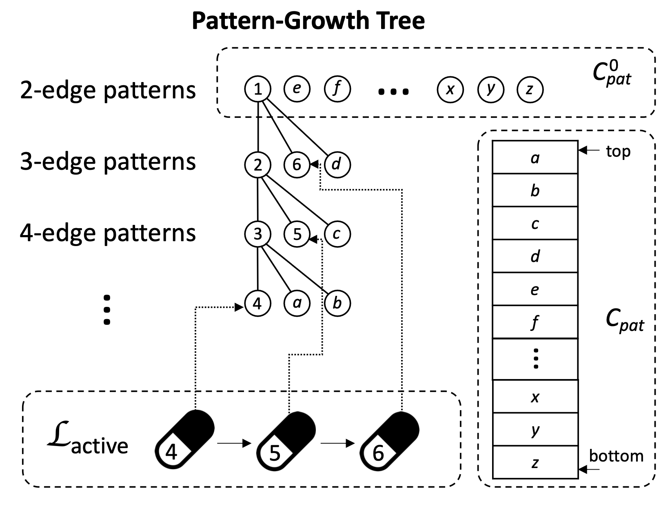

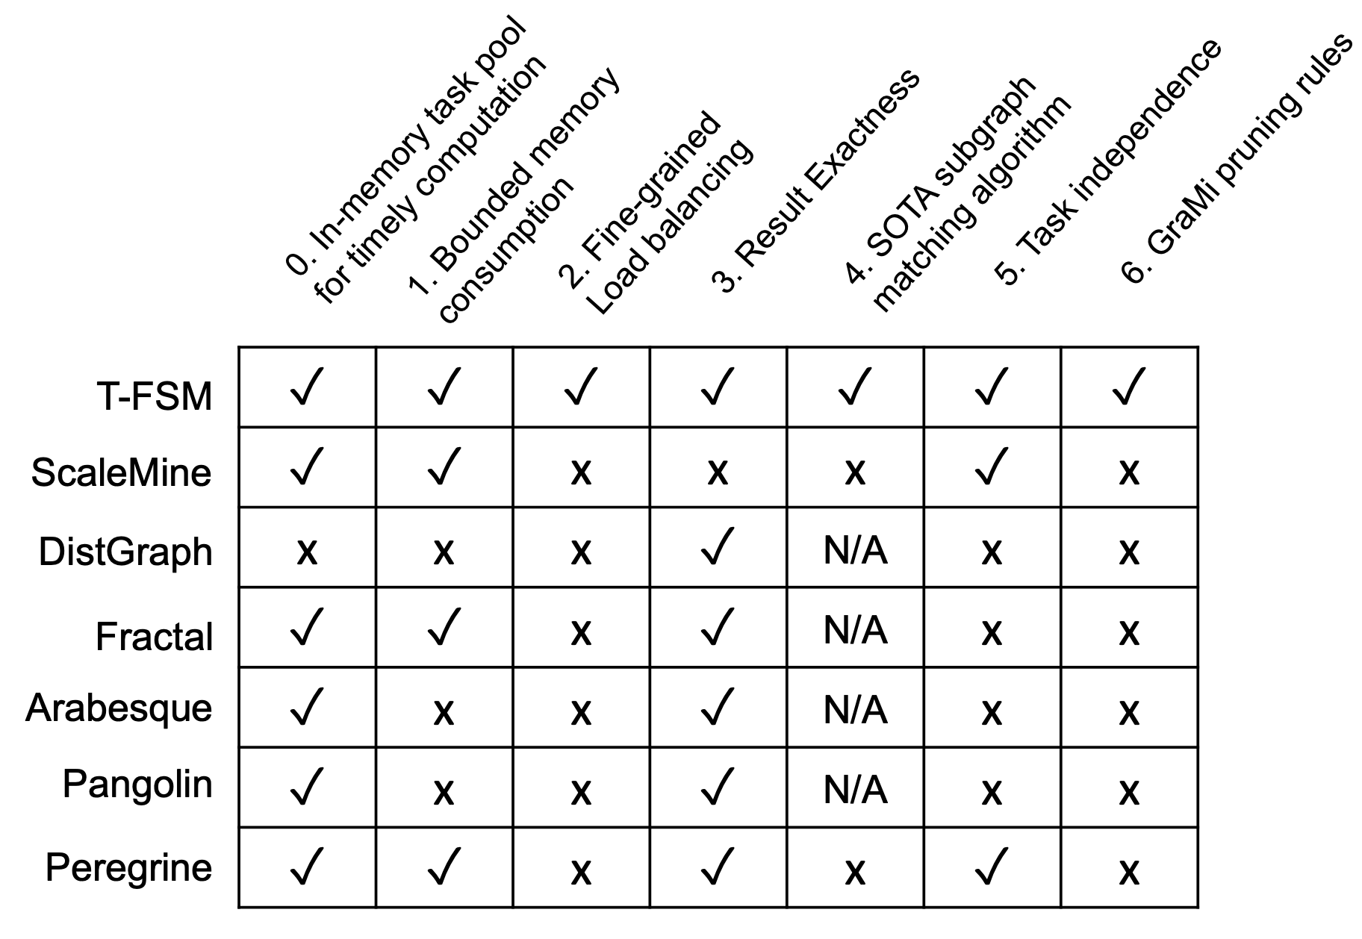
Proposed Methods (26/29)
Task Management
  Each active pattern has a pattern capsule
graph matching from v_{i}
head
v_{i}
tail
① fetch a task
?
② update status
L
_{active}
…
⑤ delete capsule
③ if pattern frequentness finalized
C_{pat}
…
⑥ pop
④ if frequent: extend & push
Initial 2-edge patterns (computed by the worker)
…
Notes:
In the T-FSM system, it only keep at most 32 patterns active with subgraph-matching tasks at any time | to keep the memory consumption bounded.
Here, the tasks of each active pattern is kept in a pattern capsule.
When a computing thread fetches a task to process [click],
it will obtain the first pattern in the list with an available task, so that patterns that were added early are prioritized for processing, to finish early to make room for new patterns to be added to the active list.
Assume that a subgraph-matching task from the second pattern capsule is obtained, then [click] we will update the pattern status using the task result after task computation.
[click] If we can determine whether a pattern is frequent or not after the status update of some task,
[click] we will extend the pattern if it is frequent, and add the child patterns to a stack of pending patterns to process
[click] The current pattern is then deleted from the active list since it finishes processing
[click] Later if a computing thread cannot get any task after checking all the active pattern capsules, a new pattern can be moved to the active list for task creation to fill the available capacity slot.
[click] By organizing the pending pattern pool as a last-in-first-out stack, we can show that the memory consumption is bounded.
[click] The next question is how are tasks in a pattern capsule organized?

Slide 40
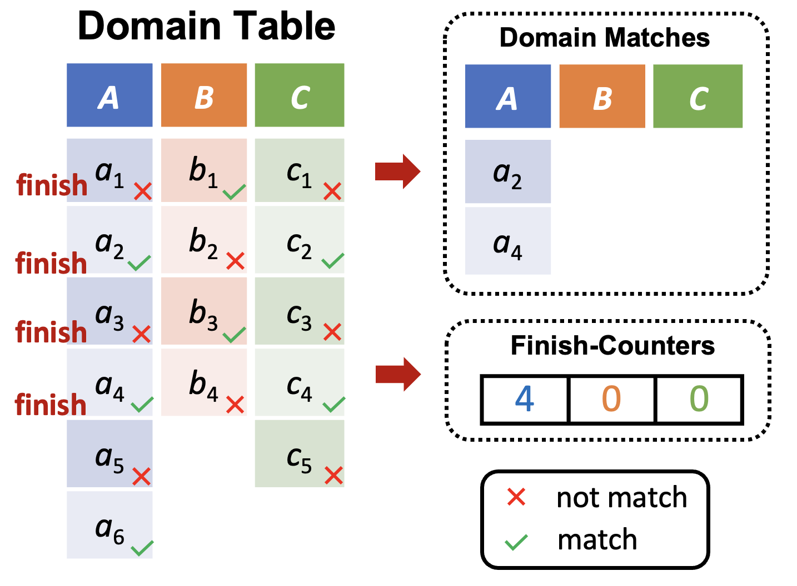
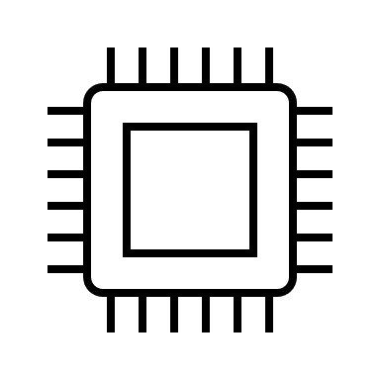
Proposed Methods (27/29)
Pattern Capsule (for Each Pattern)
v₃
v₆
u₁
v₁
v₄
v₇
u₂
v₂
v₅
…
u₃
v₃
v₆
…
② fetch
① refill
v₇
v₂
v₅
Q_{reg}
compers
③ timeout & insert
v₄
…
…
…
…
L_{timeout}
② fetch
…
…
v₁
⑤ insert
④ timeout & decompose
…
v_{1a}
v_{1b}
Pattern Capsule
[5] Yuan L, Yan D, Qu W, et al. T-FSM: A task-based system for massively parallel frequent subgraph pattern mining from a big graph[J]. Proceedings of the ACM on Management of Data, 2023, 1(1): 1-26.
Notes:
Inside a pattern capsule, the subgraph-matching tasks are initially spawned from vertices in the domain table when capacity allows.
If a task times out, it will be decomposed and the new tasks will be added to a timeout task list for load balancing.
The tasks are fetched by computing threads in the order such that u1’s tasks will be prioritized for processing before those of u2, which are in turn before those of u3, to facilitate early pruning.

Slide 41
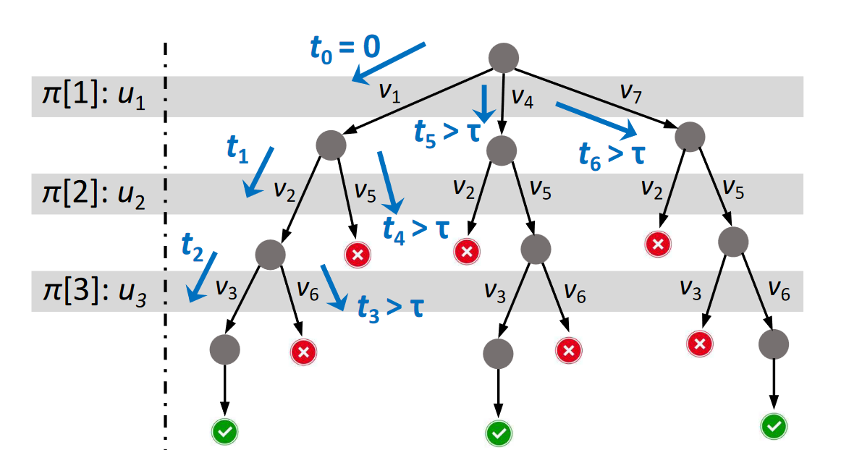
Proposed Methods (28/29)
Task Decomposition
[5] Yuan L, Yan D, Qu W, et al. T-FSM: A task-based system for massively parallel frequent subgraph pattern mining from a big graph[J]. Proceedings of the ACM on Management of Data, 2023, 1(1): 1-26.
Notes:
We next explain how we decompose a task 𝑡𝑣 in Step 4 ○ of the former Figure when 𝑡𝑣 times out.
The figure illustrates this timeout process: the current task traverses the search-space tree in depth-first order, processing for 3 recursive steps (𝑡0, 𝑡1 and 𝑡2) and when reaching to check 𝑣6 ∈ 𝐶𝑀 (𝑢3), the current time 𝑡3 times out, so the subtree from extending 𝑣6 is wrapped as an independent and added to the system. Also, when the current task backtracks the recursion stack, three subsequent tasks are created due to timeout (𝑡4, 𝑡5 and 𝑡6). Note that these tasks are created at different granularities that are necessary and not over-decomposed.

Slide 42
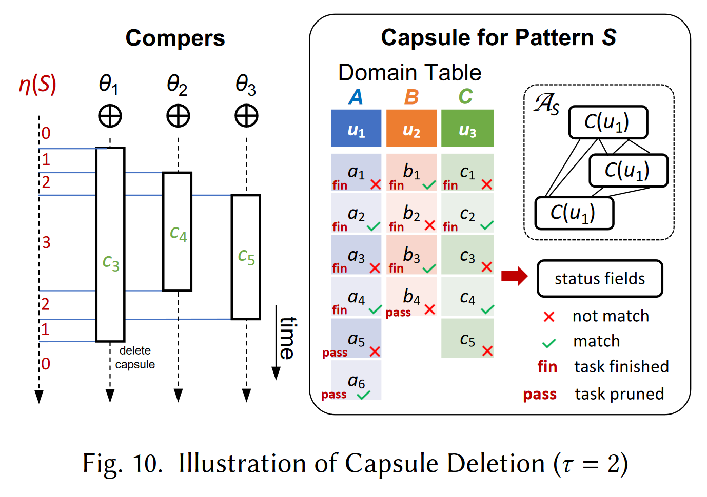
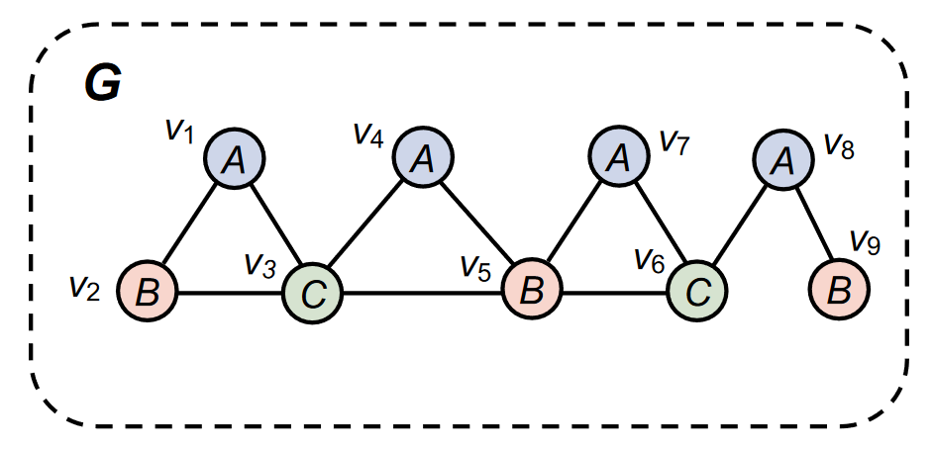
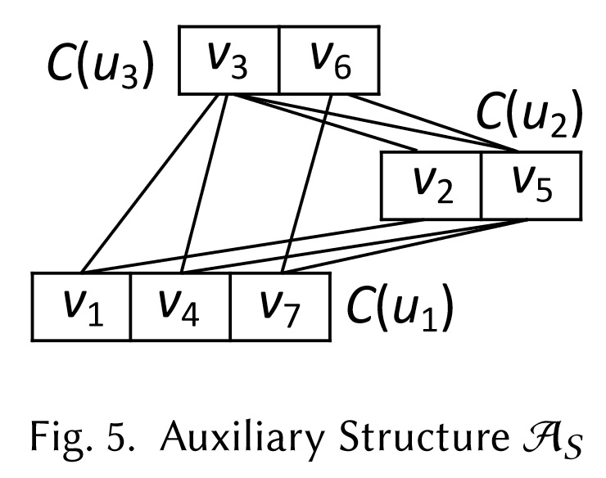
Proposed Methods (29/29)
Capsule Deletion
42
Notes:
an auxiliary structure A𝑆 for a pattern 𝑆, where each 𝑢𝑖 is associated with a set of pruned candidates 𝐶 (𝑢𝑖 ), and for each edge (𝑢𝑖, 𝑢𝑗 ) ∈ 𝐸𝑆 , its matched edges in 𝐺 between 𝐶 (𝑢𝑖 ) and 𝐶 (𝑢𝑗 ) are materialized
(to illustrate, Figure 5 shows A𝑆 for pattern 𝑆)
Consider the pattern capsule in Figure 10 and assume that the support threshold 𝜏 = 2. We also assume that (1) the pattern only has 3 entries yet to create subgraphmatching tasks: 𝑐3, 𝑐4 and 𝑐5, while all other entries have finished (or pruned) their subgraph-matching tasks; and assume that (2) compers 𝜃1, 𝜃2 and 𝜃3 process tasks 𝑡𝑐3 , 𝑡𝑐4 and 𝑡𝑐5 , respectively. If 𝑡𝑐4 finds that 𝑐4 is a valid match to 𝑢3 so all 𝑢𝑖 ’s have at least 2 valid matches, then 𝑆 is determined to be frequent and 𝜃2 will delete 𝑆’s capsule. However, 𝜃1 and 𝜃3 may still be processing
𝑡𝑐3 and 𝑡𝑐5 , and will need to access A𝑆 for subgraph enumeration and then update 𝑆’s status in the capsule!

Slide 43
Outline
Introduction (5 min)
  What is a graph?
  What is Frequent Subgraph Mining (FSM)?
  Two problem settings
  Mining frequent subgraphs in a single graph
Analysis & Motivation (5 min)
  Existing Solutions
  Think Like a Task (T-Thinker)
Proposed Methods (25 min)
  G-thinker
  PrefixFPM
  T-FSM
Experiments (5 min)
Q/A (5 min)
Notes:
The presentation includes five parts, I will introduce them step by step. If you have any question, feel free to ask me. Ok, Let’s get started!

Slide 44
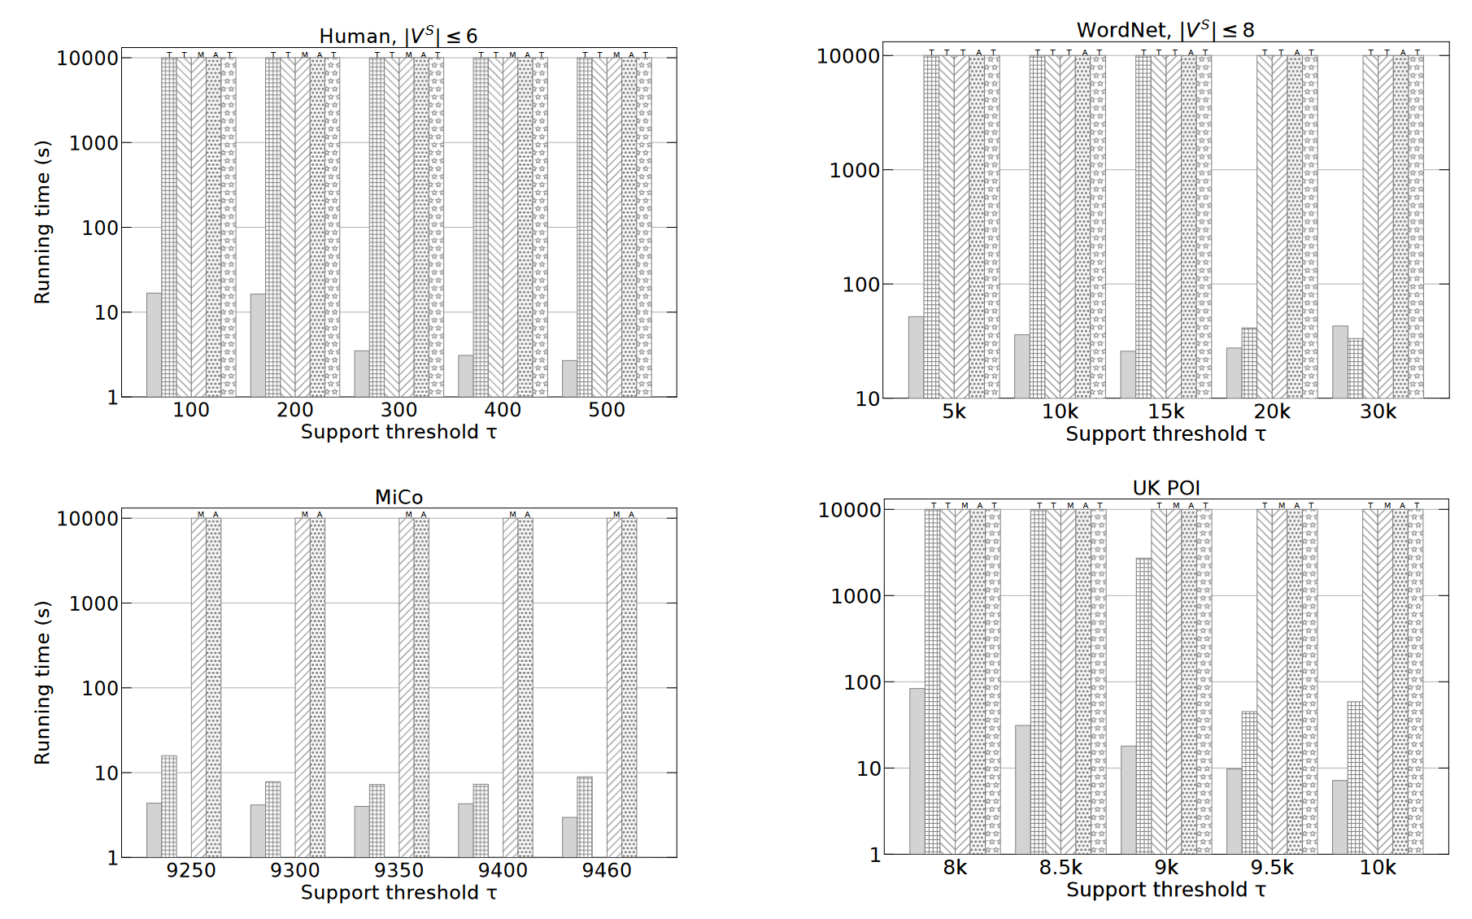
Experiments (1/4)
Notes:
The Figure shows that T-FSM generally has the best performance on all the graphs, especially the denser ones. For example, on Human, T-FSM is the only system that can mine all pattern with no more than 6 vertices, since Human is very dense with an average degree of 36.92. A similar observation can be reached for UK POI, where ScaleMine is the only other system that can finish for some tested values of 𝜏.

Slide 45
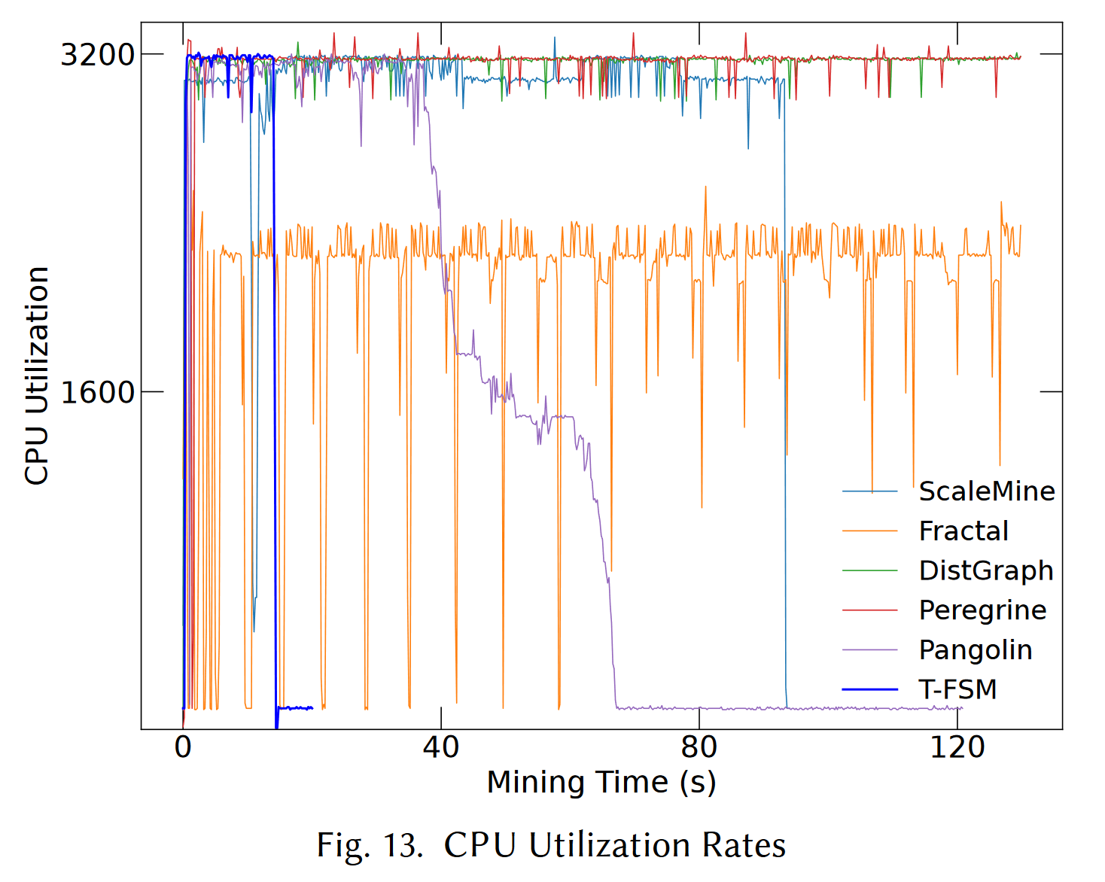
Experiments (2/4)
Notes:
Figure 13 shows the CPU rates for the first 120 seconds, where we can see that the CPU rate of T-FSM (blue line) jumps to 3200% and completes the job quickly.
DistGraph and Peregrine also achieve 3200% but their running times are much longer. ScaleMine has a slightly lower CPU rate but is able to complete within 120 seconds.
The peak CPU rate of Fractal is far from 3200%, while the CPU rate of Pangolin gradually drops with a very long tailing period of low CPU utilization rate.

Slide 46
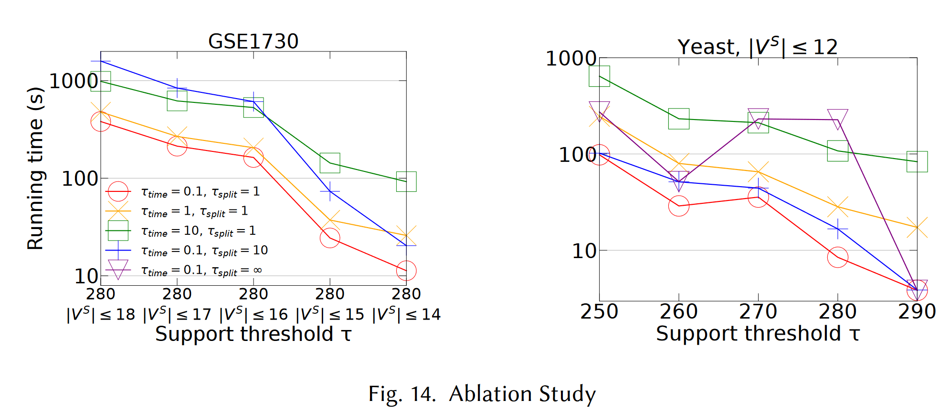
Experiments (3/4)
Notes:
There are performance tradeoffs for the values of 𝜏𝑡𝑖𝑚𝑒 and 𝜏𝑠𝑝𝑙𝑖𝑡 . Specifically, if there are sufficient candidates 𝑣 ∈ 𝐷 (𝑢𝑖 ) that can be quickly checked to be a valid match to 𝑢𝑖 ,
then if 𝜏𝑡𝑖𝑚𝑒 is set too large, we might stick on expensive tasks 𝑡𝑣 that can otherwise be skipped to save time.
Also, while a smaller 𝜏𝑠𝑝𝑙𝑖𝑡 improves load balancing, it causes more overhead for subtask creation and scheduling.
The paper tested different combinations of 𝜏𝑡𝑖𝑚𝑒 and 𝜏𝑠𝑝𝑙𝑖𝑡 , and some results are shown in Figure 14 for GSE1730 and Yeast. Note that our default parameters (red line) lead to the best performance.
if we increase 𝜏𝑡𝑖𝑚𝑒 from 0.1 s to 10 s (green line), the running time is increased by up to 8× on GSE1730 and 20× on Yeast.
We did not further increase 𝜏𝑡𝑖𝑚𝑒 in Figure 14 since the time would continue to increase significantly.
Also, if we increase 𝜏𝑠𝑝𝑙𝑖𝑡 from 1 s to ∞ (purple line), the running time is increased by up to 30× on Yeast.
We did not show the results for 𝜏𝑠𝑝𝑙𝑖𝑡 = ∞ on GSE1730 in Figure 14 since the job runs out of time.

Slide 47
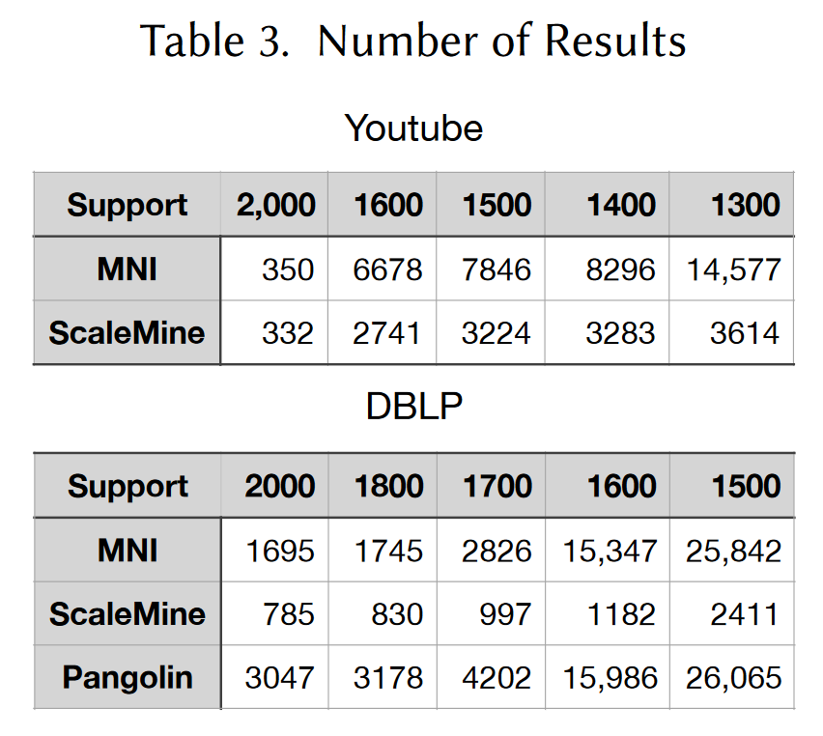
Experiments (4/4)
Notes:
Recall that ScaleMine returns only approximate results.
Table 3 shows the exact number of subgraph patterns (i.e., MNI) and those returned by ScaleMine on Youtube and DBLP,
where we see that ScaleMine misses a lot of patterns due to an overly aggressive pruning heuristic.
Surprisingly, we find that Pangolin returns more patterns than the exact ones on DBLP, even though it is supposed to be an exact approach. This is likely due to implementation issues.

Slide 48
Outline
Introduction (5 min)
  What is a graph?
  What is Frequent Subgraph Mining (FSM)?
  Two problem settings
  Mining frequent subgraphs in a single graph
Analysis & Motivation (5 min)
  Existing Solutions
  Think Like a Task (T-Thinker)
Proposed Methods (25 min)
  G-thinker
  PrefixFPM
  T-FSM
Experiments (5 min)
Q/A (5 min)
Notes:
The presentation includes five parts, I will introduce them step by step. If you have any question, feel free to ask me. Ok, Let’s get started!

Slide 49
Q & A
Thank you!
Notes:
Figure 13 shows the CPU rates for the first 120 seconds, where we can see that the CPU rate of T-FSM (blue line) jumps to 3200% and completes the job quickly.

