Slide 1
Operating System And Artificial Intelligence: A Systematic Review 2024.10.28
Large Language Models (LLMs) focused
Xidong Wang
School of Data Science
Chinese University of Hong Kong, Shenzhen
Notes:
Hello, everyone, My name is Wang xidong, and today I primirally will talk about Operating System And Artificial Intelligence, but as you can see, the topic is too large, so i narrow down to the os within LLMs for presentation, and show the statistics for OS and AI.

Slide 2
Outline
Introduction (15 min)
Statistically Analyze the Selected Papers (5 min)
How LLMs create opportunities for OS? (20 min)
LLM AS OS
LLM4OS
Opportunities for Future Work (10 min)
LLM AS OS
LLM4OS
Q&A (5 min)
Notes:
Today's presentation will be devided into 4 parts, first I will briefly introduce the background to emphsis the importance and fill the context for this presentaion, and then I’ll show the statistical analysis of the recent papers related to OS and AI, and then I will focus on LLM-related topics to show more details of the oppotunities and future.

Slide 3
Outline
Introduction (15 min)
Statistically Analyze the Selected Papers (5 min)
How LLMs create opportunities for OS? (20 min)
LLM AS OS
LLM4OS
Opportunities for Future Work (10 min)
LLM AS OS
LLM4OS
Q&A (5 min)
Notes:
Let’s begin with filling the context of today’s topic. LLM and OS.

Slide 4
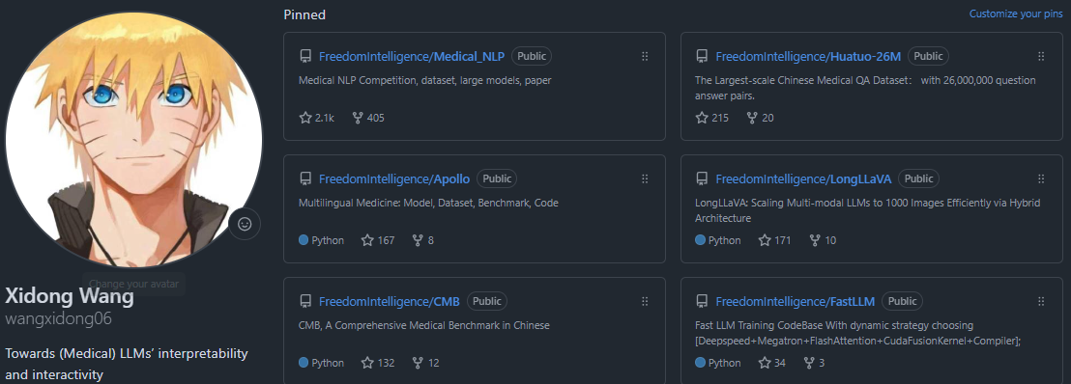
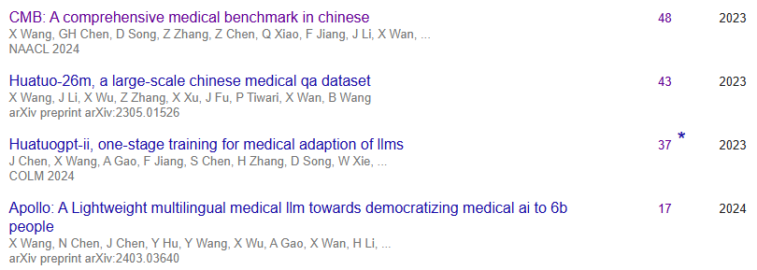
Self Background Introduction
A Second-Year LLM-Traing Guy~
Focus on (Medical) LLM’s Interactivity
HuatuoGPT, Phoenix, Apollo, LongLLaVA, ApolloMoE ...
https://github.com/wangxidong06
Notes:
before the presentation, let me briefly introduce my self, I’m a second-year LLm-Training guy, I mainly focus on Medical LLM’s and LLMs’Interactivity, And I did train a lot of models that get popular and gain some impact within the community, both in code repo star and citations.

Slide 5
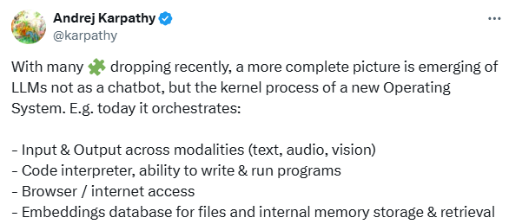
Why LLM with Operation System is the new hot and so important erea?
LLM for Operation System
https://github.com/wangxidong06
Notes:
So, why the Operation system is especially hot in recent day, especially in the past month, first LLM can help generate the new Operation system for the future. As Andrej Karphathy said, the new operation system have orchestrated. With the multi-modal modality, COde interpreter, internet access and database storage. Looking at LLMs as chatbots is the same as looking at early computers as calculators. it’s just a new story to sell papers.

Slide 6
Why LLM with Operation System is the new hot and so important erea?
LLM for Operation System
Operation System for LLM
A Brief Demo
vLLM: Inferencean attention algorithm inspired by the classic idea of virtual memory and paging in operating systems
https://github.com/wangxidong06
Notes:
On the other hand, which is much more intresting and stractive to me, is the Operation system for LLM, as we all know, the LLM too Unreliable to help works with Low error tolerance but the operation system can help it, and let the LLM access the world Within the boundaries set by the operating system, that would be more stable and full of imagination.
Last week, antropic the company develop the claud series release their new function for computer use, here is a breif demo,
it’s pretty stratforward for us to imagin the influence.
but operation system for LLM is not within this story, there still a new direction to think about this, cause the LLM create a new Rough and unexplored performance optimization territory, just borrow a little idea from operation systems’ master can Gain huge influence and make a totally difference for this large new community, vllm is a very good examples. It JUST borrow the classic idea of virtual memory and paging in operation systems to optimize LLM inference, they get 802 citation with one year. and the idea is just so principle, which for operation systems optimization master is just so straghtforward

Slide 7
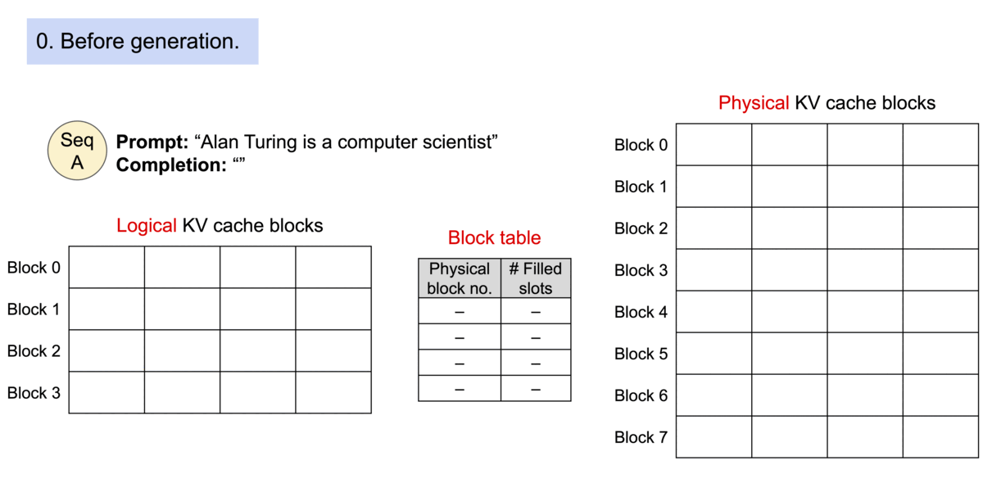
Why LLM with Operation System is the new hot and so important erea?
Operation System for LLM
vLLM: Inferencean attention algorithm inspired by the classic idea of virtual memory and paging in operating systems
https://github.com/wangxidong06
Notes:
In the autoregressive decoding process, all the input tokens to the LLM produce their attention key and value tensors, and these tensors are kept in GPU memory to generate next tokens. These cached key and value tensors are often referred to as KV cache. The KV cache is
Dynamic: Its size depends on the sequence length, which is highly variable and unpredictable. As a result, efficiently managing the KV cache presents a significant challenge. Existing systems waste 60% – 80% of memory due to fragmentation and over-reservation.
To address this problem, the reseachers introduce PagedAttention. Unlike the traditional attention algorithms, PagedAttention allows storing continuous keys and values in non-contiguous memory space. Specifically, PagedAttention partitions the KV cache of each sequence into blocks, each block containing the keys and values for a fixed number of tokens. During the attention computation, the PagedAttention kernel identifies and fetches these blocks efficiently.
Because the blocks do not need to be contiguous in memory, we can manage the keys and values in a more flexible way as in OS’s virtual memory: one can think of blocks as pages, tokens as bytes, and sequences as processes. The contiguous logical blocks of a sequence are mapped to non-contiguous physical blocks via a block table. The physical blocks are allocated on demand as new tokens are generated.

Slide 8
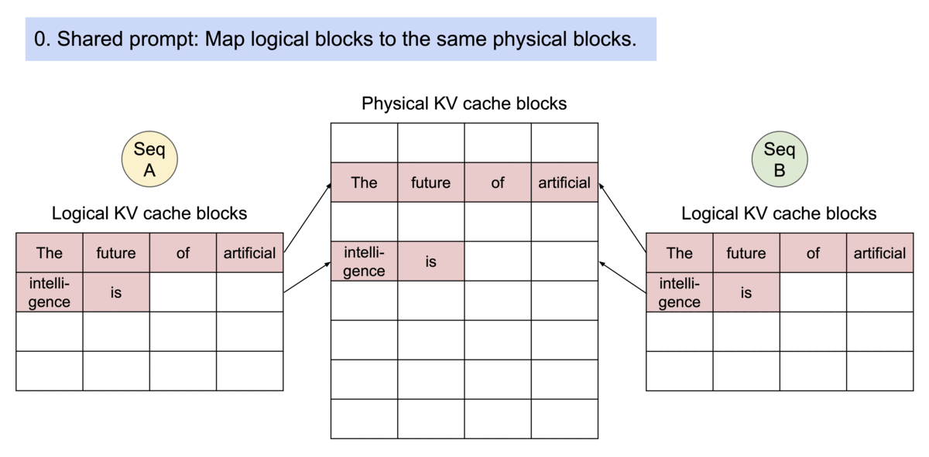
Why LLM with Operation System is the new hot and so important erea?
Operation System for LLM
PageAttention’s memory sharing Example generation process for a request that samples multiple outputs.
https://github.com/wangxidong06
Notes:
PagedAttention naturally enables memory sharing through its block table. Similar to how processes share physical pages, different sequences in PagedAttention can share the blocks by mapping their logical blocks to the same physical block. To ensure safe sharing, PagedAttention keeps track of the reference counts of the physical blocks and implements the Copy-on-Write mechanism.
PageAttention’s memory sharing greatly reduces the memory overhead of complex sampling algorithms, such as parallel sampling and beam search, cutting their memory usage by up to 55%. This can translate into up to 2.2x improvement in throughput. This makes such sampling methods practical in LLM services.
And all this is just a borrowed idea from virtual pages.

Slide 9
Outline
Introduction (15 min)
Statistically Analyze the Selected Papers (5 min)
How LLMs create opportunities for OS? (20 min)
LLM AS OS
LLM4OS
Opportunities for Future Work (10 min)
LLM AS OS
LLM4OS
Q&A (5 min)
Notes:
now let’s look at the statistic analysis of OS and AI papers, to see the whole picture in the research papers’view

Slide 10
Paper Selection
Paper Search
212
Inclusion criteria
Exclusion criteria
Peer-Reviewed Research Paper
Primary Study
Publication Date
Length Constraint
Avoiding Duplicates
Language
108
Notes:
we identify four AI-related terms and two OS-related terms, then combine these two categories of terms by logical ORs to create search strings. After specifying the range the papers were published: 2019–March 2024, we deliver these search strings to Google Scholar, to collect related papers in the intersection of AI and OS. The defined search terms are as shown in above.
We began with an initial pool of 212 papers related to the intersection of AI and Operating Systems (OS). To narrow down our focus, we applied the following inclusion criteria and exclusion criteria :
with repesct to the inclusion criteria We considered only peer-reviewed research papers and included primary studies that directly addressed AI-OS integration. and We also restricted our selection to papers published within the past 5 years. and only considered papers written in English.
As a result, 108 papers met our criteria and are within the scope of our research.

Slide 11
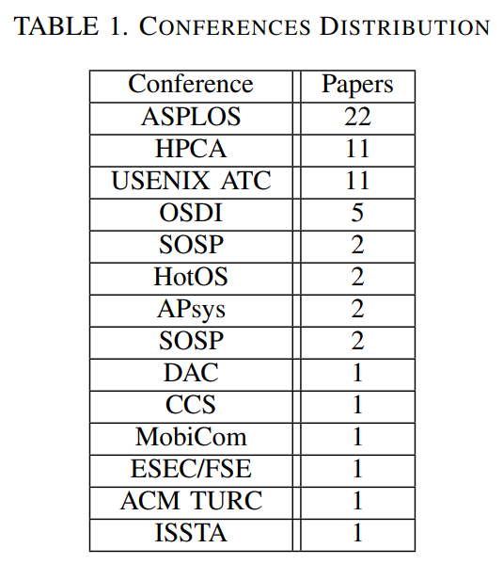
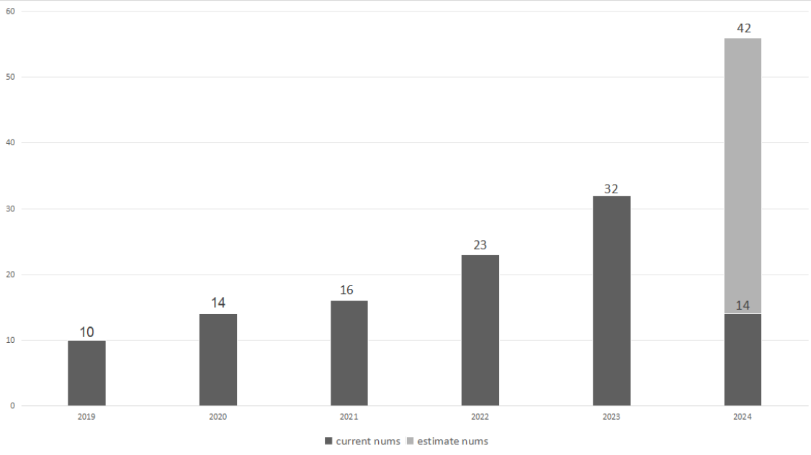
Paper Analysis
Time
Conference
Subjects: AI4OS(38), OS4AI(53), LLM AS OS(9) and LLM4OS(8).
Notes:
After analysisi,
in the view of published years, the related community are becoming large and the paper number in exponential growth.
Journals and conferences are also listed , the selection criterion is how many times they appear in our paper pool. International Conference on Architectural Support for Programming Languages and Operating Systems(ASPLOS) is the most prevalent conference.
as for subjects, ai4os, os4ai, llm as os, llm4os are 38, 53, 9 and 8 respectively. as the llm become more and more popular, the paper number ditribution maybe totally diffrent in the next 3 years

Slide 12
Outline
Introduction (15 min)
Statistically Analyze the Selected Papers (5 min)
How LLMs create opportunities for OS? (20 min)
LLM AS OS
LLM4OS
Opportunities for Future Work (10 min)
LLM AS OS
LLM4OS
Q&A (5 min)
Notes:
next, we focus on more detailed information and papers about the oppotunities for OS and existiing works, we will talk about it in two parts, namely, LLM as OS and LLM4OS respectively

Slide 13
LLM AS OS
LLM AS OS: Integration of LLMs into the core of an OS, effectively serving as the brain of the system,make OS capable of understanding and responding to natural language commands, thereby enabling more intuitive and flexible human-computer interaction.
Notes:
”LLM AS OS” refers to the integration of LLMs into the core of an OS, effectively serving as the ”brain” of the system,make OS capable of understanding and responding to natural language commands, thereby enabling more intuitive and flexible human-computer interaction

Slide 14
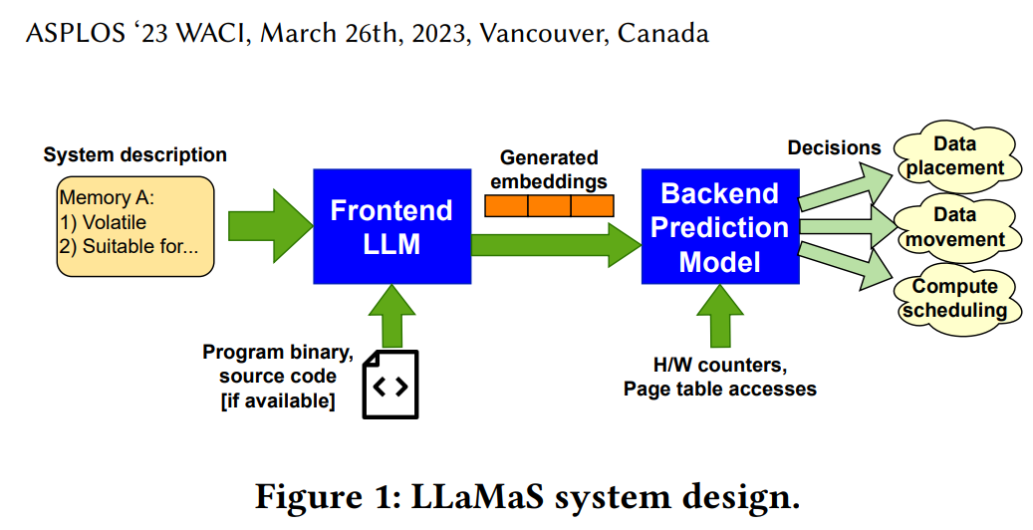
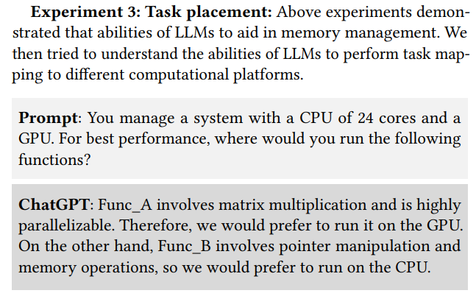
LLM AS OS (LLaMaS: Simulator and Optimizer)
https://arxiv.org/abs/2401.08908
Notes:
LLaMaS[54] addresses the complexities of diverse computing environments by leveraging LLMs to ease OS challenges in hardware adaptation and resource management.
It adapts to new devices by interpreting plain texts, recommending optimized OS tactics.
The LLM frontend deciphers system characteristics, converting them into actionable embeddings.
The backend uses these for on-the-fly OS decisions, like memory tier data movement.
An experiment with ChatGPT demonstrated its skill in adjusting memory allocation for CPU and GPU tasks based on usage.

Slide 15
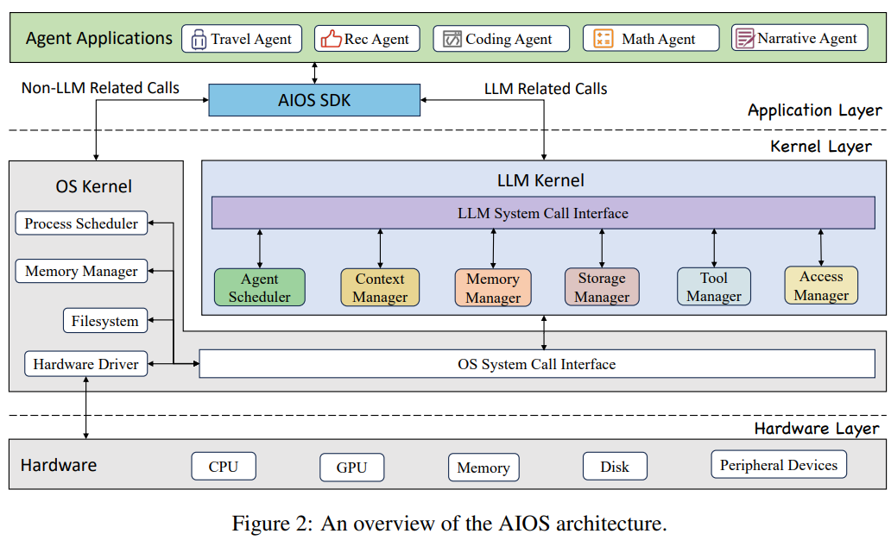
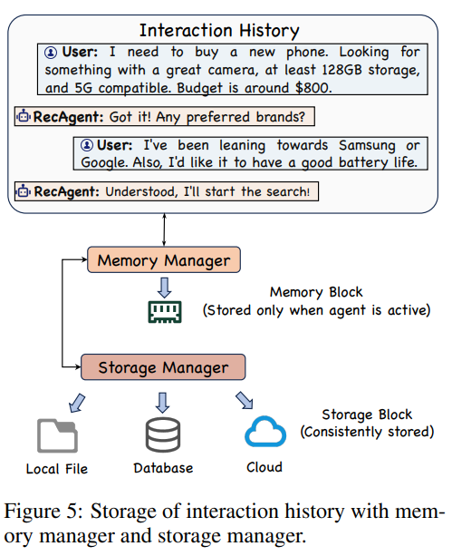
LLM AS OS (AIOS-Agent: Simulator and More Natural )
https://arxiv.org/pdf/2403.16971
Notes:
AIOS-Agent ecosystem[55][56], where LLMs act essentially as an ”operating system with soul”.
LLMs are embedded in the OS kernel for intelligent decision-making and resource allocation.
Its context window acts as memory, managing relevant data, while external storage serves as a file system with enhanced retrieval capabilities.
Hardware and software are treated as libraries, enabling agent-environment interaction.
Natural language becomes the primary programming interface

Slide 16
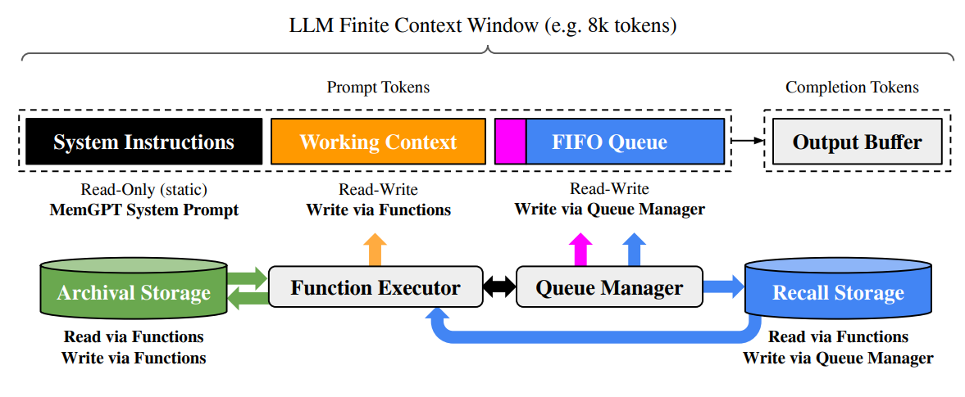
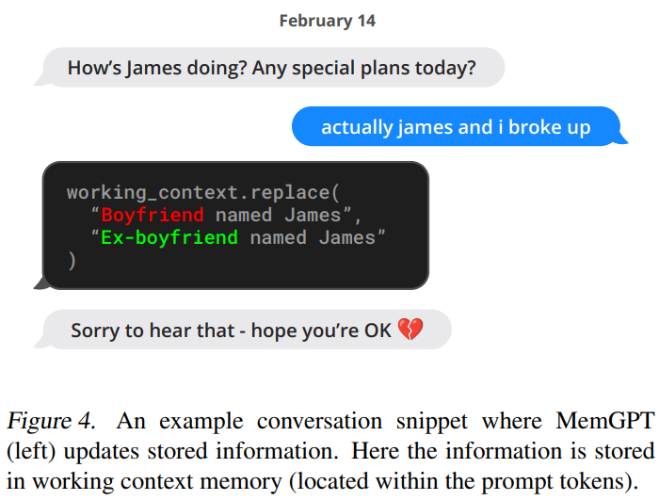
LLM AS OS (MemGPT: Simulator and Longer)
https://arxiv.org/pdf/2310.08560
Notes:
MemGPT[57] presents a solution to overcome the fixed-length context window limitation in LLMs
Drawing parallels with traditional OS memory systems, MemGPT introduces virtual context management.
It enables LLMs to access information beyond immediate capacity, mirroring OS memory management through strategic ’paging’.
This system reacts to events like user messages, system alerts, and timers.
Additionally, it supports function chaining for uninterrupted, sequential task executions.

Slide 17
Outline
Introduction (15 min)
Statistically Analyze the Selected Papers (5 min)
How LLMs create opportunities for OS? (20 min)
LLM AS OS
LLM4OS
Opportunities for Future Work (10 min)
LLM AS OS
LLM4OS
Q&A (5 min)
Notes:
next, we focus on LLM4OS

Slide 18
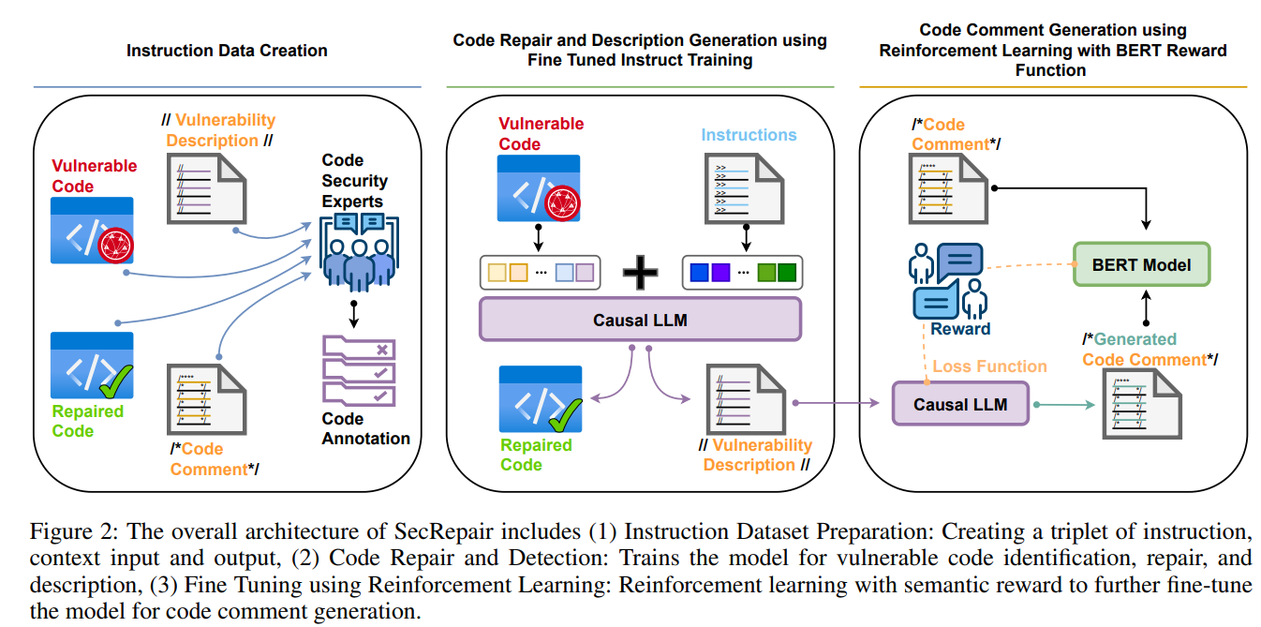
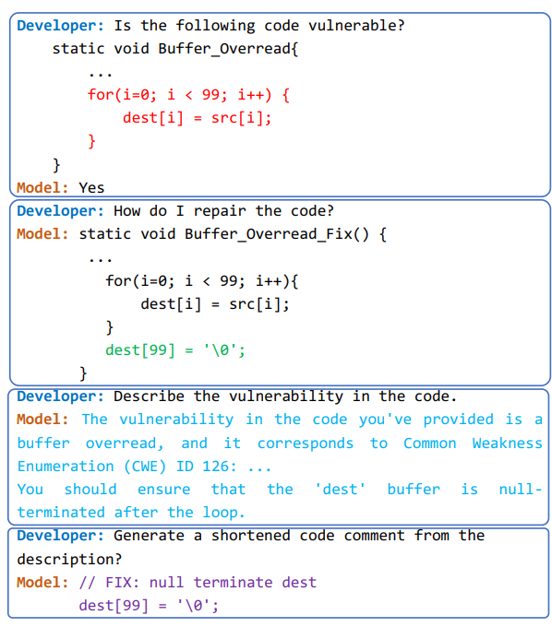
LLM4OS (SecRepair: Code vulnerabilities)
https://arxiv.org/pdf/2401.03374
Notes:
As for LLM4OS
SecRepair[58], designed to address the challenge of identifying and repairing code vulnerabilities in software development.
This system is powered by a LLM and incorporates reinforcement learning and semantic rewards to enhance its capabilities.
To support the training process and prepare a robust model for vulnerability analysis, the authors have compiled and released a comprehensive instruction-based vulnerability dataset.
They also propose a reinforcement learning technique with a semantic reward mechanism to generate concise and appropriate code commit comments.
This technique is inspired by how humans fix code issues and provides developers with a clear understanding of the vulnerability and its resolution.

Slide 19
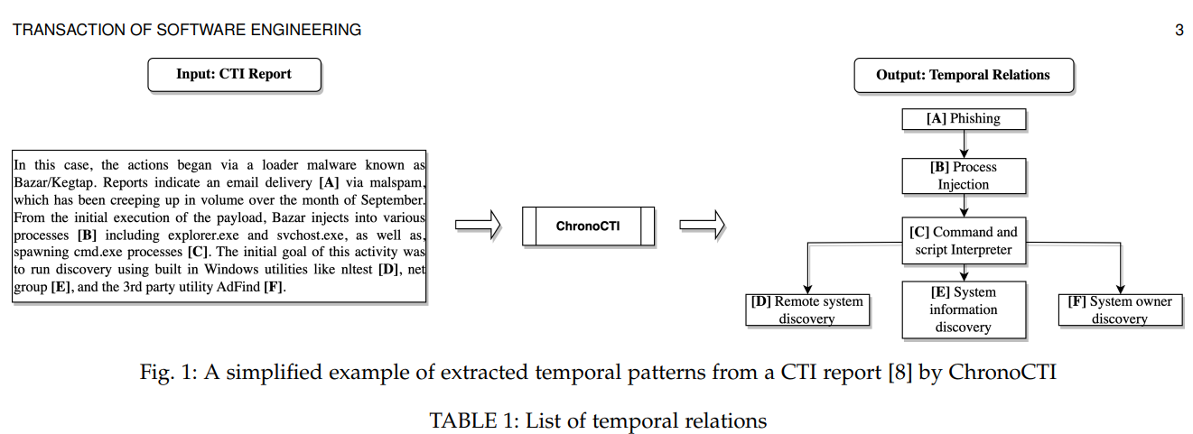
LLM4OS (ChronoCTI: Mining Temporal Attack Patterns from Reports.)
https://arxiv.org/pdf/2401.01883
Notes:
ChronoCTI, is an automated pipeline for mining temporal dynamics between attacker actions from text-based accounts of cyber incidents.
The focus is on pinpointing repetitive action sequences, termed temporal attack patterns.
ChronoCTI is anchored by a curated dataset linking sentences to temporal linkages across 94 attack narratives, and large language models refined on cybersecurity topics.
The research propose a structured approach, harnessing cutting-edge language models, NLP methods, and ML techniques to decipher the temporal structure within attack stories.

Slide 20
Outline
Introduction (15 min)
Statistically Analyze the Selected Papers (5 min)
How LLMs create opportunities for OS? (20 min)
LLM AS OS
LLM4OS
Opportunities for Future Work (10 min)
LLM AS OS
LLM4OS
Q&A (5 min)
Notes:
next, we will spend a little time talking about the opportunity for future work about os and LLM

Slide 21
LLM AS OS
Platform-Agnostic Adaptation
Natural Language Interface
Customized User Experience
Enhanced Security Measures
https://arxiv.org/pdf/2401.01883
Notes:
As for LLM AS OS direction, Future research in the domain of LLMs integrated as OS may focus on following areas.
First, LLMs’ inherent understanding of natural language empowers them to interpret a spectrum of system artifacts, from logs to hardware specs, irrespective of software platforms or hardware architectures. This capability facilitates dynamic OS parameter adjustment and context-aware optimization strategies.
Second, Integrating LLMs into the OS interface enables a conversational interaction model, replacing traditional interfaces with intuitive text-based requests.
Third, LLMs learn from user behavior and preferences, dynamically adjusting the OS interface and functionality to cater to individual needs.
But At the same time LLM can also contribute to OS security by analyzing data for threats, enforcing policies, and managing access. They can predict security incidents, provide real-time code analysis, and offer personalized security guidance

Slide 22
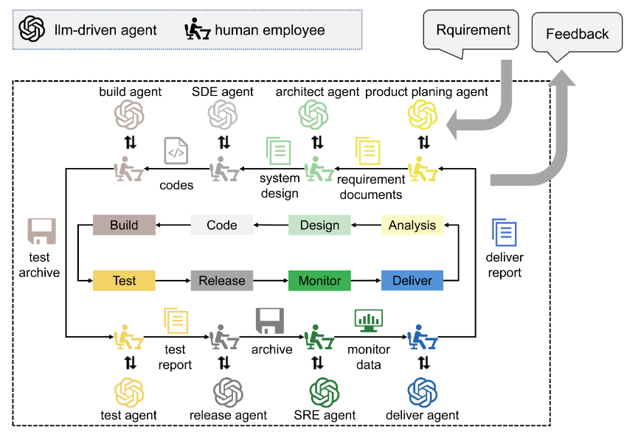
LLM4OS (Multi-agent LLM for OS Development)
Notes:
As for LLM4OS, one distinct domains where LLMs can potentially revolutionize the functioning and capabilities of OSes as Multi-agent LLM for OS Development.
As shown in Figure, in the realm of OS development, the integration of multi-agent systems fosters a specialized, collaborative, and flexible environment.
These agents facilitate knowledge exchange and consensus-building similar to human collaboration.
They concurrently tackle OS component in response to evolving project dynamics, and oversee integration, testing, and debugging phases, addressing potential issues.

Slide 23
Outline
Introduction (15 min)
Statistically Analyze the Selected Papers (5 min)
How LLMs create opportunities for OS? (20 min)
LLM AS OS
LLM4OS
Opportunities for Future Work (10 min)
LLM AS OS
LLM4OS
Q&A (5 min)
Notes:
That’s all for today’s presentation,

Slide 24
Thanks for listening
Q&A
Notes:
Thanks for listening, and any questions?

