Slide 1
Towards Ensuring Cloud Reliability Through Different Objectives 2024.10.22
Zhiqing Zhong
School of Data Science
Chinese University of Hong Kong, Shenzhen

Slide 2
Outline
Introduction (5 min)
Background & Motivation (15 min)
Proposed Methods & Performance Evaluation (20 min)
via software reliability
via hardware reliability
via network reliability
Summary (5 min)
Q&A (5 min)

Slide 3
Introduction
Background & Motivation
Proposed Methods & Performance Evaluation
Summary
Q&A

Slide 4
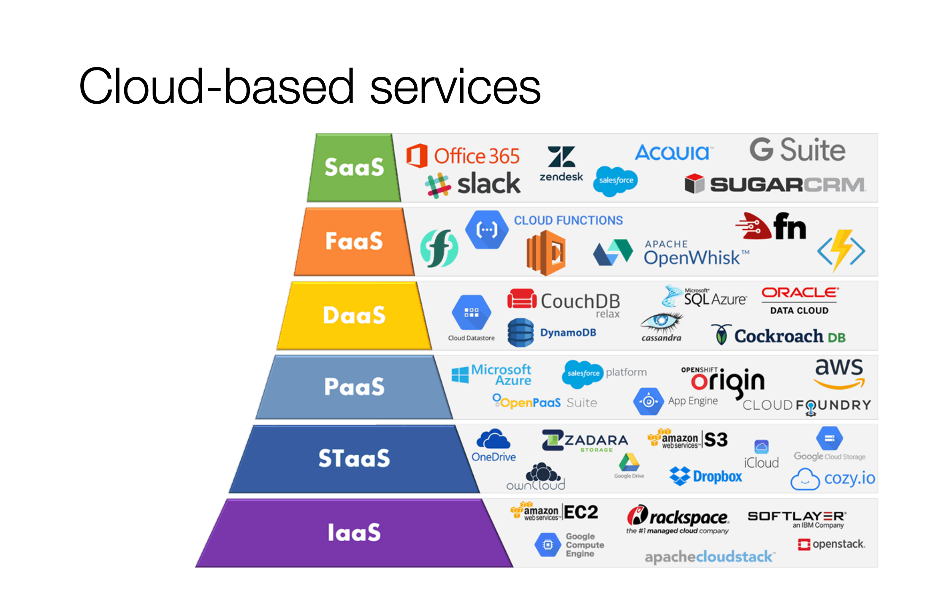
Introduction – What is cloud (1/3)
On-demand network access to a shared pool of configurable computing resources
Notes:
What computing resources denote?
Example: computing resources can be servers like AWS EC2 provided by Amazon,
storage services, like OneDrive by Microsoft, iCloud by Apple
applications

Slide 5
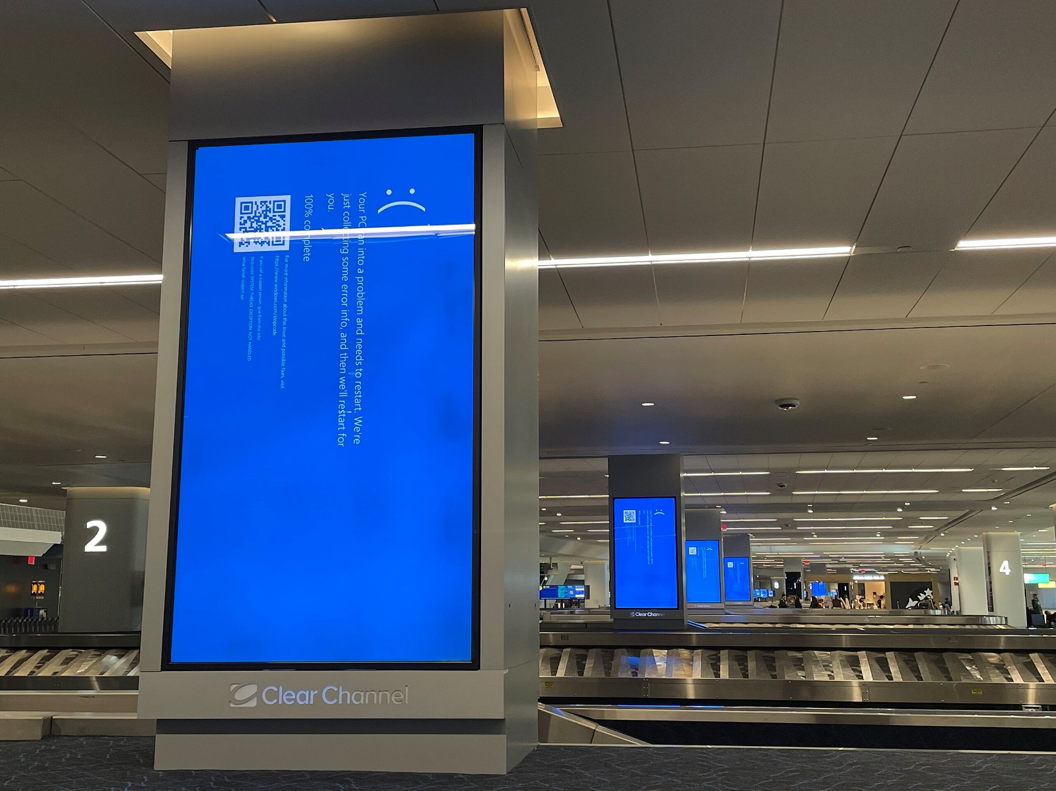
Introduction – Cloud Reliability (2/3)
US Fortune 500 companies face $5.4 billion in losses due to the CrowdStrike outage
Notes:
Since cloud is fundamental infrastructure in modern internet, it's reliability is important, can sometimes cause huge financial loss.
Recall the CrowdStrike outage few months ago.

Slide 6
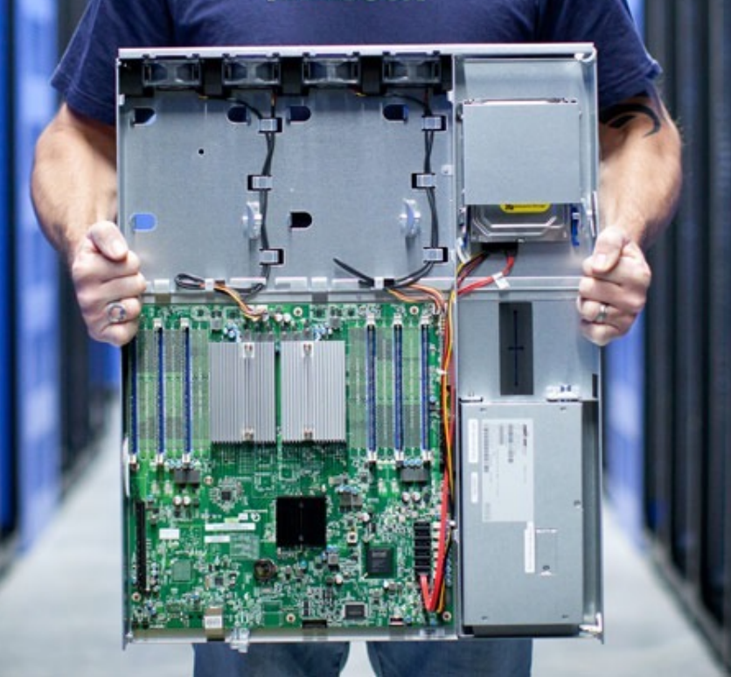
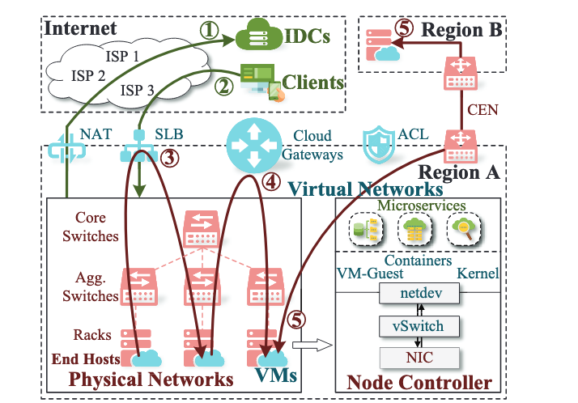
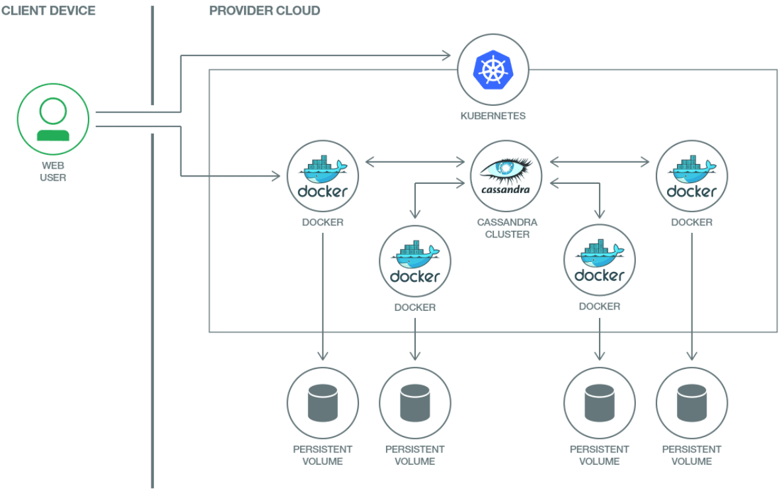
Introduction – Cloud Reliability (3/3)
Hardware failure
Network failure
Software failure
Huge cost on operations
Notes:
Cloud failures reveal in many forms, it can be hardware failure, network failure, and software failure, etc.
Cloud company spend huge expense on operating the cloud to ensure the reliability. For example, employing a huge operation team, replacing faulty component.
In following sections, I will introduce different techniques that enhance cloud reliability via software reliability, hardware reliability, and network reliability

Slide 7
Introduction
Background & Motivation
Proposed Methods & Performance Evaluation
Summary
Q&A
Notes:
Let's introduce some preliminaries.

Slide 8
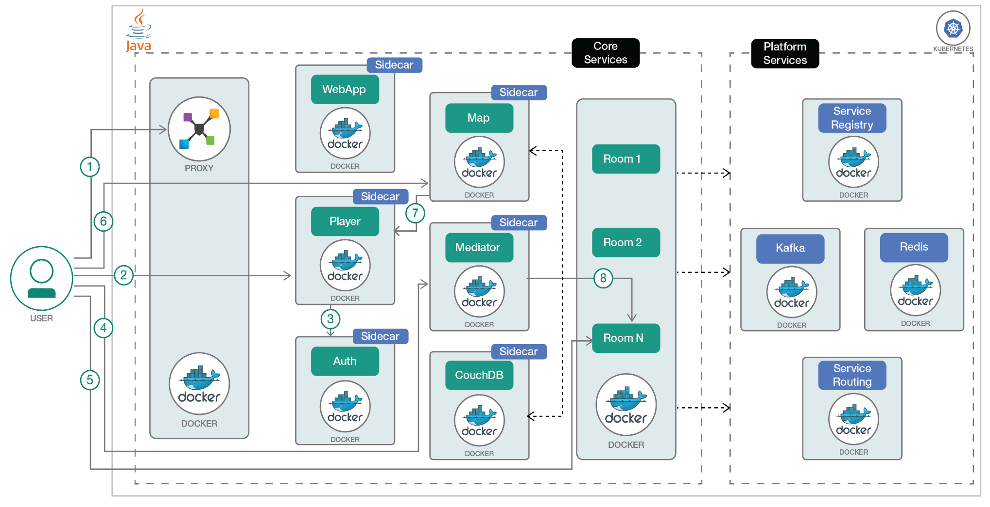
Background – Kubernetes (1/6)
Microservices architecture
Independently deployable
Loosely coupled
Kubernetes automates the deployment, scaling, and management of containerized applications
Notes:
Many modern cloud applications are structured in microservice style as a collection of two or more services that are independently deployable and loosely coupled.
Services are typically containerized as container images.
In order to implement a chat room, we have
this is a basic example of microservice applications
Kubernetes is an open source system that automates the deployment, scaling, and management of containerized applications anywhere.
The difference between docker and Kubernetes is that docker lets you put everything you need to run your application into a box that can be stored and opened when and where it is required. Once you start boxing up your applications, you need a way to manage them; and that's what Kubernetes does.

Slide 9
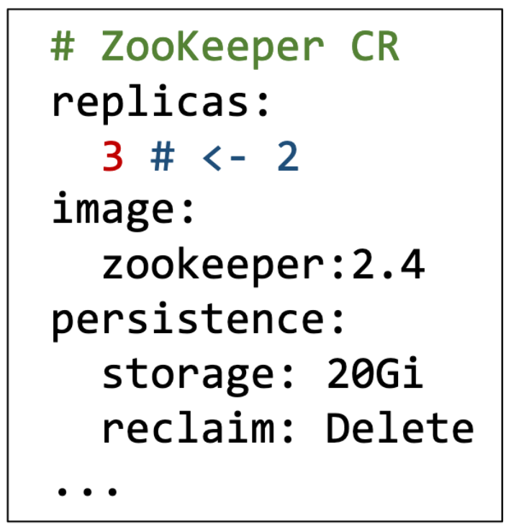
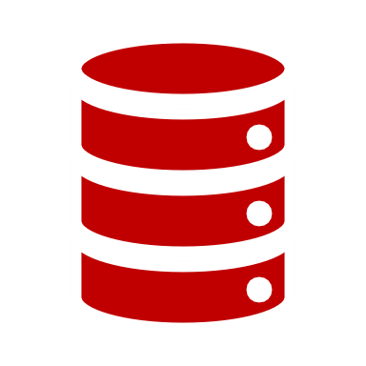
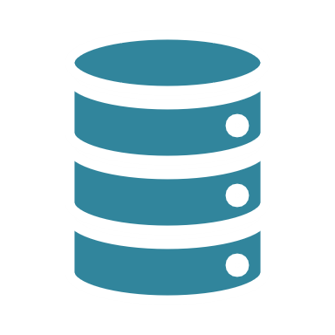
Background – Kubernetes Operators (2/6)
Operators for modern cloud management platforms follow a declarative, state-reconciliation design pattern.
Upscale ZooKeeper
ZooKeeper Operator
State Objects
Kubernetes Core
Managed ZooKeeper
Statefulset Controller
Pods:
Pod
Pod
Vols:
Volume Controller
Vol
Vol
…
…
…
Notes:
What is Kubernetes operator? Kubernetes offers limited initial functionality to ensure flexibility and scalability. K8s Operators are software extensions that make use of Kubernetes APIs to use custom resources to manage applications and their components.
Operation programs (i.e., operators) for modern cloud management platforms like Kubernetes, and ECS follow a declarative, state-reconciliation design pattern.
what is state? What (custom resources) CR is? How CRs works? Let’s take ZooKeeper as an example…
Modern cloud management platforms based on state reconciliation like this.
However, since the lack of end-to-end testing on Kubernetes operators, it sometimes fail to reconcile to desired state as declared in CR and fail to recover from error-state.

Slide 10
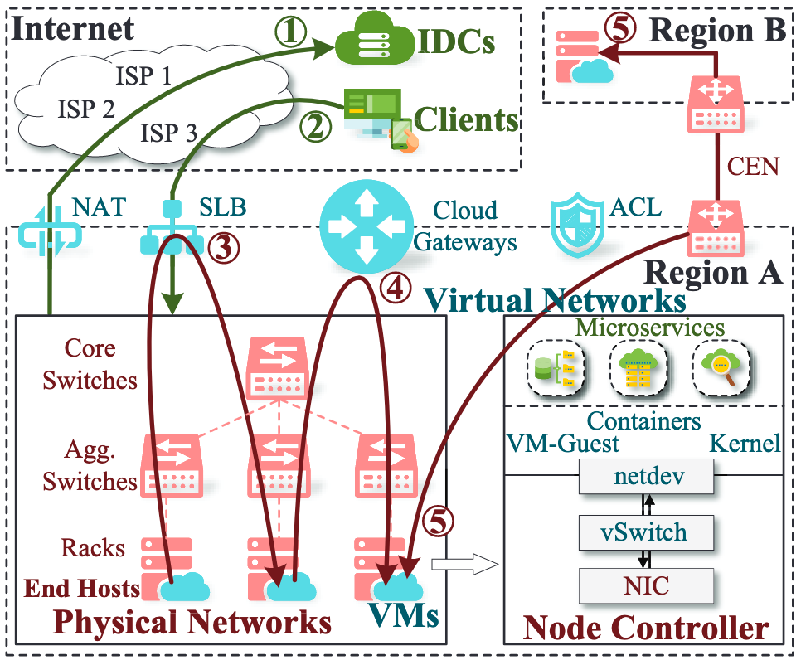
Background – Network Traffic (3/6)
Cloud services actively access internet data centers (IDCs)
User client request services hosted by the cloud
Cloud services access other intranet services via SLB
Cloud services access each other directly forwarding gateways
Cloud services access each other cross regions
Notes:
There are five common scenarios of cloud traffic
1. xxx

Slide 11
Background – Network Monitoring (4/6)
Monitoring and diagnostic tools are built at each layer
Lack a unified monitoring/diagnostic system
Notes:
The complex layered architecture poses great challenges to the operation of cloud services — anomalies may happen at each layer. The operation teams at each layer have built abundant monitoring and diagnostic tools including end-host monitors, virtual network or physical network probings/telemetries,to quickly detect and locate anomalies.
Currently, the efficiency of anomaly routing to a blamed layer is still low, with multiple attribution teams and complex traffic scenarios involved
Nevertheless, we still lack a unified monitoring/diagnostic system that can assess the impact of anomalies/failures at a microservice level, quickly route anomalies to attribution teams, and cover the entire cloud with low overheads.

Slide 12
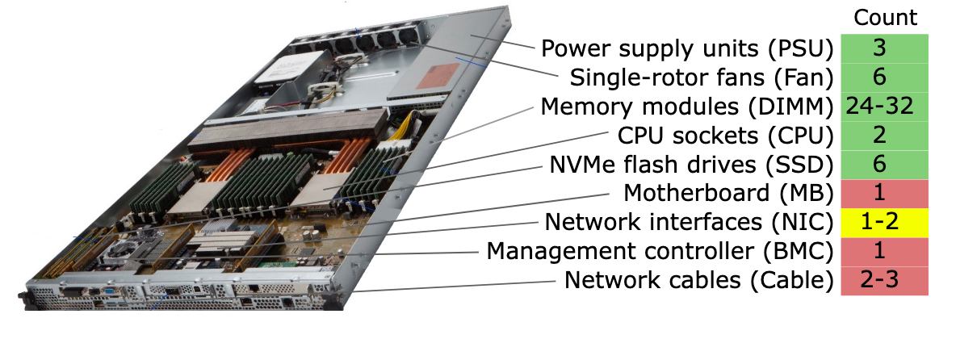
Background – Hardware (5/6)
0.1% per DIMM, 0.2% per SSD, 22% of servers will have at least one failure during the typical 6-year lifetime
Notes:
A typical server consists of xxx.
It is reported that xxx

Slide 13
Background – Repair Workflow (6/6)
All-or-Nothing Repair workflow in Azure
Liquid cooling significantly increases the time and effort required to repair servers
Since servers staying in datacenters for longer, repair costs are increasing
Component supply chains have emerged as a barrier to extend server lifetimes
Human repair process can cause interruptions to nearby servers
Notes:
To check whether there is faulty component
A software agent called Server Health Monitor (SHM) checks server error logs and component types, counts, and capacity for deviations from the expected (homogeneous) configuration. If the SHM suspects any kind of fault, the server is marked as “offline”, which signals the VM scheduler to filter out this server. VMs are migrated away or gracefully evicted. The server is then rebooted into a diagnostics environment. If diagnostics finds a hardware problem, it immediately creates a repair ticket.
After the repair is finished, it goes through numerous test as certifications.
This type of operations is called all-or-nothing operating model because it stops the entire affected server.
It suffers from numerous limitations

Slide 14
Introduction
Background & Motivation
Proposed Methods & Performance Evaluation
Summary
Q&A
Notes:
And now, we have a basic understanding of the software, hardware, and network of the cloud, along with their limitations. We introduce the methods to enhance the cloud reliability from these three aspects.

Slide 15
Acto – Testing Kubernetes Operator (1/4)
Acto models an operation as a pair, $(S^{c}, D)$
$S^{c}$: Current state
$D$: Declaration (Constrained by CR definition in Kubernetes)
$S^{D}$: Declared state
$S^{e}$: Erroneous state
$$D$$
$$S^{c}$$
$$S^{D}$$
$$D_{i}$$
$$S^{c}$$
$$S^{e}$$
$$D_{i−1}$$
Notes:
First, we introduce Acto, an end-to-end testing framework on Kubernetes operators,which should enhance cloud reliability via software reliability
Before we start introducing the workflow of Acto, let me first introduce some simple notations
Acto models xx
If we apply an misoperation, which means the declaration we apply violates xxxx, then the state will transit to an erroneous state.
And the operator is responsible for rolling the erroneous state back to state right before applying the misoperation

Slide 16
Acto – Testing Kubernetes Operator (2/4)
$$S_{0}$$
$$D_{i}$$
$$S_{i}$$
$$S_{0}$$
$$D_{1}$$
$$S_{1}$$
$$D_{2}$$
$$S_{2}$$
…
$$D_{i}$$
$$S_{i}$$
…
Single operation
Operation sequence
$$D_{i−1}$$
$$S_{0}$$
…
$$D_{i−1}$$
$$S_{i−1}$$
$$D_{i}$$
$$S_{i}^{e}$$
$$S_{i+1}$$
…
$$D_{i+1}$$
Operation sequence with error-state recovery
Notes:
To test the operator, acto starts a test campaign and keep automatically generates a new declaration based on the current system state.
Acto uses 3 strategies to generate declarations
Single operation, it is applied to the initial state of the system, which is similar to existing manual tests
Operation sequences, which enables the test starts from any state.
Error-state recovery, which applies misoperations to the operator, then ,the operator is responsible for rolling back, and then apply Declaration d plus 1.
Generate state declarations and monitor explicit or implicit error

Slide 17
Acto – Testing Kubernetes Operator (3/4)
$$D_{i−1}$$
$$S_{0}$$
$$D_{1}$$
$$S_{1}$$
$$D_{2}$$
$$S_{2}$$
…
$$D_{i−1}$$
$$S_{i−1}$$
$$D_{i}$$
$$S_{i}^{e}$$
$$S_{i+1}$$
…
$$D_{2}$$
$$D_{i+1}$$
$$D_{i−1}$$
$$D_{i+1}$$
Notes:
Acto combines three paradigm together and run a test campaign. Test campaign means it won’t stop until the operator crashes or all property in CR are tested
As Acto applies operation sequence, it aslo applies single operation at the same time
After the operator is applied with misoperation and roll back, Acto keep applies next operations.

Slide 18
Acto – Testing Kubernetes Operator (4/4)
Checking whether $S_{i}$ satisfied $D_{i}$ is challenging
$$D_{i−1}$$
$$S_{0}$$
$$D_{1}$$
$$S_{1}$$
$$D_{2}$$
$$S_{2}$$
…
$$D_{i−1}$$
$$S_{i−1}$$
$$D_{i}$$
$$S_{i}^{e}$$
$$S_{i+1}$$
…
Differential Oracle
$$D_{2}$$
$$D_{i+1}$$
$$D_{i−1}$$
$$D_{i+1}$$
# State Object:
...
PodDisruptionBudget:
spec:
redis-follower:
(pdb) null
…
# Redis CR:
redisFollower:
pdb:
minAvailable: 2
…
Consistency Oracle
Notes:
If the operator doesn't reconcile the system the the desired state, which means S_i doesn't satisfy D_i, then Acto report an alarm.
checking whether xxx
so the authors comes up with two oracles
Differential oracle is based on the idea that given the same declaration, the operator should reconcile to the same states from different states
With this idea, Acto checks whether the operator reconcile to the same state from S_i-1 and S_0, and it also checks whether operator rolls back to the same state as it was after reaching to an error-state
Consistency oracle: Some bugs occur if an operator stops reconciliation because the system is in state Si satisfies D in the operator’s view, but Si does not satisfies D in the management platform’s view. To detect such bugs, Acto additionally checks whether the management platform’s view matches D
While the property is available in operators, the property in Di is not consistent with Kubernetes’ view of Redis followers, in which there is no pdb. The root cause is that OCK/RedisOp was missing code to support pdb for followers, this is common as software evolves

Slide 19
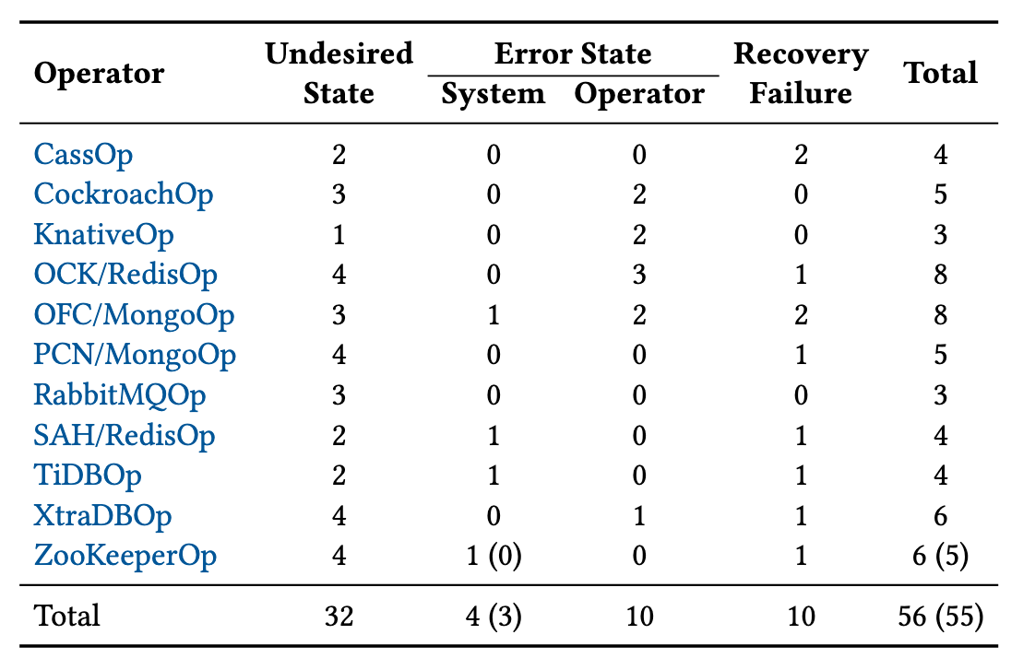
Evaluation – Acto (1/1)
56 real bugs
No false positive
Most can be finished in 8 hours
Notes:
Acto finds 56 new bugs in eleven operators, 42 bugs have been confirmed, 30 have been fixed.
Among the 2243 reported test failures, there is no false alarm
Most of the test campaigns started by Acto stopped in 8 hours. Which means all the property in the CR is covered.

Slide 20
AND – Diagnosing Network System (1/3)
Monitoring single metric: TCP retransmission (retx)
Retx inherently exists in in-band traffic and correlate applications
Notes:
To quickly routing network failures, researchers has designed and deployed an system, namely AND, to the Alibaba cloud
AND exploits the single metric of TCP retransmission (retx for short) to capture anomalies at microservice levels and correlates applications with network end-to-end
The key insight is that retxs are effective signs of anomalies, inherently exist in in-band traffic, and correlate applications to fundamental platforms and infrastructure end-to-end.

Slide 21
AND – Diagnosing Network System (2/3)
Notes:
First AND extracts retxs at the microservice level via nBPF, a eBPF based collecting tool. Specifically, nBPF monitors SYN retxs during connection establishment, which indicates that applications cannot establish service. Additionally, nBPF only extracts RTO retxs for established connections (around 0.1%)
Then AND perform a real-time detection procedure to extract anomalies from “noisy” retxs.
the feature values are obtained by differencing real-time counters with prediction values of“noises”. Second, the feature values are penalized and scaled according to the stability and seasonality of the time series. For example, time series that exhibit unstable/unpredictable ‘noise’ can hardly extract true anomalies and are prone to be penalized
In step 3, AND develop an anomaly routing model to delimit anomalies among multiple target teams

Slide 22
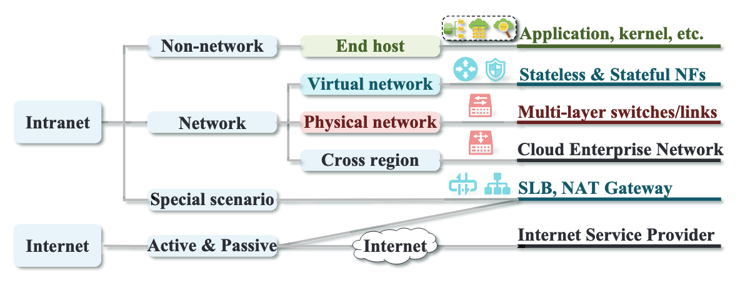
AND – Diagnosing Network System (3/3)
Hierarchical Diagnostic Mechanism
Notes:
Specifically, in step 3,
AND uses a hierarchical diagnostic mechanism to narrow the scope of problems step-by-step. First, AND distinguishes anomalies between intranet and internet traffic in the collecting phase. AND thus avoids interference from the unstable network environments of the internet in anomaly routing. After that, AND routes anomalies among networks, non-networks (end hosts, applications, etc.) and special scenarios like SLB/NAT/Internet. Finally, AND analyzes the location and root cause of anomalies by correlating domain-specific metrics and monitors

Slide 23
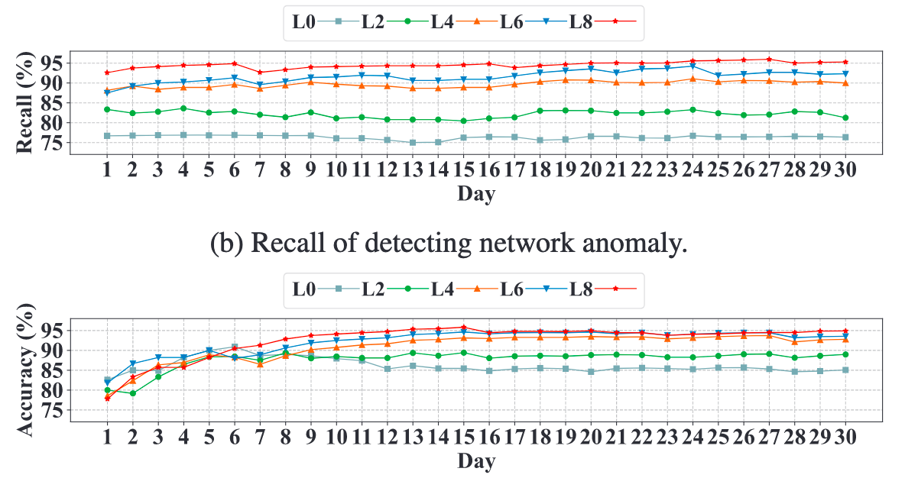
Evaluation – AND (1/2)
The performance of AND after retraining and iteratively deploying model everyday
75% - 96% recall
85% - 96% accuracy
Notes:
Each day the anomaly detection and diagnostic model evolve with new training data.
Subsequently, after xx

Slide 24
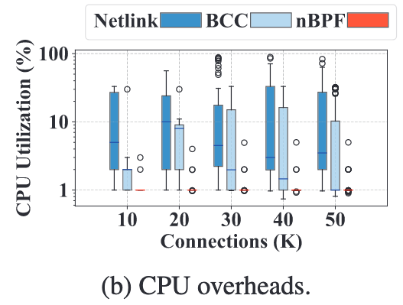
Evaluation – AND (2/2)
CPU overheads of nBPF keep around or below 1%
Notes:
They compare the CPU overheads of nBPF with end-host monitoring tools. Existing works collect connection-/packet-level metrics at end hosts. For example, they adopt Netlink to collect TCP info from the kernel. The burst loads easily cause a full occupation of a single CPU core. The BCC tools monitor TCP connections using eBPF and reduce the overheads compared to Netlink, however, the peak CPU utilization still exceeds 10%. As a comparison, the CPU overheads of nBPF keep around or below 1%, because nBPF only collects retxs events with dedicated optimizations like filtering/sampling, zero-copy collecting, etc.

Slide 25
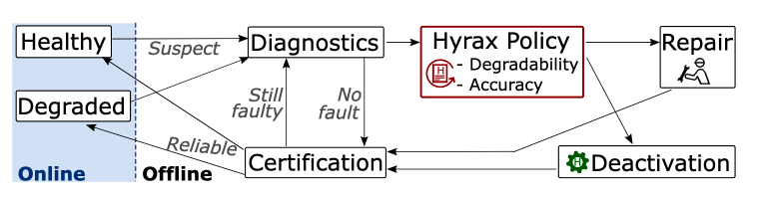
Hyrax – Fail-in-place Paradigm (1/1)
Fail-in-place paradigm: servers with faulted components continue to host VMs without requiring repairs
Performance: Achieve the same peak performance
Efficiency: Effectively use the capacity on degraded servers
Capacity: Satisfy a region’s demand for VM resources
Majority of hardware repair tickets are due to the failure of degradable components
Notes:
Regarding the hardware limitations, current all-or-nothing paradigm suffers from many limitations. Hence, researcher from Microsoft designed a systems called Hyrax to implement a fail-in-place paradigm where servers with faulty components continue to host VMs without requiring repairs.
A fail-in-place paradigm should satisfy several constraints:
The key insight is that: the majority of hardware repair tickets are due to the failure of degradable components, which indicates that the server with degraded components can still be utilized
After a server is marked as suspect, results from Diagnostics are used by the Hyrax Policy to decide whether to degrade or repair. This policy applies first filters for degradable component types. Second, it verifies that diagnostics points to a specific pathway within this component type. Third, it applies a threshold on how many components of each type can be degraded. Degraded servers are created by deactivating the faulty component pathway
Degraded servers are created by deactivating the faulty component pathway. Repairs are scheduled for undegradable component types, when diagnostics cannot identify the faulty component pathway, or if deactivation would cross the policy’s threshold
Currently, Hyrax implements 3 pathways separately for Memory, SSD, and Fan, which are considered as degradable components

Slide 26
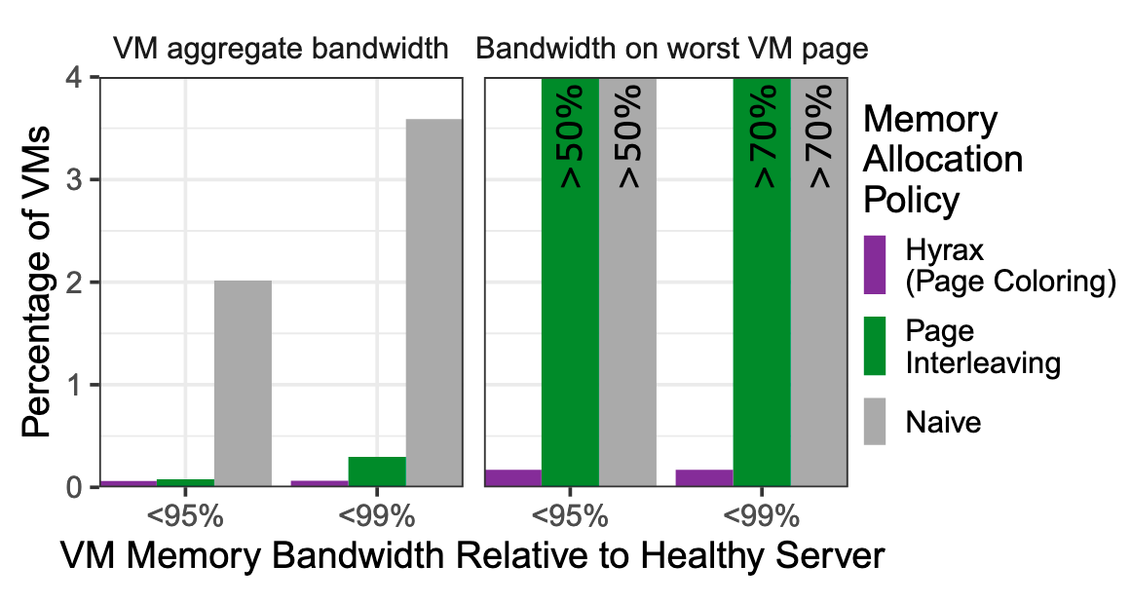
Evaluation – Hyrax (1/2)
Almost the same VM memory bandwidth on degraded nodes as VMs would on healthy servers

Slide 27
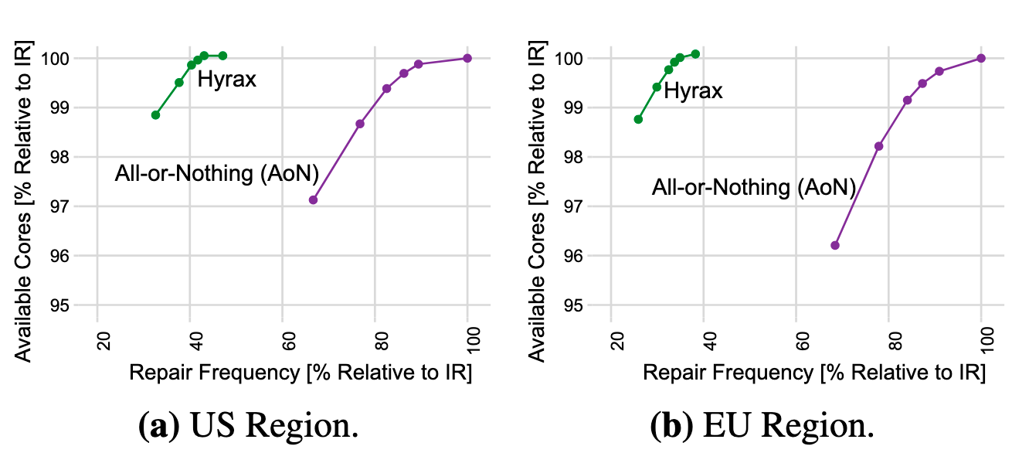
Evaluation – Hyrax (2/2)
Fail-in-place paradigm reduces repair frequency compared to All-or-Nothing paradigm
Notes:
The authors evaluate Hyrax on a subset of Azure clusters.
Furthermore, Hyrax reduces replacement rates by 40% for fans, 50% for SSDs, and 75% for memory, which enables extending server lifetimes for multiple years to amortize server costs and carbon emissions

Slide 28
Introduction
Background & Motivation
Proposed Methods & Performance Evaluation
Summary
Q&A

Slide 29
Summary
Cloud reliability can be enhanced via
Enhancing software reliability (testing Kubernetes operators)
Enhancing hardware reliability (fail-in-place paradigm)
Enhancing network reliability (diagnosing network system)
Notes:
Acto an end-to-end testing framework for Kubernetes operators which tests whether Kubernetes operators can reconcile to the desired state and recover from misoperation
Hyrax a fail-in-place paradigm that enables servers with faulted components continue to host VMs without requiring repairs.
AND an end-to-end application-network diagnosing system exploiting a single metric of TCP retx.
All three systems are deployed in the real-world cluster in the industry.

Slide 30
Thanks for listening
Q&A

