Slide 1
Serverless: Making Your Computing Quantifiable
2024.10.17
Changyue Li
School of Data Science
Chinese University of Hong Kong, Shenzhen

Slide 2
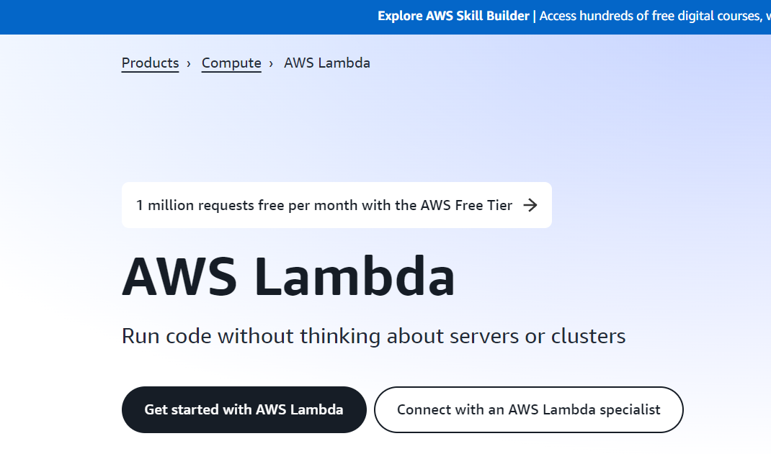

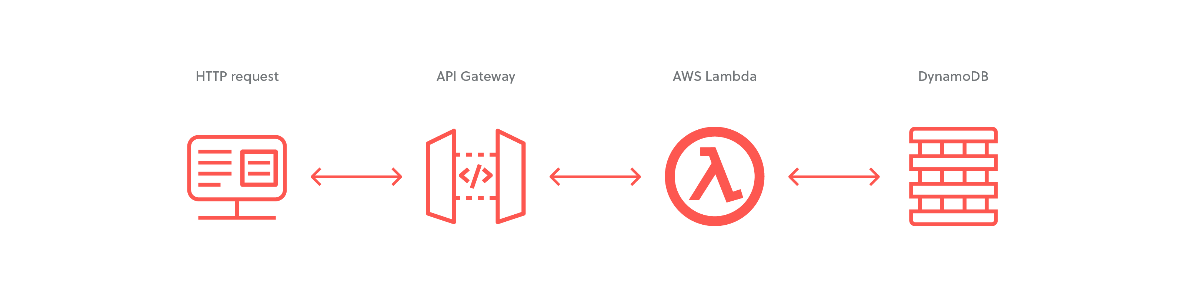
What am I going to talk?
How to deploy serverless
√
An introduction to serverless
√
Main research focuses of serverless

Slide 3
Outline
Introduction to Serverless
  Why Serverless?
  How Serverless Works?
Challenges and Research Questions
Current Solutions
Conclusion and Discussion

Slide 4
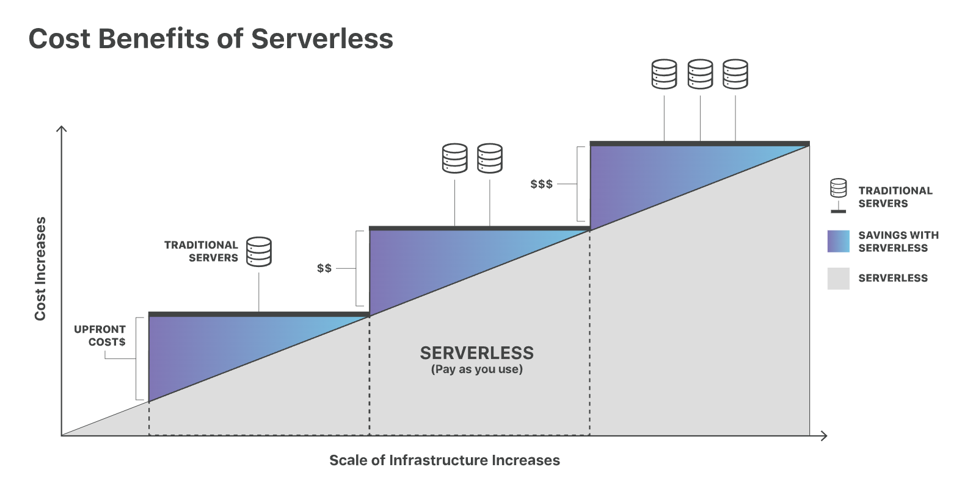
Introduction
Serverless is a cloud-native model that enables developers to focus on building and running applications without having to manage servers
Service is automatically expanded
Pay based on the amount of computing
Making Your Computing Quantifiable
Notes:
For example, I just want to print hello world but I need to buy a server.
Serverless allows users to pay based on the amount of computing. As service is automatically expanded, there is no need to reserve and pay for a fixed amount of bandwidth or servers.

Slide 5
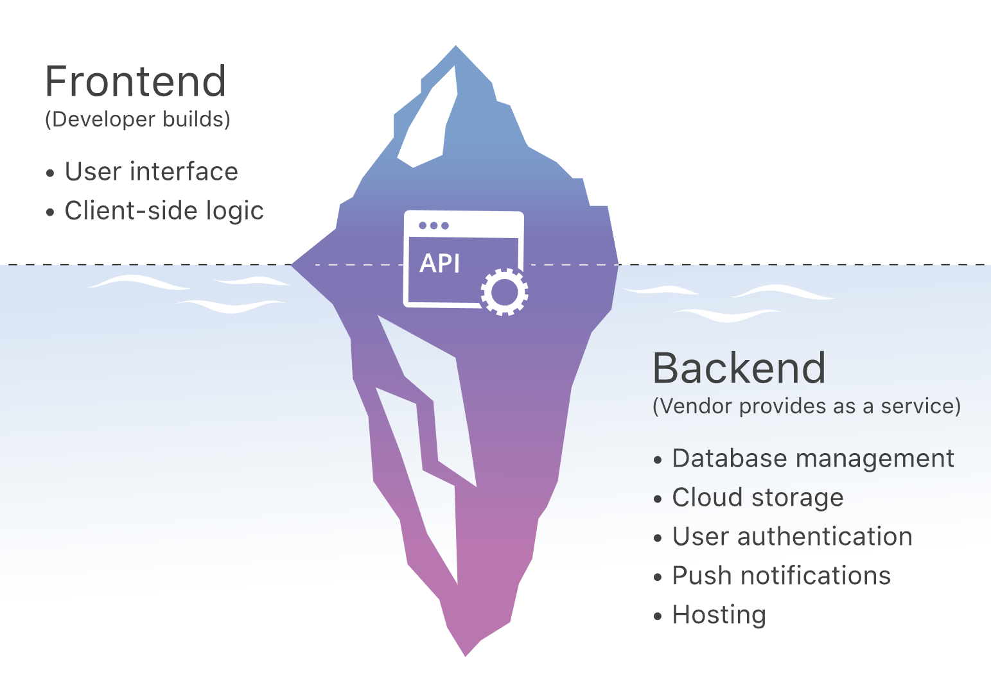
Introduction
Two main components:
  Backend as a Service (BaaS) : customized cloud services
  Function as a Service (FaaS) : stateless, event-driven serverless functions
Applicable scenarios:
  Asynchronous （异步）, stateless applications that start instantly
  Infrequent or drastic changes in requests
Notes:
BaaS represents customized cloud services provided by cloud providers, such as cloud storage and notification services. These services can choose to provide FaaS services to simplify the development of backend functions for developers.
FaaS means that developers can write stateless, event-driven serverless functions, allowing them to focus on the logic of serverless applications.
For example, there is a preprocessing task for images, which may not run frequently, but from time to time a large number of images will arrive at one time.
Asynchronous：don't need to wait other programs’ results

Slide 6
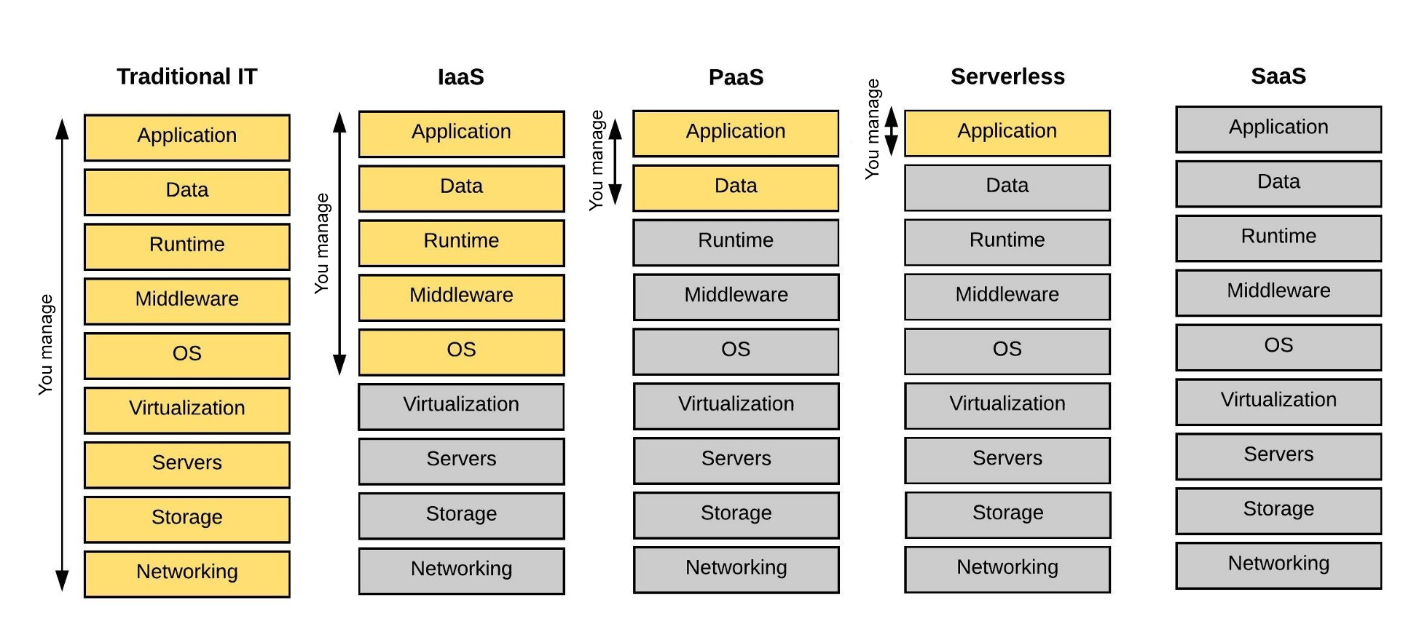
Why Serverless?
Serverless computing offers many advantages over traditional cloud-based or server-centric infrastructure.
Greater Scalability
Greater Flexibility
Faster Release Time
Lower Cost
With serverless architectures, developers don't have to worry about purchasing, provisioning, and managing backend servers.
Notes:
Serverless computing offers many advantages over traditional cloud-based or server-centric infrastructure. For many developers, serverless architectures offer greater scalability, greater flexibility, and faster time to release at a lower cost. With serverless architectures, developers don't have to worry about purchasing, provisioning, and managing backend servers. However, serverless computing isn't a panacea for all web application developers.
Serverless architecture and containers are similar in that they both give developers the flexibility they need to build applications with less overhead. There are use cases for each. However, cloud computing is more cost-effective and offers more scalability.
I think the development of Large Language Models sheds the light on the SaaS.

Slide 7
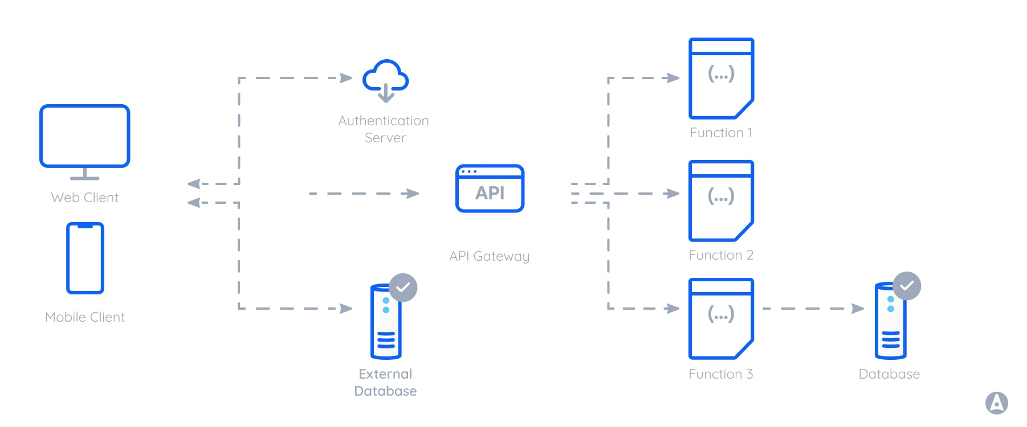
How Serverless Works?
Serverless architecture is a cloud computing model where the cloud provider manages the infrastructure and dynamically allocates resources as needed.
Notes:
These datasets are typically stored in external data sources like databases, object storage, or APIs. Serverless functions can access and manipulate this external data during their execution, enabling them to perform more complex tasks or retrieve specific information as needed.

Slide 8
Outline
Introduction to Serverless
Challenges and Research Questions
  1. Cold Start Performance
  2. Resource Management
Current Solutions
Conclusion and Discussion
  3. Programming Framework
  4. Security
Notes:
Now, we focus on four aspects of Serverless, that is cold start performance, resource allocation, function communication, resource allocation and security. There are also some other factors we should pay attention to, such as monitoring, debugging, and programming framework, but at present we don’t analysis them.
In this section, I will introduce the concept of current challenges and research questions.

Slide 9
Cold Start Performance
Serverless platforms can automatically scale function instances according to the application workload
However, scaling makes incoming new requests face the cold start problem, which takes a long time to prepare required runtime environments from scratch
Prewarm preparation
Efficient scheduling
Lightweight structure
Pawel Zuk and Krzysztof Rzadca. 2020. Scheduling methods to reduce response latency of function as a service. In Proceedings of the 2020 IEEE 32nd International Symposium on Computer Architecture and High Performance Computing. 132–140.

Slide 10
Resource Management
Resource management is responsible for allocating the proper resource provision for serverless functions and scheduling serverless functions on appropriate function instances.
This process guarantees software developers’ and cloud providers’ quality of service requirements.
Dynamical adjustment
Fine-grained architecture
Effective measuring and prediction
Young Ki Kim, M Reza HoseinyFarahabady, Young Choon Lee, and Albert Y Zomaya. 2020. Automated fine-grained cpu cap control in serverless computing platform. IEEE Transactions on Parallel and Distributed Systems 31, 10 (2020), 2289–2301.

Slide 11
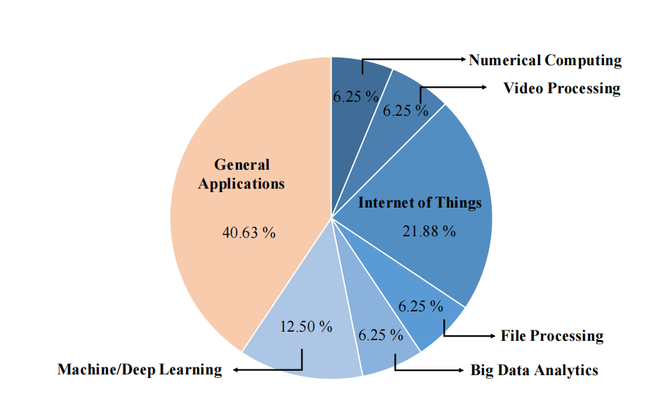
Programming Framework
Serverless computing has been applied to various specific scenarios
Different scenarios may pose new challenges for serverless computing
Specific Framework Design
General Framework Design
Jinfeng Wen, et al. Rise of the planet of serverless computing: A systematic review. ACM Transactions on Software Engineering and Methodology, 2023.

Slide 12

Security
Serverless computing can reduce the attack surface, since maintaining and patching up the security loopholes is assigned to the cloud providers.
Information flow tracking
Safe design
Arnav Sankaran, Pubali Datta, and Adam Bates. 2020. Workflow integration alleviates identity and access management in serverless computing. In Proceedings of the Annual Computer Security Applications Conference. 496–509.

Slide 13
Outline
Introduction to Serverless
Challenges and Research Questions
Current Solutions
Conclusion and Discussion
Notes:
Now, we focus on four aspects of Serverless, that is cold start performance, resource allocation, function communication, resource allocation and security. There are also some other factors we should pay attention to, such as monitoring, debugging, and programming framework, but at present we don’t analysis them.
In this section, I will introduce the concept of current challenges and research questions.

Slide 14
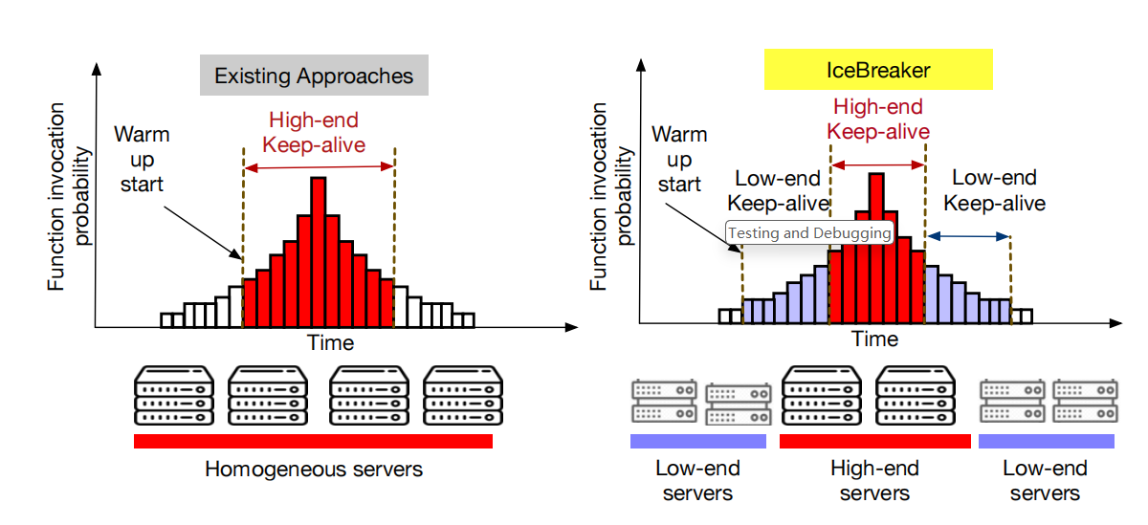
Cold Start Performance: Icebreaker
Employ heterogeneity (异质) to reduce the keep-alive cost and service time
Rohan Basu Roy, Tirthak Patel, and Devesh Tiwari. Icebreaker: Warming serverless functions better with heterogeneity. Proceedings of the 27th ACM International Conference on Architectural Support for Programming Languages and Operating Systems (ASPLOS). 2022

Slide 15
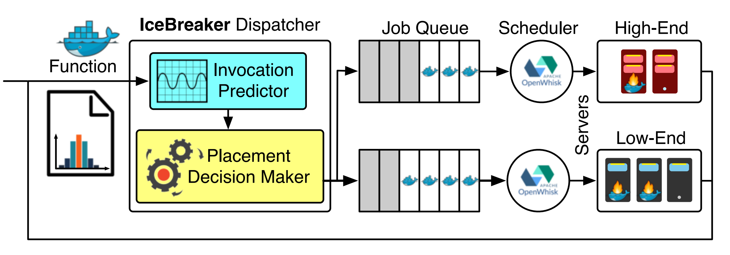
Cold Start Performance: Icebreaker
Predict if a function will be invoked within a particular time interval
If invoked, decide where to warm up a function
Rohan Basu Roy, Tirthak Patel, and Devesh Tiwari. Icebreaker: Warming serverless functions better with heterogeneity. Proceedings of the 27th ACM International Conference on Architectural Support for Programming Languages and Operating Systems (ASPLOS). 2022

Slide 16
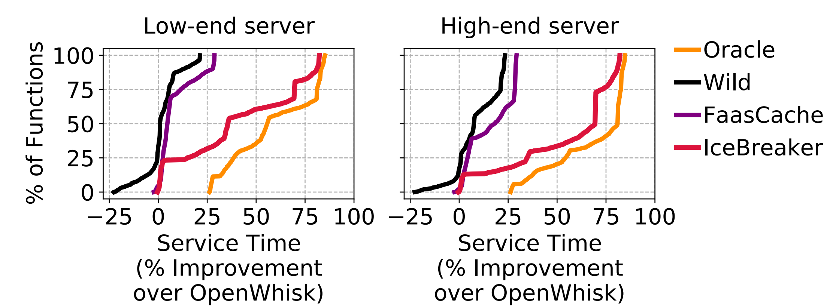
Cold Start Performance: Icebreaker
IceBreaker improves the service time on both low-end servers and high-end servers.
Rohan Basu Roy, Tirthak Patel, and Devesh Tiwari. Icebreaker: Warming serverless functions better with heterogeneity. Proceedings of the 27th ACM International Conference on Architectural Support for Programming Languages and Operating Systems (ASPLOS). 2022

Slide 17
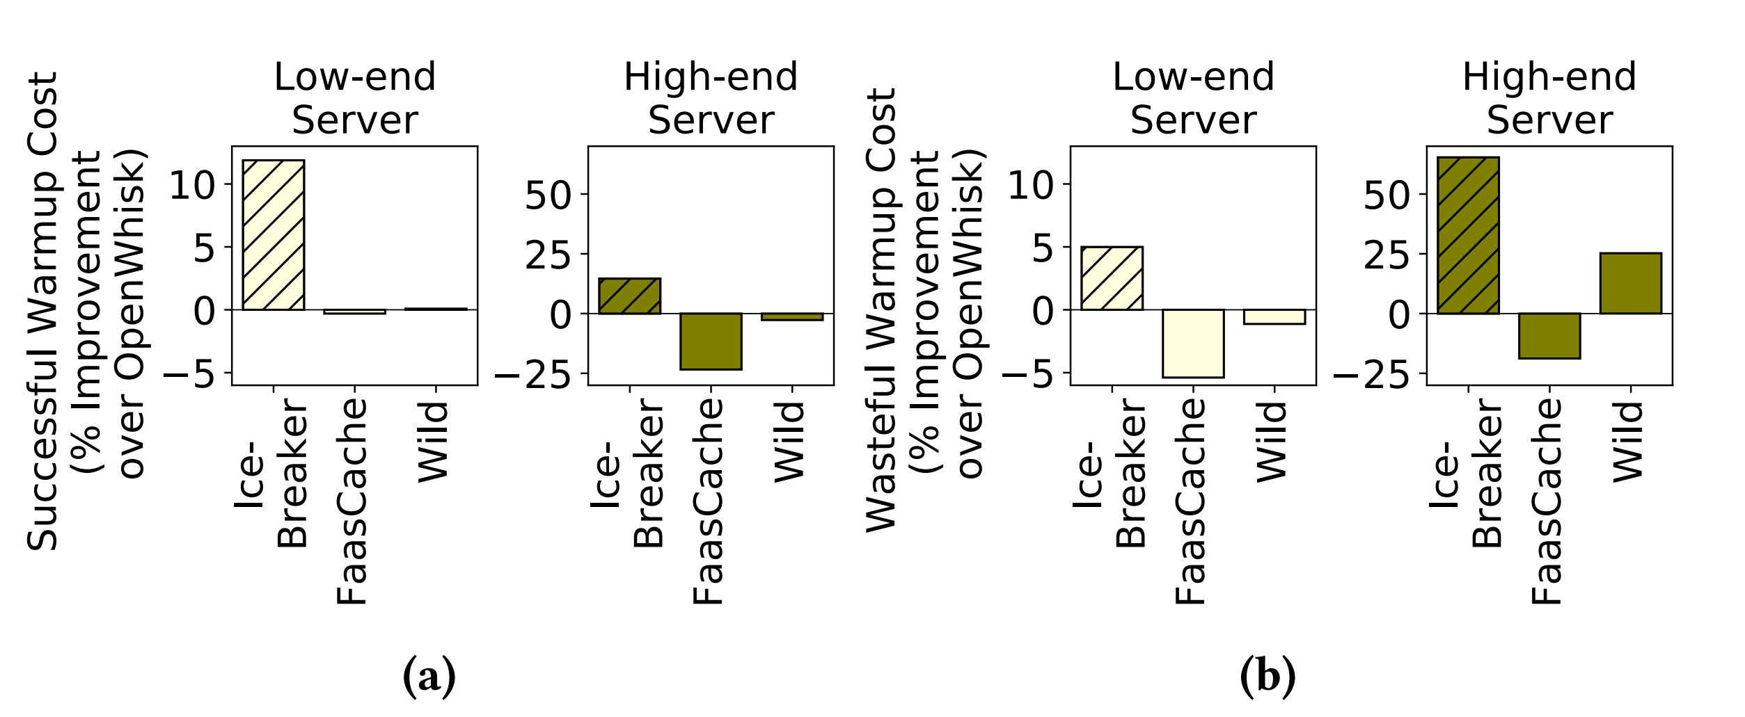
Cold Start Performance: Icebreaker
IceBreaker reduces the cost of successful, and wasteful warm-ups on both high- and low-end servers.
Rohan Basu Roy, Tirthak Patel, and Devesh Tiwari. Icebreaker: Warming serverless functions better with heterogeneity. Proceedings of the 27th ACM International Conference on Architectural Support for Programming Languages and Operating Systems (ASPLOS). 2022

Slide 18
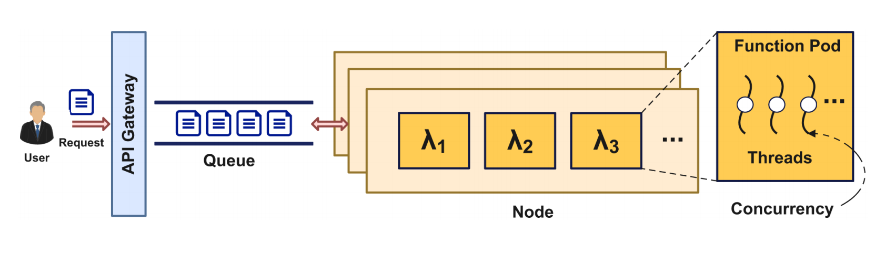
Resource Management: ComboFunc
Serverless can dynamically scale resources based on the workload of the function, which involves creating and destroying multiple function containers on cluster nodes.
However, the speed of container creation affects the agility of resource expansion.
Zhaojie Wen , Qiong Chen, et al. ComboFunc: Joint Resource Combination and Container Placement for Serverless Function Scaling with Heterogeneous Container. IEEE Transactions on Parallel and Distributed Systems (TPDS), 2024.

Slide 19
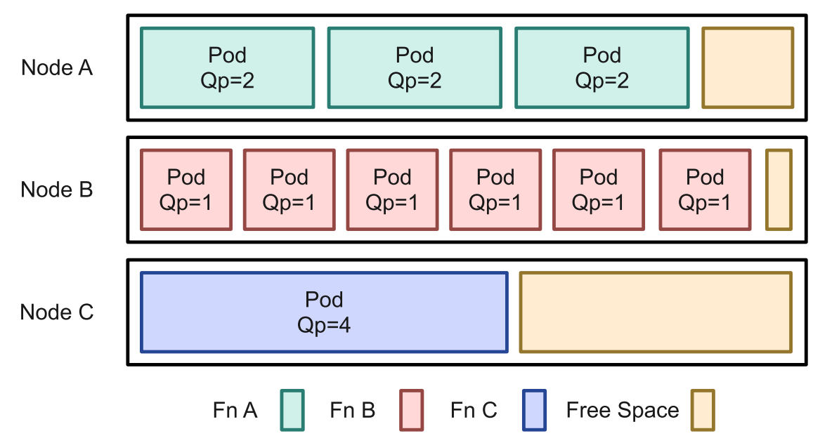
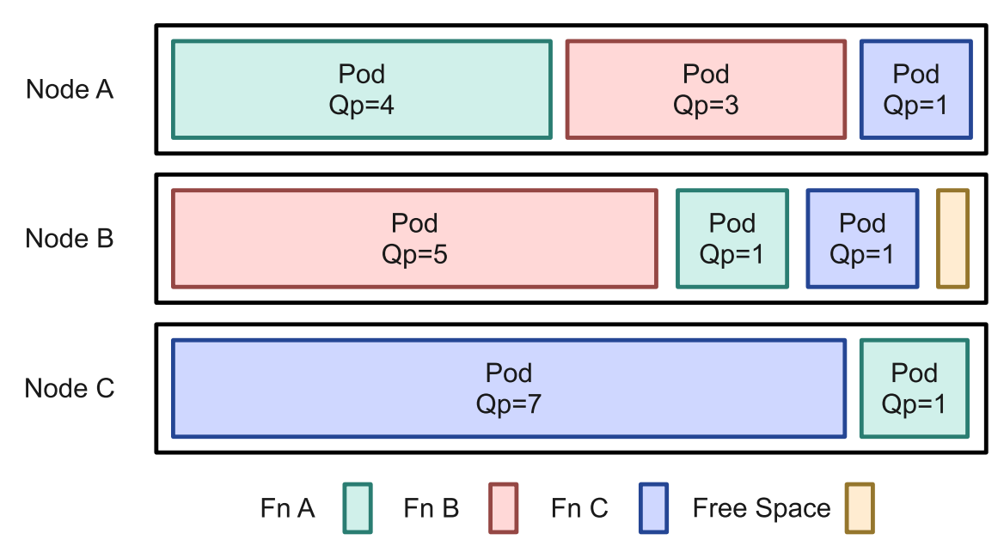
Resource Management: ComboFunc
ComboFunc associates functions with heterogeneous （异质） containers of varying specifications and optimize their resource combination and placement
Zhaojie Wen , Qiong Chen, et al. ComboFunc: Joint Resource Combination and Container Placement for Serverless Function Scaling with Heterogeneous Container. IEEE Transactions on Parallel and Distributed Systems (TPDS), 2024.

Slide 20
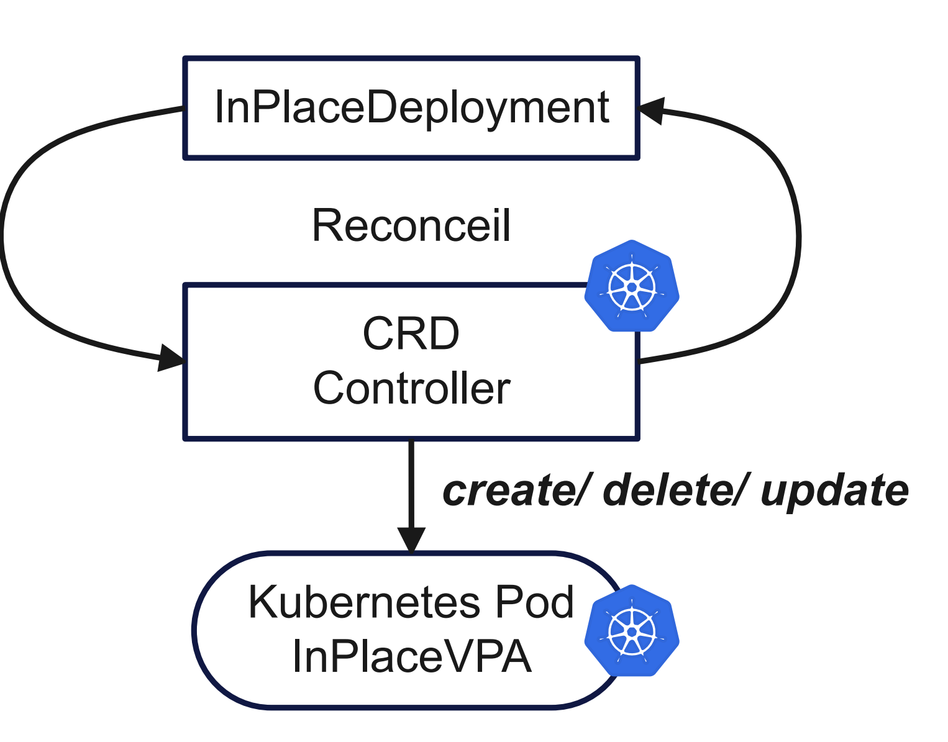
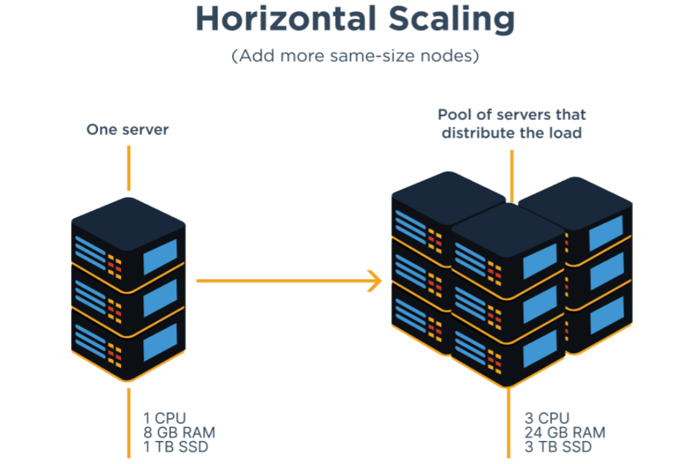
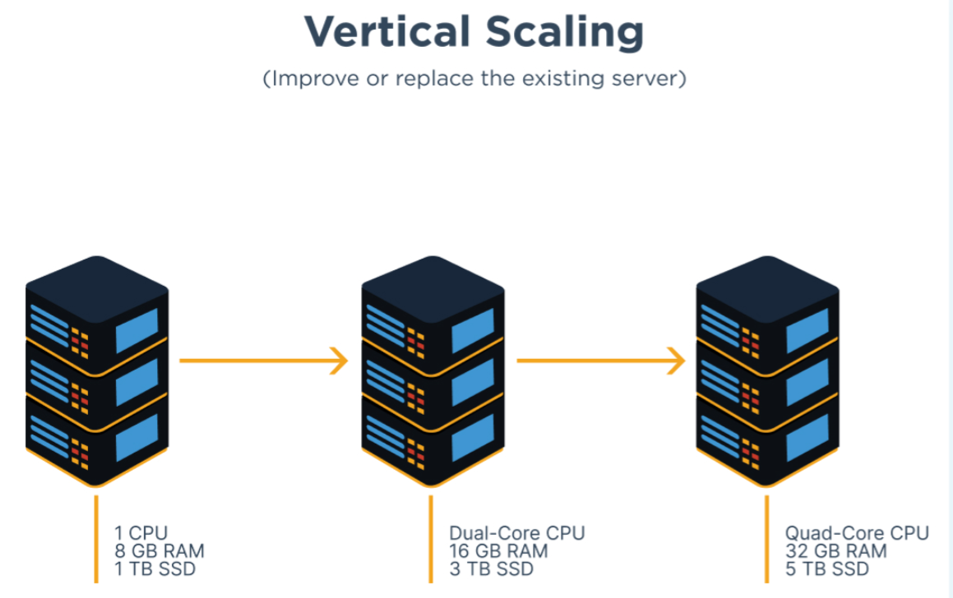
Resource Management: ComboFunc
Leverage the new feature of Kubernetes In-place Pod Vertical Scaling to enhance resource scaling agility and efficiency.
√
VS
Zhaojie Wen , Qiong Chen, et al. ComboFunc: Joint Resource Combination and Container Placement for Serverless Function Scaling with Heterogeneous Container. IEEE Transactions on Parallel and Distributed Systems (TPDS), 2024.
Notes:
水平扩展是通过增加集群中的节点数量来增加系统的容量和性能。垂直扩展是通过增加单个节点的计算能力来提高系统性能。

Slide 21
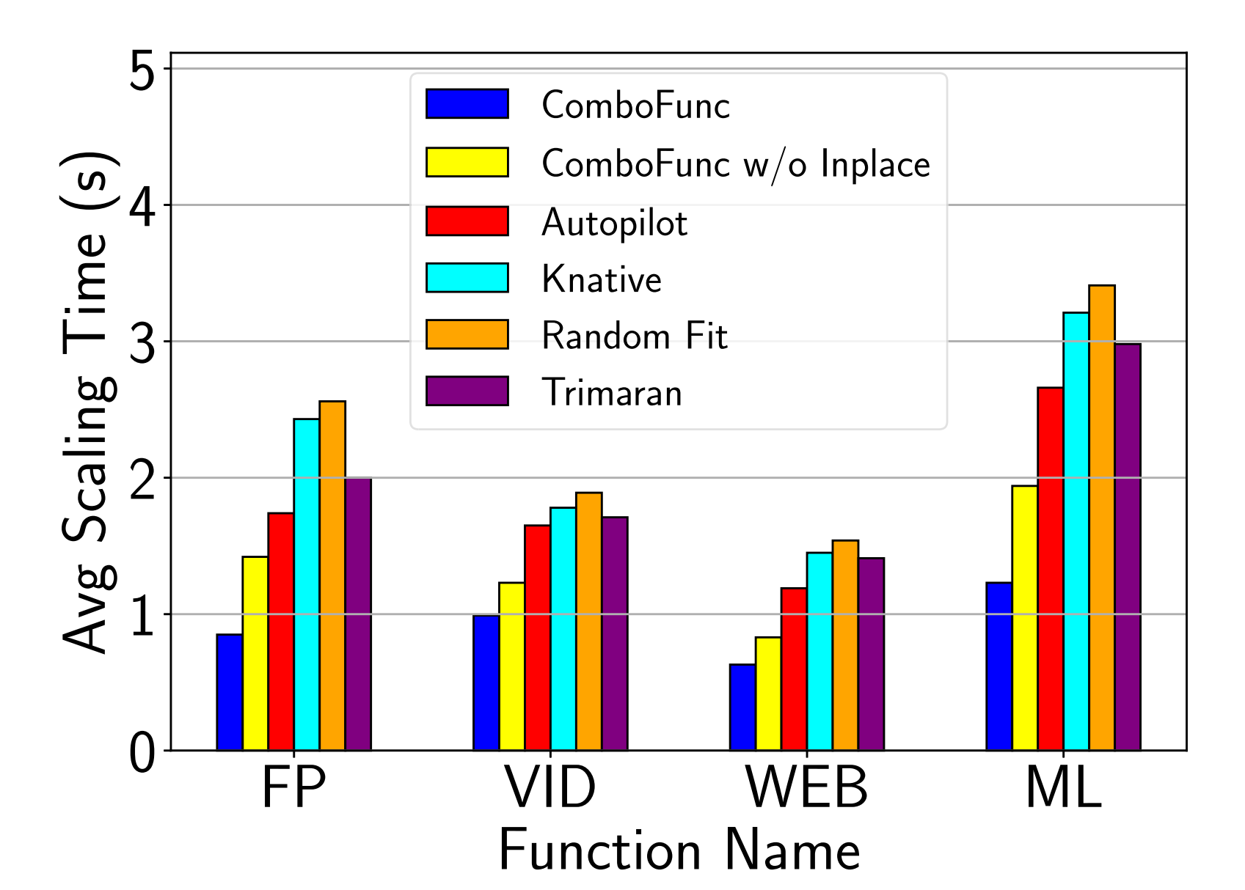
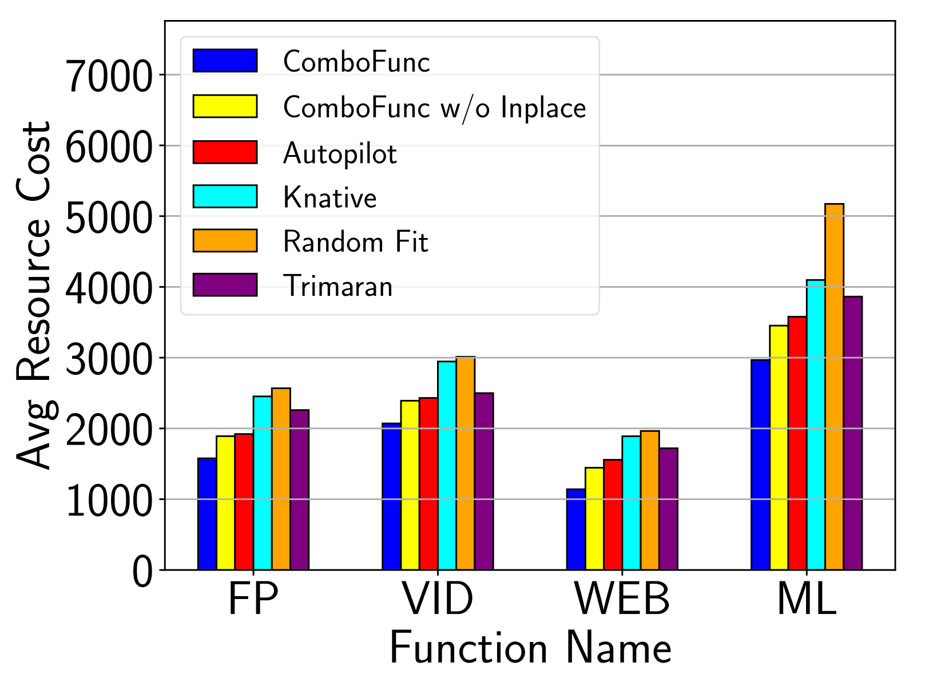
Resource Management: ComboFunc
ComboFunc exhibits the lowest average scaling time and average resource cost.
Zhaojie Wen , Qiong Chen, et al. ComboFunc: Joint Resource Combination and Container Placement for Serverless Function Scaling with Heterogeneous Container. IEEE Transactions on Parallel and Distributed Systems (TPDS), 2024.

Slide 22
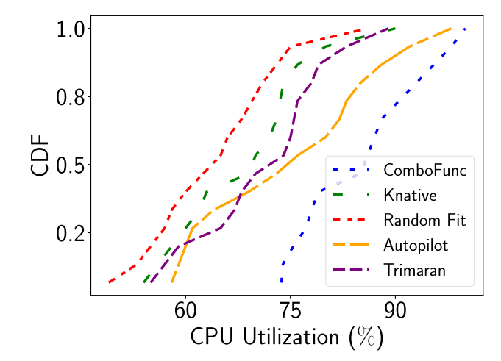
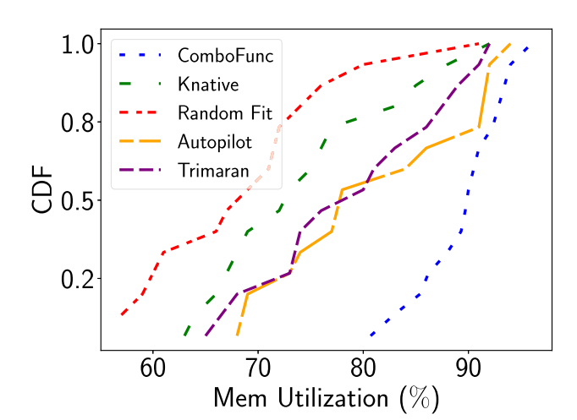
Resource Management: ComboFunc
ComboFunc exhibits higher overall resource utilization according to the Cumulative Distribution Function(CDF) graphs.
Zhaojie Wen , Qiong Chen, et al. ComboFunc: Joint Resource Combination and Container Placement for Serverless Function Scaling with Heterogeneous Container. IEEE Transactions on Parallel and Distributed Systems (TPDS), 2024.

Slide 23
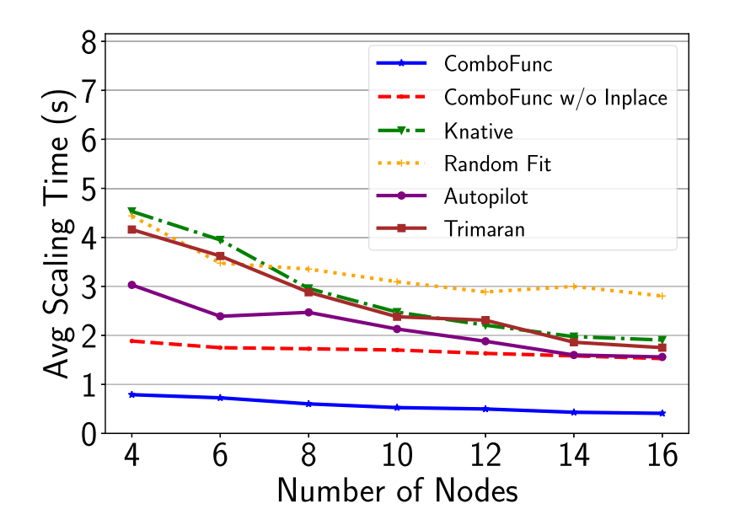
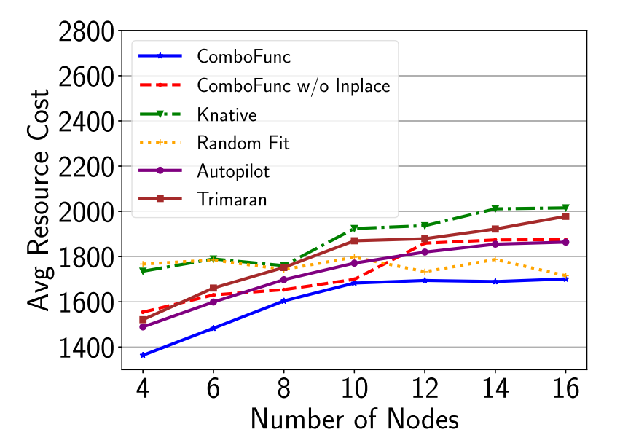
Resource Management: ComboFunc
ComboFunc mitigates the impact of increased resource costs associated with larger clusters.
Zhaojie Wen , Qiong Chen, et al. ComboFunc: Joint Resource Combination and Container Placement for Serverless Function Scaling with Heterogeneous Container. IEEE Transactions on Parallel and Distributed Systems (TPDS), 2024.

Slide 24
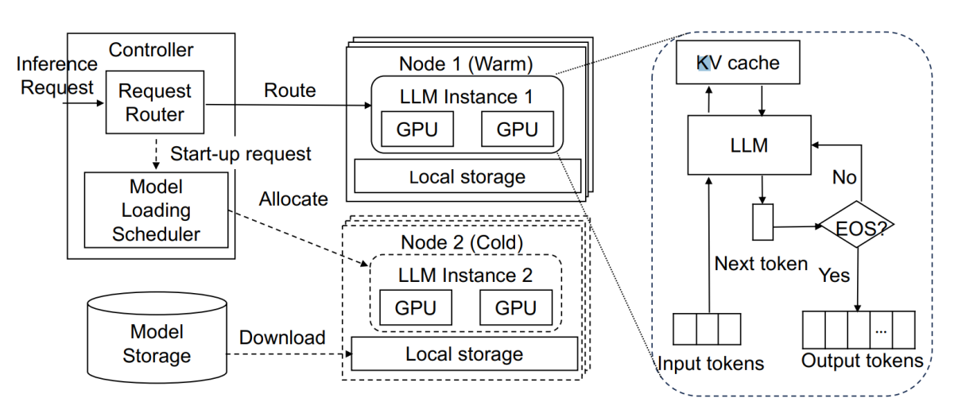
Programming Framework: ServerlessLLM
Despite high scalability of serverless, existing systems exhibit high latency overheads, due to the need to load large model parameters into the GPU during cold start.
Yao Fu, Leyang Xue, et al. ServerlessLLM: Low-latency serverless inference for large language models. 18th USENIX Symposium on Operating Systems Design and Implementation (OSDI). 2024

Slide 25
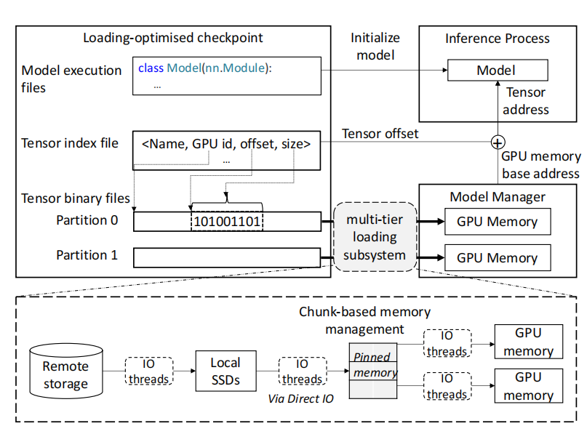
Programming Framework: ServerlessLLM
Rapid checkpoint loading
  Loading-optimized checkpoint format
  Maximizes bandwidth utilization across network, SSDs, DRAM, and GPU memory.
Yao Fu, Leyang Xue, et al. ServerlessLLM: Low-latency serverless inference for large language models. 18th USENIX Symposium on Operating Systems Design and Implementation (OSDI). 2024

Slide 26
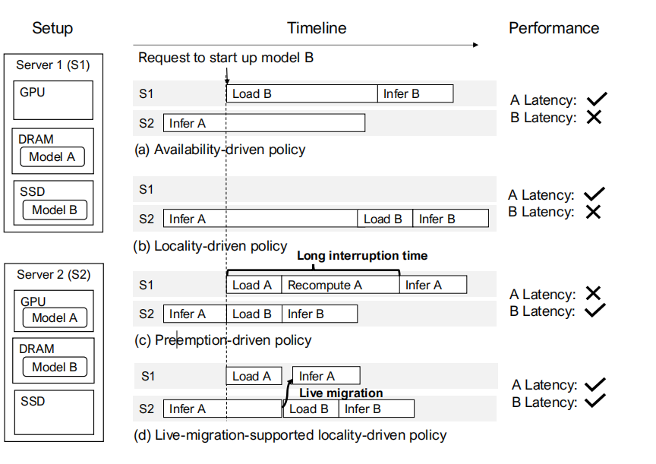
Programming Framework: ServerlessLLM
Rapid checkpoint loading
Live migration for locality-driven inference
  Only transmit essential prompt tokens over the network, avoiding slow snapshot transfer
  Uninterrupted inference by asynchronously recomputing cache states
Yao Fu, Leyang Xue, et al. ServerlessLLM: Low-latency serverless inference for large language models. 18th USENIX Symposium on Operating Systems Design and Implementation (OSDI). 2024

Slide 27
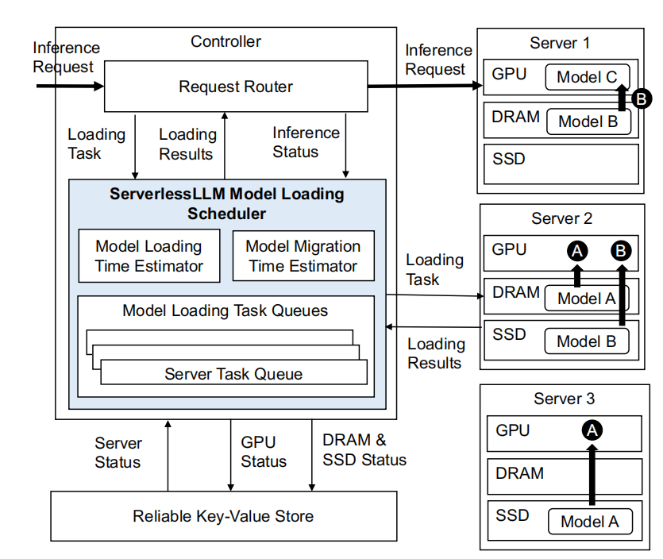
Programming Framework: ServerlessLLM
Rapid checkpoint loading
Live migration for locality-driven inference
Latency-optimized server allocation
  Accurately estimate checkpoint loading times from each tier and migration times for a server
  Select servers to minimize expected startup latency
Yao Fu, Leyang Xue, et al. ServerlessLLM: Low-latency serverless inference for large language models. 18th USENIX Symposium on Operating Systems Design and Implementation (OSDI). 2024

Slide 28
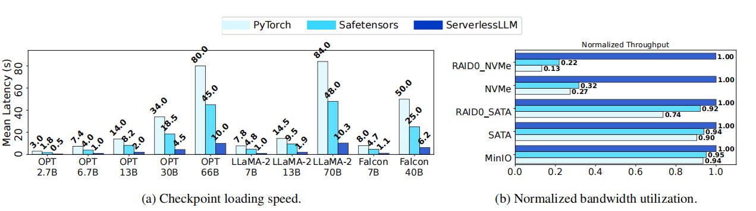
Programming Framework: ServerlessLLM
ServerlessLLM reduces LLM loading times by 4-8X and end-to-end startup times by over 25X compared to existing systems.
Yao Fu, Leyang Xue, et al. ServerlessLLM: Low-latency serverless inference for large language models. 18th USENIX Symposium on Operating Systems Design and Implementation (OSDI). 2024

Slide 29
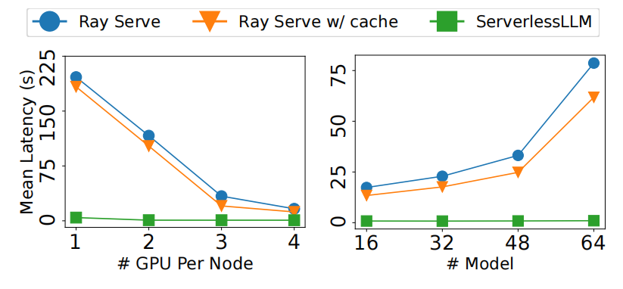
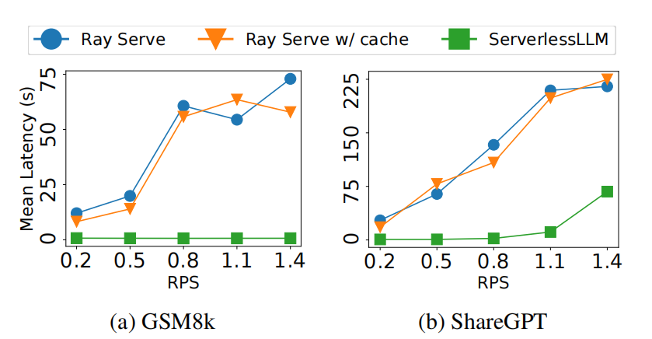
Programming Framework: ServerlessLLM
ServerlessLLM can achieve the lowest latency in different number of RPS, GPU nodes and models.
Yao Fu, Leyang Xue, et al. ServerlessLLM: Low-latency serverless inference for large language models. 18th USENIX Symposium on Operating Systems Design and Implementation (OSDI). 2024
Notes:
Requirest per second (RPS)

Slide 30
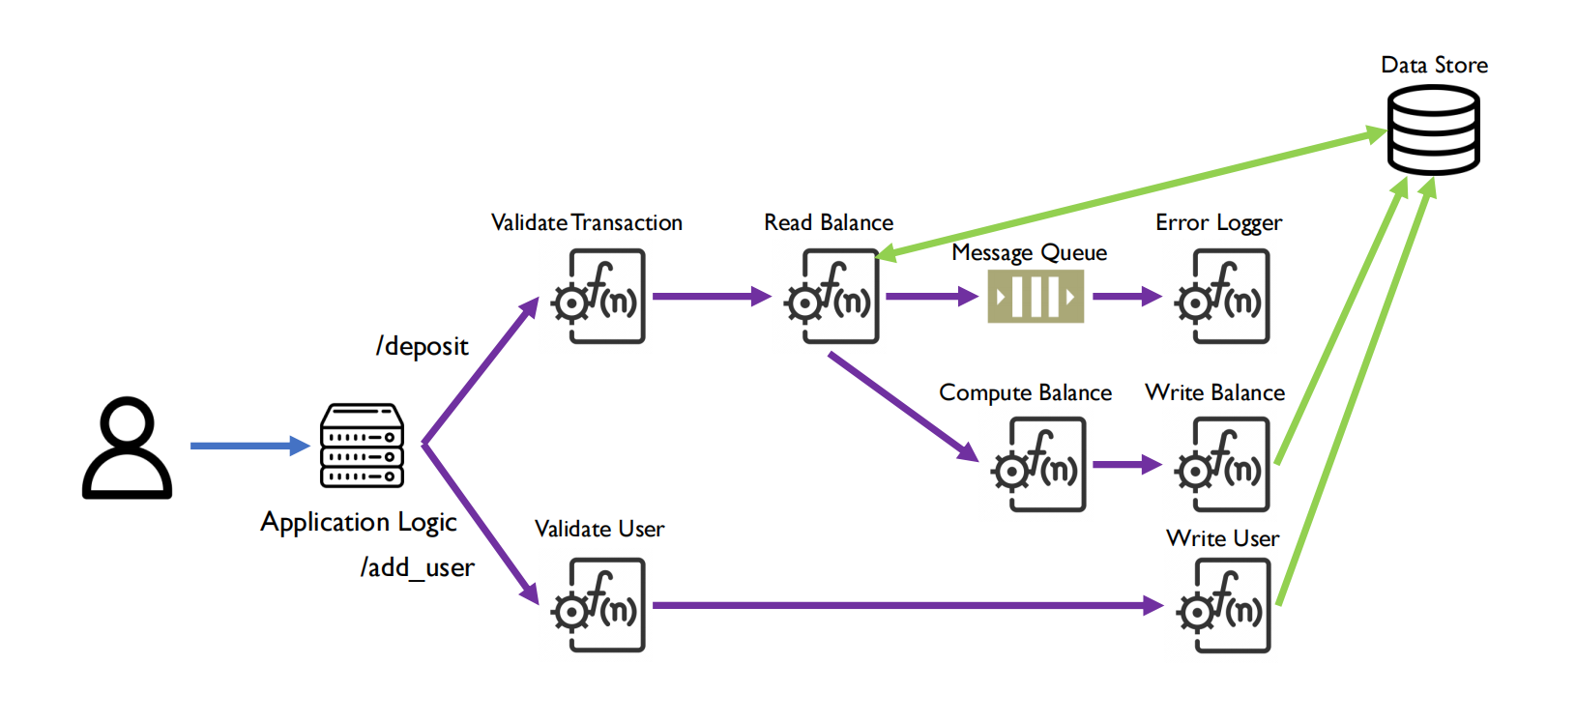
Security: Kalium
Execution Paths in Serverless Computing
Deepak Sirone Jegan , Liang Wang, et al. Guarding serverless applications with Kalium. 32nd USENIX Security Symposium (USENIX Security 23). 2023.

Slide 31
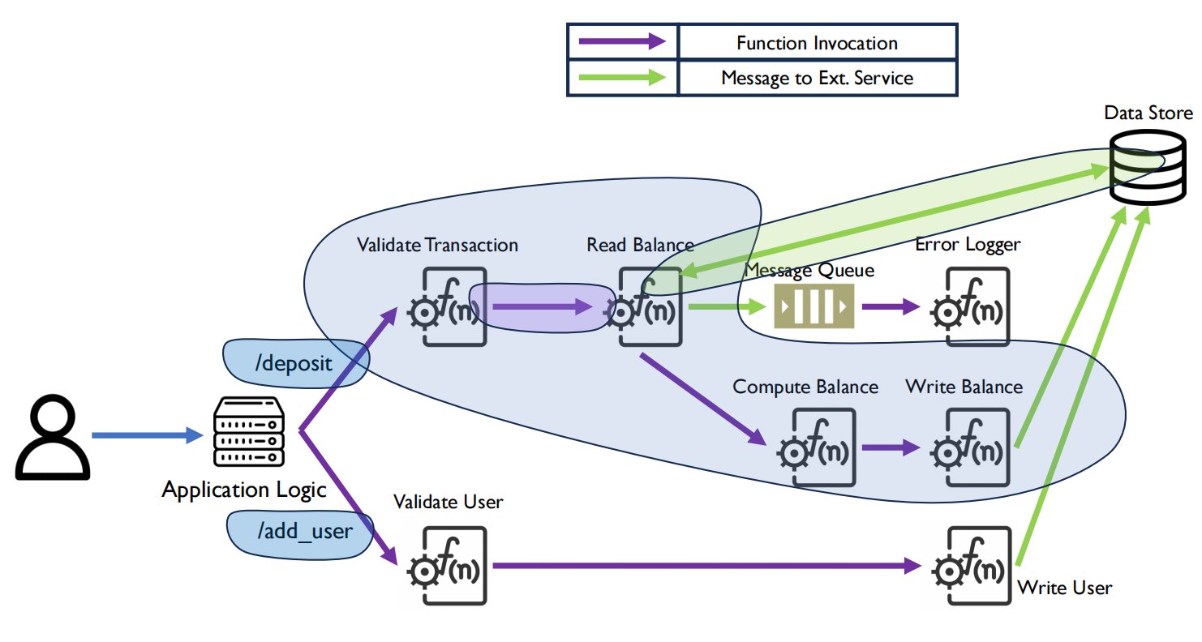
Security: Kalium
Execution Paths in Serverless Computing
  Functions can be invoked from other functions or external services: Purple Arrows
  A function can send messages to external services: Green Arrows
  Output of last function in a path is returned to the application logic
Deepak Sirone Jegan , Liang Wang, et al. Guarding serverless applications with Kalium. 32nd USENIX Security Symposium (USENIX Security 23). 2023.

Slide 32
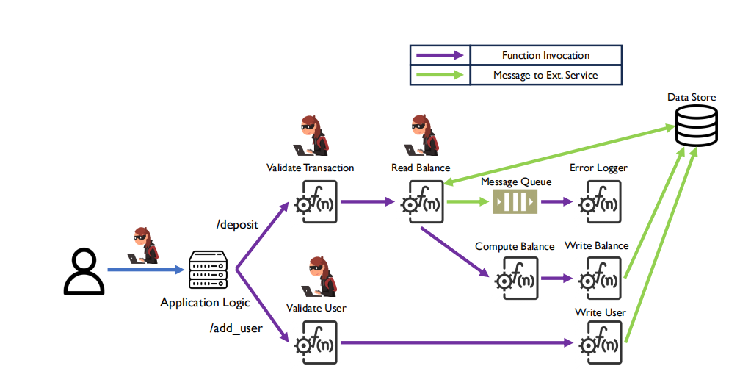
Security: Kalium
Threat Model
  Serverless Infrastructure is secure
  At least one serverless function has Remote Code Execution bugs: Data input to application logic is untrusted
Deepak Sirone Jegan , Liang Wang, et al. Guarding serverless applications with Kalium. 32nd USENIX Security Symposium (USENIX Security 23). 2023.

Slide 33
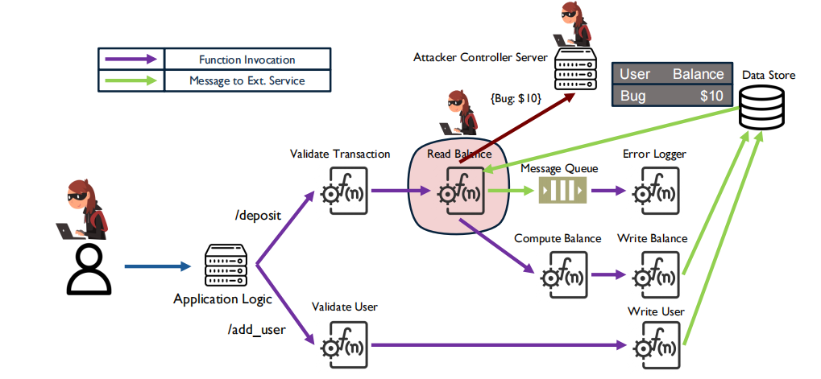
Security: Kalium
Attack Scenario #1
Confidential Information Should not Flow to Unintended External Locations
Deepak Sirone Jegan , Liang Wang, et al. Guarding serverless applications with Kalium. 32nd USENIX Security Symposium (USENIX Security 23). 2023.

Slide 34
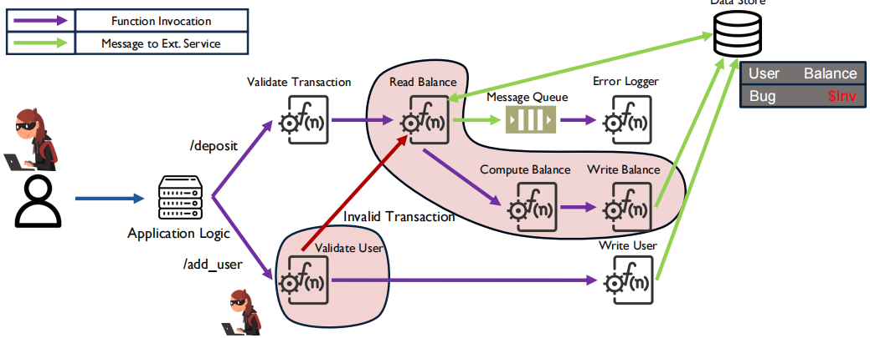
Security: Kalium
Attack Scenario #1
Confidential Information Should not Flow to Unintended External Locations
Attack Scenario #2
Data Written to External Storage Should be the Result of a Valid Path
Deepak Sirone Jegan , Liang Wang, et al. Guarding serverless applications with Kalium. 32nd USENIX Security Symposium (USENIX Security 23). 2023.

Slide 35
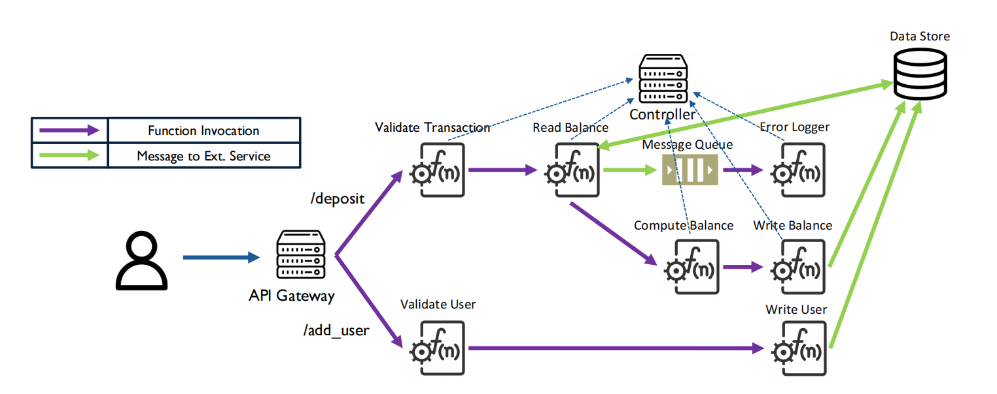
Security: Kalium
Key Idea: All executed paths in serverless application should be valid
Deepak Sirone Jegan , Liang Wang, et al. Guarding serverless applications with Kalium. 32nd USENIX Security Symposium (USENIX Security 23). 2023.

Slide 36
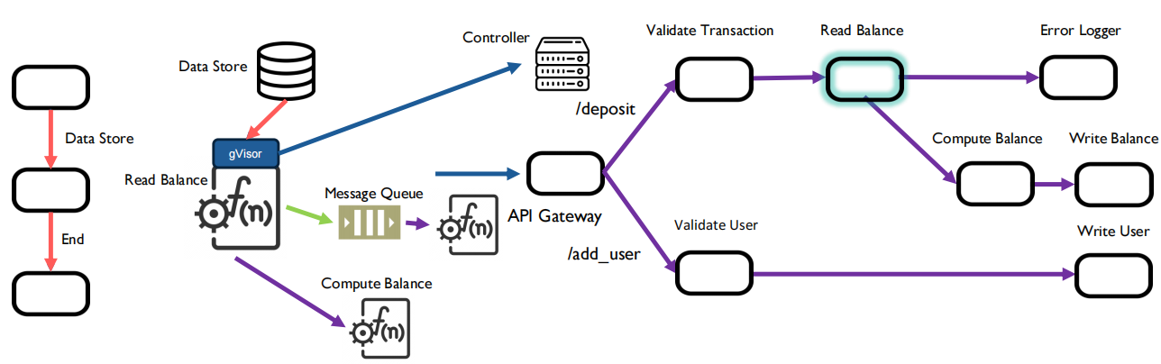
Security: Kalium
Leverage application control flow graph to depict order of function invocations in application
  Intercept function messages at the network syscall level
  Once a function finishes execution, it checks with the global controller whether to allow outgoing edge
  A global controller maintains the position of the current function on application CFG
Deepak Sirone Jegan , Liang Wang, et al. Guarding serverless applications with Kalium. 32nd USENIX Security Symposium (USENIX Security 23). 2023.

Slide 37
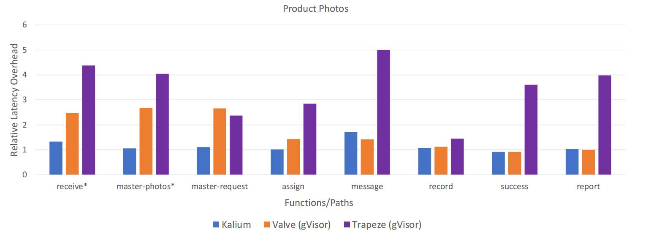
Security: Kalium
Evaluation
Deepak Sirone Jegan , Liang Wang, et al. Guarding serverless applications with Kalium. 32nd USENIX Security Symposium (USENIX Security 23). 2023.

Slide 38
Outline
Introduction to Serverless
Challenges and Research Questions
Current Solutions
Conclusion and Discussion
Notes:
Now, we focus on four aspects of Serverless, that is cold start performance, resource allocation, function communication, resource allocation and security. There are also some other factors we should pay attention to, such as monitoring, debugging, and programming framework, but at present we don’t analysis them.
In this section, I will introduce the concept of current challenges and research questions.

Slide 39
Conclusion
The talk focused on Serverless Computing, outlining its fundamental principles, benefits, and operational mechanisms. Inspired by the potential of Serverless, this talk suggested that Serverless can make your computing quantifiable.
The presentation discussed challenges and research questions across Cold Start Performance, Resource Management, Programming Framework, and Security.
For each of these areas, the discussion delved into cutting-edge research and presented existing solutions to address the outlined issues effectively.

Slide 40
Discussion
Developers do not know which containers will be used in underlying platforms during deployment; thus, it shows an open challenge for serverless application testing.
In distributed application scenarios, like IoT, how to guarantee data privacy and device communication is a critical problem.
Since required resources are accessed via configure, the configuration management burden on serverless developers is heavy.
Notes:
An automated detection may be useful to reduce the risk of misconfiguration and ease the burden of configuration management on serverless-based developers.

Slide 41
Conclusion
Q & A
Changyue Li
School of Data Science
Chinese University of Hong Kong, Shenzhen
Thanks
changyueli@link.cuhk.edu.cn

