Slide 1
Heterogeneous System for LLM Inference Acceleration 2024.10.15
Yuhao LIU
School of Data Science
Chinese University of Hong Kong, Shenzhen

Slide 2
Outline
Introduction (4 min)
Preliminaries (10 min)
Motivation (5 min)
Proposed Methods (15 min)
Scheduler
Tensor placement
Overlapping
Performance Evaluation (15 min)
Conclusions (1 min)
Q/A (5 min)

Slide 3
Introduction (4 min)
Preliminaries (10 min)
Motivation (5 min)
Proposed Methods (15 min)
Scheduler
Tensor placement
Overlapping
Performance Evaluation (15 min)
Conclusions (1 min)
Q/A (5 min)

Slide 4
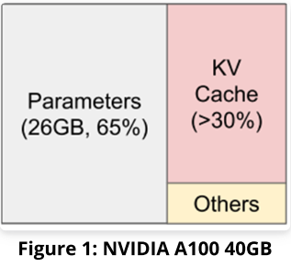
Introduction (1/2)
The Large Language Models become ever larger
Billions, or even trillions of parameters
LLM inference would be run in diverse system and expensive
devices where high-end GPUs are not available
serving a GPT-3 model for a production-scale application could cost between $100,000 to $300,000 monthly
memory needed is exceeding general GPU memory
Notes:
E.g. Edge computing environment, mobile devices
Llama-33B(60GB of memory) parameters represented in FP16 format

Slide 5
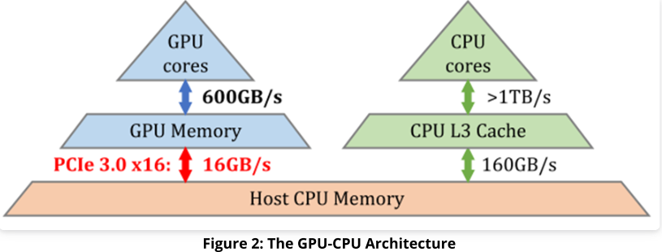
Introduction (2/2)
Response time is much more important
The latency GPU gets data(weights, parameters) by PCIe bus is the bottleneck
pipeline: spend much time to load, but just for only a short period using
GPU runs at the I/O bus speed, it’s severely under-utilized!!!

Slide 6
Introduction (4 min)
Preliminaries (10 min)
Motivation (5 min)
Proposed Methods (15 min)
Scheduler
Tensor placement
Overlapping
Performance Evaluation (15 min)
Conclusions (1 min)
Q/A (5 min)

Slide 7
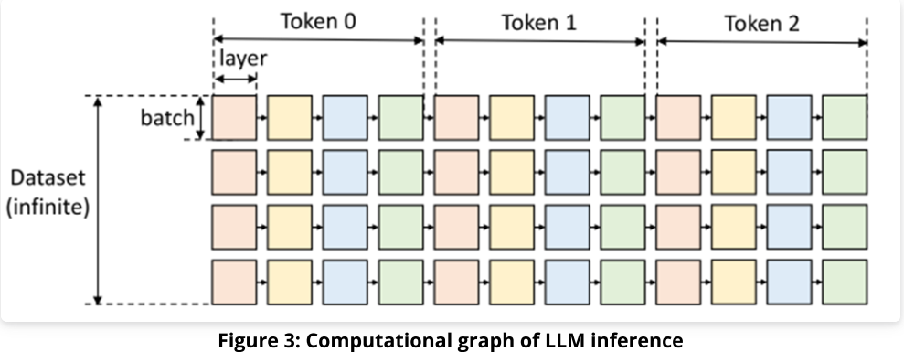
Preliminaries (1/6)
LLM structure
Square: the computation of a prompt(batch) for a layer
Computation rules
Sequentially compute in the same row
All inputs to be loaded
KV cache lasting time
Memory capacity
Notes:
Token by token

Slide 8
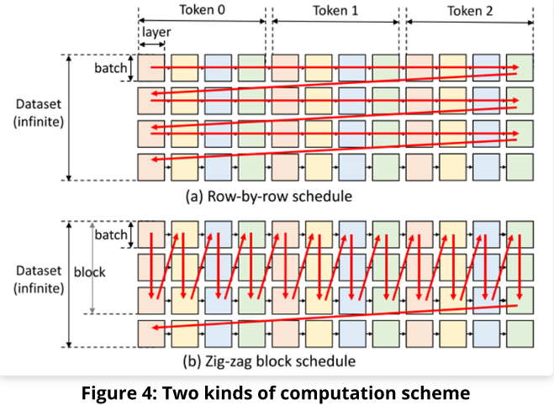
Preliminaries (2/6)
Problem Formulation
Three-level memory hierarchy
GPU - smallest but fastest memory
CPU - middle
Disk - largest but slowest memory
Graph traversal problem
When an LLM parameters cannot fit entirely within the GPU, we need to offload
Find a valid path that minimizes the total execution time
Notes:
Data size limitation, all kv cache cannot fit within GPU

Slide 9
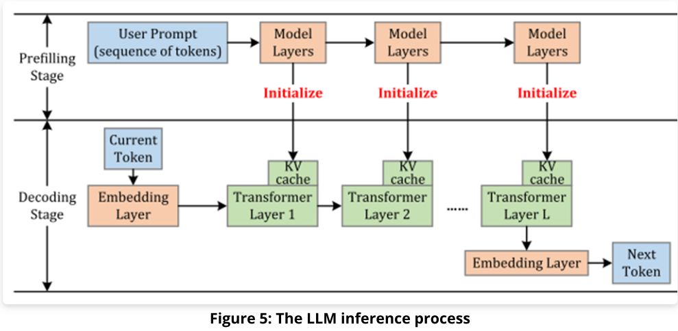
Preliminaries (3/6)
Large Language Model Inference
Prefilling stage: initializes the KV cache
Decoding stage: utilizes and updates the KV cache to generate output tokens sequentially
Notes:
Prefilling: user prompt is fed into the model and generate the key-value cache

Slide 10
Preliminaries (4/6)
Decoding Stage
Embedding Layer
Row indexing input to its weight matrix
Transformer Layer
Matrix multiplication, time-consuming decoding stage
Notes:
Transformer Layer: dominating the latency of the time-consuming decoding stage

Slide 11
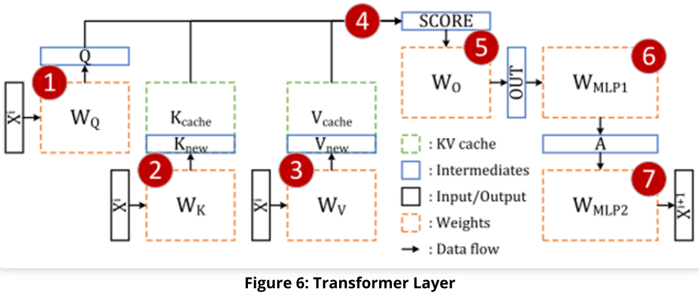
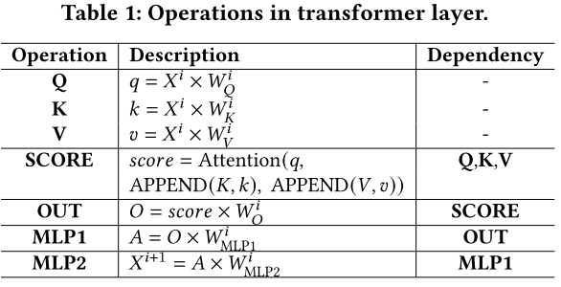
Preliminaries (5/6)
The Transformer Layer Operations
A large number of matrix multiplication

Slide 12
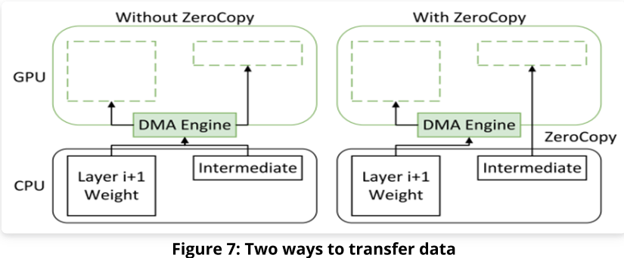
Data Transfer Trick (6/6)
GPU DMA
Efficiently transfers large amounts of data between CPU memory and GPU memory
Non-Preemptive
Zero-Copy
Direct PCIe read/write from GPU cores without copying
Limited by PCIe bandwidth
Notes:
without CPU intervention
direct access to CPU memory from the GPU without explicit memory copying
page-locked CPU memory
Small data

Slide 13
Introduction (4 min)
Preliminaries (10 min)
Motivation (5 min)
Proposed Methods (15 min)
Scheduler
Tensor placement
Overlapping
Performance Evaluation (15 min)
Conclusions (1 min)
Q/A (5 min)

Slide 14
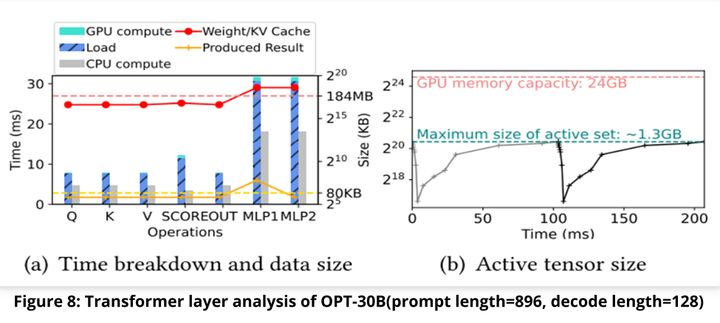
Motivation (1/3)
The potential of leveraging CPU to accelerate
Utilized CPU for several operations
Most data resides in the host memory
Less loading time and smaller data size
Notes:
CPU may relieve the burden of GPU

Slide 15
Motivation (2/3)
Utilizing GPU memory
Working set
active tensors for current layers
pre-allocated space for the next layer’s weights and KV cache
It leaves us a certain amount of available memory space

Slide 16
Motivation (3/3)
A new computing paradigm
GPU(s) and CPU run in parallel to collaboratively perform inference
Typical and new CPU-cache-memory structure

Slide 17
Introduction (4 min)
Preliminaries (10 min)
Motivation (5 min)
Proposed Methods (15 min)
Scheduler
Tensor placement
Overlapping
Performance Evaluation (15 min)
Conclusions (1 min)
Q/A (5 min)

Slide 18
Proposed Methods (1/15)
Scheduler
Policy decision on computation execution or data placement/transfer
Tensor placement
Weights, KV cache, activations
Overlapping
Data loading/storing, computations

Slide 19
Proposed Methods (2/15)
FlexGen
GPU-centric inter-layer pipeline
Llama.cpp
Lightweight inference framework
Designed for various hardware
Features CPU inference
TwinPilots
GPU(s)-CPU collaborative inference paradigm

Slide 20
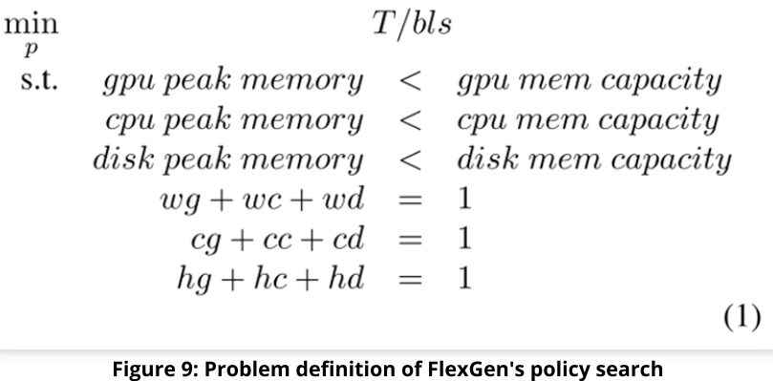
Scheduler (3/15)
FlexGen
Cost model
to predict the latency(i.e. computing and transferring) of transformer layer’s inference
Policy search
to find the best data placement(i.e. the proportion of weights, activations or KV cache)
Linear programming
Notes:
The proportion of data stored in different memory levels
FlexGen: Performs most of computations on the GPU, except SCORE

Slide 21
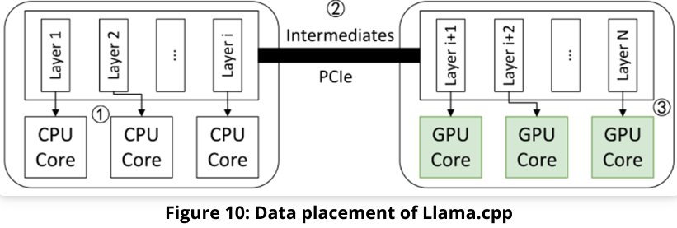
Scheduler (4/15)
Llama.cpp
Static layer partitioning strategy
Place first few contiguous layers on CPU, other layers on GPU

Slide 22
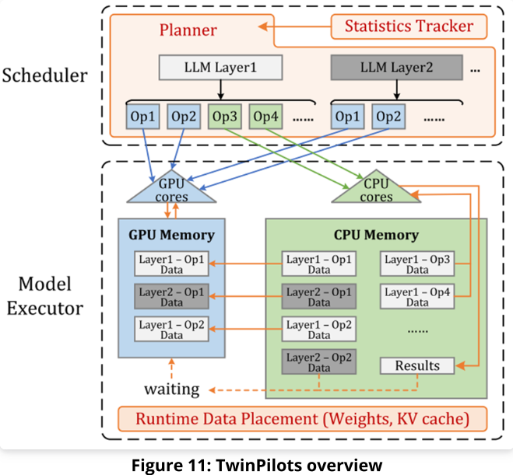
Scheduler (5/15)
TwinPilots
Online scheduler
Statistics tracker and Planner
Model executor
Prefetching and computation
Notes:
Collects historical execution information from the statistics tracker and generates execution plans
performs data prefetching and operation computation based on the plan

Slide 23
TwinPilots - Online Scheduler (6/15)
Historical timing information
Operation execution time on CPU(computing) and GPU(loading)
Collection and Estimate
Aggregate information at the end of each decoding step

Slide 24
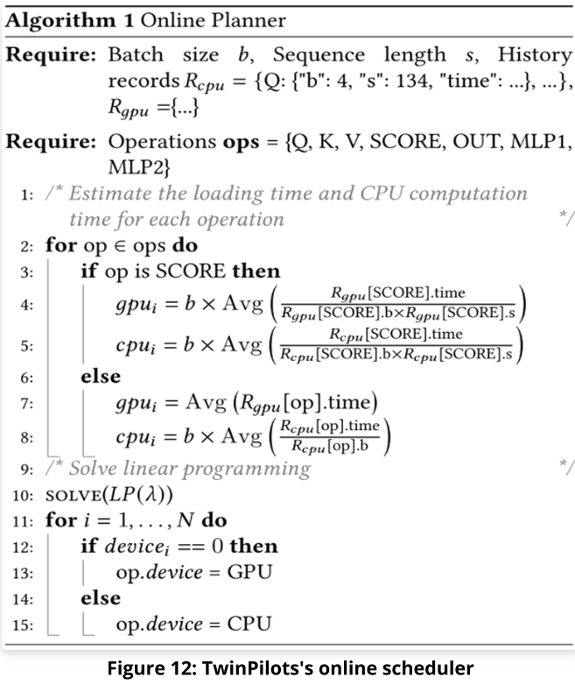
TwinPilots - Online Scheduler (7/15)
Planner – Load balancing
Linear programming(LP($λ$))
$S_{cpu}=\sum_{i}^{N}{{cpu}_{i}{device}_{i}}$
$S_{gpu}=\sum_{i}^{N}{{gpu}_{i}{(1−device}_{i})}$
${ device}_{i}$∊ {0,1}
Minimize$λ=max⁡(S_{cpu},S_{gpu})$
Though NP-complete, small solution space (few number of operations)

Slide 25
Weight placement (8/15)
FlexGen
Layer granularity: pins partial weight of layers in the GPU memory
Policy search to find the best data placement
Zig-zag: reuse the weights in the same column

Slide 26
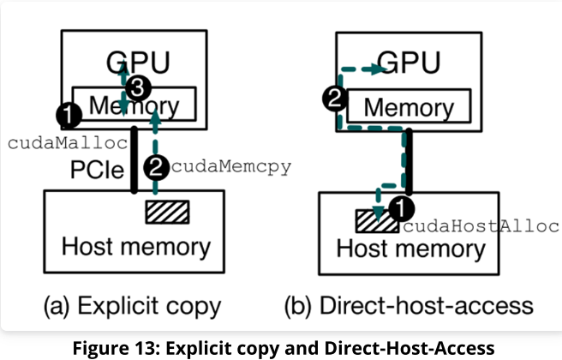
Weight placement (9/15)
TwinPilots
Embedding layers - Row indexing to the weight matrix
Sparse memory access pattern
Host memory
Direct-Host-Access(zero-copy)

Slide 27
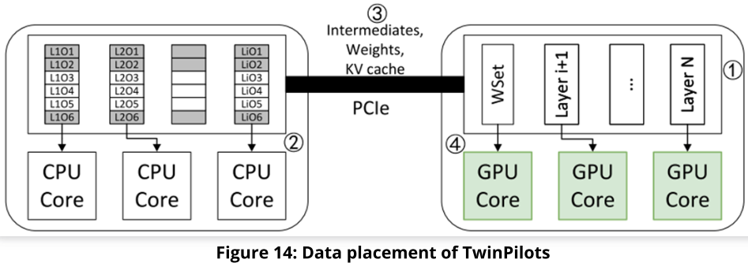
Weight placement (10/15)
TwinPilots
Transformer layers
Pinned and unpinned layers
First few transformer layers(Pinned – GPU memory)
Online scheduler offloading strategy(Unpinned – Host memory)
Notes:
Online scheduler to manage GPU memory

Slide 28
KV Cache Placement (11/15)
FlexGen
Tensor granularity: pins portion elements in a tensor to the GPU
Policy search
Llama.cpp
Reserve memory for the maximum sequence length
Dynamic Growth

Slide 29
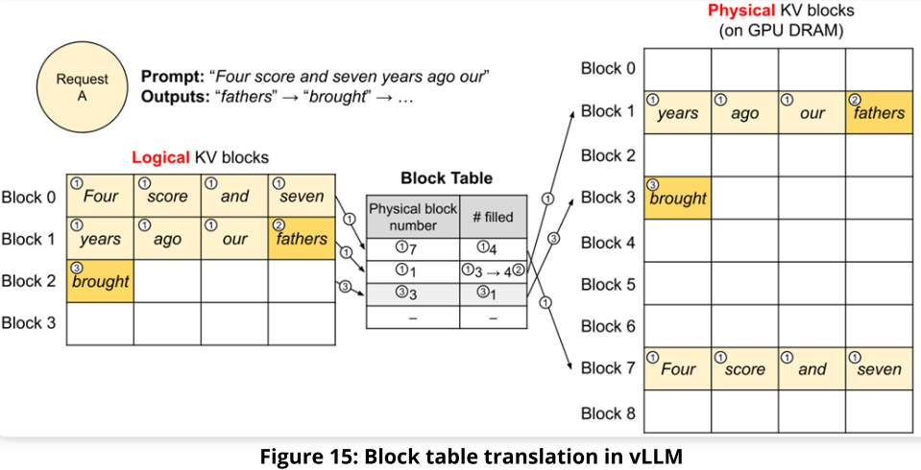
KV Cache Placement (12/15)
vLLM
Dynamically allocates and manages the KV cache
Block granularity, which is like the page of OS virtual memory
Notes:
There is new logical cache block, then physical block

Slide 30
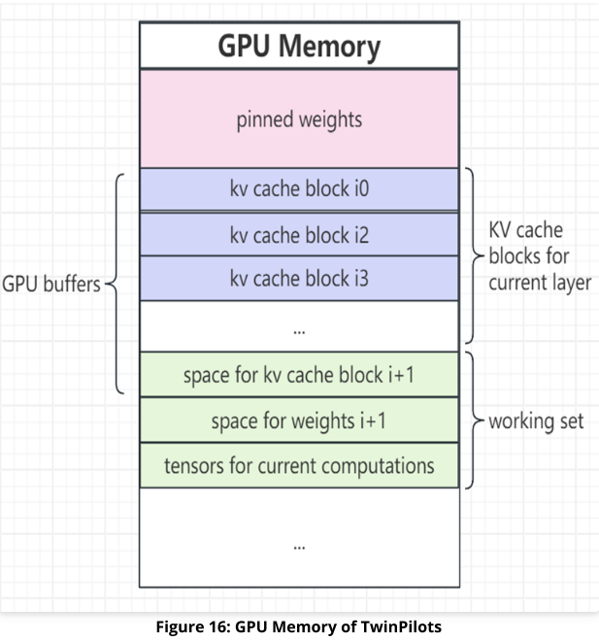
KV Cache Placement (13/15)
TwinPilots
Dynamic allocation and management
Block granularity
GPU FIFO buffers store partial KV cache blocks

Slide 31
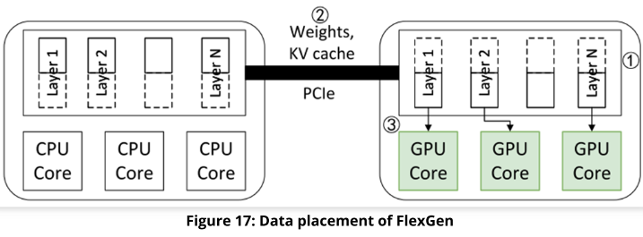
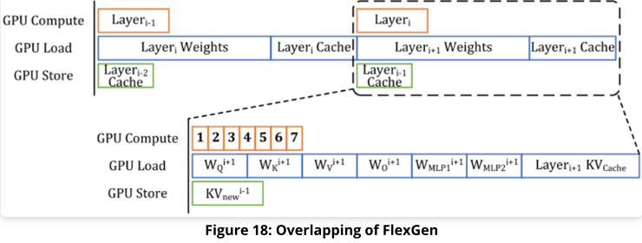
Overlapping (14/15)
FlexGen
Overlap the GPU computation and data loading
Llama.cpp
Batch processing

Slide 32
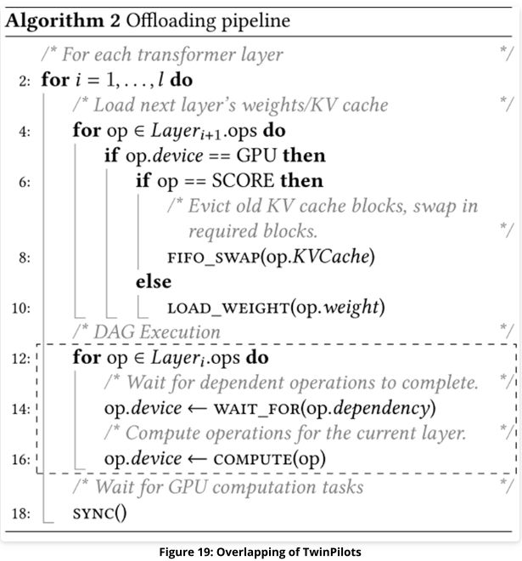
Overlapping (15/15)
TwinPilots
Load-balancing problem
Weights load of the next layer
Or KV cache swap between old and new layers
Each operation computing

Slide 33
Introduction (4 min)
Preliminaries (10 min)
Motivation (5 min)
Proposed Methods (15 min)
Scheduler
Tensor placement
Overlapping
Performance Evaluation (15 min)
Conclusions (1 min)
Q/A (5 min)

Slide 34
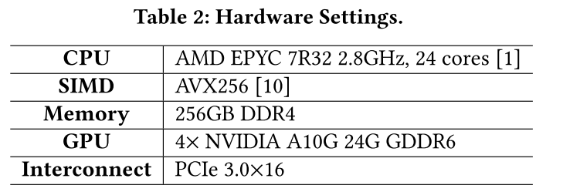
Evaluation (1/13)
Setup
CPU: Implement on PyTorch 2.3 with Intel-MKL and OpenMP
GPU: Linux 6.5 with CUDA 12.1
LLM: OPT-30B, OPT-66B, and Llama-30B represented in FP16 format with different batch sizes and sequence lengths

Slide 35
Evaluation - Single GPU (2/13)
Decoding Throughput
Setting
Batch size ranges from 1 to 48
Prompt length ranges from 32 to 896 tokens
Decoding length ranges from 32 to 128
FlexGen
Pipeline inference across three consecutive transformer layers
$$throughput=\frac{decode length}{decoding time}$$
Notes:
Three consecutive: Previous, current, next layers

Slide 36
Evaluation - Single GPU (3/13)
Decoding Throughput
TwinPilots
Zero copy: NVIDIA Unified Addressing
Zero-size GPU KV cache buffer but holds pinned weights
Notes:
Direct access from GPU cores to the host memory

Slide 37
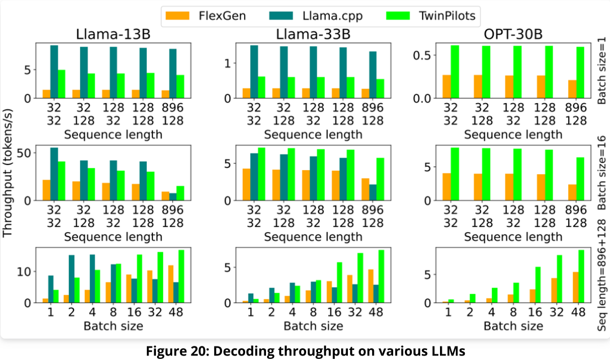
Evaluation - Single GPU (4/13)
Results
TwinPilots has higher throughput because of higher CPU utilization
unchanged GPU execution time
Notes:
- Decoding throughput: TwinPoilts CPU gets more operations, CPU save the data loading time and shorten pipeline
CPU execution time grows linearly since the computation demands scale linearly with the batch size
- GPU execution time is dominated by loading time

Slide 38
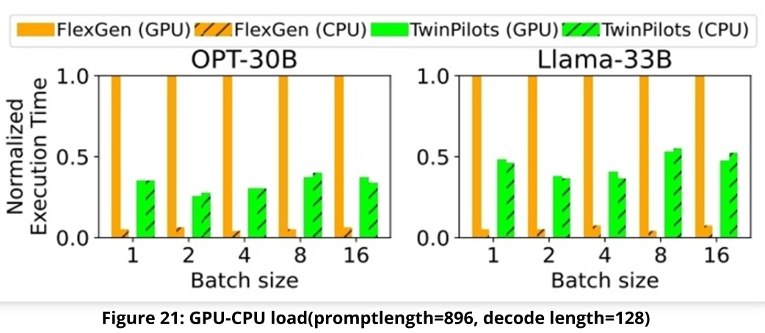
Evaluation - Single GPU (5/13)
CPU-GPU Load Balance
The overall pipeline execution time is determined by the maximum among CPU execution time and GPU execution time.
TwinPilots has a balanced load distribution.

Slide 39
Evaluation - Single GPU (6/13)
Performance Breakdown
FlexGen: own pinning, scheduling strategy
+Planner: adding load balancing planner, without pinning any model weights
+Pin: employing the data placement strategy
+ZeroCopy: involving the zero copy for IR

Slide 40
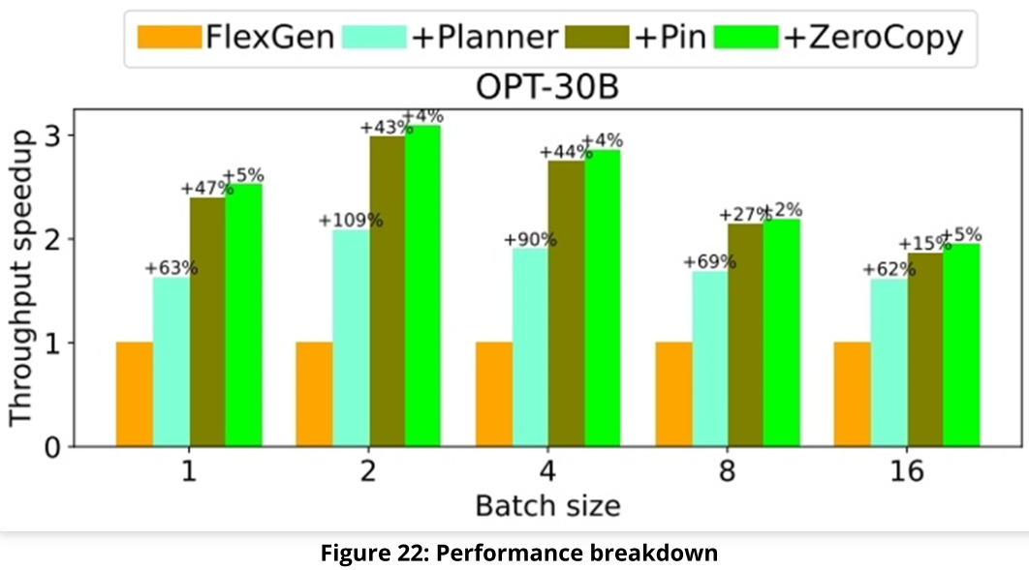
Evaluation - Single GPU (7/13)
Results
Load balancing planner improves performance significantly
Substantial potential of leveraging the CPU to reduce data loading and shorten the pipeline
Utilization of GPU memory

Slide 41
Evaluation - Multiple GPUs (8/13)
Setting
Llama-70B
prompt length and decode length equal to 128
1-4 GPU(s)
FlexGen
Each GPU handles several consecutive layers
Original pinning and computing strategy

Slide 42
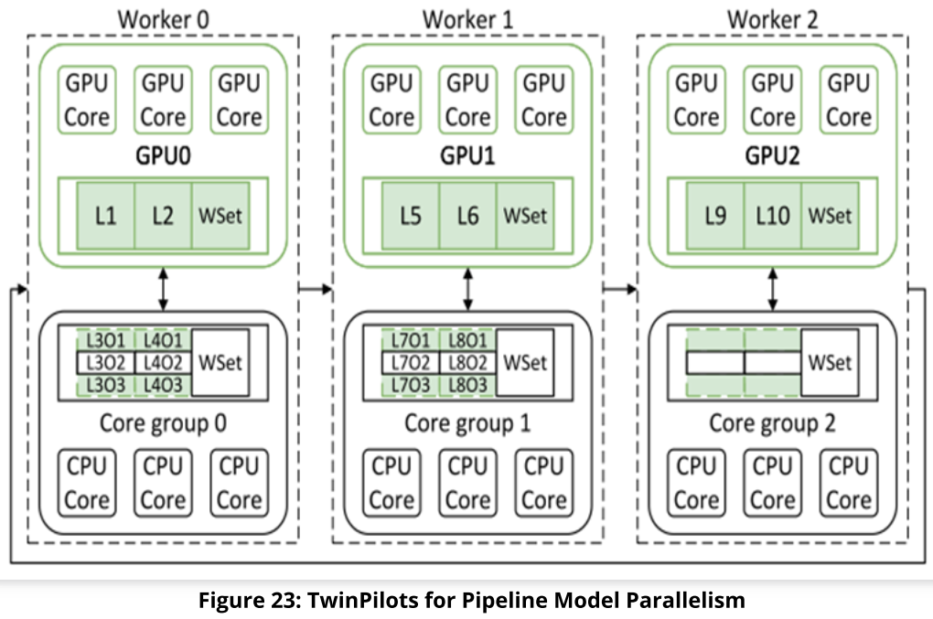
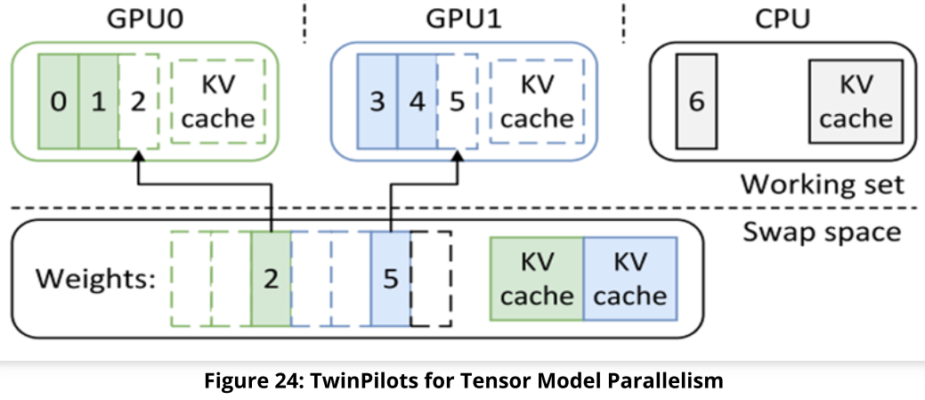
Evaluation - Multiple GPUs (9/13)
TwinPilots
Pipeline Model Parallelism
Handle a portion of consecutive layers
Tensor Model Parallelism
Partition the tensors along the row or column dimension at a finer granularity
Notes:
Worker: GPU + CPU core group
Works asynchronously with others
Passing intermediate results to others

Slide 43
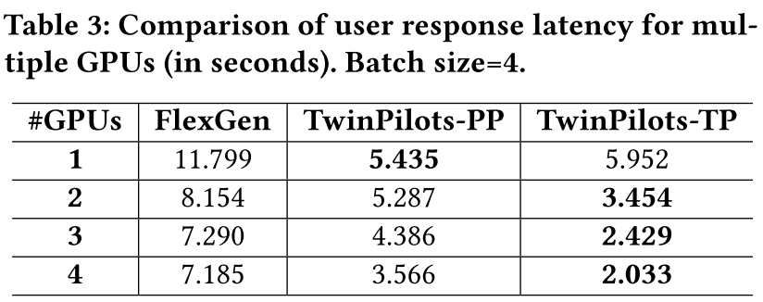
Evaluation - Multiple GPUs (10/13)
Result
TwinPilots-PP has higher throughput and good scalability
Less data to transfer(Weights)
TwinPilots-TP has lower response latency
Finer-grained granularity reduces idle time
Notes:
load-balancing planner design and the resource partition strategy of GPUs and CPU core groups.
TP: better balance the workload across GPUs and reduce idle time, leading to faster token generation for individual user requests. increased coordination and data transfers across GPUs.

Slide 44
Evaluation - Llama.cpp VS TwinPilots (11/13)
Decoding Throughput
Following the same setting with Single GPU experiment
Llama.cpp
Higher throughput for smaller batch and sequence
Minimized communication between CPU and GPU
Notes:
Llama.cpp demonstrates impressive performance for small batch sizes, but it decreases quickly as the sequence length increases
performance degradation of Llama.cpp is more severe on larger models
Llama.cpp
Higher throughput for smaller batch

Slide 45
Evaluation - Llama.cpp VS TwinPilots (12/13)
Llama.cpp
The throughput decreases quickly as the batch size and sequence length increases
CPU becomes the bottleneck
No enough GPU memory
Notes:
Llama.cpp demonstrates impressive performance for small batch sizes, but it decreases quickly as the sequence length increases
performance degradation of Llama.cpp is more severe on larger models
Llama.cpp
Higher throughput for smaller batch

Slide 46
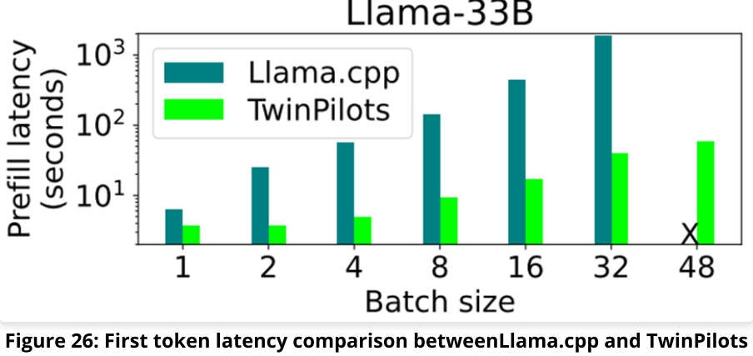
Evaluation - Llama.cpp VS TwinPilots (13/13)
Response Latency
Llama.cpp requires several minutes when the batch size exceeds 4
hours of latency when the batch size gets much larger
TwinPilots consistently achieves a much lower prefill latency across various batch size
Notes:
Llama.cpp: target CPU or lightweight single-GPU inference

Slide 47
Introduction (4 min)
Preliminaries (10 min)
Motivation (5 min)
Proposed Methods (15 min)
Scheduler
Tensor placement
Overlapping
Performance Evaluation (15 min)
Conclusions (1 min)
Q/A (5 min)

Slide 48
Conclusion (1/1)
Balance in Heterogeneous Systems
The potential of utilizing CPU
GPU-CPU works collaboratively
Bottleneck: GPU-CPU communication bandwidth
New architecture: shared memory management
Novel software way to transferring data

Slide 49
Introduction (4 min)
Preliminaries (10 min)
Motivation (5 min)
Proposed Methods (15 min)
Scheduler
Tensor placement
Overlapping
Performance Evaluation (15 min)
Conclusions (1 min)
Q/A (5 min)

