Slide 1
Imitation Attack： Extracting and Exploiting Model Capabilities 2024.10.10
Ziwen Cai
School of Data Science
Chinese University of Hong Kong, Shenzhen

Slide 2
Outline
Introduction (15min)
Related Work (5min)
Proposed Methods & Performance Evaluation (20min)
Model imitation
Adversarial attack
How to defense
Conclusions(5min)
Q&A(5min)

Slide 3
Imitation attack:
Introduction (15min)
Related Work (5min)
Proposed Methods & Performance Evaluation (20min)
Model imitation
Adversarial attack
How to defense
Conclusions(5min)
Q&A(5min)

Slide 4
Introduction _{(1/8)}
What is imitation attack: Imitation attack aims to steal a trained model by querying it
Victim model
Obtain prediction
Imitation Model
(imitator)
Use the prediction to
train the imitator
Query data

Slide 5
Introduction _{(2/8)}
Why imitation attack:
Training a model requires significant resources, both time and money
Training data may be proprietary
Victim model
Query data

Slide 6
Introduction _{(3/8)}
Adversarial Attack
After we train the imitator model, we can “white-box” attack the imitator model to obtain adversarial examples(AEs), and use them to attack the victim.
Victim model
(victim)
Imitation Model
(imitator)

Slide 7
Introduction _{(4/8)}
Adversarial Attack
After we train the imitator model, we can “white-box” attack the imitator model to obtain adversarial examples(AEs), and use them to attack the victim.
Victim model
(victim)
Adversarial data
Imitation Model
(imitator)
Attack Algorithm
Benign data

Slide 8
Introduction _{(5/8)}
Imitation attack in Machine Translation
Adversarial Examples
MT errors can have serious consequences.
Eric Wallace, Mitchell Stern, and Dawn Song. 2020. Imitation Attacks and Defenses for Black-box Machine Translation Systems. In Proceedings of the 2020 Conference on Empirical Methods in Natural Language Processing, EMNLP 2020, Online, November 16-20, 2020, Bonnie Webber, Trevor Cohn, Yulan He, and Yang Liu (Eds.). Association for Computational Linguistics..

Slide 9
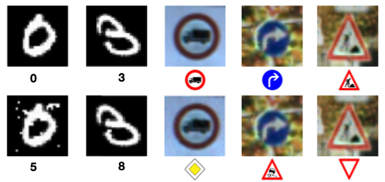
Introduction _{(6/8)}
Imitation attack in Classification
Adversarial Examples
Adversarial Goal: Produce a minimally altered version of any input $\vec{x}$, named adversarial example, and denoted $\vec{x∗}$, misclassified by oracle O: $\tilde{O}$($\vec{x∗}$) $≠$ $\tilde{O}$($\vec{x}$).
Why is it possible?
Nicolas Papernot, Patrick McDaniel, Ian Goodfellow, Somesh Jha, Z Berkay Celik, and Ananthram Swami. 2017. Practical black-box attacks against machine learning. In Proceedings of the 2017 ACM on Asia conference on computer and communications security, pages 506–519.

Slide 10
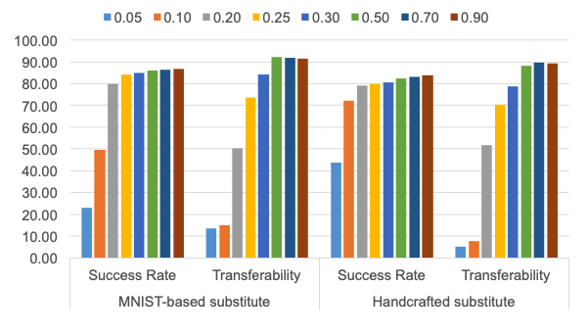
Introduction _{(7/8)}
Adversarial Transferability
Research^{[1]} has shown that adversarial transferability enables adversarial examples to transition from one model to others.
Fast Gradient Sign Method (FGSM)^{[2]}
Perturbation Impact (ϵ):
Increasing ϵ makes it more likely that the adversarial example $\vec{x∗}$ will be misclassified by the model.
Not training data
[1] Nicolas Papernot, Patrick McDaniel, Ian Goodfellow, Somesh Jha, Z Berkay Celik, and Ananthram Swami. 2017. Practical black-box attacks against machine learning. In Proceedings of the 2017 ACM on Asia conference on computer and communications security, pages 506–519.
[2] Ian J Goodfellow, et al. Explaining and harnessing adversarial examples. In Proceedings of the International Conference on Learning Representations, 2015.

Slide 11
Introduction _{(8/8)}
Adversarial Transferability
Step：
Generate Adversarial Example: An adversarial example is crafted by adding small, carefully designed perturbations to a normal input (e.g., an image or text) so that it appears unchanged to humans but causes a machine learning model to make a wrong prediction.
Apply to One Model (Substitute Model): This adversarial example is first tested on a specific model, often called the "substitute" model, and it successfully fools this model by making it produce an incorrect output.
Transfer to Other Models (Victim Models): The same adversarial example is then applied to other models, often with different architectures or training data. If the example also fools these other models, the transferability has occurred.
Nicolas Papernot, Patrick McDaniel, Ian Goodfellow, Somesh Jha, Z Berkay Celik, and Ananthram Swami. 2017. Practical black-box attacks against machine learning. In Proceedings of the 2017 ACM on Asia conference on computer and communications security, pages 506–519.

Slide 12
Imitation attack:
Introduction (15min)
Related Work (5min)
Proposed Methods & Performance Evaluation (20min)
Model imitation
Adversarial attack
How to defense
Conclusions(5min)
Q&A(5min)

Slide 13
Related Work_{(1/3)}
Model Extraction Attack (model stealing)
Enables malicious users to forge the functionality of a black-box victim model as closely as possible.
Model extraction attacks (also referred to as “model stealing") have been effectively applied to different tasks, ranging from computer vision¹ tasks to NLP tasks².
¹ Tribhuvanesh Orekondy, Bernt Schiele, and Mario Fritz. 2019. Knockoff nets: Stealing functionality of black-box models. In Proceedings of the IEEE Conference on Computer Vision and Pattern Recognition, pages 4954–4963.
² Varun Chandrasekaran, Kamalika Chaudhuri, Irene Giacomelli, Somesh Jha, and Songbai Yan. 2020. Exploring connections between active learning and model extraction. In 29th {USENIX} Security Symposium ({USENIX} Security 20), pages 1309–1326.

Slide 14
Related Work _{(2/3)}
Benchmarking prior knowledge for imitation attacks.
Zongjie Li, Chaozheng Wang, Pingchuan Ma, Chaowei Liu, Shuai Wang, Daoyuan Wu, Cuiyun Gao, and Yang Liu. 2024. On Extracting Specialized Code Abilities from Large Language Models: A Feasibility Study. In Proceedings of the IEEE/ACM 46th International Conference on Software Engineering (ICSE '24)..

Slide 15
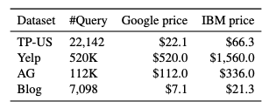
Related Work _{(3/3)}
Stealing a task classifier is highly economical and worthwhile, in terms of the money spend on querying the API.
Xuanli He, Lingjuan Lyu, Lichao Sun, and Qiongkai Xu. 2021. Model Extraction and Adversarial Transferability, Your BERT is Vulnerable!. In Proceedings of the 2021 Conference of the North American Chapter of the Association for Computational Linguistics: Human Language Technologies.

Slide 16
Imitation attack:
Introduction (15min)
Related Work (5min)
Proposed Methods & Performance Evaluation (20min)
Model imitation
Adversarial attack
How to defense
Conclusions(5min)
Q&A(5min)

Slide 17
Proposed Methods-Model imitation_{(1/9)}
Imitation attack in Machine Translation
Workflow:
Victim model
Query
Imitation Model
(imitator)
Eric Wallace, Mitchell Stern, and Dawn Song. 2020. Imitation Attacks and Defenses for Black-box Machine Translation Systems. In Proceedings of the 2020 Conference on Empirical Methods in Natural Language Processing, EMNLP 2020, Online, November 16-20, 2020, Bonnie Webber, Trevor Cohn, Yulan He, and Yang Liu (Eds.). Association for Computational Linguistics..

Slide 18
Proposed Methods-Model imitation_{(2/9)}
Two factors that may affect how well a model can be stolen
Victim model
Training
Data
(victim)
Query
Imitation Model
(imitator)
Query Data
Eric Wallace, Mitchell Stern, and Dawn Song. 2020. Imitation Attacks and Defenses for Black-box Machine Translation Systems. In Proceedings of the 2020 Conference on Empirical Methods in Natural Language Processing, EMNLP 2020, Online, November 16-20, 2020, Bonnie Webber, Trevor Cohn, Yulan He, and Yang Liu (Eds.). Association for Computational Linguistics..

Slide 19
Proposed Methods-Model imitation_{(3/9)}
Two factors that may affect how well a model can be stolen
Victim model
Architecture mismatch
Training
Data
(victim)
2. Data mismatch
Query
Imitation Model
(imitator)
Query Data
Eric Wallace, Mitchell Stern, and Dawn Song. 2020. Imitation Attacks and Defenses for Black-box Machine Translation Systems. In Proceedings of the 2020 Conference on Empirical Methods in Natural Language Processing, EMNLP 2020, Online, November 16-20, 2020, Bonnie Webber, Trevor Cohn, Yulan He, and Yang Liu (Eds.). Association for Computational Linguistics..

Slide 20
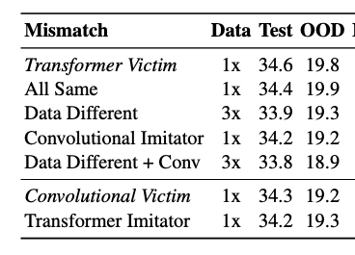
Proposed Methods-Model imitation_{(4/9)}
An experiment to test feasibility:
BLEU score
Victim model
(M_{v})
Training
Data
(D_{v})
D_{v} = D_{a} ,M_{v} = M_{a}
Query
D_{v} $≠$ D_{a} ,M_{v} = M_{a}
Imitation Model
(imitator, M_{a})
D_{v} = D_{a} ,M_{v} $≠$ M_{a}
D_{v} $≠$ D_{a} ,M_{v} $≠$ M_{a}
Query Data
(D_{a})
Eric Wallace, Mitchell Stern, and Dawn Song. 2020. Imitation Attacks and Defenses for Black-box Machine Translation Systems. In Proceedings of the 2020 Conference on Empirical Methods in Natural Language Processing, EMNLP 2020, Online, November 16-20, 2020, Bonnie Webber, Trevor Cohn, Yulan He, and Yang Liu (Eds.). Association for Computational Linguistics..

Slide 21
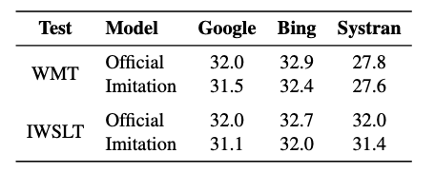
Performance Evaluation-Model imitation_{(5/9)}
Evaluation of the effectiveness
Eric Wallace, Mitchell Stern, and Dawn Song. 2020. Imitation Attacks and Defenses for Black-box Machine Translation Systems. In Proceedings of the 2020 Conference on Empirical Methods in Natural Language Processing, EMNLP 2020, Online, November 16-20, 2020, Bonnie Webber, Trevor Cohn, Yulan He, and Yang Liu (Eds.). Association for Computational Linguistics..

Slide 22
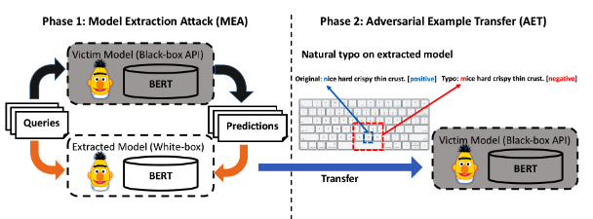
Proposed Methods-Model imitation_{(6/9)}
Workflow of the Text Classification
Xuanli He, Lingjuan Lyu, Lichao Sun, and Qiongkai Xu. 2021. Model Extraction and Adversarial Transferability, Your BERT is Vulnerable!. In Proceedings of the 2021 Conference of the North American Chapter of the Association for Computational Linguistics: Human Language Technologies.

Slide 23
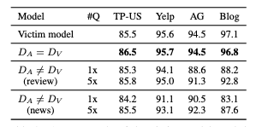
Performance Evaluation-Model imitation_{(7/9)}
Accuracy rate in Text Classification
The success of the extraction correlates to the domain closeness between the victim’s training data and the attacker’s queries
Using same data even outperforms the victim models, which is also known as self-distillation
Although more queries suggest a better extraction performance, small query budgets (0.1x and 0.5x) are often sufficiently successful when D_{v} $≠$ D_{a} .
Accuracy
Xuanli He, Lingjuan Lyu, Lichao Sun, and Qiongkai Xu. 2021. Model Extraction and Adversarial Transferability, Your BERT is Vulnerable!. In Proceedings of the 2021 Conference of the North American Chapter of the Association for Computational Linguistics: Human Language Technologies.

Slide 24
Proposed Methods-Model imitation_{(8/9)}
Recently, people have started to dissect commercial black box LLMs (Large Language Models), aiming to
extract their specialized code capabilities.
LLMs may process natural language (NL) or programming language (PL) inputs and emit NL/PL outputs accordingly.
Code Synthesis
Code Translation
Code Summarization
Zongjie Li, Chaozheng Wang, Pingchuan Ma, Chaowei Liu, Shuai Wang, Daoyuan Wu, Cuiyun Gao, and Yang Liu. 2024. On Extracting Specialized Code Abilities from Large Language Models: A Feasibility Study. In Proceedings of the IEEE/ACM 46th International Conference on Software Engineering (ICSE '24)..

Slide 25
Performance Evaluation-Model imitation_{(9/9)}
Effectiveness in Code Capability
All results are presented as BLEU scores or CodeBLEU scores on the test split of reference datasets.
M_{imi} : Imitation model trained on the collected dataset.
API : Stands for the best original LLM result under all three query settings.
M_{pure} :Backbone model without fine-tuning.
Zongjie Li, Chaozheng Wang, Pingchuan Ma, Chaowei Liu, Shuai Wang, Daoyuan Wu, Cuiyun Gao, and Yang Liu. 2024. On Extracting Specialized Code Abilities from Large Language Models: A Feasibility Study. In Proceedings of the IEEE/ACM 46th International Conference on Software Engineering (ICSE '24)..

Slide 26
Imitation attack:
Introduction (15min)
Related Work (5min)
Proposed Methods & Performance Evaluation (20min)
Model imitation
Adversarial attack
How to defense
Conclusions(5min)
Q&A(5min)

Slide 27
Proposed Methods-Adversarial attack_{(1/5)}
How to generate Adversarial Example?
a white-box, gradient-based adversarial attack
At each iteration, the attack adjusts the input by selecting a token and replacing it with another token from the model’s vocabulary
Eric Wallace, Mitchell Stern, and Dawn Song. 2020. Imitation Attacks and Defenses for Black-box Machine Translation Systems. In Proceedings of the 2020 Conference on Empirical Methods in Natural Language Processing, EMNLP 2020, Online, November 16-20, 2020, Bonnie Webber, Trevor Cohn, Yulan He, and Yang Liu (Eds.). Association for Computational Linguistics..

Slide 28
Proposed Methods-Adversarial attack_{(2/5)}
Key Steps to Generate Adversarial Examples:
Gradient-based method: Use gradients of the gold labels w.r.t. token embeddings to identify key tokens.
Token Corruption: Apply one of the following typo-based transformations:
Insertion
Deletion
Swap
Mistype (e.g., "oh" → "0h")
Pronunciation errors (e.g., "egg" → "agg")
Frequent typos (based on Wikipedia typo statistics).
Xuanli He, Lingjuan Lyu, Lichao Sun, and Qiongkai Xu. 2021. Model Extraction and Adversarial Transferability, Your BERT is Vulnerable!. In Proceedings of the 2021 Conference of the North American Chapter of the Association for Computational Linguistics: Human Language Technologies.

Slide 29
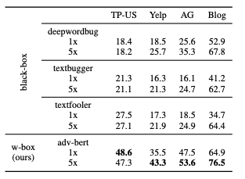
Proposed Methods -Adversarial attack_{(3/5)}
Transferability percentage
Direct attack the victim
Transferring from imitator
Transferability is the percentage of adversarial examples transferred from the extracted model to the victim model.
Xuanli He, Lingjuan Lyu, Lichao Sun, and Qiongkai Xu. 2021. Model Extraction and Adversarial Transferability, Your BERT is Vulnerable!. In Proceedings of the 2021 Conference of the North American Chapter of the Association for Computational Linguistics: Human Language Technologies.

Slide 30
Proposed Methods -Adversarial attack_{(4/5)}
In the code summarization (CSum) task, a successful AE results in a small mutation in the input code, leading to a significantly incorrect summary. The AE generation process includes two steps:
Identifying the most sensitive tokens.
Applying semantically-equivalent transformations to those tokens iteratively until AEs are generated.
Zongjie Li, Chaozheng Wang, Pingchuan Ma, Chaowei Liu, Shuai Wang, Daoyuan Wu, Cuiyun Gao, and Yang Liu. 2024. On Extracting Specialized Code Abilities from Large Language Models: A Feasibility Study. In Proceedings of the IEEE/ACM 46th International Conference on Software Engineering (ICSE '24)..

Slide 31
Proposed Methods-Adversarial attack_{(5/5)}
Large language models (LLMs) are thought to be more resistant to AEs due to two primary factors:
LLMs often operate in a black-box environment, exposing only APIs to users.
Vendors invest significant effort into fine-tuning and safety testing LLMs before release. For instance, OpenAI spent over six months ensuring the safety and alignment of GPT-4, involving a large team of domain experts.
There are several methods for generating AEs in code-related tasks:
CodeAttack: Gathers logit information and makes minor modifications to code tokens to generate AEs.
Radar: A search-based framework that generates AEs.
CCTest: This approach mutates Python code using semantics-preserving transformations and identifies inconsistent outputs in Copilot when tested on these mutated inputs.
Zongjie Li, Chaozheng Wang, Pingchuan Ma, Chaowei Liu, Shuai Wang, Daoyuan Wu, Cuiyun Gao, and Yang Liu. 2024. On Extracting Specialized Code Abilities from Large Language Models: A Feasibility Study. In Proceedings of the IEEE/ACM 46th International Conference on Software Engineering (ICSE '24)..

Slide 32
Imitation attack:
Introduction (15min)
Related Work (5min)
Proposed Methods & Performance Evaluation (20min)
Model imitation
Adversarial attack
How to defense
Conclusions(5min)
Q&A(5min)

Slide 33
Proposed Methods -How to defense_{(1/10)}
Common method
Defense in text classification: Add noise on the victim output
But with the cost of undermining the original performance
Victim model
Normalization
+
Original
Gaussian
Noise
Output
Prediction
Query
Imitation Model
(imitator)
Use the prediction
to train
Query Data
Xuanli He, Lingjuan Lyu, Lichao Sun, and Qiongkai Xu. 2021. Model Extraction and Adversarial Transferability, Your BERT is Vulnerable!. In Proceedings of the 2021 Conference of the North American Chapter of the Association for Computational Linguistics: Human Language Technologies.

Slide 34
Proposed Methods -How to defense_{(2/10)}
Performances between the two
MEA: Performance of the imitator
AET: Percentage of successful transferred adversaries
():Performance of victim model
Xuanli He, Lingjuan Lyu, Lichao Sun, and Qiongkai Xu. 2021. Model Extraction and Adversarial Transferability, Your BERT is Vulnerable!. In Proceedings of the 2021 Conference of the North American Chapter of the Association for Computational Linguistics: Human Language Technologies.

Slide 35
Proposed Methods -How to defense_{(3/10)}
Train an undistillable victim model
Core idea: train a nasty teacher (victim model in imitation attack) model that cannot provide good supervision for distillation
Nasty teacher
（victim)
Query
Imitation Model
(imitator)
Query Data
Haoyu Ma , Tianlong Chen , Ting-Kuei Hu , Chenyu You , Xiaohui Xie , Zhangyang Wang,2021, UNDISTILLABLE: MAKING A NASTY TEACHER THAT CANNOT TEACH STUDENTS,ICLR

Slide 36
Proposed Methods -How to defense_{(4/10)}
Core idea: train a nasty teacher (victim model in imitation attack) model that cannot provide good supervision for distillation
Nasty teacher
（victim)
Query
Imitation Model
(imitator)
Query Data
Haoyu Ma , Tianlong Chen , Ting-Kuei Hu , Chenyu You , Xiaohui Xie , Zhangyang Wang,2021, UNDISTILLABLE: MAKING A NASTY TEACHER THAT CANNOT TEACH STUDENTS,ICLR

Slide 37
Proposed Methods -How to defense_{(5/10)}
Train an undistillable victim model
Step1: Train a clean teacher normally
Clean teacher
Training
Data

Slide 38
Proposed Methods -How to defense_{(6/10)}
Train an undistillable victim model
Step2: Train a nasty teacher whose objectives are
Clean teacher
Nasty teacher
（victim)
Training
Data

Slide 39
Proposed Methods -How to defense_{(7/10)}
Train an undistillable victim model
Step2: Train a nasty teacher whose objectives are
Minimizing the cross entropy (CE) loss of classification
Clean teacher
Nasty teacher
（victim)
Minimize CE
Training
Data

Slide 40
Proposed Methods -How to defense_{(8/10)}
Train an undistillable victim model
Step2: Train a nasty teacher whose objectives are
Minimizing the cross entropy (CE) loss of classification
Maximizing the KL-divergence (KLD) between the nasty teacher and the clean teacher
Clean teacher
Maximize KLD
Nasty teacher
（victim)
Minimize CE
Training
Data

Slide 41
Proposed Methods -How to defense_{(9/10)}
Train an undistillable victim model
Step3: Release the nasty teacher
Nasty teacher
（victim)

Slide 42
Proposed Methods -How to defense_{(10/10)}
Train an undistillable victim model
Step3: Release the nasty teacher
Nasty teacher
（victim)
Query
Imitation Model
(imitator)
Query Data

Slide 43
Imitation attack:
Introduction (15min)
Related Work (5min)
Proposed Methods & Performance Evaluation (20min)
Model imitation
Adversarial attack
How to defense
Conclusions(5min)
Q&A(5min)

Slide 44
Conclusion(1/3)
Model Imitation attack
Replicate a target model’s behavior
White-box adversarial attacks
Transferability
Pseudo white-box attacks

Slide 45
Conclusion(2/3)
Defense Strategies
Gaussian noise
Degrading the model's performance
adversarial training

Slide 46
Conclusion(3/3)
Ethic
Minimal Real-world Harm
Responsible Data Disclosure

Slide 47
Imitation attack:
Introduction (15min)
Related Work (5min)
Proposed Methods & Performance Evaluation (20min)
Model imitation
Adversarial attack
How to defense
Conclusions(5min)
Q&A(5min)

Slide 48
Q&A

Slide 49
Conclusion
Thanks for listening.

