Slide 1
CSC6103 – Virtualization Techniques
Introduction
Prof. Yeh-Ching Chung
School of Data Science
Chinese University of Hong Kong, Shenzhen

Slide 2
Outline
Virtualization Introduction
System Virtualization
CPU Virtualization
Memory Virtualization
Storage Virtualization
IO Virtualization
Network Virtualization
GPU Virtualization
Software Virtualization
Hardware Support Virtualization

Slide 3
Introduction
Definition of Virtualization
  In computing, virtualization means to create a virtual version of a device or resource, such as a server, storage device, network or even an operating system where the framework divides the resource into one or more execution environments.

Slide 4
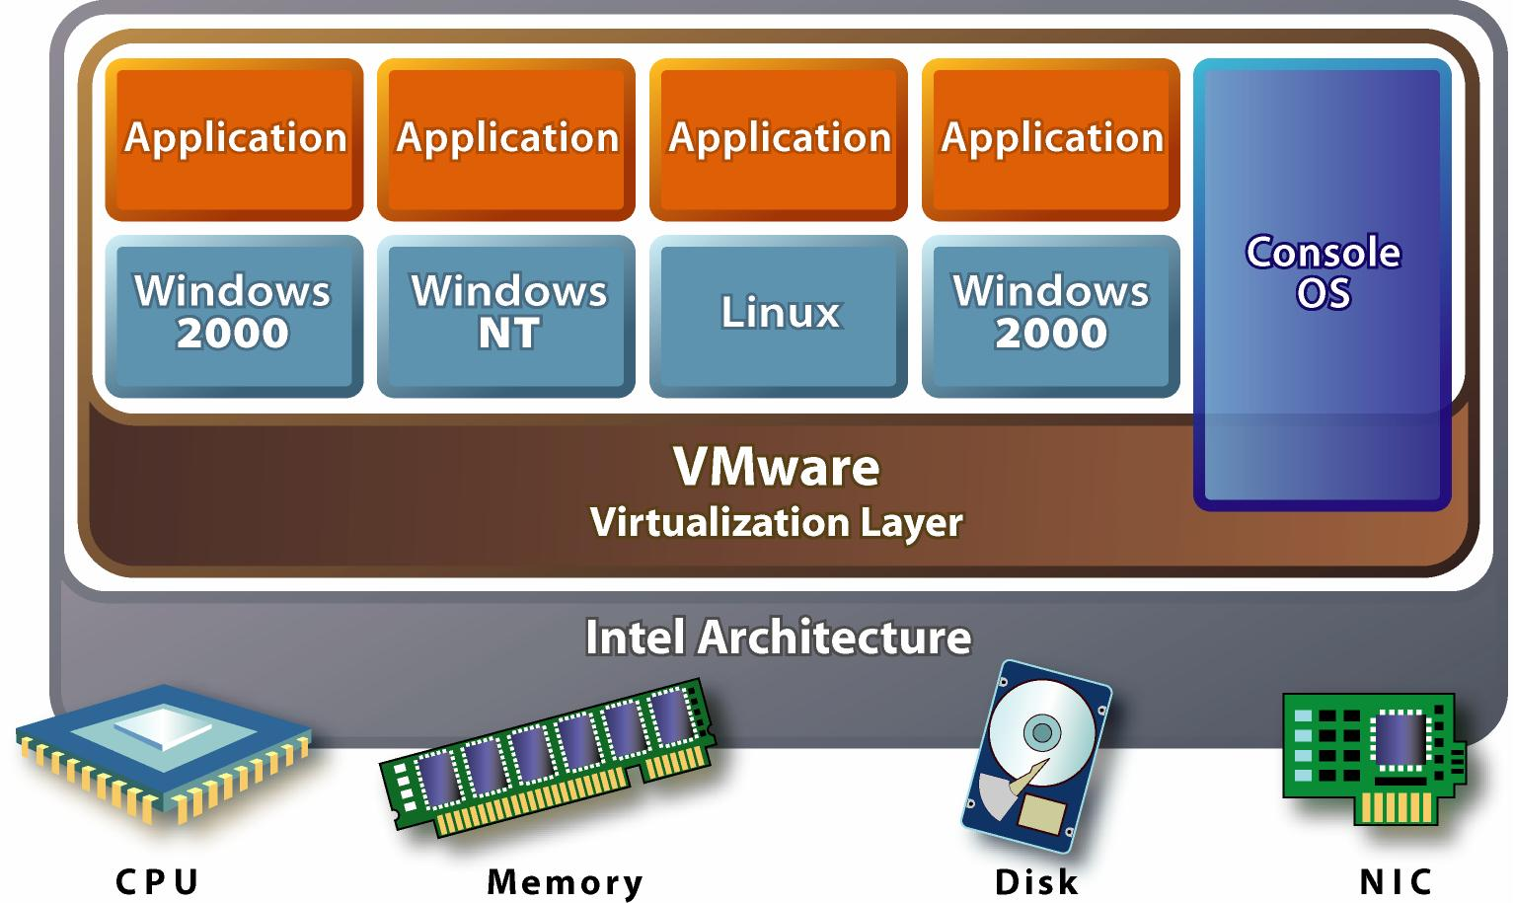
Multiple VMs in One Machine

Slide 5
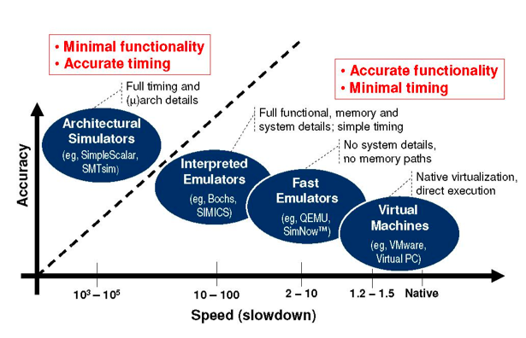
Performance of Virtualizations

Slide 6
History of Virtualization
Para-virtualization
Traditional-virtualization
HW-assist
1964 IBM CP-40
1972 IBM VM/370
1997 Virtual PC
1999 VMware
2003
Xen
2005
Intel VT
2006
AMD VT
2007
KVM-X86
2012
Xen-ARM
KVM-ARM
Mainframe
Virtualization
Desktop
Virtualization
Server
Virtualization
Cloud
Computing
Time Sharing
Virtual Memory
Mobile
Virtualization

Slide 7
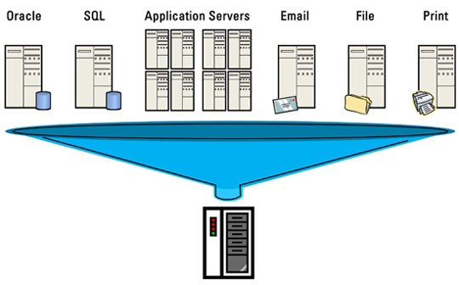
Example - Server Virtualization
http://www.energystar.gov/index.cfm?c=power_mgt.datacenter_efficiency_virtualization

Slide 8
Benefits of Server Virtualization
Virtualization can reduce data center energy expenses by 10%–40%
Virtualization also improves scalability, reduces downtime, and enables faster deployments.
Reduce the data center footprint

Slide 9
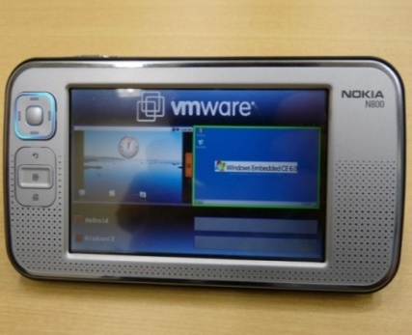
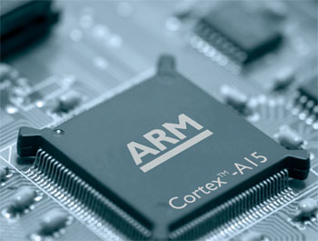
Example - Mobile Virtualization
Gartner predicted that by 2012, more than 50% of new smart phones shipped will be virtualized
VMware MVP
ARM Cortex-A15 enables efficient handling of the complex software environments including full hardware virtualization

Slide 10
Benefits of Mobile Virtualization
Portability
Multiple OSes on a single chip
Security
Dynamic Update of System Software
Legacy Code re-use
IP Protection
Mobile Manageability
Linux
RTOS
Linux
Security
Embedded
Hypervisor
Embedded
Hypervisor
P1
P2
P1
P2
multiple operating systems
security environment
Reference : http://en.wikipedia.org/wiki/Embedded_Hypervisor

Slide 11
Virtualization Techniques (1)
System Virtualization
  CPU Virtualization
  Memory Virtualization
  I/O Virtualization
Storage Virtualization
  LVM (Logical Volume Management)
  RAID
Network Virtualization
  Software Defined Network
  Open vSwitch
  InfiniBand Virtualization

Slide 12
Virtualization Techniques (2)
GPU Virtualization
Software Virtualization
  Virtual Desktop Infrastructure (VDI)
  EyeOS
Hardware Support Virtualization
  Intel VT
  ARM
  SRIOV
  MRIOV

Slide 13
Virtualization Techniques
System Virtualization
Storage Virtualization
Network Virtualization
GPU Virtualization
Software Virtualization
Hardware Support Virtualization

Slide 14
Virtual Machine (1)
A virtual machine (VM) is a software implementation of a machine that executes programs like a physical machine.
Virtual machines are separated into two major classifications
  A system virtual machine provides a complete system platform that supports the execution of a complete operating system (OS)
  A process virtual machine is designed to run a single program in a single process

Slide 15
Virtual Machine (2)
Guest Applications
Guest Operating System
Java Program
System VM
Process VM
VMware
Java Virtual Machine
We will focus on the system virtualization

Slide 16
System Virtual Machine
System virtual machine is controlled by a hypervisor or VMM (Virtual Machine Monitor)
A hypervisor or VMM is a software to provide a hardware emulation interface including CPU, memory, I/O by multiplexing host resources

Slide 17
Two Types of Hypervisor (1)
In their 1974 article "Formal Requirements for Virtualizable Third Generation Architectures" Gerald J. Popek and Robert P. Goldberg classified two types of hypervisor:
  Type 1 hypervisor : Bare metal type
  Type 2 hypervisor : Hosted type

Slide 18
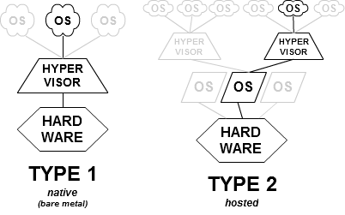
Two Types of Hypervisor (2)
Type 1 (or native, bare metal)
hypervisors
Type 2 (or hosted)
hypervisors

Slide 19
Purposes of Hypervisor
CPU Virtualization
  Handle all sensitive instructions by emulation
Memory Virtualization
  Allocate guest physical memory
  Translate guest virtual address to host virtual address
I/O Virtualization
  Emulate I/O devices for guest
  Ex: Keyboard, UART, Storage and Network

Slide 20
Implementations of Hypervisor
Full Virtualization
  A wholly emulated virtual machine makes guest operating system binary can be executed directly without modifying guest source code
  For efficiency, it needs hardware-assisted virtualization
Para-Virtualization
  Hypercalls are defined and used in a guest operating system to make a virtual machine abstraction
  According to literature, it’s most efficient way
Pre-Virtualization
  By compiling technique, guest operating system binary or source could be compiled for virtualization

Slide 21
Hypervisor Case - KVM
QEMU
VM 0
VM 1
I/O
Virtualization
Hypervisor
Linux + KVM
CPU Virtualization
MMU
Virtualization
Hardware
CPU
MMU
Timer
I/O
Interrupt
CPU and memory virtualizations are handled in the Linux Kernel Space
I/O virtualization is handled in the Linux User Space by QEMU
It’s a type 2 virtual machine
It’s a full virtualization implementation

Slide 22
Virtualization Techniques
System Virtualization
Storage Virtualization
Network Virtualization
GPU Virtualization
Software Virtualization
Hardware Support Virtualization

Slide 23
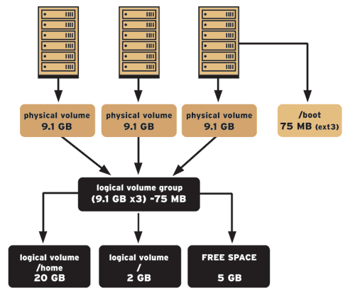
LVM
LVM is a logical volume manager for the Linux kernel
  It manages disk drives and similar mass-storage devices.
Logical Volume Manager

Slide 24
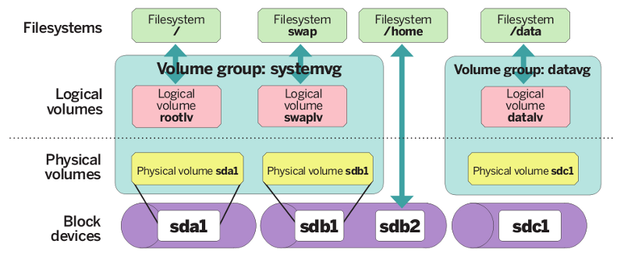
LVM - Example
Disk partition -> physical volumes -> volume group -> logical volumes -> file systems

Slide 25
RAID
RAID (redundant array of independent disks) is a storage technology that combines multiple disk drive components into a logical unit
Data is distributed across the drives in one of several ways called "RAID levels“, such as RAID0, RAID1, etc., depending on the level of redundancy and performance required

Slide 26
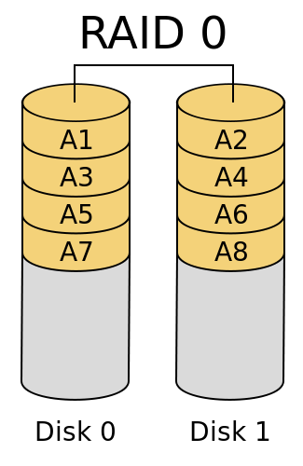
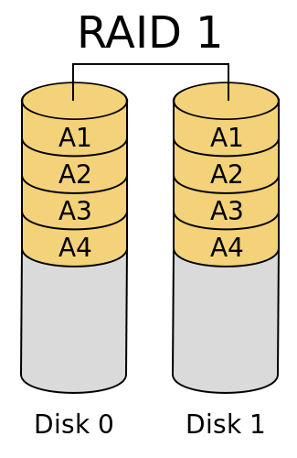
Example - RAID 0 and RAID 1
It provides improved performance and additional storage but no fault tolerance (block-level striping without parity or mirroring) .
mirroring without parity or striping

Slide 27
LVM and RIAD for Virtualization
LVM provides a virtual storage systems which is flexible to partition and allocate logical volumes to virtual machines
RAID not only improves storage performance but has fault tolerance capability
Leaning how to configure LVM and RAID in the virtualization system

Slide 28
Virtualization Techniques
System Virtualization
Storage Virtualization
Network Virtualization
GPU Virtualization
Software Virtualization
Hardware Support Virtualization

Slide 29
Software Defined Network (1)
Software defined networking (SDN) is an approach to building computer networks that separates and abstracts elements of these systems
SDN decouples the system that makes decisions about where traffic is sent (the control plane) from the underlying system that forwards traffic to the selected destination (the data plane)

Slide 30
Software Defined Network (2)
The inventors and vendors of these systems claim that this technology simplifies networking and enables new applications, such as
  Network virtualization in which the control plane is separated from the data plane and implemented in a software application.

Slide 31
Open vSwitch (1)
Open vSwitch is a flexible, multi-layer software network switch. Typically used in virtualization environments as the network switching component in the hypervisor.
Open vSwitch maintains the logical state of a virtual machine's network connection across physical hosts when a virtual machine is migrated, and it can be managed and monitored by standard protocols such as: OpenFlow, NetFlow, sFlow, SPAN, RSPAN.

Slide 32
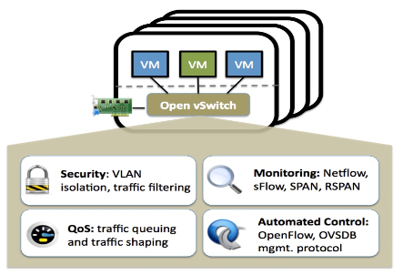
Open vSwitch (2)
When it comes to virtualization, open vSwitch is attractive because it provides the ability for a single controller to manage your virtual network across all your servers

Slide 33
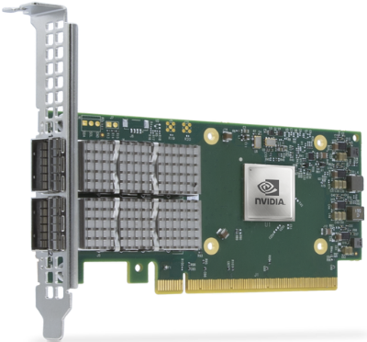
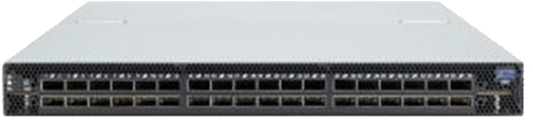
InfiniBand Virtualization
InfiniBand is a switched fabric communications link used in high-performance computing and enterprise data centers.
It has two key features : low latency and high bandwidth
Virtualization using InfiniBand brings big benefits to data centers

Slide 34
Virtualization Techniques
System Virtualization
Storage Virtualization
Network Virtualization
GPU Virtualization
Software Virtualization
Hardware Support Virtualization

Slide 35
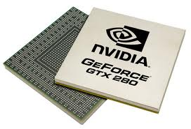
Graphics Processing Unit （GPU）
A Graphics Processing Units (GPUs) are high-performance many-core processors capable of very high computation and data throughput.

Slide 36
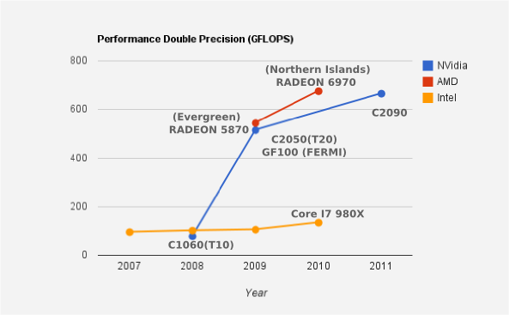
Performance Comparison - GPU vs. CPU
While the Intel Core I7 980X (extreme edition) gives us around 110GFLOPS, GPUs such as AMD Radeon 6970 and NVidia C2090 offer more than 660GFLOPS.

Slide 37
GPGPU
High performance of modern Graphics Processing Units may be utilized not only for graphics related application but also for general computing.
Today’s GPUs are general-purpose parallel processors with support for accessible programming interfaces and industry-standard languages such as C.
Developers who port their applications to GPUs often achieve speedups of orders of magnitude vs. optimized CPU implementations.

Slide 38
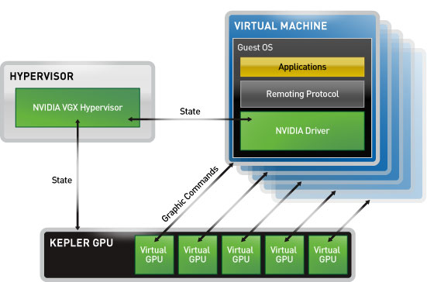
GPU Virtualization
GPU virtualization allows multiple virtual machines to interact directly with a GPU and manages the GPU resources so multiple users can share common hardware, while improving user density

Slide 39
Virtualization Techniques
System Virtualization
Storage Virtualization
Network Virtualization
GPU Virtualization
Software Virtualization
Hardware Support Virtualization

Slide 40
Software Virtualization
IT administrators have a lot to deal with in today’s corporate infrastructure. With the ever increasing prices of upgrading desktop computers, software virtualization is becoming very appealing.
It has following features:
  Ease of Management
  Security
  Green
  Portable

Slide 41
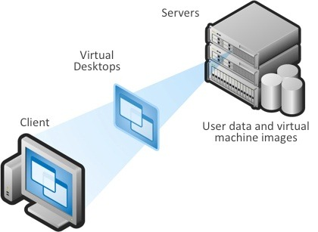
Virtual Desktop Infrastructure (VDI)
Virtual desktop Infrastructure (VDI) is a desktop-centric service that hosts users desktop environments on remote servers, which are accessed over a network using a remote display protocol.

Slide 42
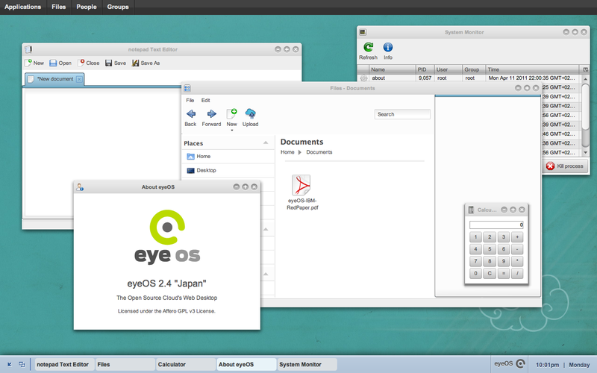
EyeOS - Web Desktop Virtualization
eyeOS is a web desktop following the cloud computing concept that seeks to enable collaboration and communication among users. It is mainly written in PHP, XML, and JavaScript

Slide 43
Virtualization Techniques
System Virtualization
Storage Virtualization
Network Virtualization
GPU Virtualization
Software Virtualization
Hardware Support Virtualization

Slide 44
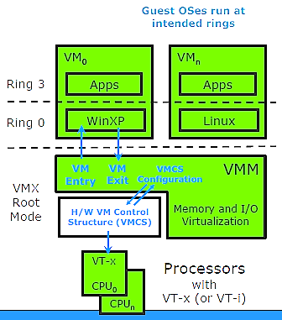
Intel VT-x
New CPU Operating Mode
  VMX Root Operation
  Non-Root Operation
New Transitions
  VM entry to Guest
  VM exit to VMM
VM Control Structure
  Configured by VMM software

Slide 45
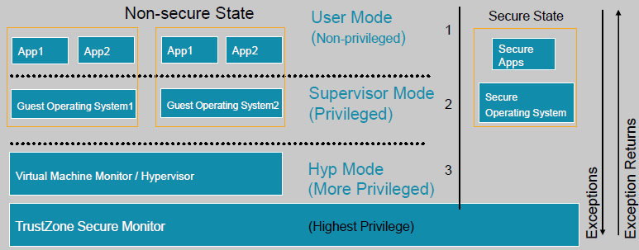
ARM Virtualization Extension
Secure world supports a single virtual machine
New Non-secure level of privilege to hold Hypervisor
  Hypervisor mode applies to normal world
  Hyp Mode is used by the Hypervisor
  Guest OS given same kernel/user privilege structure as for a non virtualized environment
Monitor mode controls transition between worlds

Slide 46
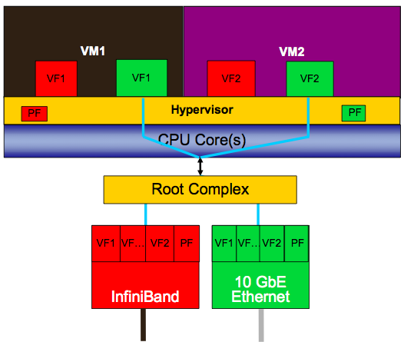
Single-Root I/O Virtualization
PCI-SIG specifies multiple functional elements addressing performance and security aspects of I/O virtualization
PCIe devices will have multiple virtual functions (VF’s)

Slide 47
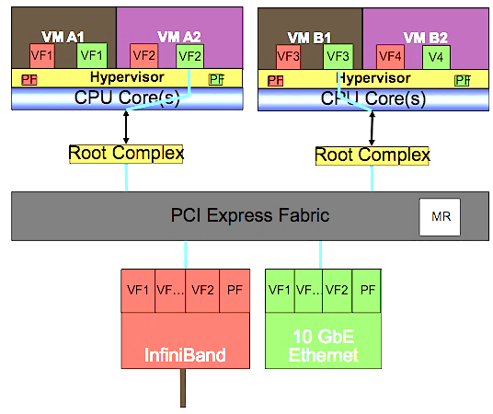
Multi-Root I/O Virtualization
Multiple hardware domains utilizing same IO endpoints
Virtual functions are dedicated to virtual machines

