Slide 1
Chapter 13
File-System Interface

Slide 2
Outline
File Concept
Access Methods
Disk and Directory Structure
Protection
Memory-Mapped Files

Slide 3
Objectives
To explain the function of file systems
To describe the interfaces to file systems
To discuss file-system design tradeoffs, including access methods, file sharing, file locking, and directory structures
To explore file-system protection

Slide 4
File Concept
Contiguous logical address space
Types:
  Data
    Numeric
    Character
    Binary
  Program
Contents defined by file’s creator
  Many types
    text file,
    source file,
    executable file

Slide 5
File Attributes
Name – only information kept in human-readable form
Identifier – unique tag (number) identifies file within file system
Type – needed for systems that support different types
Location – pointer to file location on device
Size – current file size
Protection – controls who can do reading, writing, executing
Time, date, and user identification – data for protection, security, and usage monitoring
Information about files are kept in the directory structure, which is maintained on the disk
Many variations, including extended file attributes such as file checksum
Information kept in the directory structure

Slide 6
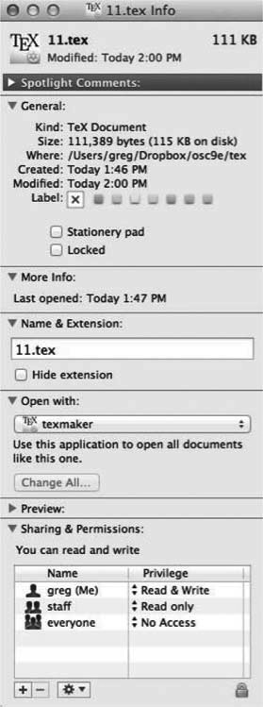
File info Window on Mac OS X

Slide 7
Directory Structure
A collection of nodes containing information about all files
Both the directory structure and the files reside on disk

Slide 8
File Operations
Create
Write – at write pointer location
Read – at read pointer location
Reposition within file - seek
Delete
Truncate
Open (F_{i}) – search the directory structure on disk for entry F_{i}, and move the content of entry to memory
Close (F_{i}) – move the content of entry F_{i} in memory to directory structure on disk

Slide 9
Open Files
Several pieces of data are needed to manage open files:
  Open-file table: tracks open files
  File pointer: pointer to last read/write location, per process that has the file open
  File-open count: counter of number of times a file is open – to allow removal of data from open-file table when last processes closes it
  Disk location of the file: cache of data access information
  Access rights: per-process access mode information

Slide 10
File Locking
Provided by some operating systems and file systems
  Similar to reader-writer locks
  Shared lock similar to reader lock – several processes can acquire concurrently
  Exclusive lock similar to writer lock
Mediates access to a file
Mandatory or advisory:
  Mandatory – access is denied depending on locks held and requested
  Advisory – processes can find status of locks and decide what to do

Slide 11
File Locking Example – Java API (1)
import java.io.*;
import java.nio.channels.*;
public class LockingExample {
public static final boolean EXCLUSIVE = false;
public static final boolean SHARED = true;
public static void main(String arsg[]) throws IOException {
FileLock sharedLock = null;
FileLock exclusiveLock = null;
try {
RandomAccessFile raf = new RandomAccessFile("file.txt", "rw");
// get the channel for the file
FileChannel ch = raf.getChannel();
// this locks the first half of the file - exclusive
exclusiveLock = ch.lock(0, raf.length()/2, EXCLUSIVE);
/** Now modify the data . . . */
// release the lock
exclusiveLock.release();

Slide 12
File Locking Example – Java API (2)
// this locks the second half of the file - shared
sharedLock = ch.lock(raf.length()/2+1, raf.length(), SHARED);
/** Now read the data . . . */
// release the lock
sharedLock.release();
} catch (java.io.IOException ioe) {
System.err.println(ioe);
}finally {
if (exclusiveLock != null)
exclusiveLock.release();
if (sharedLock != null)
sharedLock.release();
}
}
}

Slide 13
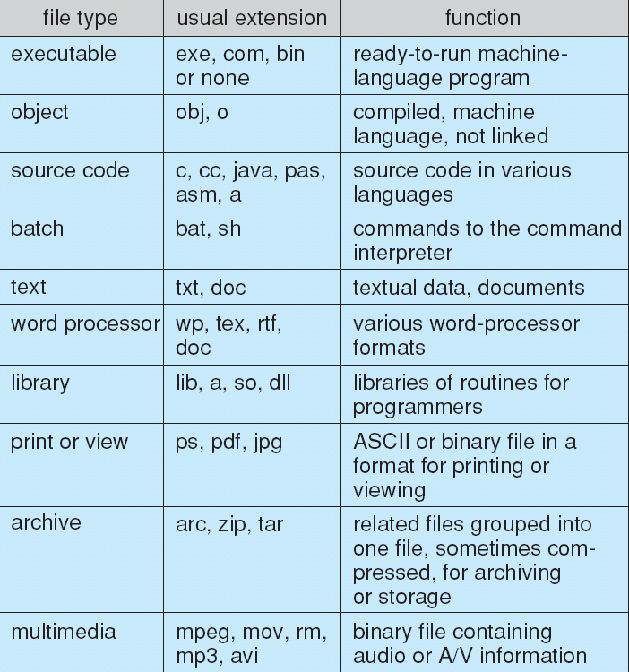
File Types – Name, Extension

Slide 14
File Structure
None - sequence of words, bytes
Simple record structure
  Lines
  Fixed length
  Variable length
Complex Structures
  Formatted document
  Relocatable load file
Can simulate last two with first method by inserting appropriate control characters
Who decides:
  Operating system
  Program

Slide 15
Access Methods
A file is fixed length logical records
Sequential Access
Direct Access
Other Access Methods

Slide 16
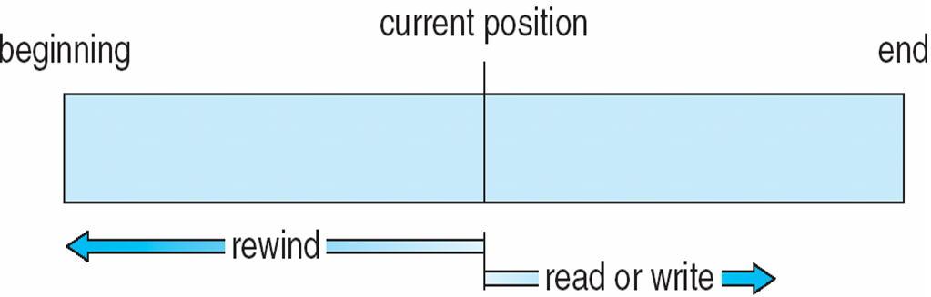
Sequential Access
Operations
  read next
  write next
  Reset
  no read after last write (rewrite)
Figure

Slide 17
Direct Access (1)
Operations
  read n
  write n
  position to n
    read next
    write next
    rewrite n
n = relative block number
Relative block numbers allow OS to decide where file should be placed

Slide 18
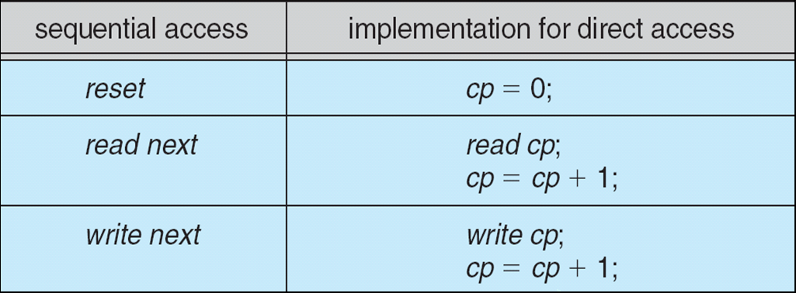
Direct Access (2)
Simulation of Sequential Access on Direct-access File

Slide 19
Other Access Methods
Can be other access methods built on top of base methods
General involve creation of an index for the file
Keep index in memory for fast determination of location of data to be operated on (consider Universal Produce Code (UPC code) plus record of data about that item)
If the index is too large, create an in-memory index, which an index of a disk index
IBM indexed sequential-access method (ISAM)
  Small master index, points to disk blocks of secondary index
  File kept sorted on a defined key
  All done by the OS
VMS operating system provides index and relative files as another example (see next slide)

Slide 20
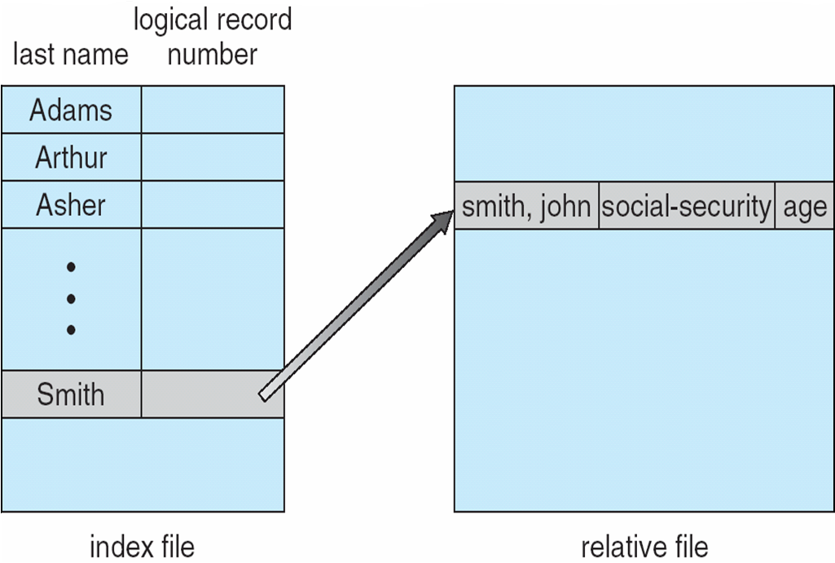
Example of Index and Relative Files

Slide 21
Disk Structure
Disk can be subdivided into partitions
Disks or partitions can be RAID protected against failure
Disk or partition can be used raw – without a file system, or formatted with a file system
Partitions also known as minidisks, slices
Entity containing file system is known as a volume
Each volume containing a file system also tracks that file system’s info in device directory or volume table of contents
In addition to general-purpose file systems there are many special-purpose file systems, frequently all within the same operating system or computer

Slide 22
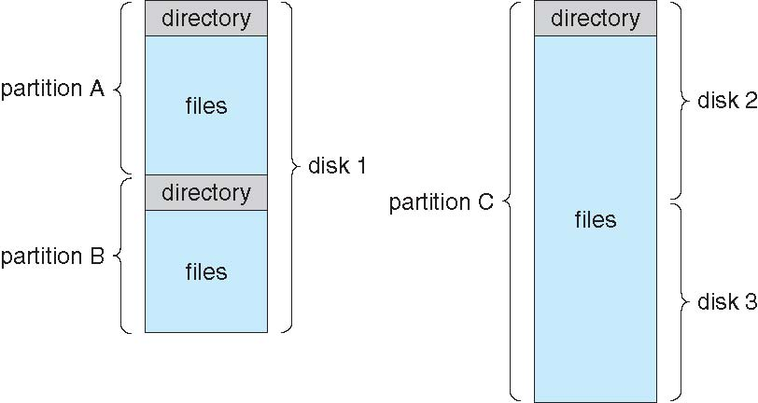
A Typical File-System Organization

Slide 23
Types of File Systems
We mostly talk of general-purpose file systems
But systems frequently have may file systems, some general- and some special- purpose
Consider Solaris has
  tmpfs – memory-based volatile FS for fast, temporary I/O
  objfs – interface into kernel memory to get kernel symbols for debugging
  ctfs – contract file system for managing daemons
  lofs – loopback file system allows one FS to be accessed in place of another
  procfs – kernel interface to process structures
  ufs, zfs – general purpose file systems

Slide 24
Directory Structure
A collection of nodes containing information about all files
Both the directory structure and the files reside on disk

Slide 25
Operations Performed on Directory
Search for a file
Create a file
Delete a file
List a directory
Rename a file
Traverse the file system

Slide 26
Directory Organization
The directory is organized logically to obtain
  Efficiency – locating a file quickly
  Naming – convenient to users
    Two users can have same name for different files
    The same file can have several different names
  Grouping – logical grouping of files by properties, (e.g., all Java programs, all games, …)

Slide 27
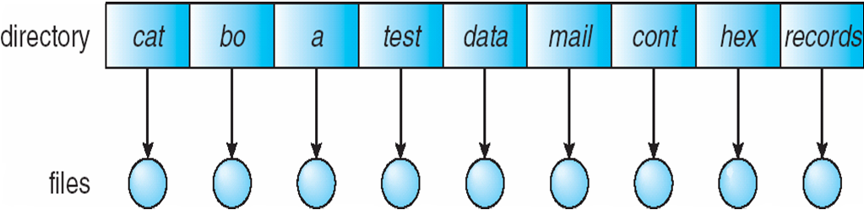
Single-Level Directory
A single directory for all users
Naming problem
Grouping problem

Slide 28
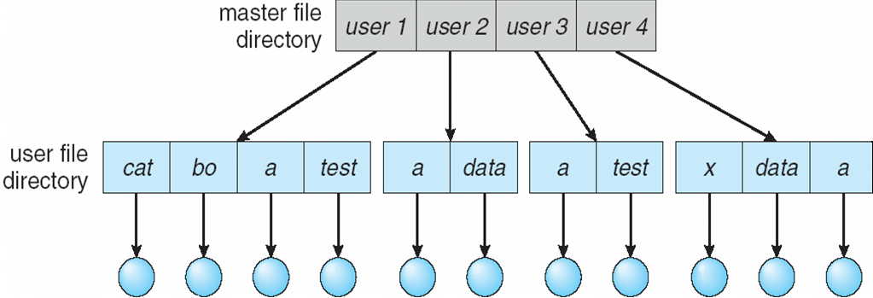
Two-Level Directory
Separate directory for each user
Path name
Can have the same file name for different user
Efficient searching
No grouping capability

Slide 29
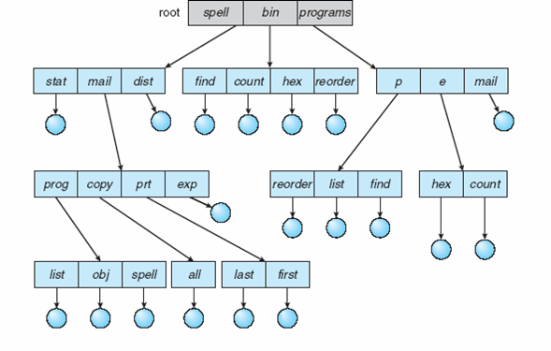
Tree-Structured Directories

Slide 30
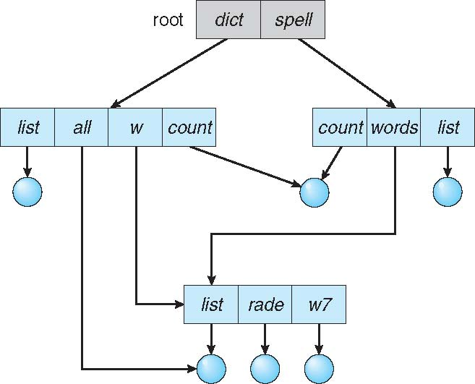
Acyclic-Graph Directories (1)
Have shared subdirectories and files
Example

Slide 31
Acyclic-Graph Directories (2)
Two different names (aliasing)
If dict deletes w/list ⇒ dangling pointer
Solutions:
  Backpointers, so we can delete all pointers.
    Variable size records a problem
  Backpointers using a daisy chain organization
  Entry-hold-count solution
New directory entry type
  Link – another name (pointer) to an existing file
  Resolve the link – follow pointer to locate the file

Slide 32
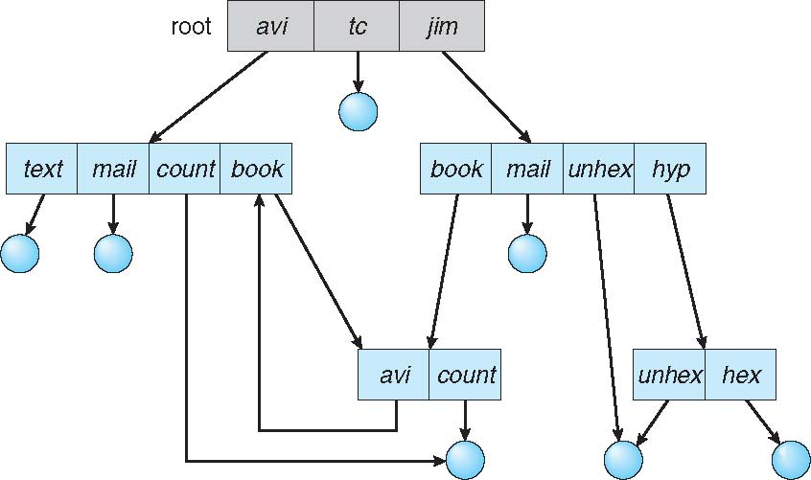
General Graph Directory (1)

Slide 33
General Graph Directory (2)
How do we guarantee no cycles?
  Allow only links to files not subdirectories
  Garbage collection
  Every time a new link is added use a cycle detection algorithm to determine whether it is OK

Slide 34
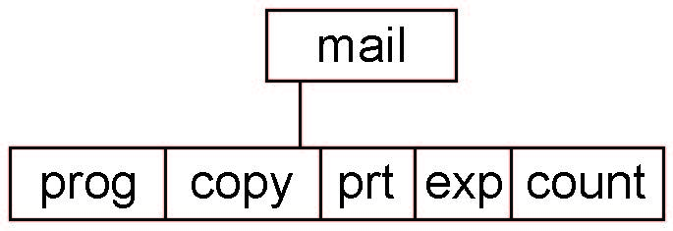
Current Directory
Can designate one of the directories as the current (working) directory
  cd /spell/mail/prog
  type list
Creating and deleting a file is done in current directory
Example of creating a new file
  If in current directory is /mail
  The command
mkdir <dir-name>
  Results in:
  Deleting “mail” ⇒ deleting the entire subtree rooted by “mail”

Slide 35
Protection
File owner/creator should be able to control:
  What can be done
  By whom
Types of access
  Read
  Write
  Execute
  Append
  Delete
  List

Slide 36
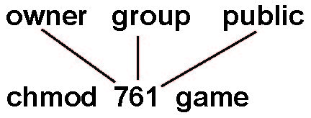
Access Lists and Groups in Unix
Mode of access: read, write, execute
Three classes of users on Unix / Linux
RWX
a) owner access 7 ⇒ 1 1 1
RWX
b) group access 6 ⇒ 1 1 0
RWX
c) public access 1 ⇒ 0 0 1
Ask manager to create a group (unique name), say G, and add some users to the group.
For a file (say game) or subdirectory, define an appropriate access.
Attach a group to a file
chgrp G game

Slide 37
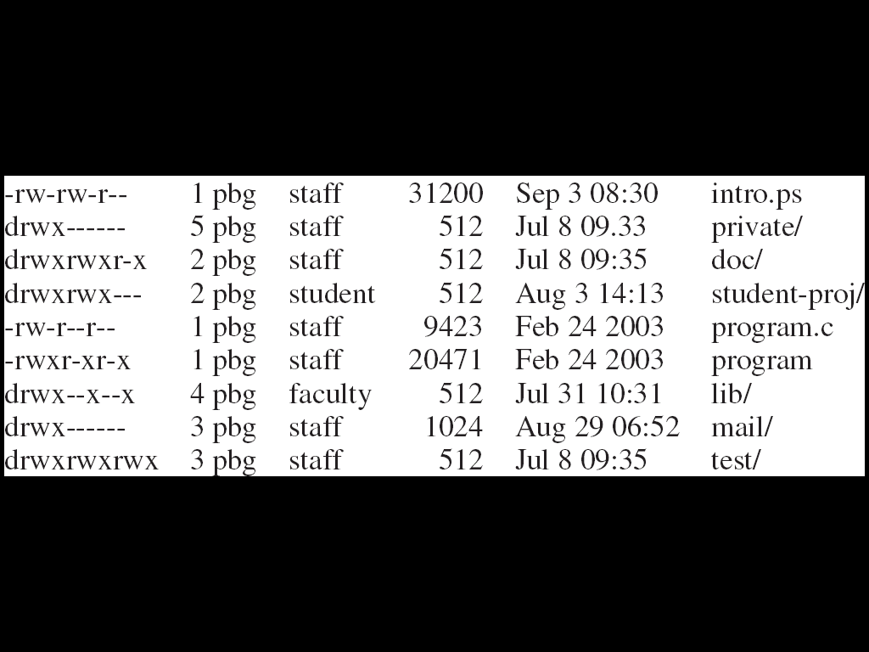
A Sample UNIX Directory Listing

Slide 38
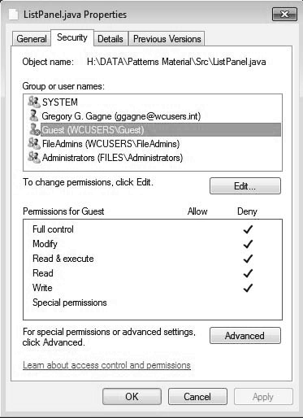
Windows 7 Access-Control List Management

Slide 39
End of Chapter 13

