Slide 1
CSC3150 – Operating Systems
Prof. Yeh-Ching Chung
School of Data Science
Chinese University of Hong Kong, Shenzhen

Slide 2
Final Examination Information
Close book examination
Date
December 7, 2025
Venue
TB102, TB104, and TB105
Time
12:00-15:00
Scope
Chapters 1-5, 9-12

Slide 3
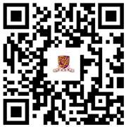
Course Teaching Evaluation (CTE)
Link to OCTE: https://octe.cuhk.edu.cn
QR code to OCTE

