Slide 1
Scaling Graph Neural Networks: Innovations in Distributed and Decentralized Training for Billion-Scale Graphs 2024.11.28
Yuayang Liang
School of Data Science
Chinese University of Hong Kong, Shenzhen

Slide 2
Outline
Introduction (3 min)
Background & Motivation (5 min)
Proposed Methods & Performance Evaluation (30 min)
DistDGL (10 min)
ByteGNN (10 min)
SANCUS (10 min)
Conclusions (2 min)
Q & A (5 min)

Slide 3
Outline
Introduction (3 min)
Background & Motivation (5 min)
Proposed Methods & Performance Evaluation (30 min)
DistDGL (10 min)
ByteGNN (10 min)
SANCUS (10 min)
Conclusions (2 min)
Q & A (5 min)

Slide 4
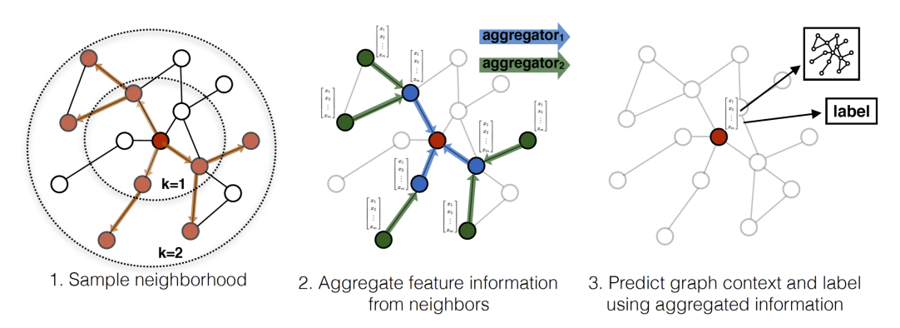
Introduction – GNN (1/3)
What is GNN?
A Graph Neural Network (GNN) is a type of neural network designed to work directly with graph-structured data.
Graphs consist of nodes (representing entities) and edges (representing relationships between entities).

Slide 5
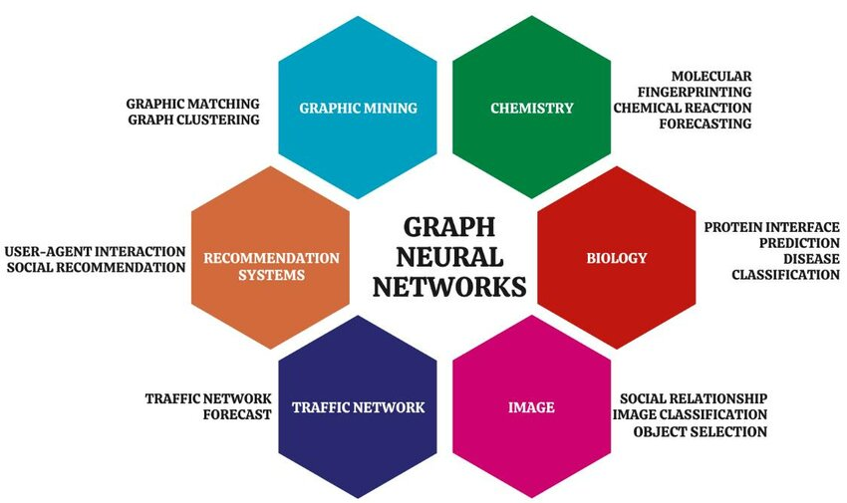
Introduction – GNN (2/3)
Why use GNN?
Many real-world systems, such as social networks, biological networks, and recommendation systems, are naturally represented as graphs.
GNNs leverage the structural and relational information in graphs to make predictions or extract features.

Slide 6
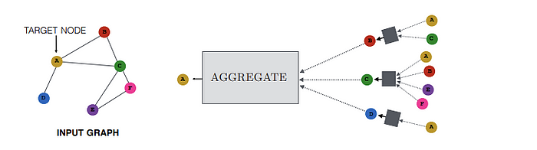
Introduction – GNN (3/3)
How GNNs work?
Core Idea: Message Passing
GNNs iteratively update node embeddings by aggregating information from neighboring nodes.
First collect information from neighbors. Then combine aggregated messages with the current node's features.

Slide 7
Outline
Introduction (3 min)
Background & Motivation (5 min)
Proposed Methods & Performance Evaluation (30 min)
DistDGL (10 min)
ByteGNN (10 min)
SANCUS (10 min)
Conclusions (2 min)
Q & A (5 min)

Slide 8
Background & Motivation (1/4)
Challenges of GNN:
Large-Scale Graphs: Real-world graphs often have millions or billions of nodes and edges (e.g., social networks, citation networks). Directly loading and processing such graphs is memory-intensive and computationally expensive.
Neighbor Explosion: Each node aggregates information from its neighbors, and this dependency grows exponentially with deeper layers. This results in a significant increase in computation and memory requirements.

Slide 9
Background & Motivation (2/4)
Solution: Distributed Mini-batch Training
Instead of processing the entire graph, sample subsets (mini-batches) of nodes or edges as subgraphs. Only compute updates for the sampled nodes/subgraphs. Elevate the performance by distributed computing.
Two Phases:
Sampling: For each vertex v in the mini-batch, the sampler samples a limited number of neighbors of v in each hop, fetches the sampled remote neighbors to the local machine, and constructs the neighborhood subgraph of v from its sampled neighbors locally.
Training: The trainer trains the model on the neighborhood subgraphs of the vertices in the mini-batch locally.

Slide 10
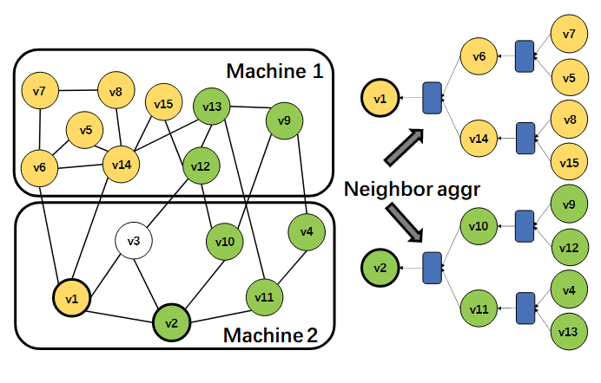
Background & Motivation (3/4)
Solution: Distributed Mini-batch Training

Slide 11
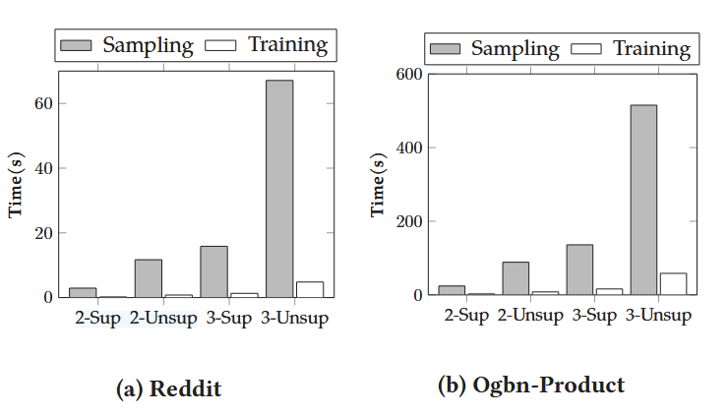
Background & Motivation (4/4)
New problem encountered:
Sampling phase takes most of time.
Overhead of communication is large.
How to improve?
Better sampling strategy.
Better system structure design.
Other solutions…

Slide 12
Outline
Introduction (3 min)
Background & Motivation (5 min)
Proposed Methods & Performance Evaluation (30 min)
DistDGL (10 min)
ByteGNN (10 min)
SANCUS (10 min)
Conclusions (2 min)
Q & A (5 min)

Slide 13
Outline
Introduction (3 min)
Background & Motivation (5 min)
Proposed Methods & Performance Evaluation (30 min)
DistDGL (10 min)
ByteGNN (10 min)
SANCUS (10 min)
Conclusions (2 min)
Q & A (5 min)

Slide 14
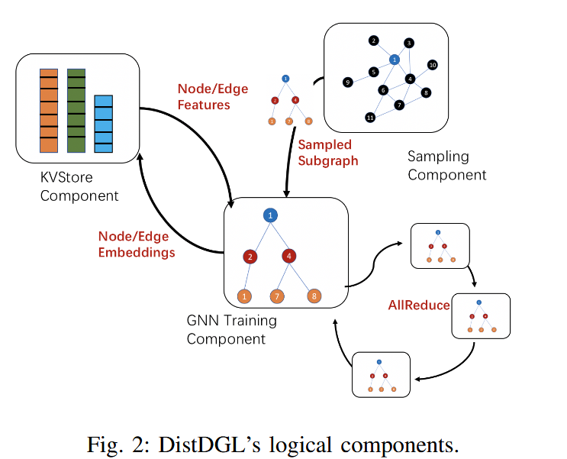
DistDGL (1/6)
Architecture Overview
Sampler: Sampling the minibatch graph structures from the input graph.
KVStore: Stores all vertex data and edge data distributedly.
Trainer: Compute the gradients of the model parameters over a mini-batch.
Dense model update component: Aggregating dense GNN parameters to perform synchronous SGD (stochastic gradient descent).

Slide 15
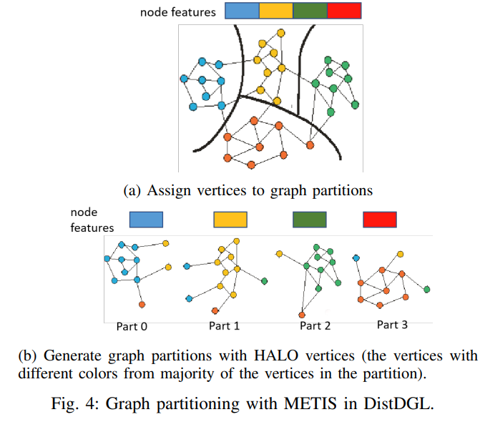
DistDGL (2/6)
Graph Partitioning
METIS: Assigns densely connected vertices to the same partition to reduce the number of edge cuts between partitions.
After assigning some vertices to a partition, DistDGL assigns all incident edges of these vertices to the same partition. (Duplicated vertices: HALO vertices)
To reduce memory complexity, DistDGL extended METIS to only retain a subset of the edges in each successive graph so that the degree of each coarse vertex is the average degree of its constituent vertices.

Slide 16
DistDGL (3/6)
Distributed Key-Value Store
Use shared memory for fast data access.
The KVStore server shares all data with the trainer process via shared memory. Thus, trainers can access most of the data directly without paying any overhead of communication and process/thread scheduling.
Support sparse embedding for training transductive models with learnable vertex embeddings.

Slide 17
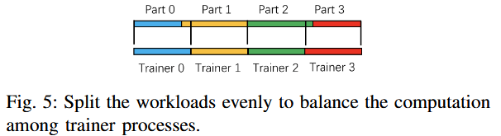
DistDGL (4/6)
Trainer
Split the training set evenly across all trainers at the beginning of distributed training.
METIS can only assign roughly the same number of training samples to each partition.
Evenly split the training samples based on their IDs and assign the ID range to a machine whose graph partition has the largest overlap with the ID range.
A tradeoff between load balancing and data locality.
Use synchronous SGD to update dense model parameters.
Use OpenMP to parallelize the framework operator computation.

Slide 18
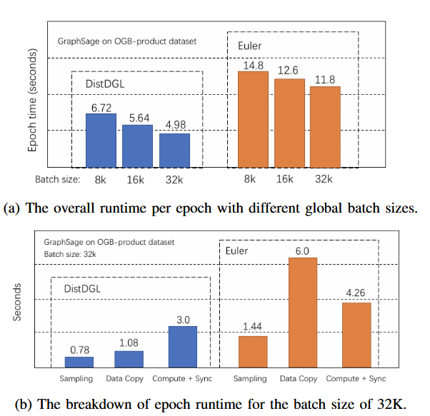
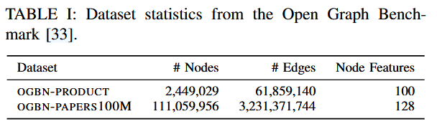
DistDGL (5/6)
Evaluation

Slide 19
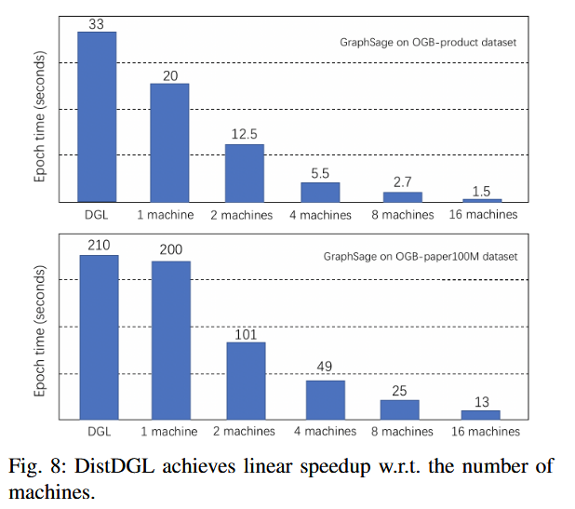
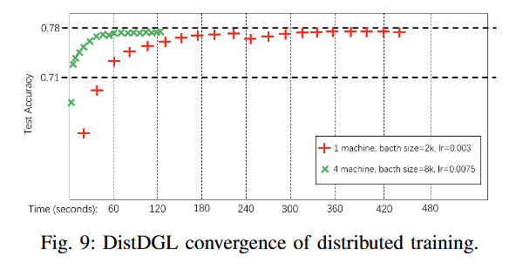
DistDGL (6/6)
Evaluation

Slide 20
Outline
Introduction (3 min)
Background & Motivation (5 min)
Proposed Methods & Performance Evaluation (30 min)
DistDGL (10 min)
ByteGNN (10 min)
SANCUS (10 min)
Conclusions (2 min)
Q & A (5 min)

Slide 21
ByteGNN (1/15)
Architecture Overview
Graph Store stores a partition of the input graph data and the Graph Stores of all machines form a distributed Graph Store.
PS is a parameter server that stores the model parameters.
Sampling Worker (S-Worker) handles the sampling phase and constructs sampled neighborhood subgraphs for sampled seed vertices.
Training Worker (T-Worker) handles the training phase, which computes model gradients on the sampled neighborhood subgraphs constructed by the S-Worker in the same machine and synchronizes the gradients with PS to update the model parameters.

Slide 22
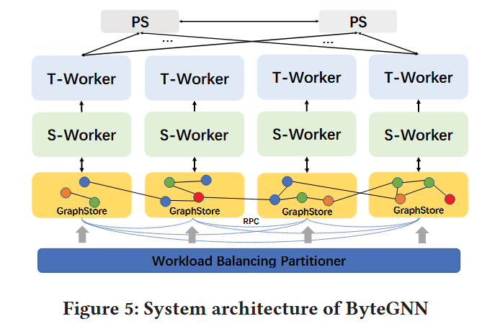
ByteGNN (2/15)

Slide 23
ByteGNN (3/15)
Mini-Batch Graph Sampling
ByteGNN models the sampling process as a DAG of tasks
A common abstraction for the sampling phase of GNNs with five operators:
Seed Sampler: sampling a set of vertices as seeds from the local graph store;
Positive Sampler: sampling vertices from the direct neighbors of each seed;
Negative Sampler: sampling vertices from those that are not the direct neighbors of each seed;
Neighborhood Subgraph Construction (NSC): sampling vertices from the multi-hop neighborhood of a given vertex and constructing the sampled neighborhood subgraph;
Feature Fetching: fetching the attributes of a given vertex/edge to construct its feature vector.

Slide 24
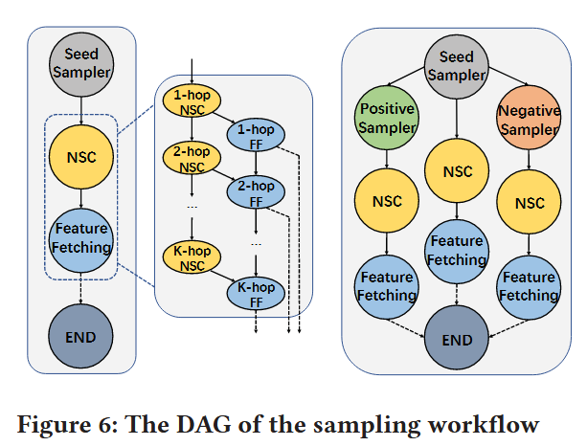
ByteGNN (4/15)
Abstraction of Mini-Batch Graph Sampling

Slide 25
ByteGNN (5/15)
Two-Level Scheduling
Designed to improve CPU utilization and reduce the end-to-end GNN training time.
Coarse-grained scheduling
The S-Worker in each machine executes multiple DAGs in parallel to increase throughput and reduce the end-to-end GNN training time.
How many DAGs should be launched in a machine?
Fine-grained scheduling
DAG tasks are put in a queue when their dependency is cleared (i.e., their parent tasks in the DAG are completed) and are handled by a pool of processing threads.
How to do the scheduling of these tasks?

Slide 26
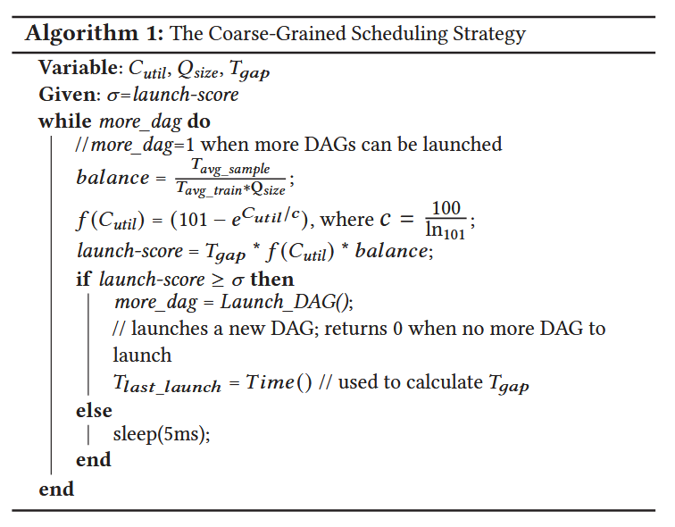
ByteGNN (6/15)
Coarse-grained scheduling
C_{util}: the CPU utilization rate
Q_{size}: the size of the queue
T_{gap}: time gap elapsed since the previous DAG launch.

Slide 27
ByteGNN (7/15)
Fine-grained scheduling
Schedule tasks according to the following orders: (1) tasks in a DAG with a smaller ID will be executed first; (2) tasks in the same DAG will be executed in ascending order of their costs (the number of vertices/edges to be fetched multiplied by the vertex/edge feature dimension.)

Slide 28
ByteGNN (8/15)
GNN-based Graph Partitioning
The main idea is to group vertices into multi-hop neighborhood-based blocks and then assign these blocks to partitions by balancing the numbers of training, validation and test vertices in the partitions.
Step 1: Neighborhood Block Construction
Start a K-hop breadth-first search from each vertex v (v is called the block center) and broadcast the unique block ID of v to its K-hop neighbors being visited.
Every vertex only keeps the first block ID it receives, except for block centers which keep their own block ID.
A block is then formed of all the vertices that keep the same block ID.
Step 2: Block Assignment

Slide 29
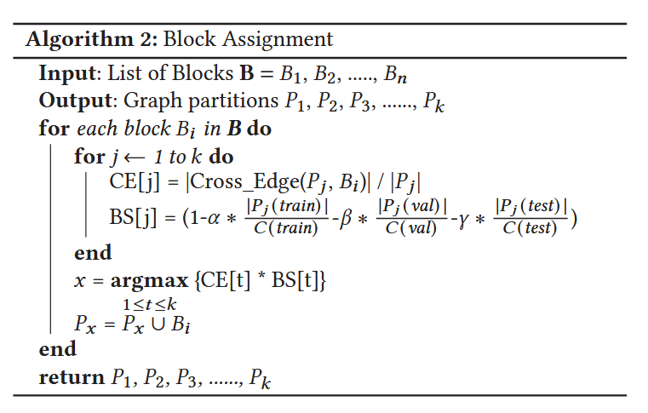
ByteGNN (9/15)
P_{j} is the set of vertices that have already been assigned to partition j.
CE [ j] is the number of cross-edges between B_{i} and P_{j}.
BS [ j] is the balancing score that controls the number of training/validation/test vertices in partition j to be close to the average value.

Slide 30
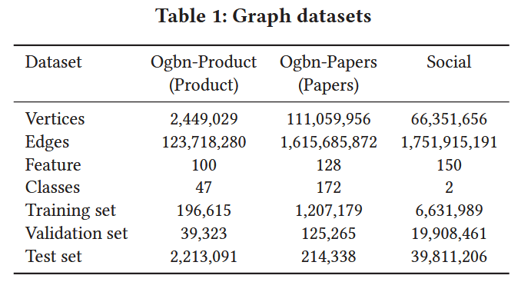
ByteGNN (10/15)
Evaluation

Slide 31
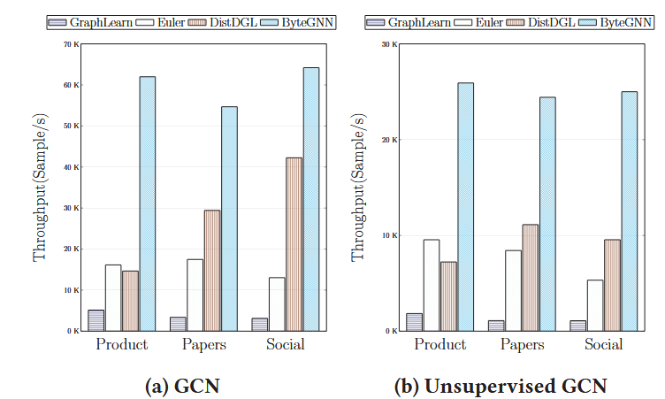
ByteGNN (11/15)
Evaluation

Slide 32
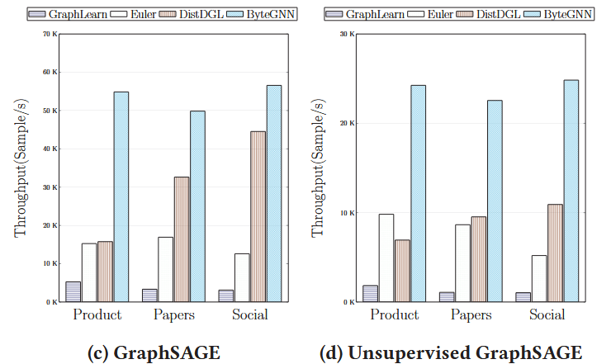
ByteGNN (12/15)
Evaluation

Slide 33
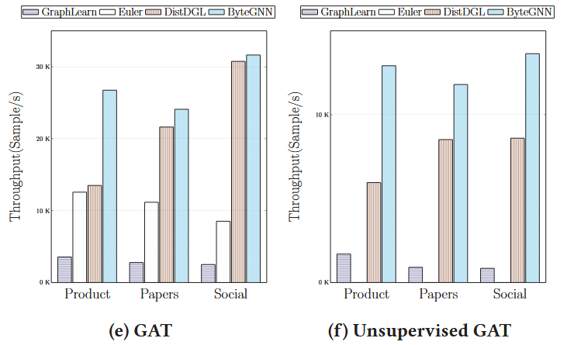
ByteGNN (13/15)
Evaluation

Slide 34
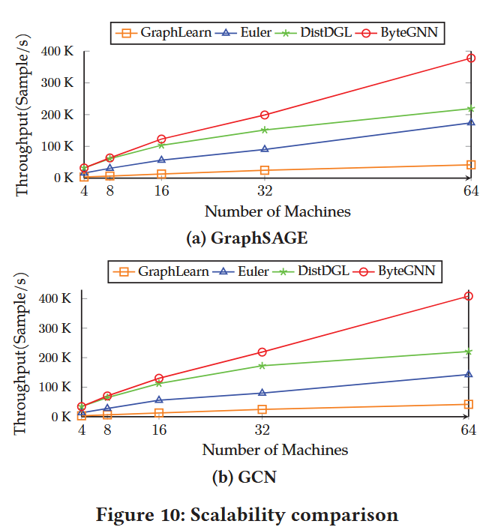
ByteGNN (14/15)
Evaluation

Slide 35
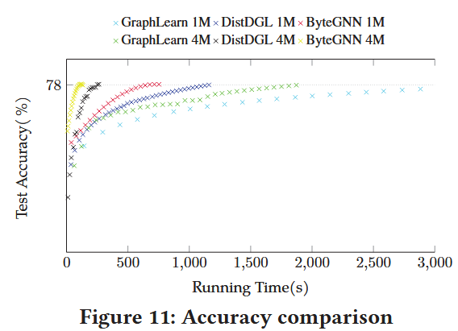
ByteGNN (15/15)
Evaluation

Slide 36
Outline
Introduction (3 min)
Background & Motivation (5 min)
Proposed Methods & Performance Evaluation (30 min)
DistDGL (10 min)
ByteGNN (10 min)
SANCUS (10 min)
Conclusions (2 min)
Q & A (5 min)

Slide 37
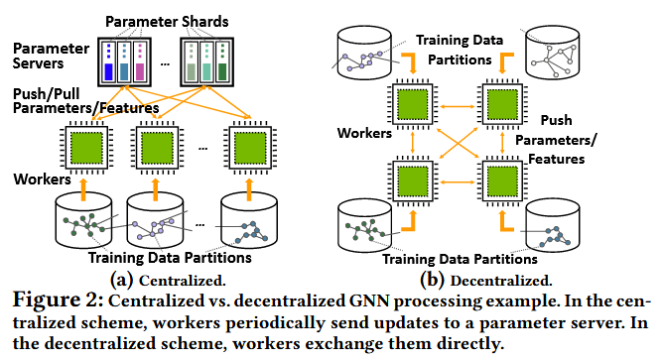
SANCUS (1/9)

Slide 38
SANCUS (2/9)
Pipeline Overview
Data Loading: The whole sparse adjacency matrix of the full graph and the dense embedding matrix are split into matrix blocks, then loaded to individual worker. Each worker keeps its own replica of the full model.
Staleness Bound Checking: On each GPU, check whether the staleness of historical embeddings are within proposed bounds. If the staleness is within bounds, the embedding broadcast is skipped and the cached historical embeddings are reused for this iteration’s model computing.
Embedding Broadcasting: If the staleness exceeds the limit, the latest results are broadcast to all workers and updated in cache.
GNN Model Computing: Either latest embeddings or cached historical embeddings are loaded to the GNN model to compute.
Results Caching: Updated embeddings are dispatched to next iteration’s staleness check before the broadcast.

Slide 39
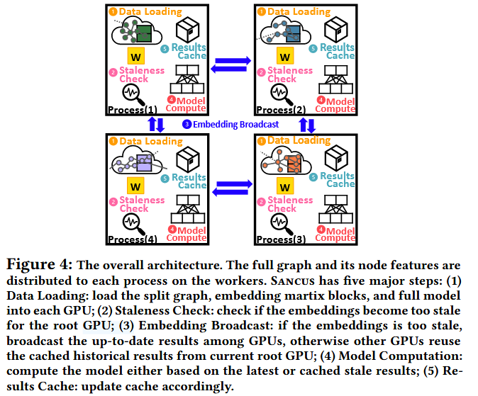
SANCUS (3/9)

Slide 40
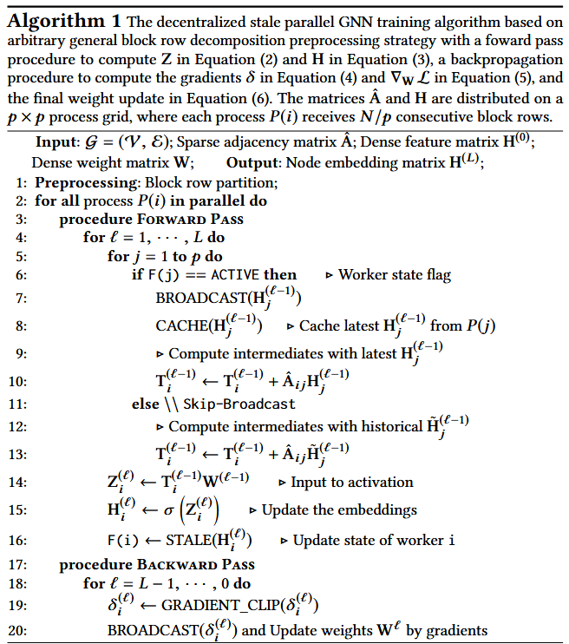
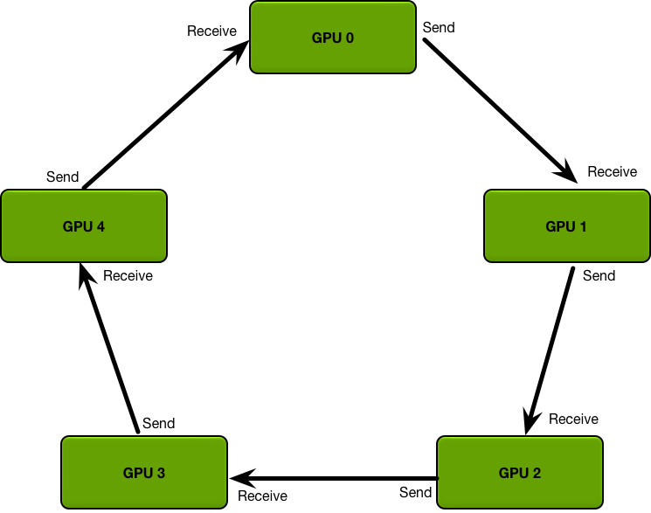
SANCUS (4/9)
Ring-Allreduce Architecture Applied

Slide 41
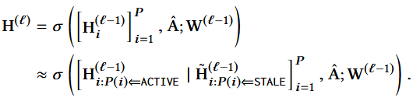
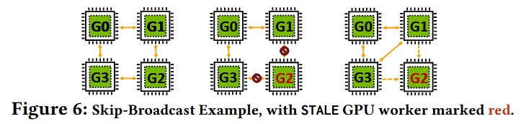
SANCUS (5/9)
Historical Embedding
Skip-Broadcast
Allowing seamlessly reshape ring-based communication topology.

Slide 42

SANCUS (6/9)
Bounded Embedding Staleness
Epoch-Fixed Embedding Staleness
|epoch number of stale embedding - current epoch| <= threshold
Epoch-Adaptive Embedding Staleness
|epoch number of stale embedding – in-coming neighbor process epoch number| <= threshold
Epoch-Adaptive Variation-Gap Embedding Staleness

Slide 43
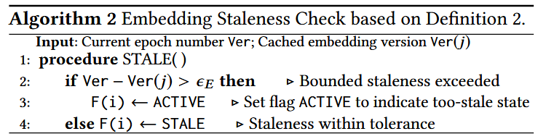
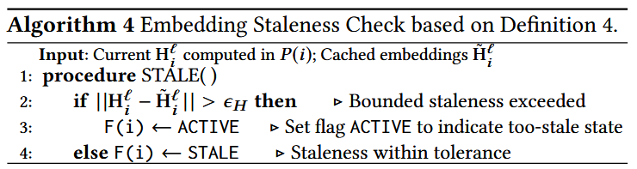
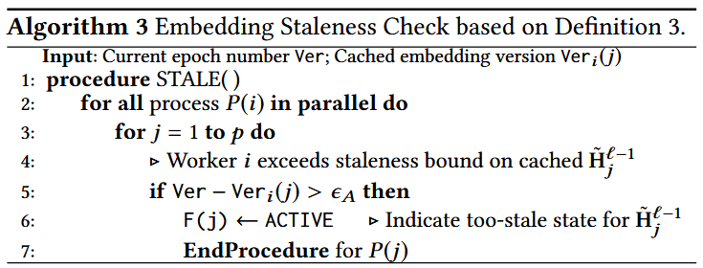
SANCUS (7/9)
Bounded Embedding Staleness

Slide 44
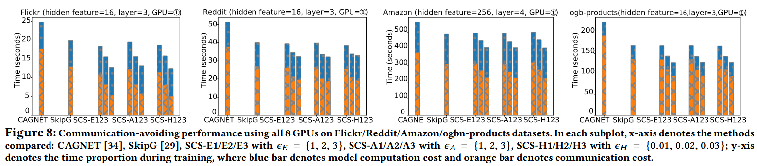
SANCUS (8/9)
Evaluation

Slide 45
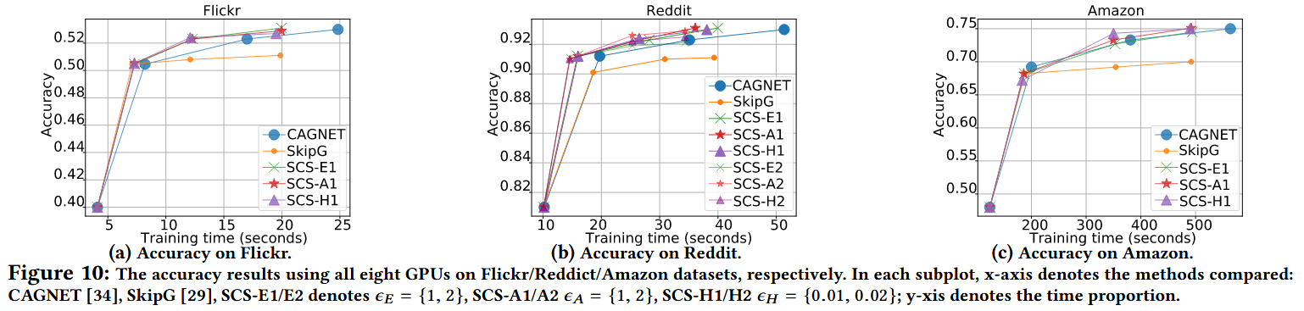
SANCUS (9/9)
Evaluation

Slide 46
Outline
Introduction (3 min)
Background & Motivation (5 min)
Proposed Methods & Performance Evaluation (30 min)
DistDGL (10 min)
ByteGNN (10 min)
SANCUS (10 min)
Conclusions (2 min)
Q & A (5 min)

Slide 47
Conclusions
Accelerating GNN: Distributed/Decentralized Training
Sampling Strategy
System Design

Slide 48
Outline
Introduction (3 min)
Background & Motivation (5 min)
Proposed Methods & Performance Evaluation (30 min)
DistDGL (10 min)
ByteGNN (10 min)
SANCUS (10 min)
Conclusions (2 min)
Q & A (5 min)

