Slide 1
2025 Spring CS 613200
Advanced Logic Synthesis
(高等邏輯合成)

Slide 2
A Typical System Design Process
Idea
System
Hardware
Software
Chips
OS
Application SW
System board

Slide 3
A Typical Chip Design Process
Chip spec
RTL synthesis
Logic synthesis
Physical design
Layout

Slide 4
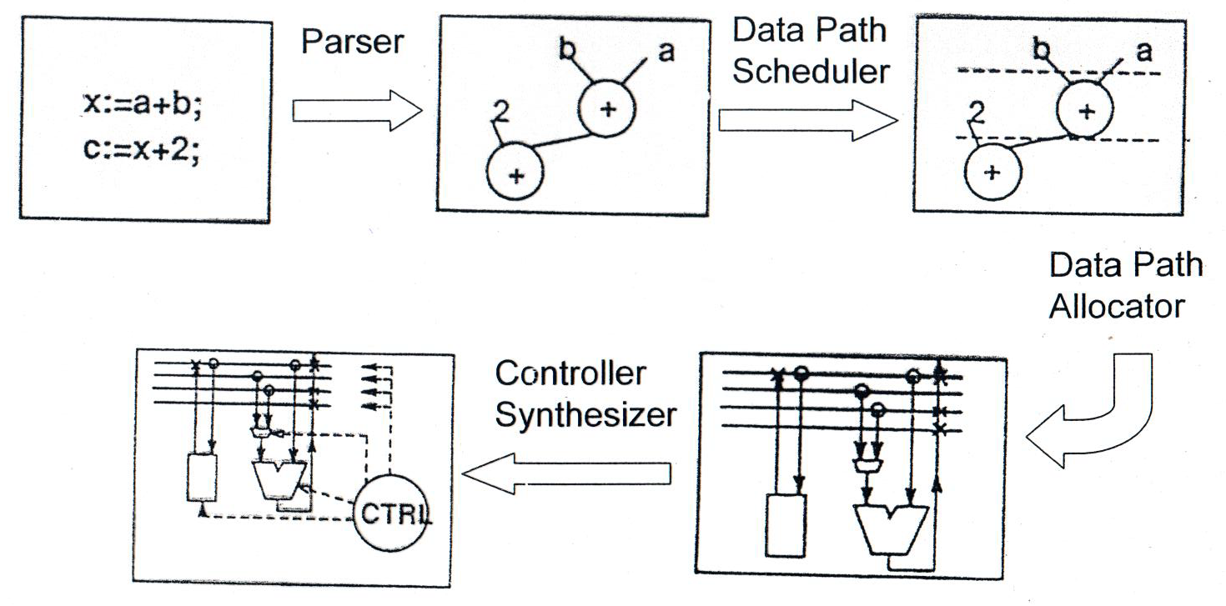
Register-Transfer-Level Synthesis

Slide 5
RTL-Level Synthesis
Inputs: an RTL netlist and a set of design constraints
Each component in the netlist is described either in behavioral, structural, or logic level
Data path scheduling and data path allocation
Controller synthesis: the transition from controller behavior to structure
Module generation

Slide 6
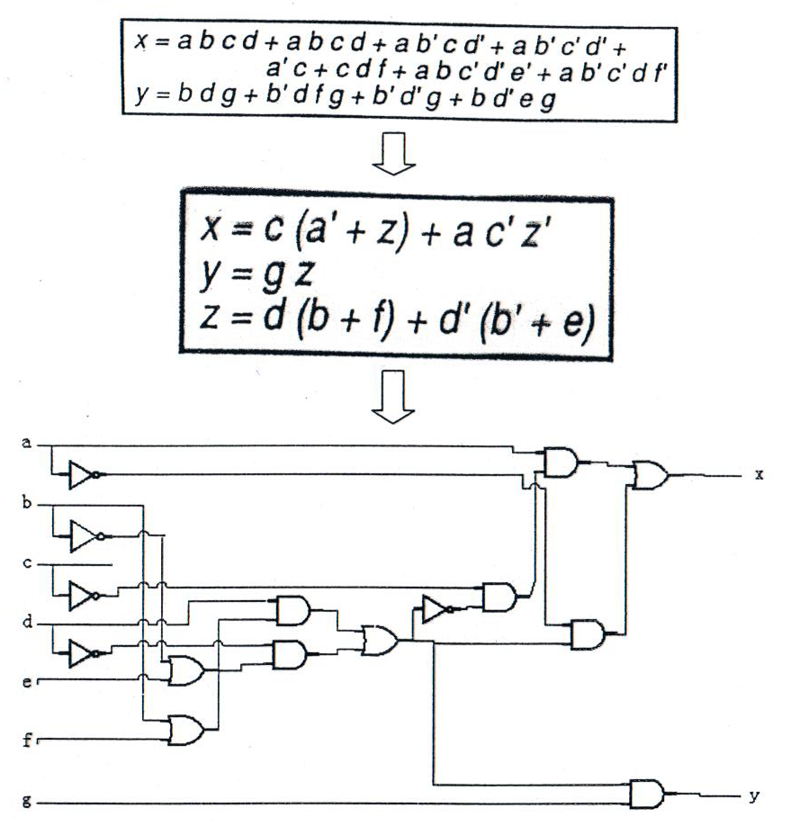
Logic Synthesis

Slide 7
Logic Synthesis
Inputs: Boolean functions and FSMs
Outputs: the blocks of combinational logic and storage elements
Logic minimization and optimization
Technology mapping

Slide 8
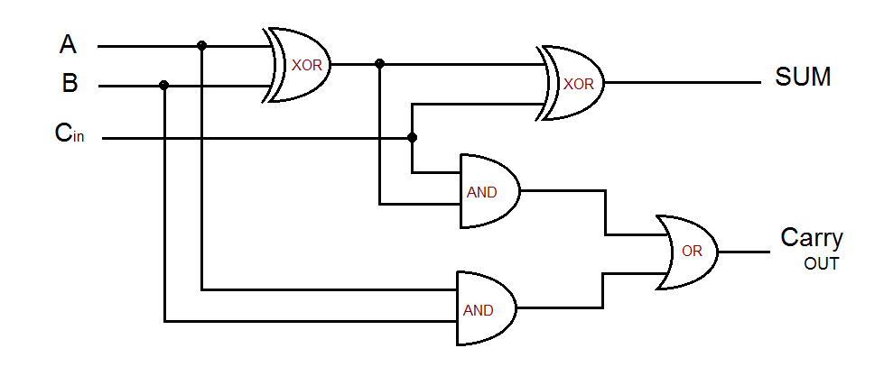
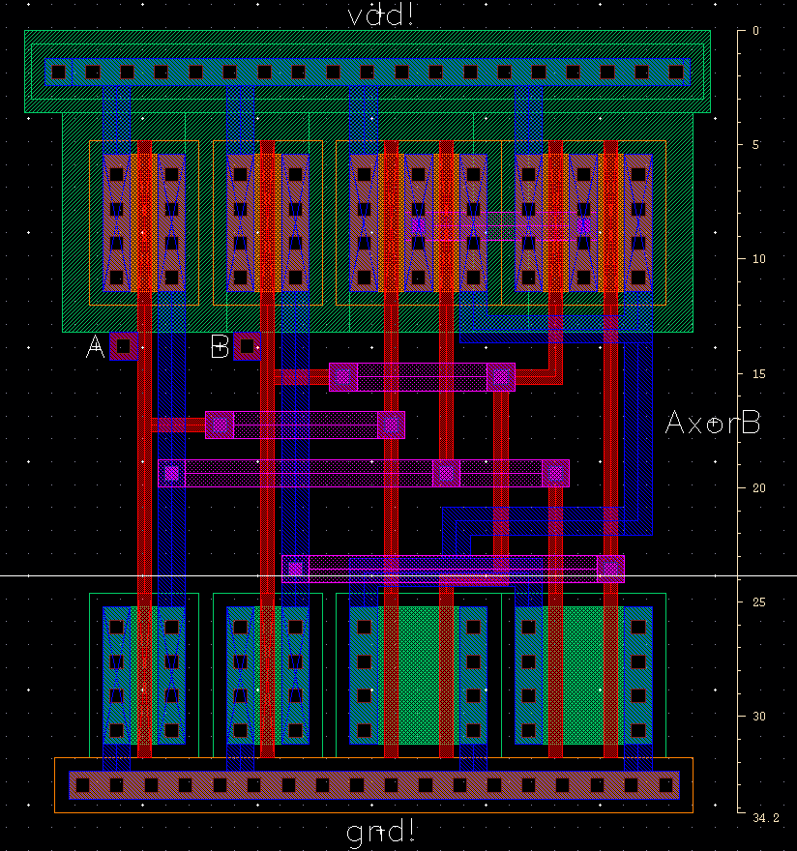
Physical Design

Slide 9
Physical-Level Synthesis
Inputs: a hierarchical gate-level netlist which may contain hard macros and flexible soft macros
Outputs: a layout
Floorplanning
Placement
Routing
Compaction

Slide 10
This Course
Presents theories for design and analysis of logic-level networks

Slide 11
Course Outlines
Representations for Boolean functions
Two-level logic minimization
Multi-level logic minimization
Timing optimization
Technology mapping
Synthesis for finite state machines
Low power design
Automatic test pattern generation & logic optimization
Synthesis for hardware security

Slide 12
Course Information
3 Credits
Time : T56 W4
Place: EECS R224
Website: http://www.cs.nthu.edu.tw/~tingting/course1.html or eeclass: https://eeclass.nthu.edu.tw/course/24626
Instructor:
  Hwang, TingTing (黃婷婷)
  Office: EECS bldg. R442
  Ext.: 31310
  E-mail: tingting@cs.nthu.edu.tw
Prerequisite:
  Logic Design

Slide 13
Course Material
Text Book:
  None
References:
  Logic minimization algorithms for VLSI synthesis, by R. Brayton et. al., Kluwer Academic
  Switching theory for logic synthesis, by Tsutomu Sasao, Kluwer Academic
  Logic synthesis and verification algorithms, by Gary D. Hachtel and Fabio Somenzi, Kluwer Academic
  papers

Slide 14
Grading
One midterm exam (25%)
  April 28
Report on the use of tools (25%)
Paper presentation (25%)
Software project (25%)

