Slide 1
CS5102 High Performance Computer Systems
Thread-Level Parallelism
Prof. Chung-Ta King
Department of Computer Science
National Tsing Hua University, Taiwan
(Slides are from textbook, Prof. O. Mutlu)

Slide 2
Outline
Introduction (Sec. 5.1)
Centralized shared-memory architectures (Sec. 5.2)
Distributed shared-memory and directory-based coherence (Sec. 5.4)
Synchronization: the basics (Sec. 5.5)
Models of memory consistency (Sec. 5.6)

Slide 3
Why Multiprocessors?
Improve performance (execution time or task throughput)
Reduce power consumption: 4N cores at frequency F/4 consume less power than N cores at frequency F
Leverage replication, reduce complexity, improve scalability
Improve dependability: redundant execution in space

Slide 4
Types of Multiprocessors
Loosely coupled multiprocessors
  No shared global memory address space (processes)
  Multicomputer network
    Network-based multiprocessors
  Usually programmed via message passing
    Explicit calls (send, receive) for communication
Tightly coupled multiprocessors
  Shared global memory address space
  Programming model similar to uniprocessors (i.e., multitasking uniprocessor)
  Threads cooperate via shared variables (memory), while operations on shared data require synchronization

Slide 5
Loosely-Coupled vs Tightly-Coupled
Summation of elements of an array
  for (i = 0; i < 10000; i++)
  sum = sum + A[i];
For tightly-coupled multiprocessors: 10 nodes
  for (i = 1000*pid; i < 1000*(pid+1); i++)
  sum = sum + A[i]; // critical section!
For loosely-coupled multiprocessors
  for (i=0; i<1000; i++) sum = sum + A[i];
  if (pid != 0) send(0,sum);
  else for(i=1; i<9; i++) {
  receive(i,partial_sum);
  sum = sum + partial_sum;}

Slide 6

Loosely Coupled Multiprocessors
Each node has private memory
Cannot directly access memory on another node
Use explicit send/recv to exchange data
Data allocation is important
IBM SP-2, cluster of workstations
MPI programming
Node 0
Node 1
send
P
0
N-1
0
N-1
P
Mem
Mem
$
$
NI
NI
Interconnection
network
NI
NI
$
$
Mem
0
N-1
0
N-1
Mem
P
P
Node 2
Node 3

Slide 7
Message Passing Programming Model
User-level send/receive abstraction
  Local buffer (x, y), process(or) (P, Q) and tag (t)
  Explicit communication, synchronization
Local Process
Address Space
Local Process
Address Space
match
Recv y, P, t
address y
Send x, Q, t
address x
Process(or) P
Process(or) Q
Notes:
Process P specifies to send x to Q with a tag t; Process Q specifies to receive a data from P with a tag t and put it into y.

Slide 8
Thread-Level Parallelism
Thread-level parallelism
  Have multiple program counters, share address space
  Use MIMD model
  Amount of computation assigned to each thread (grain size) must be sufficiently large, as compared to array or vector processors
We will focus on tightly-coupled multiprocessors
  Computers consisting of tightly-coupled processors whose coordination and usage are controlled by a single OS and that share memory through a shared address space
  If the multiprocessor is implemented on a single chip, then we have a multicore

Slide 9
Tightly Coupled Multiprocessors
Multiple threads/processors use shared memory (address space)
Communication is implicit via loads and stores
  Opposite of explicit message-passing multiprocessors
Theoretical foundation: PRAM model
P₁
P₂
P₃
P₄
Memory System
Notes:
Familiar for system (OS and DB) as well as application programmers
Why? The same techniques that use concurrency to overlap disk and network latencies also work for parallel speedup on MPs. The exact same software can take advantage of MPs with only small changes

Slide 10
Why Shared Memory?
Pros:
  Application sees multitasking uniprocessor
  Familiar programming model, similar to multitasking uniprocessor and no need to manage data allocation
  OS needs only evolutionary extensions
  Communication happens without OS
Cons:
  Synchronization is complex
  Communication is implicit and indirect (hard to optimize)
  Hard to implement (in hardware)

Slide 11
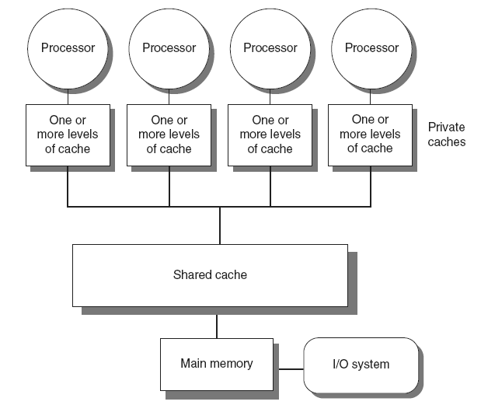
Tightly Coupled Multiprocessors: 2 Types
Symmetric multiprocessors (SMP)
  Small number of cores
  Share single memory with uniform memory access/latency (UMA)
Fig. 5.1

Slide 12
UMA: Uniform Memory/Cache Access
All cores have same uncontended latency to memory
  Latencies get worse as system grows
  + Data placement unimportant/less important (easier to optimize code and make use of available memory space)
  - Contention could restrict bandwidth and increase latency

Slide 13
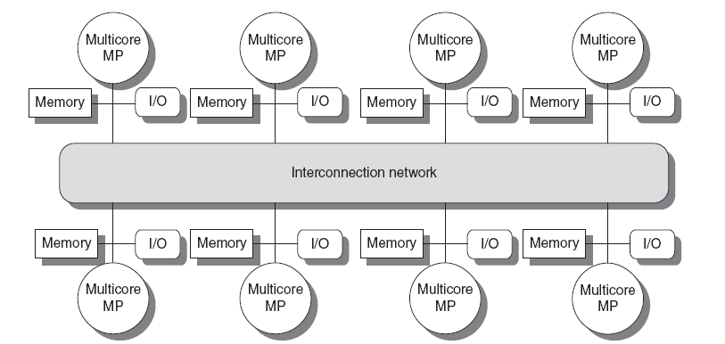
Tightly Coupled Multiprocessors: 2 Types
Distributed shared memory (DSM)
  Memory distributed among processors → more # of cores
  Non-uniform memory access/latency (NUMA)
Fig. 5.2

Slide 14
Alternative View of DSM
Node 0
Node 1
All local memories are addressed by a global addressing space
A node can directly access memory on other nodes, using normal ld/st
  Nodes connected via direct (switched) or multi-hop interconnection
  networks
ld
P
0
N-1
N
2N-1
P
Mem
Mem
$
$
NI
NI
Interconnection
network
NI
NI
$
$
Mem
2N
3N-1
3N
4N-1
Mem
P
P
Node 2
Node 3

Slide 15
NUMA: NonUniform Memory/Cache Access
Shared memory as local versus remote memory
  + Low latency, high bandwidth to local memory
  - Much higher latency to remote memories
  - Performance very sensitive to data placement

Slide 16
Caveats of Parallelism
Amdahl’s Law
  f: Parallelizable fraction of a program
  N: Number of processors
Maximum speedup limited by serial portion: serial bottleneck
Parallel portion is usually not perfectly parallel
  Synchronization overhead (e.g., updates to shared data)
  Load imbalance overhead (imperfect parallelization)
  Resource sharing overhead (contention among N cores)
1
Speedup =
1 - f
+
f
N

Slide 17
Bottlenecks in Parallel Portion
Synchronization: operations manipulating shared data cannot be parallelized
  Locks, mutual exclusion, barrier synchronization
  Communication: tasks may need values from each other
  Causes thread serialization when shared data is contended
Load imbalance: parallel tasks have different lengths
  Imperfect parallelization or microarchitectural effects
  Reduces speedup in parallel portion
Resource contention: parallel tasks can share hardware resources, delaying each other
  Replicating all resources (e.g., memory) expensive
  Additional latency not present when each task runs alone

Slide 18
Issues in Tightly Coupled Multiprocessors
Exploiting parallelism in applications
Long latency of remote access
Shared memory synchronization
  Locks, atomic operations
Cache coherence and memory consistency
Ordering of memory operations
  What should programmer expect hardware to provide?
Resource sharing, contention, partitioning
Communication: interconnection networks
Load imbalance

