Slide 1
CS5100 Advanced Computer Architecture Performance Evaluation
Prof. Chung-Ta King
Department of Computer Science
National Tsing Hua University, Taiwan
(Slides are from textbook, Prof. Hsien-Hsin Lee, Prof. Yasun Hsu)

Slide 2
Outline
Goal of this lecture:
To learn how to evaluate the performance of computers as the basis of a quantitative approach to computer design
Know performance evaluation and understand the implications behind the numbers
Lecture outline
Measuring, reporting, summarizing performance (Sec. 1.8)
Quantitative principles of computer design (Sec. 1.9)

Slide 3



Which Device Has the Best Performance?

Slide 4
Things to Clarify
What do you mean by “performance”?
How to quantify the performance?
What performance metrics to use?
Best performance ≠ Best!
How to measure the “performance”?
What configurations of the devices are used?
What workloads are used?
How to get the performance data?
How to summarize and compare the performance?
A total ordering needed
How to report the results?

Slide 5
Which Design is Better?
P0
P1
P2
P3
P0
P1
P2
P3
L1$
L1$
L1$
L1$
L1$
L1$
L1$
L1$
Bus
Bus
L2$
Memory
Memory

Slide 6
Things to Clarify
What do you mean by “better”?
How to estimate the performance of designs, even before hardware is ready and software is running?
What kinds of tools are available?
At what level of details do you want the performance be studied? e.g. get performance data only or get correct execution outputs also, specific component or whole system, accurate to clock cycle or to function, single application or OS+applications, …

Slide 7
What Do You Mean by “Performance”?
6
Many performance metrics:
GHz, number of cores
MIPS (million instructions per second)
MFLOPS (million floating-point operations per second)…
Time is the primary measure of performance
Execution/response time (latency) vs. throughput (BW)
Wall clock time: latency to complete a task, including all system overheads
CPU time: the time that the processor is computing, not including I/O or running other programs
Single program vs. whole system
Notes:
MIPS (meaningless indicator of performance from salesman): lack of a uniform measure of work
-- instruction sets are not equivalent
-- different programs use different instruction mix
-- instruction count is not a reliable indicator of work (some optimizations add instructions)
FLOPS:
-- programs must be FP intensive
-- ignore other instructions, e.g. loads and stores
-- peak GFLOPS: manufacturer guarantees not to exceed

Slide 8
CPU Performance (of a Program)
Execution Time = Seconds/Program
=
CPI
Programmer
Algorithms
ISA
Compilers
Microarchitecture
System architecture
Microarchitecture, pipeline depth
Circuit design
Technology

Slide 9
Cycles Per Instruction (CPI)
Alternative formula: instruction frequency
CPI = Cycles / Instruction Count
= (CPU Time * Clock Rate) / Instruction Count
n
CPU time = CycleTime × Σ CPI_{i} × I_{i}
How about pipelined processors?
i = 1
n
CPI = Σ CPI_{i} × F_{j} where F_{j} = I_{j}
i = 1
Instruction Count

Slide 10
Example: Calculating CPI
Run benchmarks, collect workload characterization (by simulation, machine counters, or sampling)
Base Machine (Reg - Reg)
Op Freq Cycles CPI(i) (% Time)
ALU 50% 1 .5 (33%)
Load 20% 2 .4 (27%)
Store 10% 2 .2 (13%)
Branch 20% 2 .4 (27%)
1.5
9

Slide 11
Accounting Stalls
CPI = CPI_{ideal} + CPI_{stall}
CPI_{ideal}: cycles per instruction if no stall
CPI_{stall} contributors
Data dependences: RAW, WAR, WAW
Structural hazards
Control hazards: branches, exceptions
Memory latency: cache misses

Slide 12
New Breed of Metrics
Performance/Watt
Performance achievable at the same cooling capacity
Performance/Joule (Energy)
Achievable performance at the lifetime of the same energy source (i.e., battery = energy)
Equivalent to reciprocal of energy-delay product (ED product)
11

Slide 13
Outline of Performance Evaluation
What do you mean by “performance”?
Performance metrics
What to evaluate?
Workloads, benchmarks
How to evaluate?
How to summarize and report?

Slide 14
Performance Benchmarking
Benchmark: a standard of measurement as a reference point for comparison
Model real job mix with a small set of representative programs
Kernels:
Small key pieces of real programs, e.g. Linpack
Best used to isolate performance of individual features
(Toy) programs:
Typically 10 to 100 lines to test a special function and/or its performance, e.g. quicksort, matrix multiply

Slide 15
Performance Benchmarking
Synthetic benchmarks:
Try to match the average frequency and operation of a large set of programs , e.g. Dhrystone, Whetstone
(Real) programs
Having inputs, outputs, and options; running on standard OS, e.g. SPEC2006, TPC-C, SYSMARK, 3D Winbench
Often come with a suite
14

Slide 16
Benchmark Suites: SPEC
SPEC goal: a fair and useful set of metrics to compare performance
www.spec.org
SPECCPU: popular desktop benchmark suite
CPU only, split between integer and floating-point programs, where SPECint2006 has 12 integer, SPECfp2006 has 17 floating-point programs
Use geometric mean
SPECSFS (NFS file server) and SPECWeb (WebServer) added as server benchmarks (mainly for I/O: disk and network)

Slide 17
Benchmark Suites
TPC (Transaction Processing Council) measures server performance and cost-performance for databases
TPC-C Complex query for Online Transaction Processing
Metrics: # transactions per sec and response time
EEMBC (EDN embedded Microprocessor Benchmark Consortium)
Set of 41 kernels for performance of embedded applications
Benchmarks for mobile phones:
Quadrant, AnTuTu, CFBench, MobileBench

Slide 18
Some Warnings about Benchmarking
Benchmarks reflect yesterday’s programs
Benchmarks can lead to positive feedbacks
If you make an operation fast (slow), it will be used more (less) often; so you make it faster (slower), and so on…
Tricks and common mistakes in benchmarking:
Different system configurations
Compiler and libraries optimized for benchmarks
Workload/inputs arbitrarily picked
Very small benchmarks → ignore caching effects
Only average behavior represented in test workload
Ignoring monitoring overhead
Too much data but too little analysis

Slide 19
Outline of Performance Evaluation
What do you mean by “performance”?
Performance metrics
What to evaluate?
Workloads, benchmarks
How to evaluate?
How to summarize and report?

Slide 20
To Evaluate Real Machines
Run the benchmark and obtain performance
How to measure program execution time?
How to obtain instruction count?
How to separate effects of OS, virtual machine, and measuring tool itself?
Programs use timer API
Instrumentation
PinTool: dynamic binary instrumentation engine for Intel x86
Performance monitor and profiler
Oprofile: monitor HW/SW events through CPU perf. counters
Linux perf

Slide 21
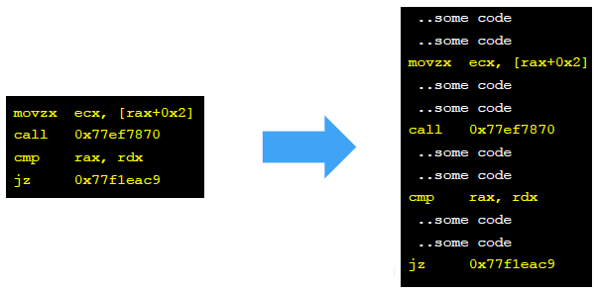
Instrumentation
A technique that inserts code into a program to collect run-time information
Source code instrumentation
Static binary instrumentation
Dynamic binary instrumentation
Tevi Devor, Intel

Slide 22
To Evaluate Designs
Scope: full system vs. component
Component simulators: instruction set simulator, cache, network-on-chip (NoC), DRAM, disk, …
Full-system: simulate an entire computer that complete software stacks from real systems can run without any modification → a virtual hardware, e.g. QEMU, Gem5
Detail: functional vs. timing
Timing simulators: cycle accurate, cycle-count accurate
Input: trace-driven vs. execution-driven
Tradeoffs between simulation speed and accuracy

Slide 23
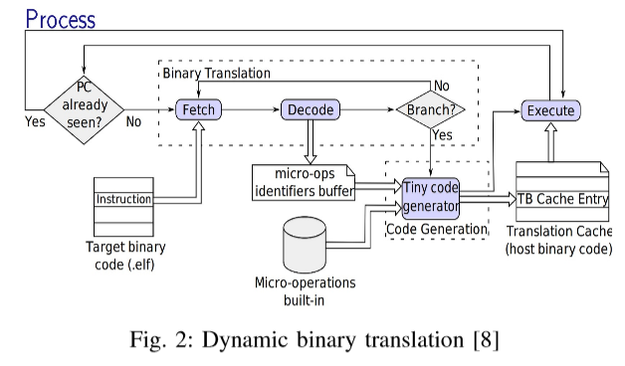
QEMU
A processor emulator using dynamic binary translation
Full system emulation
User mode emulation
Notes:
Full system emulation. In this mode, QEMU emulates a full system (for example a PC), including one or several processors and various peripherals. It can be used to launch different Operating Systems without rebooting the PC or to debug system code.
User mode emulation. In this mode, QEMU can launch processes compiled for one CPU on another CPU. It can be used to launch the Wine Windows API emulator (http://www.winehq.org) or to ease cross-compilation and cross-debugging.

Slide 24
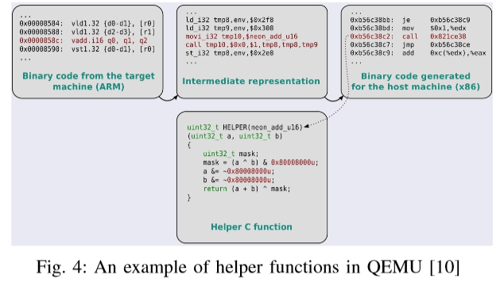
QEMU
Helper functions
Inserted during binary translation (guest code -> TCG IR) to handle extra works, e.g. profiling

Slide 25
Outline of Performance Evaluation
What do you mean by “performance”?
Performance metrics
What to evaluate?
Workloads, benchmarks
How to evaluate?
How to summarize and report?

Slide 26
Run and Reporting Rules
Goal #1: reproducible results
Document everything
Others should be able to reproduce your results
Goal #2: fair results
Restrict “tricks” that can be played, e.g. optimizations must work for more than just this benchmark
Specify how results may be summarized, e.g. use an appropriate averaging technique
How to reduce n performance indices into a single number to produce a total ordering of computers?

Slide 27
Summarize Performance
A straightforward idea:
Sum individual benchmark times and then average
Arithmetic Mean (Weighted Arithmetic Mean)
The problem:
Benchmark Comp 1 Comp 2 Comp 3
A 1 10 20
B 1000 100 20
Total 1001 110 40
Is Computer 3 really the fastest?
Benchmark B dominates the performance!

Slide 28
Summarize Performance with Ratios
Arithmetic mean of ratios: Σ(R_{i})/n
Normalized with respect to Computer 3: Benchmark Comp 1 Comp 2 Comp 3 A 1 (0.05) 10 (0.5) 20 (1) B 1000 (50) 100 (5) 20 (1) Mean 25.025 2.75 1
Computer 3 is the fastest!
But, if normalized with respect to Computer 1: Benchmark Comp 1 Comp 2 Comp 3 A 1 (1) 10 (10) 20 (20) B 1000 (1) 100 (0.1) 20 (0.02) Mean 1 5.05 10.01
Computer 1 is the fastest! 3 is the slowest!

Slide 29
Geometric Mean for Ratios
Geometric mean:
Independent of the reference machine Benchmark Comp 1 Comp 2 Comp 3 A 1 (0.05) 10 (0.5) 20 (1) B 1000 (50) 100 (5) 20 (1) Mean wrt 3 1.58 1.58 1
Computer 3 is the fastest!
Benchmark Comp 1 Comp 2 Comp 3 A 1 (1) 10 (10) 20 (20) B 1000 (1) 100 (0.1) 20 (0.02) Mean wrt 1 1 1 0.63
Computer 3 is the fastest!

Slide 30
Geometric Mean for Ratios
Geometric mean is not consistent with time:
Benchmark Comp 1 Comp 2 Comp 3 A 12 6 24 B 16 32 8
Total time 28 38 32
Normalize to 1 1.00 1.36 1.14
G. mean wrt 1 1.00 1.00 1.00
So, what can we say about summarizing performance?

Slide 31
Geometric Mean for Ratios
If benchmark execution times are normalized to some reference machine, and means of normalized execution times are computed, only the geometric mean gives consistent results no matter what the reference machine is.
This has led to declaring the geometric mean as the preferred method of summarizing execution time (e.g., SPEC2006)

Slide 32
Summarizing Performance
Time is the ultimate measure of performance
(Weighted) arithmetic mean tracks time:
But may be skewed by individual programs
Is meaningless with normalized numbers
Geometric mean:
Consistent regardless of reference
Independent of execution times of individual programs
Does not predict execution time
Best strategy: show the summarized number as well as numbers of individuals

Slide 33
Performance Evaluation: Summary
Performance evaluation affects and guides the design of computers
Good performance evaluation requires:
Good benchmarks
Good ways to summarize performance
Execution time is the ultimate measure of computer performance!

Slide 34
Outline
Measuring, reporting, summarizing performance (Sec. 1.8)
Quantitative principles of computer design (Sec. 1.9)
Take advantage of parallelism: e.g. multiple processors, disks, memory banks, pipelining, multiple functional units
Principle of locality: Reuse of data and instructions
Focus on the common case
Amdahl’s Law

Slide 35
1) Taking Advantage of Parallelism
Increasing throughput of server computer via ILP, multiple cores/processors or multiple disks
Examples of detailed HW designs
Carry lookahead adders uses parallelism to speed up from linear to logarithmic in number of bits per operand
Multiple memory banks searched in parallel in set-associative caches
Pipelining: overlap instruction execution to reduce the total time to complete an instruction sequence.
Not every instruction depends on immediate predecessor → executing instructions completely/partially in parallel
Superscalar, multithreading

Slide 36
2) Principle of Locality
Programs access a relatively small portion of the address space at any instant of time
90/10 rule: a program spends 90% of its execution time in only 10% of the code
Two different types of locality:
Temporal locality (locality in time): If an item is referenced, it tends to be referenced again soon (e.g., loops, reuse)
Spatial locality (locality in space): If an item is referenced, items whose addresses are close by tend to be referenced soon (e.g., straight-line code, array access)
Last 30 years, HW relied on locality for memory performance

Slide 37
3) Focus on the Common Case
Common sense guides computer design
Since its engineering, common sense is valuable
In making a design tradeoff, favor the frequent case over the infrequent case
e.g., Instruction fetch and decode unit used more frequently than multiplier, so optimize it first
Frequent case is often simpler and can be done faster than the infrequent case
e.g., overflow is rare when adding 2 numbers, so improve performance by optimizing no-overflow
What is frequent case and how much performance improved by making case faster → Amdahl’s Law

Slide 38
Amdahl’s Law (Law of Diminishing Returns)
Speedup due to enhancement E:
= Perf_{new} / Perf_{old} = T_{old} / T_{new} =
Performance improvement from using enhancement E is limited by the fraction that E can be applied
The best that one can hope is 1/(1-f)
T_{old}
(1 - f)
f
T_{new}
(1 - f)
f/P

Slide 39
Amdahl’s Law Analogy
38
Driving from NTHU in Hsinchu to NCKU in Tainan
Driving at 110 km/hr using Highway 3 to ChangHua and then Highway 1 to Tainan → 2 hr
Driving at Hsinchu local (10 min.), Tainan local (20 min.)
What is speedup using high-speed rail?
High-speed rail at 230 km/hr: 1.1 hr (Speedup = 2/1.1 = 1.82)
Including local driving:
Total Speedup = 2.5 hr / 1.6 hr = 1.56
The efforts to resolve a bottleneck will lead to new bottlenecks in other parts
Key is to speed up the frequently executed blocks

Slide 40
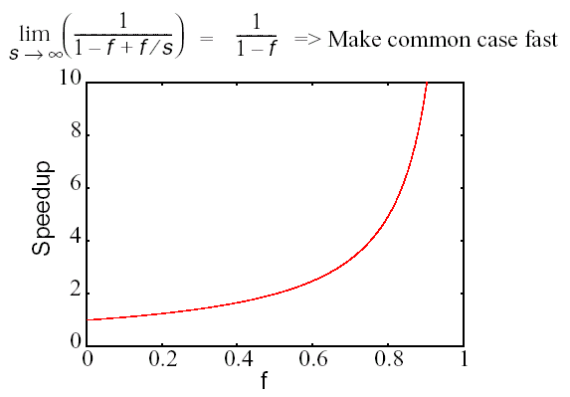
Maximum Speedup
f = 0.9, s→∞
Speedup=10
G.M. Amdahl, “Computer Architecture and Amdahl’s Law,” Computer, Dec. 2013.

Slide 41
Recap
Performance evaluation
Performance metrics
Performance benchmarking
Performance summary
Computer design principles
Take advantage of parallelism
Principle of locality
Focus on the common case

