Slide 1
CS5100 Advanced Computer Architecture
Technology and Computing
Prof. Chung-Ta King
Department of Computer Science
National Tsing Hua University, Taiwan
(Slides are from textbook, Prof. Hsien-Hsin Lee, Prof. Yasun Hsu, Prof. Marc Snir)

Slide 2
Outline
Goal of this lecture:
  Understand how technology affects automatic computing
    Learn from the history
    Know how we come to here
Lecture outline
  History of computing and role of technology
  Computer performance trend (Sec. 1.1)
    Trends in technology (Sec. 1.4)
    Trends in power and energy (Sec. 1.5)
  Classes of computers (Sec. 1.2)
Notes:
How do we define the progresses of civilization?

Slide 3
Automatic Computing: The Beginning
?? BC Abacus
1642 Pascal - mechanical +/-
1649 Leibniz - mechanical +/*
1823 Babbage (1s+, 1m*)
- analytical engine
1854 Boole - Boolean Algebra
1889 Hollerith - punched card
tabulator
1935 Zues - Z1, fixed-program
relay machine
1937 Aiken - Mark I (300ms +)
1941 Atanasoff - ABC
- vacuum tubes
1943-8 Eckert & Mauchly
ENIAC - fixed program
vacuum tubes
1946-52 von Neumann
EDVAC - stored prog.
1946-49 Wilkes
EDSAC (1ms add)
1947-51 Forrester (MIT)
Whirlwind -
core memory in ‘53
1958 MIT TX-0 - transistors
Notes:
https://global.britannica.com/technology/digital-computer
http://www.computerhope.com/issues/ch000984.htm
Charles Babbage (26 December 1791 – 18 October 1871, English) is considered a “father of the computer“ and credited with inventing the first mechanical computer. The difference engine was made to compute values of polynomial functions automatically using the method of finite differences. The Analytical Engine (1837) marks the transition from mechanized arithmetic to fully-fledged general purpose computation. The major innovation was that the Analytical Engine was to be programmed using punched cards. The Engine was intended to use loops of Jacquard’s punched cards to control a mechanical calculator, which could use as input the results of preceding computations. The machine was also intended to employ several features subsequently used in modern computers, including sequential control, branching and looping. It would have been the first mechanical device to be, in principle, Turing-complete. But, it was never completed.
Herman Hollerith (February 29, 1860 – November 17, 1929) was an American inventor who developed an electromechanical punched card tabulator to assist in summarizing information and, later, accounting. He developed a mechanical tabulator (1889) based on punched cards to rapidly tabulate statistics from millions of pieces of data. He was the founder of the Tabulating Machine Company that later merged to become IBM. Hollerith is widely regarded as the father of modern machine data processing.
Konrad Zuse (Germany, 22 June 1910 – 18 December 1995) developed the world's first programmable computer; the functional program-controlled Turing-complete Z3 became operational in May 1941. The Z3 was an electromechanical computer as the world's first working programmable, fully automatic digital computer. The Z3 was built with 2000 relays, implementing a 22-bit word length that operated at a clock frequency of about 5–10 Hz. Program code and constant data were stored on punched film. The Z3 was completed in Berlin in 1941.
The IBM Automatic Sequence Controlled Calculator (ASCC), called Mark I by Harvard University’s staff, was a general purpose electro-mechanical computer that was used in the war effort during the last part of World War II. The original concept was presented to IBM by Howard Aiken in November 1937.
John Vincent Atanasoff (October 4, 1903 – June 15, 1995) was an American physicist and inventor, best known for inventing the first electronic digital computer. Atanasoff invented the first electronic digital computer in the 1930s at Iowa State College. His special-purpose machine has come to be called the Atanasoff–Berry Computer. Conceived in 1937, the machine was not programmable, being designed only to solve systems of linear equations. It was successfully tested in 1942. The ABC pioneered important elements of modern computing, including binary arithmetic and electronic switching elements, but its special-purpose nature and lack of a changeable, stored program distinguish it from modern computers.

Slide 4
Summary: Technology Development
Mechanic → electro-mechanic → electronic
(vacuum tube → transistor → integrated circuit)
  Size ↓
  Switching speed ↑
  Reliability ↑
  Power consumption ↓
  Cost ↓
Technology progresses improve cost and performance of computing machines
➔ Allow more functions, easier use and management
0-1 switch

Slide 5
Technology and Architecture Evolution
1950s Vacuum tubes
1958 Transistors
1960s Integrated circuits
Disk storage
1970s Microprocessors
Semiconductor mem.
1980s-90s CMOS convergence
(smaller, faster, low
power, …)
1951 Index registers
1960 Memory protection (B5000)
1960 Demand paging
(Atlas)
1960s Deep pipelines
(IBM Stretch, CDC6600)
1960s Superscalar issue
Dynamic scheduling
Branch prediction
(CDC6600, IBM 360/95)
1968 Cache memory (360/85)

Slide 6
Technology and Architecture Evolution
1970s
  multi-chip CPUs
  semiconductor memory (very expensive)
  complex instruction sets (good code density)
  microcoded control
1980s
  single-chip CPUs
  hardwired control
  simple instruction sets
  small on-chip caches
1990s
  lots of transistors
  complex control to exploit instruction-level parallelism
2000s
  even more transistors
  slow wires
  more power
  multi-core
2010s
  specialized accelerators

Slide 7
Technology Affects Software, Too!
Year Logic Storage Prog. lang. OS
54 vacuum tubes core (8 ms)
58 transistors (10 ms) Fortran
60 Algol, Cobol
66 IC (100ns)
67 Multiprog.
71 LSI (10ns) 1K DRAM O.O. V.M.
73 8-bit μP
75 16-bit μP 4K DRAM
78 VLSI (10ns) 16K DRAM Networks
84 32-bit μP 256K DRAM C++
92 64-bit μP 16M DRAM Fortran 90

Slide 8
How Does Technology Affect Performance?
Lecture outline
History of computing and role of technology
Computer performance trend (Sec. 1.1)
  Trends in technology (Sec. 1.4)
  Trends in power and energy (Sec. 1.5)
Classes of computers (Sec. 1.2)

Slide 9
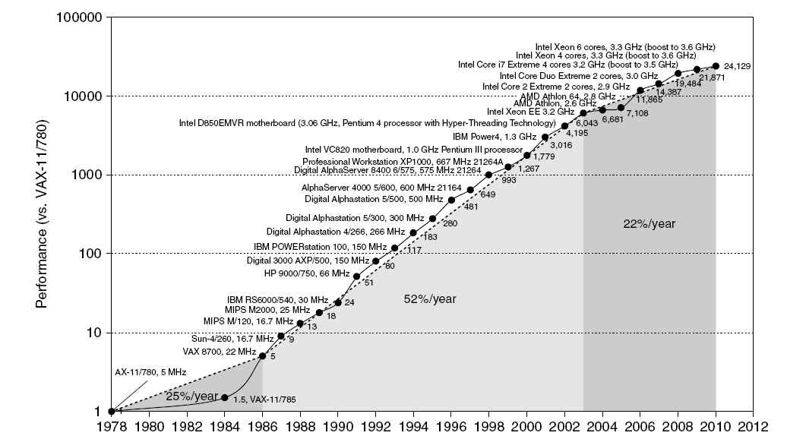
Single Processor Perf in Perspective
Move to multi-core
RISC
Fig. 1.1

Slide 10
Single Processor Perf in Perspective
Prior to mid-80’s, processor performance largely technology driven, averaged 25% per year
Development of single-chip microprocessors (mostly CISCs) in late 70’s makes it possible to ride the improvements in IC technology, leading to 35% growth per year since 1984
Introduction of RISC processors in mid-80’s increases the growth rate to 52% per year
  Architecture + technology improvement
Since 2003, power and available ILP limits performance to less than 22% per year
  Performance gain now from multi-cores
Architecture innovation plays a role

Slide 11
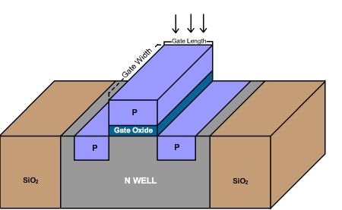
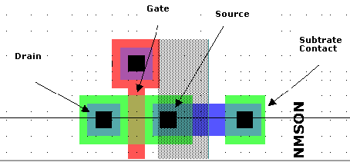
Examine Technology Scaling First
10 µm – 1971 6 µm – 1974 3 µm – 1977 1.5 µm – 1982 1 µm – 1985 800 nm – 1989 600 nm – 1994 350 nm – 1995 250 nm – 1997 180 nm – 1999 130 nm – 2001 90 nm – 2004 65 nm – 2006 45 nm – 2008 32 nm – 2010 22 nm – 2012 14 nm – 2014 10 nm – 2016
Feature size:
  Min size of transistor or wire in x or y dim.
  10 microns in 1971 to 14 nm in 2014
  New technology node every 2 years or so
  ~70% (S) reduction for each generation
Moore’s Law
0.7x
0.7x

Slide 12
Effects of Scaling
More transistors per unit area
  Feature size reduced by 0.7 (S) → area of a transistor reduced by 0.5 (S²)
  2X # transistors/unit area
  Fixed cost per wafer → lower cost per transistor
Faster transistors
  Reduce time to switch on/off transistors
  → speed improved by S
  → exponential increase in clock rate
Less supplied voltage and power
  Power to switch transistor reduced, but not power density
  Voltage to drive transistors reduced

Slide 13
Effects of Scaling
Local wires are getting faster
Global wires are getting slower, i.e. scale poorly
  No longer possible to cross chip in one cycle
  Computer architects need to plan around this
Solutions:
3D stacking
Distributed mechanisms
...

Slide 14
General Technology Trends
Integrated circuit technology:
  Transistor density: 35%/year
  Die size: 10-20%/year
  Integration overall: 40-55%/year (slow down after 2003!)
DRAM capacity: 25-40%/year (slowing)
Flash capacity: 50-60%/year
  15-20X cheaper/bit than DRAM
Magnetic disk capacity: 40%/year
  15-25X cheaper/bit than Flash
  300-500X cheaper/bit than DRAM
  But not speed

Slide 15
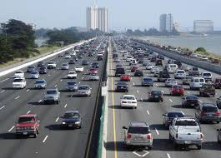
Bandwidth versus Latency
Bandwidth or throughput
  Total work done in a given time
  10,000-25,000X improvement for processors
  300-1200X improvement for memory and disks
Latency or response time
  Time between start and completion of an event
  30-80X improvement for processors
  6-8X improvement for memory and
  disks

Slide 16
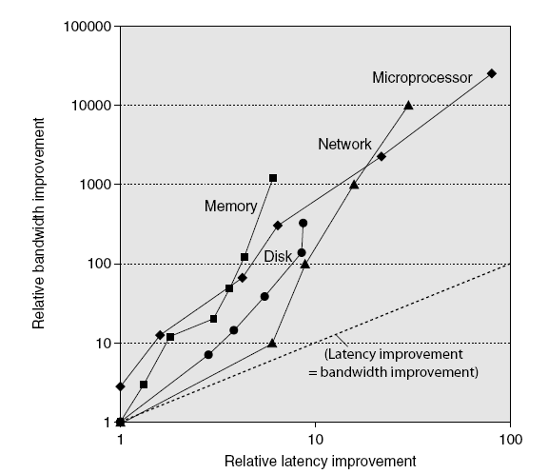
Bandwidth versus Latency
Log-log plot of bandwidth and latency milestones

Slide 17
Bandwidth versus Latency
For disk, LAN, memory, microprocessor, bandwidth improves by square of latency improvement
  In the time that bandwidth doubles, latency improves by no more than 1.2X to 1.4X
Lag probably even larger in real systems, as BW gains multiplied by replicated components
  Multiple processors in a cluster or in a chip
  Multiple disks in a disk array
  Multiple memory modules in a large memory
  Simultaneous communication in switched LAN
HW and SW developers should innovate assuming latency lags bandwidth
Notes:
Parallelism is the direction

Slide 18
Architecture Innovations Matters
RISC
Fig. 1.1

Slide 19
Why RISC Significant?
Pre-RISC: CISC (complex instruction set computer)
  Good code density for small and slow memory
  Inherit from multi-chip/board-level processor to single-chip processors
Opportunities
  More computers based on single-chip microprocessors
  A chip can accommodate sufficient # of transistors
  Maturity of high-level languages (HLL) and compilers
  → no assembly, no need for object-code compatible
  Vendor-independent OSs, e.g. UNIX/Linux
  Easy to introduce new architectures
How to effectively use available transistors on a chip?

Slide 20
Why RISC Significant?
RISC concept:
  Simplify ISA → simplify control circuitry
  (quantitative approach to simplification)
  Use extra transistors for effective architectural designs
  → pipelining, caches, register file, 32-bit, multi-issue, …
  As # transistors ↑, can integrate more → 52%/year
  Sparc, MIPS, Power, Alpha, ARM, …
Effects of RISC:
  Wipe out prior CISC, e.g. VAX
  Or force to keep up, e.g. Intel 80x86 (RISC-like core)
Distinction less obvious now

Slide 21
Effects of Dramatic Growth Rate
Lead to new classes of computers
  From desktops/workstations to cell phones/tablets
  Bringing 4-bit, 8-bit, through 64-bit microprocessors
Quantitative changes leading to qualitative changes
  25K to 30K transistors per chip in early 1980s
  → possible to build a single-chip 32-bit microprocessor
  By mid 1980s, FP unit can be integrated
  By late 1980s, L1 cache can fit on the same chip
  → Performance improvements often in discrete steps
Dominance of microprocessor-based computers across entire range of computer design
  Cluster-based supercomputers and mainframes

Slide 22
Effects of Dramatic Growth Rate
Changing software developments
  Trade performance for productivity: managed PL, scripting, SaaS, JIT, trace-based compiling
  Multimedia-rich, interactive applications
Free Lunch for software developers
  Working to optimize/parallelize your code was often not worth the time, because if you just waited until next year, your application would probably run faster on a new CPU
  Why?
    Shrinking transistors leading to increased clock frequency
    Advanced computer architecture designs that enhance instruction-level parallelism (ILP) continuously improve performance of sequential processing
Why performance is non-issue?
Notes:
CMOS was used in fast growing markets: controllers, workstations, PCs
CMOS had a 40 year history and clear evolution path (“Moore’s Law”)

Slide 23
Sequential Program Semantic Matters
Human expects “sequential semantics”
  A program counter (PC) goes through instructions of the program sequentially until the computation is completed
  Result of computing is considered “correct” (ground truth)
  Any optimizations, e.g. pipelining or parallelism, must keep the same semantics (result)
Sequential semantics dictates a computation model of one instruction executed after another
While ensuring execution “correctness” (i.e. sequential semantics), how to optimize performance?
  Focus on ILP

Slide 24
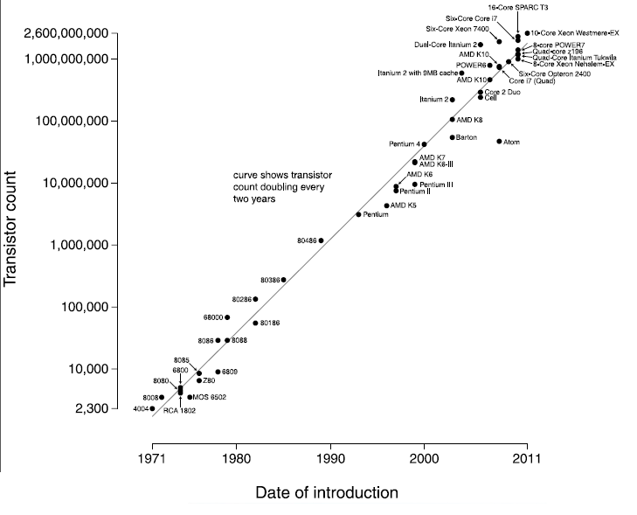
The Good Old Days
Moore’s Law: (1965)
# of transistors per chip doubles every 2+ years
Dennard Scaling: (1974)
Decrease feature size by a factor of λ and voltage by λ
• # transistors increase by λ²
• Clock speed increases by λ
• Energy consumption does not change
(Dr. Marc Snir, ANL)

Slide 25
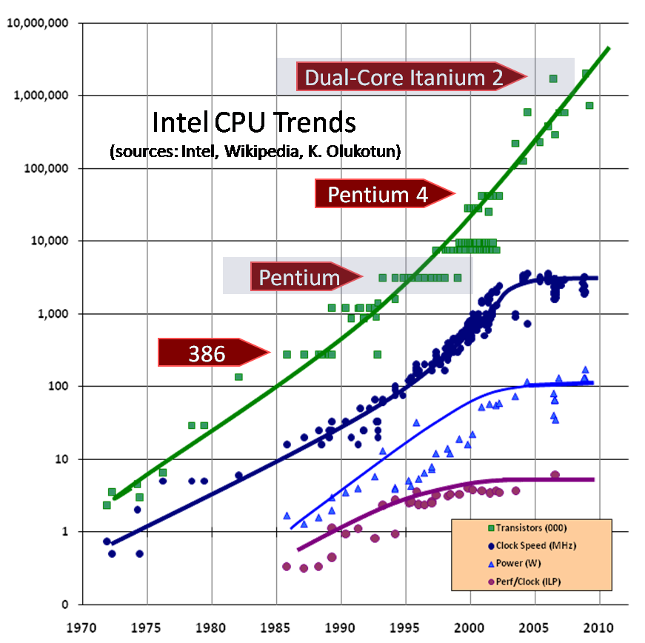
Gone Are the Good Old Days
Processor clock rate stops increasing
No further benefit from ILP
(Prof. Kayvon Fatahalian, CMU)
(Image credit: “The free Lunch is Over”, by Herb Sutter, Dr. Dobbs 2005)

Slide 26
Dennard Scaling Ended
At around 130 nm in 2001~2004
  CMOS circuits leak too much current (static energy)
Growth in density continues after 2004, but clock speed is (slowly) decreasing
Since 2003, single-processor performance improvement dropped to 22% per year
  Limitation of max power dissipation and lack of ILP
No more free lunch

Slide 27
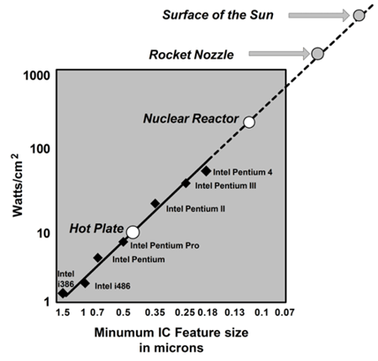

Power Density Trend
Power generates heat and heat must be dissipated from the chip
Source: Intel Corp.
Notes:
If scaling continues at present pace, by 2005, high speed processors would have power density of nuclear reactor, by 2010, a rocket nozzle, and by 2015, surface of sun

Slide 28
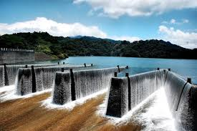
Power and Energy
P_{avg} = P_{dynamic} + P_{static}
Energy is related to power through time
If power dissipation remains constant through time T, then
E = (P_{avg} x T)

Slide 29
Dynamic Power and Energy
For CMOS chips, traditional dominant energy consumption has been in switching transistors, called dynamic power
  ½ x capacitive load x voltage² x frequency switched
For mobile devices, energy is better metric
  ½ x capacitive load x voltage²
Reducing clock rate reduces power, but not energy
Strategies to reducing power:
  Do nothing well: turn off clock of inactive modules
  Dynamic Voltage-Frequency Scaling (DVFS)
  Low power state for DRAM, disks
  Overclocking, turning off cores

Slide 30
Static Power
Because leakage current flows even when a transistor is off, now static power is important too
  Current_{static} x Voltage
  Scales with number of transistors
  Increase as transistors shrink and # transistors increases
    With 65nm or better technologies, leakage can account for 50% of total power if not designed properly
  To reduce: power gating

Slide 31
Implications of Power for Architecture
Architectural designs for low power using metrics such as tasks per joule or performance per watt
  Use the right power/energy to do the right things
Sometimes, do things faster but at a higher power may be better → race to halt
  Often techniques for performance also lead to power saving
From relying on ILP to DLP (data-level parallelism), TLP (thread-level parallelism), warehouse-scale computers, RLP (request-level parallelism)
  DLP, TLP, RLP: explicit parallel; ILP: implicit
No more free lunch

Slide 32
2015 and Beyond: Near End of Light?
Physical and engineering limits
  Transistor size cannot shrink forever
    Need a few hundred atoms per gate
    5 nm seems to be the limit for 2D (5 nm = 20 atoms)
  Decreased return on feature size: performance improvement is not proportional to size reduction
    Need additional spacing and larger safety margins
Economical limits
  Investments for new fabs keep growing
  Chip manufacturing costs keep increasing (more masks …)
  IC market cannot grow forever and faster
(Dr. Marc Snir, ANL)

Slide 33
Conventional Wisdom in Comp. Arch
Old: power is free, transistors expensive
New: “power wall” - power expensive, Xtors free
  Can put more on a chip than can afford to turn them on (dark silicon)
Old: sufficiently increasing ILP via compilers, innovation (out-of-order, speculation, VLIW, …)
New: “ILP wall” - diminishing returns on HW for ILP
  Need scalable design with little complexity, good locality
Old: took longer for multiplication than memory access
New: “memory wall” - memory slow, multiplies fast
  Hundreds of cycles to DRAM, a few cycles for multiply

Slide 34
Conventional Wisdom in Comp. Arch
Old: uniprocessor performance 2X / 1.5 yrs
New: not any more
Power Wall + ILP Wall + Memory Wall = Brick Wall
  No longer brag on uniprocessor performance since 2003
  ⇒ sea change in chip design: multiple “cores”
  Multiple powerful cores vs many more simple cores
    More simpler processors may be more power efficient
  Heterogeneous, specialized processor/accelerator: right HW to do right thing, e.g., big.LITTLE, GPGPUs, DSP, neuron net
  Deep memory hierarchy, monitoring and profiling, run-time optimization, self-adapting, self-management, self-healing
  Asynchrony, resilience, inexact computations

Slide 35
Outline
A bit of history → technology and computer design
Computer performance trend (Sec. 1.1)
  Trends in technology (Sec. 1.4)
  Trends in power and energy (Sec. 1.5)
Classes of computers (Sec. 1.2)
Notes:
How do we define the progresses of civilization?

Slide 36
Classes of Computers
Personal Mobile Device (PMD)
  e.g. smart phones, tablet computers
  Emphasis on energy efficiency and real-time
Desktop Computers
  Emphasis on price-performance
Servers
  Emphasis on availability, scalability, throughput
Clusters/Warehouse Scale Computers
  Used for “Software as a Service (SaaS)”
  Emphasis on availability and price-performance
  Sub-class: supercomputers, emphasizing FP and internal networks
Embedded Computers
  Emphasis on price

Slide 37
Parallelism to Drive Computer Designs
Parallelism is the driving force of computer design, with energy and cost being the constraints
Classes of parallelism in applications:
  Data-Level Parallelism (DLP): many data items operated at the same time
  Task-Level Parallelism (TLP): tasks operated independently and in parallel
Classes of architectural parallelism:
  Instruction-Level Parallelism (ILP): DLP
  Vector architectures/Graphic Processor Units (GPUs): DLP
  Thread-Level Parallelism: DLP or TLP
  Request-Level Parallelism: TLP

Slide 38
Flynn’s Taxonomy
Single instruction stream, single data stream (SISD)
Single instruction stream, multiple data streams (SIMD)
  Vector architectures, multimedia extensions, GPU units
Multiple instruction streams, single data stream (MISD)
  No commercial implementation
Multiple instruction streams, multiple data streams (MIMD)
  Tightly-coupled MIMD: SMP, NUMA
  Loosely-coupled MIMD: cluster
Notes:
Classes of architectural parallelism:
Instruction-Level Parallelism (ILP)
Ideas such as pipelining and speculative exec
Vector architectures/Graphic Processor Units (GPUs)
Apply a single instn to a collection of data in parallel
Thread-Level Parallelism
Exploits parallelism in tightly coupled HW that allows for interaction among parallel threads
Request-Level Parallelism
Exploits parallelism among largely decoupled tasks
For example, running lots of different web searches at the same time
These may require explicit restructuring of applications

Slide 39
Recap
A bit of history
  Effects of technology on computer designs
Computer performance trend and technology limitations
  Technology scaling, architecture innovations (RISC), power limitations
Classes of computers
  SISD, SIMD, MIMD
Have you learned the trend of computer performance?
Are you able to explain the implications?

Slide 40
Sidebar

Slide 41
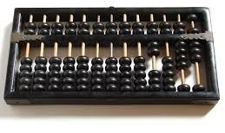
Abacus
What kind of technology is used?

Slide 42
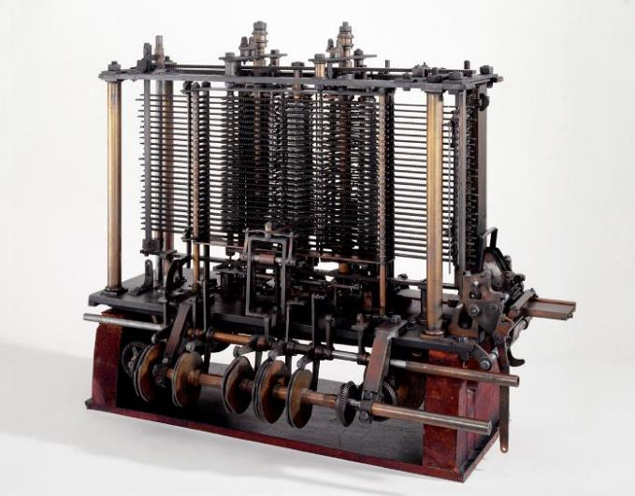

Analytical Engine
First concept of general-purpose computer
  By Charles Babbage (1791-1871) in 1837
  A mechanical device designed to combine basic arithmetic operations with decisions based on its own computations
  Contained an ALU, basic flow
  control, punch cards (inspired
  by Jacquard Loom), memory
What kind of technology is used?
Trial model of a part of the Analytical Engine, built by Babbage (Science Museum, London)

Slide 43
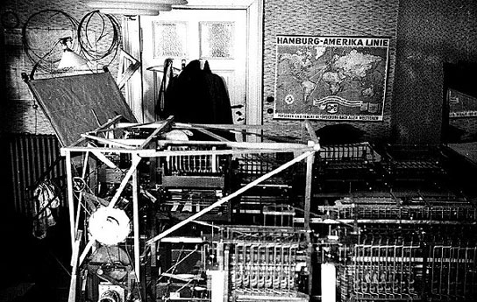
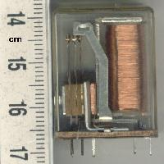
Z1
First electro-mechanical binary programmable computer
  By Konrad Zuse (1910 - 1995) from 1936 to 1938
What kind of technology is used?
Relay: an electrically operated switch, normally by electromagnet
http://computergenerations.wikispaces.com/Z1,+Z2,+Z3,+Z4

Slide 44
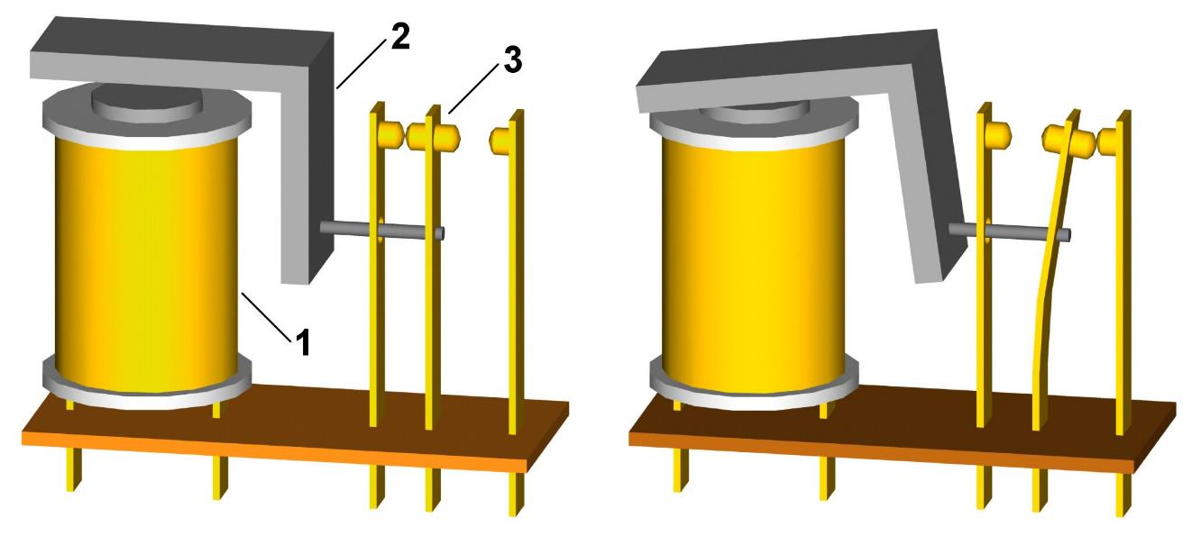
How Does a Relay Work?
0
1
0-1 switching involves mechanical movements
https://commons.wikimedia.org/wiki/File:Relay_principle_horizontal.jpg
Notes:
https://www.youtube.com/watch?v=YLS7u-TG5Q4
https://www.youtube.com/watch?v=hhYWEh4Dfoc

Slide 45
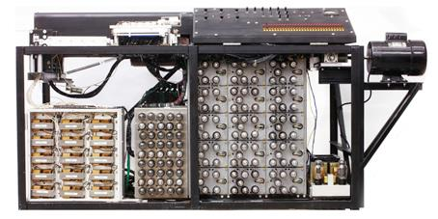
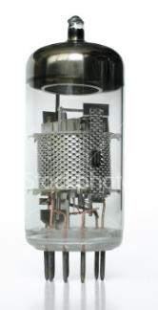
ABC - Atanasoff-Berry Computer
First electronic digital computer
  By Prof. John Vincent Atanasoff and graduate student Cliff Berry at Iowa State College from 1939 - 1942
What kind of technology is used?
Vacuum tube: an electronic switch that controls electric current between
electrodes in an evacuated container

Slide 46
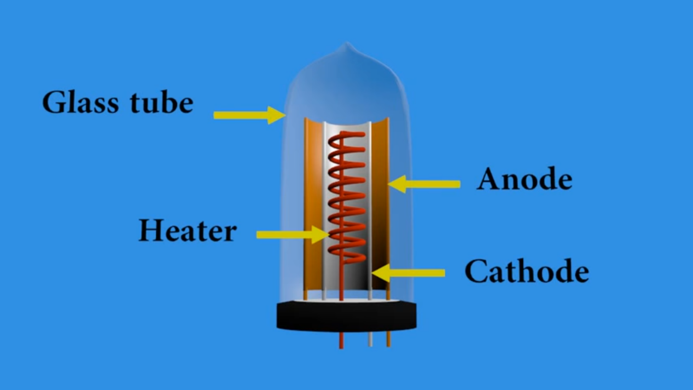
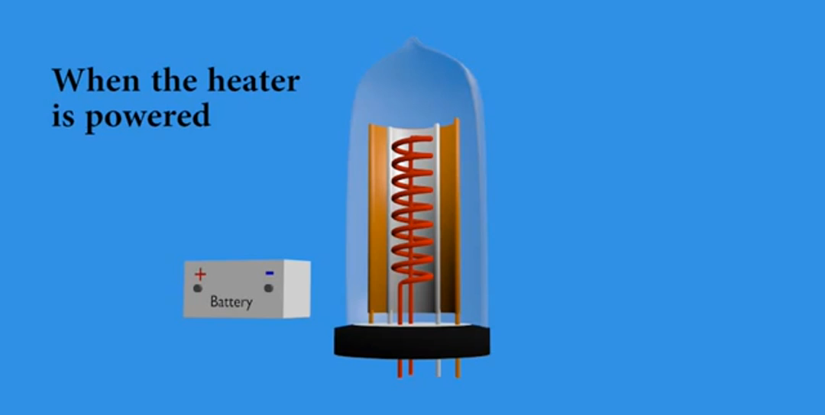
How Does a Vacuum Tube Work?
Switching involves heating
0 → 1
https://www.youtube.com/watch?v=K6BgZ8s1Vuw
Notes:
https://www.youtube.com/watch?v=K6BgZ8s1Vuw

Slide 47
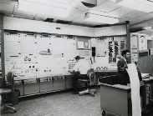
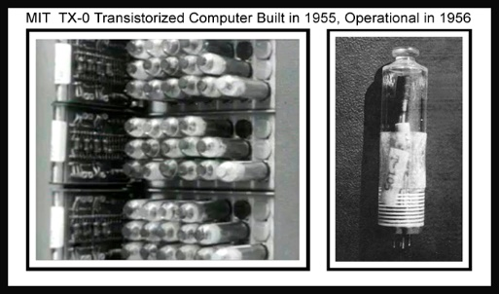
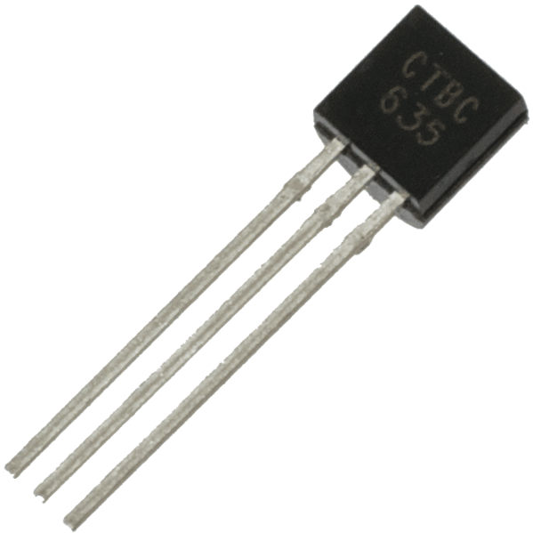
TX-0
First general-purpose programmable computer built with transistors
  TX-0 (Transistor eXperimental - 0) by MIT
https://en.wikipedia.org/wiki/TX-0#/media/File:MIT_TX-0_computer_Philco_surface-barrier_transistors.JPG
http://www.humbertsanz.com/2012_07_01_archive.html
What kind of technology is used?
Notes:
Transistors invented in 1948, more than 10 years of developmental work was needed to render it a viable alternative to the vacuum tube. The small size of the transistor, its greater reliability, and its relatively low power consumption made it vastly superior to the tube. Its use in computer circuitry permitted the manufacture of digital systems that were considerably more efficient, smaller, and faster than their first-generation ancestors.

Slide 48
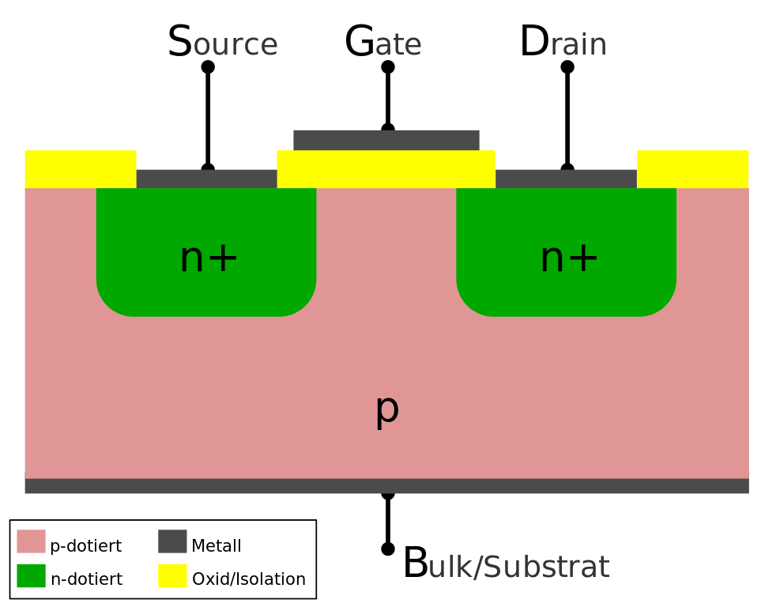
How Does a Transistor Work?
Switching is purely electronic
https://en.wikipedia.org/wiki/File:Scheme_of_metal_oxide_semiconductor_field-effect_transistor.svg

