Slide 1
Midterm Exam Discussion

Slide 2
Lab1 Part

Slide 3
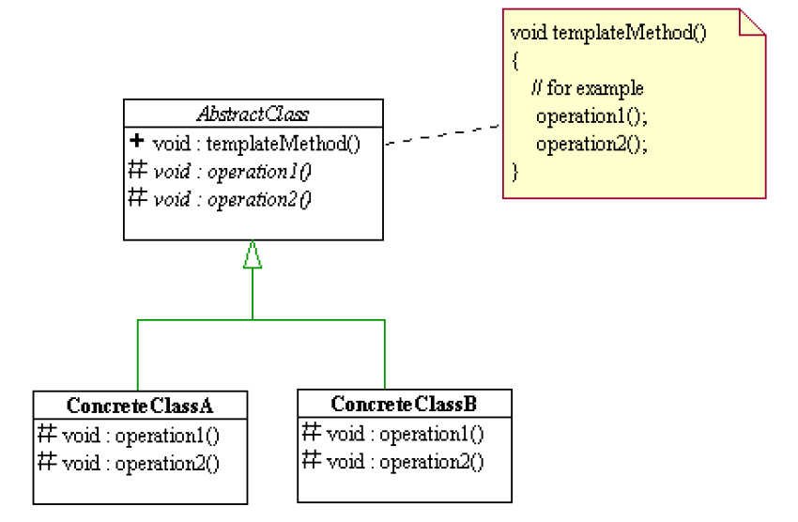

Slide 4
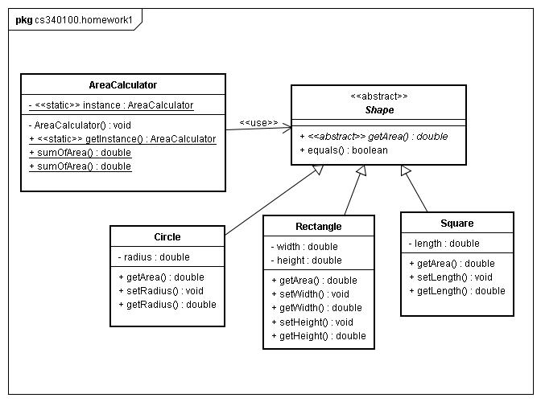

Slide 5
package cs340100.homework1;
abstract class Shape {
public abstract double getArea();
public boolean equals(Object o) {
if( (o instanceof Shape) == false) {
return false;
}
Shape otherShape = (Shape) o;
if( this.getArea() == otherShape.getArea() ) {
return true;
}
else {
return false;
}
}
}
在這裡, 我們不知道到底是什麼形狀, 也依然可以比較大小. WHY?

Slide 6
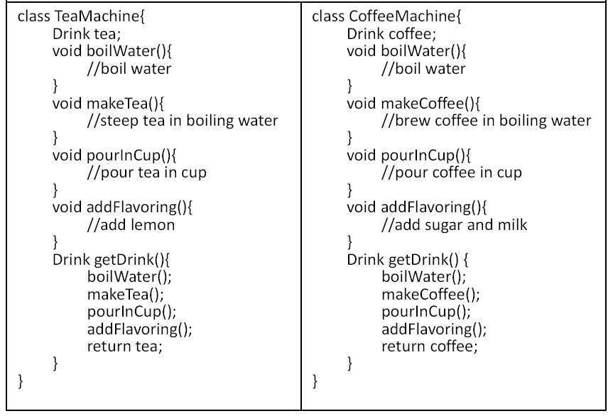

Slide 7
public abstract class DrinkMachine {
Drink drink;
public void boilWater() {
//boil water
}
public abstract makeDrink();
public void pourInCup() {
//pour in cup
}
public abstract void addFlavoring();
public Drink getDrink() {
boilWater();
makeDrink();
pourInCup();
addFlavoring();
return drink;
}
}
class CoffeeMachine extends DrinkMachine {
public void makeDrink() {
drink = new Coffee();
}
public void addFlavoring() {
drink.add(new Sugar());
drink.add(new Milk());
}
}
class TeaMachine extends DrinkMachine {
public void makeDrink() {
drink = new Tea();
}
public void addFlavoring() {
drink.add(new Lemon());
}
}

Slide 9
Advanced Part
24. String longString = “abcdefghi………..”
String shortString = longString.substring(0,1);
shortString causes longString cannot be freed
Immutability
25. Should Square extends Rectangle?

Slide 10
To be inherited or not to be inherited
void g(Rectangle r) {
//semantic inconsistent r.setWidth(5); r.setHeight(4); if (r.getWidth() * r.getHeight() != 20) { throw new RuntimeException(); } }
//some other place
Rectangle square = new Square();
g(square);

Slide 11
26. Yes
public void swap(int[] array) {
int tmp = array[0];
array[0] = array[1];
array[1] = tmp;
}
public void m() {
int[] x = new int[2];
x[0] = 0;
x[1] = 1;
swap(x);
}

Slide 12
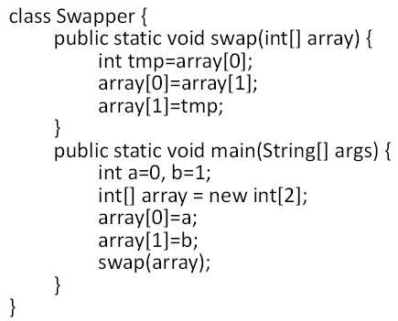
27. No
Values inside array are swapped
But a and b are not

Slide 13
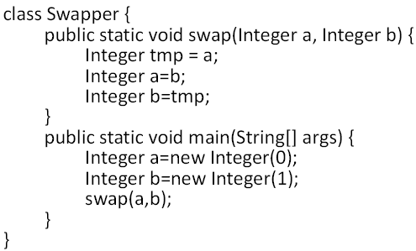
28. No
Reference values are copied!
We cannot exchange the values of a and b in main method, only in swap method.

Slide 14
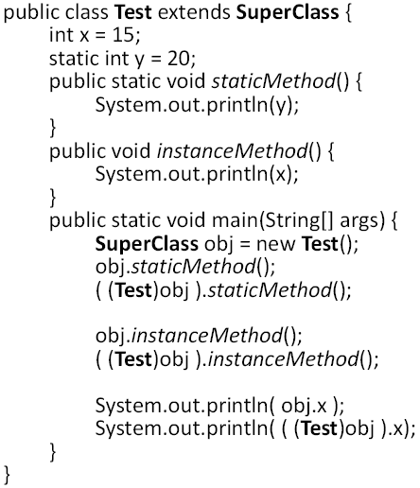
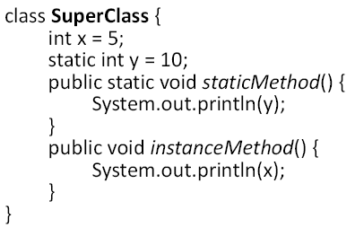
Overriding
29.
10, 20, 15, 15, 5, 15

Slide 15
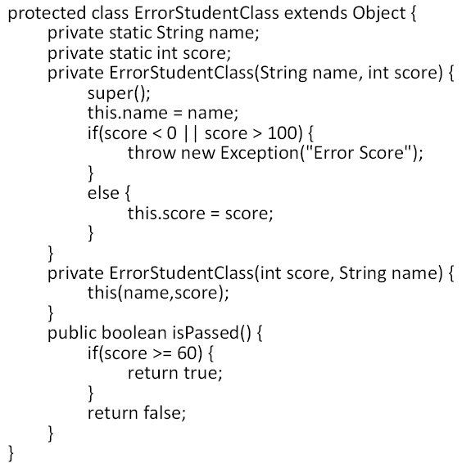
Compile errors
Design mistakes

Slide 16
Challenge: Decorator Pattern
This is a important design pattern which is used very often in java.io.*
We will use a more detail slide to introduce it.
Reference: O’Reilly Head First Design Patterns
http://oreilly.com/catalog/hfdesignpat/chapter/ch03.pdf

Slide 17
