Slide 1
Introduction to Java Server Page (JSP)
Yoshi

Slide 2
What is JSP
JSPs have dynamic scripting capability that works in tandem with HTML code, separating the page logic from the static elementsJSPs are compiled into Java Servlets by a JSP compiler. A JSP compiler may generate a servlet in Java code that is then compiled by the Java compiler
Similar to PHP, ASP, ASP.NET, …etc
For more information
http://en.wikipedia.org/wiki/JavaServer_Pages

Slide 3
Four kinds of segments
Declaration
For member level declaration
Methods and fields
<%! … %>
Scriptlet
_jspService()
<% … %>
Expression
<%= “Hello World” %>
Directive
<%@ … %>

Slide 4
JSP is …
<%@ page errorPage="myerror.jsp" %>
<%@ page import="com.foo.bar" %>
<html>
<head>
<%! int serverInstanceVariable = 1;%>
<% int localStackBasedVariable = 1; %>
<table>
<tr><td><%= toStringOrBlank( "expanded inline data " + 1 ) %></td></tr>
</table>
</head>
</html>

Slide 5
To servlet is …
package jsp_servlet;
import java.util.*;
import java.io.*;
import javax.servlet.*;
import javax.servlet.http.*;
import javax.servlet.jsp.*;
import javax.servlet.jsp.tagext.*;
import com.foo.bar;
// Imported as a result of <%@ page import="com.foo.bar" %>
import …

Slide 6
To servlet is … (2)
class _myservlet implements javax.servlet.Servlet, javax.servlet.jsp.HttpJspPage {
// Inserted as a
// result of <%! int serverInstanceVariable = 1;%>
int serverInstanceVariable = 1;
…
public void _jspService( javax.servlet.http.HttpServletRequest request,
javax.servlet.http.HttpServletResponse response )
throws javax.servlet.ServletException,
java.io.IOException
{
javax.servlet.ServletConfig config = …; // Get the servlet config

Slide 7
To servlet is … (3)
Object page = this;
// Get the page context for this request
PageContext pageContext = …;
javax.servlet.jsp.JspWriter out = pageContext.getOut();
HttpSession session = request.getSession( true );
try {
out.print( "<html>\r\n" );
out.print( "<head>\r\n" );
…
// From <% int localStackBasedVariable = 1; %>
int localStackBasedVariable = 1;
…

Slide 8
To servlet is … (4)
out.print( "<table>\r\n" );
out.print( " <tr><td>" );
// From <%= toStringOrBlank( "expanded inline data " + 1 ) %>
out.print( toStringOrBlank( "expanded inline data " + 1 ) );
out.print( " </td></tr>\r\n" );
…
} catch ( Exception _exception ) {
// Clean up and redirect to error page in <%@ page
// errorPage="myerror.jsp" %>
}
}
}

Slide 9
Implicit Objects
What are they in servlet?
out
The JspWriter used to write the data to the response stream(output page).
page
The servlet itself.
pageContext
A PageContext instance that contains data associated with the whole page. A given HTML page may be passed among multiple JSPs.
request
The HttpServletRequest object that provides HTTP request information.

Slide 10
Implicit Objects (2)
response
The HttpServletResponse object that can be used to send data back to the client.
session
The HttpSession object that can be used to track information about a user from one request to another.
config
Provides servlet configuration data.
application
Data shared by all JSPs and servlets in the application.
exception
Exceptions not caught by application code.

Slide 11
Get the Container
An engine to compile/run your JSP/Servlet
Tomcat
http://tomcat.apache.org/
Resin (We choose this one)
http://www.caucho.com/

Slide 12
Resin
Let’s run it
Test it by Browser with port 8080
http://localhost:8080
You should see a default homepage
Do you have any idea to write a Web Application?
If no now, let’s implement a fake lab3 now!

Slide 13
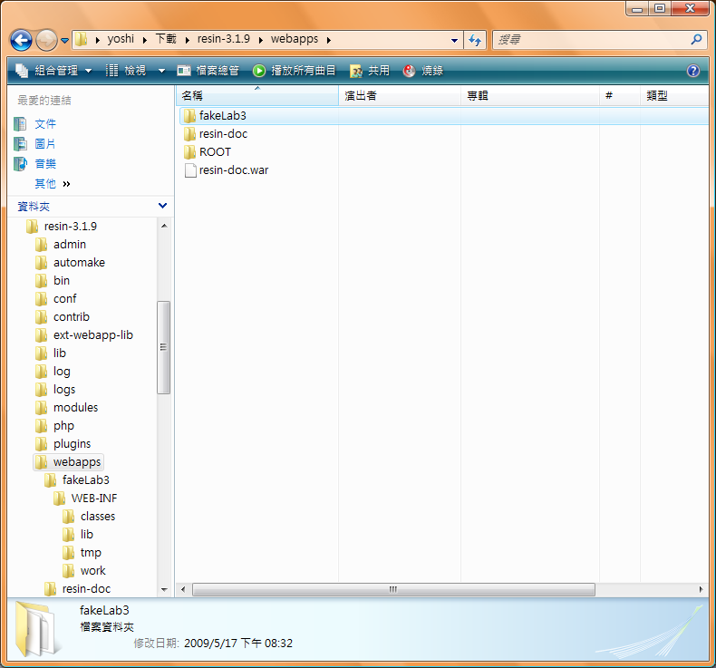
Directory structure

Slide 14
Let’s implement Lab3
resin-3.1.9\webapps\fakeLab3\upload.html
Put BeanShell into
resin-3.1.9\webapps\fakeLab3\WEB-INF\lib\bsh-core-2.0b4.jar
Why?
Check resin-3.1.9\conf\app-default.xml

Slide 15
upload.html
<html>
<FORM ACTION="uploadHandle.jsp" METHOD=POST>
Post your code:<BR>
<TEXTAREA NAME="code" COLS=40 ROWS=15></TEXTAREA>
<P><INPUT TYPE=SUBMIT VALUE="submit">
</FORM>
</html>

Slide 16
uploadHandle.jsp
<html>
<%@ page import="bsh.Interpreter, java.io.*" %>
<%
synchronized(this) {
String code = request.getParameter("code");
PrintStream originalOut = System.out;
ByteArrayOutputStream outBuffer =
new ByteArrayOutputStream();
PrintStream newStream = new PrintStream(outBuffer);
System.setOut(newStream);
System.setErr(newStream);
Interpreter i = new Interpreter();
try {
WHY?

Slide 17
uploadHandle.jsp
i.eval(code);
}
catch(Exception e) {
e.printStackTrace();
System.err.flush();
}
System.out.flush();
out.println(outBuffer.toString());
System.setOut(originalOut);
System.setErr(originalOut);
}
%>
</html>

Slide 18
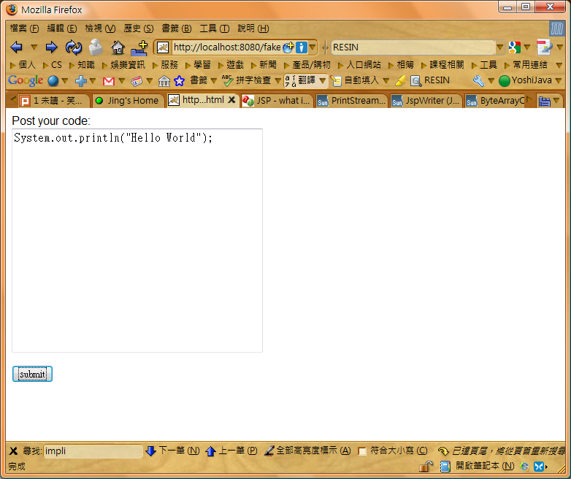
Run!
Let’s try it!

Slide 19
Discussions
Compare with our Lab3, is it easier to achieve the goal?
Undoubtedly, yes!
But before we use it, we have to know some configurations inside the container
Containers may follow the same standards, ideally
Your application becomes “web application”
Can you give more popular web applications?
Gmail, YouTube, Wretch, Pixnet, …etc
Can you write one for promoting NTHU?

Slide 20
Useful references
http://caterpillar.onlyfun.net/Gossip/JSPServlet/JSPServlet.htm (Easy)

