Slide 1
Java I/O and Java Networking
Yoshi

Slide 2
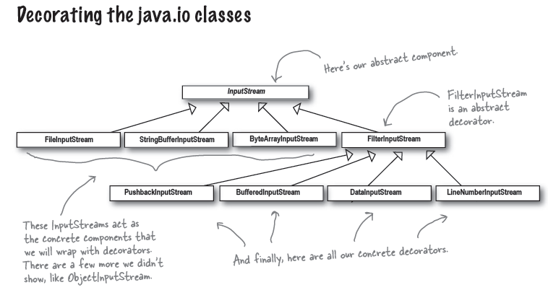
Recall that…

Slide 3
Murmur…
張無忌只花了幾個時辰就學會了別人要學好幾年的乾坤大挪移，為什麼?
因為張無忌有深厚的九陽神功!
Decorator pattern & other patterns
九陽神功 (內功)
Java I/O
乾坤大挪移 (外功)
光學會內功，不懂得外功仍舊無太大用途
覺遠大師即為一例
光會外功，內功薄弱
令狐沖，但是他後來還是靠了吸星大法和易筋經

Slide 4
RTFSC
Please see IOExample.zip
Exercise
Write your own input/output filters which encrypt/decrypt the stream data
For example: a simple encryption
I love you → J mpwf zpv (shift 1)
Write your own writer filter which makes 中文字 to 注音文
For example
我也不知道啊, 呵呵 →我也ㄅㄓ道ㄚ, ㄏㄏ

Slide 5
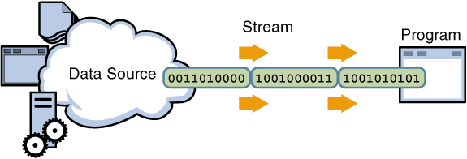
Stream Concept
Input Stream
Output Stream

Slide 6
Character Stream
The Java platform stores character values using Unicode conventions. Character stream I/O automatically translates this internal format to and from the local character set.
Character streams are often wrappers for byte streams. The character stream uses the byte stream to perform the physical I/O, while the character stream handles translation between characters and bytes.
FileReader → FileInputStream
FileWriter → FileOutputStream

Slide 7
Line-Oriented
public class CopyLines {
public static void main(String[] args) throws IOException {
BufferedReader inputReader = null;
PrintWriter outputWriter = null;
try {
inputReader = new BufferedReader(new FileReader(“input.txt"));
outputWriter = new PrintWriter(new FileWriter("output.txt"));
String line;
while ((line = inputReader.readLine()) != null) {
outputWriter.println(line);
}
}
finally {
if (inputReader != null) {
inputReader.close();
}
if (outputWriter != null) {
outputWriter.close();
}
}
}
}

Slide 8
Let’s see the 注音文 filter

Slide 9
java.net.Socket
This class implements client sockets (also called just "sockets").
A socket is an endpoint for communication between two machines.
Very similar to local I/O operations

Slide 10
Retrieve Yahoo! Homepage
import java.io.*;
import java.net.*;
public class RetrieveWeb {
public RetrieveWeb(String host, int port) throws IOException {
Socket socket = new Socket(host, port);
InputStream in = socket.getInputStream();
BufferedReader reader = new BufferedReader(
new InputStreamReader(in, "UTF8"));
OutputStream out = socket.getOutputStream();
PrintWriter pw = new PrintWriter(new OutputStreamWriter(out));
pw.println("GET /");
pw.flush();
String line="";
while( (line=reader.readLine()) != null) {
System.out.println(line);

Slide 11
Retrieve Yahoo! Homepage
}
reader.close();
pw.close();
}
public static void main(String[] args) throws IOException {
//delete the following three lines to make this program general
args = new String[2];
args[0] = "tw.yahoo.com";
args[1] = "80";
int port = Integer.parseInt(args[1]);
RetrieveWeb obj = new RetrieveWeb(args[0], port);
}
}

Slide 12
Something strange?
java.io.InputStream
public abstract int read() throws IOException
java.io.OutputStream
public abstract void write(int b) throws IOException

Slide 13
Something strange? (2)
byte
-128 ~ +127
-1 implies end of stream
http://gaznjang.blogspot.com/2007/06/java-io-stream-read-write.html
You can also find it in O’Reilly Java I/O

Slide 14
Exercise
Trace java.io.BufferedReader
http://www.docjar.com/html/api/java/io/BufferedReader.java.html
Write a program to connect to hulabear.twbbs.org:23

