Slide 1
Chapter 4: Threads

Slide 2
Chapter 4: Threads
Overview
Multithreading Models
Threading Issues
Pthreads
Windows XP Threads
Linux Threads
Java Threads

Slide 3
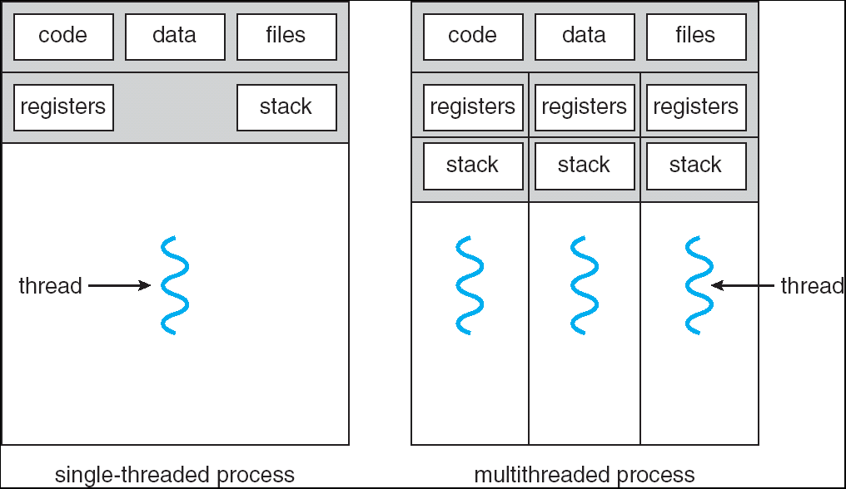
Single and Multithreaded Processes

Slide 4
Benefits
Responsiveness
Resource Sharing
Economy
Utilization of MP Architectures

Slide 5
User Threads
Thread management done by user-level threads library
Three primary thread libraries:
POSIX Pthreads
Win32 threads
Java threads

Slide 6
Kernel Threads
Supported by the Kernel
Examples
Windows XP/2000
Solaris
Linux
Tru64 UNIX
Mac OS X

Slide 7
Multithreading Models
Many-to-One
One-to-One
Many-to-Many

Slide 8
Many-to-One
Many user-level threads mapped to single kernel thread
Examples:
Solaris Green Threads
GNU Portable Threads

Slide 9
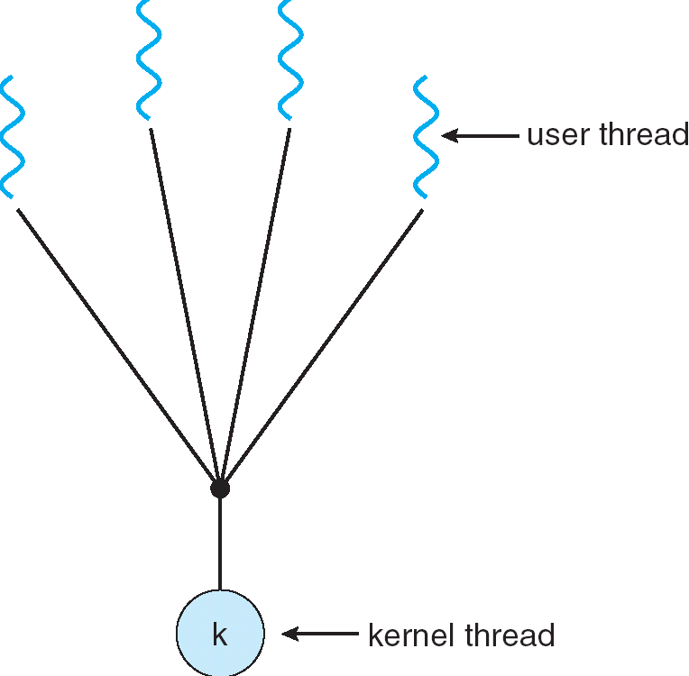
Many-to-One Model

Slide 10
One-to-One
Each user-level thread maps to kernel thread
Examples
Windows NT/XP/2000
Linux
Solaris 9 and later

Slide 11
One-to-one Model

Slide 12
Many-to-Many Model
Allows many user level threads to be mapped to many kernel threads
Allows the operating system to create a sufficient number of kernel threads
Solaris prior to version 9
Windows NT/2000 with the ThreadFiber package

Slide 13
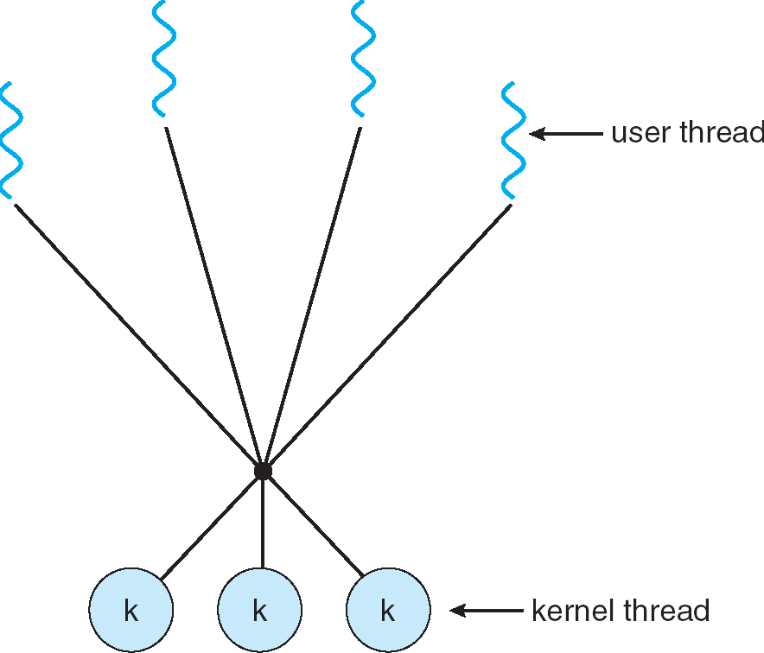
Many-to-Many Model

Slide 14
Two-level Model
Similar to M:M, except that it allows a user thread to be bound to kernel thread
Examples
IRIX
HP-UX
Tru64 UNIX
Solaris 8 and earlier

Slide 15
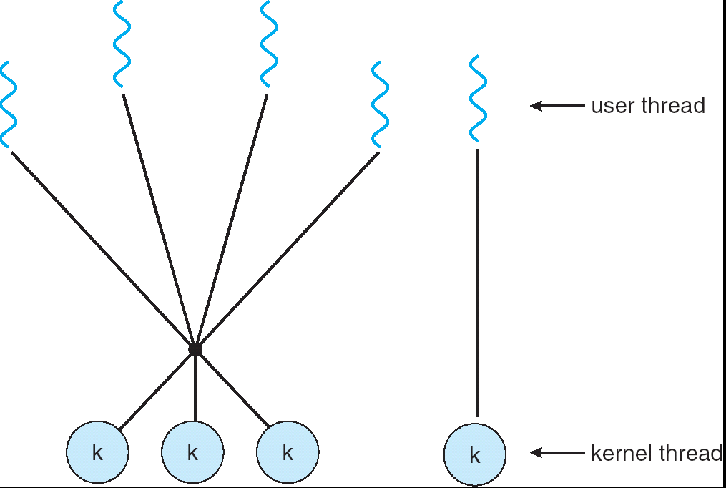
Two-level Model

Slide 16
Thread Pools
Create a number of threads in a pool where they await work
Advantages:
Usually slightly faster to service a request with an existing thread than create a new thread
Allows the number of threads in the application(s) to be bound to the size of the pool

Slide 17
Thread Specific Data
Allows each thread to have its own copy of data
Useful when you do not have control over the thread creation process (i.e., when using a thread pool)

Slide 18
Pthreads
A POSIX standard (IEEE 1003.1c) API for thread creation and synchronization
API specifies behavior of the thread library, implementation is up to development of the library
Common in UNIX operating systems (Solaris, Linux, Mac OS X)

Slide 19
Windows XP Threads
Implements the one-to-one mapping
Each thread contains
A thread id
Register set
Separate user and kernel stacks
Private data storage area
The register set, stacks, and private storage area are known as the context of the threads
The primary data structures of a thread include:
ETHREAD (executive thread block)
KTHREAD (kernel thread block)
TEB (thread environment block)

Slide 20
Linux Threads
Linux refers to them as tasks rather than threads
Thread creation is done through clone() system call
clone() allows a child task to share the address space of the parent task (process)

Slide 21
Java Threads
Java threads are managed by the JVM
Java threads may be created by:
Extending Thread class
Implementing the Runnable interface

Slide 22
Java Thread States

Slide 23
A Simple Example of Java Thread
class ThreadExample extends Thread {
public ThreadExample(String name) {
super(name);
}
public void run() {
while(true) {
System.out.println(getName()+": Hello");
}
}
public static void main(String[] args) {
ThreadExample t1 = new ThreadExample("Yoshi");
ThreadExample t2 = new ThreadExample("King");
t1.start();
t2.start();
}
}

Slide 24
Check the API Doc for java.lang.Thread
http://java.sun.com/j2se/1.5.0/docs/api/java/lang/Thread.html

