Slide 1
Java Exception Handling
Yoshi
http://java.sun.com/docs/books/tutorial/essential/exceptions/

Slide 2
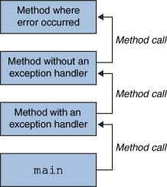
What is an Exception?
An exception is an event that occurs during the execution of a program that disrupts the normal flow of instructions.

Slide 3
Possible Scenarios
A program is going to read a file, but it is missing
A program is reading an array, but the out of bound case occurs
A program is receiving a network packet, but the connection fails
JVM crashes
Are the cases above all exceptions?

Slide 4
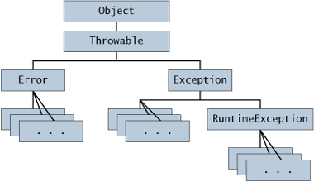
Hierarchy

Slide 5
Error Class
When a dynamic linking failure or other hard failure in the Java virtual machine occurs, the virtual machine throws an Error.
Simple programs typically do not catch or throw Errors.

Slide 6
Exception Class
Most programs throw and catch objects that derive from the Exception class. An Exception indicates that a problem occurred, but it is not a serious system problem.
Most programs you write will throw and catch Exceptions as opposed to Errors.

Slide 7
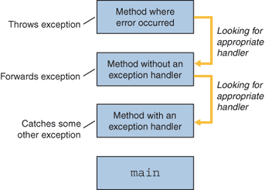
Review the call stack

Slide 8
Three kinds of exceptions
Checked exception
  These are exceptional conditions that a well-written application should anticipate and recover from.
Unchecked exceptions
  Error
    These are exceptional conditions that are external to the application, and that the application usually cannot anticipate or recover from.
  Runtime exception
    These are exceptional conditions that are internal to the application, and that the application usually cannot anticipate or recover from.
    These usually indicate programming bugs, such as logic errors or improper use of an API

Slide 9
Identifying the following cases
Divided by zero
Stack overflow
I/O exceptions, such as packet lost
Disk writing error
Out of memory

Slide 10
Try-catch block
To those checked exceptions, we have to consider the case that exception happens
private Vector vector;
private static final int SIZE = 10;
PrintWriter out = null;
try {
System.out.println("Entered try statement");
out = new PrintWriter(new FileWriter("OutFile.txt"));
for (int i = 0; i < SIZE; i++) {
out.println("Value at: " + i + " = "
+ vector.elementAt(i));
}
}
catch and finally statements . . .

Slide 11
Try-catch block (2)
try {
//maybe read a file or something…
}
catch (FileNotFoundException e) {
System.err.println("FileNotFoundException: " + e.getMessage());
throw new SampleException(e);
}
catch (IOException e) {
System.err.println("Caught IOException: " + e.getMessage());
}
//Why we catch FileNotFoundException first, and then IOException?

Slide 12
See the API docs
http://java.sun.com/j2se/1.4.2/docs/api/java/io/FileNotFoundException.html
java.io
Class FileNotFoundException
java.lang.Object
- java.lang.Throwable
- java.lang.Exception
- java.io.IOException
- java.io.FileNotFoundException

Slide 13
The finally block
The finally block always executes when the try block exits.
The finally block is useful for more than just exception handling
  it allows the programmer to avoid having cleanup code accidentally bypassed by a return, continue, or break.
  Putting cleanup code in a finally block is always a good practice, even when no exceptions are anticipated.

Slide 14
Finally block example
public class TestFinally {
private void m1() {
System.out.println("Before entering m2()");
m2();
System.out.println("After exiting m2()");
}
private void m2() {
try {
System.out.println("In m2()");
return;
}
finally {
System.out.println("In m2's finally");
}
}
public static void main(String[] args) {
new TestFinally().m1();
}
}

Slide 15
Synopsis of finally block
The finally block is a key tool for preventing resource leaks.
When closing a file or otherwise recovering resources, place the code in a finally block to insure that resource is always recovered.

Slide 16
Now we know that…
try {
//…something might have exception
}
catch (SomeExceptionClass e) {
//handle the exception here
}
finally {
//recover resources
}
What is something?

Slide 17
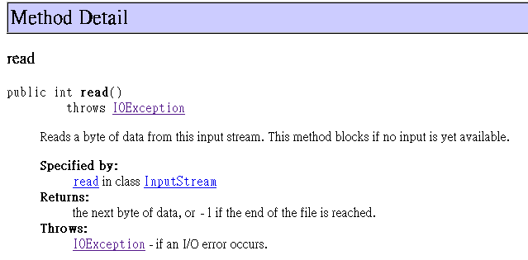
Again, see the API docs
http://java.sun.com/javase/6/docs/api/java/io/FileInputStream.html#read(byte[])

Slide 18
Throw out an exception
When we want others to “handle the possible exception”, add the “throws” keyword to the method
  Tell others to “catch the exception which I throw”

Slide 19
Compile the example
public class ThrowExceptionExample {
private void m1() {
m2();
}
private void m2() throws Exception {
//I just want to throw an exception
throw new Exception();
}
public static void main(String[] args) {
new ThrowExceptionExample().m1();
}
}

Slide 20
Compile the example (2)
C:\javasrc>javac ThrowExceptionExample.java
ThrowExceptionExample.java:4: unreported exception java.lang.Exception; must be
caught or declared to be thrown
m2();
^
1 error
C:\javasrc>

Slide 21
Compile the example (3)
public class ThrowExceptionExample {
private void m1() {
try {
m2();
}
catch(Exception e) {
System.out.println("I catch it!");
}
}
private void m2() throws Exception {
//I just want to throw an exception
throw new Exception();
}
public static void main(String[] args) {
new ThrowExceptionExample().m1();
}
}

Slide 22
Note
You can throw multiple exceptions
  private void m2() throws Exception, ArrayIndexOutOfBoundsException
You can throw runtime exception
  Remember that ArrayIndexOutOfBoundsException is an unchecked exception; including it in the throws clause is not mandatory.
  That is, you can skip it
You can define your own “Throwable class”
  Extend java.lang.Throwable, or java.lang.Exception
Suggestions
  If a client can reasonably be expected to recover from an exception, make it a checked exception.
  If a client cannot do anything to recover from the exception, make it an unchecked exception.

Slide 23
Summary
The try block identifies a block of code in which an exception can occur.
The catch block identifies a block of code, known as an exception handler, that can handle a particular type of exception.
The finally block identifies a block of code that is guaranteed to execute, and is the right place to close files, recover resources, and otherwise clean up after the code enclosed in the try block.

Slide 24
Exercises
http://java.sun.com/docs/books/tutorial/essential/exceptions/QandE/questions.html

