Slide 1
Inheritance and the Modifiers
CS340100, NTHU
Yoshi

Slide 2
Outline
Inheritance
  Basic concept
  Overriding
  super
Modifiers
  final
  abstract
  interface

Slide 3
Inheritance
Inheritance is…
  Aka Generalization/Specialization principle
  In Java, use the keyword extends

Slide 4
Why to Inherit?
Reuse
  A subclass can have the states and behaviors from the superclass
  Extract the common parts
  A subclass can still have its own behaviors and states
  Original methods can still be overridden

Slide 5
Example
class Person
  class Student

Slide 6
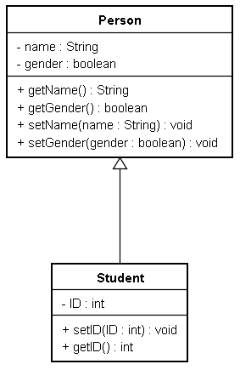
Class Diagram

Slide 7
An Example: Person and Student
public class Person {
private String name;
private boolean gender;
public Person(String name2, boolean gender2) {
name = name2;
gender = gender2;
}
public String getName() {
return name;
}
public boolean getGender() {
return gender;
}
}

Slide 8
Use of Person
public class App {
public static void main(String argv[]){
Person myPerson=new Person(“John”, true);
String name = myPerson.getName();
boolean gender = myPerson.getGender();
System.out.println(name);
System.out.println(gender);
}
}

Slide 9
A Subclass : Student
public class Student extends Person {
private String ID;
public void setID(int id2){
ID = id2;
}
public void getID(){
System.out.print(“ID is”+ ID);
}
}

Slide 10
Use of Student
public class App {
public void main(String argv[]) {
Student myStudent=new Student();
//what if: Person myStudent = new Student();
myStudent.setName(“John”);
myStudent.setGender(true);
myStudent.setID(“123456”);
myStudent.getName();
myStudent.getGender();
myStudent.getID();
}
}

Slide 11
Overriding
Also known as method rewrite
Rewrite a instance method inherited from the superclass
  Note that a static method can not be overridden
A subclass can have a field/method which has the same name as the one derived from the superclass
  This is called field/method hiding

Slide 12
Example
class Superclass {
public static void staticMethod() {
System.out.println("Superclass static method.");
}
public void instanceMethod() {
System.out.println("Superclass instance method.");
}
}
class Subclass extends Superclass{
public static void staticMethod() {
System.out.println("Subclass static method.");
}
public void instanceMethod() {
System.out.println("Subclass instance method.");
}
}

Slide 13
Example (cont’d)
public class Test {
public static void main(String[] args) {
Subclass obj = new Subclass();
//static method
Superclass.staticMethod();
Subclass.staticMethod();
//instance method
obj.instanceMethod();
((Superclass) obj).instanceMethod();
}
}

Slide 14
this and shadow
Shadow effect: the local variable shadows the member in the class
Use this to solve the problem
Remember how we use this in the previous slide?
  class Car{
  public int wheel;
  Car(int wheel){
  wheel = wheel;
  }
  }
  class Car{
  public int wheel;
  Car(int wheel){
  this.wheel = wheel;
  }
  }

Slide 15
this and shadow (cont’d)
this for
  “this” stands for the object itself
  Actually, “this” saves the address of the object which is executing this line of code
  “this” is also used for indicating the shadowed variable

Slide 16
super
super is for indicating the superclass of current class
  super() calls the constructor of the superclass
    If you don’t write it, the compiler will add super() for you
      That is, calling the no-arg constructor
  super() need to be placed in the first line of the subclass’s constructor
  super.fieldNameInSuperclass;
  super.methodNameInSuperclass();

Slide 17
Superclass
Superclass object
Subclass
Subclass
object

Slide 18
Wrong program
//建立一個Vehicle的類別
class Vehicle {
Vehicle(String x){
System.out.println(“Vehicle’s Constructor”);
}
public void drive(){
System.out.println(“I’m driving”);
}
}

Slide 19
Wrong program
//建立一個Car的類別extend Vechicle
class Car extends Vehicle {
}
public class App{
public static void main(String[] args){
Car aCar=new Car();
}
}
Why this program is wrong??

Slide 20
How to fix it!
//建立一個Vehicle的類別
class Vehicle {
Vehicle(){
System.out.println(“Vehicle’s Constructor”);
}
Vehicle(String x){
System.out.println(“Vehicle’s Constructor”);
}
public void drive(){
System.out.println(“I’m driving”);
}
}

Slide 21
How to fix it!!
//建立一個Car的類別extend Vechicle
class Car extends Vehicle {
Car(){
Super(“X”);
}
}
public class App{
public static void main(String[] args){
Car aCar=new Car();
}
}

Slide 22
How to fix it!!
//建立一個Car的類別extend Vechicle
class Car extends Vehicle {
Car(String x){
super(x);
}
}
public class App{
public static void main(String[] args){
Car aCar=new Car(“x”);
}
}

Slide 23
Modifiers
final
abstract
interface

Slide 24
final
Can be applied in classes, variable, and methods
  Method
    The method cannot be overridden
  Variable
    Cannot change the value the variable holds
      For primitive types, the scalar cannot be modified
      For reference type, this variable can only point to a fixed object
  Class
      This class cannot be extended

Slide 25
Final with Variables
public class ConstantData{
public static void main(String[] args){
final int constantInteger=10;
constantInteger=12; //error, can not assign!!
}
public class ConstantReference{
public static void main(String[] args){
final Student stuObj=new Student(“John”);
stuObj.setName(“Yoshi”); //OK!!
}

Slide 26
Final with Variables
public class ConstantReference{
public static void main(String[] args){
final Student stuObj=new Student(“John”);
stuObj = new student(“John”); //error!!
}
Final constrains this
Instance of class Student
Not constrained

Slide 27
Final with Classes
Object
Life
Will not be extended
Animal
Plants
final class Plant {
}

Slide 28
Abstract
Indicate that a class is abstract idea
Can be applied in
  Classes
  Methods
An abstract class cannot be instantiated. That is, cannot be “new”
An abstract method has only name, argument, and return type
  Does not have method body
If a class has one abstract method, then the class needs to be abstract class
  But can still have non-abstract method

Slide 29
abstract Example
abstract class GraphicObject {
int x, y;
...
void moveTo(int newX, int newY) {
...
}
abstract void draw();
abstract void resize();
}

Slide 30
Circle extends GraphicObject
class Circle extends GraphicObject {
void draw() {
...
}
void resize() {
...
}
}

Slide 31
Rectangle extends GraphicObject
class Rectangle extends GraphicObject {
void draw() {
...
}
void resize() {
...
}
}

Slide 32
Usage
GraphicObject shape1 = new Circle();
GraphicObject shape2 = new Rectangle();
…
public void draw(GraphicObject shape) {
shape.draw(); //what is the shape?
}

Slide 33
Object Equality?
To check that if the objects are equal, the most well-known ways are
  “==“
  Call method equals()
Primitive types can be compared by “==“
While reference types are compared with “==“, the things to compare are reference values
However, equality should be defined by yourself!

Slide 34
Review This Figure
objRef1=0x3200
objRef1==ObjRef4?
objRef2=0x4650
heap
objRef3=0x3288
objRef4=0x3200
(Reference type variables)
intValue=3
(Object instances inside)
booleanValue=true
(Primitive type variables)

Slide 35
Object Equality (cont’d)
Recall that
  Equality should be defined by yourself!
That is, the content should be compared
  Ex: Two instances of class Student, if their IDs and names are equal, then they should be the same person
  Overriding the equal method in class Object
    public boolean equals(Object o)

Slide 36
The Myth of Object Equality
class Student {
String name;
String id;
public boolean equals(Object obj) {
Student otherStudent = (Student) obj;
if( this.name.equals(otherStudent.name) &&
this.id.equals(otherStudent.id) ) {
return true;
}
else {
return false;
}
}
}

Slide 37
equals method
Defined in java.lang.Object
The default implementation is to compare the reference value
  Please check the source code of JDK! (src.zip)
We have to override the equals method in java.lang.Object

Slide 38
萬物之源：java.lang.Object
In Java, all objects are the subclass of class java.lang.Object
Represent the hierarchy in tree structure, the tree root is java.lang.Object

Slide 39
Interface
Synopsis
  Describes a selected part of the externally visible behavior of model elements
Interface defines specification, standard interactive interface
There are only constants and abstract methods
  Cannot use new to instantiate objects

Slide 40
Example of Interface
interface Base1 {
void fun1(args1,args2,…);
}
interface Base2 {
void fun2(args1,args2,…);
}
class Sub1 implements Base1, Base2 {
public void fun1(args1,args2,…) { … }
public void fun2(args1,args2,…) { … }
}

Slide 41
Declare an interface
Only states and behaviors, no constructor
interface Actions {
public String name = "Some Actions"; //becomes public static final
public void canFly(); //becomes public abstract
public void canRun();
}
interface Specification{
int constantInteger; //error,沒有宣告初始值
public static void show(); //error,不能為static靜態…必為抽象
}

Slide 42
Implementation
Use the keyword implements
Java does not allow a class extends more than one class, but allow implements multiple interfaces
A class need to implement all the abstract methods in the interface
  Remember that all the methods in an interface are public abstract
class Bird extends Animal implements Actions {}
class Bird implements Actions, Action2, Action3 {}

Slide 43
Comparison between interface and abstract
 | interface | abstract
multiple | Yes | No
constructor | No | Yes
Methods | All public abstract | Not always all public abstract
fields | All public static final | Modifiable
Variable inherited | Yes | Yes

Slide 44
Error implements
interface USB{
public void show();
public void print();
}
Class USBMouse implements USB{
//error, why?
}
public class Application {
public static void main(String agrs){
USBMouse usbMouse = new USBMouse();
}
}

Slide 45
Correct implements
interface USB{
public void show();
public void print();
}
Class USBMouse implements USB{
public void show(){
System.out.println(“I’m USB Mouse”);
}
public void print(){
System.out.println(“I’m moving”);
}
}

Slide 46
Polymorphism
Synopsis (from UML book)
  Polymorphism means that an operation may behave differently (in different classes)
  There are two kinds of polymorphism
    Static (overloading) and dynamic
Precondition
  Late binding is needed
    Binding: the point in the life of a program at which the caller of an operation is given the (memory) address of that operation
    The precise memory location of an operation is determined only when the call takes place
  Important idea: decided at runtime

Slide 47
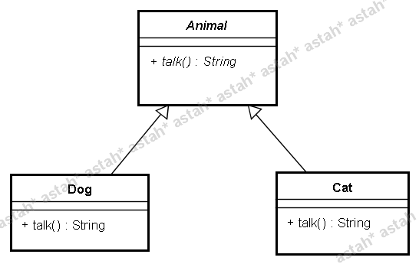
Example
void invokeTalk(Animal animal) {
String say= animal.talk();
System.out.println(say);
}
….
Animal cat = new Cat();
Animal dog = new Dog();
invokeTalk(cat);
invokeTalk(dog);

Slide 48
Example: Comparable
class Student implements Comparable {
private int score;
String name;
public Student(String name, int score) {
this.name = name;
this.score = score;
}
//-1代表less than, 0代表等於, 1代表greater than
//實作了Comparable介面，就必須實作compareTo方法
//代表這個物件具有可以"被比較大小"的性質
public int compareTo(Object obj) {
Student otherStu = (Student) obj;
if(this.score > otherStu.score) {

Slide 49
Example: Comparable
return 1;
}
else if(this.score == otherStu.score) {
return 0;
}
else return -1;
}
public String toString() {
return name + ":" + score;
}
}

Slide 50
TestCompareTo
import java.util.SortedSet;
import java.util.TreeSet;
class TestCompareTo {
public static void main(String[] args) {
Student stu1 = new Student("King",100);
Student stu2 = new Student("Yoshi",80);
Student stu3 = new Student("John",60);
SortedSet set = new TreeSet();
//依序加入三個人
//set.first()會回傳最低分的人
//一開始只有King一個人，當然最低
set.add(stu1);
System.out.println(set.first());
//後來Yoshi加入，變成最低分
set.add(stu2);
System.out.println(set.first());
//John進來後，變成最低分
set.add(stu3);
System.out.println(set.first());
}
}

Slide 51
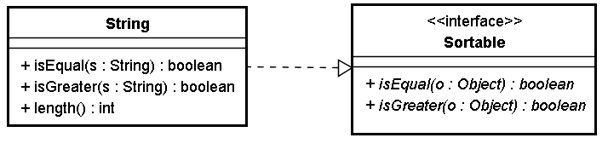
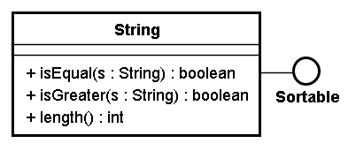
UML
or

Slide 52
Interface or Abstract?
You tell me

Slide 53
Template Method Pattern
A template method defines the program skeleton of an algorithm
In object-oriented programming, first a class is created that provides the basic steps of an algorithm design.
  Basic steps are still abstract methods!
Later on, subclasses change the abstract methods to implement real actions

Slide 54
AbstractClass
{abstract} method1
{abstract} method2
{abstract} method3
templateMethod
ConcreteClass
method1
method2
method3

Slide 55
abstract class Game {
/* A template method : */
final void playOneGame(int playersCount) {
this.playersCount = playersCount;
initializeGame();
int j = 0;
while (!endOfGame()) {
makePlay(j);
j = (j + 1) % playersCount;
}
printWinner();
}
protected int playersCount;
abstract void initializeGame();
abstract void makePlay(int player);
abstract boolean endOfGame();
abstract void printWinner();
}

Slide 56
class Monopoly extends Game {
/* Implementation of necessary concrete methods */
void initializeGame() {
// Initialize money
}
void makePlay(int player) {
// Process one turn of player
}
boolean endOfGame() {
// Return true of game is over according to Monopoly rules
}
void printWinner() {
// Display who won
}
/* Specific declarations for the Monopoly game. */
}

Slide 57
class Chess extends Game {
/* Implementation of necessary concrete methods */
void initializeGame() {
// Put the pieces on the board
}
void makePlay(int player) {
// Process a turn for the player
}
boolean endOfGame() {
// Return true if in Checkmate or Stalemate has been reached
}
void printWinner() {
// Display the winning player
}
/* Specific declarations for the chess game. */
}

Slide 58
Reference
Object-Oriented Concepts
  http://java.sun.com/docs/books/tutorial/java/concepts/index.html
  http://java.sun.com/j2se/1.4.2/docs/api/java/lang/Object.html
  http://en.wikipedia.org/wiki/Template_method_pattern

