Slide 1
Introduction to Constructor, Overloading, and Accessibility
CS340100, NTHU
Yoshi

Slide 2
Outline
Review blueprints and instances
Constructor
Overloading
Accessibility

Slide 3
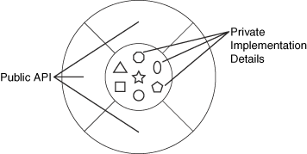
Class and Instances
Review blueprint and instances
Encapsulation

Slide 4
Class and Instances (2)
Architect writes class
Class instantiates objects

Slide 5
Encapsulation and Modularity
Easy for Maintenance and Integration
Lead to low coupling & high cohesion

Slide 6
Constructor
The same name as the class
Set the initial states and run the initial behaviors while constructing
No return type
class Vehicle { //定義的類別
private int wheel; //定義一個實體變數
public Vehicle() { //類別的建構子
wheel = 4;
}
}

Slide 7
Constructor (cont’d)
Each class has at least one constructor
If you don’t give one, the default constructor will be created

Slide 8
Wrong Program (Why?)
//建立一個Vehicle的類別
class Vehicle {
Vehicle(String x){
System.out.println(“Vehicle’s Constructor”);
}
}
…
public class App {
public static void main(String[] args){
Vehicle obj = new Vehicle();
}
}

Slide 9
How to fix it!
//建立一個Vehicle的類別
class Vehicle {
Vehicle() {
System.out.println(“Vehicle’s Constructor”);
}
Vehicle(String x){
System.out.println(“Vehicle’s Constructor”);
}
public void drive(){
System.out.println(“I’m driving”);
}
}
Any other way?

Slide 10
Overloading
Also known as static polymorphism
May be applied to
Constructors
Normal methods

Slide 11
Overloading
物件是依接收的訊息類型來執行不同的方法
名稱重用
只需訊息不同，足以讓物件辨識，一樣可以執行同名的方法
例如：執行Utility物件的max()方法的訊息，如下所示：
Utility.max(23, 45);
Utility.max(23, 45, 87);
Utility.max(‘a’, ‘z’);

Slide 12
Constructor with Parameters
A class may have multiple constructors, and decided according to the parameters
class Vehicle { //定義的類別
private int wheel; //定義一個實體變數
Vehicle() { //類別的建構子
wheel = 4;
}
Vehicle(int n) { //定義有參數的建構子
wheel = n;
}
}
Vehicle newCar1 = new Vehicle(); //實體化一個類別
Vehicle newCar2 = new Vehicle(6); //實體化一個類別，並傳入參數

Slide 13
this
在建構子中呼叫另一個建構子，以避免重複撰寫初始資料成員的程式碼 。
使用「this()」的方式呼叫另一個建構子的語法只能使用於建構子中
不可以在建構子中重複的呼叫「this()」

Slide 14
Example
public class Flower {
int petalCount = 0;
String s = new String("null"); //String=“null”;
Flower(int petals) {
petalCount = petals;
System.out.println("petalCount= "+ petalCount);
}
Flower(String ss) {
System.out.println( "s=" + ss);
s = ss;
}

Slide 15
Example (cont’d)
Flower(String ss, int petals) {
this(petals);
//this(s); // Can't call two this()!
s = ss;
System.out.println("String & int args");
}
Flower() {
this("hi", 47);
System.out.println("default constructor (no args)");
}
void print() {
//this(11); // Not inside non-constructor!
System.out.println("petalCount = " + petalCount + " s = "+ s);
}
public static void main(String[] args) {
Flower x = new Flower();
x.print();
}
}

Slide 16
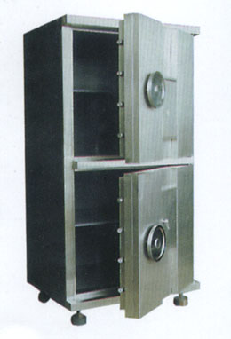
Information Hiding
Protection
Some properties are never modified
Interface to programmers
A programmer does not need to know the details, but use the interactive interfaces

Slide 17
建立資料存取的方法
避免直接存取內部變數
Setter : 設定資料成員的值
public void setWheel(int n){ //設定wheel的值
wheel = n;
}
Getter : 取出資料成員的值
public int getWheel(){ //傳回wheel的值
return wheel;
}
Can you give me a good setter/getter example?

Slide 18
Accessibility
位置 | private | (default) | protected | public
同一類別 |  |  |  | 
同一套件中的子類別 |  |  |  | 
同一套件，但不是子類別 |  |  |  | 
不同套件的子類別 (之instance) |  |  |  | 
不同套件，也不是子類別 |  |  |  | 

Slide 19
Modifier
public
每各class皆可存取
(Default)
同一個package的class才可以存取
protected
同一個package的class才可以存取
不同package但是如果有繼承也可存取
可以存取“繼承下來的”
private
同一個class才能存取

Slide 20
Tips
Use the most restrictive access level that makes sense for a particular member.
That is, use private unless you have a good reason not to
Avoid public fields except for constants

Slide 21
Example: Account
public class Account {
private int money;
public void setMoney(int m) {
if(m < 0)
System.out.println("Error");
else
money = m;
}
public void foo(Account otherAccount) {
//private的保護是class層級
otherAccount.money = -1000;
}
}

Slide 22
Summary
We have learnt
Constructor
Overloading
Encapsulation and information hiding
Accessibility

Slide 23
References
http://java.sun.com/docs/books/tutorial/java/javaOO/accesscontrol.html

