Slide 1
Singleton and Basic UML
CS340100, NTHU
Yoshi

Slide 2
What is UML
Unified Modeling Language
A standardized general-purpose modeling language in the field of software engineering
UML includes a set of graphical notation techniques to create visual models of software-intensive systems.

Slide 3
Diagrams Overview

Slide 4
Basic Class Diagram
Accessibility
States and behaviors
Association
Aggregation
Composition

Slide 5
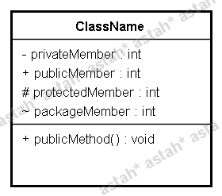
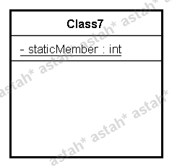
Class

Slide 6
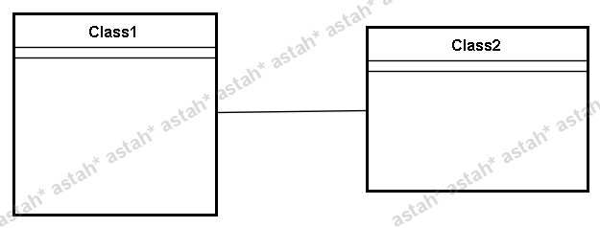
Association

Slide 7
Composition and Aggregation

Slide 8
Design Pattern - Singleton
We have learnt
Accessibility
A method or a constructor can be set as private accessibility, i.e., can only be used in the same class
While a constructor has been set as private, how to use it? i.e., how to create such an object? Is it useful?
class Example {
…
private Example() {
//empty constructor
}
…
}

Slide 9
Design Pattern – Singleton (cont’d)
public class Singleton {
private static final Singleton INSTANCE = new Singleton();
// Private constructor prevents instantiation from other classes
private Singleton() {}
public static Singleton getInstance() {
return INSTANCE;
}
}

Slide 10
When to Use?
In system design, the object should have only one copy
Any example?

Slide 11
Lazy Initialization
Create an instance when you really need it
Can you give me an example which has the idea of lazy initialization?

Slide 12
Check the Code
public class Singleton {
private static final Singleton INSTANCE;
private Singleton() {}
public static Singleton getInstance() {
if( INSTANCE == null ) {
INSTANCE = new Singleton();
}
return INSTANCE;
}
}
Any Bug?

Slide 13
Race Condition
The race condition may result in two copies of a singleton object
Disobey the definition of the singleton pattern
How to cause
race condition?
Try to write it down!

Slide 14
Solutions
By synchronization
Review your OS textbook!
Throw lazy initialization away, use eager initialization

