Slide 1
Object-Based Design/Programming
An Informal Introduction and Overview
CS340100, NTHU
Yoshi

Slide 2
5

Slide 3
4,5,6

Slide 4
Let’s Start with an Example
Let x be an Integer
  int x = 1;
How do you “get the next number”?

Slide 5
Solution
Write a function next
int next(int number) {
return number+1;
}
…
int nextNum = next(x);
Any other way?

Slide 6
Integer as an Object
Actually, integer can be treated as an “Object”
Why not
  int nextNumber = x.next();
What do you get in this example?

Slide 7
Another Example
Let’s think about “Linked List”
How to get B’s “next node”? i.e., node C
A
B
C
D

Slide 8
Solutions – function next
//Data structure Node
typedef struct {
Node* next;
int value;
} Node;
//Function next
Node next(Node* node) {
return node->next;
}

Slide 9
Solution – Object-based
//Blueprint of a node
class Node {
private int value;
private Node nextNode;
public Node next() {
return nextNode;
}
}
…
//Method next
b.next();

Slide 10
Object-Based Design
All the things are individual objects
Three main properties in OOP
  Encapsulation
  Inheritance
  Polymorphism

Slide 11
Give Me Examples
(You give me)

Slide 12
Let’s See the Descriptions on Wikipedia
A class is a noun…
  A blueprint to create objects, aka object factory
  Describes the state and behavior that the objects of the class all share.
  Encapsulates state through data placeholders called attributes
    Attributes = member variables = instance variables
  Encapsulates behavior through reusable sections of code called methods
    Behavior = operation = member method = instance method
    Usually represents a verb (why?)

Slide 13
Review the class Node
class Node {
private int value;
private Node nextNode;
public Node next() {
return nextNode;
}
}
See the hierarchy now?

Slide 14
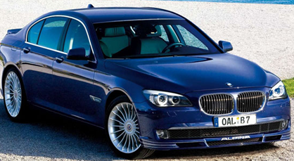
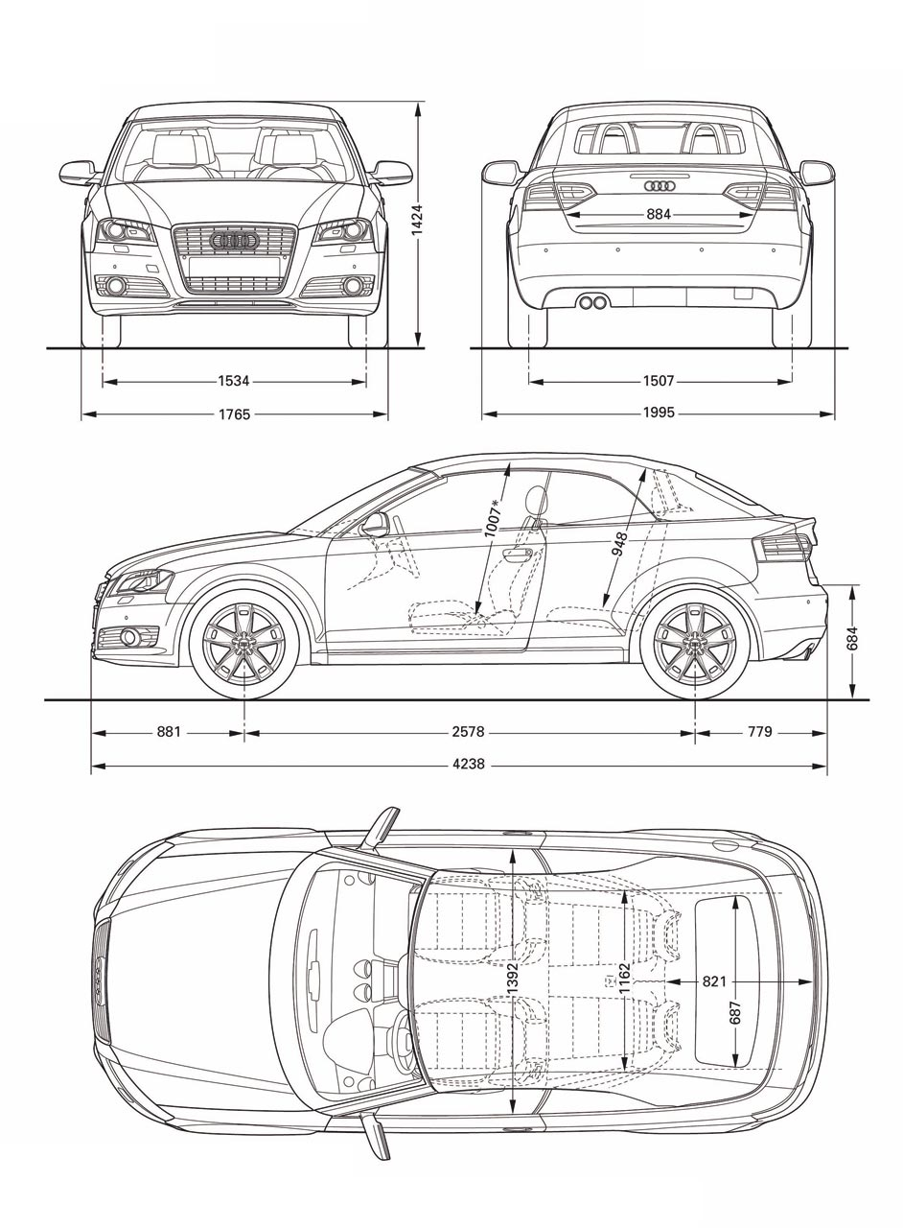
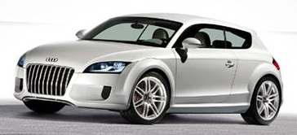
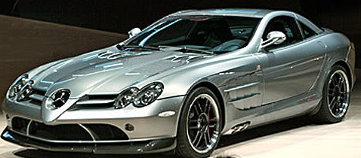
Can you write the class Car now?

Slide 15
Summary
We have explained Object-Based Design, but we are still far from Object-Oriented Programming (why?)
We will study OOP and modeling tools (UML) in the following courses
Also, we will study Design Patterns (subset)

Slide 16
Q & A

Slide 17
Homework
Use your pencil and paper to write down an example of blueprint and instances, and indicate which parts are attributes and which are operations

Slide 18
References
http://en.wikipedia.org/wiki/Class_(computer_science)

