Slide 1

Java Programming Language
CS340100, NTHU
Yoshi

Slide 2
Course
Course Number: CS 340100
Credit：2
Size of Limit：110
Course Title
  Java Programming Language
Instructor：黃世傑
Time：M5M6R5
Room：資電Room 234

Slide 3


Teaching Assistants
Name: 張苑瑩
Location: EECS Room 734
Email: bulapalm@gmail.com
Name: 周雋鎧
Location: EECS Room 734
Email: kavenc@gmail.com

Slide 4
The Goal of Course
本課程主要說明JAVA程式語言的內容與其物件導向的基本概念，並且強調程式的再用性與繼承延伸性。
透過本課程讓同學能夠了解JAVA的寫法，並能自行撰寫應用程式，進而輔助同學考取SCJP的證照。
透過本課程能讓同學會使用其他網路上JAVA公開的程式碼，加以利用來輔助PROJECT的製作。

Slide 5
The Wrong Concept about JAVA
Java is an extension of HTML. JavaScript is a simpler version of Java.
  Java 跟 HTML 完全是兩回事
  Java 跟 JavaScript 完全是兩回事
Java is an easy programming language to learn.
  Maybe yes, maybe not.
  其實要寫的完全符合JAVA開發的概念很困難!
Java has an easy environment to program.
  JAVA SDK一點也不方便，除非你很習慣用 command line。要方便就要使用 IDE。

Slide 6
The Wrong Concept about JAVA (2)
Java will become an universal programming language for all platforms.
  This is possible, only in theory…
  You still need virtual machine (VM) anywhere
Java executes program quickly
  Java is not faster than C++ for most situations

Slide 7
The Wrong Concept about JAVA (3)
Java has good memory management
  Java does not have “pointer” and uses “automatic garbage collection”
  C/C++ may have “Memory Leak“
    “Memory Leak“ : out of memory finally
  But using “pointer” well brings benefits
    You can release the memory space by yourself

Slide 8


The Wrong Concept about JAVA (4)
Java is only a toy programming language
  Counterexamples!
  Desktop
    Azureus
      The 2nd popular in SourceForge (the 1st is eMule)
  Web-application
    JSP, Servlet in e-banks, companies
  Handheld devices
    Android (Dalvik VM)
    J2ME games

Slide 9
Ranking (2010)
http://www.tiobe.com/index.php/content/paperinfo/tpci/index.html
Position Feb 2010 | Position Feb 2009 | Delta in Position | Programming Language | Ratings Feb 2010 | Delta Feb 2009 | Status
1 | 1 |  | Java | 17.348% | -2.05% | A
2 | 2 |  | C | 16.602% | +0.76% | A
3 | 5 |  | PHP | 10.001% | +1.22% | A
4 | 3 |  | C++ | 9.447% | -0.19% | A
5 | 4 |  | (Visual) Basic | 7.051% | -1.79% | A
6 | 6 |  | C# | 5.015% | -0.05% | A
7 | 7 |  | Python | 4.314% | -0.25% | A
8 | 8 |  | Perl | 3.600% | -0.52% | A
9 | 9 |  | Delphi | 2.656% | -0.97% | A
10 | 10 |  | JavaScript | 2.636% | -0.90% | A

Slide 10
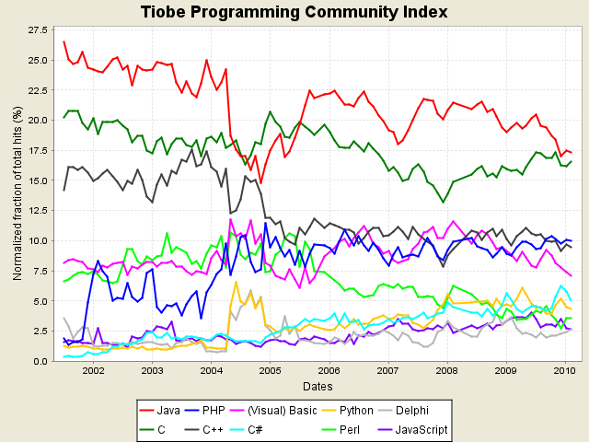
Ranking cont’d (2010)

Slide 11
Books and Website
Only reference books
  Core Java 2
  Head First Java
  Head First Design Pattern
  Developing Software with UML
  Design Patterns於Java語言上的實際應用
  O’Reilly 專門系列
    Ex: Java I/O, Java Networking, etc
  Java JDK 5.0 學習筆記
Website
  http://www.javaworld.com.tw (中文)
  http://java.sun.com/javase/6/docs/api/
  http://java.sun.com/docs/books/tutorial/

Slide 12
Syllabus
Java基本概念 & 環境設定
Class, Object, 以及語法概念, Inheritance, Polymorphism
資料表示 法，運算式，陣列，Coding conventions, documents
Core library探討, Collection, Regular Expression
Exceptions
Thread ← may be a big trouble for newbie
Network programming
Jakarta, 3rd-party libraries
Design concepts (Basic design patterns) and UML
Basic GUI programs (Cover if we have time)
Web-application, JSP, Servlet (Cover if we have time)

Slide 13
Project & Homework
Three coding homework last year
  This year may extend to 6~8, according to the comments
1 final project

Slide 14
Evaluation
上課問答(10%) → Bonus
  以復習為主的簡易問答
作業 & 上機考(40%)
  請按照deadline時間繳交，若有延遲繳交分數將會打折扣!
期中考(10%)
期末考(25%)
Project與上台報告(25%)

Slide 15
Course Links
http://www.cs.nthu.edu.tw/~d9662827/cs340100/
telnet://hulabear.twbbs.org java_happy

Slide 16

Have fun!

