Slide 1
Concurrency and Thread
Yoshi

Slide 2
Two Ways to Create Thread
Extending class Thread
Actually, we need to override the run method in class Thread
Implementing interface Runnable
Solve the disability of multiple inheritance

Slide 3
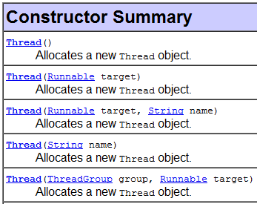
Implement Runnable
There is only one public abstract method defined in interface Runnable
public void run()
A runnable object can be passed to the constructor of class Thread
Check the source code of public void run() in class Thread!
What is the strategy?
private Runnable target;
…
public void run() {
if (target != null)
target.run();
}
}

Slide 4
Thread States

Slide 5
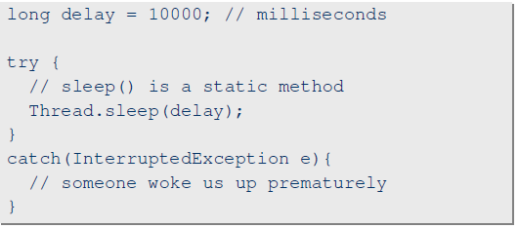
Thread.sleep()
A static method
Why?
Note that the obtained locks are not released!

Slide 6
join
The join method allows one thread to wait for the completion of another.
t.join();
The current thread pauses execution until t's thread terminates.
Note that join is dependent on the OS for timing, so you should not assume that join will wait exactly as long as you specify.

Slide 7
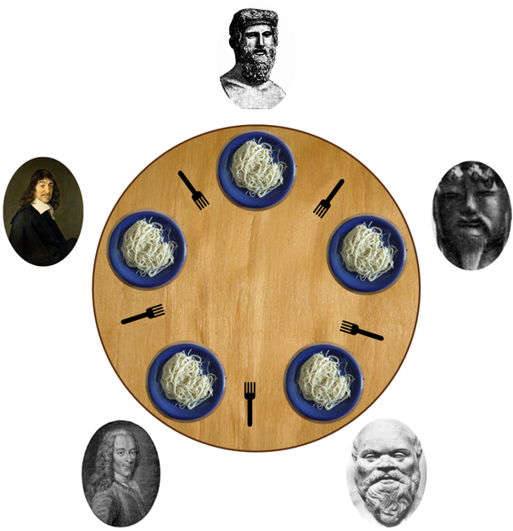
Thread Safe
Example: Dinning Philosopher Problem
http://en.wikipedia.org/wiki/Dining_philosophers_problem

Slide 8
Lock / key
In Java, every class and every instance of a class has a lock associated with it
The synchronized keyword identifies places where a thread must acquire the lock before proceeding
Note that: For those methods which do not have synchronized, they are not constrained, so they can access anything
The logical correctness should be guaranteed by you!

Slide 9
Keyword: Synchronized
synchronized(fork1) {
synchronized(fork2) {
//eat
}
}

Slide 10
Deadlock
It is possible that every philosopher gets only one fork, and no one can continue
Deadlock happens
Breaking the circular waiting
Release the lock you obtained before
fork1.wait(), fork2.wait()
Once you call something.wait(), you are queued into the waiting list, and need to be notified by someone later
something.notify();
something.notifyAll();

Slide 11
Two Ways for Synchronization
synchronized void method() {
//…
}
//When will we use this?
void method() {
synchronized(this) {
//…
}
}

Slide 12
Wait and Notify
What are they waiting for?

Slide 13
Related Data Structures
java.util.ArrayList
Thread unsafe
java.util.Vector
Thread safe

Slide 14
Synchronization in static method
Race condition also happens in static method
Remember that we always require some method/block to obtain the lock to continue

Slide 15
Review this
synchronized void method() {
//…
}
void method() {
synchronized(this) {
//…
}
}

Slide 16
In static method
synchronized static void method() {
//…
}
class XY {
static void method() {
synchronized(XY.class) {
//…
}
}
}

Slide 17
Blueprints are also objects
An instance of class Class
(Blueprint of XY)
Hard Disk
XY.class
ClassLoader
newInstance()
XY instance 1
XY instance 2

Slide 18
Actually, we can also use an additional lock
class XY {
static Object lock = new Object();
static void method() {
synchronized(lock) {
//…
}
}
}

Slide 19
Be Careful When You Create Threads
What’s the difference?
class XY extends Thread {
int x = 4;
public void run() {
//modify x
}
}
XY obj1 = new XY();
XY obj2 = new XY();
class XY implements Runnable {
int x = 4;
public void run() {
//modify x
}
}
XY xyObj = new XY();
Thread obj1 = new Thread(xyObj);
Thread obj2 = new Thread(xyObj);

Slide 20
Atomic Access
An atomic action is one that effectively happens all at once
An atomic action cannot stop in the middle
It either happens completely, or it doesn't happen at all
The following are guaranteed
Reads and writes are atomic for reference variables and for most primitive variables
All types except long and double
Reads and writes are atomic for all variables declared volatile
Including long and double variables

Slide 21
Immutable Objects in Multi-Thread
An object is considered immutable if its state cannot change after it is constructed
What’s the benefit?

Slide 22
References
Sun Java Tutorial: Concurrency
http://java.sun.com/docs/books/tutorial/essential/concurrency/index.html
Java Multithread Design Pattern
Java多執行緒與平行處理

