Slide 1
Decorator Pattern & Java I/O
Yoshi

Slide 2
Why decorator?
Once you know the techniques of decorating, you’ll be able to give your (or someone else’s) objects new responsibilities without making any code changes to the underlying classes.

Slide 3
SO嵐飲料店
一家國內知名的連鎖飲料店叫５０嵐
這家SO嵐飲料店是山寨版
最近推出粉條系列，得到相當大的歡迎
出了很多飲料，每種飲料有它自己的價格，自己的介紹
我們在做銷售系統，要電腦算出售價

Slide 4
Abstract class
飲料
description
getDescription()
getPrice()
Abstract method
奶茶
咖啡
getPrice()
getPrice()

Slide 5
加料
加珍珠
加布丁
加椰果
…

Slide 6
Class大爆炸
Abstract class
飲料
description
getDescription()
getPrice()
Abstract method
奶茶
咖啡
摩卡咖啡
拿鐵咖啡
getPrice()
getPrice()
getPrice()
getPrice()
奶茶三兄弟?
加濃摩卡咖啡?
珍珠奶茶
布丁奶茶
椰果奶茶
getPrice()
getPrice()
getPrice()

Slide 7
換個想法?
飲料
description
大珍珠
小珍珠
椰果
布丁
巧克力
牛奶
…
int getPrice() {
int price=0;
if(has大珍珠()) {
price+=5;
}
if(has小珍珠()) {
price+=5;
}
if(has椰果()) {
price+=7;
}
if(has布丁()) {
price+=10;
}
…
return price;
}
getDescription()
getPrice()
has大珍珠()
set大珍珠()
has小珍珠()
set小珍珠()
has椰果()
set椰果()
has布丁()
set布丁()
has巧克力()
set巧克力()
has牛奶()
has牛奶()
…

Slide 8
換個想法? (2)
飲料
cost()
int 加料價= super.cost();
int 總價 = 加料價 + 奶茶價;
return 總價;
奶茶
cost()

Slide 9
What’s the drawback?
布丁漲價怎麼辦?
新料上市 (粉條)?
新飲品上市 (四季春)?
二倍珍珠?
  SO嵐是間黑店, 二倍珍珠就要收二份珍珠的錢
上述的設計，無法解決這些問題

Slide 10
Decorator出場
做一杯奶茶三兄弟
  先來做個奶茶
  加上珍珠
  加上仙草
  加上布丁
加了料的飲料是什麼?
  還是飲料!

Slide 11
奶茶三兄弟也是種飲料
Cost()
奶茶
Cost()
布丁
Cost()
仙草
Cost()
珍珠

Slide 12
奶茶三兄弟也是種飲料
價錢多少?
Cost()
奶茶
Cost()
布丁
Cost()
仙草
Cost()
珍珠
To be decorated

Slide 13
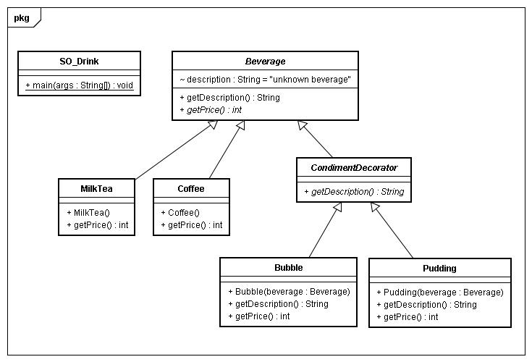
PS: You can download the code at course web site

Slide 14
What we have now?
Decorators have the same supertype as the object they decorate
You can use more than one decorators as a chain to decorator a single object
Decorators are transparent, so we can replace original Component with a decorator one anywhere
The decorator adds its own behavior either before and/or after delegating to the object it decorates to do the job
Objects can be decorated at runtime!

Slide 15
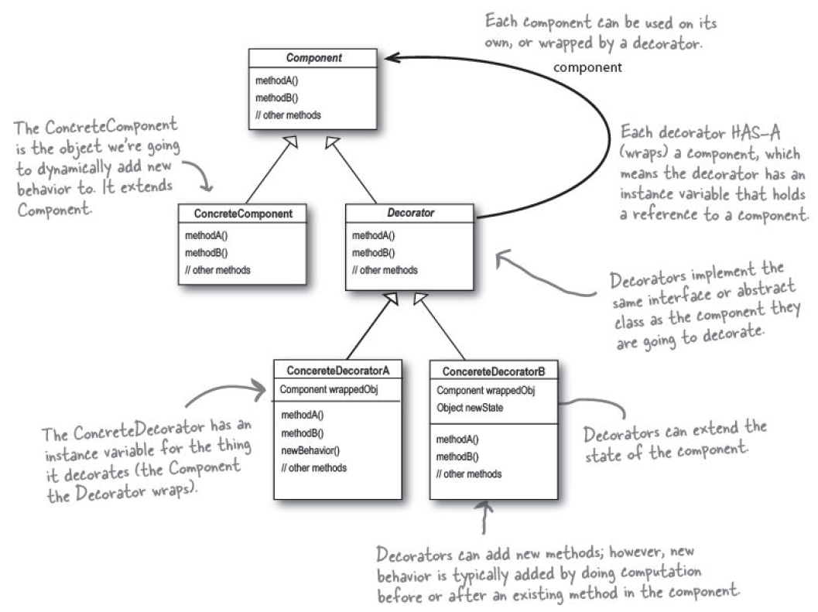

Slide 16
Participants
Component
  Define an interface for objects that can have responsibility added to them dynamically
Concrete component
  Define an object to which additional responsibility can be attached
Decorator
  Maintain a reference to a Component object and define an interface that conform to Component’s interface
Concrete decorator
  Add responsibilities to the component

Slide 17
Question
Why not just let ConcreteDecorator extend Component?
Try the code!

Slide 18
Because…
This example is still too simple
  Let’s take a look at the design of java.io

Slide 19
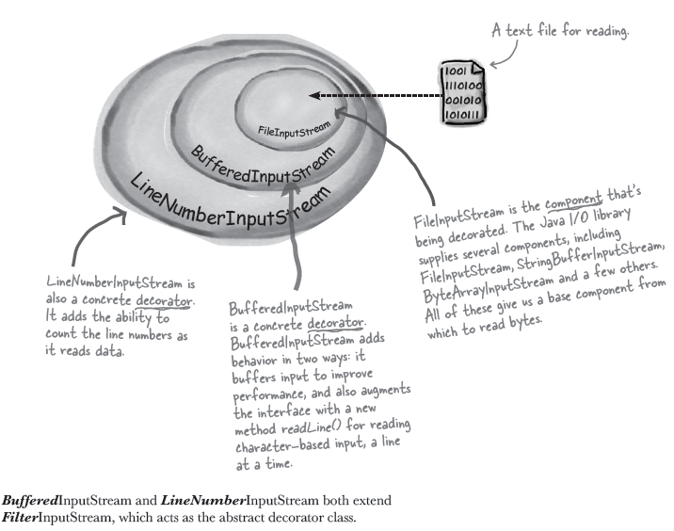

Slide 20
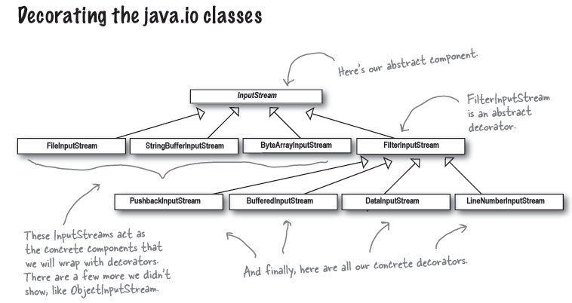
Can you map it back to decorator pattern?

Slide 21
See
java.io.InputStream
  http://java.sun.com/j2se/1.5.0/docs/api/java/io/InputStream.html
java.io.FilterInputStream
  http://java.sun.com/j2se/1.5.0/docs/api/java/io/FilterInputStream.html

Slide 22
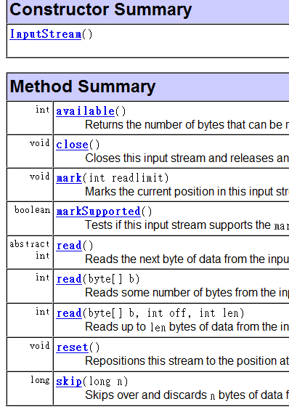
java.io.InputStream
Why only one abstract?
Remember
Template Method Pattern?

Slide 23
java.io.FilterInputStream
The class FilterInputStream itself simply overrides all methods of InputStream with versions that pass all requests to the contained input stream.
  In short, delegation!
Subclasses of FilterInputStream may further override some of these methods and may also provide additional methods and fields.
  In short, help you override all the methods defined in java.io.InputStream
  You can provide additional functionalities in decorators

Slide 24
RTFSC
26 package java.io;
45 public class FilterInputStream extends InputStream {
50 protected volatile InputStream in;
61 protected FilterInputStream(InputStream in) {
62 this.in = in;
63 }
82 public int read() throws IOException {
83 return in.read();
84 }
106 public int read(byte b[]) throws IOException {
107 return read(b, 0, b.length);
108 }
132 public int read(byte b[], int off, int len) throws IOException {
133 return in.read(b, off, len);
134 }
141 public long skip(long n) throws IOException {
142 return in.skip(n);
143 }

Slide 25
158 public int available() throws IOException {
159 return in.available();
160 }
171 public void close() throws IOException {
172 in.close();
173 }
174
191 public synchronized void mark(int readlimit) {
192 in.mark(readlimit);
193 }
194
216 public synchronized void reset() throws IOException {
217 in.reset();
218 }
219
233 public boolean markSupported() {
234 return in.markSupported();
235 }
236 }

Slide 26
After RTFSC
Without this, the all delegating works need to be done by yourself!

Slide 27
Finally
Can you give an example to use this pattern?

