Slide 1
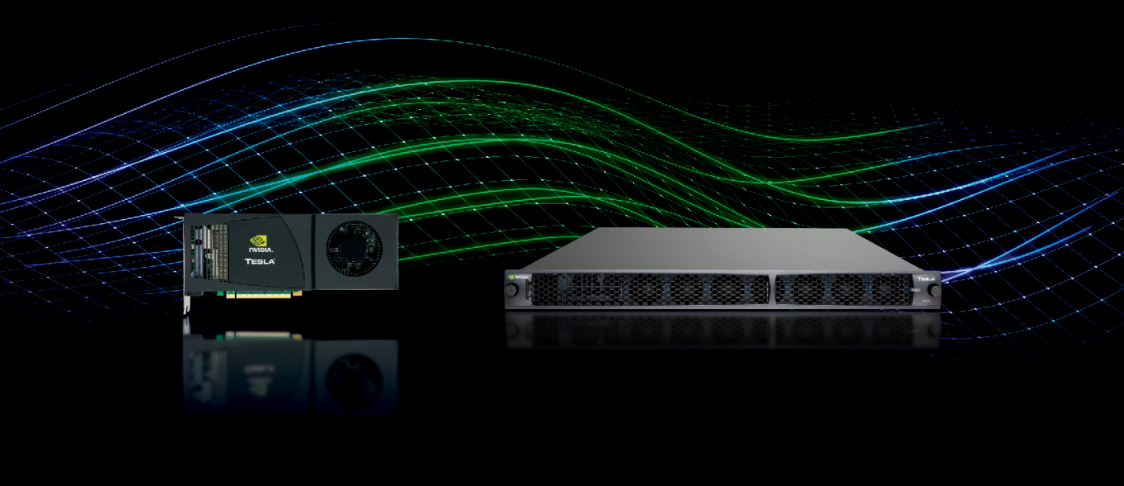
Tesla GPU Computing A Revolution in High Performance Computing
Mark Harris
NVIDIA Corporation
Notes:
1

Slide 2
Agenda
CUDA Review
Architecture
Programming Model
Memory Model
CUDA C
CUDA General Optimizations
Fermi
Next Generation Architecture
Getting Started
Resources
Notes:
2

Slide 3
CUDA Architecture

Slide 4
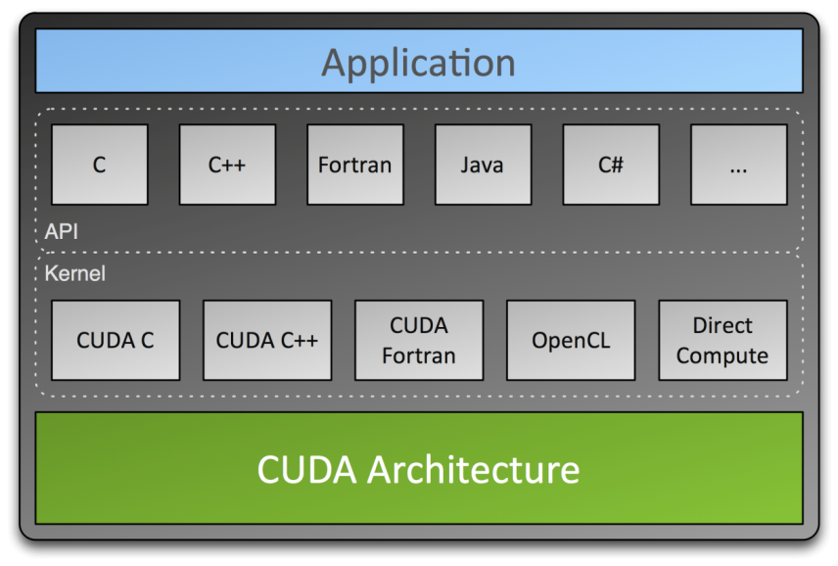
CUDA Parallel Computing Architecture
Parallel computing architecture and programming model
Includes a CUDA C compiler, support for OpenCL and DirectCompute
Architected to natively support multiple computational interfaces (standard languages and APIs)
Notes:
CUDA is an architecture with a number of entry points.
Today, developers are programming in C for CUDA. Using NVIDIA compilers. Programming language support for Fortran and other languages is coming soon.
Also, CUDA supports emerging API programming standards such as OpenCL. Because the OpenCL and CUDA constructs for parallelism are so similar, applications written in C can easily be ported to OpenCL if desired. OpenCL applications sit on top of the CUDA architecture.

Slide 5
CUDA Parallel Computing Architecture
CUDA defines:
Programming model
Memory model
Execution model
CUDA uses the GPU, but is for general-purpose computing
Facilitate heterogeneous computing: CPU + GPU
CUDA is scalable
Scale to run on 100s of cores/1000s of parallel threads
Notes:
5

Slide 6
Programming model
CUDA

Slide 7
CUDA Kernels
Parallel portion of application: execute as a kernel
Entire GPU executes kernel, many threads
CUDA threads:
Lightweight
Fast switching
1000s execute simultaneously
CPU | Host | Executes functions
GPU | Device | Executes kernels

Slide 8
CUDA Kernels: Parallel Threads
A kernel is a function executed on the GPU
Array of threads, in parallel
All threads execute the same code, can take different paths
Each thread has an ID
Select input/output data
Control decisions
float x = input[threadID];
float y = func(x);
output[threadID] = y;

Slide 9
CUDA Kernels: Subdivide into Blocks

Slide 10
CUDA Kernels: Subdivide into Blocks
Threads are grouped into blocks

Slide 11
CUDA Kernels: Subdivide into Blocks
Threads are grouped into blocks
Blocks are grouped into a grid

Slide 12
CUDA Kernels: Subdivide into Blocks
Threads are grouped into blocks
Blocks are grouped into a grid
A kernel is executed as a grid of blocks of threads

Slide 13
CUDA Kernels: Subdivide into Blocks
GPU
Threads are grouped into blocks
Blocks are grouped into a grid
A kernel is executed as a grid of blocks of threads

Slide 14
Communication Within a Block
Threads may need to cooperate
Memory accesses
Share results
Cooperate using shared memory
Accessible by all threads within a block
Restriction to “within a block” permits scalability
Fast communication between N threads is not feasible when N large

Slide 15
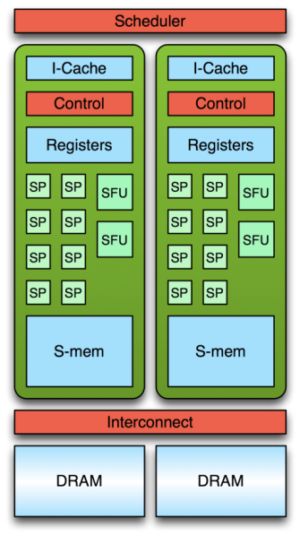
Transparent Scalability – G84
1
2
3
4
5
6
7
8
9
10
11
12
11
12
9
10
7
8
5
6
3
4
1
2

Slide 16
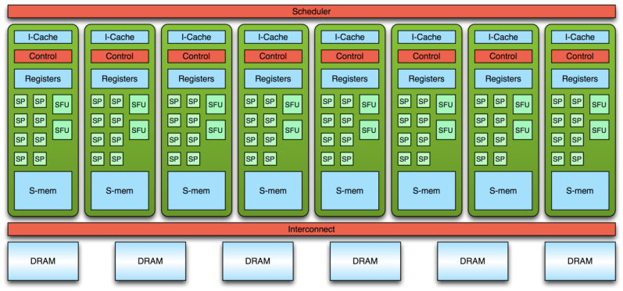
Transparent Scalability – G80
1
2
3
4
5
6
7
8
9
10
11
12
9
10
11
12
1
2
3
4
5
6
7
8

Slide 17
Transparent Scalability – GT200
1
2
3
4
5
6
7
8
9
10
11
12
...
1
2
3
4
5
6
7
8
9
10
11
12
Idle
Idle
Idle

Slide 18
CUDA Programming Model - Summary
Host
Device
A kernel executes as a grid of thread blocks
A block is a batch of threads
Communicate through shared memory
Each block has a block ID
Each thread has a thread ID
Kernel 1
0
1
2
3
1D
0,0
0,1
0,2
0,3
Kernel 2
2D
1,0
1,1
1,2
1,3

Slide 19
Memory Model
CUDA

Slide 20
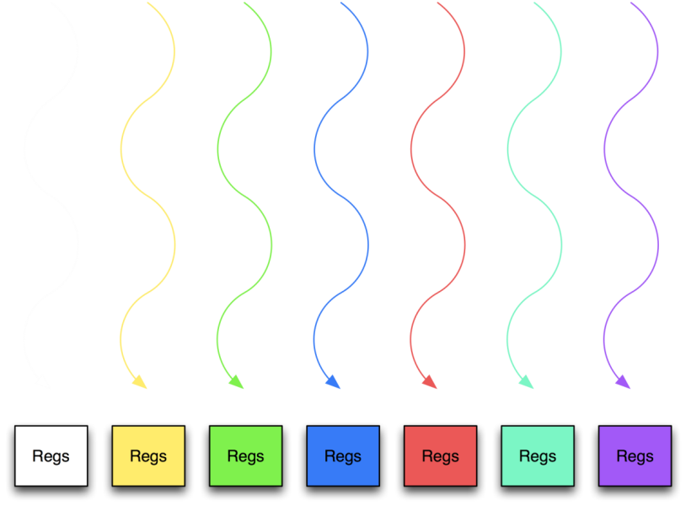
Memory hierarchy
Thread:
Registers

Slide 21
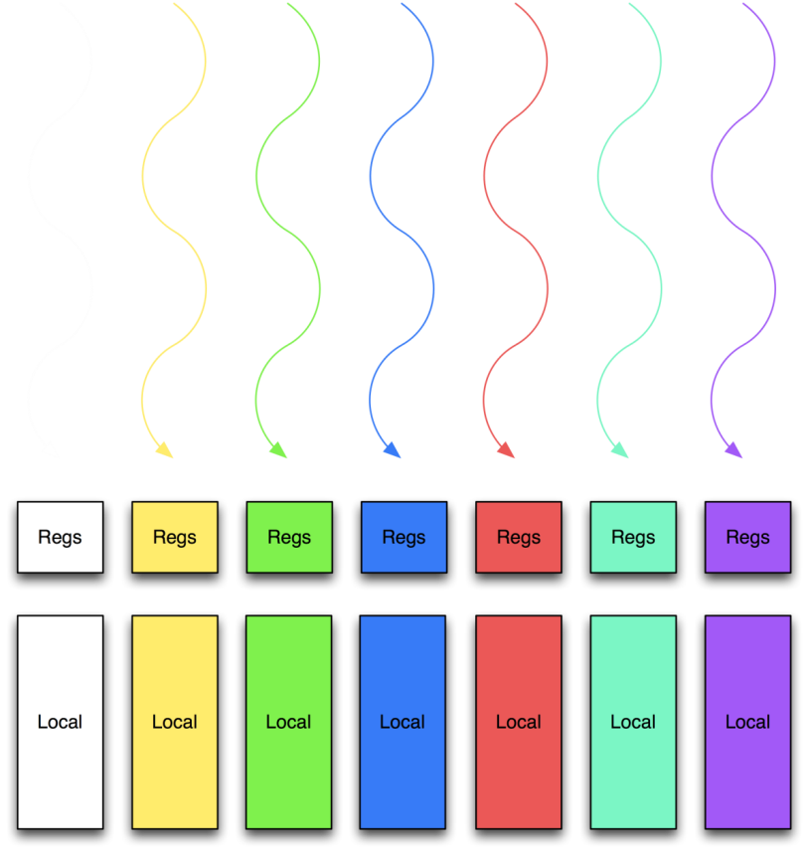
Memory hierarchy
Thread:
Registers
Thread:
Local memory

Slide 22
Memory hierarchy
Thread:
Registers
Thread:
Local memory
Block of threads:
Shared memory

Slide 23
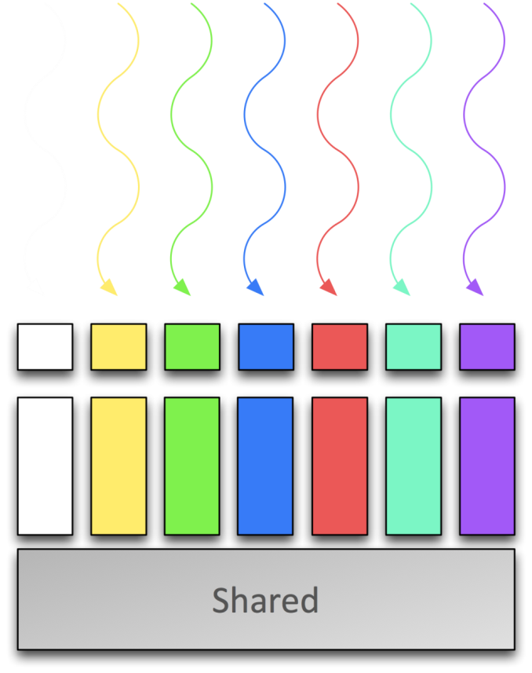
Memory hierarchy
Thread:
Registers
Thread:
Local memory
Block of threads:
Shared memory

Slide 24
Memory hierarchy
Thread:
Registers
Thread:
Local memory
Block of threads:
Shared memory
All blocks:
Global memory

Slide 25
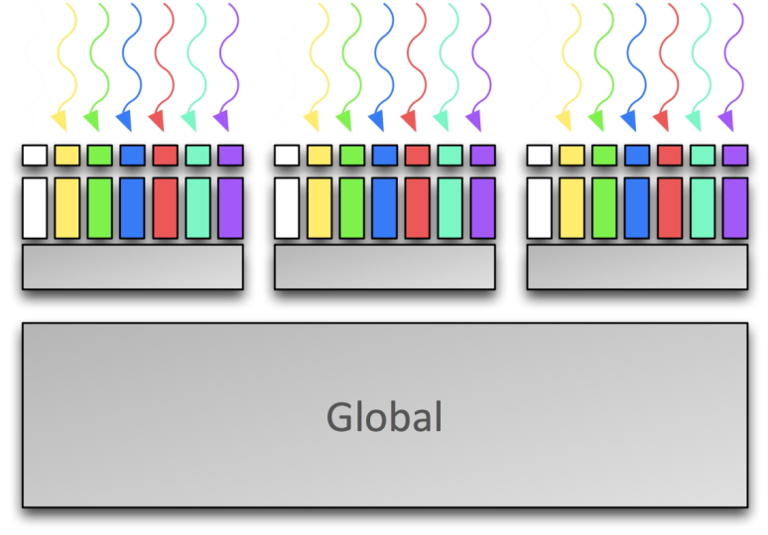
Memory hierarchy
Thread:
Registers
Thread:
Local memory
Block of threads:
Shared memory
All blocks:
Global memory

Slide 26
Programming Environment
CUDA

Slide 27
CUDA APIs
API allows the host to manage the devices
Allocate memory & transfer data
Launch kernels
CUDA C “Runtime” API
High level of abstraction - start here!
CUDA C “Driver” API
More control, more verbose
OpenCL
Similar to CUDA C Driver API

Slide 28
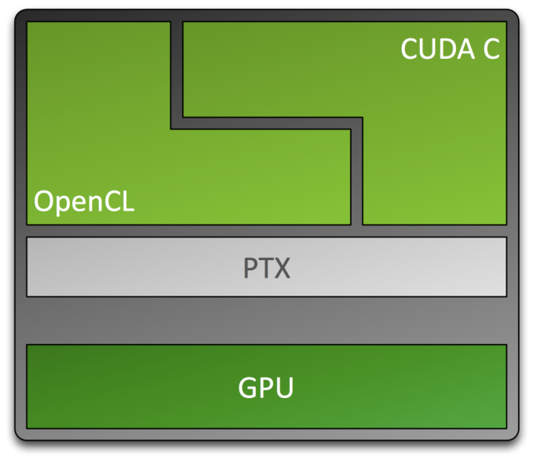
CUDA C and OpenCL
Entry point for developers who want low-level API
Entry point for developers who prefer high-level C
Shared back-end compiler and optimization technology
Notes:
What are the differences between C for CUDA and OpenCL?
When compiled for NVIDIA GPUs both go through the PTX layer to generate the machine language of the GPU they target. The differences are primarily stylistic. The Khronos Group designed the OpenCL API as an expert level API akin to the OpenGL API (another spec from the Khronos Group) and the developer is given access to the hardware device and expected to carry out housekeeping tasks such as memory management. This will resonate with certain kinds of programmers and those who are used to this style of programming are reluctant to relinquish the control they are used to having. There are other groups of programmers who are not interested in the intricacies of hardware. They typically are proficient in one higher level programming language, usually C, and they just want to program algorithms and want the hardware device to be transparent to them. These types of programmers are found in many HPC areas, such as oil and gas, financial services, biological computing, etc. The C level abstraction of C for CUDA appeals to them.
The performance implications are dominated much more by how the sequential algorithm is parallelized - the stylistic differences are not important when compared to that.

Slide 29
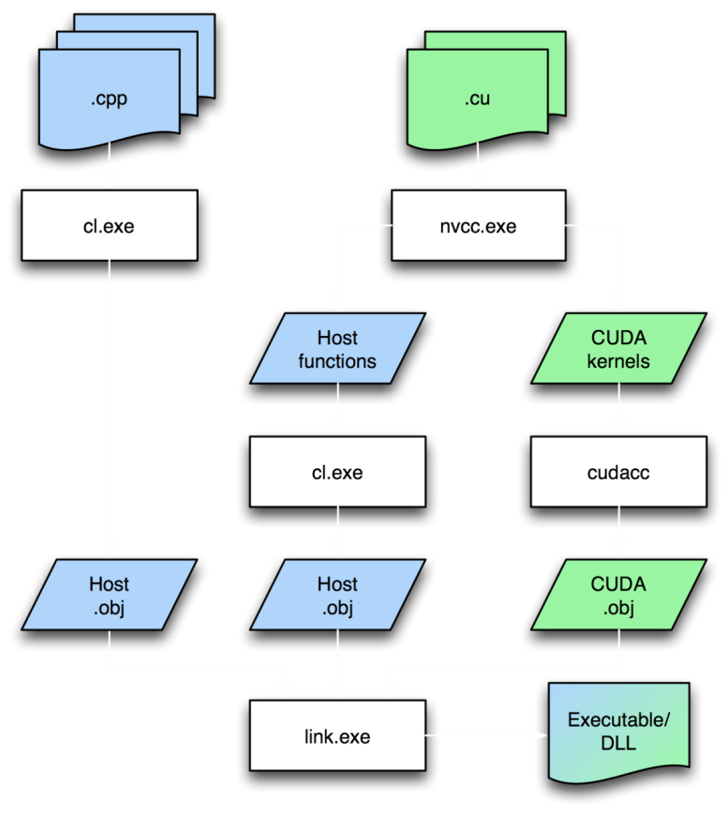
Visual Studio
Separate file types
.c/.cpp for host code
.cu for device/mixed code
Compilation rules: cuda.rules
Syntax highlighting
Intellisense
Integrated debugger and profiler: Nexus

Slide 30
NVIDIA Nexus IDE
The industry’s first IDE for massively parallel applications
Accelerates co-processing (CPU + GPU) application development
Complete Visual Studio-integrated development environment
Notes:
NVIDIA NEXUS is the industry’s first Integrated Development Environment (IDE) for GPU Computing with support for C, C++, OpenCL, DirectCompute and both graphics API’s: DirectX and OpenGL. With integration directly into Microsoft Visual Studio it bridges the programming gap between CPU and GPU code by simultaneously enabling parallel-aware hardware source debugging and performance analysis across both processors.
NEXUS accelerates the development of co-processing applications on the CPU and GPU as it can capture performance events and information across both processors. This integration processes and presents the information to the developer on a single correlated timeline. Developers gain insight by seeing how their application behaves and performs on the entire system, rather than through narrow views focused on a particular sub-system or processor.

Slide 31
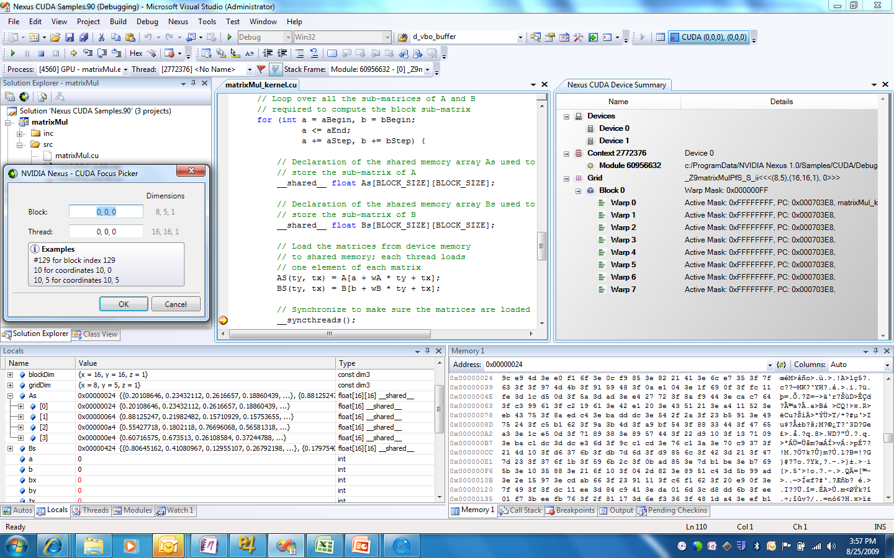
NVIDIA Nexus IDE - Debugging

Slide 32
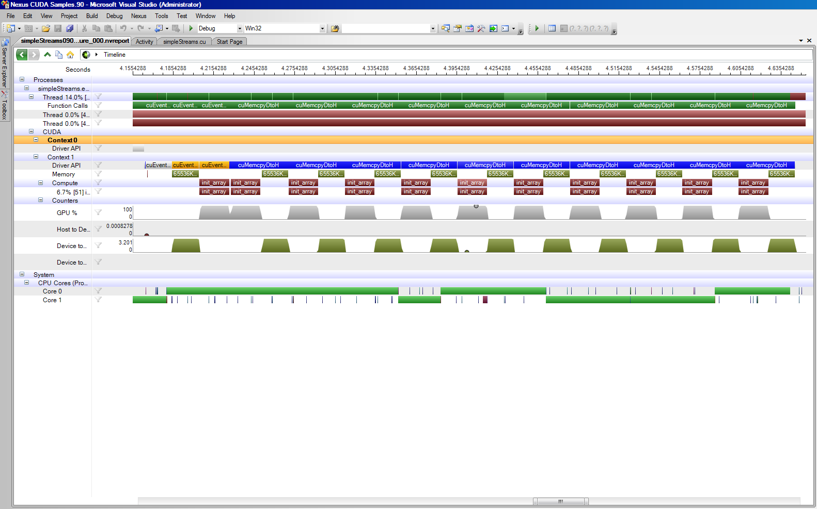
NVIDIA Nexus IDE - Profiling

Slide 33
Linux
Separate file types
.c/.cpp for host code
.cu for device/mixed code
Typically makefile driven
cuda-gdb for debugging
CUDA Visual Profiler

Slide 34
CUDA C
CUDA

Slide 35
Example: Vector Addition Kernel
Device Code
// Compute vector sum C = A+B
// Each thread performs one pair-wise addition
__global__ void vecAdd(float* A, float* B, float* C)
{
int i = threadIdx.x + blockDim.x * blockIdx.x;
C[i] = A[i] + B[i];
}
int main()
{
// Run N/256 blocks of 256 threads each
vecAdd<<< N/256, 256>>>(d_A, d_B, d_C);
}

Slide 36
Example: Vector Addition Kernel
// Compute vector sum C = A+B
// Each thread performs one pair-wise addition
__global__ void vecAdd(float* A, float* B, float* C)
{
int i = threadIdx.x + blockDim.x * blockIdx.x;
C[i] = A[i] + B[i];
}
int main()
{
// Run N/256 blocks of 256 threads each
vecAdd<<< N/256, 256>>>(d_A, d_B, d_C);
}
Host Code

Slide 37
CUDA: Memory Management
Explicit memory allocation returns pointers to GPU memory
cudaMalloc()
cudaFree()
Explicit memory copy for host ↔ device, device ↔ device
cudaMemcpy()

Slide 38
Example: Vector Addition Kernel
// Compute vector sum C = A+B
// Each thread performs one pair-wise addition
__global__ void vecAdd(float* A, float* B, float* C)
{
int i = threadIdx.x + blockDim.x * blockIdx.x;
C[i] = A[i] + B[i];
}
int main()
{
// Run N/256 blocks of 256 threads each
vecAdd<<< N/256, 256>>>(d_A, d_B, d_C);
}

Slide 39
Example: Host code for vecAdd
// allocate and initialize host (CPU) memory
float *h_A = …, *h_B = …;
// allocate device (GPU) memory
float *d_A, *d_B, *d_C;
cudaMalloc( (void**) &d_A, N * sizeof(float));
cudaMalloc( (void**) &d_B, N * sizeof(float));
cudaMalloc( (void**) &d_C, N * sizeof(float));
// copy host memory to device
cudaMemcpy( d_A, h_A, N * sizeof(float), cudaMemcpyHostToDevice) );
cudaMemcpy( d_B, h_B, N * sizeof(float), cudaMemcpyHostToDevice) );
// execute the kernel on N/256 blocks of 256 threads each
vecAdd<<<N/256, 256>>>(d_A, d_B, d_C);

Slide 40
CUDA: Minimal extensions to C/C++
Declaration specifiers to indicate where things live
__global__ void KernelFunc(...); // kernel callable from host
__device__ void DeviceFunc(...); // function callable on device
__device__ int GlobalVar; // variable in device memory
__shared__ int SharedVar; // in per-block shared memory
Extend function invocation syntax for parallel kernel launch
KernelFunc<<<500, 128>>>(...); // 500 blocks, 128 threads each
Special variables for thread identification in kernels
dim3 threadIdx; dim3 blockIdx; dim3 blockDim; dim3 gridDim;
Intrinsics that expose specific operations in kernel code
__syncthreads(); // barrier synchronization
Notes:
Simple model, extending C only where necessary

Slide 41
Synchronization of blocks
Threads within block may synchronize with barriers
… Step 1 … __syncthreads(); … Step 2 …
Blocks coordinate via atomic memory operations
e.g., increment shared queue pointer with atomicInc()
Implicit barrier between dependent kernels
vec_minus<<<nblocks, blksize>>>(a, b, c); vec_dot<<<nblocks, blksize>>>(c, c);

Slide 42
Using per-block shared memory
Block
Variables shared across block
__shared__ int *begin, *end;
Scratchpad memory
__shared__ int scratch[blocksize];
scratch[threadIdx.x] = begin[threadIdx.x]; // … compute on scratch values … begin[threadIdx.x] = scratch[threadIdx.x];
Communicating values between threads
scratch[threadIdx.x] = begin[threadIdx.x];
__syncthreads(); int left = scratch[threadIdx.x - 1];
Shared

Slide 43
GPU Architecture
CUDA

Slide 44
10-Series Architecture
240 Scalar Processor (SP) cores execute kernel threads
30 Streaming Multiprocessors (SMs) each contain
8 scalar processors
2 Special Function Units (SFUs)
1 double precision unit
Shared memory enables thread cooperation
Multiprocessor
Scalar
Processors
Double
Shared
Memory

Slide 45
Execution Model
Software
Hardware
Scalar
Processor
Threads are executed by scalar processors
Thread
Thread blocks are executed on multiprocessors
Thread blocks do not migrate
Several concurrent thread blocks can reside on one multiprocessor - limited by multiprocessor resources (shared memory and register file)
Thread
Block
Multiprocessor
A kernel is launched as a grid of thread blocks
Only one kernel can execute on a device at one time
...
Grid
Device

Slide 46
Warps and Half Warps
32 Threads
A thread block consists of 32-thread warps
A warp is executed physically in parallel (SIMD) on a multiprocessor
...
=
32 Threads
32 Threads
Thread
Block
Warps
Multiprocessor
DRAM
A half-warp of 16 threads can coordinate global memory accesses into a single transaction
16
16
Global
Half Warps
Local
Device
Memory

Slide 47
Memory Architecture
Host
Device
GPU
CPU
DRAM
Multiprocessor
Registers
Shared Memory
Local
Multiprocessor
Registers
Shared Memory
Chipset
Multiprocessor
Registers
Shared Memory
Global
DRAM
Constant
Constant and Texture
Caches
Texture

Slide 48
OPTIMIZATION GuIDELINES
CUDA

Slide 49
Optimize Algorithms for the GPU
Maximize independent parallelism
Maximize arithmetic intensity (math/bandwidth)
Sometimes it’s better to recompute than to cache
GPU spends its transistors on ALUs, not memory
Do more computation on the GPU to avoid costly data transfers
Even low parallelism computations can sometimes be faster than transferring back and forth to host

Slide 50
Optimize Memory Access
Coalesced vs. Non-coalesced = order of magnitude
Global/Local device memory
Optimize for spatial locality in cached texture memory
In shared memory, avoid high-degree bank conflicts

Slide 51
Take Advantage of Shared Memory
Hundreds of times faster than global memory
Threads can cooperate via shared memory
Use one / a few threads to load / compute data shared by all threads
Use it to avoid non-coalesced access
Stage loads and stores in shared memory to re-order non-coalesceable addressing

Slide 52
Use Parallelism Efficiently
Partition computation to keep the GPU multiprocessors equally busy
Many threads, many thread blocks
Keep resource usage low enough to support multiple active thread blocks per multiprocessor
Registers, shared memory

Slide 53
Next Generation Architecture
Fermi

Slide 54
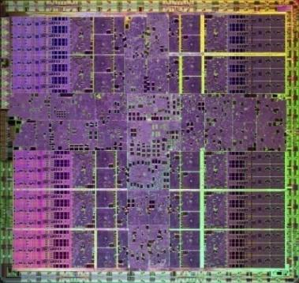
Many-Core High Performance Computing
Each core has:
Floating point & Integer unit
Logic unit
Move, compare unit
Branch unit
Cores managed by thread manager
Spawn and manage over 30,000 threads
Zero-overhead thread switching
10-series GPU has 240 cores
1.4 billion transistors
1 Teraflop of processing power

Slide 55
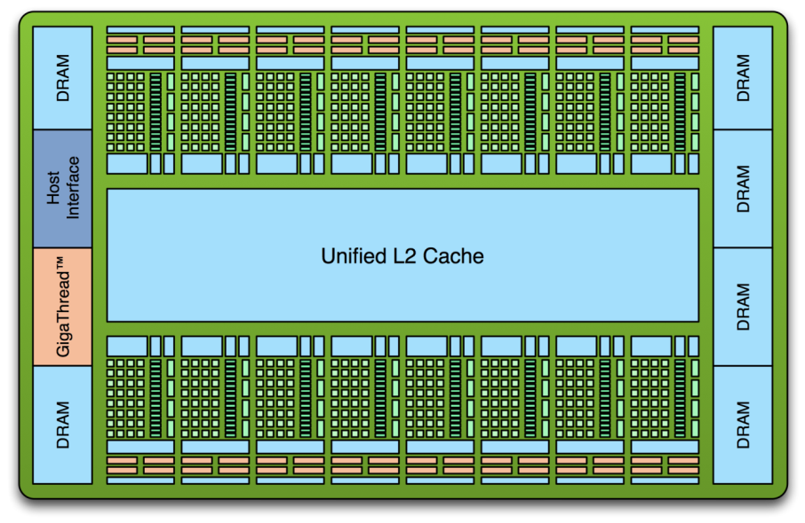
Introducing the Fermi Architecture
3 billion transistors
512 cores
DP performance 50% of SP
ECC
L1 and L2 Caches
GDDR5 Memory
Up to 1 Terabyte of GPU Memory
Concurrent Kernels, C++

Slide 56
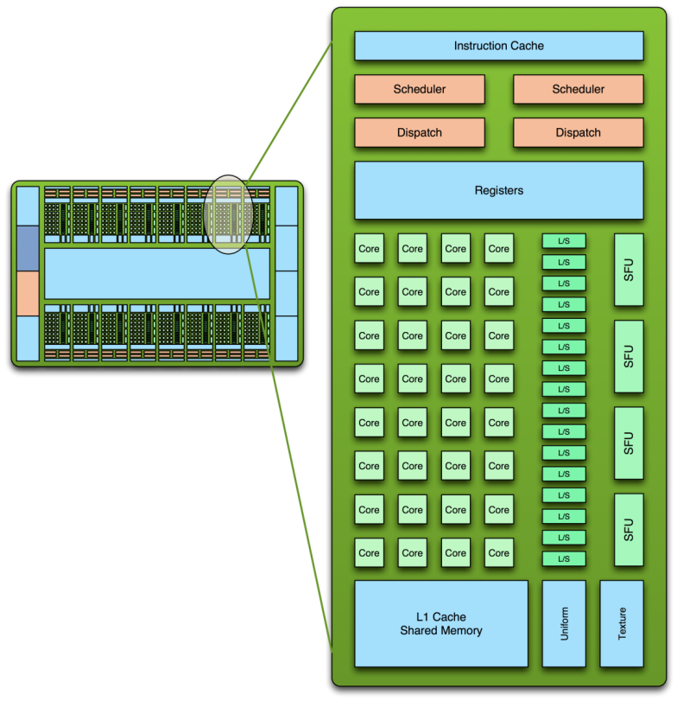
Fermi SM Architecture
32 CUDA cores per SM (512 total)
Double precision 50% of single precision
8x over GT200
Dual Thread Scheduler
64 KB of RAM for shared memory and L1 cache (configurable)
Notes:
In the Fermi architecture, each streaming multiprocessor has 32 CUDA cores -- four times as many as the previous GT 200 and G80 architectures. All 32 cores share the common resources of their streaming multiprocessor, such as registers, caches, local memory, and load/store units.
Double precision arithmetic is at the heart of HPC applications such as linear algebra, numerical simulation, and quantum chemistry. The Fermi architecture has been specifically designed to offer unprecedented performance in double precision; up to 16 double precision fused multiply-add operations can be performed per SM, per clock, a dramatic improvement over the GT200 architecture.
Fermi improves on the scheduler in previous CUDA architectures by issuing two instructions per clock cycle instead of one. Each streaming multiprocessor can manage 48 warps. Because each warp has 32 threads, a streaming multiprocessor can manage 1,536 threads. With 16 streaming multiprocessors, a Fermi-class GPU can handle 24,576 parallel threads. Using this elegant model of dual-issue, Fermi achieves near peak hardware performance.
Working with hundreds of GPU computing applications from various industries, we learned that while Shared memory benefits many problems, it is not appropriate for all problems. Some algorithms map naturally to Shared memory, others require a cache, while others require a combination of both. The optimal memory hierarchy should offer the benefits of both Shared memory and cache, and allow the programmer a choice over its partitioning. The Fermi memory hierarchy adapts to both types of program behavior. We’ll talk more about Fermi’s cache hierarchy later.

Slide 57
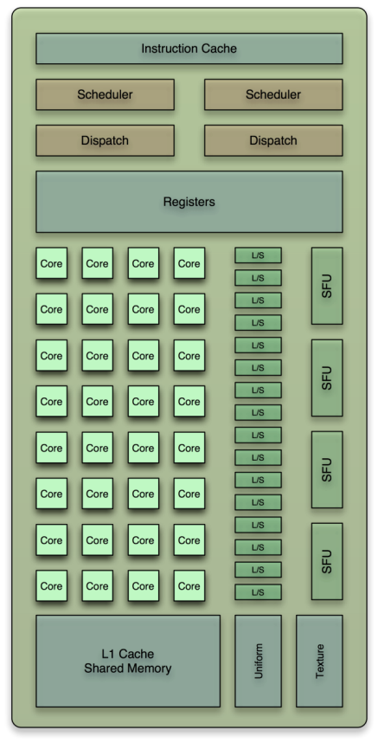
CUDA Core Architecture
New IEEE 754-2008 floating-point standard, surpassing even the most advanced CPUs
Fused multiply-add (FMA) instruction for both single and double precision
Newly designed integer ALU optimized for 64-bit and extended precision operations
Notes:
Each CUDA processor has a fully pipelined floating point unit (FPU). Prior GPUs used IEEE 754-1985 floating point arithmetic. The Fermi architecture implements the new IEEE 754-2008 floating-point standard, surpassing even the most advanced CPUs.
It supports fused multiply-add (FMA) instructions for both single and double precision arithmetic. FMA improves over a multiply-add (MAD) instruction by doing the multiplication and addition with a single final rounding step, with no loss of precision in the addition. FMA is more accurate than performing the operations separately.

Slide 58
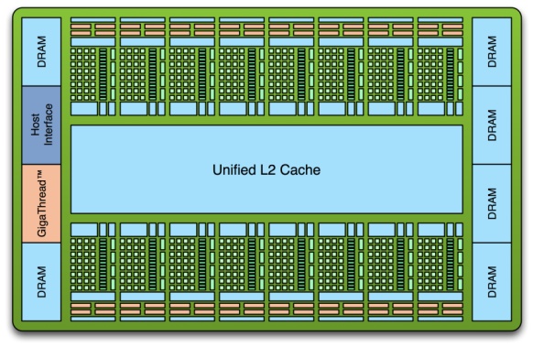
Cached Memory Hierarchy
First GPU architecture to support a true cache hierarchy in combination with on-chip shared memory
L1 Cache per SM (per 32 cores)
Improves bandwidth and reduces latency
Unified L2 Cache (768 KB)
Fast, coherent data sharing across all cores in the GPU
Parallel DataCache™
Memory Hierarchy
Notes:
Each Fermi SM multiprocessor has 64 KB of high-speed, on-chip RAM configurable as 48 KB of Shared memory with 16 KB of L1 cache, or as 16 KB of Shared memory with 48 KB of L1 cache. When configured with 48 KB of shared memory, programs that make extensive use of shared memory (such as electrodynamic simulations) can perform up to three times faster. For programs whose memory accesses are not known beforehand, the 48 KB L1 cache configuration offers greatly improved performance over direct access to DRAM.
Fermi also features a 768 KB unified L2 cache that services all load, store, and texture requests. The L2 cache is coherent across all SMs. The L2 provides efficient, high speed data sharing across the GPU. Algorithms for which data addresses are not known beforehand, such as physics solvers, raytracing, and sparse matrix multiplication especially benefit from the cache hierarchy.

Slide 59
Larger, Faster Memory Interface
GDDR5 memory interface
2x speed of GDDR3
Up to 1 Terabyte of memory attached to GPU
Operate on large data sets

Slide 60
ECC
ECC protection for
DRAM
ECC supported for GDDR5 memory
All major internal memories
Register file, shared memory, L1 cache, L2 cache
Detect 2-bit errors, correct 1-bit errors (per word)
Notes:
Fermi is the first GPU to support error checking and correction (ECC) on memory. ECC was requested by GPU computing users to enhance data integrity in very large scale high performance computing environments. ECC is a highly desired feature in areas such as medical imaging and large-scale cluster computing.
Naturally occurring radiation can cause a bit stored in memory to be altered, resulting in a soft error. ECC technology detects and corrects single-bit soft errors before they affect the system. Because the probability of such radiation induced errors increase linearly with the number of installed systems, ECC is an essential requirement in large cluster installations.
Fermi’s register files, shared memories, L1 caches, L2 cache, and DRAM memory are ECC protected, making it not only the most powerful GPU for HPC applications, but also the most reliable.

Slide 61
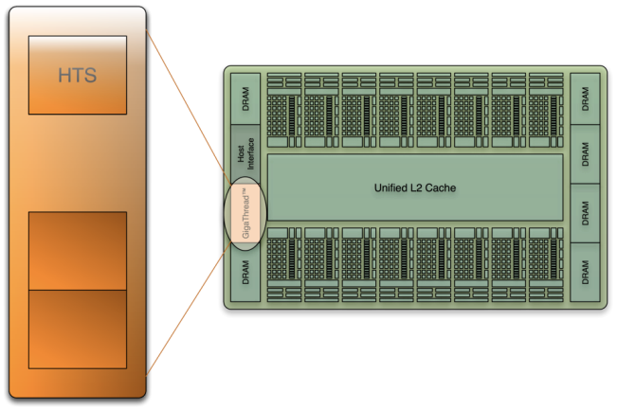
GigaThread™ Hardware Thread Scheduler
Hierarchically manages thousands of simultaneously active threads
10x faster application context switching
Concurrent kernel execution
Notes:
One of the most important technologies of the Fermi architecture is its two-level, distributed thread scheduler. At the chip level, a global work distribution engine schedules thread blocks to various SMs, while at the SM level, each warp scheduler distributes warps of 32 threads to its execution units. The first generation GigaThread engine introduced in G80 managed up to 12,288 threads in realtime. The Fermi architecture improves on this foundation by providing not only greater thread throughput (24,576), but dramatically faster context switching, concurrent kernel execution, and improved thread block scheduling.

Slide 62
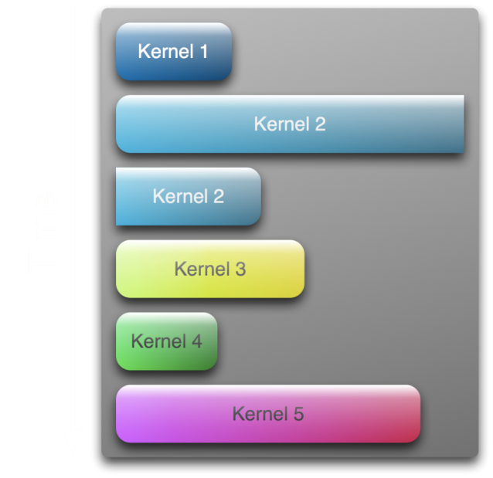
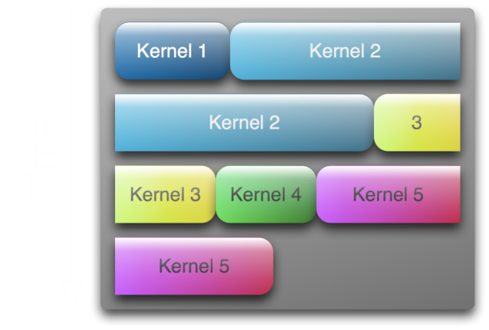
GigaThread™ Hardware Thread Scheduler
Concurrent Kernel Execution + Faster Context Switch
Serial Kernel Execution
Parallel Kernel Execution
Notes:
Fermi supports concurrent kernel execution, where different kernels of the same application context can execute on the GPU at the same time. Concurrent kernel execution allows programs that execute a number of small kernels to utilize the whole GPU. For example, a PhysX program may invoke a fluids solver and a rigid body solver which, if executed sequentially, would use only half of the available thread processors. On the Fermi architecture, different kernels of the same CUDA context can execute concurrently, allowing maximum utilization of GPU resources. Kernels from different application contexts (e.g. a game with graphics + PhysX) can still run sequentially with great efficiency thanks to the improved context switching performance.

Slide 63
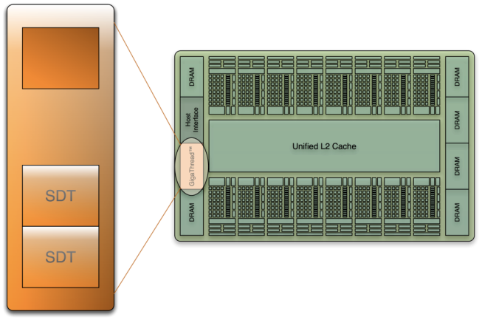
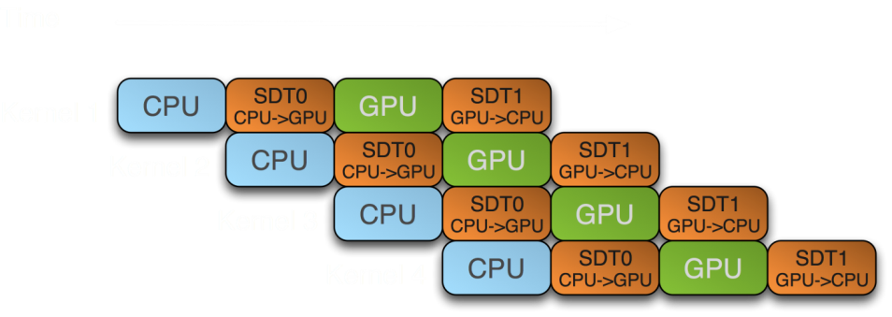
GigaThread Streaming Data Transfer Engine
Dual DMA engines
Simultaneous CPU→GPU and GPU→CPU data transfer
Fully overlapped with CPU and GPU processing time
Activity Snapshot:

Slide 64
Enhanced Software Support
Full C++ Support
Virtual functions
Try/Catch hardware support
System call support
Support for pipes, semaphores, printf, etc
Unified 64-bit memory addressing

Slide 65
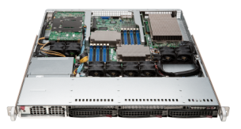
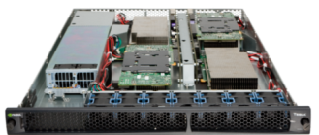
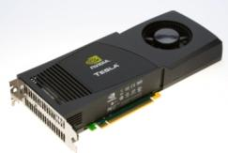
Tesla GPU Computing Products
SuperMicro 1U
GPU SuperServer
Tesla S1070
1U System
Tesla C1060
Computing Board
Tesla Personal Supercomputer
GPUs | 2 Tesla GPUs | 4 Tesla GPUs | 1 Tesla GPU | 4 Tesla GPUs
Single Precision Performance | 1.87 Teraflops | 4.14 Teraflops | 933 Gigaflops | 3.7 Teraflops
Double Precision Performance | 156 Gigaflops | 346 Gigaflops | 78 Gigaflops | 312 Gigaflops
Memory | 8 GB (4 GB / GPU) | 16 GB (4 GB / GPU) | 4 GB | 16 GB (4 GB / GPU)

Slide 66
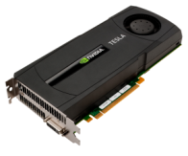
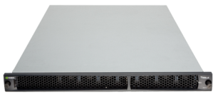
Tesla GPU Computing Products: Fermi
Tesla S2050
1U System
Tesla S2070
1U System
Tesla C2050
Computing Board
Tesla C2070
Computing Board
GPUs | 4 Tesla GPUs |  | 1 Tesla GPU
Double Precision Performance | 2.1 – 2.5 Teraflops |  | 520 – 630 Gigaflops
Memory | 12 GB (3 GB / GPU) | 24 GB (6 GB / GPU) | 3 GB | 6 GB

Slide 67
Tesla GPU Computing
Questions?

Slide 68
Resources
Getting Started

Slide 69
Getting Started
CUDA Zone www.nvidia.com/cuda
Introductory tutorials/webinars
Forums
Documentation
Programming Guide
Best Practices Guide
Examples
CUDA SDK

Slide 70
Libraries
NVIDIA
CUBLAS Dense linear algebra (subset of full BLAS suite)
CUFFT 1D/2D/3D real and complex
Third party
NAG Numeric libraries e.g. RNGs
CULAPACK/MAGMA
Open Source
Thrust STL/Boost style template language
CUDPP Data parallel primitives (e.g. scan, sort and reduction)
CUSP Sparse linear algebra and graph computation
Many more...

