Slide 1
What You Can Learn in Research
Yi-Shin Chen

Slide 2
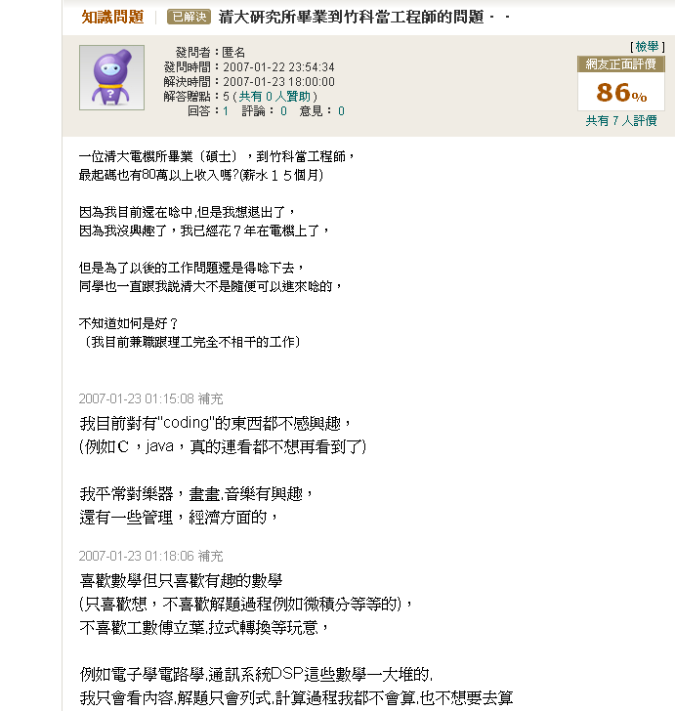
Let’s See Some Story

Slide 3
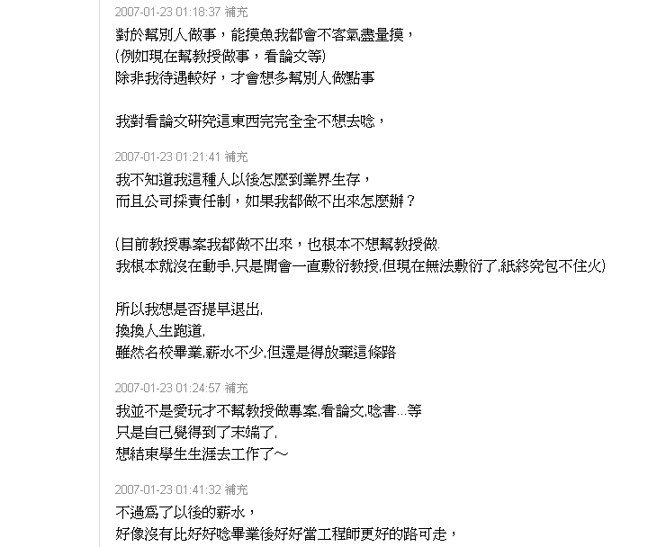
Let’s See Some Story

Slide 4
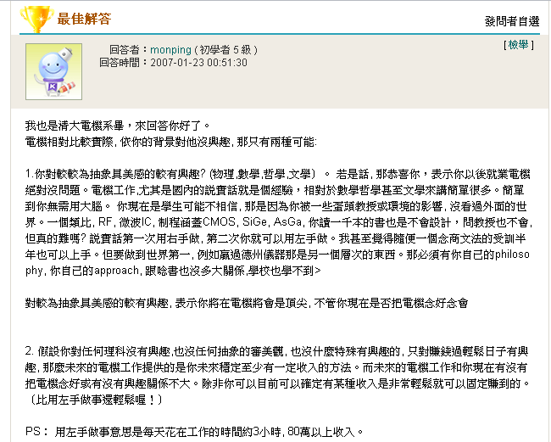
Story (Contd.)

Slide 5
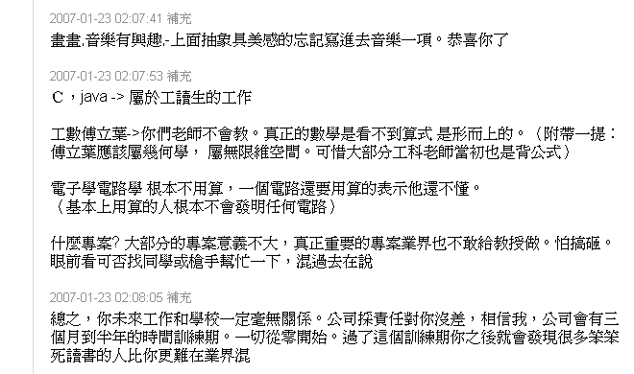
Story (Contd.)

Slide 6
True or False?
School training and industry training are totally different?!
No industry will work on your research topic, so why waste your time in graduate school?!
School can help us to get some “certificate”, and that’s the only thing matters to get in industry.

Slide 7
Universities
Latin universitas magistrorum et scholarium
  Community of teachers and scholars
Current definition
  An institution of learning of the highest level, having a college of liberal arts and a program of graduate studies together with several professional schools

Slide 8

Industries
Latin word industria
  Diligent activity directed to some purpose
Old French industrie
  “Activity,” “ability,” and “a trade or occupation”
Current definition
  The aggregate of manufacturing or technically productive enterprises in a particular field
  Any general business activity; commercial enterprise

Slide 9
Gap
Between the universities and industries
  Goal of universities: learning
    Students learn through lectures
    Lectures are organized by instructors
    Instructors need to solve student problems
  Goal of industries: production ⇒ making money
    The workers solve the problems on their own

Slide 10
Problem
From students to workers
  Getting the answers ⇒ solving the problems
Known problems
  Utilize the knowledge from textbooks
New problems
Unknown problems

Slide 11
Ability of Problem Solving
Ability to identify the problem
Have the key to open the resource
Research

Slide 12
Research
1577, act of searching closely
Current definition
  A close and careful study to find out new facts or information

Slide 13
What You Can Learn
Learn from the processes
  Identify the problem
  Gather information
  Develop the method
  Analyze and Justify
  Presentation

Slide 14
Identify The Problem
Predict problems
Filter unneeded data
Isolate the key point
Make hypothesis

Slide 15
Gather Information
Where we are
Validate the information
  Are the sources OK?
  The credibility of the data
  Filter the biased information

Slide 16
Develop The Method
On top of the previous methods
Evaluate the strength and the weakness
  For your method
  For your ability
    Additional help?
  Fair evaluation
Gradually improve it
Might need to start from zero again

Slide 17
Analyze and Justify
Gather enough good data to validate
Design fair mechanisms to compare
  Logic
  Criteria
  Stand on top of giants’ shoulders
Bit by bit
NOT just believe what you want to believe
  Fair, fair, fair….

Slide 18
Presentation
Wrap the content
Nice package
Persuade others with reasons and logic
Practices
Learn from Listening & Practice

Slide 19
Patient
Achievement
Effort

Slide 20
Apply
Apply what you learn
  In daily life
  At your work
  At your home
  With your friends
  While digesting information
Thus, you might bridge the gap

