Slide 1
Principal Component Analysis and
Linear Discriminant Analysis
Chaur-Chin Chen
Institute of Information Systems and Applications
National Tsing Hua University
Hsinchu 30013, Taiwan
E-mail: cchen@cs.nthu.edu.tw

Slide 2
Outline
◇ Motivation for PCA
◇ Problem Statement for PCA
◇ The Solution and Practical Computations
◇ Examples and Undesired Results
◇ Fundamentals of LDA
◇ Discriminant Analysis
◇ Practical Computations
◇ Examples and Comparison with PCA

Slide 3
Motivation
Principal Component Analysis (PCA) and Linear Discriminant Analysis (LDA) are multivariate statistical techniques that are often
useful in reducing dimensionality of a collection of unstructured random variables for analysis and interpretation.

Slide 4
Problem Statement
• Let X be an m-dimensional random vector with the covariance matrix C. The problem is to consecutively find the unit vectors a₁, a₂, . . . , a_{m} such that y_{i}= x^{t} a_{i} with Y_{i} = X^{t} a_{i} satisfies
1. var(Y₁) is the maximum.
2. var(Y₂) is the maximum subject to cov(Y₂, Y₁)=0.
3. var(Y_{k}) is the maximum subject to cov(Y_{k}, Y_{i})=0,
where k = 3, 4, · · ·,m and k > i.
• Y_{i} is called the i-th principal component
• Feature extraction by PCA is called PCP

Slide 5
The Solutions
Let (λ_{i}, u_{i}) be the pairs of eigenvalues and eigenvectors of the covariance matrix C such that
λ₁ ≥ λ₂ ≥ . . . ≥ λ_{m} ( ≥0 )
and
∥u_{i} ∥₂ = 1, ∀ 1 ≤ i ≤ m.
Then
a_{i} = u_{i} and var(Y_{i})=λ_{i} for 1 ≤ i ≤ m.

Slide 6
Computations
Given n observations x₁, x₂, . . . , x_{n} of m-dimensional column vectors
1. Compute the mean vector μ = (x₁+x₂+. . . +x_{n} )/n
2. Compute the covariance matrix by MLE
C = (1/n) Σ_{i=1}^{n} (x_{i} − μ)(x_{i} − μ)^{t}
3. Compute the eigenvalue/eigenvector pairs (λ_{i}, u_{i}) of C
with λ₁ ≥ λ₂ ≥ . . . ≥ λ_{m} ( ≥0 )
4. Compute the first d principal components y_{i}^{(j)} = x_{i}^{t} u_{j}, for each observation x_{i}, 1 ≤ i ≤ n, along the direction u_{j} , j = 1, 2, · · · , d.
5. (λ₁ +λ₂ + . . . + λ_{d})/ (λ₁ +λ₂ + . . .+ λ_{d} + . . .+ λ_{m}) > 85%

Slide 7
An Example for Computations
x₁ =[3.03, 2.82]^{t}
x₂ =[0.88, 3.49]^{t}
x₃ =[3.26, 2.46]^{t}
x₄ =[2.66, 2.79]^{t}
x₅ =[1.93, 2.62]^{t}
x₆ =[4.80, 2.18]^{t}
x₇ =[4.78, 0.97]^{t}
X₈ =[4.69, 2.94]^{t}
X₉ =[5.02, 2.30]^{t}
x₁₀ =[5.05, 2.13]^{t}
μ =[3.61, 2.37]^{t}
C = 1.9650 -0.4912
-0.4912 0.4247
λ₁ =2.1083
λ₂ =0.2814
u₁ =[0.9600, -0.2801]^{t}
u₂=[0.2801, 0.9600]^{t}

Slide 8
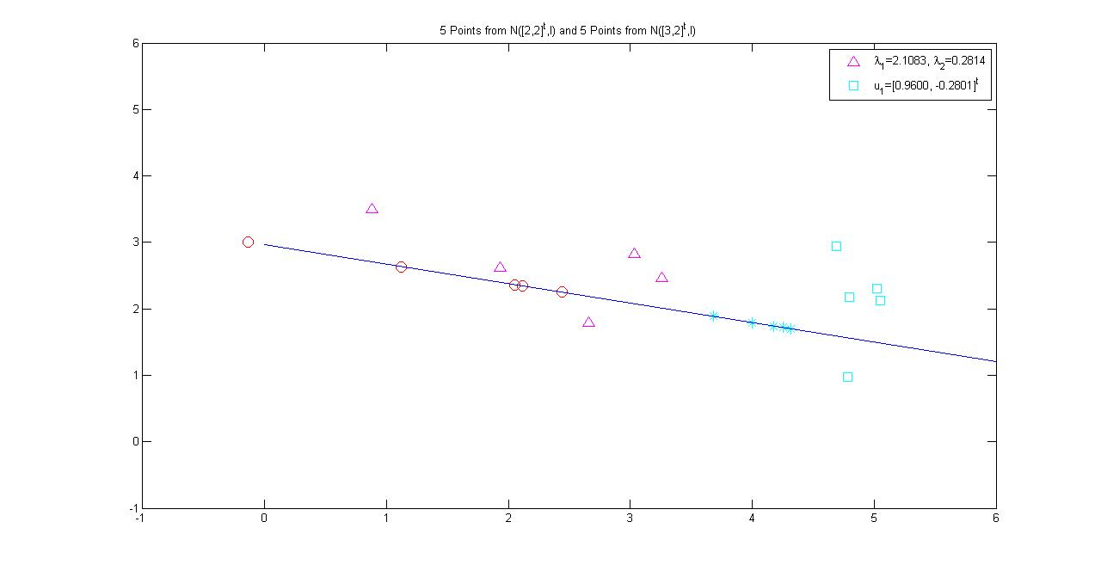
Results of Principal Projection

Slide 9
Examples
1. 8OX data set
2. IMOX data set
8: [11, 3, 2, 3, 10, 3, 2, 4]
The 8OX data set is derived from the Munson’s hand printed Fortran character set. Included are 15 patterns from each of the characters ‘8’, ‘O’, ‘X’. Each pattern consists of 8 feature measurements.
O: [4, 5, 2, 3, 4, 6, 3, 6]
The IMOX data set contains 8 feature measurements on each character of ‘I’, ‘M’, ‘O’, ‘X’. It contains 192 patterns, 48 in each character. This data set is also derived from the Munson’s database.

Slide 10
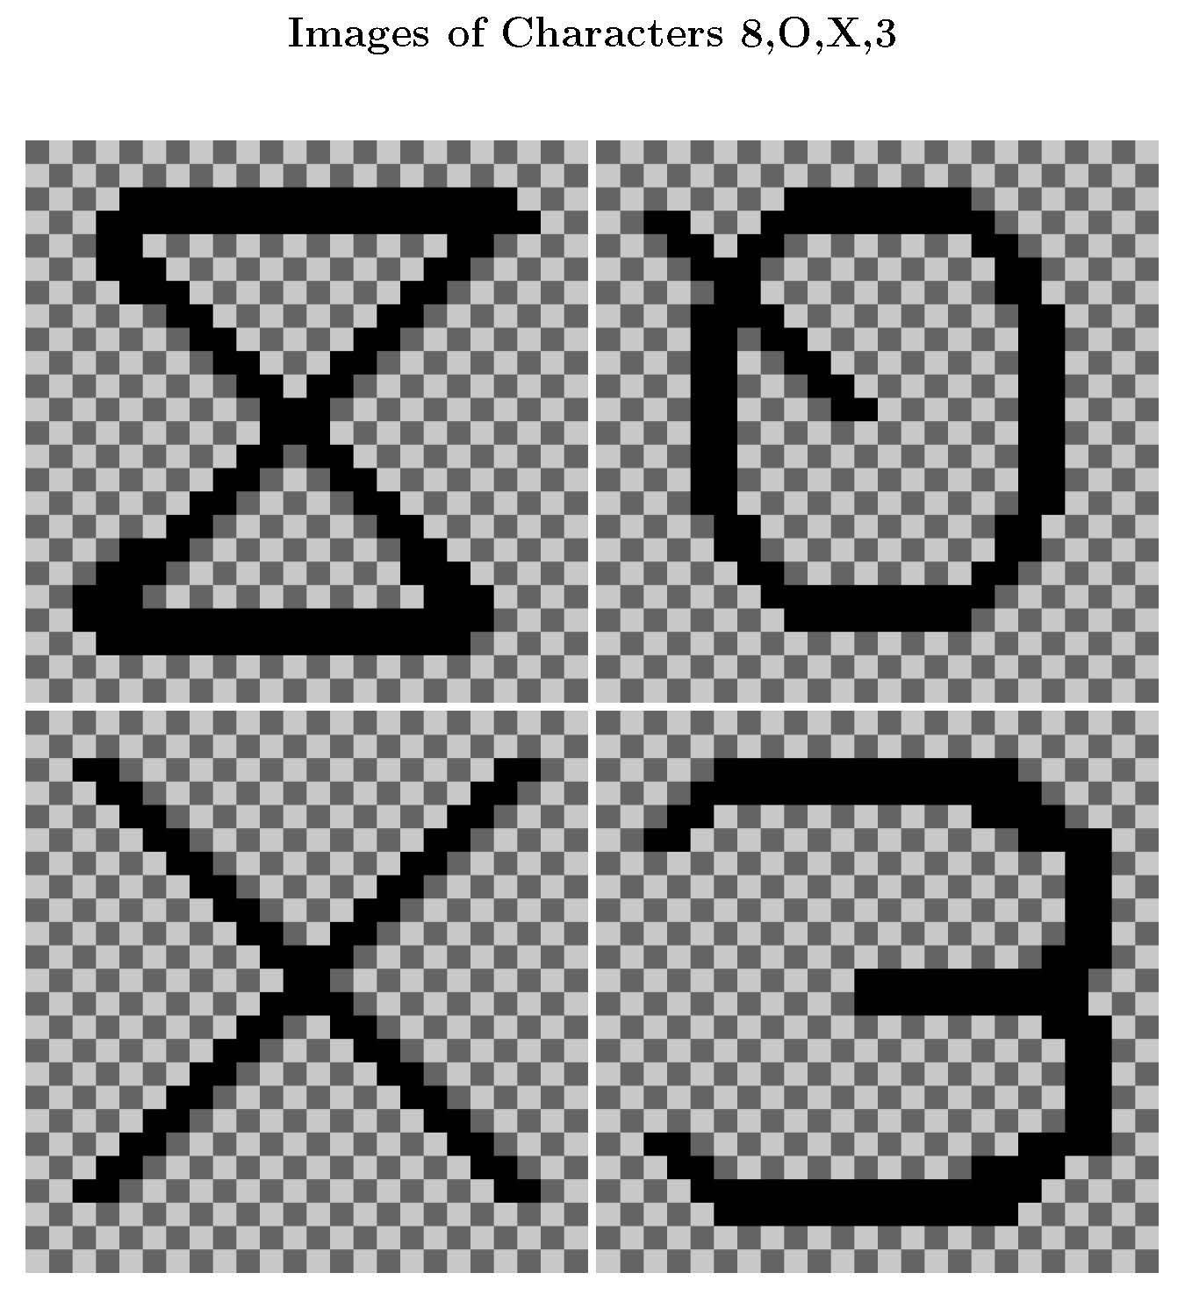

Slide 11
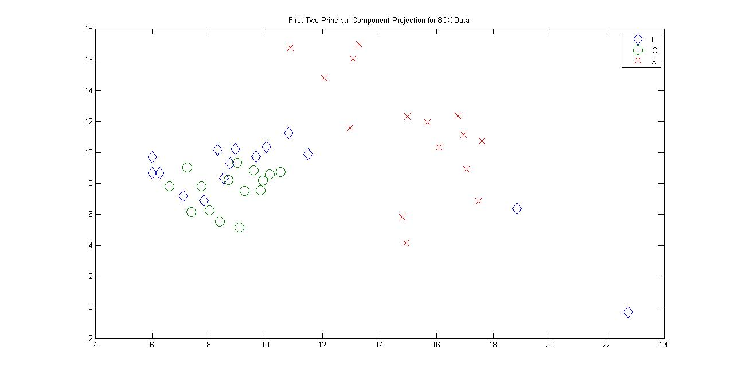
First and Second PCP for data8OX

Slide 12
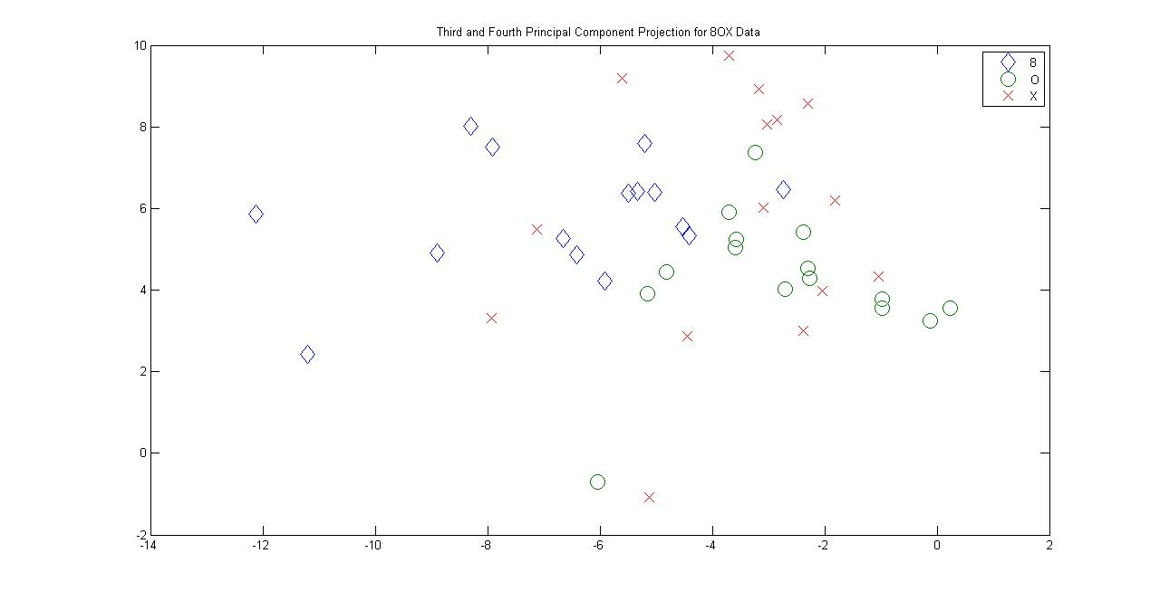
Third and Fourth PCP for data8OX

Slide 13
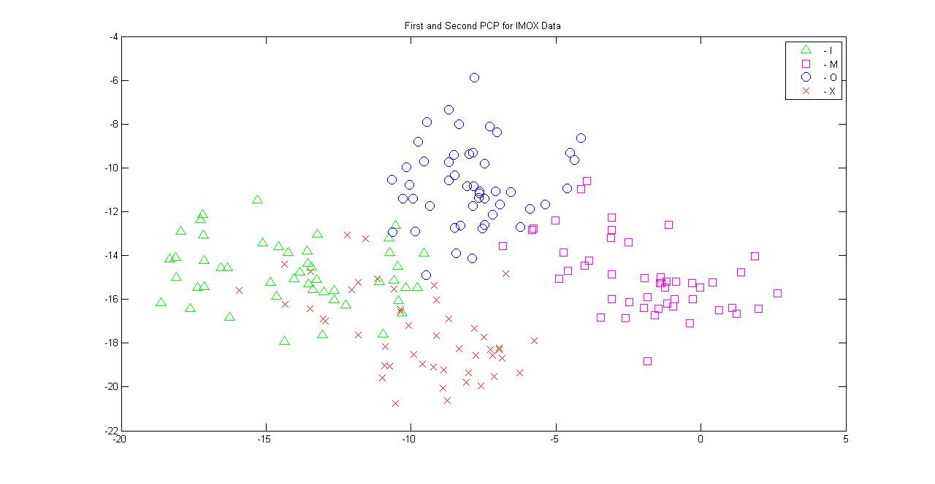
First and Second PCP for dataIMOX

Slide 14
Description of datairis
□ The datairis.txt data set contains the
measurements of three species of iris
flowers (setosa, versicolor, virginica).
□ It consists of 50 patterns from each species
on each of 4 features (sepal length, sepal
width, petal length, petal width).
□ This data set is frequently used as an
example for clustering and classification.

Slide 15
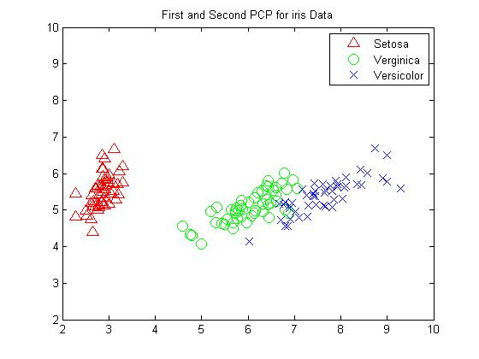
First and Second PCP for datairis

Slide 16
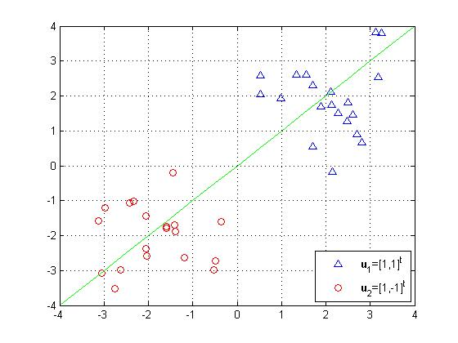
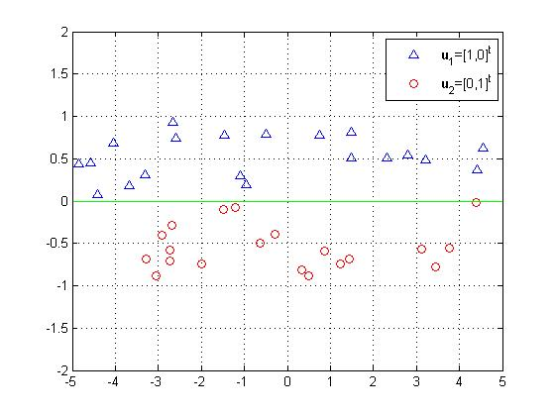
Example that PCP is Not Working
PCP works as expected
PCP is not working as expected

Slide 17
Fundamentals of LDA
Given the training patterns x₁, x₂, . . . , x_{n} from K categories, where n₁ + n₂ + … + n_{K} = n of m-dimensional column vectors. Let the between-class scatter matrix B, the within-class scatter matrix W, and the total scatter matrix T be defined below.
1. The sample mean vector u= (x₁+x₂+. . . +x_{n} )/n
2. The mean vector of category i is denoted as u_{i}
3. The between-class scatter matrix B= Σ_{i=1}^{K} n_{i}(u_{i} − u)(u_{i} − u)^{t}
4. The within-class scatter matrix W= Σ_{i=1}^{K} Σ_{x in} _{ωi}(x-u_{i} )(x-u_{i} )^{t}
5. The total scatter matrix T =Σ_{i=1}^{n} (x_{i} - u)(x_{i} - u)^{t}
Then T= B+W

Slide 18

Fisher’s Discriminant Ratio
Linear discriminant analysis for a dichotomous problem attempts to find an optimal direction w for projection which maximizes a Fisher’s discriminant ratio
J(w) =
The optimization problem is reduced to solving the generalized eigenvalue/eigenvector problem Bw= λ Ww by letting (n=n₁n₂)
Similarly, for multiclass (more than 2 classes) problems, the objective is to find the first few vectors for discriminating points in different categories which is also based on optimizing J₂(w) or solving
Bw= λ Ww for the eigenvectors associated with few largest eigenvalues.

Slide 19
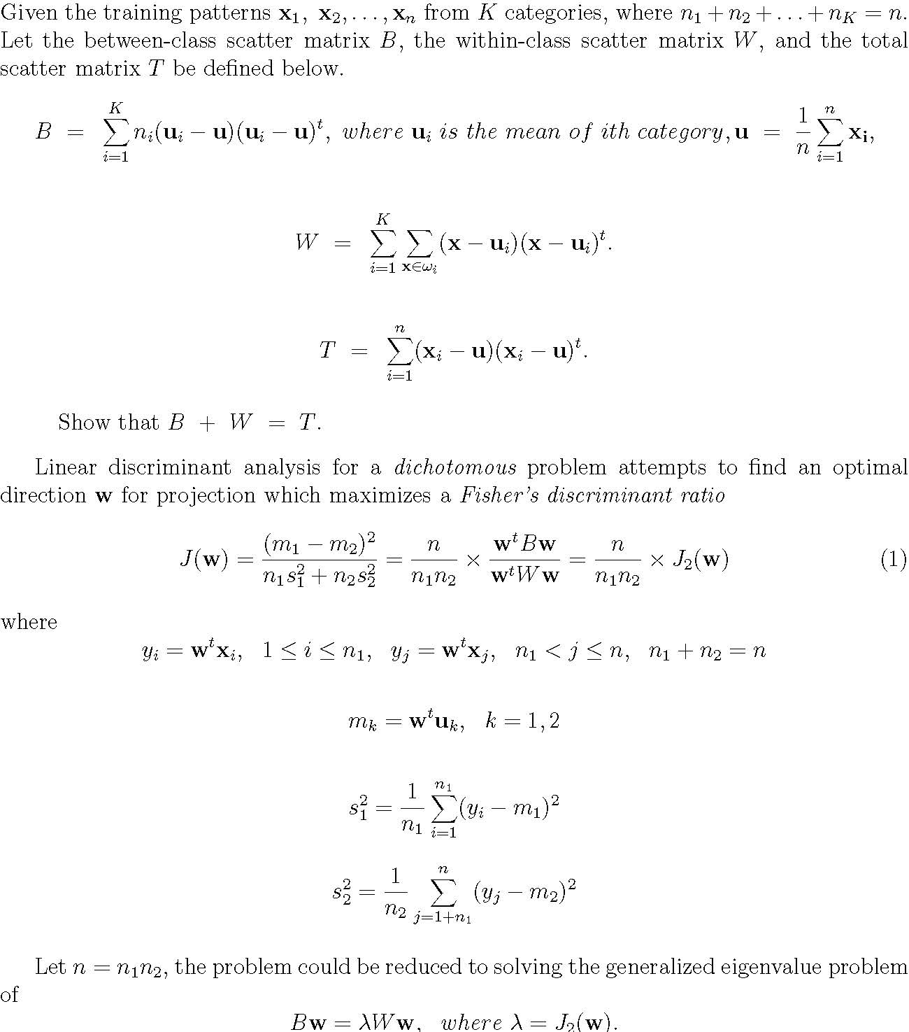
Fundamentals of LDA

Slide 20
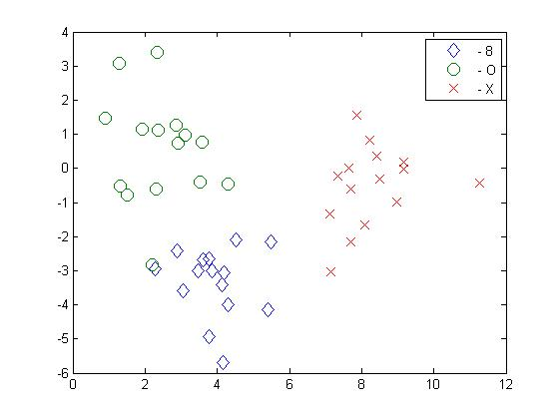
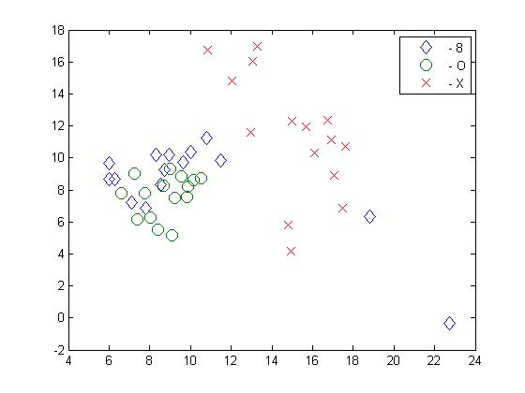
LDA and PCA on data8OX
LDA on data8OX
PCA on data8OX

Slide 21
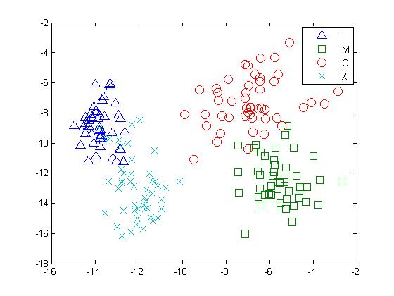
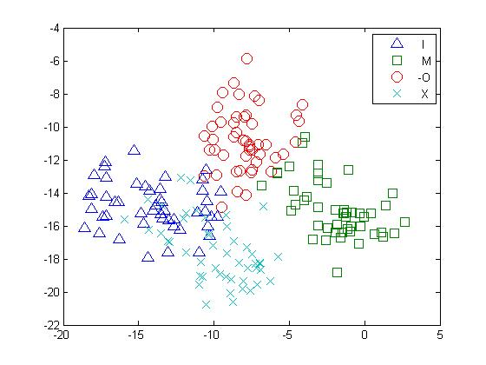
LDA and PCA on dataimox
LDA on dataimox
PCA on dataimox

Slide 22
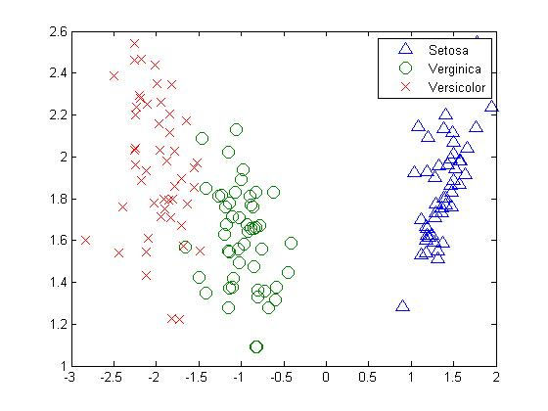

LDA and PCA on datairis
LDA on datairis
PCA on datairis

Slide 23
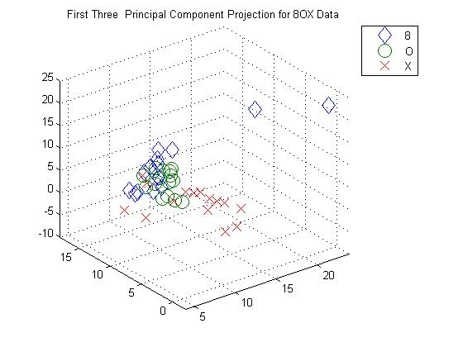
Projection of First 3 Principal Components for data8OX

Slide 24
pca8OX.m
fin=fopen('data8OX.txt','r');
d=8+1; N=45; % d features, N patterns
fgetl(fin); fgetl(fin); fgetl(fin); % skip 3 lines
A=fscanf(fin,'%f',[d N]); A=A'; % read data
X=A(:,1:d-1); % remove the last columns
k=3; Y=PCA(X,k); % better Matlab code
X1=Y(1:15,1); Y1=Y(1:15,2); Z1=Y(1:15,3);
X2=Y(16:30,1); Y2=Y(16:30,2); Z2=Y(16:30,3);
X3=Y(31:45,1); Y3=Y(31:45,2); Z3=Y(31:45,3);
plot3(X1,Y1,Z1,'d',X2,Y2,Z2,'O',X3,Y3,Z3,'X', 'markersize',12); grid
axis([4 24, -2 18, -10,25]);
legend('8','O','X')
title('First Three Principal Component Projection for 8OX Data‘)

Slide 25
PCA.m
% Script file: PCA.m
% Find the first K Principal Components of data X
% X contains n pattern vectors with d features
function Y=PCA(X,K)
[n,d]=size(X);
C=cov(X);
[U D]=eig(C);
L=diag(D);
[sorted index]=sort(L,'descend');
Xproj=zeros(d,K); % initiate a projection matrix
for j=1:K
Xproj(:,j)=U(:,index(j));
end
Y=X*Xproj; % first K principal components

