Slide 1
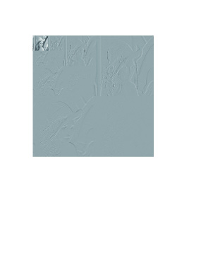
3-Scale Haar-Transformed Lenna

