Slide 1
EECS3030(02) Course Description
Probability theory is a powerful tool that helps Computer Science and Electrical Engineering students explain, model, analyze, and design the technology they develop. This course introduces the basic concepts and illustrates the applications of probability. We suggest that students be familiar with C or C++ programming, Data Structure, and College Calculus (I,II) before taking this course. Lecture notes will be provided in my website.

Slide 2
Fundamentals of Probability and Statistics
Basic Concepts
The discipline of statistics deals with the collection and analysis of data which is based
on the probability theory.
Consider Experiments for which the outcome cannot be predicted with certainty, two definitions are given
S: Sample space (Outcome space)
E: An Event (a subset of outcome space)
Example 1: Flipping a fair coin S={h, t}, E={h}
Example 2: Sum of two numbers observed from rolling a pair of two dice S={2, 3, 4, 5, 6, 7, 8, 9, 10, 11, 12}, E={2,3,4}

Slide 3
Some Terminologies
frequency, relative frequency, histogram, and mode
probability mass function, histogram
Example: The number of children in each family of 100 students is recorded as follows.
2 2 5 3 4 4 3 3 6 4 3 4 4 4 4 2 5 9 2 3
1 3 5 2 4 4 4 3 3 2 2 4 2 2 6 6 1 3 3 3
3 2 3 4 7 3 3 3 2 2 2 2 3 2 3 2 3 2 5 2
3 2 2 2 4 3 3 2 3 2 4 3 3 3 4 2 4 1 2 2
2 4 3 3 3 5 2 3 3 2 2 3 3 4 2 2 2 7 2 3
(a) Find the tabulation, frequency, and relative frequency.
(b) Construct the histogram of (relative) frequency.

Slide 4
Frequency and Relative Frequency
Number of Kids | Frequency | Relative Frequency
1 | 3 | 0.03
2 | 34 | 0.34
3 | 34 | 0.34
4 | 18 | 0.18
5 | 5 | 0.05
6 | 3 | 0.03
7 | 2 | 0.02
8 | 0 | 0.00
9 | 1 | 0.01

Slide 5
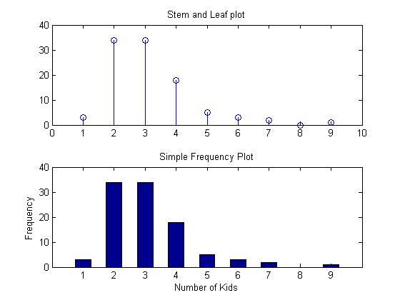
Histogram

Slide 6
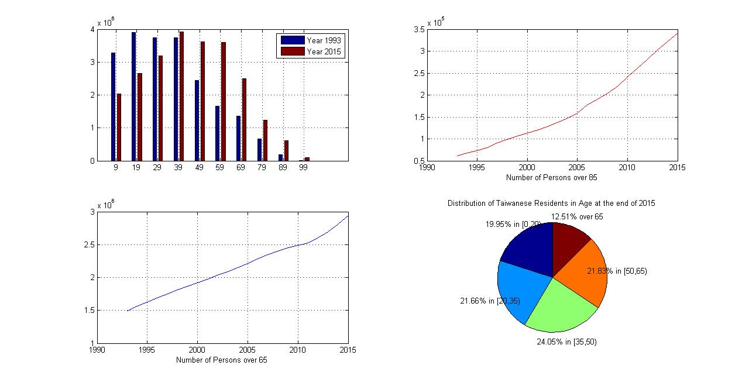
Demographic Data Analysis (2015)

Slide 7
Exploratory Data Analysis
stem-and-leaf display
order statistics (of the sample)
25th percentile, 0.25 quantile, 1st quartile
minimum (Min), mean, median, maximum (Max), range
1st quartile (q1), 2nd quartile (median), 3rd quartile (q3)
five-number summary (Min, q1, q2, q3, Max)
box-and-whisker diagram, outliers

Slide 8
Scores of CS3332 Students in Fall/1999
72 77 58 67 70 76 70
83 42 58 49 74 65 55
80 31 61 53 82 90 51
55 84 70 48 76 61 76
70 70 66 50 80 73 77 43
71 99 66 63 63 52 54 80
29 52 83 62 60 61 86
61 70 73
(a) List the order statistics of the 59 scores.
(b) Find sample mean and variance for these scores.
(c) Find the 25th, 75th percentiles, and the median.
(d) Draw a box-and-whisker diagram.
(e) Give the five-number summary of data.
(f) Are there outliers? Explain it.

Slide 9
Scores of CS3332 Students in Fall/1999
72 77 58 67 70 76 70
83 42 58 49 74 65 55
80 31 61 53 82 90 51
55 84 70 48 76 61 76
70 70 66 50 80 73 77 43
71 99 66 63 63 52 54 80
29 52 83 62 60 61 86
61 70 73
31 42 43 48 48 49 50
52 52 53 54 55 55 58
58 60 61 61 61 61 61 62
63 63 65 66 66 67 67 70
70 70 70 70 70 71 72 73
73 74 76 76 76 76 77 77
80 80 80 82 83 83 84 86
90 90 99

Slide 10
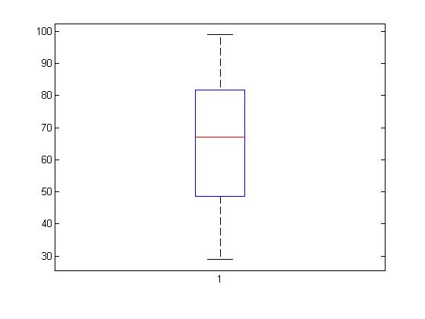
Summary of Statistics
[Min, q1, med, q3, Max]
[29, 55, 67, 76, 99]

Slide 11
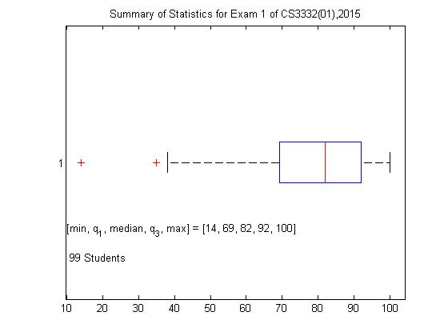
Summary Statistics of Exam 1, 2015

Slide 12
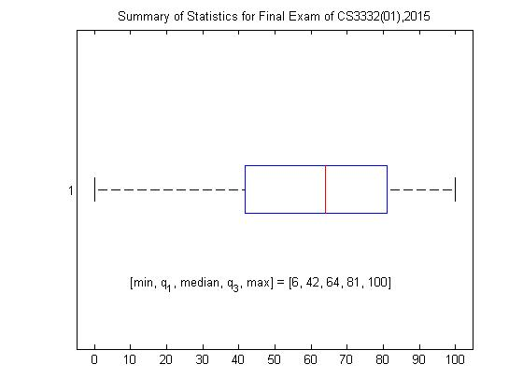
Summary Statistics of Exam 2, 2015

Slide 13
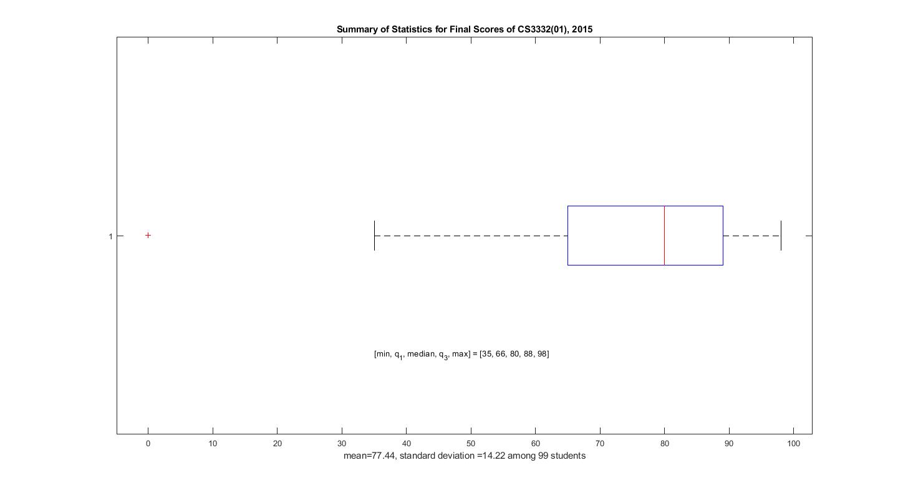
Summary of Final Grades, 2015

