Slide 1
計 算 機 結 構
國立清華大學資訊工程系 黃婷婷教授

Slide 2

為什麼電腦不用十進位而用二進位？

Slide 3
Signal: Two States (二進制)
對、錯
本土化、非本土化
陰、陽
high、low
正、反
勝、負
真、偽

Slide 4
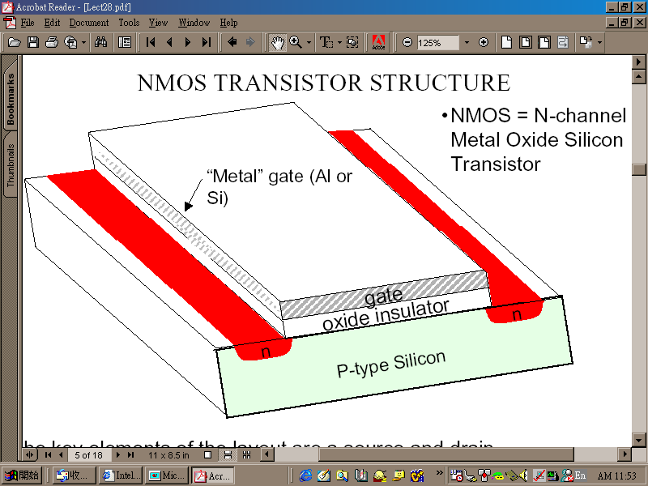
Switch (電子開關)
“gate” as the switch

Slide 5
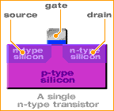
A Working Transistor (1/5)
Transistors consist of three terminals;
the source, the gate, and the drain:

Slide 6
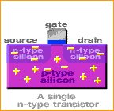
A Working Transistor (2/5)
In the n-type transistor, both the source and
the drain are negatively-charged and
sit on a positively-charged well of p-silicon.

Slide 7
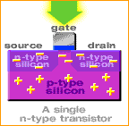
A Working Transistor (3/5)
When positive voltage is applied to the gate, electrons in the p-silicon are attracted to the area under the gate forming an electron channel between the source and the drain.

Slide 8
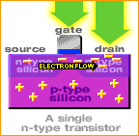
A Working Transistor (4/5)
When positive voltage is applied to the drain,
the electrons are pulled from the source to the drain.
In this state the transistor is on.
開

Slide 9
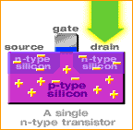
A Working Transistor (5/5)
If the voltage at the gate is removed, electrons are not attracted to the area between the source and drain. The pathway is broken and the transistor is turned off.
關

Slide 10
相關電壓電流特性
及電路分析等知識
我們是在＿＿＿課中介紹的
答：「電子電路學」「超大型積體電路設計」

Slide 11
Switch (電子開關)
“gate” as the switch

Slide 12
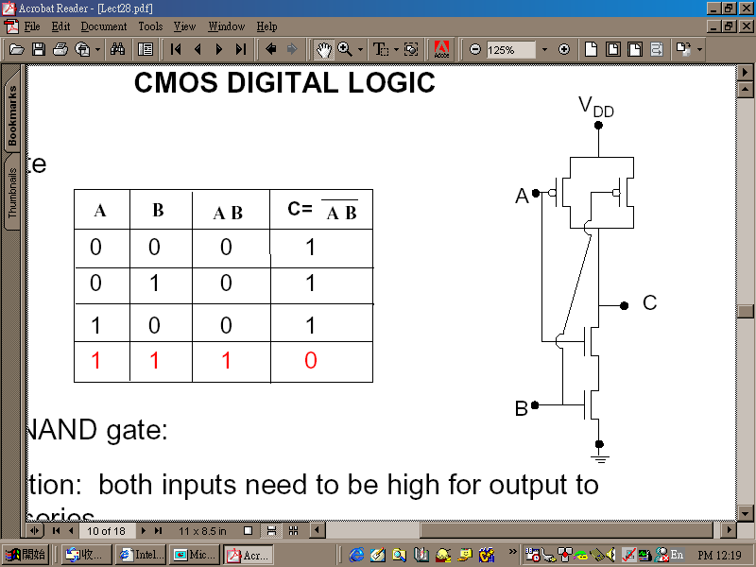
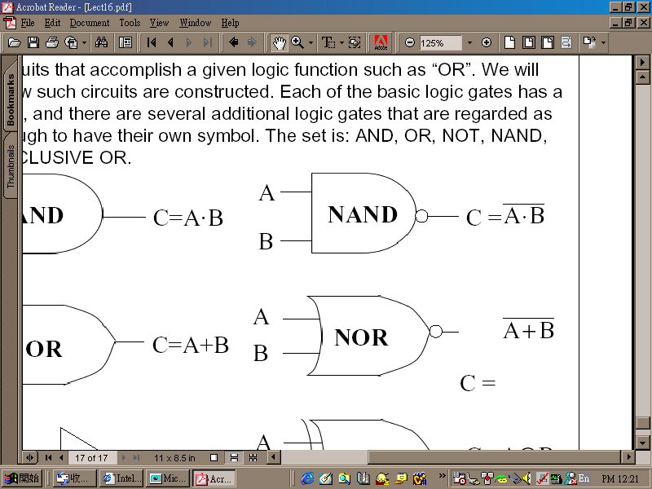
有了開關就可以做邏輯閘
CMOS NAND:

Slide 13
有了邏輯閘就可做邏輯電路
加法器：
A
A
B
CO
B
Cl
S
A
Cl
B

Slide 14
也可以做記憶元件
可存一個bit的東西：
R
R'
Q
clock'
Q'
S'
S

Slide 15

這部份的學問叫＿＿＿＿
答：「數位邏輯設計」

Slide 16
最後，電腦的主要部份就都可以做了
暫存器
記憶體
控制器
控制信號
ALU
N
Z
clock
IR
PC

Slide 17
Basic Organization of Any Computer
Computer
Keyboard,
Mouse
Processor
(active)
Memory
(passive)
(where
programs,
data
live when
running)
Devices
Disk
(where
programs,
data
live when
not running)
Control
(“brain”)
Input
Datapath
(“brawn”)
Output
Display,
Printer
Notes:
That is, any computer, no matter how primitive or advance, can be divided into five parts:
1. The input devices bring the data from the outside world into the computer.
2. These data are kept in the computer’s memory until ...
3. The datapath request and process them.
4. The operation of the datapath is controlled by the computer’s controller.
All the work done by the computer will NOT do us any good unless we can get the data back to the outside world.
5. Getting the data back to the outside world is the job of the output devices.
The most COMMON way to connect these 5 components together is to use a network of busses.

Slide 18
Computer Organization
Capabilities and performance characteristics of principal functional units, e.g., registers, ALU, shifters, ...
Ways in which these components are interconnected (structure)
Information flows between components (data, datapath)
Logic and means by which such information flow is controlled (control logic)
Register Transfer Level (RTL) description
Notes:
Deeper view. Design state of art organization in 1990. This is only the computer organization. What is computer architecture ?

Slide 19
What is Computer Architecture?
Computer Architecture =
Instruction Set Architecture
+ Machine Organization
Application (IE)
Operating
Compiler
System
(MS Windows)
Software
Assembler
Hardware
Instruction Set
Architecture
Processor
Memory
I/O system
Datapath & Control
Digital Design
Circuit Design
Machine Organization
Transistors

Slide 20
Instruction Set as a Critical Interface
Coordination of many levels of abstraction
software
instruction set
hardware
Does it have to be hardware?

Slide 21
Another Perspective
High Level Language Program
temp = v[k];
v[k] = v[k+1];
v[k+1] = temp;
Compiler
Assembly Language Program
lw $15, 0($2)
lw $16, 4($2)
sw $16, 0($2)
sw $15, 4($2)
ISA
Assembler
Machine Language Program
0000 1001 1100 0110 1010 1111 0101 1000
1010 1111 0101 1000 0000 1001 1100 0110
1100 0110 1010 1111 0101 1000 0000 1001
0101 1000 0000 1001 1100 0110 1010 1111
Machine Interpretation
Control Signal Specification
ALUOP[0:3] <= InstReg[9:11] & MASK
°
°

Slide 22
Instruction Set Architecture (ISA)
“... the attributes of a [computing] system as seen by the programmer, i.e. the conceptual structure and functional behavior, as distinct from the organization of the data flows and controls, the logic design, and the physical implementation.”
— Amdahl, Blaaw, and Brooks, 1964
Organization of Programmable
Storage
Data Types and Data Structures:
Encodings and Representations
Instruction Set
Instruction Formats
Modes of Addressing and Accessing Data Items and Instructions
Exceptional Conditions
SOFTWARE

Slide 23
MIPS R3000 ISA
Registers
Instruction categories:
  Load/Store
  Computational
  Jump and Branch
  Floating Point
    coprocessor
  Memory Management
  Special
R0 - R31
PC
HI
LO
3 Instruction Formats: all 32 bits wide
OP
rs
rt
rd
sa
funct
OP
rs
rt
immediate
OP
jump target

Slide 24
Example ISA
Digital Alpha (v1, v3) 1992-97
HP PA-RISC (v1.1, v2.0) 1986-96
Sun Sparc (v8, v9) 1987-95
SGI MIPS (MIPS I, II, III, IV, V) 1986-96
Intel (8086,80286,80386, 1978-
80486,Pentium, MMX,
SIMD, IA-64, ...)
ARM (v1,v2…v8) 1985-
RISC-V

Slide 25
Why Do Computer Architecture?
RAPID CHANGES
It is exciting!
It has never been more exciting!
It impacts every other aspect of electrical engineering and computer science

Slide 26
Flipped Classroom

Slide 27
Group Performance
Forming study groups (12/14 groups) by TA. Each group has 7-8 students.
  For members in the same group, their group performance will be the same
  Advanced learner will help less advanced learner!

Slide 28
Flipped Classroom
Before class:
  Watch video and learn it by yourself (or group study)
  Submit two question-and-answers to eeclass by each group before noon every Friday
In class:
  First part:
  Question and answer (for general question)
  Second part:
  Group study or individual student tutored by TAs and teacher
  A set of questions discussed in each group
  Third part:
  Tournament
  Submission of final answer sheet per group

Slide 29
Flipped Classroom
After class
  Review the course and take a quiz online after each class
  Complete three homework assignments
  Take midterm and final exams
  Submit one final project

Slide 30
In Class – Second & Third Parts
  Group Discussion:
    TA will select several questions from the questions uploaded by each group and give a question sheet on Sunday
    Group discussion
  Tournament:
    TA selects some questions from question sheet (Q-group)
    TA randomly select one member of groups whose question is not selected to answer the question (A-group)
    If A-group can not answer the question, a member randomly selected from Q-group has to give the answer
    The question is answered on the blackboard
    Points are given to these two groups based on their performance
  Submission:
    Your group answer-sheet at the end of class

Slide 31
In Class – Second & Third Parts
Second and third parts:
  TA is the moderator
  Each group prepares two question-and-answers and upload the questions to https://eeclass.nthu.edu.tw by Friday noon.
  Moderator checks all questions and may ask some groups to reload questions if there is too much duplication among groups.
  Good question is important. If it is selected by TA in tournament, it is worth points!

Slide 32
After Class – Quiz
    Quiz contains a set of single or multiple-choice questions
    Quiz is uploaded before 20:00 every Monday after class
    Questions are all from the question sheet !!
    Complete the quiz before Thursday noon each week
    Grading: Total number of correct answers/total number of answers x 7%

Slide 33
Group Performance
Group performance (in each class period)
  First part: Student participation and interaction with teacher (teacher asks question or students raise question)
  Second and third parts:
    Group discussion : prepare your answers
    Tournament – points are given to the two groups (Q-group and A-group)
    Submission of answer sheet

Slide 34
Course Administration
授課老師: 黃婷婷
  辦公室: 資電442 電話: 31310
  email: tingting@cs.nthu.edu.tw
助教:
林承賢 s110062801@m110.nthu.edu.tw Online office hours: 星期二19:00~21:00
王睿杰 wrj651121@gmail.com Online office hours: 星期三19:00~21:00
唐梧遷 wqtang@cs.nthu.edu.tw Online office hours: 星期四19:00~21:00
助教辦公室: 資電227, 228 Online office 請同學在eeclass討論區發問!
上課時間:
  CS4100-00: 星期一 13:20-16:00
上課地點: DELTA 台達 109
課程網頁: http://www.cs.nthu.edu.tw/~tingting/cs4100.html

Slide 35
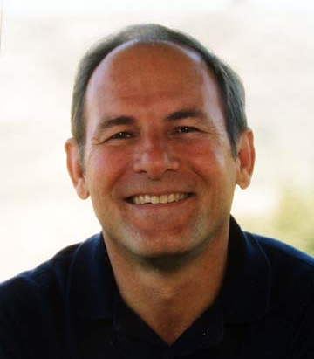
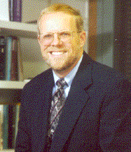
Text Book
Computer Organization and Design: The Hardware/Software Interface, 5th ed.
David Patterson and John Hennessy, 2013
RISC, RAID
史丹福大學
校長

Slide 36
Topics Covered
Computer Organization and Design: The Hardware/Software Interface, D. Patterson and J. Hennessy
Topic
--------------------------------------------
Introduction
The Role of Performance
Instructions: Language of the Machine
Arithmetic for Computers
The Processor: Datapath and Control
Enhancing Performance with Pipelining
Exploiting Memory Hierarchy

Slide 37
Prerequisite
Prerequisite courses:
  Logic design

Slide 38
Expected Course Workload
Learn MIPS instruction set
Learn processor emulators and benchmarking
1 final project
One mid-term and one final examination
Grade breakdown
  In-class performance 23%
  Quizzes 7%
  Assignments & Final project 10%
  Midterm Exam (Oct 21) 30%
  Final Exam (Dec 16) 30%

Slide 39
Resource on Internet to Help Your Learning
Course Website
  http://www.cs.nthu.edu.tw/~tingting/cs4100.html
ShareCourse (Please register)
  https://www.sharecourse.net/sharecourse/course/view/courseInfo/2888
FB粉絲專頁 (TA online office)
  https://www.facebook.com/NTHUArch
Open Course Ware (OCW)
  http://ocw.nthu.edu.tw/ocw/index.php?page=course&cid=76&

Slide 40
Course Problems
Cannot attend the class
  One absence is allowed but no point of group performance will be given for that class
  Two absents => you don’t have to come any more
Cannot be in the class on time
  Late = absent
Cannot turn in homework on time
  No late homework is accepted
What is cheating?
  Study together in group is encouraged
  Work must be your own. Copying is cheating!

