Slide 1
CS5102 High Performance Computer Systems Warehouse-Scale Computers
Prof. Chung-Ta King
Department of Computer Science
National Tsing Hua University, Taiwan
(Slides are from textbook, Prof. A.W. Moore, Prof. J. Urbain, Dr. A.E. Evrard)

Slide 2
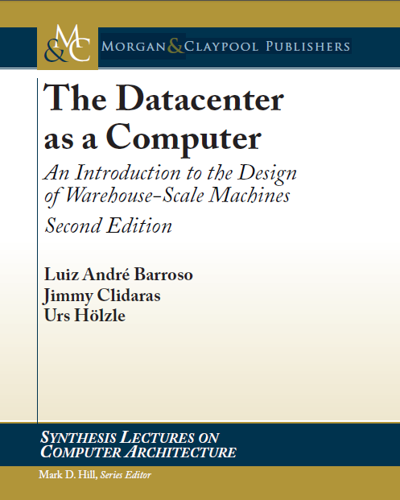
Main Reference
The Datacenter as a Computer: An Introduction to the Design of Warehouse-Scale Machines, 2nd Ed., Luiz André Barroso, Jimmy Clidaras, Urs Hölzle, Morgan & Claypool Publishers, 2013.

Slide 3
Internet Services Becoming Prevalent
Internet services:
Webmail, search, social network, maps, video/picture sharing, storage, video streaming, language translation, ...
The trend toward server-side or “cloud” computing
Moving away from PC-like clients to smaller, often mobile, devices combined with large-scaled internet services
Many Internet services were previously resided in the client, but now are moved to the cloud
Characteristics of internet services
Tens or more individual programs that interact to implement complex services to serve a massive amount of end users → one service for many
Notes:
It is not like supercomputing or high-performance computing that one large-scale application solves one problem for one person/team

Slide 4
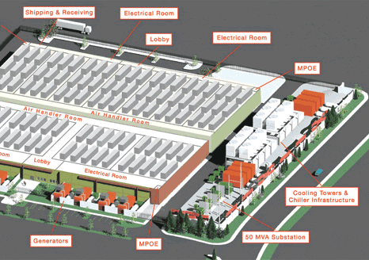
What Computers for Internet Services?
WSC: warehouse-scale computer
Large-scaled internet services require a computing power that can only be provided by clusters of 100s or 1000s of machines, i.e. a warehouse full of computers
Hardware and software resources in such a facility must work in concert as would a single computer
→ datacenter is the computer
Server and networking equipment
Cooling towers
(Ana Radovanovic)
Generators
MW substation

Slide 5
Warehouse-Scale Computer (WSC)
Program is an Internet service
May consist of tens or more individual programs that interact to implement complex end-user services such as email, search, or maps
Software runs on hardware consisting of thousands of individual computing nodes with:
Networking and storage subsystems
Power distribution and conditioning equipment
Extensive cooling systems
The enclosure for these systems is in fact a building structure and often indistinguishable from a large warehouse

Slide 6
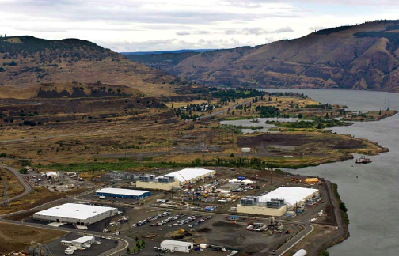
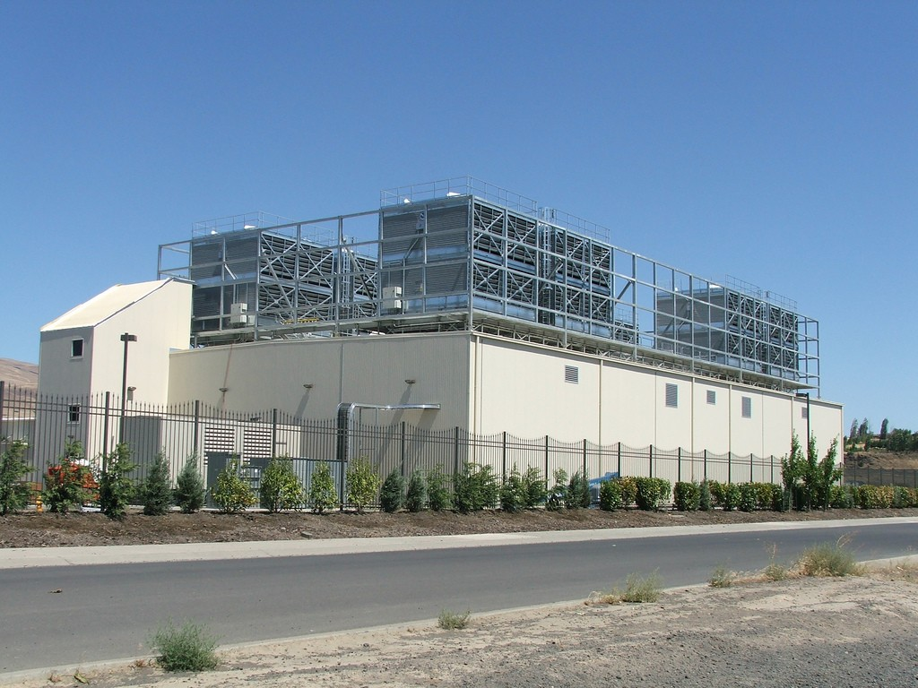
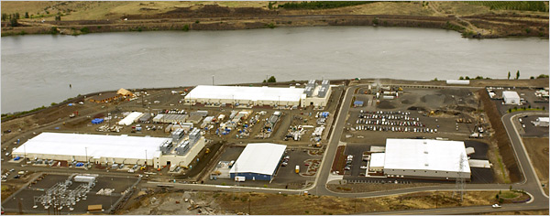
Google Oregon WSC

Slide 7
Warehouse-Scale Computer (WSC)
Single facility for a single organization
Designed for narrower set of needs, fewer requirements
Use a relatively homogeneous hardware and system software platform, often customized OS & software
Easier to maximize efficiency
Share a common systems management layer
Internet services must achieve high availability, typically aiming for at least 99.99% uptime (about an hour of downtime per year)

Slide 8
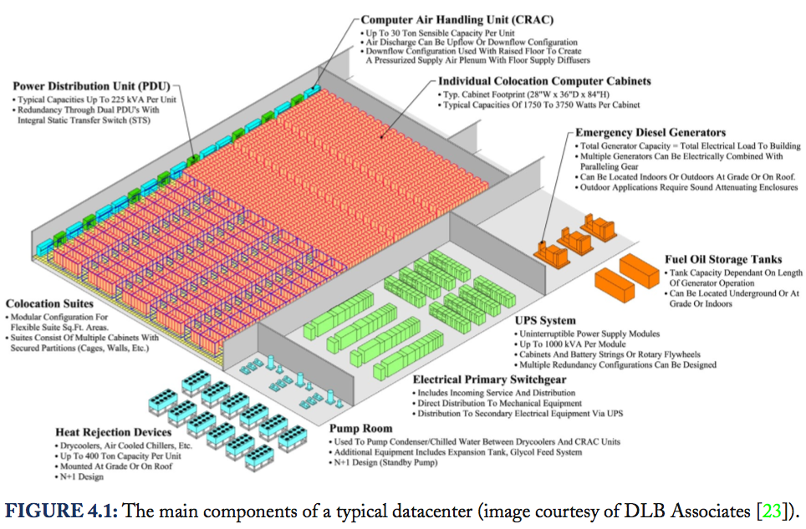
Datacenter as a Computer
Notes:
Power enters first at a utility substation (not shown) which transforms high voltage (typically 110 kV and above) to medium
voltage (typically less than 50 kV). Medium voltage is used for site-level distribution to the primary distribution centers (also known as unit substations) which include the primary switchgear and medium-to-low voltage transformers (typically below 1000 V).
From here, the power enters the building with the low-voltage lines going to the uninterruptible power supply (UPS) systems. The UPS switchgear will also take a second feed (at the same voltage) from a set of diesel generators that will cut in when utility power fails. In any case, the output lines from the UPS system are finally routed to the datacenter floor where they are connected to Power Distribution Units (PDUs). PDUs are the last layer in the transformation/distribution architecture and route individual circuits to the computer cabinets.

Slide 9
Warehouse-Scale Computer (WSC)
Different from HPC “clusters” (e.g., Top 500):
Clusters have higher performance processors and network
Clusters solve one problem for a small team
Clusters emphasize thread-level parallelism, while WSCs emphasize request-level parallelism
Different from traditional datacenters:
Datacenters consolidate different machines and software into one location → a co-location facility
Datacenters emphasize virtual machines and hardware heterogeneity in order to serve varied customers
Datacenters are often singly managed for many clients with specialized needs, different (specific) requirements
Broad scope: multiple, standard OSs and application suites

Slide 10
WSC vs Data Center vs HPC Cluster vs Server
Homogeneous
Heterogeneous
WSC
Data
Center
High latency
Low bandwidth
Low latency
High bandwidth
High quality
Expensive components
Server
HPC
Cluster

Slide 11
Design Factors for WSC
Cost-performance (i.e., work done/$)
A WSC infrastructure can cost $150 M, a 10% reduction in capital cost saves $15 M → small savings add up
Energy efficiency
Power distribution and cooling are critical
Work done per joule has to be maximized due to scaling
Dependability via redundancy:
At least 99.99% availability: down less than one hour/year
Multiple servers and WSCs for redundancy
Network I/O: inter and intra WSC
Interactive (search, social) and batch processing (indexing) workloads
Just like server
architecture
Notes:
Networking is needed to keep data consistent between multiple WSCs and to interface to the public

Slide 12
Design Factors for WSC
Ample parallelism: finding parallelism is non-issue
Data-level parallelism: independent processing on data
Software as a Service: millions of independent users → request-level parallelism: no coordinate or synchronize
Operational costs count
WSCs have longer lifetimes: building, electrical/cooling are amortized over 10 or more years → op. costs add up, e.g., energy, power distribution, cooling > 30% cost over 10 yr
Scale and its opportunities and problems
Can afford to build customized systems since WSC require volume purchase
Flipside: failures
Unlike server
architecture
Notes:
Servers are designed for peak performance within a cost budget and power is considered to not exceed the cooling capacity of the enclosure

Slide 13
Outline
Programming models and workloads for warehouse-scale computers (Sec. 6.2)
Computer architecture of warehouse-scale computers (Sec. 6.3)
Physical infrastructure and costs of warehouse-scale computers (Sec. 6.4)
Could computing: the return of utility computing (Sec. 6.5)

Slide 14
Characteristics of Internet Services
Ample parallelism:
Internet services often have large amount of parallelism stemming from both data- and request-level parallelism
The problem is not to find parallelism but to manage and efficiently harness the explicit parallelism
Data parallelism: from the large data sets of relatively independent records that need substantial processing → can hide or tolerate comm. and synch. overheads
Request-level parallelism: from huge amount of requests per second received, which rarely involve read–write sharing of data or synchronization across requests → computation can be easily partitioned both within a request and across different requests
Notes:
These very large data sets often require significant computation for each parallel (sub) task, which in turn helps hide or tolerate communication and synchronization overheads
The computation can be easily partitioned both within a request and across different requests.

Slide 15
Characteristics of Internet Services
Workload churn:
Users of Internet services are isolated from the service’s implementation details by relatively well-defined and stable high-level APIs (e.g., simple URLs)
Easier to deploy new software quickly, e.g., weekly cycle
By hundreds of developers making thousands of independent code changes per week
Good for rapid product innovation but hard for system designers to extract useful benchmarks and workload mix → potentially affecting the optimal design point of WSCs
Hardware need not strive for good performance for immutable pieces of code, but consider software rewrites to take advantage of new hardware capabilities or devices

Slide 16
Characteristics of Internet Services
Platform homogeneity:
Internet services typically require a small number of hardware and system software configurations → a more homogeneous target for software development
Homogeneity simplifies cluster-level scheduling and load balancing and reduces maintenance burden for platforms software (kernels, drivers, etc.)
Homogeneity allows more efficient supply chains and repair processes (e.g., having more experience with fewer types of systems)

Slide 17
Characteristics of Internet Services
Fault-free operation:
Internet services run on clusters of thousands of machines → fault is expected every few hours or less
Internet services need to work in an environment where faults are part of daily life
Ideally, system software should provide a layer that hides most of fault complexity from application-level software

Slide 18
Software Layers of WSC
Platform-level software:
Common firmware, kernel, OS distribution, libraries that are present in individual servers to abstract the hardware of a single machine and provide basic server-level services
Cluster-level infrastructure:
Software that manages resources and provides services at cluster level, e.g., distributed file systems, RPC libraries, programming models (MapReduce, Hadoop, BigTable, …) → OS of the datacenter
Application-level software:
Software that implements a specific service: online services (search, mail), offline computations (build index)

Slide 19
Platform-Level Software
Similar to that on a regular server platform
But, firmware, drivers, or OS can be simplified
HW homogeneity with fewer combinations of devices allows streamline firmware and driver and testing
WSC server is deployed in a relatively well-known environment, leading to further optimizations, e.g., networking is within same building and incur low losses
Virtualization is now popular in WSCs
Provides portable interface to manage security and performance isolation and to perform live migration, e.g., allowing infrastructure to be upgraded or repaired without impacting a user’s computation

Slide 20
Cluster-Level Infrastructure Software
OS of a WSC
Resource management: controls mapping of user tasks to HW resources, enforces priorities and quotas, considers power limitations and energy usage optimization
Hardware abstraction and basic services: e.g., reliable distributed storage, message passing, and cluster-level synchronization as reusable modules or services
Deployment and maintenance: e.g., software image distribution, configuration management, monitoring and debugging and optimization
Programming frameworks: e.g., MapReduce and BigTable improve programmability by automatically handling data partitioning, distribution, fault tolerance

Slide 21
Programming Models
Most prevalent programming model: MapReduce
Embarrassingly parallel operations performed on very large datasets, e.g., search on a keyword, aggregate a count over several documents
Application writer provides Map and Reduce functions that operate on key-value pairs
Hadoop:
An open-source implementation of the MapReduce framework; makes it easy for users to write MapReduce programs without worrying about low-level task/data management

Slide 22
Programming Models
Map: operates on a collection of records
A record is (say) a webpage or a facebook user profile
The records are in the file system and scattered across several servers
Thousands of map functions are spawned on thousands of computers to work on all records in parallel
Provides new set of key-value pairs as intermediate values
Reduce: aggregates and sorts the results produced by the Mappers, also performed in parallel

Slide 23
Hadoop: MapReduce Open Source
Hadoop jobs consist of two types of tasks:
Map and Reduce tasks
Reduce tasks can only start when all map tasks have finished
Hadoop cluster:
Compute nodes: where map and reduce tasks execute
Each compute node has a number of slots for the execution of map and reduce tasks
Each compute node has a TaskTracker daemon that monitors the execution of map and reduce tasks

Slide 24
MapReduce Model
M: number of map tasks of a job
k: number of map slots per worker node
c: number of compute nodes
n = k x c concurrent tasks

Slide 25
WordCount Example
Goal: count the number of occurrences of each word in a large file
Approach:
File is broken down into a large number of chunks
Each map task takes a chunk from the file and breaks it into words and emits a (key, value) pair consisting of the word and a value of “1”
The reduce tasks add the number of “1”s for each word and output the word and the sum

Slide 26
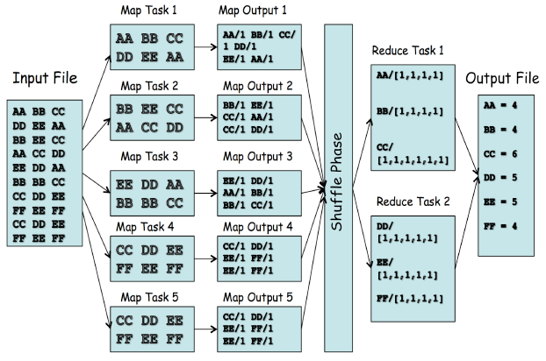
WordCount: Data Flow

Slide 27
WordCount: Simplified Code
map(String key, String value):
// key: doc name; value: doc contents
for each word w in value
EmitIntermediate(w,”1”);
// Produce list of all words
reduce(String key, Iterator values):
// key: a word; value: list of counts
int result = 0;
for each v in values:
result += ParseInt(v);
Emit(AsString(result));
Notes:
Calculate the number of occurrences of every English word in a large collection of documents
Show only the inner loop and assume just one occurrence of all English words found in a document
ParseInt(): gets the number of occurrences per word for each document

Slide 28
MapReduce Execution
MapReduce runtime manages MapReduce jobs
Assigns MAP tasks to nodes based on how fast the nodes execute → balances the load
Replicates execution of tasks and lets the nodes race
Improves completion time but (somewhat) waists resources
Counteracts hardware failures by rerunning failed tasks
Provides stable storage
e.g., Google File System, Dynamo (Amazon), Big Table
Replicates data
Using erasure coding for more efficient storage
Improves resilience and performance
Delivers storage consistency
Deals with variability in utilization (maybe 100% change)

Slide 29
Outline
Programming models and workloads for warehouse-scale computers (Sec. 6.2)
Computer architecture of warehouse-scale computers (Sec. 6.3)
Physical infrastructure and costs of warehouse-scale computers (Sec. 6.4)
Could computing: the return of utility computing (Sec. 6.5)

Slide 30
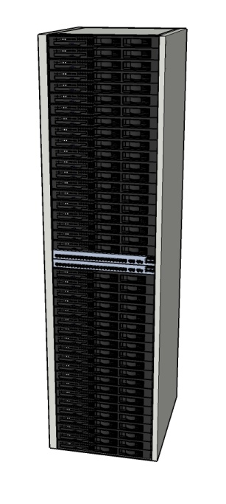
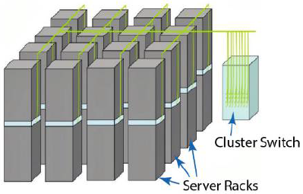
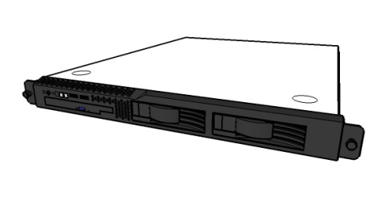
WSC Building Blocks
A datacenter contains one or more clusters, and has a network and a power topology
Server: 1¾“ high (1U) x 19” wide x 16-20” (e.g., 8 cores, 16 GB DRAM, 4x1 TB disk)
Cluster: 16-32 server racks + larger LAN switch (“array switch”)
Rack: 40-80 servers + Ethernet switch (“rack switch”)
Notes:
29
29

Slide 31
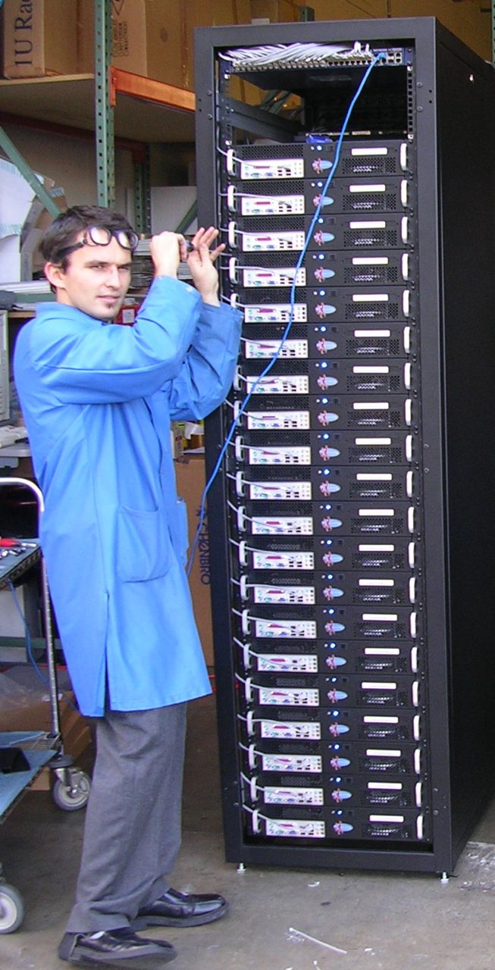
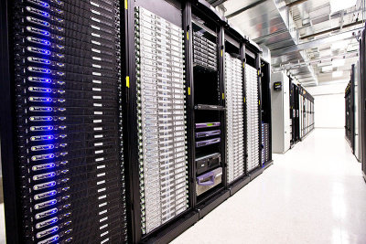
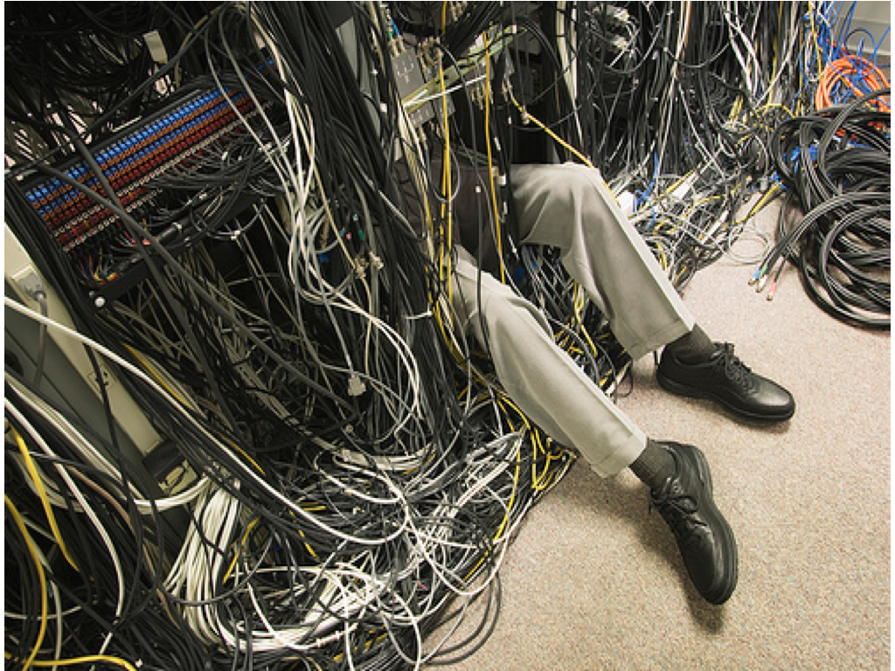
WSC Building Blocks
Server
Cluster
Rack

Slide 32
WSC Building Blocks
Low-end servers:
Typically in 1U (1¾“ high x 19” wide) or blade format
Rack:
Servers are mounted within a rack (typically 19” wide with 48 1U servers), interconnected with an Ethernet switch
Rack-level switches (1- or 10-Gbps links) have a number of uplink connections to one or more cluster-level (or datacenter-level) Ethernet switches
Cluster (or array):
A collection of server racks
The second-level, cluster-level switching domain can span more than ten thousand individual servers

Slide 33
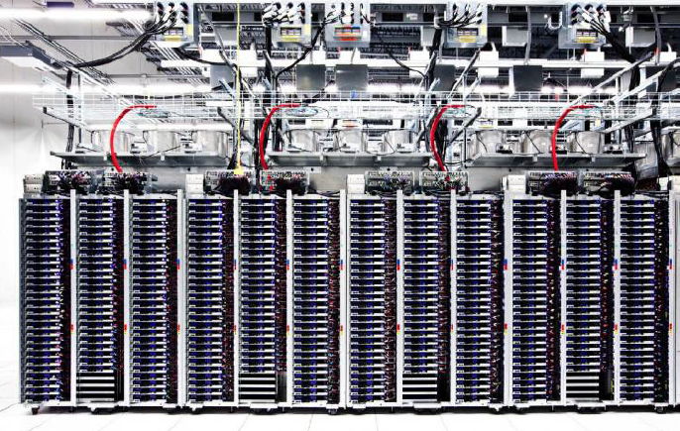
A Row of Servers in a Google WSC (2012)

Slide 34
Typical System Parameters
Lower latency to DRAM in another server than local disk
Higher bandwidth to local disk than to DRAM in another server
 | Local | Rack | Array
Racks | -- | 1 | 30
Servers | 1 | 80 | 2400
Cores (Processors) | 8 | 640 | 19,200
DRAM Capacity (GB) | 16 | 1,280 | 38,400
Disk Capacity (GB) | 4,000 | 320,000 | 9,600,000
DRAM Latency (microseconds) | 0.1 | 100 | 300
Disk Latency (microseconds) | 10,000 | 11,000 | 12,000
DRAM Bandwidth (MB/sec) | 20,000 | 100 | 10
Disk Bandwidth (MB/sec) | 200 | 100 | 10

Slide 35
WSC Building Blocks
A rack switch is used for communication within and out of a rack
A cluster switch connects a cluster of racks
Latency grows if data is fetched from remote DRAM or disk
Bandwidth within a rack is much higher than between racks
Hence, software must be aware of data placement and locality

Slide 36
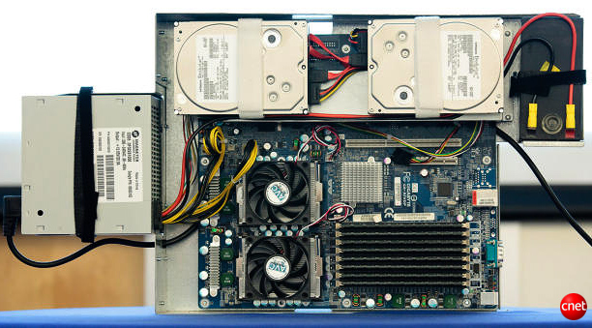
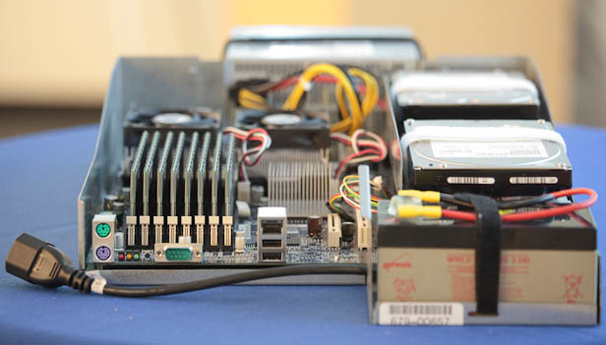
Google Has Its Own Way: Server (2009)
Fig. 6.21
(http://news.cnet.com/8301-1001_3-10209580-92.html#ixzz0yo8bhTOH)
Notes:
The power supply is on the left and the two disks are on the top. The two fans below cover the two sockets of the AMD microprocessor, each with two cores, running at 2.2 GHz. The 8 DIMMs in the lower right each hold 1 GB, giving a total of 8 GB. There is no extra sheet metal, as the servers are plugged into the battery and a separate plenum is in the rack for each server to help control the airflow. In part because of the height of the batteries, 20 servers fit in a rack.
Most companies buy servers from the likes of Dell, Hewlett-Packard, IBM, or Sun Microsystems. But Google, which has hundreds of thousands of servers and considers running them part of its core expertise, designs and builds its own. Ben Jai, who designed many of Google's servers, unveiled a modern Google server before the hungry eyes of a technically sophisticated audience.
Google's big surprise: each server has its own 12-volt battery to supply power if there's a problem with the main source of electricity. The company also revealed for the first time that since 2005, its data centers have been composed of standard shipping containers--each with 1,160 servers and a power consumption that can reach 250 kilowatts.
It may sound geeky, but a number of attendees--the kind of folks who run data centers packed with thousands of servers for a living--were surprised not only by Google's built-in battery approach, but by the fact that the company has kept it secret for years. Jai said in an interview that Google has been using the design since 2005 and now is in its sixth or seventh generation of design.
Read more: http://news.cnet.com/8301-1001_3-10209580-92.html#ixzz0yo8bhTOH

Slide 37
Storage Options
Connect disk/flash devices directly to each server
Managed by a global distributed file system, e.g., GFS, or
Use Network Attached Storage (NAS) devices directly connected to cluster-level switching fabric
Comparisons:
NAS may be simpler to deploy by outsourcing to vendor
NAS is easier to enforce QoS since it runs no compute jobs besides storage server
Direct disks reduce hardware costs (leveraging existing server enclosure)
Direct disks improve networking fabric utilization (each network port is dynamically shared between computing tasks and the file system)

Slide 38
Storage
Replication model between attached disks and NAS
NAS provides extra reliability through replication or error correction capabilities within each appliance
Desktop-class attached disk drives with GFS:
Low cost, but may not be designed for continuous operation
Replica across different machines (at least 3 replica), thus use more network bandwidth to complete write operations
Can keep data available even after the loss of an entire server enclosure or rack
Allow higher aggregate read BW because same data can be sourced from multiple replicas
Solid State Drives (SSDs) is becoming popular for databases in Web services for their very high IO rates
Notes:
Software approach to data reliability

Slide 39
Networking Fabric
Trade-off between speed, scale, and cost
1-Gbps Ethernet switches with 48 ports are commodity, less than $30/Gbps per server to connect a single rack
Uplink count varies (2-8) which gives oversubscription in terms of bandwidth (48/2 to 48/8)
Software scheduler should be aware of the difference and aim at mapping sender and receiver to the same rack
Switches with high port counts to connect WSC clusters are 10 times more expensive than commodity switches
Therefore the networking of WSCs is often organized as a two-level hierarchy
Also need to trade off between spending on networking vs. on buying more servers or storage

Slide 40
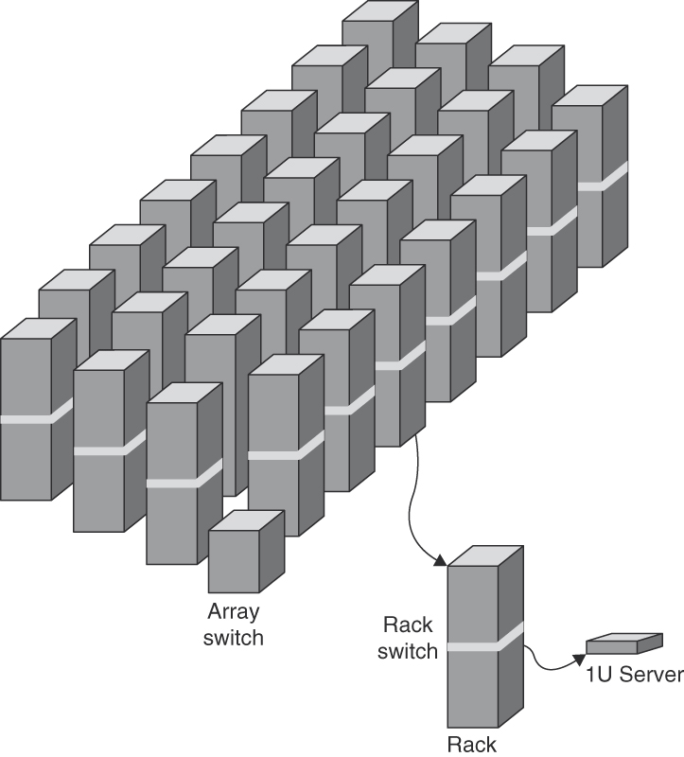
Two-Level Hierarchy of Switches in a WSC
Such a hierarchical structure in turn affects programmers’ view of memory and storage
Fig. 6.5

Slide 41
Programmers’ View of Memory
A server consists of a number of processor sockets, each with a multicore CPU and its internal cache hierarchy, local shared DRAM, and a number of directly attached disk drives
A rack has DRAM and disk resources, accessible through the first-level rack switches (assuming some sort of remote procedure call API to them)
A cluster has accesses to all resources in all racks via the cluster-level switch
The relative balance of various resources depends on the needs of target applications

Slide 42
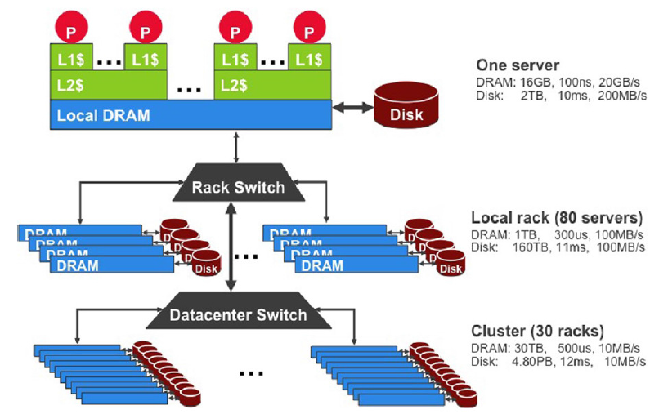
Storage Hierarchy

Slide 43
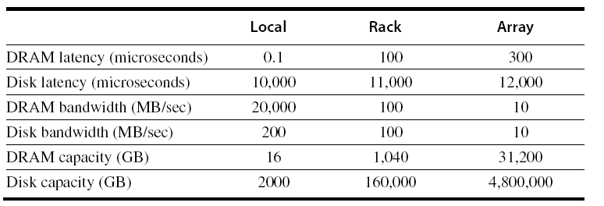
WSC Memory Hierarchy
Servers can access DRAM and disks on other servers using a NUMA-style interface
Fig. 6.6
Notes:
Assumptions:
A server contains (1) 16 GB of memory with a 100-ns access time and transfers at 20 GB/sec and (2) 2 TB of disk that offers a 10 ms access time and transfers at 200 MB/sec. There are two sockets per board and they share one 1 Gb/sec Ethernet port.
Every pair of racks includes one rack switch and holds 80 2U servers. Networking software plus switch overhead increases the latency to DRAM to 100 ms and disk access latency to 11 ms. The total storage capacity of a rack is roughly 1 TB of DRAM and 160 TB of disk. The 1 Gb/sec Ethernet limits the remote BW to DRAM or disk within the rack to 100 MB/sec.
The array switch can handle 30 racks, so storage capacity of an array goes up to a factor of 30: 30 TB of DRAM and 4.8 PB of disk. The array switch HW and SW increases latency to DRAM within an array to 500 ms and disk latency to 12 ms. The BW of the array switch limits the remote BW to array DRAM or disk to 10 MB/sec.

Slide 44
WSC Memory Hierarchy – Example I
What is the average latency assuming that 90% of accesses are local to the server, 9% are outside the server but local to the rack , and 1% are outside the rack but within the array (cluster)?
(90%x0.1)+(9%x100)+(1%x300)=12.09 msec

Slide 45
WSC Memory Hierarchy – Example II
How long does it take to transfer 1000MB between disks within the server, between servers in the rack, and between servers in different racks of an array?
Within server: 1000/200=5 sec
Within rack: 1000/100=10 sec
Within array: 1000/10= 100 sec

Slide 46
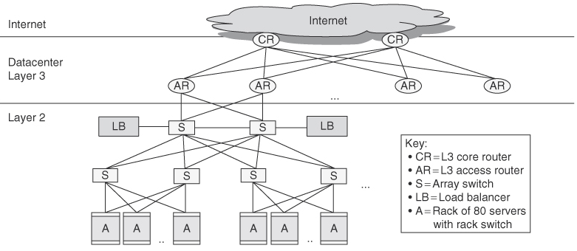
A Layer 3 Network for Linking Clusters
To connect 50,000 servers, the WSC needs 20 clusters → one more level of networking hierarchy
Fig. 6.8

Slide 47
Implications of Memory Hierarchy
Applications must deal effectively with the large discrepancies in latency, bandwidth, and capacity → making it difficult to program a WSC
A challenge for architects of WSCs is to smooth out these discrepancies in a cost-efficient manner
Another challenge is to build cluster infrastructure and services that hide most of this complexity from application developers
Flash offers a viable option for bridging the cost and performance gap between DRAM and disks, especially for random reads (3 orders of magnitude)

Slide 48
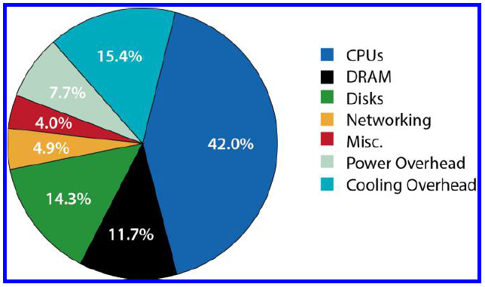
Power Usage
Example breakdown of peak power usage of a datacenter using 2012 generation servers
Assumes two-socket x86 servers, 16 DIMMs and 8 disk drives per server, and an average utilization of 80%
Notes:
First, sophisticated thermal management have allowed CPUs to run closer to their maximum power envelope, resulting in higher energy consumption per CPU socket.
Second, memory technology shifted away from power hungry FBDIMMs to DDR3 systems with better energy management.
Third, DRAM voltage has dropped from 1.8 V down to 1.5 V and below.
Finally, today’s systems have a higher ratio of CPU performance per gigabyte of DRAM, possibly a result of a more challenging technology scaling roadmap for main memory.

Slide 49
Outline
Programming models and workloads for warehouse-scale computers (Sec. 6.2)
Computer architecture of warehouse-scale computers (Sec. 6.3)
Physical infrastructure and costs of warehouse-scale computers (Sec. 6.4)
Could computing: the return of utility computing (Sec. 6.5)

Slide 50
Warehouse for WSCs
Building(s) to house computing and storage infrastructure in a variety of networked formats
Deliver the utilities needed by housed equipment and personnel, e.g., power, cooling, shelter, and security
Location considerations: proximity to ...
Internet backbone optical fibers, low cost electricity, low risk of environment disasters (earthquakes, floods, hurricanes, …), geographical vicinity of large population of users, real estate deals and low property taxes
Main design challenge and costs: delivery of input energy (power distribution) and removal of waste heat (cooling)

Slide 51
Datacenter Power and Cooling System
Notes:
Power enters first at a utility substation (not shown) which transforms high voltage (typically 110 kV and above) to medium
voltage (typically less than 50 kV). Medium voltage is used for site-level distribution to the primary distribution centers (also known as unit substations) which include the primary switchgear and medium-to-low voltage transformers (typically below 1000 V).
From here, the power enters the building with the low-voltage lines going to the uninterruptible power supply (UPS) systems. The UPS switchgear will also take a second feed (at the same voltage) from a set of diesel generators that will cut in when utility power fails. In any case, the output lines from the UPS system are finally routed to the datacenter floor where they are connected to Power Distribution Units (PDUs). PDUs are the last layer in the transformation/distribution architecture and route individual circuits to the computer cabinets.

Slide 52
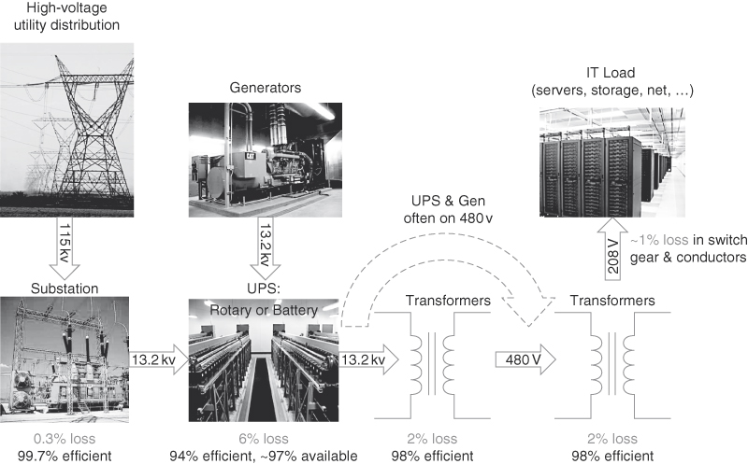
Power Distribution
Room for improvement is 11%
Fig. 6.9

Slide 53
Power Distribution
High voltage lines at utility tower: 115 kv
Substation switches 115 kv to 13.2 kv
UPS (Uninterruptable Power Supply) with generators
Power conditioning, holding electrical load while generators start and come on line, and switching back to the electrical utility
Take a large space and account for 7% to 12% IT cost
PDU (power distribution unit): convert to 480 v
One PDU unit handles around 10 racks
One more level conversion to 208 v for servers
Total efficiency:
99.7% x 94% x 98% x 98% x 99% = 89%

Slide 54
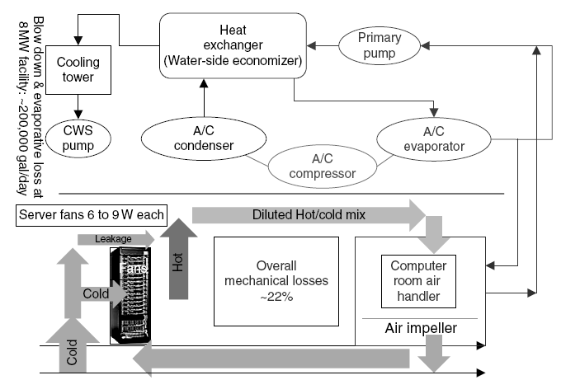
Cooling System
Notes:
CWS: circulating water system

Slide 55
Cooling System
Computer room air-conditioning (CRAC) units
Cools the air using chilled water
Fans push warm air past a set of coils filled with cold water, and a pump moves the warmed water to external chillers to be cooled down
e.g. 70,000 to 200,000 gallons per day for an 8 MW facility
Cool air typically between 18°C ~ 22°C
Improving energy efficiency
Keep temperature of IT equipment higher (closer to 22°C)
But increases failure rate and wear of components
Cooling tower can use the colder outside air to cool the water before it is sent to the chillers
Careful separation of cold and hot: alternating aisles
Notes:
Careful separation of cold and hot air helps with energy efficiency
Do not allow front of the server to face the back of another server

Slide 56
Typical Heat Management
CRAC unit
rack
rack
rack
rack
CRAC unit
floor tiles
Liquid supply

Slide 57
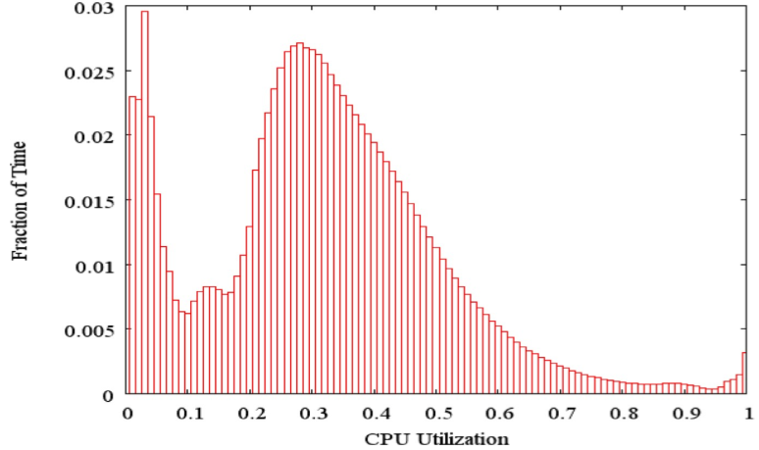
Improving Energy Efficiency
Unloaded servers dissipate large amount of power
Can approach energy-proportionality by turning on a few servers that are heavily utilized
Fig. 6.3
Notes:
Average CPU utilization of more than 5000 servers during a 6-month period at Google. Servers are rarely completely idle or fully utilized, instead operating most of the time at between 10% and 50% of their maximum utilization. (From Figure 1 in Barroso and Hölzle [2007].) The column the third from the right in Figure 6.4 calculates percentages plus or minus 5% to come up with the weightings; thus, 1.2% for the 90% row means that 1.2% of servers were between 85% and 95% utilized.

Slide 58
Costs of Cooling System
Power cost breakdown relative to IT equipment:
Chillers: 30-50% of the power used by the IT equipment
Air conditioning: 10-20% of IT power, mostly due to fans
How many servers can a WSC support?
Can get this number based on required power
Measure a single server under a variety of workloads
Divide available IT power by measured server power
Can oversubscribe cumulative server power by 40%, because not all servers running at peak at the same time
But need to monitor power closely

Slide 59
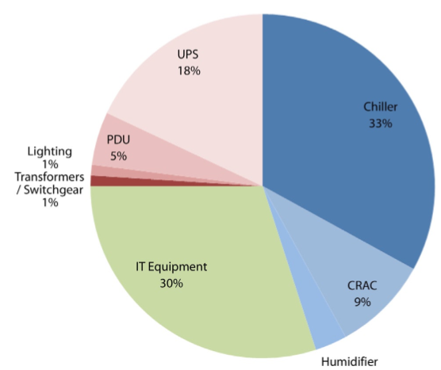
Measuring Energy Efficiency of a WSC
Power Utilization Effectiveness (PEU) = Total facility power / IT equipment power
PEU ↑ → less efficient
PEU > 1 (1.33 to 3.03 in 2006)
Median PUE: 1.69 → cooling power is roughly half the power used by servers

Slide 60
How to Improve Energy Efficiency?
Datacenter-level (PUE)
Use passive cooling (NCSA Blue Waters, UC Berkeley CRTF)
Avoid UPS devices (lower Tier level)
Avoid AC/DC conversion
Use green power (Icelandic model)
Rack-level (SPUE)
Avoid local power supplies
More efficient voltage regulation
Processor/process-level
Speed-variable processors
Embedded, low-power processors
Smarter parallelization/distribution of works
Notes:
Passive cooling is a building design approach that focuses on heat gain control and heat dissipation in a building in order to improve the indoor thermal comfort with low or nil energy consumption.^{[1][2]} This approach works either by preventing heat from entering the interior (heat gain prevention) or by removing heat from the building (natural cooling). Natural cooling utilizes on-site energy, available from the natural environment, combined with the architectural design of building components (e.g. building envelope), rather than mechanical systems to dissipate heat.^{[3]} Therefore, natural cooling depends not only on the architectural design of the building but how it uses the local site natural resources as heat sinks (i.e. everything that absorbs or dissipates heat). Examples of on-site heat sinks are the upper atmosphere (night sky), the outdoor air (wind), and the earth/soil.

Slide 61
Measuring Performance of a WSC
Latency is important metric because users concern
Users’ satisfaction and productivity are tied to response time of a service
User productivity = 1 / time of interaction t(interaction) = t(human entry) + t(system response) + t(analysis of response)
t(response) reduced by 30% → 70% less t(interaction), because people think continuously when not interrupted by a long delay
Bing study: users use search ↓ as response time ↑
200 ms longer delay → 500 ms longer time to next click
Revenue and user satisfaction drops linearly with increasing delay

Slide 62
Primary Concern: User Satisfaction
Based on Internet studies...
Page load above few tens of milliseconds cause user to switch to another task
Page load time must be below 1s or it is deemed broken
Users do not come back
Quantifying influence of response delays
Use % requests below a latency threshold instead of avg.
SLO (Server Level Objective), SLA (Server Level Agreement)
Example: 99% of requests must be below 100 ms delay
Amazon's Dynamo: 99.9% of key-value request must be below a threshold
Which is more important: average case or the tail (diminishing return)?
Notes:
Dynamo is the name given to a set of techniques that when taken together can form a highly available key-value structured storage system or a distributed data store. It has properties of both databases and distributed hash tables (DHTs).

Slide 63
Reliability and Availability
Reliability (MTTF) & Availability (MTTF/MTTF+MTTR) are very important, given the large scale
MTTF: mean time to failure
MTTR: mean time to repair
A server with MTTF of 25 years ➔ 50K servers would lead to 5 server failures a day
Annual disk failure rate of 2-10% ➔ 1 disk failure per hour

Slide 64
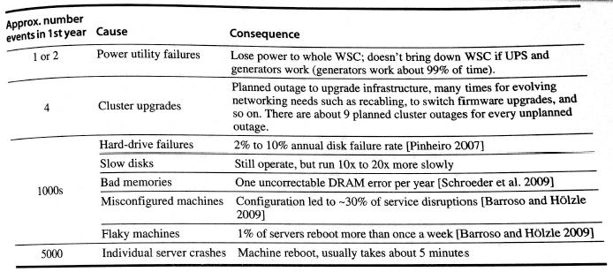
Outages and Anomalies
Approximate frequencies of outages and anomalies in the first year of a new cluster of 2400 servers
Fig. 6.1

Slide 65
Outages and Anomalies Example
Calculate the availability of a service running the 2400 servers in Fig. 6.1, assuming
Service cannot tolerate software or hardware failures
Reboot time= 5 minutes
Hardware repair time= 1 hour
Ignore slow disks and power utility failures
All events have equal probability
Hours outage = 1192 hours = (4+250+250+250) x 1hr + (250+5000) x 5min
Availability = (365x24-1192)/8760 = 86% → service down average 1 day per week
Notes:
(Cluster upgrades:4 x Hard-drive failures:250 x Bad memories: 250 x Misconfigured machines: 250) x 1 hr +
(Flaky machines: 250 + Machine reboots:250) x 5 min

Slide 66
Cost of a WSC
Capital expenditures (CapEx)
Infrastructure costs for the building, power delivery, cooling, and servers, i.e., cost to build a WSC
Operational expenditures (OpEx)
Cost to operate a WSC, e.g., monthly bill for energy, failures, personnel, etc.
CapEx can be amortized into a monthly estimate
E.g., assume facilities will last 10 years, server parts will last 3 years, and networking parts will last 4 years
Estimates of CapEx and OpEx give an idea of where to invest to cut costs: software, hardware, infrastructure
Notes:
(monthly cost of power and cooling infrastructure: $765K + monthly cost of power use:$475K) / (facility size in watts: 8M) x 12
= $1.86 ➔ To reduce costs by saving energy, you should not spend more than $2 per watt-year!

Slide 67
CapEx/OpEx Case Study
8 MW facility → cost $88M 46,000 servers → cost $67M $13M for networking equipment PUE: 1.45
Monthly expense: $3.8M
Servers 53% (amortized CapEx)
Networking 8% (amortized CapEx)
Power/cooling infrastructure 20% (amortized CapEx)
Other infrastructure 4% (amortized CapEx)
Monthly power bill 13% (true OpEx)
Monthly personnel salaries 2% (true OpEx)
(Fig. 6.13)
(Fig. 6.14)

