Slide 1
CS5102 High Performance Computer Systems Distributed Shared Memory
Prof. Chung-Ta King
Department of Computer Science
National Tsing Hua University, Taiwan
(Slides are from textbook, Prof. O. Mutlu, Prof. Hsien-Hsin Lee, Prof. K. Asanovic,
http://compas.cs.stonybrook.edu/courses/cse502-s14/)

Slide 2
Outline
Introduction
Centralized shared-memory architectures (Sec. 5.2)
Distributed shared-memory and directory-based coherence (Sec. 5.4)
Synchronization: the basics (Sec. 5.5)
Models of memory consistency (Sec. 5.6)

Slide 3
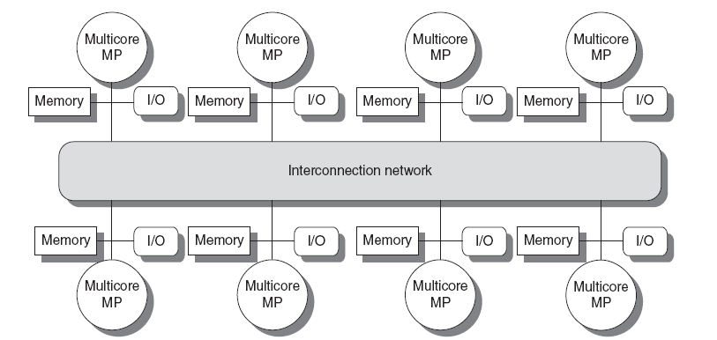
Distributed Shared Memory (DSM)
Non-uniform memory access (NUMA) architecture
Memory distributed among processors, logically shared
All processors can directly access all memory
Can use scalable point-to-point interconnection networks → no single point of coordination → simultaneous communications
PE
PE
PE
PE
R
R
R
R
PE
PE
PE
PE
R
R
R
R
PE
PE
PE
PE
R
R
R
R
PE
PE
PE
PE
R
R
R
R

Slide 4
Can snoopy protocol work for cache coherence on DSM?
Broadcast
Write propagation and write serialization?

Slide 5
Races in DSM
Consider a DSM with a mesh interconnection NW
Different caches (PEs) will see different orders of writes
Races due to network
P
Mem
st X,0
$
NI
PE
PE
PE
PE
X
1
R
R
R
R
PE
PE
PE
PE
X
1
R
R
R
R
st X,2
PE
PE
PE
PE
R
X
1
R
R
R
PE
PE
PE
PE
R
R
R
R

Slide 6
Scalable Cache Coherence
We need a mechanism to serialize/order writes
Idea: instead of relying on interconnection network to provide serialization, ask a coordinate node → directory
PE
PE
PE
PE
X
1
R
R
R
R
PE
PE
PE
PE
X
1
R
R
R
R
PE
PE
PE
PE
R
X
1
R
R
R
Directory
PE
PE
PE
PE
R
X
R
R
R

Slide 7
Scalable Cache Coherence
Directory:
Single point of serialization, one entry for one block
An entry tracks cached copies (sharer set) for each block
Processors make requests for blocks through directory
Directory coordinates invalidation appropriately and communicate only with processors that have copies
e.g. P1 asks directory for exclusive copy, directory asks all sharers to invalidate, waits for ACKs, then responds to P1
Communication with directory and copies is through network transactions but is independent of the network, as long as it provides point-to-point communications
Directory can be centralized or distributed

Slide 8
Directory-based Cache Coherence
Directory tracks who has what
Every memory block has an entry in the directory
HW overhead for the directory (~ # blocks * # nodes)
Can work with UMA SMP, too!
P
P
P
P
$
$
$
$
Interconnection Network
Memory
(Centralized)
Directory
Modified bit
Presence bits, one for each node

Slide 9
Directory-based Cache Coherence
P
P
P
P
P
$
$
$
$
$
Interconnection Network
(Centralized)
Directory
Memory
0
1
0
0
0
1
1
0
C(k)
1
0
1
0
0
0
0
0
C(k+1)
0
0
1
0
0
0
0
1
C(k+j)
1 modified bit for each cache block in memory
1 presence bit for each processor, each cache block in memory

Slide 10
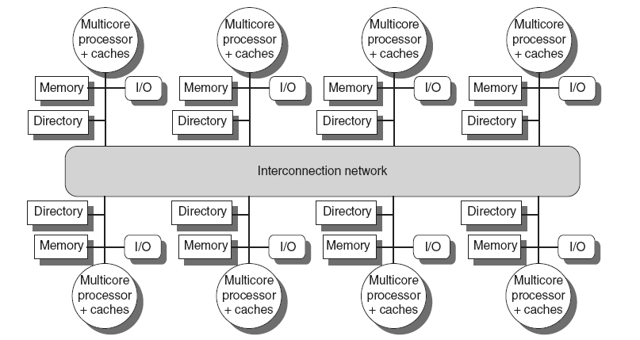
Distributed Directory Cache Coherence
Distributed directories track local memory to maintain cache coherence (CC-NUMA)
Assumptions: reliable network, FIFO message delivery between any given source-destination pair

Slide 11
Directory Coherence Protocol: Read Miss
Every memory block has a “home” node, where its directory entry resides
Home node can be calculated from block address
P₀
Read Z (missed)
P_{n-1}
P_{n}
$
$
$
Z
Block Z is
shared (clean)
Z
Home of Z
Memory
Memory
Memory
Z
0
1
1
1
0
Go to Home Node
Interconnection Network

Slide 12
Directory Coherence Protocol: Read Miss
Block Z is dirty (“Modified” in P_{n-1})
Block Z is now clean, “Shared” by 3 nodes (M→S)
P₀
Read Z (missed)
P_{n-1}
P_{n}
$
$
$
Z
Z
Memory
Memory
Memory
Z
1
0
0
1
1
0
1
Go to Home node
Interconnection Network
Ask Owner
Reply to the request node
Reply block
Notes:
Design choice: who is responsible for sending the up-to-date copy to the requesting node?

Slide 13
Directory Coherence Protocol: Write Miss
P₀ can now write to block Z (I→M)
P₀
Write Z (missed)
P_{n-1}
P_{n}
X
X
$
$
$
Z
Z
Z
Memory
Memory
Memory
Z
0
1
0
1
1
0
1
0
Go to Home Node
Interconnection Network
Reply block
Invalid sharers
Ack
Notes:
Design choice: who invalidate other caches, directory or requesting node?

Slide 14
Directory: Basic Operations
Follow semantics of snoop-based system (MSI)
but with explicit request and reply messages
Directory:
Receives Read, ReadEx requests from nodes
Sends Invalidate messages to sharers if needed
Forwards request to memory if needed
Replies to requestor and updates sharing state
Protocol design is flexible
Exact forwarding paths depend on implementation, e.g. directory node or requesting node perform all bookkeeping operations?
Must not have race conditions

Slide 15
A Possible 4-hop Implementation
L has a cache read miss on a load instruction
H is the home node
R is the current owner of the block, who has the most up-to-date data for that block, which is in the Modified state
State: M Owner: R
1: Read Req
2: Recall Req
L
H
R
4: Read Reply
3: Recall Reply

Slide 16
A Possible 3-hop Implementation
L has a cache read miss on a load instruction
H is the home node
R is the current owner of the block, who has the most up-to-date data for that block, which is in the Modified state
State: M Owner: R
1: Read Req
2: Fwd’d Read Req
L
H
R
3: Fwd’d Read Ack
3: Read Reply

Slide 17
Example Cache States
For each block, a home directory maintains its state:
Shared: one or more nodes have the block cached, value in memory is up-to-date
Modified: exactly one node has a dirty copy of the cache block, value in memory is out-of-date
May add transient states to indicate the block is waiting for previous coherence operations to complete
Caches in the nodes also need to track the state (e.g. MSI) of the cached blocks
Nodes send coherence messages to home directory
Home directory only sends messages to nodes that care

Slide 18
Operations in Directory (MSI)
For uncached block:
Read miss: requesting node is sent the requested data and is made the only sharing node, block is now shared in directory and in requesting node
Write miss: the requesting node is sent the requested data and becomes the owner node, block is now modified in directory and in requesting node

Slide 19
Operations in Directory (MSI)
For shared block:
Read miss: the requesting node is sent the requested data from memory, node is added to sharing set and block is shared in directory and in requesting node
Write miss: the requesting node is sent the block, all nodes in the sharing set are sent invalidate messages, sharing set now only contains requesting node, block is now modified in directory and in requesting node

Slide 20
Operations in Directory
For modified block:
Read miss: the owner is sent a data request message, block becomes shared, owner replies the block to the directory, block written back to memory, sharers set now contains old owner and requestor, block is shared in directory and in requesting node
Write miss: the owner is sent an invalidation message, requestor becomes new owner, block remains modified in directory and in requesting node
Data write back: the owner replaces and writes back the block, block becomes uncached, sharer set is empty

Slide 21
Read Miss to Uncached or Shared Block
CPU
Load request at head of CPU->Cache queue.
Update cache tag and data and return load data to CPU.
1
9
Load misses in cache.
Cache
2
Send ReadReq message to directory.
ReadReply arrives at cache.
8
3
Interconnection Network
Message received at directory controller.
Send ReadReply message with contents of cache block.
7
4
Directory Controller
Update directory by setting bit for new processor sharer.
DRAM Bank
6
Access state and directory for block. Block’s state is S, with 0 or more sharers
5
Notes:
Delay is a fact of life
Serialization by directory, no longer the bus
SC not guarantied

Slide 22
Write Miss to Read Shared Block
CPU
CPU
Multiple sharers
CPU
CPU
Store request at head of CPU->Cache queue.
Update cache tag and data, then store data from CPU
1
Invalidate cache block. Send InvRep to directory.
12
Store misses in cache.
Cache
Cache
2
Cache
ExRep arrives at cache
Cache
InvReq arrives at cache.
Send ReadReqX message to directory.
3
11
8
7
Interconnection Network
ReadReqX message received at directory controller.
When no more sharers, send ExRep to cache.
10
4
InvRep received. Clear down sharer bit.
9
Directory Controller
Send one InvReq message to each sharer.
6
DRAM Bank
Access state and directory for block. Block’s state is S, with some set of sharers
5
Notes:
Delay is a fact of life
Serialization by directory, no longer the bus
SC not guarantied

Slide 23
Directory: Data Structures
Key operation to support is set inclusion test
False positives are OK: want to know which caches may contain a copy of a block, and spurious invalidations are ignored
False positive rate determines performance
Most accurate (and expensive): full bit-vector
Compressed representation, linked list, Bloom filters are all possible
Directory
Modified bit
Presence bits, one for each node

Slide 24
Issues with Contention Resolution
May have concurrent transactions to cache blocks
Can have multiple requests in flight to same cache block!
Need to escape race conditions by:
NACKing requests to busy (pending invalidate) entries
Original requestor retries
OR, queuing requests and granting in sequence
(Or some combination thereof)
Fairness
Which requestor should be preferred in a conflict?
Interconnect network delivery order, and distance, both matter

Slide 25
An Example Race: Writeback and Read
L has dirty copy, wants to write back to H
R concurrently sends a read to H
Races require complex intermediate states
Race! WB and Fwd Rd
No need to ack
Race!
Final State: S
No need to Ack
State: M Owner: L
1: WB Req
2: Read Req
L
6:
H
R
4:
3: Fwd’d Read Req
5: Read Reply

Slide 26
Hybrid Snoopy and Directory
Stanford DASH (4 CPUs per cluster, total 16 clusters)
Invalidation-based cache coherence
Keep one of 3 states of a cache block at its home directory
Uncached, shared (unmodified state), dirty
P
P
P
P
$
$
$
$
Memory
Memory
Memory
Memory
Snoop bus
Snoop bus
Directory
Directory
Interconnection Network

Slide 27
Snoopy vs. Directory Coherence
Snoopy
+ Miss latency (critical path) is short
+ Global serialization is easy: bus arbitration
+ Simple: adapt bus-based uniprocessors easily
- Relies on broadcast seen by all caches (in same order):
→ single point of serialization (bus): not scalable
Directory
- Adds miss latency: request → dir. → mem.
- Requires extra storage space to track sharer sets
- Protocols and race conditions are more complex
+ Does not require broadcast to all caches
+ Exactly as scalable as interconnect and directory storage
Notes:
Make reference to SGI Origin paper

