Slide 1
CS5100 Advanced Computer Architecture Graphics Processing Units
Prof. Chung-Ta King
Department of Computer Science
National Tsing Hua University, Taiwan
(Slides are from textbook, Prof. O. Mutlu, D. Sanchez, J. Emer, P. Cozzi, D. Luebke, T. Thorne,
http://www.es.ele.tue.nl/~heco/courses/EmbeddedComputerArchitecture/GPU.ppt)

Slide 2
Outline
Introduction to parallel processing and data-level parallelism (Sec. 4.1)
Vector architecture (Sec. 4.2)
SIMD instruction set extensions (Sec. 4.3)
Graphics processing units (Sec. 4.4)
Introduction to graphics pipeline
CUDA programming model
GPU architectures
Detecting and enhancing loop-level parallelism (Sec. 4.5)

Slide 3
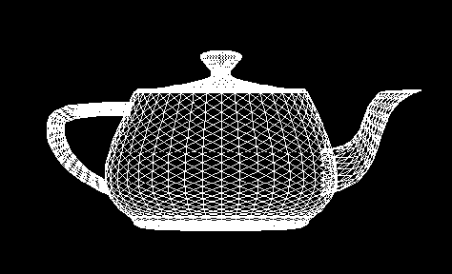

Computer Graphics Processing
Computer graphics require many stages of processing, which can be implemented as a pipeline
Computer graphics concern with the pixels drawn on the screen and thus are data parallel in nature
Geometric objects (in triangles)
Properties: color, textual, …
Move camera and objects around
Pixels
Frame Buffer
Graphics pipeline

Slide 4

A High-Level View of Graphics Pipeline
CPU
GPU
Application Processing
Geometry Processing
Rasterization
(Pixel pipeline or fragment pipeline)
(Vertex pipeline)

Slide 5
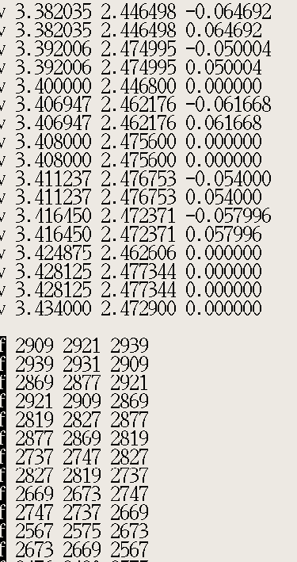
Application Stage
Read data
3D models from world geometry database
Commonly represented as triangles in 3D with attributes, e.g. color, normal vector, texture, transparency
Vertices of triangles are the primary data to operate on
User’s input by mouse, sensing gloves, … → changes the view or scene

Slide 6
Geometry Stage
Transforming objects
Model and view transformation
Illumination and shading (for vertices)
Loaded 3D Models
Model and View Transformation
Projection Transformation
Hidden Surface Elimination
Shading: reflection and lighting

Slide 7
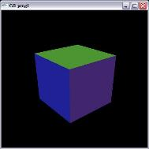
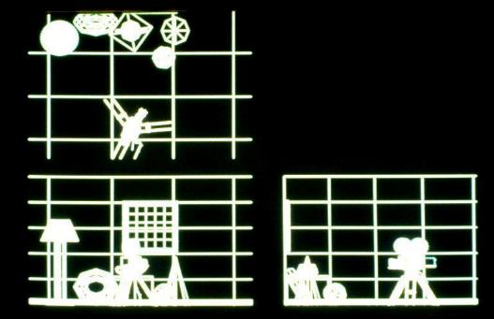
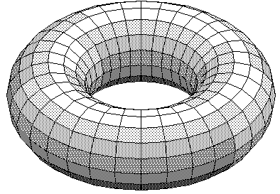
Geometry Stage: Model Transformation
Put objects into the scene to required position, size, orientation by applying translation, scaling, rotation
Locations of all vertices are updated

Slide 8
Geometry Stage: View Transformation
Transforming the scene such that the view point is at the origin, viewing direction is aligned with the negative Z axis and the view-up vector is aligned with the positive Y axis
Uses rotation and translation

Slide 9
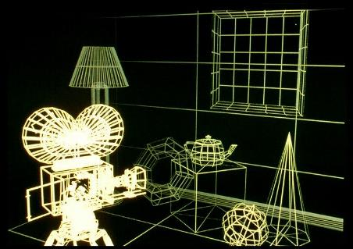
Geometry Stage: Perspective Projection
Create a picture of scene viewed from the camera
Apply a perspective transformation to convert the 3D coordinates to 2D coordinates of the screen
Objects far away appear smaller, closer objects bigger
-Z
Y
X
near
far

Slide 10
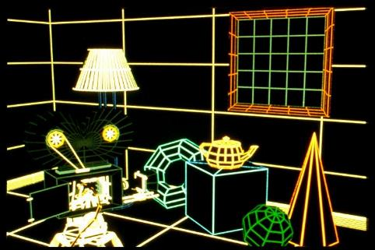
Geometry Stage: Hidden Surface Removal
Objects hidden by other objects must NOT be drawn
Clipping
Not everything should be visible on the screen
Any vertices that lie outside of the viewing volume are clipped

Slide 11

Geometry Stage: Shading
Decide the colour of each vertex of object taking into account the object’s colour, lighting condition and the camera position
point light source
Object

Slide 12
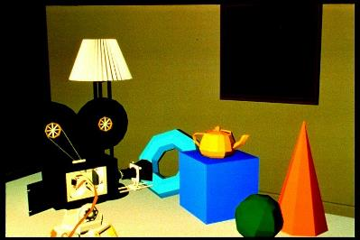

Geometry Stage: Coloring and Lighting
Objects coloured based on its own colour and the lighting condition
One colour for one face
Lighting calculation per vertex

Slide 13
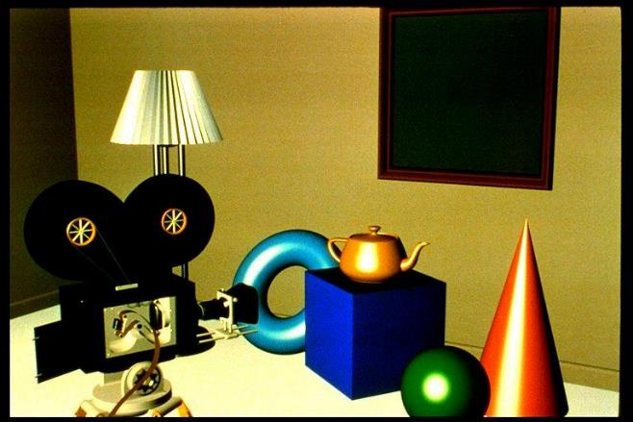
Geometry Stage: Coloring and Lighting
Light reflected in a mirror-like way

Slide 14
Rasterization Stage
Geometry
Rasterization and Sampling
Pipeline
Texture Mapping
Image Composition
Intensity and Colour Quantization
Frame Buffer/Display

Slide 15

Rasterization Stage: Rasterization
Converts the vertex information output by the geometry pipeline into pixel information needed by the video display
Generating pixels in the scan (horizontal) line order (top to bottom, left to right)
Pixel + associated data: color, depth, stencil, etc.
Interpolate per-vertex quantities across pixels

Slide 16


Rasterization Stage: Texture Mapping
Add other effects, e.g., reflections, shadows

Slide 17
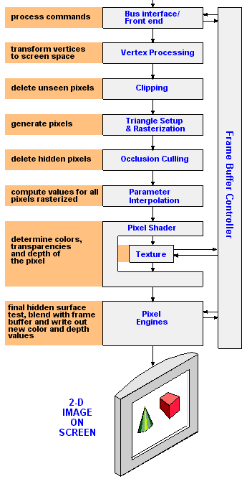
Putting it Together
Vertex processing: convert each vertex into a 2D screen position, apply lighting for its color
Primitive assembly and triangle setup: collect vertices and convert them into triangles
Rasterization: fill triangles with pixels known as "fragments“
Occlusion culling: removes pixels that are hidden by other objects in the scene
Parameter interpolation: compute values for each pixel that were rasterized based on color, fog, texture, etc.
Pixel shader: adds textures and final colors to the fragments
Pixel engines: combine final pixel color, its coverage and degree of transparency
http://www.pcmag.com/encyclopedia/term/43933/graphics-pipeline

Slide 18
GPU Evolution
Till mid-90s
VGA controllers used to accelerate some display functions
Mid-90s to mid-2000s
Fixed-function accelerators for OpenGL and DirectX APIs
3D graphics: triangle setup and rasterization, texture mapping, shading
Modern GPUs
Programmable multiprocessors optimized for data-parallelism for both geometric and rasterization
OpenGL/DirectX and general purpose languages (CUDA, OpenCL, …)
From GPU to GPGPU (general-purpose computing on GPU)

Slide 19
Outline
Introduction to parallel processing and data-level parallelism (Sec. 4.1)
Vector architecture (Sec. 4.2)
SIMD instruction set extensions (Sec. 4.3)
Graphics processing units (Sec. 4.4)
Introduction to graphics pipeline
CUDA programming model
GPU architectures
Detecting and enhancing loop-level parallelism (Sec. 4.5)

Slide 20
Programming GPU
Need a programming model that can handle a large number of triangles and pixels, all are operated on by the same operations
A suitable programming abstraction is multithreading, one thread for each triangle/pixel
CUDA (Compute Uniform Device Architecture)
Expresses DLP in terms of TLP
Host (typically CPU) and device (typically GPU) interact through command buffer
GPU reads commands from here
Pending GPU commands
CPU writes commands here

Slide 21
CUDA Program
Contains both host and device code
Device code is enclosed in C functions called kernels
Example: matrix addition
void MatAdd(float A[N][N],float B[N][N],float C[N][N]) {
for(int i = 0; i < N; i++)
for(int j = 0; j < N; j++)
C[i][j] = A[i][j] + B[i][j];
}
int main() {
...
MatAdd(A, B, C);
...
}
Sequential version

Slide 22
Matrix Addition: CUDA Code
// Kernel definition
__global__ void MatAdd(float A[N][N], float B[N][N],
float C[N][N]) {
int i = threadIdx.x;
int j = threadIdx.y;
C[i][j] = A[i][j] + B[i][j];
}
int main() {
...
// Kernel invocation with 1 block of N*N*1 threads
int numBlocks = 1;
dim3 threadsPerBlock(N, N);
MatAdd<<<numBlocks, threadsPerBlock>>>(A, B, C);
...
}

Slide 23
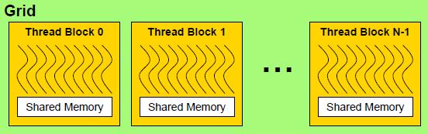
CUDA Programming Model
A kernel is executed by a grid of thread blocks
A thread block is a set of threads that can cooperate with each other through shared memory
All threads run the same code: extremely lightweight, very little creation overhead, fast switching → data parallel
Each thread has an ID that it uses to compute memory addresses for data and make control decisions
Hardware converts TLP into DLP at run time

Slide 24
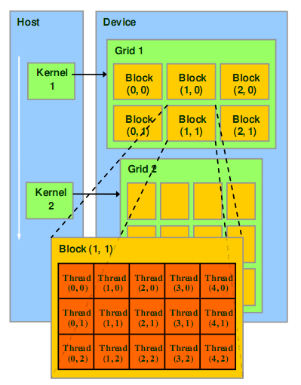
CUDA Programming Model
One kernel is executed at a time
Multidimensional thread organization:
Block ID: 1D or 2D
Thread ID: 1D, 2D, or 3D
Specified by execution configuration: <<<BlocksPerGrid, threadsPerBlock>>>

Slide 25
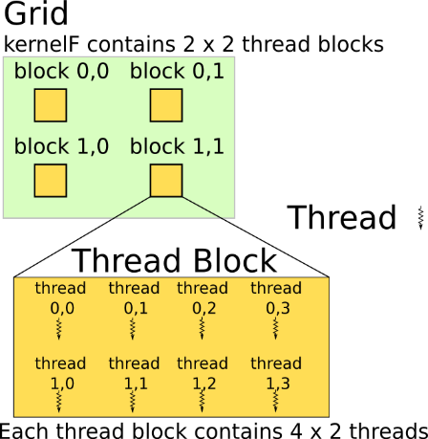
Thread Organization
Example: both grid and thread block have 2D index
kernelF<<<(2,2),(2,4)>>>(A);
__device__ kernelF(A){
i = blockDim.x * blockIdx.x
+ threadIdx.x;
j = blockDim.y * blockIdx.y
+ threadIdx.y;
A[i][j]++;
}
2 × 4

Slide 26
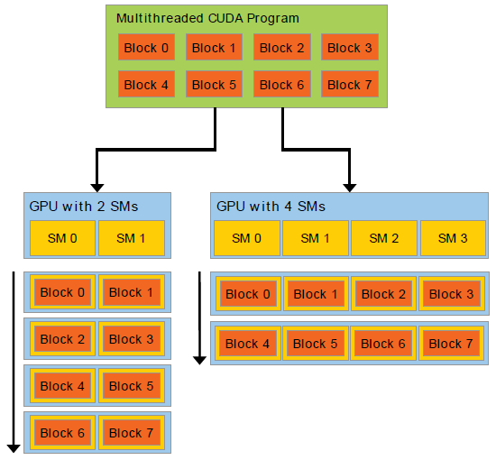
Thread Block Scheduling
Thread blocks are executed independently
Allows thread blocks to be scheduled in any order across any number of cores
Hardware is free to schedule thread blocks on any processor

Slide 27
Outline
Introduction to parallel processing and data-level parallelism (Sec. 4.1)
Vector architecture (Sec. 4.2)
SIMD instruction set extensions (Sec. 4.3)
Graphics processing units (Sec. 4.4)
Introduction to graphics pipeline
CUDA programming model
GPU architectures
Detecting and enhancing loop-level parallelism (Sec. 4.5)

Slide 28
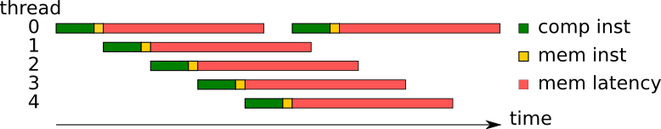
CUDA Multithreading
Basic programming model of CUDA: multithreading
data parallel → one thread (same code) for one data
How to make use of the huge number of threads?
Latency hiding to simplify hardware:
Granularity of thread interleaving (context switch time):
100 cycles: hide off-chip memory latency
10 cycles: + hide cache latency
1 cycle: + hide branch latency, instruction dependency

Slide 29
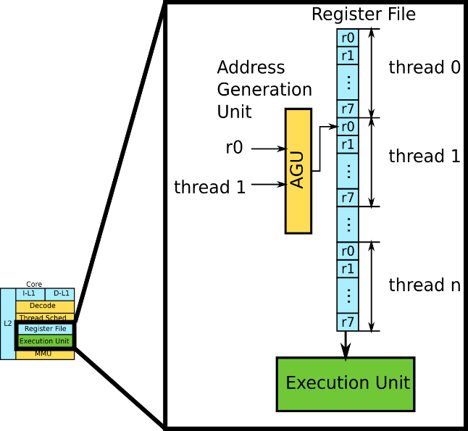
Hardware Support for Multithreading
Multiple thread contexts stored in HW registers
Register file supports zero overhead context switch between interleaved threads
Notes:
The address assignment and translation is done dynamically by hardware.

Slide 30
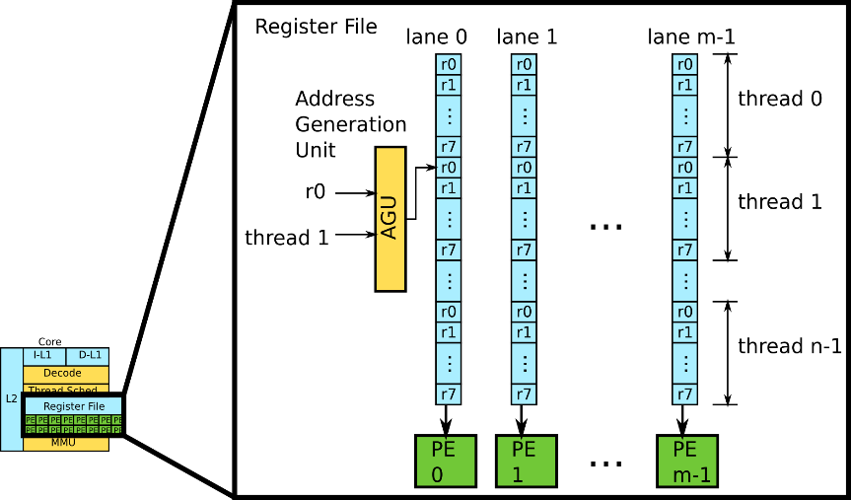
Data Lanes to Form Array Processing
Replicate to handle large number of triangles/pixels → array proc.
All PEs execute same instruction
PC 0
PC 1
...
PC n-1
Notes:
From scalar to vector.

Slide 31
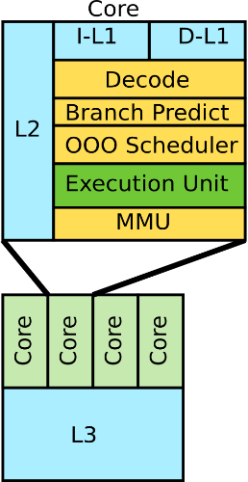
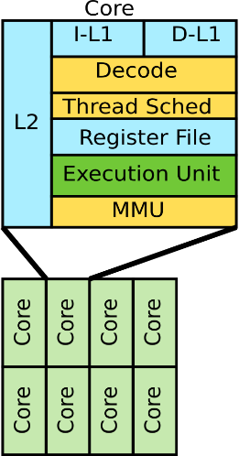
With and Without Multithreading
Pros:
reduce cache size,
no branch predictor,
no OOO scheduler
Cons:
register pressure,
thread scheduler,
require huge parallelism
Very high computation density

Slide 32
Multithreading in Array Processors
All PEs run same instruction but on different data (SIMD)
The m concurrent threads form a warp (in CUDA)
To hide memory latency, n warps are executed in an interleaved fashion
The m×n threads form a thread block
Register values of all threads stay in register file
No OS context switching
Warps available
Thread Warp 3
Thread Warp 8
for scheduling
Thread Warp 7
SIMD Pipeline (PE)
I-Fetch
Decode
R
R
R
F
F
F
Warps accessing
A
A
A
memory hierarchy
L
L
L
U
U
U
Miss?
D-Cache
Thread Warp 1
All Hit?
Data
Thread Warp 2
Writeback
Thread Warp 6
Slide credit: Tor Aamodt
Notes:
Warp can be grouped at run time by hardware. In this case it will be transparent to the programmer.
With a large number of shader threads multiplexed on the same execution resources, our architecture employs fine-grained multithreading, where individual threads are interleaved by the fetch unit to proactively hide the potential latency of stalls before they occur. As illustrated by Figure, warps are issued fairly in a round-robin queue. When a thread is blocked by a memory request, shader core simply removes that thread’s warp from the pool of “ready” warps and thereby allows other threads to proceed while the memory system processes its request.
With a large number of threads (1024 per shader core) interleaved on the same pipeline, FGMT effectively hides the latency of most memory operations since the pipeline is occupied with instructions from other threads while memory operations complete. also hides the pipeline latency so that data bypassing logic can potentially be omitted to save area with minimal impact on performance. simplify the dependency check logic design by restricting each thread to have at most one instruction running in the pipeline at any time.

Slide 33
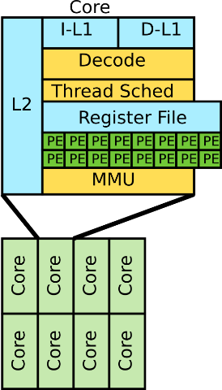
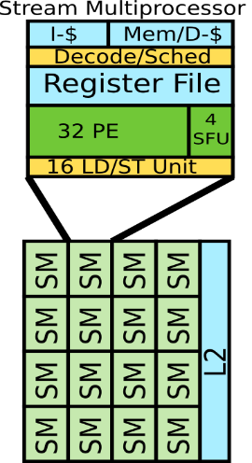
Array Processors in Multicore
Duplicate cores for multicore
Simplify thread scheduler
Stream Multiprocessor (SM) in CUDA terms
SFU: Special Function Unit
Notes:
The NVIDIA Fermi PE can do int and fp.

Slide 34
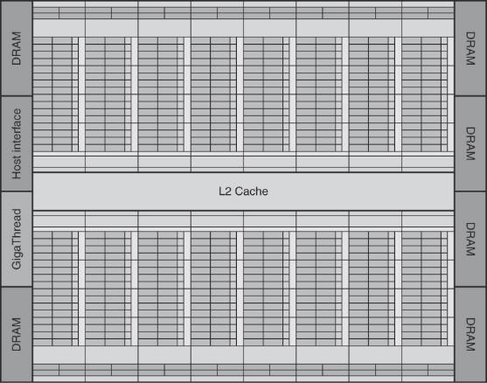
Putting It Altogether
NVIDIA Fermi GTX 480 GPU
16 SMs, executing a grid of thread blocks
6 GDDR5 ports, each 64 bits, supporting up to 6 GB of capacity
Host Interface: PCI Express 2.0
Plus fixed graphics functions
Fig. 4.15

Slide 35
Now You Know the Reasons Why …
Thread blocks must be independent
Any possible interleaving of blocks should be valid
presumed to run to completion without pre-emption
can run in any order, concurrently OR sequentially
Thread blocks may not synchronize
Threads in different blocks cannot cooperate
Threads within a block may cooperate via shared memory, because they are allocated to the same SM
Several blocks can reside concurrently on one SM
Number is limited by SM resources
Registers are partitioned among all resident threads
Shared memory is partitioned among all resident blocks
Notes:
CUDA threads in a thread block may be scheduled to different warps by hardware and they may be executed in an interleaved fashion. However, they all can communicate with each other through shared memory.

Slide 36
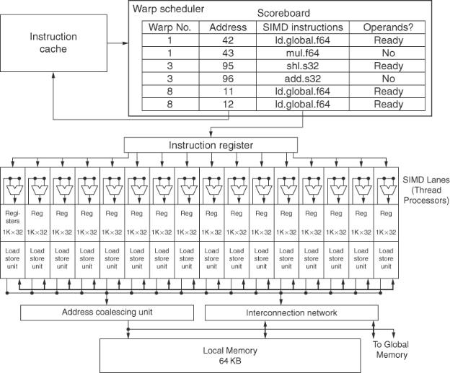
An Example Stream Multiprocessor (SM)
Called Multithreaded SIMD Processor in the textbook
16 PEs (SIMD Lanes)
48 threads of SIMD instructions
Fig. 4.14

Slide 37
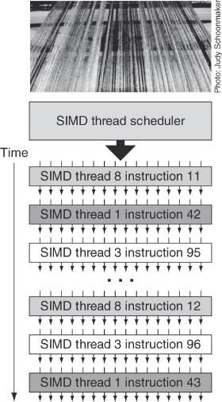
Thread Scheduling
Among SMs: Thread block scheduler (like a control processor) schedules thread blocks to SMs (multithreaded SIMD processors)
Inside a SM: SIMD thread scheduler uses scoreboard to track which SIMD thread is ready and dispatch those threads
Can do flexible scheduling policies, from fine-grain to coarse-grain
For Fermi:
Each 32-wide thread of SIMD instructions (a warp with 32 CUDA threads) is executed by 16 physical SIMD Lanes (PEs) → each SIMD instruction takes 2 cycles
Fig. 4.16

Slide 38
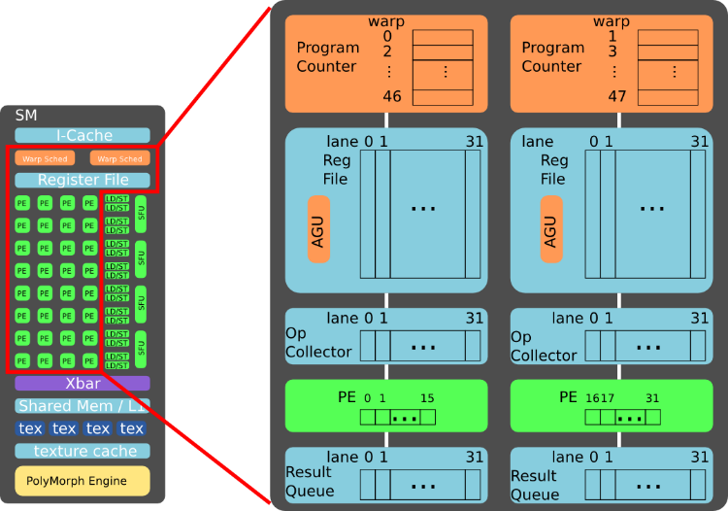
Example Implementation
Notes:
This example assumes the two warp schedulers are decoupled. It is possible that they are coupled together, at the cost of hardware complexity.

Slide 39
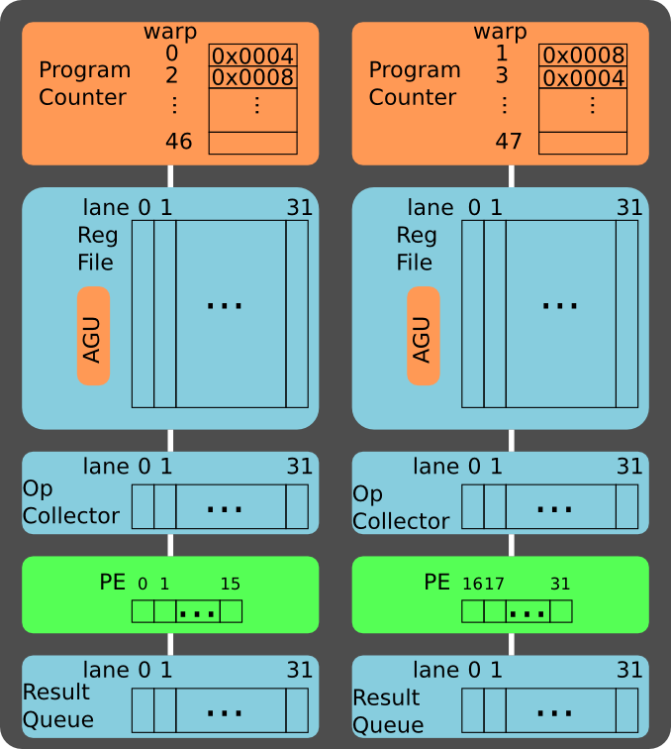
Example
Program Address: Inst
0x0004: add r0, r1, r2
0x0008: sub r3, r4, r5
Assume warp 0 and warp 1 are scheduled for execution

Slide 40
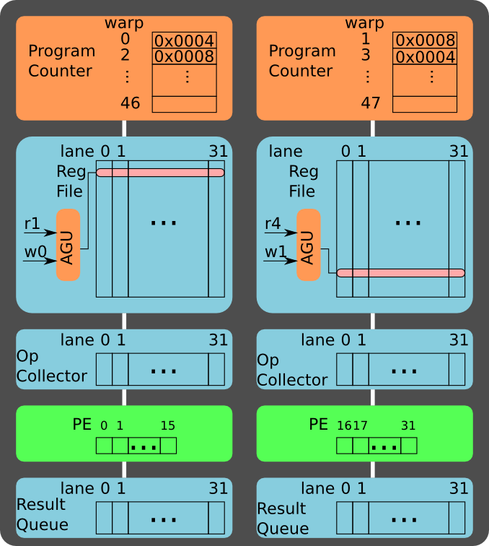
Read Src Op
Program Address: Inst
0x0004: add r0, r1, r2
0x0008: sub r3, r4, r5
Read source operands:
r1 for warp 0
r4 for warp 1
Notes:
Assume the register file has one read port.
The register file may need two read port to support instructions with 3 source operands, e.g. the Fused Multiply Add (FMA).

Slide 41
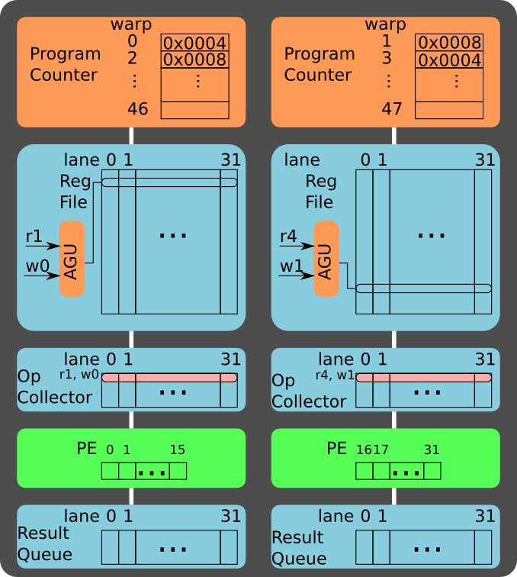
Buffer Src Op
Program Address: Inst
0x0004: add r0, r1, r2
0x0008: sub r3, r4, r5
Push ops to op collector:
r1 for warp 0
r4 for warp 1

Slide 42

Read Src Op
Program Address: Inst
0x0004: add r0, r1, r2
0x0008: sub r3, r4, r5
Read source operands:
r2 for warp 0
r5 for warp 1

Slide 43
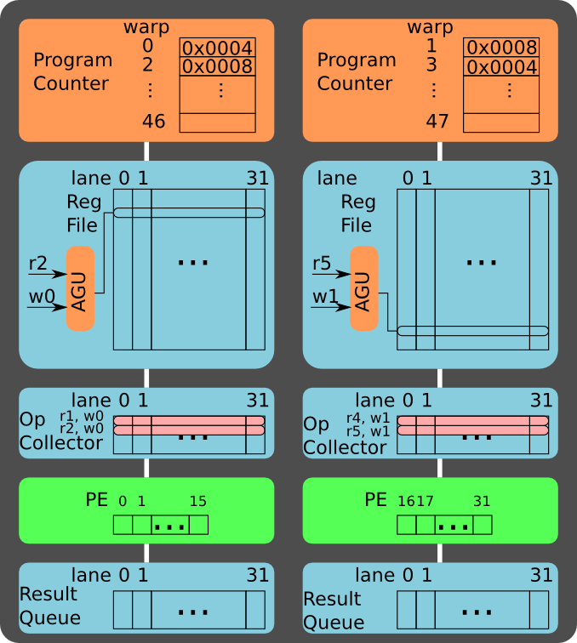
Buffer Src Op
Program Address: Inst
0x0004: add r0, r1, r2
0x0008: sub r3, r4, r5
Push ops to op collector:
r2 for warp 0
r5 for warp 1

Slide 44
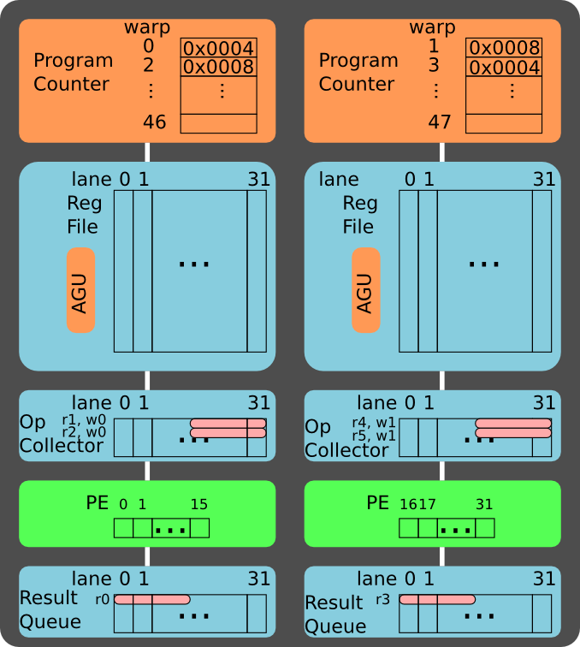
Execute
Program Address: Inst
0x0004: add r0, r1, r2
0x0008: sub r3, r4, r5
Compute the first 16 threads in the warp

Slide 45
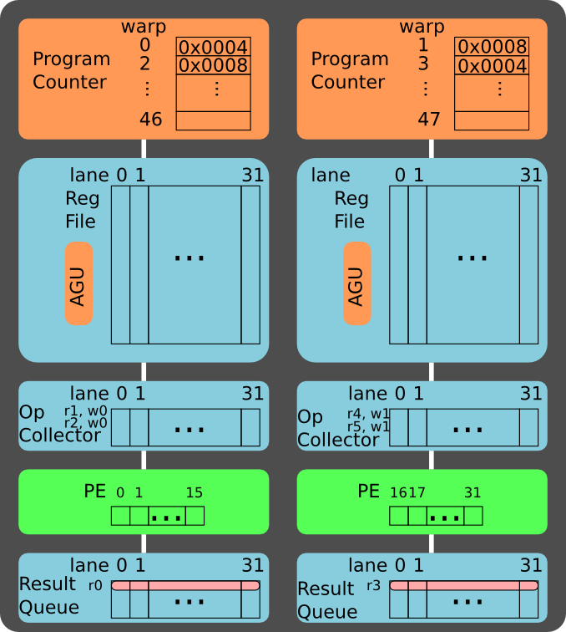
Execute
Program Address: Inst
0x0004: add r0, r1, r2
0x0008: sub r3, r4, r5
Compute the last 16 threads in the warp

Slide 46
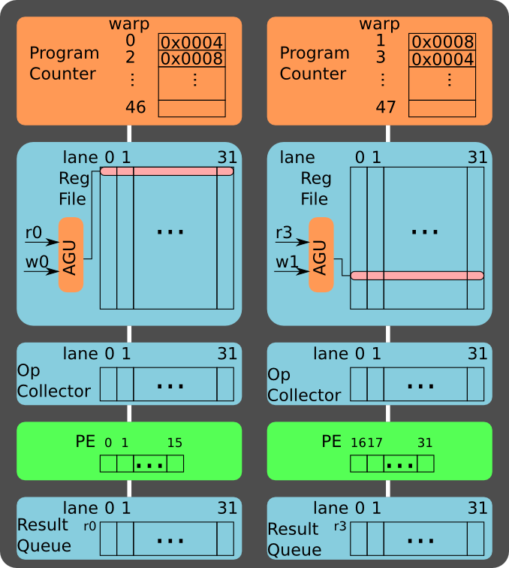
Write back
Program Address: Inst
0x0004: add r0, r1, r2
0x0008: sub r3, r4, r5
Write back:
r0 for warp 0
r3 for warp 1

Slide 47
Registers for Thread Contexts
Use the example Fermi
16 physical lanes (PEs), each with 2048 registers → 32768 32-bit registers in total → 2 MB
A SIMD thread (warp) operates on 32 CUDA threads → each lane must accommodate 2 CUDA threads
Each SIMD thread is limited to 64 registers
2048/64/2=16 SIMD threads (warps) can be interleaved
In practice, physical registers are allocated to SIMD threads dynamically and thus more SIMD threads may be accommodated if they do not use up to 64 registers

Slide 48
NVIDIA Instruction Set Architecture
PTX (Parallel Thread Execution)
Use virtual registers and compiler allocates physical reg.
Translation to machine code is performed in software
All instructions can be predicated by 1-bit predicate registers, which can be set by setp instruction
DAXPY example:
shl.s32 R8, blockIdx, 9 ; R8 = i =blockIdx.x*blockDim.x (512 or 2⁹)
add.s32 R8, R8, threadIdx ; R8 = i = my CUDA thread ID
ld.global.f64 RD0, [X+R8] ; RD0 = X[i]
ld.global.f64 RD2, [Y+R8] ; RD2 = Y[i]
mul.f64 RD0, RD0, RD4 ; Product in RD0 = RD0 * RD4 (scalar a)
add.f64 RD0, RD0, RD2 ; Sum in RD0 = RD0 + RD2 (Y[i])
st.global.f64 [Y+R8], RD0 ; Y[i] = sum (X[i]*a + Y[i])
Notes:
blockDim.x = 512 ➔ i = blockDim.x * blockIdx.x + threadIdx.x (i is in R8)

Slide 49
Control Flow Problem in GPUs
GPU uses SIMD pipeline to save area on control logic
Group scalar threads into warps
Branch divergence occurs when threads inside warps branch to different execution paths
Branch
Branch
Path A
Path A
Path B
Path B
Slide credit: Tor Aamodt

Slide 50
Branch Divergence Handling
Stack
A/1111
A
Reconv. PC
Next PC
Active Mask
TOS
TOS
TOS
TOS
-
-
-
-
-
-
-
G
A
E
E
B
E
E
1111
1111
1111
1111
1111
1111
1111
TOS
E
E
E
D
D
D
0110
0110
0110
B
B/1111
TOS
TOS
E
E
C
E
1001
1001
C
C/1001
D
D/0110
F
Thread Warp
Common PC
E
E/1111
Thread
1
Thread
2
Thread
3
Thread
4
G/1111
G
A
B
C
D
E
G
A
Time
Slide credit: Tor Aamodt

Slide 51
Conditional Branching
Similar to vector processors, but masks are handled internally
Per-warp stack stores PCs and masks of non-taken paths
On a conditional branch
Push the current mask onto the stack
Push the mask and PC for the non-taken path
Set the mask for the taken path
At the end of the taken path
Pop mask and PC for the non-taken path and execute
At the end of the non-taken path
Pop the original mask before the branch instruction
If a mask is all zeros, skip the block

Slide 52
CUDA Code for Branch Divergence
if (X[i] != 0) X[i] = X[i] – Y[i];
else X[i] = Z[i];
ld.global.f64 RD0, [X+R8] ; RD0 = X[i]
setp.neq.s32 P1, RD0, #0 ; P1 is predicate register 1
@!P1, bra ELSE1, *Push ; Push old mask, set new mask
; if P1 false, go to ELSE1
ld.global.f64 RD2, [Y+R8] ; RD2 = Y[i]
sub.f64 RD0, RD0, RD2 ; Difference in RD0
st.global.f64 [X+R8], RD0 ; X[i] = RD0
@P1, bra ENDIF1, *Comp ; complement mask bits
; if P1 true, go to ENDIF1
ELSE1: ld.global.f64 RD0, [Z+R8] ; RD0 = Z[i]
st.global.f64 [X+R8], RD0 ; X[i] = RD0
ENDIF1: <next instruction>, *Pop ; pop to restore old mask
Notes:
*Push, *Comp, *Pop are branch synchronization markers inserted by the PTX assembler

Slide 53
What About Memory Divergence?
All loads are gathers, all stores are scatters
SM address coalescing unit detects sequential and strided patterns, coalesces memory requests
Modern GPUs have caches, and ideally want all threads in the warp to hit (without conflicting with each other)
Problem: one thread in a warp can stall the entire warp if it misses in the cache
Need techniques to
Tolerate memory divergence
Integrate solutions to branch and memory divergence

Slide 54
NVIDIA GPU Memory Structures
Each SIMD Lane has private section of off-chip DRAM, called private memory
Contains stack frame, spilling registers, private variables
Rely on multithreading to hide long latencies
Each SM (multithreaded SIMD processor) also has on-chip local memory
Shared by SIMD lanes/threads within a block
Memory shared by SIMD processors is GPU memory
Host can read and write GPU memory

Slide 55
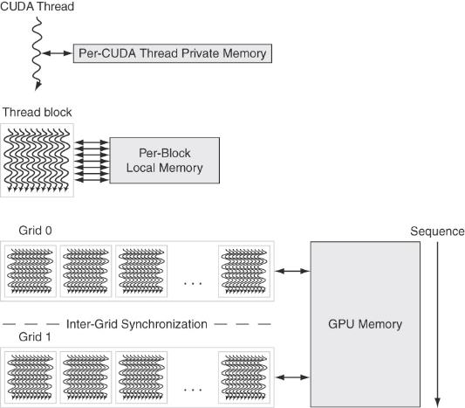
GPU Memory Structures
GPU Memory is shared by all grids
Local Memory is shared by all threads of SIMD instructions within a thread block
Private Memory is private to a single CUDA Thread
Fig. 4.18

Slide 56
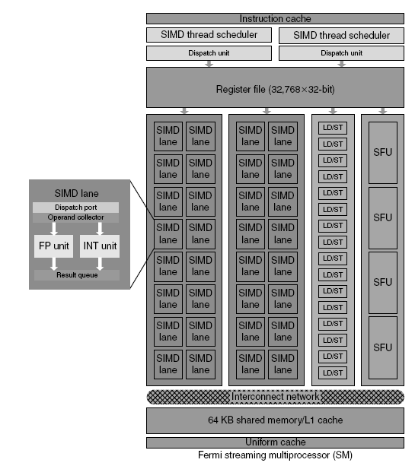
Fermi SM
Each SIMD Lane has a pipelined floating-point unit, a pipelined integer unit, some logic for dispatching instructions and operands to these units, and a queue for holding results. The four Special Function units (SFUs) calculate functions such as square roots, reciprocals, sines, and cosines.
Fig. 4.20

Slide 57
Summary: NVIDIA GPU Architecture
Similarities to vector machines:
Works well with data-level parallel problems
Scatter-gather transfers
Mask registers
Large register files
Differences:
No scalar processor
Uses multithreading to hide memory latency
Has many functional units, as opposed to a few deeply pipelined units like a vector processor

