Slide 1
CS5100 Advanced Computer Architecture Data-Level Parallelism
Prof. Chung-Ta King
Department of Computer Science
National Tsing Hua University, Taiwan
(Slides are from textbook, Prof. O. Mutlu, K. Asanovic, D. Sanchez, J. Emer)

Slide 2
Outline
Introduction to parallel processing and data-level parallelism (Sec. 4.1)
Vector architecture (Sec. 4.2)
Basic architecture
Enhancements
SIMD instruction set extensions (Sec. 4.3)
Graphics processing units (Sec. 4.4)
Detecting and enhancing loop-level parallelism (Sec. 4.5)

Slide 3
So far, We Have Studied ILP
Processors leverage parallel execution to make programs run faster, but it is invisible to programmer
Instruction level parallelism (ILP)
Instructions appear to be executed in program order (sequential semantics).
BUT independent instructions can be executed in parallel by a processor without changing program correctness
Dynamic scheduling: processor logic dynamically finds independent instructions in an instruction sequence and executes them in parallel
(Prof. Kayvon Fatahalian, CMU)

Slide 4
Diminishing Returns of Superscalar
Performance
Made sense to go
Superscalar/OOO:
good ROI
Very little gain for
substantial effort
“Effort”
Scalar
In-Order
Moderate-Pipe
Superscalar/OOO
Very-Deep-Pipe
Aggressive
Superscalar/OOO
(CSE502: Stony Brook University)

Slide 5
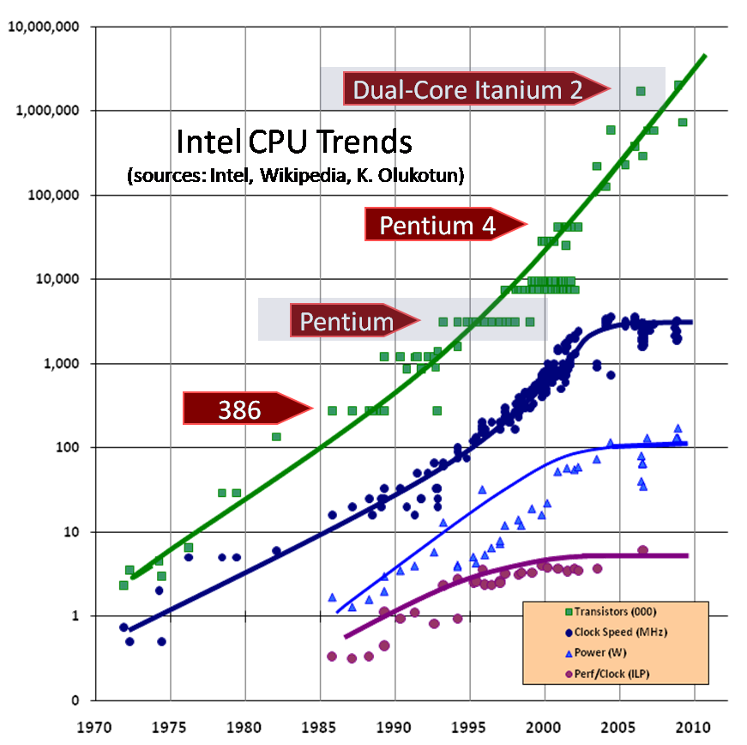
ILP Tapped out + End of Frequency Scaling
Processor clock rate stops increasing
No further benefit from ILP
(Prof. Kayvon Fatahalian, CMU)
(Image credit: “The free Lunch is Over”, by Herb Sutter, Dr. Dobbs 2005)

Slide 6
Why? The Power Wall
Per transistor:
Dynamic power ∝ capacitive load × voltage² × frequency
Static power: transistors burn power even when inactive due to leakage
High power = high heat
Power is a critical design constraint in modern processors
Single-core performance scaling
The rate of single-instruction stream performance scaling has decreased
Frequency scaling limited by power
ILP scaling tapped out
(Prof. Kayvon Fatahalian, CMU)

Slide 7
Why Parallelism?
The answer 10 years ago
To realize performance improvements that exceeded what CPU performance improvements could provide, e.g. supercomputing
The answer today:
It is the only way to achieve significantly higher application performance under the power constraint
No more free lunch for software developers!
Software must see and use underlying parallel hardware resources to get performance gains
Software (user, developer, compiler, run-time) responsible for finding parallelism and use resources
(Prof. Kayvon Fatahalian, CMU)

Slide 8
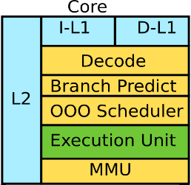
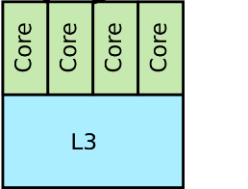
Parallelism Not Just 1 Core to m Cores
Although replicating multiple cores on a chip gives the maximum flexibility in computing and allows the most general computing to be carried out, there are many possibilities in the middle that can use more specific architectures to perform special types of computations

Slide 9
Types of Parallelism and How to Exploit
Instruction level parallelism
Different instructions within a stream executed in parallel
Pipelining, OOO execution, speculative execution, VLIW
Task level parallelism
Different applications: e.g. Browser & Office at same time
Threads within the same application: Java (scheduling, GC, etc...), explicitly coded multithreading, (pthreads, MPI, …)
Multithreading, multiprocessing (multi-core)
Data level parallelism
Different pieces of data operated on in parallel, e.g. audio, image, video, graphics processing
Vector processing, array processing, systolic arrays

Slide 10
Flynn’s Taxonomy of Computers
SISD:
Single instruction operates on single data elements
SIMD:
Single instruction stream operates on multiple data elements, e.g. array or vector processor → data parallel
MISD:
Multiple instructions operate on single data element
Closest form: systolic array processor, streaming processor
MIMD:
Multiple instructions streams operate on multiple data elements, e.g. milticore, multithread
(Mike Flynn, “Very High-Speed Computing Systems,” Proc. of IEEE, 1966)

Slide 11
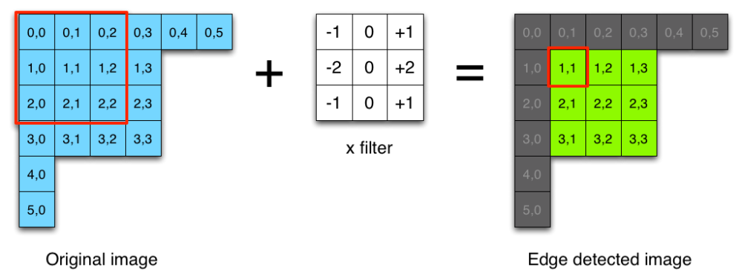
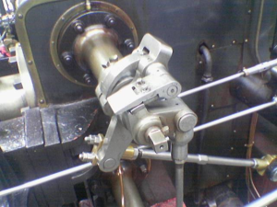

Data Level Parallelism (DLP)
Concurrency arises from performing the same operations on different pieces of data
Examples:
Addition of two dense floating-point matrices
Edge detection of an image by the Sobel operator
What kind of FU to use?
https://blog.saush.com/2011/04/20/edge-detection-with-the-sobel-operator-in-ruby/

Slide 12
Architectures to Exploit DLP
Assuming a fixed transistor budget on a chip
Addition of two dense floating-point matrices
Complex computation (FP addition) per data elements
Strategy: deeply pipeline the complex computation, e.g. 6-stage FP adder, and feed data in a pipelined fashion
Different from instruction pipeline, which needs to handle branches, dependences, interrupts → discourage larget number of stages
Edge detection of an image by the Sobel operator
Simple computation (integer multi) per data elements
Strategy: large number of simple functional units and one FU works on one data, all in parallel

Slide 13
Architectures to Exploit DLP
Pipelined FUs (vector processor)
Many simple FUs (array processor)
Register file
Register file
PE
PE
PE
PE
PE
PE
PE
PE
PE
PE
PE
PE
PE
PE
PE
PE
These FUs (a pipeline operating on multiple data or m PEs operating on m data) can be activated by a single instruction
→ SIMD
* A PE (processing element) may just be a simple integer ALU

Slide 14
Types of SIMD Parallelism
Vector architectures
One instruction to cause pipelined execution of many data operations
Graphics processing units (GPUs) and array processors
One instruction to cause simultaneous execution of many data elements
Multimedia SIMD instruction set extensions
ISA extensions with simultaneously parallel data operations for multimedia applications

Slide 15
Summary: SIMD Architectures
SIMD exploits significant data-level parallelism for special types of computations, e.g.
Matrix-oriented scientific computing
Media-oriented image, video and audio processing
Warrant special architecture designs: vector or array
SIMD is more energy efficient and has higher computation density than MIMD
Only needs to fetch one instruction per data operation
Can be used as special functional units or accelerators
SIMD allows programmer to continue to think sequentially

Slide 16
Outline
Introduction to parallel processing and data-level parallelism (Sec. 4.1)
Vector architecture (Sec. 4.2)
Basic architecture
Enhancements
SIMD instruction set extensions (Sec. 4.3)
Graphics processing units (Sec. 4.4)
Detecting and enhancing loop-level parallelism (Sec. 4.5)

Slide 17
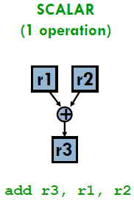
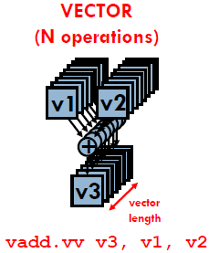
Vector Processors
A vector is a one-dimensional array of numbers
Many scientific/commercial programs use vectors
for (i=0; i<1000; i++) // DAXPY
Y[i] = a * X[i] + Y[i];
A vector processor is one whose instructions operate on vectors rather than scalar (single data) values

Slide 18
Vector Processors
A vector instruction performs an operation on each element in consecutive cycles
Vector functional units are pipelined
Each pipeline stage operates on a different data element
Basic requirements of vector processors
Load/store vectors → vector registers (contain vectors)
Operate on vectors of different lengths → vector length register (VLR)
Elements of a vector might be stored apart from each other in memory → vector stride register (VSTR)

Slide 19
What Are in a Vector Processor?
A scalar processor (e.g. a MIPS processor)
Scalar register file (32 registers)
Scalar functional units (arithmetic, load/store, ...)
A vector register file (a 2D register array)
Each register is an array of elements, e.g. 32 registers with 64 64-bit elements per register
MVL = maximum vector length = max # of elements per register
A set of vector functional units
Integer, FP, load/store, ...
Sometimes vector and scalar units are combined (shared ALUs)

Slide 20
Example Architecture: VMIPS
Vector registers
Each register holds a 64-element, 64 bits/element vector
Register file has 16 read ports and 8 write ports
Vector functional units
Fully pipelined
Data and control hazards are detected
Vector load-store unit
Fully pipelined
One word per clock cycle after initial latency
Scalar registers
32 general-purpose registers
32 floating-point registers

Slide 21
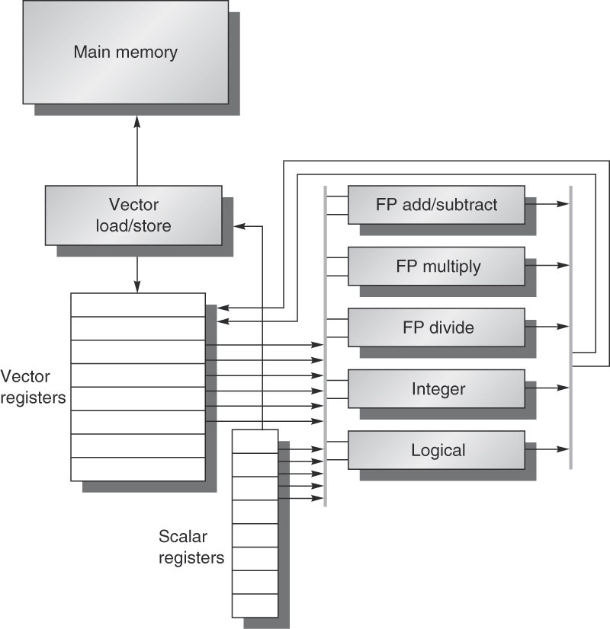
Basic Structure of VMIPS
Fig. 4.2

Slide 22
Vector Functional Units
Use deep pipeline (=> fast clock) to execute element operations
Simplified control of deep pipeline because elements in vector are independent
V1
V2
V3
Six-stage multiply pipeline
V3 ← V1 * V2
Slide credit: Krste Asanovic

Slide 23
VMIPS Instructions
ADDVV.D: add two vectors
ADDVS.D: add vector to a scalar
LV/SV: vector load and vector store from address
Example: DAXPY (Y = a * X + Y)
L.D F0,a ; load scalar a
LV V1,Rx ; load vector X
MULVS.D V2,V1,F0 ; vector-scalar multiply
LV V3,Ry ; load vector Y
ADDVV.D V4,V2,V3 ; add
SV Ry,V4 ; store the result
Requires 6 instructions vs. almost 600 for MIPS
(see Fig. 4.3)

Slide 24
Advantages of Vector Processors
No dependencies within a vector
Pipelining, parallelization work well
Can have very deep pipelines, no dependencies!
Each instruction generates a lot of work
Reduces instruction fetch bandwidth
Highly regular memory access pattern
Interleaving multiple banks for higher memory bandwidth
Allow prefetching
No need to explicitly code loops
Fewer branches in the instruction sequence
Easier to program (but still need to explicitly say it)

Slide 25
Disadvantages of Vector Processors
Works (only) if parallelism is regular (data/SIMD parallelism)
Very inefficient if parallelism is irregular
How about searching for a key in a linked list?
Memory (bandwidth) can easily become a bottleneck, especially if
Compute/memory operation balance is not maintained
Data is not mapped appropriately to memory banks

Slide 26
Vector Execution Time
Execution time depends on three factors:
Length of operand vectors
Structural hazards
Data dependencies
VMIPS functional units consume one element per clock cycle
Execution time for one vector instruction is approximately the vector length
How to estimate the execution time of a set of vector instructions?
Intuitive: count number of vector instructions multiplied by their lengths

Slide 27
Chaining
Under the intuitive model, one vector instruction must finish its execution before the next instruction can start
Output of a vector functional unit cannot be used as the input of another (i.e., no vector data forwarding)
Chaining for optimized vector execution
Allows a vector operation to start as soon as the individual elements of its vector source operand become available from another vector functional unit
A sequence of vector instructions with read-after-write dependency hazards can be chained together

Slide 28
Vector Chaining
Data forwarding from one vector functional unit to another
LV V1,Rx
MULVV.D V3,V1,V2
ADDVV.D V5,V3,V4
V1
V2
V3
V4
V5
Chain
Chain
Load Unit
Mult.
Add
Memory
(Slide credit: Krste Asanovic)

Slide 29
Vector Chaining Advantage
Without chaining, must wait for last element of result to be written into vector register before starting dependent instruction
With chaining, can start dependent instruction as soon as first result appears
LV
MULVV
Time
ADDVV
When all the pipes are filled, we can get one result per cycle, which is equivalent to 2 FLOPS/cycle
LV
MULVV
ADDVV

Slide 30
Vector Execution Time
Convoy
A set of vector instructions that could be executed together (through chaining)
Instructions in a convoy must not contain any structural hazards
Chime
Unit of time to execute one convoy: m convoys executes in m chimes
For vector length of n, m convoys requires m x n clock cycles, ignoring vector start-up time
A quick way to estimate vector execution time

Slide 31
Example
LV V1,Rx ;load vector X
MULVS.D V2,V1,F0 ;vector-scalar multiply
LV V3,Ry ;load vector Y
ADDVV.D V4,V2,V3 ;add two vectors
SV Ry,V4 ;store the sum
Convoys:
1 LV MULVS.D
2 LV ADDVV.D
3 SV
3 chimes, 2 FP ops per result ➔ cycles per FLOP = 1.5
For 64 element vectors, requires 64 x 3 = 192 clock cycles

Slide 32
Enhancements
> 1 element per clock cycle (multiple lanes)
Non-64 wide vectors (register length register)
IF statements in vector code (vector mask)
Memory system optimizations to support vector processors (multiple memory banks)
Multiple dimensional matrices (stride)
Sparse matrices (gather/scatter)
Programming a vector computer

Slide 33
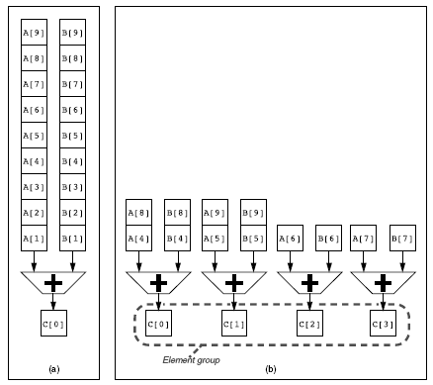
1. Getting > 1 Element per Clock Cycle
Use array processor architecture or a hybrid
Execution using four pipelined functional units
Very high bandwidth to/from vector registers
Fig. 4.4
Notes:
Very high bandwidth to/from vector registers

Slide 34
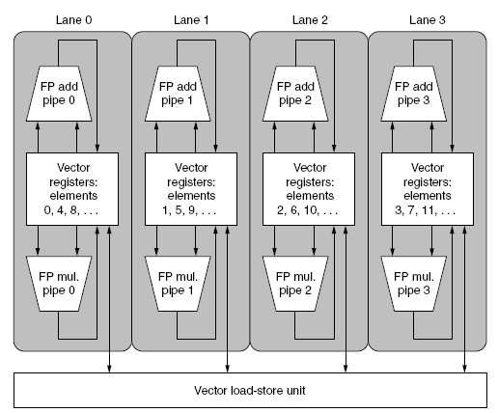
Multiple Lanes
Fig. 4.5

Slide 35
Multiple Lanes
A simple method to improve vector performance
Each lane contains one portion of the vector register file and one execution pipeline from each vector functional unit
Each lane receives identical control
Multiple element operations executed per cycle
Arithmetic pipelines local to a lane can complete the vector operations without communicating with other lanes → simple wiring and small # of ports for vector register file
Control processor can broadcast a scalar value to all lanes

Slide 36
2. Handling Non-64 Wide Vectors
What if the lengths of the vectors to be operated on are not 64, or only known at run time?
Use a vector-length register (VLR) to control the length of a vector operation
Value in VLR must not exceed length of vector registers
What if vector length > length of vector register?
Need to break the vectors so that each vector instruction operates on # elements in a vector register → vector stripmining

Slide 37
Vector Stripmining
Problem: vector registers have finite length
Solution: break loops into pieces that fit in registers
A
B
C
+
Remainder
for (i=0; i<N; i++)
C[i] = A[i] + B[i];
+
64 elements
+
64 elements

Slide 38
3. Handling Conditional Operations
How to handle conditional execution on a vector (based on a dynamically-determined condition)?
for (i=0; i<64; i++)
if (X[i] != 0)
X[i] = X[i] – Y[i];
Idea: use vector mask register to “disable” elements:
LV V1,Rx ;load vector X into V1
LV V2,Ry ;load vector Y into V2
L.D F0,#0 ;load FP zero into F0
SNEVS.D V1,F0 ;sets VM[i] to 1 if V1[i]!=F0
SUBVV.D V1,V1,V2 ;subtract under vector mask
SV Rx,V1 ;store the result in X
Notes:
SNEVS: set to 1 if not-equal

Slide 39
Masked Vector Instructions
Simple Implementation
Execute all N operations, turn off result writeback according to mask
Density-Time Implementation
Scan mask vector and only execute elements with non-zero masks
VM[7]=1
VA[7]
VB[7]
VM[7]=1
VM[6]=0
VA[6]
VB[6]
VM[6]=0
VA[7]
VB[7]
VM[5]=1
VA[5]
VB[5]
VM[5]=1
VM[4]=1
VA[4]
VB[4]
VM[4]=1
VM[3]=0
VA[3]
VB[3]
VM[3]=0
VC[5]
VM[2]=0
VC[4]
VM[1]=1
VM[2]=0
VC[2]
VM[0]=0
VM[1]=1
VC[1]
VC[1]
Write data port
VM[0]=0
VC[0]
Write Enable
Write data port
(Slide credit: Krste Asanovic)

Slide 40
4. Memory Banks
Memory system must be designed to support high bandwidth for vector loads and stores
Spread accesses across multiple memory banks
Control bank addresses independently
Load or store non-sequential words
Support multiple vector processors sharing the same memory

Slide 41
Memory Banking
Can start one bank access per cycle
Can sustain 16 parallel accesses if they go to different banks
Bank
0
Bank
1
Bank
2
Bank
15
MDR
MAR
MDR
MAR
MDR
MAR
MDR
MAR
Data bus
Address bus
CPU
(Slide credit: Derek Chiou)

Slide 42
5. Stride
Consider matrix multiplication:
for (i=0; i<100; i++)
for (j=0; j<100; j++) {
A[i][j] = 0.0;
for (k=0; k<100; k++)
A[i][j]=A[i][j]+B[i][k]*C[k][j];}
Must vectorize multiplication of rows of B with columns of C
Use non-unit stride with a vector stride register (VSTR)
Bank conflict (stall) occurs when the same bank is hit faster than bank busy time:
# banks / LCM(stride, # banks) < bank busy time
Notes:
LCM: least common multiples

Slide 43
Stride Memory Accesses
Vector Register
V1
Memory
Base
Stride
Base
Stride
Vector Registers
Address Generator
+
(Slide credit: Krste Asanovic)
0
1
2
3
4
5
6
7
8
9
A
B
C
D
E
F
Memory Banks

Slide 44
6. Scatter/Gather Operations
Handling vector operations with indirect accesses, e.g. for sparse matrices:
for (i=0; i<n; i++)
A[K[i]] = A[K[i]] + C[M[i]];
Idea: use an index vector for indexed load (Gather)
LV Vk,Rk ;load K[] into Vk (index reg.)
LVI Va,(Ra+Vk) ;load indirect A[K[]]
LV Vm,Rm ;load M[] into Vm (index reg.)
LVI Vc,(Rc+Vm) ;load indirect C[M[]]
ADDVV.D Va,Va,Vc ;add them
SVI (Ra+Vk),Va ;store A[K[]]

Slide 45
Gather/Scatter Operations
Gather/scatter operations are often implemented in hardware to handle sparse matrices
Vector loads and stores use an index vector which gives offsets to add to a base register to generate the addresses
Index Vector
1
3
6
7
Memory
3.14
0.0
6.5
0.0
0.0
71.2
2.71
Data Vector
3.14
6.5
71.2
2.71
Base register

Slide 46
Summary: Vector Operations
Read sets of data elements scattered around memory
Place them into large, sequential register files (vector registers)
Operate on data in those registers
Disperse the results back into memory
A single instruction operates on vectors of data, resulting in many register-to-register operations on individual data elements

Slide 47
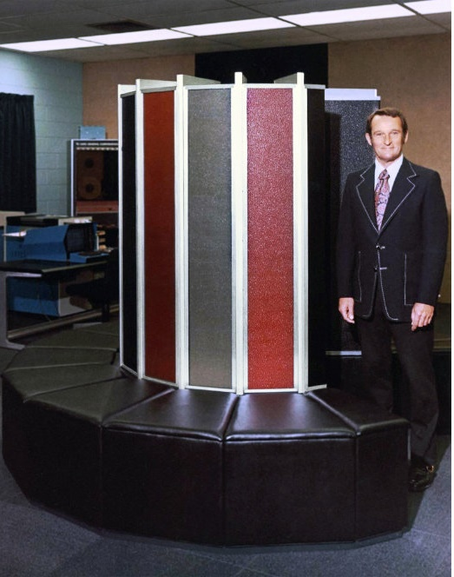
Historical Perspective
Vector supercomputers
Typified by Cray-1 (1976)
Scalar unit: load/store architecture
Vector extension: vector registers and instructions
Implementation:
Hardwired control
Highly pipelined FUs
Interleaved memory system
No data caches
No virtual memory
[©Cray Research, 1976]

Slide 48
Supercomputer Applications
Typical application areas
Military research (nuclear weapons, cryptography)
Weather forecasting
Oil exploration
Industrial design (car crash simulation)
Bioinformatics
Cryptography
All involve huge computations on large data set
Supercomputers: CDC6600, CDC7600, Cray-1, …
In 70s-80s, Supercomputer ≡ Vector Machine
Starting 90s, clusters of servers prevail
PetaFLOPS (10¹⁵) now, ExaFLOPS expected in 2020

Slide 49
Outline
Introduction to parallel processing and data-level parallelism (Sec. 4.1)
Vector architecture (Sec. 4.2)
Basic architecture
Enhancements
SIMD instruction set extensions (Sec. 4.3)
Graphics processing units (Sec. 4.4)
Detecting and enhancing loop-level parallelism (Sec. 4.5)

Slide 50
SIMD Extensions
Media applications often operate on data types narrower than the native word size
e.g. graphics use 8 bits to represent each of RGB
Can disconnect carry chains in a normal integer adder, e.g. 64-bit, to perform eight simultaneous operations on a vector of 8 elements, each 8-bit
One instruction operates on multiple data elements simultaneously and opcode determines data type:
8 8-bit bytes, 4 16-bit words, 2 32-bit doublewords, 1 64-bit quadword
Operands must be consecutive and at aligned memory locations

Slide 51
SIMD Implementations
Intel MMX (1996)
Eight 8-bit integer ops or four 16-bit integer ops
Streaming SIMD Extensions (SSE) (1999)
Eight 16-bit integer ops
Four 32-bit integer/fp ops or two 64-bit integer/fp ops
Advanced Vector Extensions (AVX) (2010)
Four 64-bit integer/fp ops (for 256-bit AVX)
Example AVX instructions:
VADDPD: add 4 packed double-precision (DP) operands
VMOVAPD: move aligned 4 packed DP operands
VBROADCASTSD: broadcast 1 DP operand to 4 locations in a 256-bit register
Notes:
Packed double for 256-bit AVX: four 64-bit operands executed in SIMD mode
Need to shuffle and replicate operands within a 256-bit register → broadcast

Slide 52
Limitations of SIMD Extensions
Limitations compared to vector instructions:
Fixed number of data operands encoded into op code → need to add a large number of instructions
No sophisticated addressing modes (strided, scatter/gather) → less vectorization opportunity
No mask registers
➔ harder to program and vectorize
Why SIMD extensions popular?
Cost little to extend standard arithmetic units
Require little extra state for easy context switch
Require smaller memory bandwidth
Can easily work with virtual memory and cache

