Slide 1
CS5100 Advanced Computer Architecture
Instruction-Level Parallelism
Prof. Chung-Ta King
Department of Computer Science
National Tsing Hua University, Taiwan
(Slides are from textbook, Prof. Hsien-Hsin Lee, Prof. Yasun Hsu)

Slide 2
About This Lecture
1
Goal:
  To review the basic concepts of instruction-level parallelism and pipelining
  To study compiler techniques for exposing ILP that are useful for processors with static scheduling
Outline:
  Instruction-level parallelism: concepts and challenges
  (Sec. 3.1)
    Basic concepts, factors affecting ILP, strategies for exploiting ILP
  Basic compiler techniques for exposing ILP (Sec. 3.2)

Slide 3
Sequential Program Semantics
Human expects “sequential semantics”
  A program counter (PC) goes through instructions of the program sequentially until the computation is completed
  Result of computing is considered “correct” (ground truth)
  Any optimizations, e.g. pipelining or parallelism, must keep the same semantics (result)
Sequential semantics dictates a computation model of one instruction executed after another
While ensuring execution “correctness” (i.e. sequential semantics), how to optimize executions?
  Overlapping executions: instruction-level, thread-level, data-level, request-level

Slide 4
Instruction-Level Parallelism (ILP)
The parallelism that exists among instructions
Example form of parallelism 1:
  sub r1,r2,r3 add r4,r5,r6
  add r4,r5,r6 sub r1,r2,r3
Example form of parallelism 2:
  sub r1,r2,r3
  add r4,r5,r6
Same result up to here!
IF
DE
EX
MEM
WB
Sub-operations can overlap

Slide 5
Instruction-Level Parallelism (ILP)
Two instructions are parallel if they can be executed simultaneously in a pipeline of arbitrary depth without causing any stalls, assuming the pipeline has sufficient resources (no structural hazards)
  If two instructions are dependent, they are not parallel and must be executed in order, although they may be partially overlapped
The amount of ILP that can be exploited is affected by program, compiler, and architecture
The key is to determine dependences among the instructions
  Data (true), name, and control dependences

Slide 7
True Dependence
Instn_{i} followed by Instn_{j}, (but j is not necessary the instruction right next to i), e.g.
  i writes a value to a register, j uses this value in the register
    add r2, r4, r6
    add r8, r2, r9
  i writes to a memory via a write buffer, j loads same value into a register
    sw r2, 100(r3)
    lw r4, 100(r3)
  i loads a register from memory, j uses the content of that register for an operation
    lw r2, 200(r7)
    add r1, r2, r3
  True dependency reflects sequential semantics and forces “sequentiality”

Slide 8
True Dependence Causes Data Hazard
True dependences indicate data flows and are a result of the program (semantics)
True dependence may cause Read-After-Write (RAW) data hazard in pipeline
  Instn_{i} followed by Instn_{j}
  Instn_{j} tries to read operand before Instn_{i} writes it
lw r1, 30(r2)
add r3, r1, r5
Read old data
Read new data
Want to avoid this

Slide 9
Name Dependence
Anti- and output dependences
  The two instructions use same name (register or memory location) but don’t exchange data → no data flow
  Due to bad compiler, architecture limitation
  Can be solved with renaming (use different registers)
lw r2, (r12)
add r1, r2, 9
mul r2, r3, r4
true dependence
output
dependence
anti-dependence

Slide 10
Anti-Dependence
Anti-dependence may cause Write-After-Read (WAR) data hazard
  Instn_{i} followed by Instn_{j}
  Instn_{j} tries to write to register/memory before Instn_{i} reads from that register/memory → get wrong, new data
Want to read old value
Get new value instead
should avoid this

Slide 11
Output Dependence
Output dependence may cause Write-after-Write (WAW) data hazard
  Instn_{i} followed by Instn_{j}
  Instn_{j} tries to write to register/memory before Instn_{i} writes to that register/memory → leave wrong result
should avoid this

Slide 12
Register Renaming
Output dependence
LW R2 0(R1)
DADD R2 R3 R4
DSUB R6 R2 R5
LW R2 0(R1)
DADD R10 R3 R4
DSUB R6 R10 R5
WAW disappears
➔
Anti-dependence
ADD.D F4 F2 F8
L.D F2 0(R10)
SUB.D F14 F2 F6
ADD.D F4 F2 F8
L.D F16 0(R10)
SUB.D F14 F16 F6
WAR disappears
➔

Slide 13
Memory Dependence
Ambiguous dependency also forces “sequentiality”
To increase ILP, needs dynamic memory disambiguation mechanisms that are either safe or recoverable
i1: lw r2, (r12)
i2: sw r7, 24(r20)
i3: sw r1, (0xFF00)
?
?
?

Slide 14
Control Dependence
Ordering of instruction i with respect to a branch instruction
  Instruction that is control-dependent on a branch cannot be moved before that branch so that its execution is no longer controlled by the branch
  An instruction that is not control-dependent on a branch cannot be moved after the branch so that its execution is controlled by the branch
bge r8,r9,Next
add r1,r2,r3
Control dependence

Slide 15
Control Dependence and Basic Blocks
Control dependence limits size of basic blocks
a = array[i];
b = array[j];
c = array[k];
d = b + c;
while (d<t) {
a++;
c *= 5;
d = b + c;
}
array[i] = a;
array[j] = d;
i1: lw r1, (r11)
i2: lw r2, (r12)
i3: lw r3, (r13)
i4: add r2, r2, r3
i5: bge r2, r9, i9
i6: addi r1, r1, 1
i7: mul r3, r3, 5
i8: j i4
i9: sw r1, (r11)
i10: sw r2, (r12)
i11: jr r31

Slide 16
Control Dependence and Basic Blocks
Control dependence limits size of basic blocks
a = array[i];
b = array[j];
c = array[k];
d = b + c;
while (d<t) {
a++;
c *= 5;
d = b + c;
}
array[i] = a;
array[j] = d;
i1: lw r1, (r11)
i2: lw r2, (r12)
i3: lw r3, (r13)
i4: add r2, r2, r3
i5: bge r2, r9, i9
i6: addi r1, r1, 1
i7: mul r3, r3, 5
i8: j i4
i9: sw r1, (r11)
i10: sw r2, (r12)
i11: jr r31

Slide 17
Control Flow Graph
i1: lw r1, (r11)
i2: lw r2, (r12)
i3: lw r3, (r13)
BB1
BB2
i4: add r2, r2, r3
i5: bge r2, r9, i9
BB3
BB4
i6: addi r1, r1, 1
i7: mul r3, r3, 5
i8: j i4
i9: sw r1, (r11)
i10: sw r2, (r12)
i11: jr r31
  Typical size of basic block = 3~6 instructions

Slide 18
Data Dependence: A Short Summary
Dependencies are property of program & compiler
Pipeline organization determines if a dependence is detected and if it causes a stall
Data dependence conveys:
  Possibility of a hazard
  Order in which results must be calculated
  Upper bound on exploitable ILP
Overcome dependences:
  Maintaining the dependence but avoid a hazard
  Eliminating dependence by transforming code
Dependencies that flow through memory locations are difficult to detect

Slide 19
Another Factor Affecting ILP Exploitation
Limited HW/SW window in search of ILP
R5 = 8(R6)
R7 = R5 – R4
R9 = R7 * R7
R15 = 16(R6)
R17 = R15 – R14
R19 = R15 * R15
ILP = 1
ILP = ?
ILP = 1.5

Slide 20
Window in Search of ILP
ILP = 6/3 = 2 → better than 1 + 1.5
Larger window gives more opportunities
Who exploit the instruction window?
But what limits the window?
C1:
R5 = 8(R6)
R7 = R5 – R4
R9 = R7 * R7
R15 = 16(R6)
R17 = R15 – R14
R19 = R15 * R15
C2:
C3:

Slide 21

Strategies for Exploiting ILP
Replicate resources
  sub r1,r2,r3
  add r4,r5,r6
  e.g., multiple adders or multi-ported data caches
  Superscalar architecture
Overlap uses of resources
  Pipelining
IF
DE
EX
MEM
WB
Reg
Reg
Datapath

Slide 22
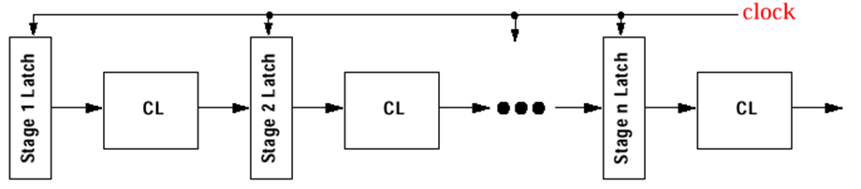
Pipelining
One machine cycle per stage
Synchronous design → slowest stage dominates
Pure hardware solution; no change to software
  Ensure sequential semantics
All modern machines are pipelined
  Key technique in advancing performance in the 80’s
Data and control signals

Slide 23
Advanced Means of Exploiting ILP
Hardware
  Control speculation (control)
  Dynamic scheduling (data)
  Register renaming (data)
  Dynamic memory disambiguation (data)
Software
  (Sophisticated) program analysis
  Predication or conditional instruction (control)
  Better register allocation (data)
  Memory disambiguation by compiler (data)

Slide 24
Exploiting ILP
Any attempt to exploit ILP must make sure the optimized program is still “correct”
Two properties critical to program correctness
  Data flow: flow of data values among instructions
  Exception behavior: the ordering of instruction execution must not change how exceptions are raised in program (or, cause any new exceptions), e.g.
DADDU R2,R3,R4
BEQZ R2,L
LW R1,0(R2) // may cause memory protection
L: ... // exception → cannot reorder
// BEQZ and LW
Notes:
Branches make data flow dynamic; an instruction may be data dependent on more than one predecessor → program order determines which predecessor, which in turn is decided by control dependence

Slide 25
Exploiting ILP – Preserving Data Flow
Example 1:
DADDU R1,R2,R3
BEQZ R4,L
DSUBU R1,R1,R6
L: …
OR R7,R1,R8
Example 2:
DADDU R1,R2,R3
BEQZ R12,skip
DSUBU R4,R5,R6
DADDU R5,R4,R9
skip: OR R7,R8,R9
OR depends on DADDU and DSUBU, but correct execution also depends on BEQZ, not just ordering of DADDU, DSUBU, and OR
Assume R4 is not used after skip → possible to move DSUBU before the branch without affecting exception or data flow

Slide 26
Outline
25
Instruction-level parallelism: concepts and challenges (Sec. 3.1)
Basic compiler techniques for exposing ILP (Sec. 3.2)

Slide 27
Finding ILP
gcc has 17% control transfer instructions
  5 instructions + 1 branch
  Must move beyond single block to get more ILP
Loop level parallelism gives one opportunity
  Loop unrolling statically by software or dynamically by hardware
  Using vector instructions
Principle of pipeline scheduling:
  A dependent instruction must be separated from the source instruction by a distance in clock cycles equal to the pipeline latency of that source instruction
How can a compiler perform pipeline scheduling?

Slide 28
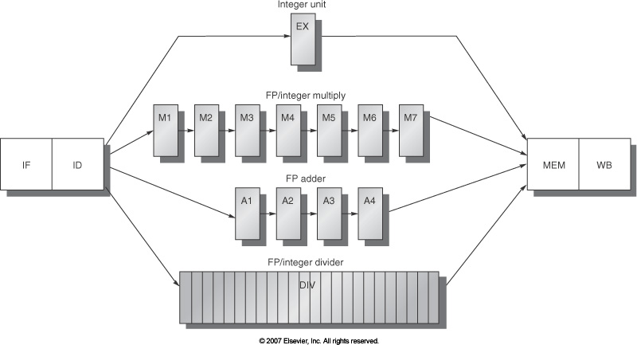
Assumptions
5-stage integer pipeline
  FP ALU: 4-cycles (3 cycle stall for consumer; 2 cycle for ST)
LD → any: 1 stall
FPALU → any: 3 stalls
FPALU → ST: 2 stalls
IntALU → BR: 1 stall

Slide 29
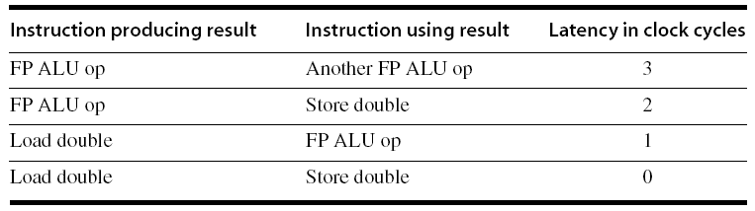
Compiler Techniques for Exposing ILP
Loop: L.D F0,0(R1)
stall
ADD.D F4,F0,F2
stall
stall
S.D F4,0(R1)
DADDUI R1,R1,#-8
stall
BNE R1,R2,Loop // need R1 in ID
  for (i=999; i>=0; i=i-1)
  x[i] = x[i] + s;
Add a scalar to a vector
Parallel loop
9 cycles
Notes:
Assume the standard five-stage integer pipeline, so that branches have a delay of 1 clock cycle.
R1 is initially the address of the element in the array with the highest address
F2 contains the scalar value s
Register R2 is precomputed, so that 8(R2) is the address of the last element to operate on
Assume a latency of 1 cycle from integer ALU to branch since the branch address is calculated in ID which occurs in the same cycle in the EX of the previous instruction.
Ignore delayed branches

Slide 30
Pipeline Scheduling
Scheduled code:
Loop: L.D F0,0(R1)
DADDUI R1,R1,#-8
ADD.D F4,F0,F2
stall
stall
S.D F4,8(R1)
BNE R1,R2,Loop
7 cycles

Slide 31
Loop Unrolling
Unroll 4 times (assume # elements is divisible by 4)
  Eliminate unnecessary instructions
Loop: L.D F0,0(R1)
ADD.D F4,F0,F2
S.D F4,0(R1) ;drop DADDUI & BNE
L.D F6,-8(R1)
ADD.D F8,F6,F2
S.D F8,-8(R1) ;drop DADDUI & BNE
L.D F10,-16(R1)
ADD.D F12,F10,F2
S.D F12,-16(R1) ;drop DADDUI & BNE
L.D F14,-24(R1)
ADD.D F16,F14,F2
S.D F16,-24(R1)
DADDUI R1,R1,#-32
BNE R1,R2,Loop
27 cycles
(LD 1 stall
ADDD 2 stall
DADDUI 1 stall)
Note: number of live registers vs. original loop

Slide 32
Loop Unrolling + Pipeline Scheduling
Loop: L.D F0,0(R1)
L.D F6,-8(R1)
L.D F10,-16(R1)
L.D F14,-24(R1)
ADD.D F4,F0,F2
ADD.D F8,F6,F2
ADD.D F12,F10,F2
ADD.D F16,F14,F2
S.D F4,0(R1)
S.D F8,-8(R1)
DADDUI R1,R1,#-32
S.D F12,16(R1)
S.D F16,8(R1)
BNE R1,R2,Loop
OK to move S.D past DADDUI even though changes register
OK to move loads before stores: analyze memory address (mem. disambiguate)
When is it safe to do such changes?
understand dependences
14 cycles
or 3.5 per iteration

Slide 33
Loop Unrolling: Summary
Increase number of instructions relative to the branch and overhead instructions
Allow instructions from different iterations to be scheduled together
Need to use different registers for each iteration → increase register count
Usually done early in compilation
  A pair of consecutive loops are actually generated; the first executes (n mod k) times and the second has the unrolled body that iterates n/k times

Slide 34
Recap
What is instruction-level parallelism?
  Pipelining and superscalar to enable ILP
Factors affecting ILP
  True, anti-, output dependence
  Dependence may cause pipeline hazard: RAW, WAR, WAW
  Control dependence, basic block, and control flow graph
Compiler techniques for exploiting ILP
  Loop unrolling

