Slide 1
CS5100 Advanced Computer Architecture
Memory Hierarchy Design
Prof. Chung-Ta King
Department of Computer Science
National Tsing Hua University, Taiwan
(Slides are from textbook, Prof. Hsien-Hsin Lee, Prof. Yasun Hsu)

Slide 2
About This Lecture
Goal:
  To review the basics of memory hierarchy design and cache optimization techniques
  To understand advanced cache optimization techniques
Outline:
  Memory hierarchy design (Sec. 2.1)
    Motivation, basic concepts
    Basic cache organization and performance
    Basic cache optimizations
  Ten advanced optimizations of cache performance (Sec. 2.2)

Slide 3
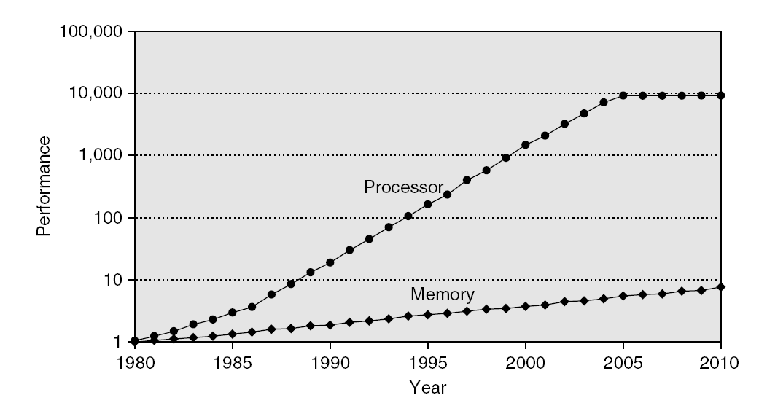
Memory Performance Gap
Fig. 2.2
Notes:
Figure 2.2 Starting with 1980 performance as a baseline, the gap in performance, measured as the difference in the time between processor memory requests (for a single processor or core) and the latency of a DRAM access, is plotted over time. Note that the vertical axis must be on a logarithmic scale to record the size of the processor–DRAM performance gap. The memory baseline is 64 KB DRAM in 1980, with a 1.07 per year performance improvement in latency (see Figure 2.13 on page 99). The processor line assumes a 1.25 improvement per year until 1986, a 1.52 improvement until 2000, a 1.20 improvement between 2000 and 2005, and no change in processor performance (on a per-core basis) between 2005 and 2010; see Figure 1.1 in Chapter 1.

Slide 4
Motivation for Memory Hierarchy
Programmers want unlimited amounts of memory with low latency
  But fast memory more expensive than slower memory
Solution: small fast memory + big slow memory
= Looks like a big fast memory
Big
Fast
M_{M}
M_{C}
Small & Fast
Big & Slow
Notes:
Why does this work?

Slide 5
Basic Idea of Memory Hierarchy
Entire addressable memory space available in largest, slowest memory
Incrementally smaller and faster memories, each containing a subset of the memory below it, proceed in steps up toward the processor
eDRAM or
Emerging memory
DRAM
SRAM
Main
Memory
DISK
L4
Cache
Reg
File
L1
Data cache
L3
Cache
L2
Cache
L1
Inst cache

Slide 6
Model of Memory Hierarchy
Cycle Words/cycle Management
1 3-10 ?
1-3 1-2 ?
5-10 1 ?
30-100 0.5 ?
10⁶-10⁷ 0.01 ?
Registers
Compiler
Hardware
Hardware
OS
OS
CPU
Chip
Level 1 Cache
Level 2 Cache
Chips
DRAM
Mechanic
Disk

Slide 7
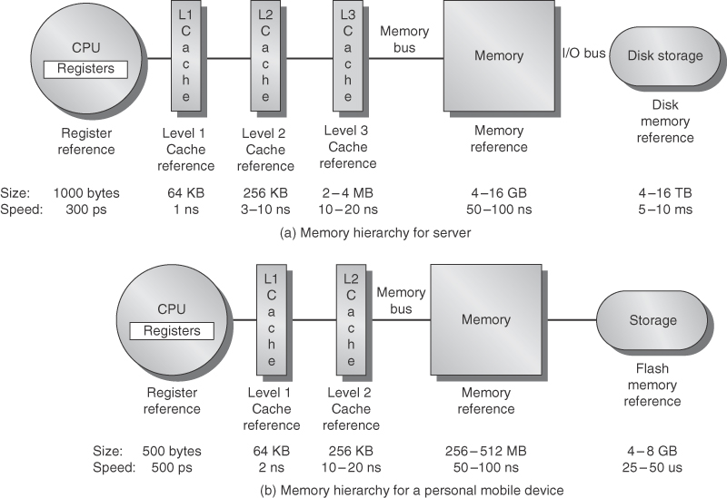
Model of Memory Hierarchy
Fig. 2.1
Notes:
Figure 2.1 The levels in a typical memory hierarchy in a server computer shown on top (a) and in a personal mobile
device (PMD) on the bottom (b). As we move farther away from the processor, the memory in the level below becomes slower
and larger. Note that the time units change by a factor of 109—from picoseconds to milliseconds—and that the size units change
by a factor of 10¹²—from bytes to terabytes. The PMD has a slower clock rate and smaller caches and main memory. A key difference is that servers and desktops use disk storage as the lowest level in the hierarchy while PMDs use Flash, which is built from EEPROM technology.

Slide 8
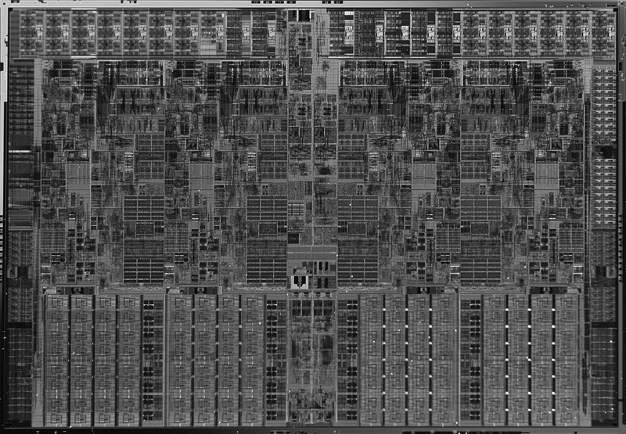
Cache Power Consumption
High-end μPs have >10 MB on-chip cache
  Consumes large amount of area and power budget
Intel Core i7
L1 D$
L1 I$
L2
Shared L3

Slide 9
Underlying Principle: Locality of Reference
Locality of reference:
  Program access a relatively small portion of the address space at any instant of time → a program property
  Temporal locality: If an item is referenced, it will tend to be referenced again soon (e.g., loops, reuse)
  Spatial locality: If an item is referenced, items whose addresses are close by tend to be referenced soon (e.g., straightline code, array access)
Stack
Code
Array
P
P
t
Location
Notes:
The principle of locality states that programs access a relatively small portion of the address space at any instant of time.
This is kind of like in real life, we all have a lot of friends. But at any given time most of us can only keep in touch with a small group of them.
There are two different types of locality: Temporal and Spatial. Temporal locality is the locality in time which says if an item is referenced, it will tend to be referenced again soon.
This is like saying if you just talk to one of your friends, it is likely that you will talk to him or her again soon.
This makes sense. For example, if you just have lunch with a friend, you may say, let’s go to the ball game this Sunday. So you will talk to him again soon.
Spatial locality is the locality in space. It says if an item is referenced, items whose addresses are close by tend to be referenced soon.
Once again, using our analogy, we can usually divide our friends into groups. Like friends from high school, friends from work, friends from home.
Let’s say you just talk to one of your friends from high school and she may say something like: So did you hear so and so just won the lottery.
You probably will say NO, I better give him a call and find out more.
So this is an example of spatial locality. You just talked to a friend from your high school days. As a result, you end up talking to another high school friend. Or at least in this case, you hope he still remember you are his friend.
+3 = 10 min. (X:50)

Slide 10
But, Program Behavior Matters
Locality depends on type of program
Some programs ‘behave’ well
  Small loop operating on data on stack (towers of hanoi)
Some programs don’t
  Frequent calls to nearly random subroutines
  Traversal of large, sparse data set
    Pointer-based data structures
    Essentially random data references with no reuse
  Traversal of large sequential data
    Streaming and multimedia data
Notes:
Think in terms of instruction (program execution behavior) and data (program data access behavior)
Programs with subroutines or classes; Pointer-based data structures; Streaming data → good for spatial but not temporal

Slide 11
Memory Hierarchy Performance
Average memory access time between levels
= Hit time + Miss rate x Miss penalty
Miss penalty: time to fetch a block from lower memory level
  Access time: time to lower level; function of latency
  Transfer time: function of bandwidth between levels
    Transfer one “cache line/block” at a time
    Transfer at the size of the memory-bus width

Slide 12
Cache on CPU Performance
CPU time = (CPU cycle + memory stall cycles) x clock cycle time
Memory stall cycles = memory access x miss rate x miss penalty
  Assumptions: memory stalls are due to cache misses, hit cycles included in CPU execution cycles, reads and writes have same miss rate and penalty
CPU time = instruction count x (CPI_{ideal} + memory access/instruction x miss rate x miss penalty) x clock cycle time
Cache design becomes more important for CPUs with lower CPI and higher clock rates

Slide 13
4 Questions for Memory Hierarchy
Block placement: where in upper level?
  fully associative, direct mapped, set-associative
Block identification: find block in upper level?
  search and match address tag:
  block address (= tag + index) + block offset
  valid bit: tag-index boundary and associativity
Block replacement: which block to replace on miss?
  easy for direct map; random/LRU for associative
Write strategy: what happens on a write?
  Write through and write back
  Write allocate and not allocate

Slide 14
Comparison of Cache Organization
Cache miss as a metric:
(causes of cache misses)
  Compulsory:
    First access to a block
  Capacity:
    Block discarded due to limited
    cache size and later retrieved
  Conflict:
    Block discarded due to conflict
    in set and later retrieved
  Coherence:
    In multicore systems (Chapter 5)
0x1234
Processor
Cache
0x1234
0x5678
0x91B1
0x111
Processor
Cache
0x1234
0x5678
0x91B1
Processor
Cache

Slide 15
Comparison of Cache Organization
Which cache organization can reduce compulsory misses?
Which cache organization can reduce capacity misses?
Which cache organization can reduce conflict misses?
Reduce cache misses = improve cache performance?

Slide 16
Comparison of Cache Organizations
Comparisons in terms of space and time:
Can access to tag and data arrays be done in parallel?
How many comparators and multiplexers are needed?
  How about wiring in IC layout?
How many bits of storage are needed in tag and data arrays?
  The index bits need not be stored!
What is the write overhead?

Slide 17
Write Hit Policy
Write through
  Update next level on every write → cache is always clean
  Lots of traffic to next level (mostly writes)
Write back
  Write to cache and mark block dirty → update main memory on eviction (more complex eviction and coherence)
Write buffer for write through
  Processor: writes data into cache and write buffer
  Memory controller: write contents of buffer to memory
Processor
Cache
DRAM
Write Buffer
Notes:
We really didn't write to the memory directly. We are writing to a write buffer.
Once the data is written into the write buffer and assuming a cache hit, the CPU is done with the write. The memory controller will then move the write buffer’s contents to the real memory behind the scene.
The write buffer works as long as the frequency of write is not too high. Notice here, I am referring to the frequency with respect to time, not with respect to number of instructions.
Remember the DRAM cycle time we talked about last time. It sets the upper limit on how frequent you can write to the main memory.
If the writes are too close together or the CPU time is so much faster than the DRAM cycle time, you can end up overflowing the write buffer and the CPU must stop and wait.

Slide 18
Write Miss Policy
Write allocate:
  Allocate a new block on each write
  Fetch on write: fetch entire block, then write word into block
  No-fetch: allocate block but don’t fetch
    Requires valid bits per word, complex eviction
Write no-allocate:
  Write around cache; typically used by write through
Write invalidate (instead of update)
Sometimes like to have a read no-allocate
  irregular accesses on machine with large block size
Notes:
Read no-allocate: avoid the cost of bringing in the large block, while only use the single word

Slide 19
Replacement Policy: Least Recently Used
For 2-way set-associative cache
  1-bit per set indicates LRU/MRU; set/clear on each access
For >2-way, LRU is difficult/expensive in HW
  Need to maintain history of access order
Not recently used (NRU)
  A “used bit” is associated with every block, initially 0
  Whenever a block is accessed, its used bit is set to 1
    If on an access, all other used bits in a set are 1, they are reset to 0 except the bit of the block that is accessed
  A replacement pointer is used to look for a block whose used bit is 0 to be replaced
  Used by Intel Itanium, Sparc T2
Other policies: Pseudo LRU, LRU Insertion Policy (LIP)

Slide 20
Six Basic Cache Optimizations
Larger block size
  Exploit spatial locality to reduce compulsory misses
  Increase capacity and conflict misses, increase miss penalty
Larger total cache capacity
  Reduce capacity misses
  Increase hit time, increase power consumption
Higher associativity
  Reduce conflict misses
  Increase hit time, increase power consumption
Giving priority to read misses over writes
  Check WB on read; if no conflicts, read bypass writes in WB

Slide 21
Six Basic Cache Optimizations
More cache levels
Main
Memory
(DRAM)
1 cyc
L1$
300 cyc
Miss % * Miss penalty
Hit Time
1 cyc
L2
L3
Main Memory (DRAM)
L1
10 cyc
20 cyc
300 cyc
On-die

Slide 22
Six Basic Cache Optimizations
Avoiding address translation in cache indexing
  Strategy 1: virtually addressed cache
    Problem 1: Every time on a process context switch, the cache must be flushed; otherwise get false hits across processes
      Cost: time to flush + “compulsory” misses
      Solution: add processes identifier tag
    Problem 2: Two different cache entries may hold data for the same physical address → aliases
VA
VA
PA
P
$
P
TLB
$
TLB
PA
Physical Cache

Slide 23
Six Basic Cache Optimizations
Avoiding address translation in cache indexing (cont’d)
  Strategy 1: virtually addressed cache (cont’d)
    Aliases (synonyms):
    void alias(int *x, int *y) {
  *x = 1; *y = 0;
  }
    Hardware solution: cache controller guarantees that every cache block has unique physical address
    Software solution: compiler guarantees lower n bits of addresses of aliased variables be the same, where the n bits cover only index+offset fields
    → the 2 variables mapped to same location if direct-mapped cache is used (page coloring)

Slide 24
Six Basic Cache Optimizations
Avoiding address translation in cache indexing (cont’d)
  Strategy 2: physically mapped, virtually tagged
    Index+offset fields are same in virtual as well as physical addresses (no need to be translated), e.g. within a VM page
    Can start cache tag access in parallel with translation so that physical tag can be compared
    Problem: limit cache size to
    a VM page
      Use higher associativity
      Use page coloring (see
      previous page)
VA
Tag
Index
$
Data
Tag
TLB
=

Slide 25
Outline
Memory hierarchy design (Sec. 2.1)
  Motivation, basic concepts
  Basic cache organization and performance
  Basic cache optimizations
Ten advanced optimizations of cache performance (Sec. 2.2)

Slide 26
Five Categories of Optimization Strategies
Reducing the hit time
  Small and simple L1 cache; way prediction
Increasing cache bandwidth
  Pipelined cache; multibanked cache; nonblocking cache
Reducing the miss penalty
  Critical word first; merging write buffer
Reducing the miss rate
  Compiler optimization
Reducing the miss penalty or miss rate by parallelism
  Hardware prefetching and compiler prefetching

Slide 27
1. Small and Simple L1 Caches
Can reduce hit time and power
Critical timing path of cache:
  addressing and accessing tag/data memory → comparing tags → selecting correct set
Simple cache:
  Direct-mapped caches can overlap tag comparison and transmission of data → reducing hit time
  Lower associativity reduces power because fewer cache lines are accessed (see Fig. 2.4)
Small cache:
  Large caches impact clock rate, but recent processor designs opt for higher associativity than larger size (see next page)
Notes:
When cache is small, use DM to reduce hit time
When cache is large, make no much different in terms of access time.
In general, DM access consumes lowest energy per read.
8-way SA cache: reads out 8 tags and data in parallel → higher energy per read

Slide 28
Small and Simple L1 Caches
3 factors for favoring higher associativity in L1 caches
  Many processors take at least 2 cycles to access cache
  → longer hit time due to higher associativity may not be critical
  L1 cache tends to be virtually indexed to keep TLB out of critical path → limit cache size to page size times associativity → favoring higher associativity
  Multithreading increases conflict misses → favoring higher associativity

Slide 29
2. Way Prediction
Predict the way within the set for next cache access
  e.g., PC of load instructions to index a prediction table
  Pre-set mux to select the way → only a single tag comparison and can read data array at same time (as if DM)
    Correct prediction: hit time and power close to DM cache
  Mis-prediction checks other blocks in the next cycle
  Prediction accuracy: > 90% for 2-way, > 80% for 4-way
  First on MIPS R10000 in mid-90s; now on ARM Cortex-A8
Valid
Cache Tag
Cache Data
Cache Index
Cache Data
Cache Tag
Valid
Cache Block 0
Cache Block 0
:
:
:
:
:
:
Adr Tag
Compare
1
0
Compare
Sel1
Mux
Sel0
OR
Hit
Cache Block
Notes:
Block predictor bits for each block
Extension: use way predictor bits to decide which cache block to actually access → way selection
Extension: increase mis-prediction penalty because need to repeat cache access again

Slide 30
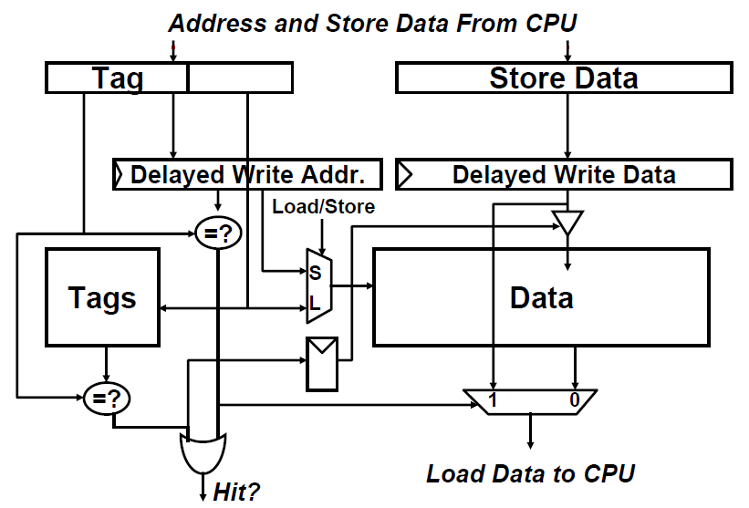
3. Pipelining Cache Accesses
Pipeline cache accesses to improve bandwidth
  Faster cycle time, higher BW, but slower hits (in cycles)
  Longer pipeline increases branch mis-prediction penalty and more cycles between
  issuing a load and
  using data
Pipelined cache write
(Prof. Joel Emer)

Slide 31
4. Non-blocking Cache
Non-blocking cache or lockup-free cache to increase cache bandwidth
  Allow cache to continue supply hits during a miss
    Requires out-of-order execution CPU
  Hit under miss: reduces the effective miss penalty by working during miss vs. stalling CPU requests
  Hit under multiple miss or miss under miss: further lower the effective miss penalty by overlapping multiple misses
  Significantly increase cache controller complexity with multiple outstanding memory accesses
  Pentium Pro allows 4 outstanding memory misses

Slide 32
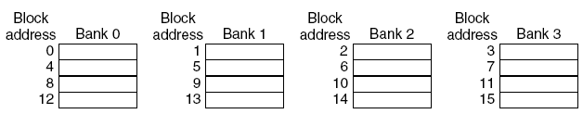
5. Multibanked Caches
Organize cache as independent banks to support simultaneous access to increase cache bandwidth and reduce power
  ARM Cortex-A8 supports 1~4 banks for L2
  Intel i7 supports 4 banks for L1 and 8 banks for L2
Sequential Interleaving: spread addresses of blocks sequentially across banks, e.g. 4-way interleaved
Fig. 2.6
Notes:
Figure 2.6 Four-way interleaved cache banks using block addressing. Assuming 64 bytes per blocks, each of these
addresses would be multiplied by 64 to get byte addressing.

Slide 33
6. Early Restart, Critical Word First
Don’t wait for full block before restarting CPU to reduce miss penalty
  Early restart: request words in normal order and, as soon as the requested word arrives, send it to CPU
  Critical word first: request missed word from memory first and send it to the CPU as soon as it arrives, then fill the rest of the block
Generally useful only in large blocks
Tend to want next sequential word, so not clear if benefit by early restart
block

Slide 34
7. Merging Write Buffers
When storing to a block that is already pending in write buffer, merge requests to reduce miss penalty
Wr. addr
V
V
V
V
Need to initiate 4 separate writes back to lower level memory
100
1
Mem[100]
0
0
0
108
1
Mem[108]
0
0
0
116
1
Mem[116]
0
0
0
124
1
Mem[124]
0
0
0
Wr. addr
V
V
V
V
One single write back to lower level memory
100
1
Mem[100]
1
Mem[108]
1
Mem[116]
1
Mem[124]
0
0
0
0
0
0
0
0
Fig. 2.7
0
0
0
0
Notes:
4 entries in the write buffer, each can hold up to 4 64-bit words
Do not apply to I/O addresses; Memory-mapped I/O assigns memory addresses to registers of I/O devices → they are not contiguous
Figure 2.7 To illustrate write merging, the write buffer on top does not use it while the write buffer on the bottom does. The four writes are merged into a single buffer entry with write merging; without it, the buffer is full even though three-fourths of each entry is wasted. The buffer has four entries, and each entry holds four 64-bit words. The address for each entry is on the left, with a valid bit (V) indicating whether the next sequential 8 bytes in this entry are occupied. (Without write merging, the words to the right in the upper part of the figure would only be used for instructions that wrote multiple words at the same time.)

Slide 35
8. Compiler Optimizations
For reducing miss rate
Instructions
  Reorder procedures in memory to reduce conflict misses
  Use profiling to look at conflicts
Data
  Loop Interchange: change nesting of loops to access data in order stored in memory
  Loop Fusion: combine two independent loops that have same looping and access some common variables
  Blocking: partition large array into smaller blocks, thus fitting the accessed array elements into cache size to improve temporal locality

Slide 36
Loop Interchange
j=0
Row-major ordering
i=0
/* Before */
for (j=0; j<100; j++)
for (i=0; i<5000; i++)
x[i][j] = 2*x[i][j]
What is the worst that could happen?
Hint: DM cache
/* After */
for (i=0; i<5000; i++)
for (j=0; j<100; j++)
x[i][j] = 2*x[i][j]
j=0
i=0
  Reduce misses by maximizing use of data
  in a cache block before it is discarded
Is this always safe transformation?
Does this always lead to higher efficiency?
Notes:
Causing trashing, or working set larger than cache size → LRU Insertion Policy in page 35

Slide 37
Loop Fusion
Separate loops that access some common data
/* Before */
for (i = 0; i < N; i++)
a[i] = 1/b[i] * c[i];
for (i = 0; i < N; i = i+1)
d[i] = a[i] + c[i];
/* After */
for (i = 0; i < N; i++) {
a[i] = 1/b[i] * c[i];
d[i] = a[i] + c[i];}
2 misses per access to a and c vs. one miss per access; improve spatial locality

Slide 38
Loop Blocking
/* Before */
for (i=0; i<N; i++)
for (j=0; j<N; j++) {
r=0;
for (k=0; k<N; k++)
r += y[i][k]*z[k][j];
x[i][j] = r;
}
Some arrays accessed by rows
and others by column
Cannot store row-by-row or
column-by-column
y[i][k]
z[k][j]
X[i][j]
k
j
i
k
i

Slide 39
Loop Blocking
Partition loop’s iteration space into many smaller chunks → improving temporal locality
Maximize accesses to the data loaded into the cache before the data are replaced
y[i][k]
z[k][j]
X[i][j]
k
j
j
i
k
i

Slide 40
Loop Blocking
/* After */
for (jj=0; jj<N; jj=jj+B)
for (kk=0; kk<N; kk=kk+B)
for (i=0; i<N; i++)
for (j=jj, r=0; j<min(jj+B-1,N); j++) {
for (k=kk; k<min(kk+B-1,N); k++)
r = r + y[i][k]*z[k][j];
x[i][j] = x[i][j] + r;
};
B is called Blocking Factor
Capacity misses from 2N³ + N² to 2N³/B +N²

Slide 41
9. Prefetching - Overview
Predict what data will be needed in future
Pollution vs. latency reduction
  If correctly predict, can reduce miss penalty. If mispredict, will bring in unwanted data and pollute the cache
To determine the effectiveness
  When to initiate prefetching? (Timeliness)
  Which blocks to prefetch?
  How big a block to prefetch? (note that cache mechanism already performs prefetching)
  What to replace?
Software (data) prefetching vs. hardware prefetching

Slide 42
Hardware Instruction Prefetching
Sequential instruction prefetching
  Fetches 2 blocks on a miss and places the extra block in stream buffer (One Block Lookahead, OBL)
  On miss, check stream buffer: if present, move stream buffer block into cache and prefetch next block (i+2)
Prefetched
instruction block
Req
block
Stream
Buffer
CPU
Unified L2 Cache
L1 Instruction
RF
Req
block

Slide 43
Hardware Data Prefetch
Sequential prefetching also effective for data
  Can extend to N block lookahead
Strided prefetch
  If observe sequence of accesses to block b, b+N, b+2N, then prefetch b+3N etc.
Example:
  IBM Power 5 supports eight independent streams of strided prefetch per processor, prefetching 12 blocks ahead of current access
  Intel Core i7 supports one block lookahead only
Prefetching benefits if having extra memory bandwidth that can be used without penalty

Slide 44
10. Compiler Prefetching
Compiler inserts data prefetching instructions before data is needed
  Register prefetch: load data into registers (HP PA-RISC)
  Cache prefetch: load data into cache (MIPS IV, PowerPC, SPARC v. 9)
Prefetching instructions may cause faults, e.g. virtual address faults or protection violations
  Ideal prefetching: semantically invisible (does not change contents of registers and memory, and cannot cause virtual memory faults)
  Most processors offer non-faulting cache prefetches (prefetch instr. turned into no-ops if would cause faults)
Notes:
Non-faulting prefetch: turn into no-ops if would result in an exception
Normal loads can be considered as “faulting register prefetch instructions”

Slide 45
Supporting Software Prefetching
Require nonblocking data cache to allow processor proceeds while prefetching data
May cause processor to stall if latency of prefetching is long → can use loop unrolling to aggregate larger chunk of computations (see next slide)
Issuing prefetch instructions incurs overhead
  Is cost of prefetch issues < savings in reduced misses?
  Should focus on references that are likely to be cache misses to prefetch

Slide 46
Unrolling for Software Prefetching
for (i=0; i<N; i++) {
prefetch(&a[i+1]);
prefetch(&b[i+1]);
sop = sop + a[i]*b[i];
}
/* unroll loop 4 times */
for (i=0; i<N-4; i+=4) {
prefetch(&a[i+4],4);
prefetch(&b[i+4],4);
sop = sop + a[i]*b[i];
sop = sop + a[i+1]*b[i+1];
sop = sop + a[i+2]*b[i+2];
sop = sop + a[i+3]*b[i+3];
}
sop = sop + a[N-4]*b[N-4];
sop = sop + a[N-3]*b[N-3];
sop = sop + a[N-2]*b[N-2];
sop = sop + a[N-1]*b[N-1];
For larger miss penalty, larger chunk of computation to overlap with prefetching latency

Slide 47
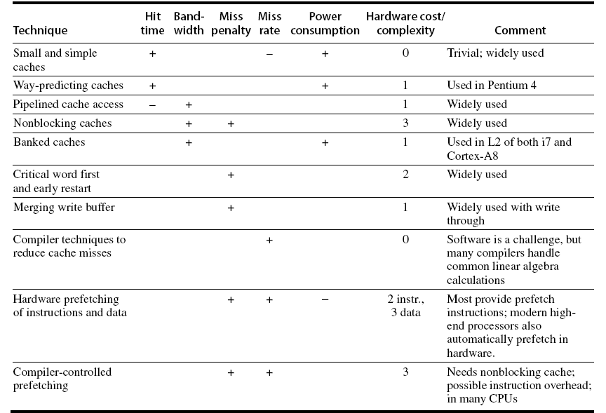
Summary

Slide 48
Recap
Memory hierarchy exploits program locality to reduce average memory access time
Types of caches
  Direct mapped, set-associative, fully associative
Cache policies
  Cache replacement: victim selection, insertion policy
  Write through vs. Write back
  Write allocate vs. No write allocate
Basic and advanced cache optimization techniques
  Reducing hit time, increasing cache bandwidth, reducing miss penalty, reducing miss rate, reducing miss penalty or miss rate by parallelism

