Slide 1
CS5100 Advanced Computer Architecture
Course Overview
Prof. Chung-Ta King
Department of Computer Science
National Tsing Hua University, Taiwan
(Slides are from textbook, Prof. Hsien-Hsin Lee, Prof. Yasun Hsu, Prof. Marc Snir)

Slide 2
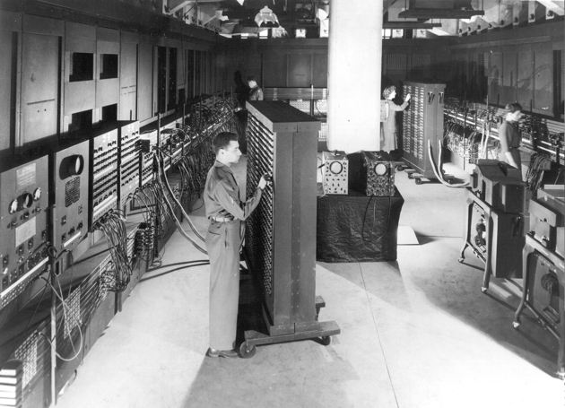
What Is This?
ENIAC (Electronic Numerical Integrator And Computer):
1st fully operational electronic general-purpose computer (1946)
https://en.wikipedia.org/wiki/ENIAC#/media/File:Classic_shot_of_the_ENIAC.jpg

Slide 3
When was the first processor on-a-chip developed?

Slide 4
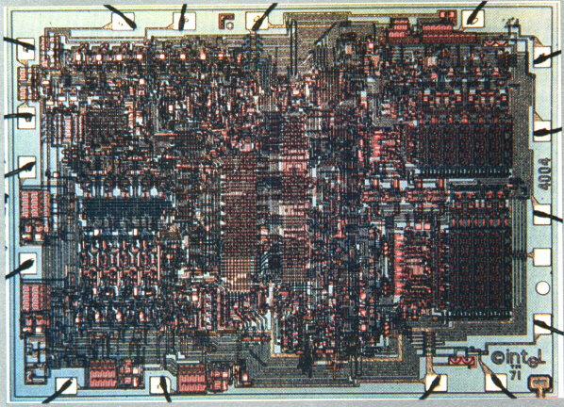
Intel 4004 (1971)
1st processor on a chip
4-bit processor for calculator
2312 transistors
16-pin DIP package
0.4 MHz
10 micron PMOS
1K data memory
4K program memory
Roughly 0.1M ops/s
http://www.physics.mcmaster.ca/phy4d6/Lab/Photos/4004.jpg

Slide 5
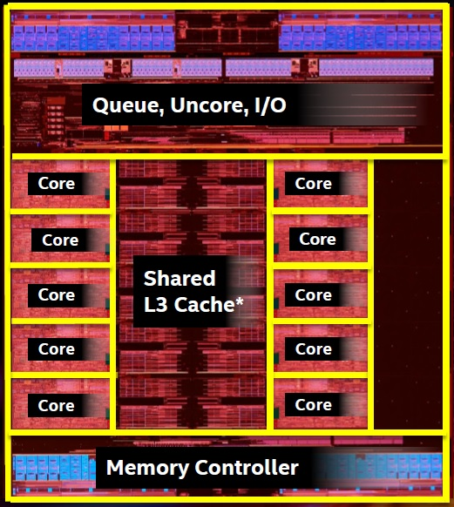
What about Today’s Processors?
Intel® Core™ i7-6950X
  10 cores, 20 threads/core
  64-bit instruction set
  25M L3 shared cache
  Up to 128 GB memory
  3.0 GHz
  14 nm
  140 W
  Launched Q2'16

Slide 6

What If Airplanes Keep the Same Rate?
If Boeing 747-200B = Intel 4004, and
today’s airplane = Intel Core i7-6950X, then today’s airplane could take
  10 cores x 20 threads x (64/4 bits) x 450 = 1,440,000 passengers
  from Taipei to New York in 0.4 MHz/3.0 GHz x 14 hr = 6.72 sec
Boeing 747-200B
In service: 1971
Passengers: 450
Cruise speed: 895 km/hr
Taipei → New York: 12500 km = 14 hr

Slide 7
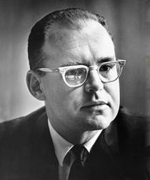
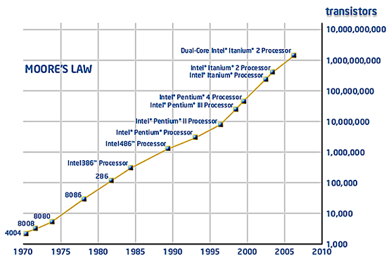
Why Such Changes in 43 Years?
# transistors on ICs x2 every 2 years
Exponential growth
Source: Intel Corp.

Slide 8
However, Quantity ≠ Performance!
What matters most in progresses of semiconductor technology is the shrinking transistors
  With the same chip size, shrinking transistors give more transistors on the chip
  Shrinking transistors lead to performance improvements…
However, given more transistors, if there were no clever ways to use them effectively, we still would not get the computer performance
➔ the critical role of computer architecture

Slide 9
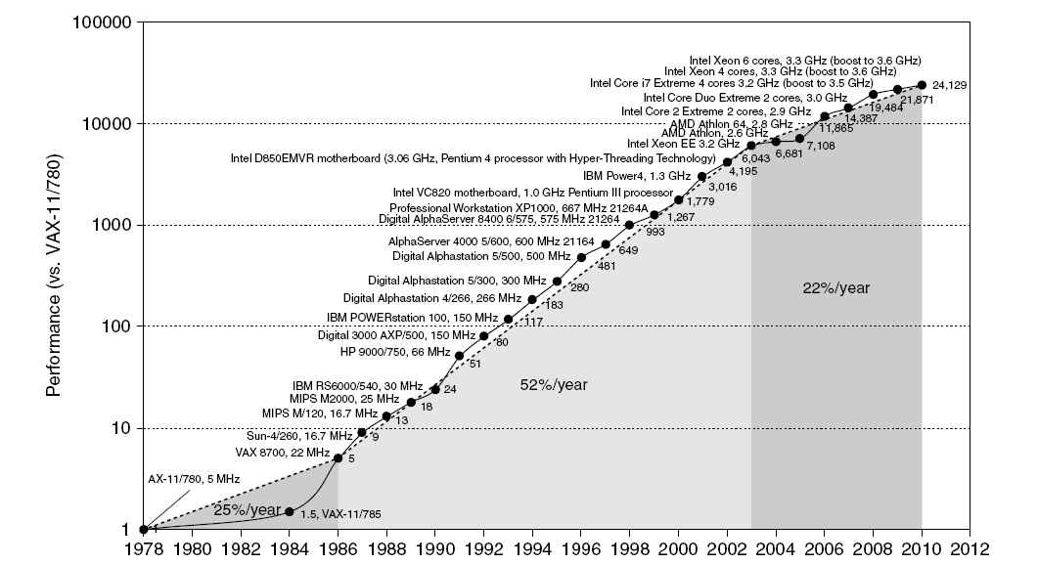
Influences of Computer Architecture
Move to multi-processor
RISC

Slide 10
What Is Computer Architecture?
“Old” view of computer architecture:
  Instruction Set Architecture (ISA) design
  i.e. decisions regarding:
    registers, memory addressing, addressing modes, instruction operands, available operations, control flow instructions, instruction encoding
“Real” computer architecture:
  Specific requirements of the target machine
  Design to maximize performance within constraints: cost, power, and availability
  Includes ISA, microarchitecture, hardware

Slide 11
Constantly Changing Definition
50s to 60s: ≈ computer arithmetic
70s to mid 80s: instruction set design, especially ISA appropriate for compilers
90s: speculation (predict this, predict that); memory system; I/O system; multiprocessors; networks
2000s: power efficiency, on-die interconnection network, heterogeneity (multi-this, multi-that)
2015 and beyond: 1000’s cores, specialization, data intensive, irregular, asynchronous, self- and dynamic adapting, deep memory, dark silicon, post-Moore

Slide 12
Job Description of a Computer Architect
Used to be “performance, performance, performance”
  Make trade-off of performance, complexity, power, technology, cost, ... → just like an architect (建築師)
New trends
  Availability: where you store your photos, emails and shared docs today? Cloud computing
  Reliability: Toyota blamed soft errors for the sudden acceleration problem
  Security: Intel acquired McAfee
  Power management: It is about money!
Notes:
Architects need a system view of the whole system

Slide 13
Job Description of a Computer Architect
Understand application requirements
  General purpose desktop (Intel, AMD)
  Mobile (ARM, Intel, Qualcomm)
  Game/multimedia (Nvidia, Wii, Xbox 360, Kinect)
  Embedded and real-time (ARM, Atom, MIPS)
  Online transactional processing (OLTP), data warehouse servers, e.g., Sun Fire T2000 (UltraSparc T1/2), IBM POWER (p690), Google Cluster, etc.
  Scientific (finite element analysis, protein folding, weather forecast, defense related, e.g., IBM BlueGene, Nvidia, Cray XK7, Fujitsu’s K Computer (京)
  Sometimes, there is no boundary …

Slide 14
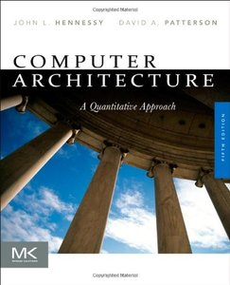
Course Scope ⎯ To Learn
Core concepts of modern microprocessor architecture
Technology and performance
Memory hierarchy: cache, DRAM, VM
Instruction-level parallelism:
  Compiler, branch prediction, dynamic scheduling,
  speculation, multithreading
Data-level parallelism
  Vector, SIMD, GPU architecture
Thread-level parallelism
  Centralized and distributed shared-memory architecture, synchronization and memory consistency
Warehouse-scale parallelism
  Programming model and architecture, cloud computing
Textbook
Notes:
Learn from the past to understand the future possibilities
Focus more on single processor

Slide 15
Course Information
Instructor: Prof. Chung-Ta King (金仲達教授)
  Office: Delta 640 Phone: x42804
  email: king@cs.nthu.edu.tw
Teaching assistants: 蔡杰霖、何基愷
  Office: CSEE 734 Phone: x33553
Class time:
  Monday 10:10 - 12:00
  Wednesday 9:00 - 9:50
Classroom: Delta 104
Course materials: iLMS
  http://www.cs.nthu.edu.tw/~king/courses/cs5100.html

Slide 16
Expected Workload and Grading
Prerequisite: CS4100 Computer Architecture or the equivalent
5~7 homework assignments: 55%
  At least two programming assignments using Gem5 or QEMU
Midterm exam: 20%
Final exam: 20%
Class participation (in-class quizzes and Q&A): 5%

Slide 17
Course Conducts
You can discuss with your classmates about the assignments, but the final work must be your own!
You are not allowed to discuss with your classmates during the exams
Any caught cheating in assignment, quiz, exam or final project will receive a grade of ZERO

Slide 18
My Expectations
For my part:
  To help you to learn the course well
  Try to stimulate class interactions
For your part:
  Strong motivation to learn and persistence
  Learn to learn proactively
  Understand that there is often no single answer
  Summarize in your own words whatever you learned
  Ask me if you do not understand
  Tell me if you cannot keep up

