Slide 1
CS4101 Introduction to Embedded Systems Lab 11: Task Synchronization
Prof. Chung-Ta King
Department of Computer Science
National Tsing Hua University, Taiwan

Slide 2
Outline
In this lab, we will learn...
Quick review of counting semaphore and mutex
More sensors:
RFID, IR Remote
How to implement a shared space between multiple tasks on Arduino using semaphores?

Slide 3
Counting Semaphores
Typically used for two things:
Counting events:
An event handler will 'give' a semaphore each time an event occurs, and a handler task will 'take' a semaphore each time it processes an event
Resource management:
The count value indicates number of available resources
To get a resource, a task must obtain (take) a semaphore
When a task finishes with the resource, it 'gives' the semaphore back
SemaphoreHandle_t xSemaphoreCreateCounting( UBaseType_t uxMaxCount, UBaseType_t uxInitialCount)

Slide 4
Counting Semaphore Example (1/2)
xSemaphoreHandle count_sem; //Global Handler int main(void){ // Parameter for uxMaxCount, uxInitialCount count_sem = xSemaphoreCreateCounting(2, 2); // Create tasks with priority 1 for both users xTaskCreate(task1, (signed char*)) “t1", 1024, NULL, 1, NULL); xTaskCreate(task2, (signed char*)) “t2", 1024, NULL, 1, NULL); vTaskStartScheduler(); return 0; }

Slide 5
Counting Semaphore Example (2/2)
void task1(void *p){ while(1){ if(xSemaphoreTake(count_sem, portMAX_DELAY)){ xSemaphoreGive(count_sem); } vTaskDelay(3000); } } void task2(void *p){ while(1){ if(xSemaphoreTake(count_sem), portMAX_DELAY){ xSemaphoreGive(count_sem); } vTaskDelay(3000); } }

Slide 6
Mutex
Mutexes are used for mutual exclusion, so that only one task at a time uses a shared resource, e.g., file, data, device, ...
To access the shared resource, a task locks the mutex associated with the resource
The task owns the mutex until it unlocks the utex

Slide 7
Mutex
Mutex acts like a token used to guard a resource
When a task wishes to access the resource, it must first obtain ('take') the token
When the task has finished with the resource it must 'give' the token back - allowing other tasks the opportunity to access the same resource
Mutex may cause a high priority task to be waiting on a lower priority one
Even worse, a medium priority task might be running and cause the high priority task to not meet its deadline!
Priority inversion problem

Slide 8
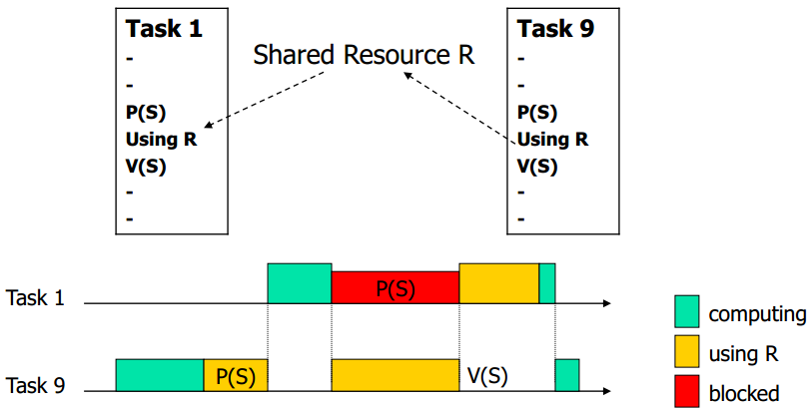
Priority Inversion: Case 1
Assume priority of T₁ > priority of T₉
If T₉ has exclusive access, T₁ has to wait until T₉ releases resource → inverting priority → can raise priority of T₉
T₁ has higher priority and preempts T₉
Critical section
(critical section)

Slide 9
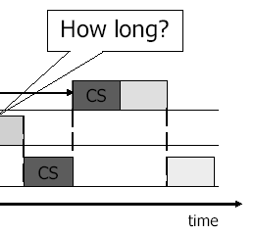
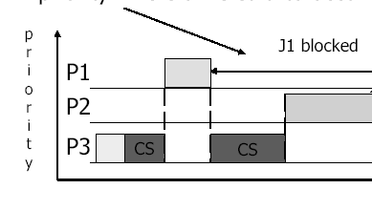
Priority Inversion: Case 2
A medium-priority task preempts a lower-priority task which is using a shared resource on which a higher priority task is blocked
If the higher-priority task would be otherwise ready to run, but a medium-priority task is currently running instead, a priority inversion is occurred

Slide 10
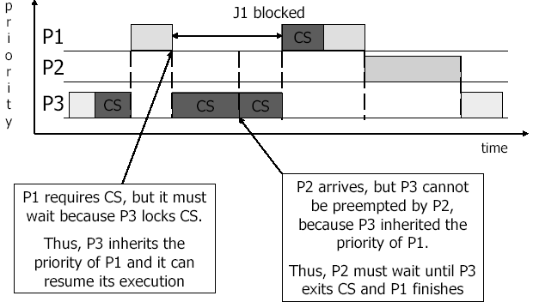
Solving Priority Inversion
Priority inheritance
If a high priority task blocks while attempting to obtain a mutex (token) that is currently held by a lower priority task, then the priority of the task holding the token is temporarily raised to that of the blocking task

Slide 11
Example of Mutex (1/3)
include <semphr.h> SemaphoreHandle_t gatekeeper = 0; //Global handler void user_1(void *p){ while(1){ if(xSemaphoreTake(gatekeeper, 100)){ Serial.println("User 1 got access"); // enter critical section vTaskDelay(200); //stay in C.S. for 200 ticks xSemaphoreGive(gatekeeper); // release semaphore, exit critical section } else{ Serial.println(“User 1 cannot access in 1000 ms"); } vTaskDelay(100); // or do other works // Without delay, user 1 will get key immediately// } }
Notes:
10
10

Slide 12
Example of Mutex (2/3)
void user_2(void *p){ while(1){ if(xSemaphoreTake(gatekeeper, 100)){ Serial.println("User 2 got access"); //critical section xSemaphoreGive(gatekeeper); //release semaphore, exit critical section } else{//fail to get the semaphore Serial.println("User 2 cannot access in 1000 ms"); } vTaskDelay(100); // or do other works // Without delay, user 2 will get key immediately after releasing the key // } }
Notes:
11
11

Slide 13
Example of Mutex (3/3)
void setup(){ Serial.begin(9600); gatekeeper = xSemaphoreCreateMutex(); // Create tasks with priority 1 for both users // xTaskCreate(user_1, (const portCHAR*)"t1", 128, NULL, 1, NULL); xTaskCreate(user_2, (const portCHAR*)"t2", 128, NULL, 2, NULL); Serial.println("test"); vTaskStartScheduler(); } void loop() { ... }
Notes:
12
12

Slide 14
Outline
In this lab, we will learn...
Quick review of mutex
More sensors:
RFID, IR Remote
How to implement a shared space between multiple tasks on Arduino using semaphores?

Slide 15
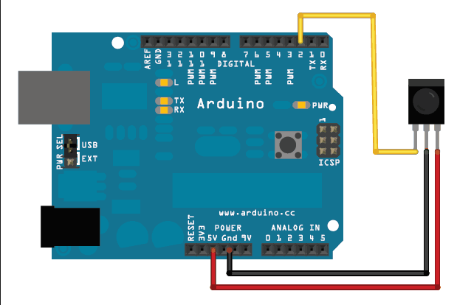
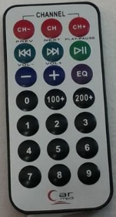
IR Remote

Slide 16
Sample Code: IR Remote
#include <IRremote.h> int RECV_PIN = 2; // set digital 2 to be receive pin IRrecv irrecv(RECV_PIN); decode_results results; void setup() { irrecv.enableIRIn(); // Start the receiver Serial.begin(9600); } void loop() { int i=0; if (irrecv.decode(&results)) { translateIR(); // see http://ppt.cc/GwLey irrecv.resume(); // Receive the next value } }
Notes:
irrecv.decode(&results): Attempt to receive a IR code. Returns true if a code was received, or false if nothing received yet. When a code is received, information is stored into "results".
results.decode_type: Will be one of the following: NEC, SONY, RC5, RC6, or UNKNOWN. results.value: The actual IR code (0 if type is UNKNOWN) results.bits: The number of bits used by this code results.rawbuf: An array of IR pulse times results.rawlen: The number of items stored in the array

Slide 17
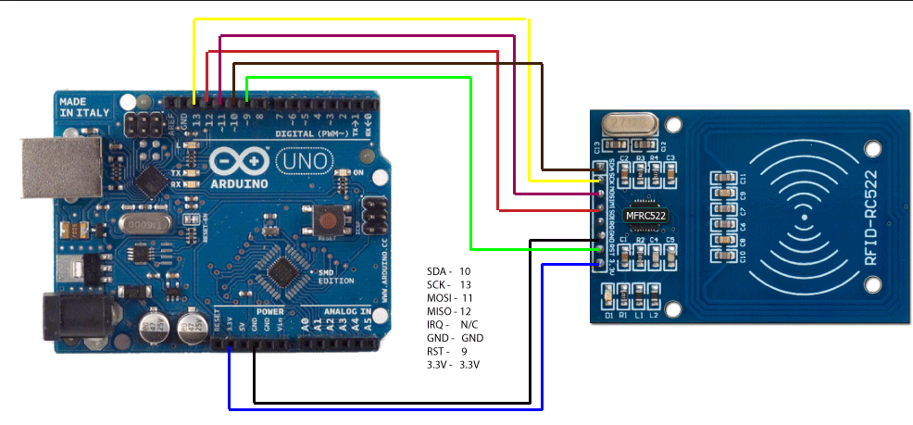
RFID-RC522
Go to https://github.com/miguelbalboa/rfid to download the library and unzip the folder to //Arduino/libraries

Slide 18
Sample Code: RFID-RC522
#include <SPI.h> // header for SPI bus #include <MFRC522.h> #define RST_PIN 9 #define SS_PIN 10 MFRC522 mfrc522(SS_PIN, RST_PIN); // Create Object void setup() { Serial.begin(9600); Serial.println("RFID reader is ready!"); SPI.begin(); mfrc522.PCD_Init(); // initialize FRC522 module }
Notes:
The Serial Peripheral Interface Bus or SPI bus is a synchronous serial data link standard named by Motorola that operates in full duplex mode. Devices communicate in a master/slave mode where the master device initiates the data frame. Multiple slave devices are allowed with individual slave select (chip select) lines using a pin for each device. The begin() method starts SPI communication.

Slide 19
Sample Code: RFID-RC522
void loop() { // check if there is a new card if (mfrc522.PICC_IsNewCardPresent() && mfrc522.PICC_ReadCardSerial()) { byte *id = mfrc522.uid.uidByte; // get new card UID byte idSize = mfrc522.uid.size; // get UID length Serial.print("PICC type: "); MFRC522::PICC_Type piccType = mfrc522.PICC_GetType(mfrc522.uid.sak); Serial.println(mfrc522.PICC_GetTypeName(piccType)); Serial.print("UID Size: "); // print length of UID Serial.println(idSize); for (byte i = 0; i < idSize; i++) { // print UID Serial.print("id["); Serial.print(i); Serial.print("]: "); Serial.println(id[i], HEX);} mfrc522.PICC_HaltA(); // stop the card } }
Notes:
UID = Unique ID PICC = Proximity Integrated Circuit Card (RFID Tag itself) 1 Kb Tags can hold data up to about 1 Kb exact usable space less because of UID. UID generally can be 4 byte or 7 byte, maybe more.

Slide 20
Outline
In this lab, we will learn...
Quick review of mutex
More sensors:
RFID, IR Remote
How to implement a shared space between multiple tasks on Arduino using semaphores?

Slide 21
Basic 1 (40%)
Make the IR remote to be interrupt-driven
Whenever the IR remote is pressed, an interrupt is generated, which wakes up a read-digits task using a binary semaphore.
The read-digits task will read 4 consecutive digits from the IR remote and print them on the LCD display. (Ignore keys that are not digits.)
Do the same to RFID-RC522 using a read-id task, except that the task prints the card UID instead.

Slide 22
Basic 2 (60%)
Instead of letting read-digits and read-id tasks print to the LCD display, let them write to either one of two buffers.
Each buffer is an array that can hold 10 characters
Create a display task will read the text from the filled buffer and print it on the LCD display.
Create yet another task, read-char, that will write to the buffer with “aaaaa” and “bbbbb” alternatively every second.
Use counting semaphores to allow data communicated between sender and receiver tasks.

