Slide 1
CS4101 Introduction to Embedded Systems Lab 10: Tasks and Scheduling
Prof. Chung-Ta King
Department of Computer Science
National Tsing Hua University, Taiwan

Slide 2
Introduction
In this lab, we will learn…
More sensors
Buzzer, LCD display, hex keypad
How to do task scheduling on Arduino?

Slide 3
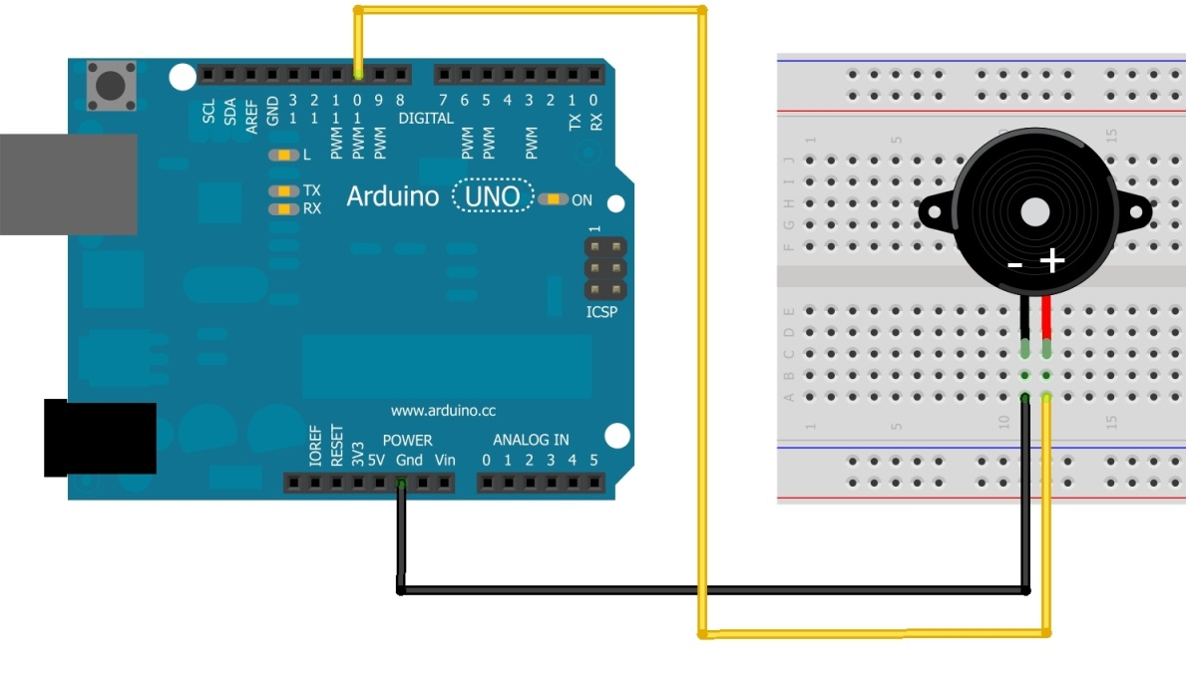
Buzzer
Piezoelectric buzzer:
Contains a metal disc that deforms under a current
By applying an alternating current at a high enough frequency, the disc will move fast to create a sound wave
You have two buzzers; use left one
Side view
Bottom view

Slide 4
Playing a Tone
tone(pin, frequency) tone(pin, frequency, duration)
Generates a square wave of the specified frequency (and 50% duty cycle) on a pin
A duration can be specified, otherwise the wave continues until a call to noTone()
Only one tone can be generated at a time. If the tone is playing on the same pin, the call will set its frequency.
For Uno: min frequency 31 Hz; max frequency 65535 Hz

Slide 5
Sample Code for Buzzer
int buzzer = 10;
int i = 0;
void setup() {
pinMode(buzzer, OUTPUT);
}
void loop() {
for(i=0; i<10; i++) { // imitate sound of ambulance
if(i%2 == 0) tone(buzzer,698);
else tone(buzzer, 523);
delay(500);
}
noTone(buzzer); // turn off the buzzer
delay(2000);
}

Slide 6
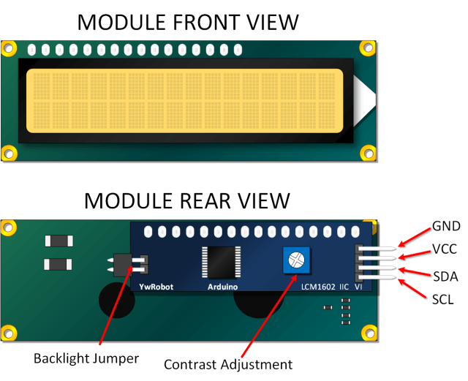
LCD Display
Liquid crystal displays (LCDs) are commonly used to display data in devices such as calculators and many other electronic devices.
They may support message scrolling, cursor displaying, and LED backlight
Most commonly used LCD display is 16×2 LCD Module, which can display 32 ASCII characters in 2 lines (16 characters in 1 line)
LCM1602 IIC V1

Slide 7
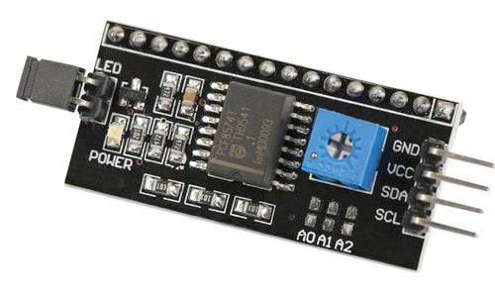
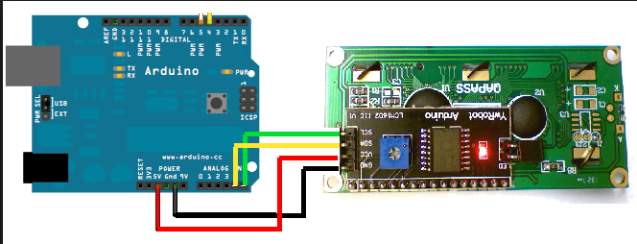
1620 IIC LCD
GND (ground)
VCC (power supply 5V)
SDA (i2c data line)
SCL (i2c clock)
A4
A5

Slide 8
LCD Library
Please download the library to support 1602 IIC LCD from this website:
https://bitbucket.org/fmalpartida/new-liquidcrystal/downloads
Please download the newest version
Remove the original LiquidCrystal folder under arduino-1.6.12\libraries

Slide 9
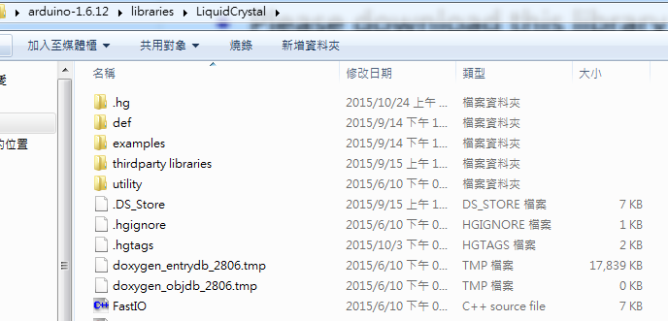
LCD Library
Unzip the file under arduino-1.6.12\libraries

Slide 10
Sample Code for LCD
#include <Wire.h>
#include <LiquidCrystal_I2C.h>
// Set the pins on the I2C chip used for LCD connections:
// addr, en,rw,rs,d4,d5,d6,d7,bl,blpol
LiquidCrystal_I2C lcd(0x3F, 2, 1, 0, 4, 5, 6, 7, 3, POSITIVE);
void setup() {
lcd.begin(16, 2); // initialize LCD
lcd.backlight(); // open LCD backlight
lcd.setCursor(0, 0); // setting cursor
lcd.print("Hello, world!");
delay(1000); lcd.clear();
lcd.setCursor(0, 1);
lcd.print("Type to display");
}
void loop() { }
Notes:
rs: the number of the Arduino pin that is connected to the RS pin on the LCD
rw: the number of the Arduino pin that is connected to the RW pin on the LCD (optional)
enable: the number of the Arduino pin that is connected to the enable pin on the LCD
d0, d1, d2, d3, d4, d5, d6, d7: the numbers of the Arduino pins that are connected to the corresponding data pins on the LCD. d0, d1, d2, and d3 are optional; if omitted, the LCD will be controlled using only the four data lines (d4, d5, d6, d7).

Slide 11
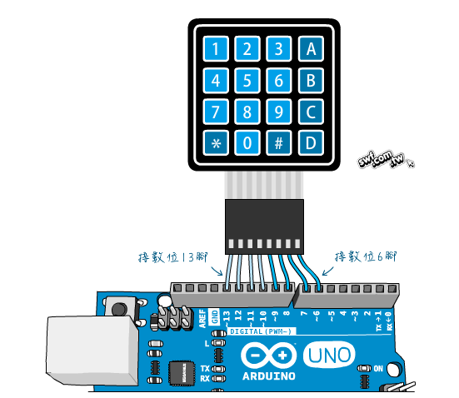
Hex Keypad
Use “column scanning” to identify the pressed key
http://www.circuitstoday.com/interfacing-hex-keypad-to-arduino
Notes:
In this method a particular row is kept low and other rows are held high. Then the logic status of each column line is scanned. If a particular column is found low, then that means the key that comes in between that column and row is short (pressed). Then the program registers that key being pressed. Then the same procedure is applied for the subsequent rows and the entire process is repeated.

Slide 12
Hex Keypad Library
Please download the library from this website:
http://playground.arduino.cc/uploads/Code/keypad.zip
Unzip the file under arduino-1.6.12\libraries

Slide 13
Sample Code for Hex Keypad
#include <Keypad.h>
#define KEY_ROWS 4
#define KEY_COLS 4
char keymap[KEY_ROWS][KEY_COLS] = {
{'1', '2', '3', 'A'},
{'4', '5', '6', 'B'},
{'7', '8', '9', 'C'},
{'*', '0', '#', 'D'}
};
// Column pin 1~4
byte colPins[KEY_COLS] = {9, 8, 7, 6};
// Column pin 1~4
byte rowPins[KEY_ROWS] = {13, 12, 11, 10};

Slide 14
Sample Code for Hex Keypad
// initialize keypad
Keypad myKeypad = Keypad(makeKeymap(keymap), rowPins, colPins, KEY_ROWS, KEY_COLS);
void setup(){
Serial.begin(9600);
}
void loop(){
char key = myKeypad.getKey();
if (key)
Serial.println(key);
}

Slide 15
Lab 10
Basic 1: Implement a traffic light
The traffic light will set the green LED on for 4 sec, then the yellow LED on for 2 sec, and the red LED on for 6 sec, and repeat.
The traffic light will change to the green light when there is an ambulance passing, which is represented by a buzzer
The buzzer will be turned on for 4 sec at 2 Hz (0.5 sec on and 0.5 sec off), indicating that the ambulance will need 4 sec to pass the cross road
The starting time is set randomly between 7 and 12 sec.
During the 4 sec that the buzzer sounds, the traffic light will be turned to the green LED.
After the 4 sec, the traffic light returns to normal.

Slide 16
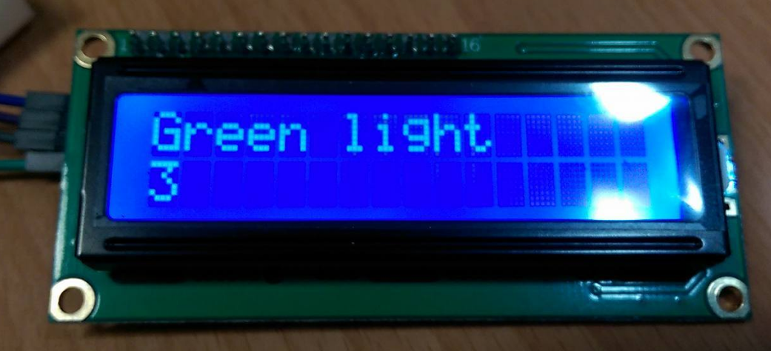
Lab 10
Basic 1 (cont.)
Set the priority of the tasks properly.
Show the current state and duration of the state on the LCD.
For example: if the green light is on for three seconds, then show the string “green light” and the number “3” on the LCD.

Slide 17
Lab 10
Basic 2: Implement a simple Screensaver
Silent mode:
The backlight is off.
If the input from the hex keypad is ‘*’, then go to the unlock mode.
Unlock mode:
Turn on the backlight and print “Enter password:”
If the user enters the correct password (at least 3 characters), then go back to the silent mode. Otherwise, stay in the unlock mode.

