Slide 1
CS4101 Introduction to Embedded Systems Lab 8: Arduino DAC and PWM
Prof. Chung-Ta King
Department of Computer Science
National Tsing Hua University, Taiwan

Slide 2
RGB LED Module
Connect to PWM pins
(pins with a ‘~’ notation)
Since the RGB mini board already contains built-in resistors, you
can connect to Arduino Uno directly.

Slide 3
Sample Code for RGB LED
int redPin = 11, greenPin = 10, bluePin = 9;
void setup() {
pinMode(redPin, OUTPUT);
pinMode(greenPin, OUTPUT);
pinMode(bluePin, OUTPUT);
}
void loop() {
analogWrite(redPin, 50);
analogWrite(greenPin, 100);
analogWrite(bluePin, 150);
delay(1000);
analogWrite(redPin, 0);
analogWrite(greenPin, 0);
analogWrite(bluePin, 0);
delay(1000);
}
Duty cycle: 0~255

Slide 4
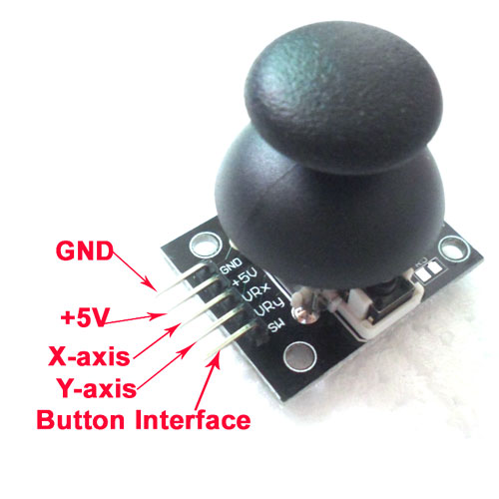
Analog Joystick

Slide 5
Sample Code for Analog Joystick
int button = 2;
int xAxis = A0, yAxis = A1;
void setup() {
Serial.begin(9600);
pinMode(button, INPUT_PULLUP); // LOW when pressed
}
void loop() {
int xVal = analogRead(xAxis);
int yVal = analogRead(yAxis);
int isPress = digitalRead(button);
Serial.print("X="); Serial.print(xVal);
Serial.print("Y="); Serial.print(yVal);
if( isPress == 0) Serial.print("Button is pressed.");
else Serial.print("Button is not pressed.");
delay(200);
}
Notes:
INPUT_PULLUP: use internal pull-up resistors (resistors that connect to power internally)
When the pushbutton is open (unpressed) there is no connection between the two legs of the pushbutton. Because the internal pull-up on pin 2 is active and connected to 5V, we read HIGH when the button is open. When the button is closed, the Arduino reads LOW because a connection to ground is completed.

Slide 6
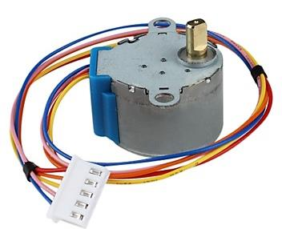
Stepper Motor: 28BYJ-48
Number of phases: 4
Step angle:
8-step sequence: 5.625° (64 steps per revolution)
4-step sequence: 11.25° (32 steps per revolution)
Gear reduction ratio: 1/64
32*64 = 2048 steps per revolution in 4-step sequence
NOTE:
Arduino "Stepper Library" runs in 4-step mode

Slide 7
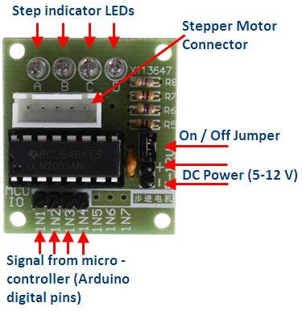
Stepper Motor Driver
5V
GND
Choose 4 pins as input

Slide 8
Sample Code for Stepper Motor
#include <Stepper.h>
#define STEPS 2048 // for 28BYJ-48
// create an instance of the stepper class
Stepper stepper(STEPS, 8, 9, 10, 11);
int previous = 0; // previous reading from analog IN
void setup() {
stepper.setSpeed(5); // set the speed to 5 RPMs
}
void loop() {
int val = analogRead(A0); // get the sensor value
// move # of steps equal to change in sensor reading
stepper.step(val - previous);
// remember the previous value of the sensor
previous = val;
}

Slide 9
Basic 1
Use the analog joystick to control the RGB LED through PWM. Turn the analog joystick and change the light intensity of red and blue LEDs as follows:
When the joystick moves down, red LED will be the brightest. When the joystick is up, turn off red LED.
When the joystick moves left, blue LED will be the brightest. When the joystick is at the right end, turn off the blue LED.
While the joystick is pressed, send 0 V to green pin. Otherwise, send 3 V to green pin.

Slide 10
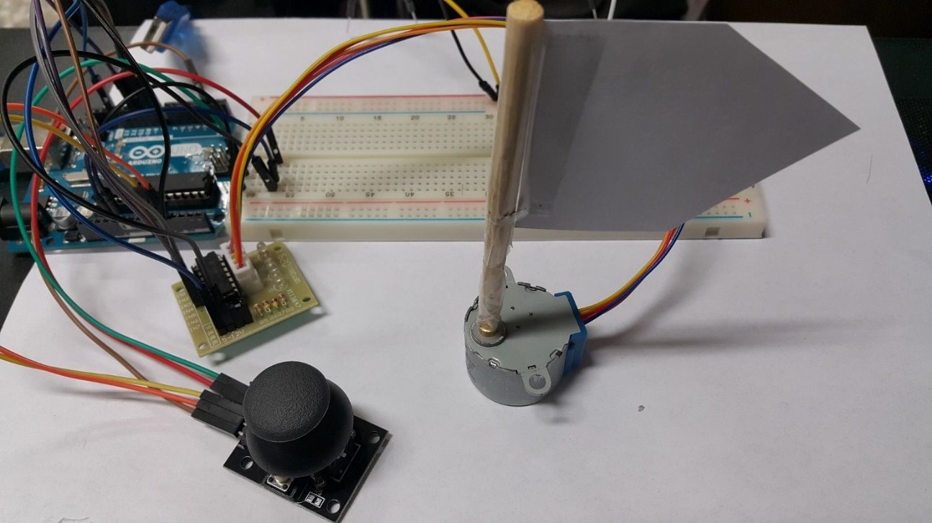
Basic 2
Glue an arrow shaped paper on a stick and put them on the axis of the stepper motor.
Move the arrow corresponding to the input from the analog joystick.
If you can only control 4 directions, you will get 70% of the score.

