Slide 1
CS4101 Introduction to Embedded Systems Lab 7: Arduino Basics
Prof. Chung-Ta King
Department of Computer Science
National Tsing Hua University, Taiwan

Slide 2
Lab 7
Basic 1: Game of Memory
In this lab, you are going to develop a round-based game to test the memory of the player.
The game requires a button, a red LED, and a green LED.
In each round, the red LED is on for x seconds, where x is set randomly between 1 to 5 seconds, and then off.
The player counts the duration that the red LED is on and then presses the button for the same amount of time.
If the difference between the button-press time and x is within a margin y seconds, then the player wins this round and the green LED is blinked twice (0.5 second on and off).
Otherwise, the red LED is blinked 5 times (0.2 second on and off).

Slide 3
Lab 7
Basic 1: (cont.)
At the end of each round, transfer the result to the PC, including the LED on time and button-press time.
The PC displays the accumulated counts of wins and loses, and the LED on time and button-press time of the last round.
All the events must be handled by interrupts.

Slide 4
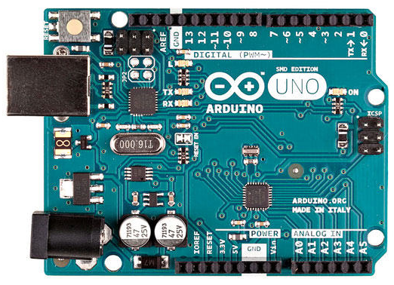
Serial Communication to/from PC
Serial communication
Arduino UNO has one serial port, called UART or USART
The serial port uses TX (pin 1) and RX (pin 0) to transmit and receive data

Slide 5
Serial Communication to/from PC
Serial communication
The Arduino IDE has a feature, called “Serial Monitor”, which is a separate pop-up window that acts as a terminal to communicate with the Arduino UNO by receiving and sending serial data
Arduino’s serial library supports serial communication
Serial.begin() - start serial port and set baud rate
Serial.println() - transmit the data to PC
Serial.read() - receive the data from PC

Slide 6
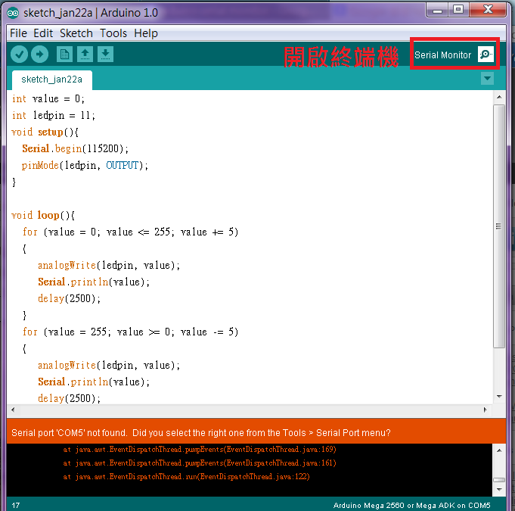
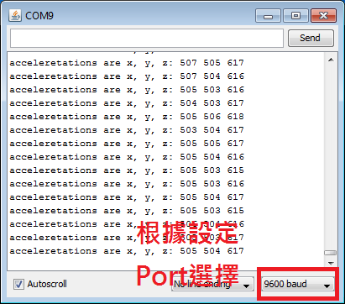

Slide 7
Sample Code for Serial Communication
void setup() {
// Open serial port, set baud rate
Serial.begin(9600);
int value = 65; // data to be transmitted
Serial.println(value); // print “65”
Serial.println(value, DEC); // same as above
Serial.println(value, HEX); // print “41”
Serial.println(value, BIN); // print “01000001”
Serial.println(value, BYTE); // print “A”
}
void loop() {
...
}

Slide 8
Sample Code for Serial Communication

Slide 9
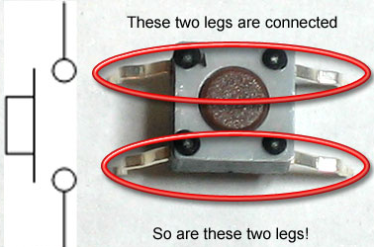
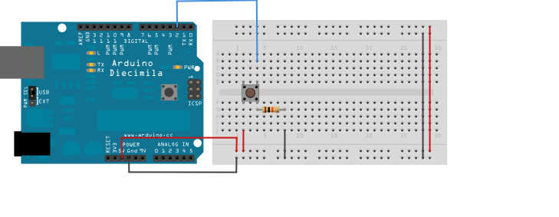
Pushbutton Switch
Pushbutton internal:
Button connection: 10K ohm resistor in series
LED connection: 220 ohm resistor in series
(http://www.ladyada.net/learn/arduino/lesson5.html)

Slide 10
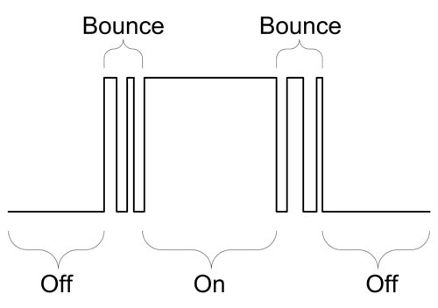
Pushbutton Bounce Problem
Pushbutton bounce:
Push buttons often generate spurious open/close transitions when pressed due to mechanical and physical issues
These transitions may be read as multiple presses in a very short time, which cause the program to confuse.
The problem can be solved with hardware or software.
A simple idea for debouncing: check twice in a short period of time to make sure the pushbutton is definitely pressed.
(http://www.protostack.com/blog/2010/03/debouncing-a-switch/)

Slide 11
Sample Code for Debouncing
int led_pin = 13;
int button_int = 0; // Interrupt 0 is on pin 2
int toggle_on = false; // Button click switches LED
void setup() {
attachInterrupt(button_int, handle_click, RISING);
// Register handler
}
void loop() {
if (toggle_on) {
digitWrite(led_pin, HIGH);
} else {
digitWrite(led_pin, LOW);
}
}

Slide 12
Sample Code for Debouncing
void handle_click() {
static unsigned long last_int_time = 0;
unsigned long int_time = millis(); // Read the clock
if (int_time - last_int_time > 200 ) {
// Ignore when < 200 msec
toggle_on = !toggle_on;
}
last_int_time = int_time;
}

