Slide 1
CS4101 Introduction to Embedded Systems Lab 2: Timer and Clock
Prof. Chung-Ta King
Department of Computer Science
National Tsing Hua University, Taiwan

Slide 2
Introduction
In this lab, we will learn the timer and clock systems of MSP430 LanuchPad
Basic setting of the timer
Capture/compare block of the timer
Characteristics of different clock sources and their settings
Clock
Timer

Slide 3
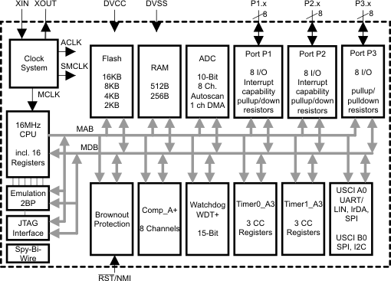
Interior of MSP430G2553
Clock system
IO
X
Not available on 20-pin device
Timer system

Slide 4
Lab 2
Basic 1:
Flash the red and green LED alternatively whenever the button is pressed and released once. The LEDs change right after the button is released. The LEDs flash at 1 Hz (0.3 sec on and 0.7 sec off) by polling Timer0_A3m which is driven by ACLK sourced from VLO (running at 12 KHz).
Note: There are two events to monitor: timer up and button up and down.
Note: Since TAR register is 16-bit (0~65535) long, you should be careful of its overflow.

Slide 5
Lab 2
Basic 2:
When the button is up, neither of the LEDs is on.
When the button is down, only flash the green LED according to the settings in Basic 1. But if the button is pressed for more than 3 seconds, flash only the red LED instead (on for 0.2 sec and off for 0.8 sec), which is controlled by polling Timer1_A driven by SMCLK sourced by DCO.
Note: You have to use the Capture/Compare Block to detect how long the button is pressed.

