Slide 1
CS4101 嵌入式系統概論 RT Scheduling & Synchronization
Prof. Chung-Ta King
Department of Computer Science
National Tsing Hua University, Taiwan
(Materials from Prof. Insup Lee, Prof. Frank Drews, MQX User Guide, Using the FreeRTOS Real Time Kernel, Study of an Operating System: FreeRTOS)

Slide 2
Outline
Real-time task scheduling
Introduction to task synchronization
Queues of FreeRTOS
Semaphores and mutexs of FreeRTOS

Slide 3
What is a Real-Time System?
Real-time systems have been defined as: "those systems in which the correctness of the system depends not only on the logical result of the computation, but also on the time at which the results are produced"
J. Stankovic, "Misconceptions about Real-Time Computing," IEEE Computer, 21(10), October 1988.
Performance measure
Timeliness on timing constraints (deadlines)
Key property
Predictability on timing constraints

Slide 4
Real-Time Characteristics
Fundamental design issues:
To specify the timing constraints of real-time systems
To achieve predictability on satisfying their timing constraints with the existence of other real-time systems
Tasks can be broken into two categories¹
Periodic Tasks: time-driven, recurring at regular intervals
A car checking for pedestrians every 0.1 second
An air monitoring system taking a sample every 10 seconds
Aperiodic: event-driven
The airbag of a car having to react to an impact
The loss of network connectivity
¹Sporadic tasks are sometimes considered as a third category. They are tasks similar to aperiodic tasks but activated with some known bounded rate, which is characterized by a minimum interval of time between two successive activations.

Slide 5
Real-Time Tasks
Periodic task (p,e)
It is invoked repetitively in a regular interval → sampling
Period p = time between sampling (0 < p)
Execution time e = maximum execution time (0 < e < p)
Utilization U = e/p
Deadline: the instant at which a result is needed
deadline
0
5
10
15
period

Slide 6
Types of Deadlines
Hard deadline:
Disastrous or very serious consequences may occur if the deadline is missed
Validation is essential: can all the deadlines be met, even under worst-case scenario?
Deterministic guarantees
Soft deadline
Ideally, deadline should be met for the result to be useful (e.g. good performance), but, even if the deadline is missed, the result still has some uses (degraded perf.)
Best effort approaches

Slide 7
Schedulability
A property indicating whether a set of real-time tasks (a real-time system) can meet their deadlines
(4,1)
(5,2)
(7,2)

Slide 8
Real-Time Scheduling
Determines the order of real-time task executions
Must meet deadlines in all cases
Variations:
Preemptive or non-preemptive
Dynamic priority or static priority
Two representative RT scheduling algorithms
Rate monotonic (RM): static priority, simple to implement, nice properties
Earliest deadline first (EDF): dynamic priority, harder to implement, very nice properties

Slide 9
Rate Monotonic Scheduling
RMS [Liu and Layland, 73]: widely-used, analyzable scheduling policy
Assumptions:
All processes run periodically on single CPU
Zero context switch time
No data dependencies between processes
Process execution time is constant
Deadline is at end of respective period
Highest-priority ready process runs
Tasks can be preempted
Liu & Layland, “Scheduling algorithms for multi-programming in a hard-real-time environment”, Journal of ACM, 1973.

Slide 10
Rate Monotonic Scheduling
Optimal static priority assignment:
Shortest-period task gets highest priority
Break ties arbitrarily
No static-priority scheme does better
In terms of CPU utilization
Deadline missed!
0
5
10
15
response time of T₃

Slide 11
Rate Monotonic Scheduling
Let n be # of tasks, if total utilization < n(2^{1/n}-1), tasks are schedulable (at n=∞ → 69.3%)
This means that RMS algorithm will work if the total CPU utilization is less than 2/3!
0
5
10
15

Slide 12
Another RMS Example
Process Execution time Period
P1 1 4
P2 2 6
P3 3 12
Utilization = 0.5
Preempted
Resumed
Preempted
Resumed
P3
P3
P3
P2
P2
P1
P1
P1
time
0
2
4
6
8
10
12

Slide 13
Earliest-Deadline-First Scheduling (EDF)
Task closest to its deadline has highest priority
Requires recalculating priority of tasks at every time unit
Dynamic priority assignment: priority of a task is assigned as the task arrives
Tasks do not have to be periodic
EDF is an optimal uniprocessor scheduling algorithm
Can use 100% of CPU
Scheduling cost is high and ready queue can reassign priority
May fail to meet a deadline
Cannot guarantee who will miss deadline, but RMS can guarantee that the lowest priority task misses deadline

Slide 14
Earliest-Deadline-First Scheduling (EDF)
Executes the task with the earliest deadline
Optimal scheduling algorithm
if there is a schedule for a set of real-time tasks, EDF can schedule it
0
5
10
15

Slide 15
Outline
Real-time task scheduling
Introduction to task synchronization
Queues of FreeRTOS
Semaphores and mutexs of FreeRTOS

Slide 16
Why Synchronization?
Synchronization may be used to solve:
Mutual exclusion
Control flow
Data flow
Synchronization mechanisms include:
Message queues
Semaphores
Mutexs
Events
Correct synchronization mechanism depends on the synchronization issue being addressed
EF
M

Slide 17
Mutual Exclusion
Problem: multiple tasks may “simultaneously” need to access the same resource
Resource may be code, data, peripheral, etc.
Need to allow the shared resource exclusively accessible to only one task at a time
How to do?
Allowing only one task to lock the resource and the rest have to wait for the resource to be unlocked
Common mechanisms: lock/unlock, mutex, semaphore

Slide 18
Control Flow Synchronization
Problem: a task or ISR may need to resume the execution of one or more other tasks, so that tasks execute in an application-controlled order
Mutual exclusion is used to prevent another task from running, while control flow is used to allow another task to run, often specific tasks
How to do?
Common mechanisms: post/wait, signal, event

Slide 19
Data Flow Synchronization
Problem: a task or ISR may need to pass some data to one or more other specific tasks, so that data may be processed in an application-specified order
How to do?
May be accomplished indirectly through control flow synchronization
Common mechanisms: queues, signal, post/wait

Slide 20
Outline
Real-time task scheduling
Introduction to task synchronization
Queues of FreeRTOS
Semaphores and mutexs of FreeRTOS

Slide 21
FreeRTOS Queues
Queues are the primary form of inter-task communications in FreeRTOS
A queue can hold a finite number of fixed size data items.
In most cases, used as thread safe FIFO (First In First Out) buffers with new data being sent to the back of the queue, and removed from the front
Can be used to send messages between tasks, and between interrupts and tasks

Slide 22
FreeRTOS Queues
Queues store a finite number of fixed-size data
May be read and written by different tasks, but do not belong to any task
# of items and item size determined at queue create time
Sending/receiving items are by copy not reference
Queue functions
Create queues: xQueueCreate(), vQueueDelete()
Send/receive data to/from queues: xQueueSend(), xQueueSendToBack(), xQueueReceive(), xQueueReceiveFromISR()
Queue management/number of items in a queue
Blocking on a queue/effect of priority

Slide 23
Blocking on Queues
Queue APIs permit a block time to be specified
When read from an empty queue,
Task will be placed into the Blocked state
Until data is available on the queue or block time expires
When write to a full queue,
Task will be placed into the Blocked state
Until space is available in the queue, or block time expires
If more than one task block on the same queue, then the task with the highest priority will be the task that is unblocked first
If the blocked tasks have equal priority, the task that has been waiting for data the longest will be unblocked

Slide 24
Queue Creation
QueueHandle_t xQueueCreate(
UBaseType_t uxQueueLength,
UBaseType_t uxItemSize);
Creates a new queue instance
Allocates queue storage and returns a handle
uxQueueLength: maximum number of items that the queue can contain
uxItemSize: number of bytes that each item in the queue will require
Items are queued by copy, not by reference, so this is the number of bytes that will be copied for each posted item
Each item on the queue must be the same size

Slide 25
Send Data through Queues
BaseType_t xQueueSend(QueueHandle_t xQueue,
const void * pvItemToQueue,
TickType_t xTicksToWait);
Post an item on a queue
The item is queued by copy, not by reference
Must not be called from an interrupt service routine
xQueue: queue handle to which the item is to be posted
pvItemToQueue: pointer to item to be placed on queue
xTicksToWait: max. time (in ticks) that task should block waiting for space to become available, should it is full
If INCLUDE_vTaskSuspend is set to '1‘, then specifying the block time as portMAX_DELAY will block task indefinitely

Slide 26
Receive Data through Queues
BaseType_t xQueueReceive(
QueueHandle_t xQueue, void *pvBuffer,
TickType_t xTicksToWait);
Receive an item from a queue
The item is received by copy so a buffer of adequate size must be provided
Must not be used in an interrupt service routine
xQueue: queue handle from which to receive item
pvBuffer: pointer to the buffer into which the received item will be copied.
xTicksToWait: max. amount of time the task should block waiting for an item should the queue be empty

Slide 27
Other Functions for Queues
portBASE_TYPE xQueuePeek(
xQueueHandle xQueue,
const void * pvBuffer,
portTickType xTicksToWait);
Receive an item from the head of the queue without the item being removed from the queue
unsigned portBASE_TYPE uxQueueMEssagesWaiting(
xQueueHandle xQueue);
Query the number of items currently in a queue

Slide 28
Example of Queues (1/3): sender_task
QueueHandle_t Global_Queue_Handle = 0; //Global Handler void sender_task(void *p){ int i=0; while(1){ Serial.println("sent a value:"); Serial.println(i); if(!xQueueSend(Global_Queue_Handle, &i, 1000)) Serial.println("Failed to send to queue"); i++; vTaskDelay(3000/portTICK_PERIOD_MS); //delay 3 sec } }
Notes:
27
27

Slide 29
Example of Queues (2/3): receiver_task
void receiver_task(void *p){ int rx_int = 0; while(1){ if(xQueueReceive(Global_Queue_Handle,&rx_int,1000)) { Serial.println("receive a value:"); Serial.println(rx_int); } else Serial.println("Failed to receive from queue"); } }
Notes:
28
28

Slide 30
Example of Queues (3/3): setup
void setup() { Serial.begin(9600); Global_Queue_Handle = xQueueCreate(3, sizeof(int)); // create a queue of 3 int // Create tasks with priority 1 // xTaskCreate(sender_task,(const portCHAR *)"sx", 128, NULL, 1, NULL); xTaskCreate(receiver_task,(const portCHAR *)"rx", 128, NULL, 1, NULL); vTaskStartScheduler(); }
Notes:
29
29

Slide 31
Outline
Real-time task scheduling
Introduction to task synchronization
Queues of FreeRTOS
Semaphores and mutexs of FreeRTOS
Binary semaphores
Counting semaphores
Mutex

Slide 32
Semaphores
Semaphores are used to:
Control access to a shared resource (mutual exclusion)
Signal the occurrence of an event
Allow two tasks to synchronize their activities
Basic idea
A semaphore contains a number of tokens. The code needs to acquire one in order to continue execution
If all the tokens of the semaphore are used, the requesting task is suspended until some tokens are released by their current owners

Slide 33
How Semaphores Work?
A semaphore has:
Counter: maximum number of concurrent accesses
Queue: for tasks that wait for access
If a task requests (waits for) a semaphore
if counter > 0, then (1) the counter is decremented by 1, and (2) task gets the semaphore and proceed to do work
Else task is blocked and put in the queue
If a task releases (posts) a semaphore
if there are tasks in the semaphore queue, then appropriate task is readied, according to queuing policy
Else counter is incremented by 1
Notes:
32
This should be a quick review from the basic RTOS section earlier
Mutex is special case where the count =1 so only one task can hold it at a time

Slide 34
Binary Semaphores
Semaphores with counter = 1, used for mutual exclusion and synchronization
For synchronization purpose, a binary semaphore can be think of as a queue that only holds one item
The queue can only be empty or full (hence binary)
Tasks using the queue don't care what the queue holds, only want to know if the queue is empty or full
If more than one task blocks on the same semaphore, then the task with the highest priority will be the task that is unblocked the next time the semaphore becomes available

Slide 35
Binary Semaphores and Interrupts
The best way to handle complex events triggered by interrupts is to not do the code in the ISR
Create a task that is blocking on a binary semaphore
When the interrupt happens, the ISR just sets (gives) the semaphore and exits
Task can now be scheduled like any other
No need to worry about nesting interrupts and interrupt priority
This is called Deferred Interrupt Processing

Slide 36
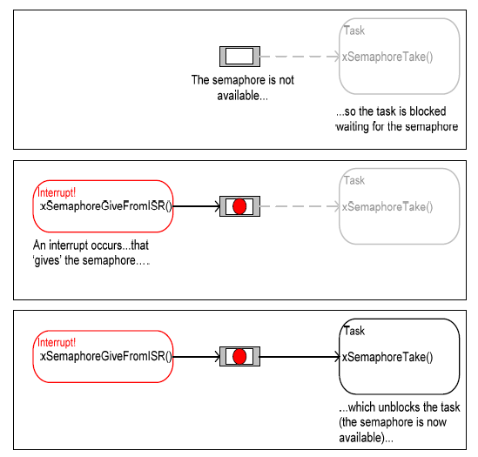
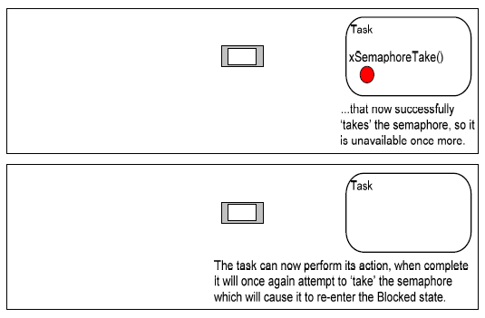
Binary Semaphores and Interrupts
Figure from Using the FreeRTOS Real Time Kernel (a pdf book), fair use claimed.

Slide 37
Create a Binary Semaphore
SemaphoreHandle_t xSemaphoreCreateBinary(void);
Function to create a binary semaphore
The semaphore is created in the 'empty' state
A binary semaphore need not be given back once obtained, so task synchronization can be implemented by one task/interrupt continuously 'giving' the semaphore while another continuously 'takes' the semaphore
Binary semaphores are assigned to variables of type SemaphoreHandle_t and can be used in any API function that takes a parameter of this type

Slide 38
Set a Binary Semaphore
xSemaphoreGiveFromISR(
SemaphoreHandle_t xSemaphore,
signed BaseType_t *pxHigherPriorityTaskWoken)
Set (give) a semaphore
Can be used from an ISR
xSemaphore: handle to the semaphore being released
pxHigherPriorityTaskWoken: set to pdTRUE if giving the semaphore caused a task of a higher priority to unblock, causing a context switch

Slide 39
Reset a Binary Semaphore
xSemaphoreTake( xSemaphoreHandle xSemaphore,
portTickType xBlockTime)
Reset (take) a semaphore
xSemaphore: handle to the semaphore being taken
xBlockTime: time in ticks to wait for the semaphore to become available
A block time of zero can be used to poll the semaphore

Slide 40
Example of Binary Semaphores
vSemaphoreHandle binary_sem; //Global handler void one_sec_isr(void){ // an ISR xSemaphoreGiveFromISR(binary_sem, NULL); } void sem_task(void *p){ while(1) if(xSemaphoreTake(binary_sem,999999)) puts("Tick!"); } int main(void){ vSemaphoreCreateBinary(binary_sem); xTaskCreate(sem_task, (signed char*)) "t1", 2048, NULL, 1, NULL); vTaskStartScheduler(); return 0; }
Notes:
39
39

Slide 41
Counting Semaphores
Typically used for two things:
Counting events:
An event handler will 'give' a semaphore each time an event occurs, and a handler task will 'take' a semaphore each time it processes an event
Resource management:
The count value indicates number of available resources
To get a resource, a task must obtain (take) a semaphore
When a task finishes with the resource, it 'gives' the semaphore back
SemaphoreHandle_t xSemaphoreCreateCounting( UBaseType_t uxMaxCount, UBaseType_t uxInitialCount)

Slide 42
Example of Counting Semaphore (1/2)
xSemaphoreHandle count_sem; //Global Handler int main(void){ /**parameter for uxMaxCount, uxInitialCount/ count_sem = xSemaphoreCreateCounting(2, 2); /*Create tasks with priority 1 for both users*/ xTaskCreate(task1, (signed char*)) “t1", 1024, NULL, 1, NULL); xTaskCreate(task2, (signed char*)) “t2", 1024, NULL, 1, NULL); vTaskStartScheduler(); return 0; }

Slide 43
Example of Counting Semaphore (2/2)
void task1(void *p){ while(1){ if(xSemaphoreTake(count_sem, portMAX_DELAY)){ xSemaphoreGive(count_sem); } vTaskDelay(3000); } } void task2(void *p){ while(1){ if(xSemaphoreTake(count_sem), portMAX_DELAY){ xSemaphoreGive(count_sem); } vTaskDelay(3000); } }

Slide 44
Mutex
Mutexes are used for mutual exclusion, so that only one task at a time uses a shared resource, e.g., file, data, device, ...
To access the shared resource, a task locks the mutex associated with the resource
The task owns the mutex, until it unlocks the utex

Slide 45
Mutex
Mutex acts like a token used to guard a resource
When a task wishes to access the resource, it must first obtain ('take') the token
When the task has finished with the resource it must 'give' the token back - allowing other tasks the opportunity to access the same resource
Mutex may cause a high priority task to be waiting on a lower priority one
Even worse, a medium priority task might be running and cause the high priority task to not meet its deadline!
Priority inversion problem

Slide 46
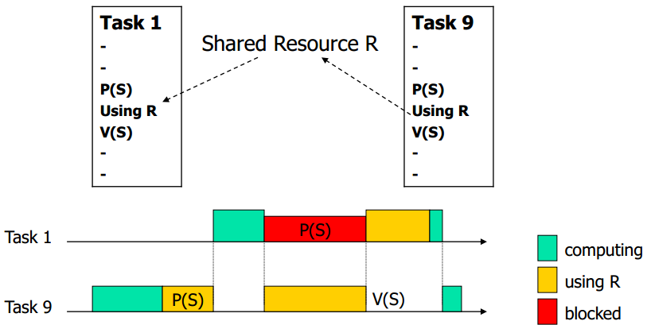
Priority Inversion: Case 1
Assume priority of T₁ > priority of T₉
If T₉ has exclusive access, T₁ has to wait until T₉ releases resource → inverting priority → can raise priority of T₉
T₁ has higher priority and preempts T₉
Critical section
(critical section)

Slide 47
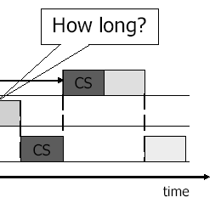
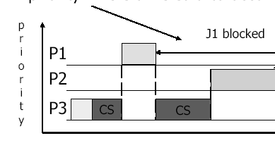
Priority Inversion: Case 2
A medium-priority task preempts a lower-priority task which is using a shared resource on which a higher priority task is blocked
If the higher-priority task would be otherwise ready to run, but a medium-priority task is currently running instead, a priority inversion is occurred

Slide 48
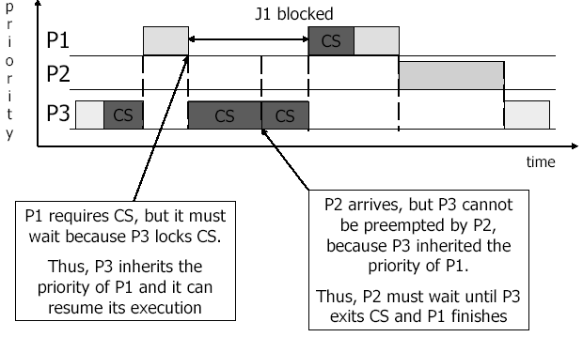
Solving Priority Inversion
Priority inheritance
If a high priority task blocks while attempting to obtain a mutex (token) that is currently held by a lower priority task, then the priority of the task holding the token is temporarily raised to that of the blocking task

Slide 49
Example of Mutex (1/3)
include <semphr.h> SemaphoreHandle_t gatekeeper = 0; //Global handler void user_1(void *p){ while(1){ if(xSemaphoreTake(gatekeeper, 100)){ Serial.println("User 1 got access"); // enter critical section vTaskDelay(200); //stay in C.S. for 200 ticks xSemaphoreGive(gatekeeper); // release semaphore, exit critical section } else{ Serial.println(“User 1 cannot access in 1000 ms"); } vTaskDelay(100); // or do other works // Without delay, user 1 will get key immediately// } }
Notes:
48
48

Slide 50
Example of Mutex (2/3)
void user_2(void *p){ while(1){ if(xSemaphoreTake(gatekeeper, 100)){ Serial.println("User 2 got access"); //critical section xSemaphoreGive(gatekeeper); //release semaphore, exit critical section } else{//fail to get the semaphore Serial.println("User 2 cannot access in 1000 ms"); } vTaskDelay(100); // or do other works // Without delay, user 2 will get key immediately after releasing the key // } }
Notes:
49
49

Slide 51
Example of Mutex (3/3)
void setup(){ Serial.begin(9600); gatekeeper = xSemaphoreCreateMutex(); // Create tasks with priority 1 for both users // xTaskCreate(user_1, (const portCHAR*)"t1", 128, NULL, 1, NULL); xTaskCreate(user_2, (const portCHAR*)"t2", 128, NULL, 2, NULL); Serial.println("test"); vTaskStartScheduler(); } void loop() { ... }
Notes:
50
50

