Slide 1
CS4101 嵌入式系統概論 Tasks and Scheduling
Prof. Chung-Ta King
Department of Computer Science
National Tsing Hua University, Taiwan
(Materials From Using the FreeRTOS Real Time Kernel, Richard Barry, Study of an operating system: FreeRTOS, Nicolas Melot, and
http://www.eecs.umich.edu/eecs/courses/eecs373/Lec/RTOS2.pptx)

Slide 2
Outline
Tasks in FreeRTOS
Task states
Task creation and deletion
Task scheduler of FreeRTOS
Priority and ticks
Delaying a task
Suspending and resuming a task
Idle task hook
Changing priority

Slide 3
Tasks in FreeRTOS
In FreeRTOS, computations are organized around tasks, which are the most basic unit of scheduling
A task is a thread
A task is a function that must return void and take a void pointer parameter:
void ATaskFunction(void *pvParameters);
A task normally runs in an infinite loop and must not return
You inform the scheduler of
The task’s resource needs (stack space, priority)
Any arguments the task needs

Slide 4
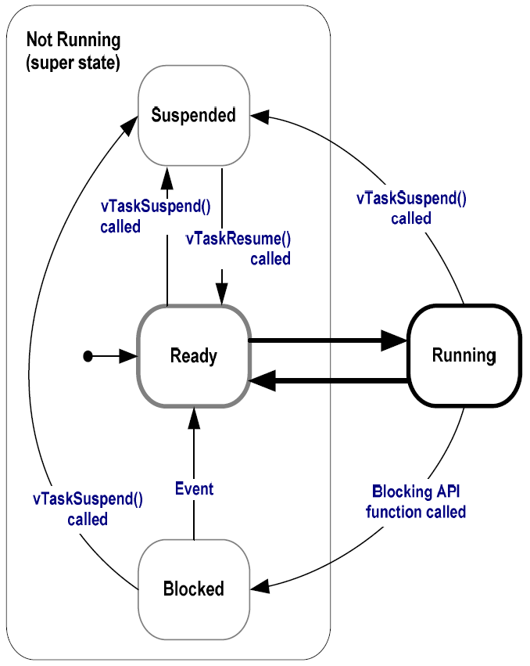
Task States in FreeRTOS
Running:
Task is actually executing
Only one task can exist in Running state at any one time (assuming 1-core system)
Ready:
Task is ready to execute but a task of equal or higher priority is Running

Slide 5
Task States in FreeRTOS
Blocked:
Task is waiting for some event
Time: if a task calls vTaskDelay() it will be blocked until the delay period has expired
Resource: tasks can also block waiting for queue and semaphore events
Suspended:
Much like blocked, but not waiting for anything
Tasks will only enter or exit the suspended state when explicitly commanded to do so through the vTaskSuspend() and vTaskResume() API calls respectively

Slide 6
Task Creation
xTaskCreate(pvTaskCode, pcName, usStackDepth, pvParameters, uxPriority, pxCreatedTask)
pvTaskCode: pointer to task entry function, implemented to never return
pcName: a descriptive name for the task to facilitate debugging
usStackDepth: size of task stack, specified as the number of variables that the stack can hold
pvParameters: pointer to parameters for the task
uxPriority: priority at which the task should run; low numeric priority values denote low priority
pvCreatedTask: pass back a handle to reference the task

Slide 7
Task Deletion
A created task commonly runs in an infinite loop, but it may invoke vTaskDestroy(NULL) to end
void vTaskDelete(TaskHandle_t xTask);
xTask: handle of the task to be deleted; NULL to cause the calling task to be deleted
Remove a task from the RTOS kernels management
void vOtherFunction(void) {
TaskHandle_t xHandle = NULL;
// Create the task, storing the handle.
xTaskCreate(vTaskCode, "NAME", STACK_SIZE, NULL,
tskIDLE_PRIORITY, &xHandle);
// Use the handle to delete the task.
if(xHandle != NULL) vTaskDelete(xHandle);
}
Notes:
Memory allocated by the task code is not automatically freed, and should be freed before the task is deleted.

Slide 8
Outline
Tasks in FreeRTOS
Task states
Task creation and deletion
Task scheduler of FreeRTOS
Priority and ticks
Delaying a task
Suspending and resuming a task
Idle task hook
Changing priority

Slide 9
Scheduler of FreeRTOS
Task scheduling: decide which task in “Ready” state has to be run at a given time
RTOS scheduler is started by calling
void vTaskStartScheduler(void);
RTOS kernel now has control over which tasks are executed and when (Arduino invokes it automatically)
An Idle task is automatically created by scheduler when vTaskStartScheduler() is called
Because CPU always needs something to execute → must always be one task that can enter Running state
The idle task has lowest priority (priority 0) to never prevent a higher priority task from running

Slide 10
Task Priority
FreeRTOS only uses the priorities of tasks to decide which task to run next
The uxPriority parameter of xTaskCreate() assigns an initial priority to the task being created
Can be changed using vTaskPrioritySet()
Low numeric priority values denote low priority tasks
Scheduler always selects the highest priority task that is able to run
When more than one task of the same priority is able to run, the scheduler uses round-robin

Slide 11
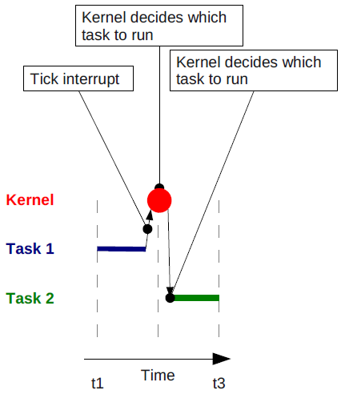
Ticks
To select the next task to run, the scheduler has to be executed periodically
By a periodic interrupt called the tick interrupt
FreeRTOS API calls always specify time in tick interrupts (or just ‘ticks’)
‘Tick count’ is the total number of tick interrupts that have occurred since the scheduler was started

Slide 12
Sample Code for Task Priority
static const char *pcTextForTask1 = “T1 running\r\n”;
static const char *pcTextForTask2 = “T2 running\t\n”;
int main(void) {
/* Create the first task at priority 1. */
xTaskCreate(vTaskFunction, "Task 1", 1000,
(void*)pcTextForTask1, 1, NULL);
/* Create the second task at priority 2. */
xTaskCreate(vTaskFunction, "Task 2", 1000,
(void*)pcTextForTask2, 2, NULL);
/* Start scheduler so the tasks start executing. */
vTaskStartScheduler();
return 0;
}

Slide 13
Running Multiple Periodic Tasks
It is inconvenient to run multiple periodic jobs using a single Arduino loop, e.g.
Measure the light using the photoresistor at 1 Hz
Measure the sound intensity using microphone at 2.5 Hz
Measure the distance of an object using the ultrasonic sensor at 0.4 Hz
Even if we run each job in a FreeRTOS task, we still need a way to schedule the tasks at specified time
Use blocked state with vTaskDelay()

Slide 14
Delaying a Task
void vTaskDelay(const TickType_t xTicksToDelay)
Places the calling task into the Blocked state for a fixed number of tick interrupts
While in the Blocked state, the task will not use any processing time → equivalent to timer interrupt
Note: Frequency of the periodic task depends on the path of the code, as well as other tasks and interrupt activities
void vTaskFunction(void * pvParameters) {
const TickType_t xDelay = 500/portTICK_PERIOD_MS;
for( ;; ) {
vToggleLED();
vTaskDelay(xDelay); /* Block for 500ms. */
}
}
Notes:
The constant portTICK_PERIOD_MS can be used to calculate real time from the tick rate - with the resolution of one tick period.

Slide 15
Delaying a Task
void vTaskDelayUntil(TickType_t *pxPreviousWakeTime, const TickType_t xTimeIncrement);
Delay a task until a specified time → to ensure a constant execution frequency
vTaskDelay() specifies a time at which the task wishes to unblock relative to the time at which vTaskDelay() is called
vTaskDelayUntil() specifies an absolute time to unblock the task
pxPreviousWakeTime: the time that task last left Blocked state
This time is used as a reference point to calculate the time at which the task should next leave the Blocked state
xTimeIncrement: frequency of the periodic task in ‘ticks’
vTaskDelayUntil() will return immediately without blocking if the specified wake time is already in the past

Slide 16
Sample Code for Periodic Tasks
void vTaskFunction(void * pvParameters){
// Perform an action every 10 ticks
TickType_t xLastWakeTime;
const TickType_t xFrequency = 10;
// Initialize the xLastWakeTime variable with the current time.
xLastWakeTime = xTaskGetTickCount();
for( ;; )
{
// Wait for the next period.
vTaskDelayUntil(&xLastWakeTime, xFrequency);
// Perform action here.
}
}
Notes:
volatile TickType_t xTaskGetTickCount( void );
Returns: The count of ticks since vTaskStartScheduler was called.

Slide 17
Suspending and Resuming a Task
void vTaskSuspend(TaskHandle_t xTaskToSuspend)
Suspend any task
Task will never get any microcontroller processing time, no matter what its priority
Calls to vTaskSuspend() are not accumulative, i.e. calling vTaskSuspend () twice on the same task still only requires one call to vTaskResume () to ready the suspended task
void vTaskResume(TaskHandle_t xTaskToResume)
Resumes a suspended task
A task that has been suspended by one or more calls to vTaskSuspend () will be made available for running again by a single call to vTaskResume ()

Slide 18
Sample Code for Suspending a Task
void vAFunction(void) {
TaskHandle_t xHandle;
// Create a task, storing the handle. xTaskCreate(vTaskCode, "NAME", STACK_SIZE, NULL, tskIDLE_PRIORITY, &xHandle);
// ...
// Use the handle to suspend the created task vTaskSuspend(xHandle);
// ...
// Created task will not run during this period
// ...
// Resume the suspended task ourselves.
vTaskResume(xHandle);
}

Slide 19
Idle Task Hook
Recall:
An Idle task is created when vTaskStartScheduler() is called so that there is at least always a task to run
Can add special functionality into the idle task through an idle hook (or call-back) function
void vApplicationIdleHook(void);
A function that is automatically called by the idle task once per iteration of the idle task loop
Common uses for the Idle task hook include:
Executing low priority, background or continuous task
Measuring the amount of spare processing capacity
Placing the processor into a low power mode
Notes:
The idle task will only run when all the other tasks have no work to perform, so measuring the amount of processing time allocated to the idle task provides a clear indication of how much processing time is spare.

Slide 20
Changing the Priority of a Task
void vTaskPrioritySet(TaskHandle_t pxTask, UBaseType_t uxNewPriority);
Set the priority of any task
pxTask: handle of the task whose priority is being modified (NULL for itself)
uxNewPriority: the priority to which the task is to be set
Capped to the maximum available priority of (configMAX_PRIORITIES – 1), where configMAX_PRIORITIES is a compile time option set in the FreeRTOSConfig.h header file
A context switch will occur before the function returns if the priority being set is higher than the currently executing task
unsigned portBASE_TYPE uxTaskPriorityGet(xTaskHandle pxTask);

Slide 21
Sample Code for Changing Priority
void vTask1(void *pvParameters) {
unsigned portBASE_TYPE uxPriority;
uxPriority = uxTaskPriorityGet(NULL); // my priority
for( ;; ) {
vPrintString(“Task1 raises Task2’s priority\r\n" );
vTaskPrioritySet(xTask2Handle, (uxPriority + 1));
/* For Task1 to reach this point Task2 must
set its priority back down to below Task1. */ }
}
void vTask2(void *pvParameters) {
unsigned portBASE_TYPE uxPriority;
uxPriority = uxTaskPriorityGet(NULL);
for( ;; ) {
vPrintString(“Task2 lower its priority\r\n");
vTaskPrioritySet(NULL, (uxPriority - 2)); }
}

Slide 22
Sample Code for Changing Priority
xTaskHandle xTask2Handle;
int main(void) {
// Create Task1 at priority 2
xTaskCreate(vTask1, "Task 1", 1000, NULL, 2, NULL);
// Create Task2 at priority 1
xTaskCreate(vTask2, "Task 2", 1000, NULL, 1,
&xTask2Handle);
// Start the scheduler
vTaskStartScheduler();
/* If all is well, then main() will never reach here
as the scheduler will now be running the tasks.
If main() does reach here, then it is likely that
there was insufficient heap memory available for
the idle task to be created.*/
for( ;; );
}

Slide 23
Summary
FreeRTOS runs Fixed Priority Preemptive Scheduling
Each task is assigned a priority
Each task can exist in one of several states
Only one task can exist in Running state at any one time
The scheduler will always select the highest priority Ready state task to enter the Running state
Scheduling is made at each tick interrupt
Notes:
‘Fixed Priority’ because each
task is assigned a priority that is not altered by the kernel itself (only tasks can change priorities).
‘Preemptive’ because a task entering the Ready state or having its priority altered will always pre-empt
the Running state task if the Running state task has a lower priority.

