Slide 1
CS4101 嵌入式系統概論 Sensors and RTOS
Prof. Chung-Ta King
Department of Computer Science
National Tsing Hua University, Taiwan
(Materials from Prof. P. Marwedel of Univ. Dortmund, Richard Barry, and
http://www.eecs.umich.edu/eecs/courses/eecs373/Lec/RTOS2.pptx)

Slide 2
Outline
Sensors
Photoresistors, ultrasonic sensors, microphone
Embedded and real-time operating systems
Embedded operating systems
Overview of real-time systems
Real-time operating systems (RTOS)
FreeRTOS
Tasks
Link to FreeRTOS on Arduino

Slide 3
What Is a Sensor?
A sensor is a device that detects either an absolute value or a change in a physical or electrical quantity, and converts that change into a useful input signal (often analog signals) for a decision making center.
Data Processing,
Control, Connectivity
Actuator
or
Output
Sensor
Input
Notes:
What is a Sensor?
A Sensor is a device that detects a physical or electrical quantity and converts this characteristic into a value for a decision making center such as an MCU. From this the MCU can decide on events, and trigger an additional output.
Some examples of physical quantities that our sensors measure include:
Temperature
Pressure
Flow rate
Acceleration
Vibration
Tilt
Touch

Slide 4
Sensors
For capturing physical data
Sensors can be designed for virtually every physical and chemical stimulus.
Heat, light, sound, weight, velocity, acceleration, electrical current, voltage, pressure, …
Chemical compounds
Many physical effects can be used for constructing sensors
Law of induction (generation of voltages in an electric field), light-electric effects. …

Slide 5
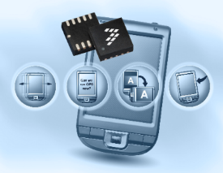



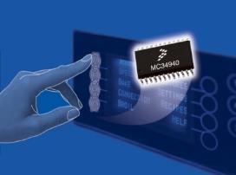

Sensor Applications
Acceleration
Gesture detection
Tilt to control
Tap detection
Position detection
Orientation
Gyroscopic
Magnetic
Ambient light sensing
Temperature/humidity
Motion detection
Pressure
Medical
Barometer/altimeter
Engine control/tire pressure
HVAC applications
Water level
Video/Audio/Lidar
Surveillance
Object detection
Depth detection
Speech recognition
Touch
Touch detection
Appliance control panels
Touch panels
Multiple sensors working together for next generation applications → sensor fusion
Notes:
Accelerometers include measurements of Gesture detection, Tilt, Tap and Orientation.
Pressure sensors measure Automotive engine control parameters, medical health monitoring, and have lots of industrial applications.
Touch sensors can be utilized in button replacement and be designed for custom applications.

Slide 6
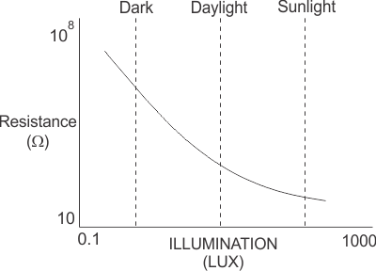
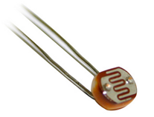
Photoresistor
Photoresistor is a light-controlled variable resistor, made of a high resistance semiconductor
The resistance of a photoresistor decreases with increasing incident light intensity
In the dark, a photoresistor can have a resistance as high as several megohms (MΩ)
While in the light, a photoresistor can have a resistance as low as a few hundred ohms

Slide 7
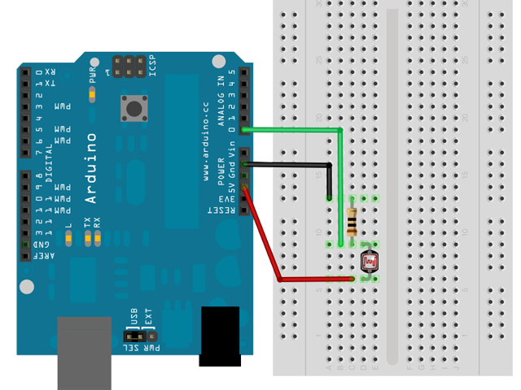
Photoresistor and Arduino

Slide 8
Sample Code for Photoresistor
void setup() { Serial.begin(9600); pinMode(A0, INPUT); pinMode(13, OUTPUT); digitalWrite(13, LOW); }
int pr_min = 400; void loop() { int pr = analogRead(A0);
/* Read value of A0 input (must in range of 0~1023) */
Serial.println(pr); digitalWrite(13, pr > pr_min ? LOW : HIGH);
/* If input value > pr_min, then flash LED */
delay(1000); }
Analog input (0~5V) with 10-bit ADC
Notes:
Reads the value from the specified analog pin. The Arduino Uno board contains a 6 channel, 10-bit analog to digital converter. It will map input voltages between 0 and 5 volts into integer values between 0 and 1023. This yields a resolution between readings of: 5 volts / 1024 units or, .0049 volts (4.9 mV) per unit. The input range and resolution can be changed using analogReference().
It takes about 100 microseconds (0.0001 s) to read an analog input, so the maximum reading rate is about 10,000 times a second.

Slide 9
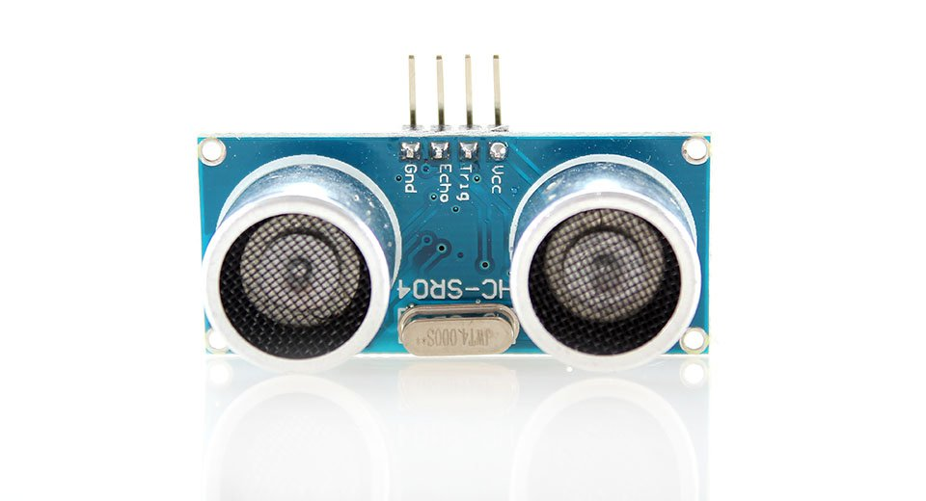
Ultrasonic Sensor
An ultrasonic sensor emits an ultrasound that travels through the air; if there is an object or obstacle on its path It will bounce back to the sensor
Considering the travel time and the speed of the sound, the distance can be calculated
Ex.: HC-SR04
Effectual angle: <15°
Ranging distance : 2cm – 500 cm
Resolution : 0.3 cm
40KHz ultrasonic signal
4 pins: Vcc, Trig, Echo, GND

Slide 10
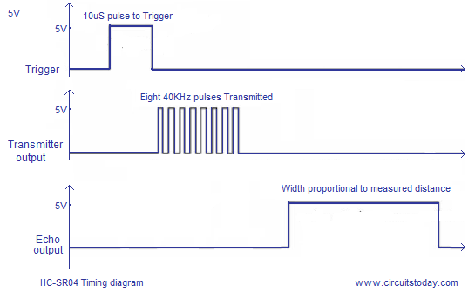
Distance Calculation
Set the Trig pin on at HIGH for > 10 µs to start
That will send out an 8-cycle sound wave that can be received in the Echo pin
Echo pin will be HIGH based on the time in microseconds that the sound wave traveled
Distance = HIGH Duration*(Sonic:340m/s)/2
HC-SR04 Timing Diagram
Trigger Pin
10 µs tripper pulse
Transmit Wave
8 x 40kHz sound wave
Echo Pin
Width proportional to measured distance

Slide 11
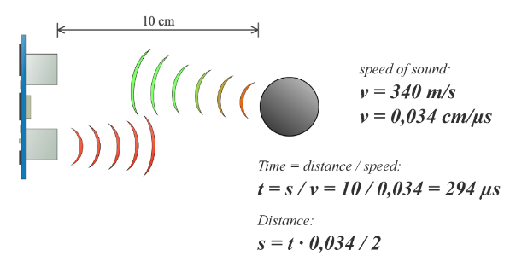
Distance Calculation: Example
So in order to get the distance in cm we need to multiply the received travel time value from the Echo pin by 0.034 cm/µs and divide it by 2

Slide 12
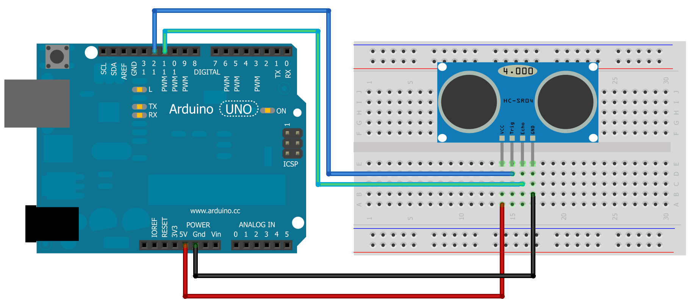
Ultrasonic Sensor and Arduino
HC-SR04 has 4 pins: Ground, Vcc, Trig, Echo
Vcc is connected to the 5 volt pin, trig and echo pins to any digital I/O pin on Arduino Uno

Slide 13
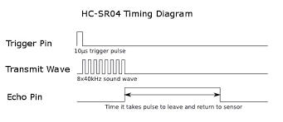
Ultrasonic Sensor and Arduino
pulseIn()reads a pulse (either HIGH or LOW) on a pin
Syntax : pulseIn(pin, value)
If value is HIGH, pulseIn() waits for the pin to go HIGH, starts timing, then waits for the pin to go LOW and stops timing
Returns the length of the pulse in microseconds or 0 if no complete pulse was received within the timeout
Echo Pin
Time it takes pulse to leave and return to sensors

Slide 14
Sample Code for Ultrasonic Sensor
const int trigPin = 12, echoPin = 11;
long duration, distance;
void setup() {
pinMode(trigPin, OUTPUT);
pinMode(echoPin, INPUT);
}
void loop() {
digitalWrite(trigPin, LOW); // Clears the trigPin
delayMicroseconds(2);
/* Sets the trigPin on HIGH state for 10ms */
digitalWrite(trigPin, HIGH); delayMicroseconds(10);
digitalWrite(trigPin, LOW);
/* Reads Echo pin, returns sound travel time in ms */
duration = pulseIn(echoPin, HIGH);
/* Calculating the distance */
distance = duration*0.034/2;
}

Slide 15
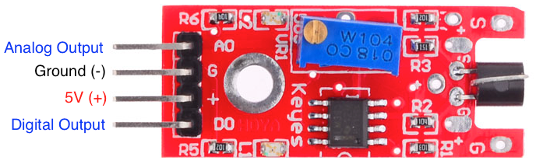
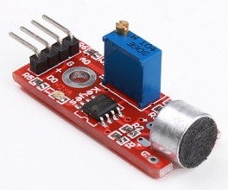
KY-038 Microphone Sound Sensor
Detect when sound has exceeded a set point
Sound is detected via a microphone and fed into an LM393 op amp
The sound level set point is adjusted via an on-board potentiometer
When the sound level exceeds the set point, an LED on the module is illuminated and the output is sent low

Slide 16
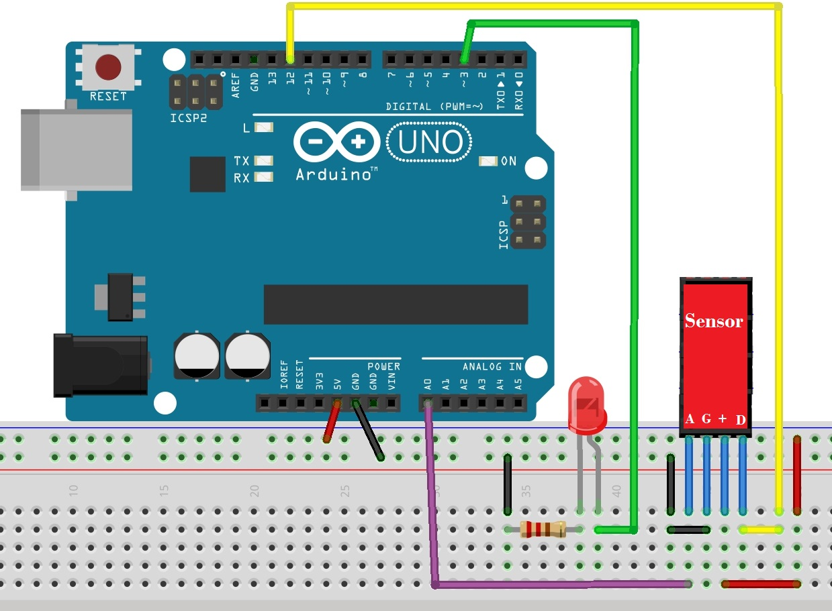
KY-038 Microphone Sound Sensor
Module has four outputs: (inputs to Arduino)
AO, analog output: real-time output voltage signal of the microphone
DO, digital output: when the sound intensity reaches a certain threshold, output high and low signal
Vcc
GND

Slide 17
Sample Code for Digital Input
int Led = 13
int sensorpin = 12;
int val = 0;
void setup() {
pinMode(Led, OUTPUT);
pinMode(sensorpin, INPUT);
}
void loop() {
val = digitalRead(sensorpin);
/* digital interface will be assigned a value of
pin 12 to read val */
if (val == HIGH) { digitalWrite(Led, HIGH); }
else { digitalWrite(Led, LOW); } }

Slide 18
Sample Code for Analog Input
int sensorPin = A0;
int ledPin = 13;
int sensorValue = 0;
void setup() {
Serial.begin(9600);
pinMode(ledPin, OUTPUT);
}
void loop() {
sensorValue = analogRead(sensorPin);
digitalWrite(ledPin, HIGH);
delay(sensorValue);
digitalWrite(ledPin, LOW);
delay(sensorValue);
Serial.println(sensorValue, DEC);
}

Slide 19
Outline
Sensors
Photoresistors, ultrasonic sensors, microphone
Embedded and real-time operating systems
Embedded operating systems
Overview of real-time systems
Real-time operating systems (RTOS)
FreeRTOS
Tasks
Link to FreeRTOS on Arduino

Slide 20
Operating Systems
The collection of software that manages a system’s hardware resources
Often include a file system module, a GUI and other components
Often times, a “kernel” is understood to be a subset of such a collection
Characteristics
Resource management
Interface between application and hardware
Library of functions for the application
Notes:
Resource management - e.g. memory, processor, hard disk, cd-rom, printer
Interface between application and hardware
Creation of an operating system-API for hardware - leads to a simple handling of the hardware for the programmer (minor knowledge of hardware)
Library of functions for application
Use:
The operating system has a big influence at software reliability, productivity, maintenance and service.
Allocation of resources (cpu, memory, etc) for the application
Deletion of conflict situations

Slide 21
Embedded Operating Systems
Fusion of the application and the OS to one unit
Characteristics:
Resource management
Primary internal resources
Less overhead
Code of the OS and the application mostly reside in ROM
Notes:
Resources management
Optimising to less memory requirement
Processor
Mostly no management of the ports and periphery (limitation to operating system kernel)
Less Overhead
Run time
Memory requirement (RAM, ROM)
Interface: Relation to the outside world (input.- and output signals)
Kind of operating system:
Single-/multi-user system
Timesharing (multi-access)
Multitasking
Batch

Slide 22
Desktop vs Embedded OS
Desktop OS: applications are compiled separately from the OS
Embedded OS: application is compiled and linked together with the embedded OS
On system start, application usually gets executed first, and it then starts the RTOS
Typically only part of RTOS (services, routines, or functions) needed to support the embedded application system are configured and linked in
(Dr Jimmy To, EIE, POLYU)

Slide 23
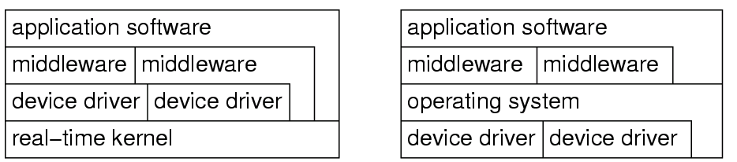
Characteristics of Embedded OS
Embedded OS need to be configurable:
No single OS fit all needs → install only those needed
e.g., conditional compilation using #if and #ifdef
Device drivers often not integrated into kernel
Embedded systems often application-specific → specific devices → move devices out of OS to tasks
Embedded OS
Standard OS
kernel

Slide 24
Characteristics of Embedded OS
Protection is often optional
Embedded systems are typically designed for a single purpose, untested programs rarely loaded, and thus software is considered reliable
Privileged I/O instructions not necessary and tasks can do their own I/O, e.g., switch is address of some switch Simply use
load register, switch instead of OS call
Real-time capability
Many embedded systems are real-time (RT) systems and, hence, the OS used in these systems must be real-time operating systems (RTOSs)

Slide 25
What is a Real-Time System?
Real-time systems have been defined as: "those systems in which the correctness of the system depends not only on the logical result of the computation, but also on the time at which the results are produced"
J. Stankovic, "Misconceptions about Real-Time Computing," IEEE Computer, 21(10), October 1988.

Slide 26
Real-Time Characteristics
Pretty much typical embedded systems
Sensors and actuators all controlled by a processor
The big difference is timing constraints (deadlines)
Tasks can be broken into two categories¹
Periodic Tasks: time-driven, recurring at regular intervals
An air monitoring system taking a sample every 10 seconds
Flash LEDs in 1 Hz
Aperiodic: event-driven
The airbag of a car having to react to an impact
Press a button
¹Sporadic tasks are sometimes considered as a third category. They are tasks similar to aperiodic tasks but activated with some known bounded rate, which is characterized by a minimum interval of time between two successive activations.

Slide 27
Soft, Firm and Hard deadlines
The instant at which a result is needed is called a deadline
If the result has utility even after the deadline has passed, the deadline is classified as soft, otherwise it is firm
If a catastrophe could result if a firm deadline is missed, the deadline is hard

Slide 28
Goals of an RTOS
Manage to meet RT deadlines
Also like
Deadlines met
Ability to specify scheduling algorithm
Interrupts are fast
Interrupt prioritization easy to set
Tasks stay out of each others’ way
Normally through page protection
Device drivers already written (and tested!) for us
Portable—runs on a huge variety of systems
Nearly no overhead so we can use a small device!
That is a small memory and CPU footprint

Slide 29
Requirements for RTOS
Predictability of timing behavior of the OS
Upper bound on execution time for all OS services
Scheduling policy must be deterministic
Period in which interrupts are disabled must be short (to avoid unpredictable delays in processing critical events)
OS should manage timing and scheduling
OS has to be aware of task deadlines (unless scheduling is done off-line)
OS should provide precise time services with high resolution
Important if internal processing of the embedded system is linked to an absolute time in the physical environment

Slide 30
Functionality of RTOS Kernel
Processor management
Memory management
Timer management
Task management (resume, wait, etc.)
Inter-task communication
Task synchronization
resource management

Slide 31
Outline
Sensors
Photoresistors, ultrasonic sensors, microphone
Embedded and real-time operating systems
Embedded operating systems
Overview of real-time systems
Real-time operating systems (RTOS)
FreeRTOS
Tasks
Link to FreeRTOS on Arduino

Slide 32
FreeRTOS
FreeRTOS is nothing but software that provides multitasking facilities
Allows to run multiple tasks and has a simple scheduler to switch between tasks (priority-based multitasking)
Fully preemptive
Always runs the highest priority task that is ready to run
Context switch occurs if a task/co-routine blocks or a task/co-routine yields the CPU
Queues to communicate between multiple tasks
Semaphores to manage resource sharing between multiple tasks
Utilities to view CPU utilization, stack utilization etc.
(http://www.socialledge.com/sjsu/index.php?title=FreeRTOS_Tutorial)

Slide 33
Tasks
In FreeRTOS each thread of execution is called a task
Tasks are implemented as C functions that must return void and take a void pointer parameter:
void ATaskFunction(void *pvParameters);
A task is a small program that has an entry point, will normally run forever within an infinite loop, will not exit
void ATaskFunction(void *pvParameters) {
/* Each instance of task will have its own copy of variable */
int iVariableExample = 0;
/* A task is normally implemented in infinite loop */
for( ;; ) { /* task functionality */ }
/* Should the code ever break out of the above loop
then the task must be deleted. */
vTaskDelete(NULL); /* NULL: this task */
}

Slide 34
Task Creation
xTaskCreate( pvTaskCode, pcName, usStackDepth, pvParameters, uxPriority, pxCreatedTask )
pvTaskCode: pointer to task entry function, implemented to never return
pcName: a descriptive name for the task to facilitate debugging
usStackDepth: size of task stack, specified as the number of variables that the stack can hold
pvParameters: pointer to parameters for the task
uxPriority: priority at which the task should run
pvCreatedTask: pass back a handle by which the created task can be referenced

Slide 35
Example: Creating a Task
void setup() {
Serial.begin(9600);
while(!Serial){;} // wait for serial port to connect.
/* Now set up two tasks to run independently */
xTaskCreate(
vTask1, /* Pointer to function for the task */
(const portCHAR *) "Task1", /* Name for the task */
128, /* Stack Size */
NULL, /* NULL task parameter */
1, /* This task will run at priority 1 */
NULL ); /* Do not use the task handle */
xTaskCreate( vTask2, "Task2", 1000, NULL, 1, NULL );
/* Now the task scheduler, which takes over control of scheduling individual tasks, is automatically started */
}

Slide 36
Example: Creating a Task
void vTask1(void *pvParameters) {
(void) pvParameters;
for( ;; ){
/* read the input on analog pin 0 */
int sensorValue = analogRead(A0);
/* print out the value you read */
Serial.println(sensorValue);
/* one tick delay in between reads for stability */
vTaskDelay(1);
}
}

Slide 37
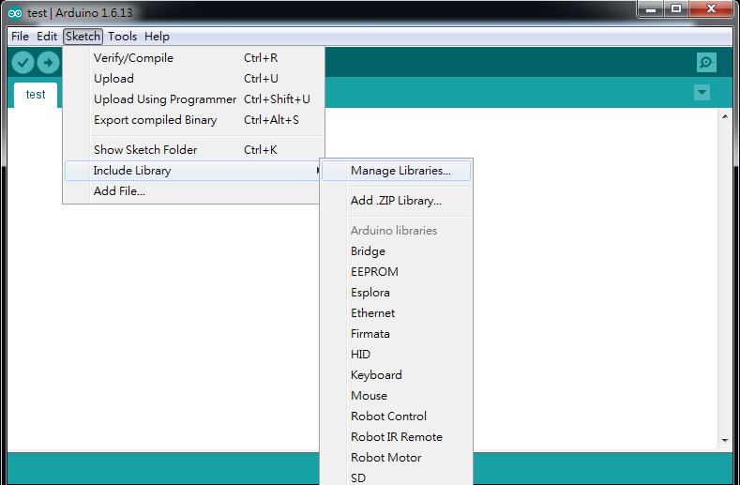
Link to FreeRTOS on Arduino
There is a FreeRTOS implementation in Arduino IDE
Go to “Sketch” -> “Include Library” -> “Manage Libraries…” to open Arduino IDE Library manager

Slide 38
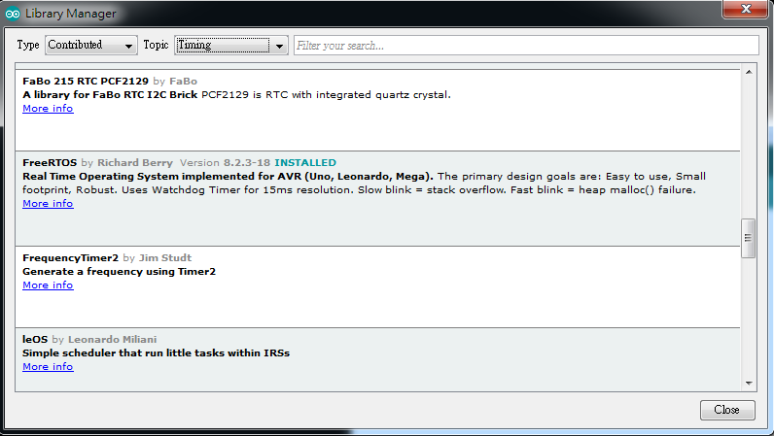
Link to FreeRTOS on Arduino
In the Arduino IDE Library manager (from Arduino Version 1.6.8) look for the FreeRTOS Library
Type: “Contributed” and Topic: “Timing”

Slide 39
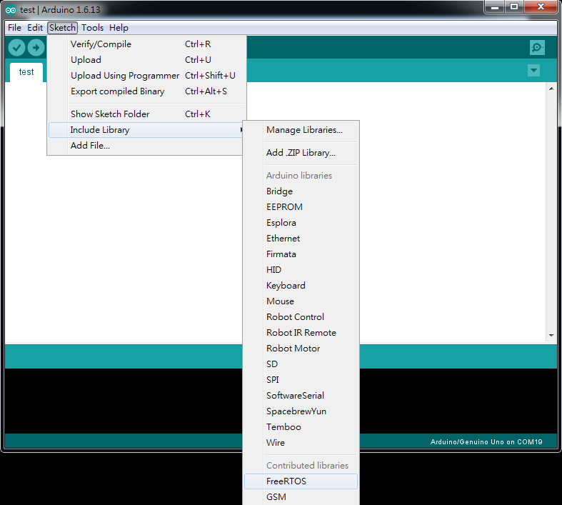
Link to FreeRTOS on Arduino
Under the “Sketch” -> “Include Library”, ensure that the FreeRTOS library is included in your sketch

Slide 40
Example: Blink_AnalogRead
#include <Arduino_FreeRTOS.h>
/* define two tasks for Blink & AnalogRead */
void TaskBlink(void *pvParameters);
void TaskAnalogRead(void *pvParameters);
void setup() {
Serial.begin(9600);
while (!Serial) {
; // wait for serial port to connect.
}
/* Now set up two tasks to run independently */
xTaskCreate( TaskBlink, (const portCHAR *)"Blink", 128, NULL, 2, NULL );
xTaskCreate( TaskAnalogRead, (const portCHAR *) "AnalogRead", 128, NULL, 1, NULL );

Slide 41
Example: Blink_AnalogRead
void TaskAnalogRead(void *pvParameters) {
(void) pvParameters;
for (;;) {
/* read the input on analog pin 0 */
int sensorValue = analogRead(A0);
/* print out the value you read */
Serial.println(sensorValue);
/* one tick delay in between reads for stability */
vTaskDelay(1);
}
}

